Slide 1
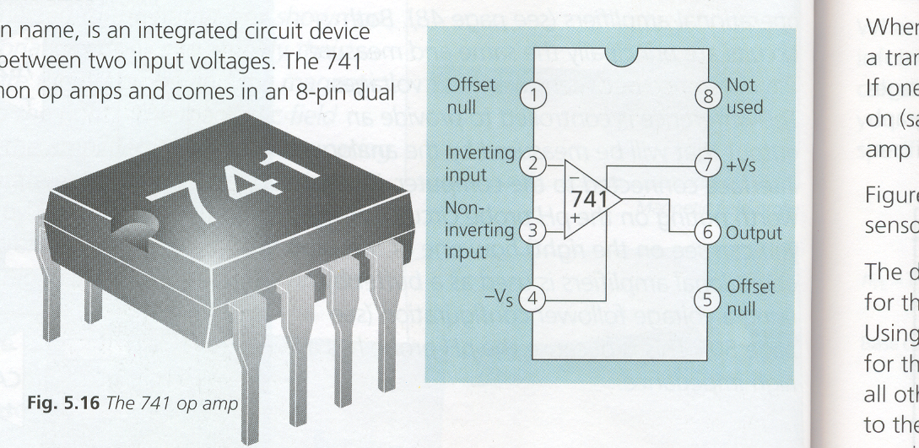
OPERATIONAL AMPLIFIERS
An operational amplifiers ( op-amp.) is an 8 terminal Integrated Circuit (I.C.).
It is a high gain amplifier capable of amplifying both a.c. and d.c.
By simply connecting a power supply to pins 4 and 7 and by connecting a few resistors around the device, as shown below, it is possible to make several different types of amplifier.
TL071

Slide 2
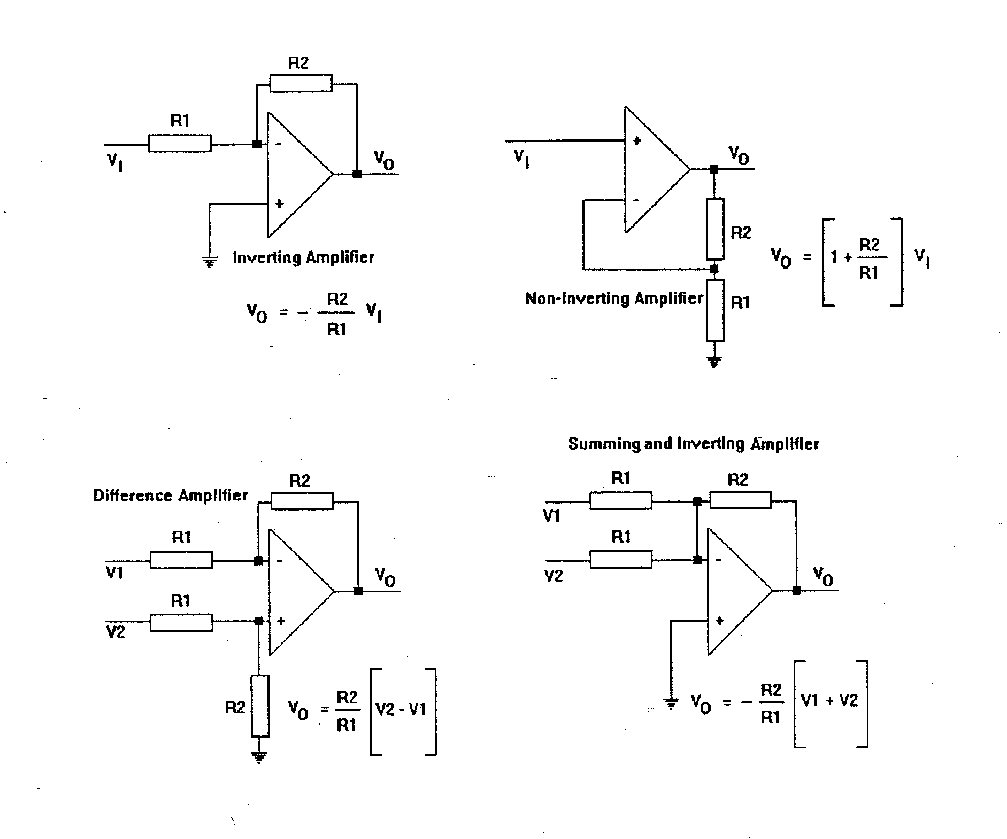
Four popular fundamental configurations are shown below:
i) the Inverting Amplifier configuration
ii) the Non-Inverting configuration
iii) the Difference Amplifier configuration ( Subtractor )
iv) the Summing Amplifier

Slide 3
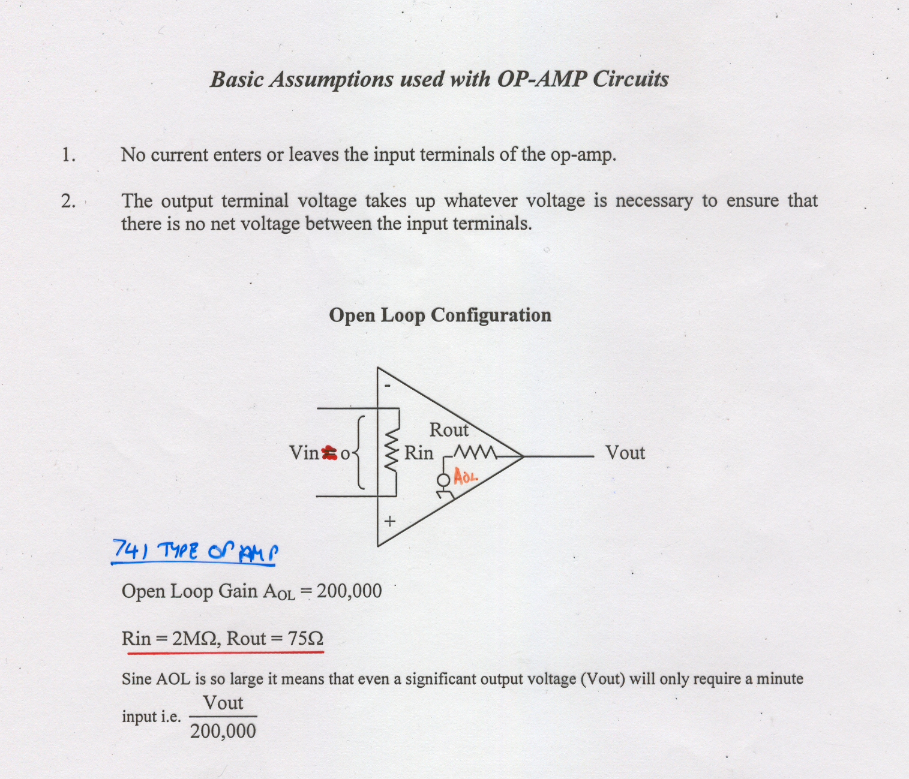
Basic Assumptions used with OP-AMP Circuits
1. No current enters or leaves the input terminals of the op-amp.
2. The output terminal voltage takes up whatever voltage is necessary to ensure that there is no net voltage between the input terminals.
Above assumptions only apply in negative feedback applications

Slide 4
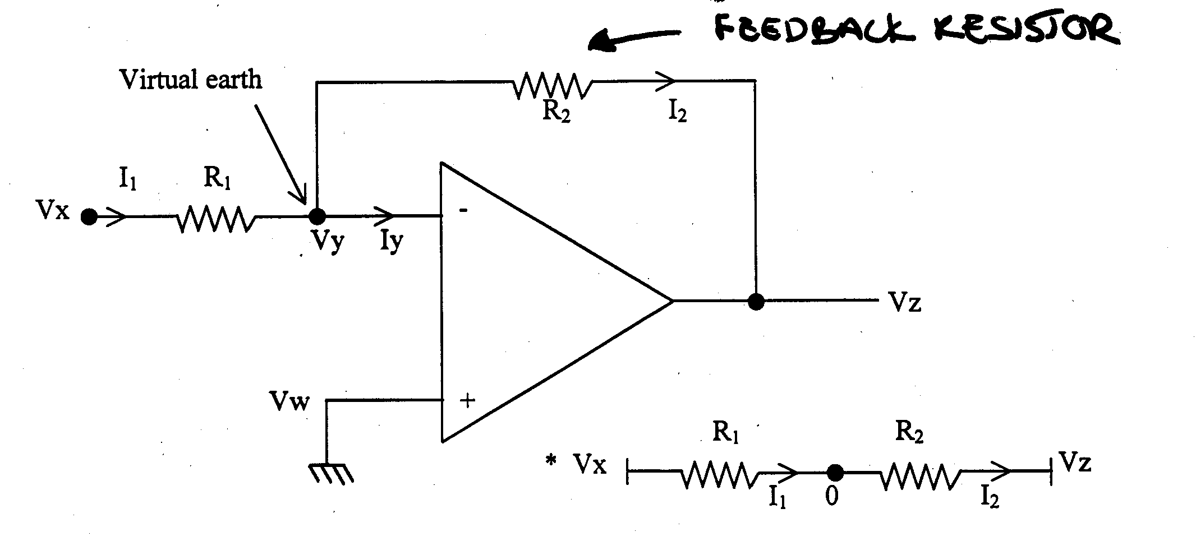
INVERTING AMPLIFIER

Slide 5
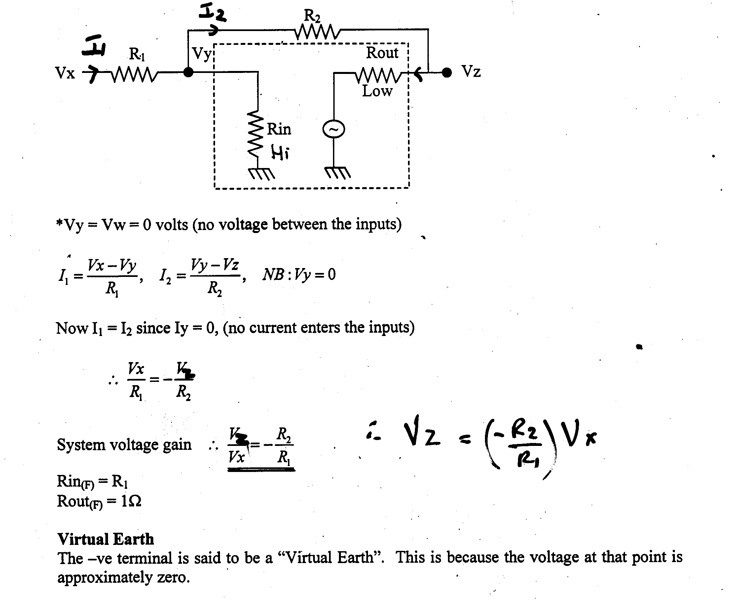

Remember: No current enters or leaves the input terminals , therefore no current flows through Rin.

Slide 6
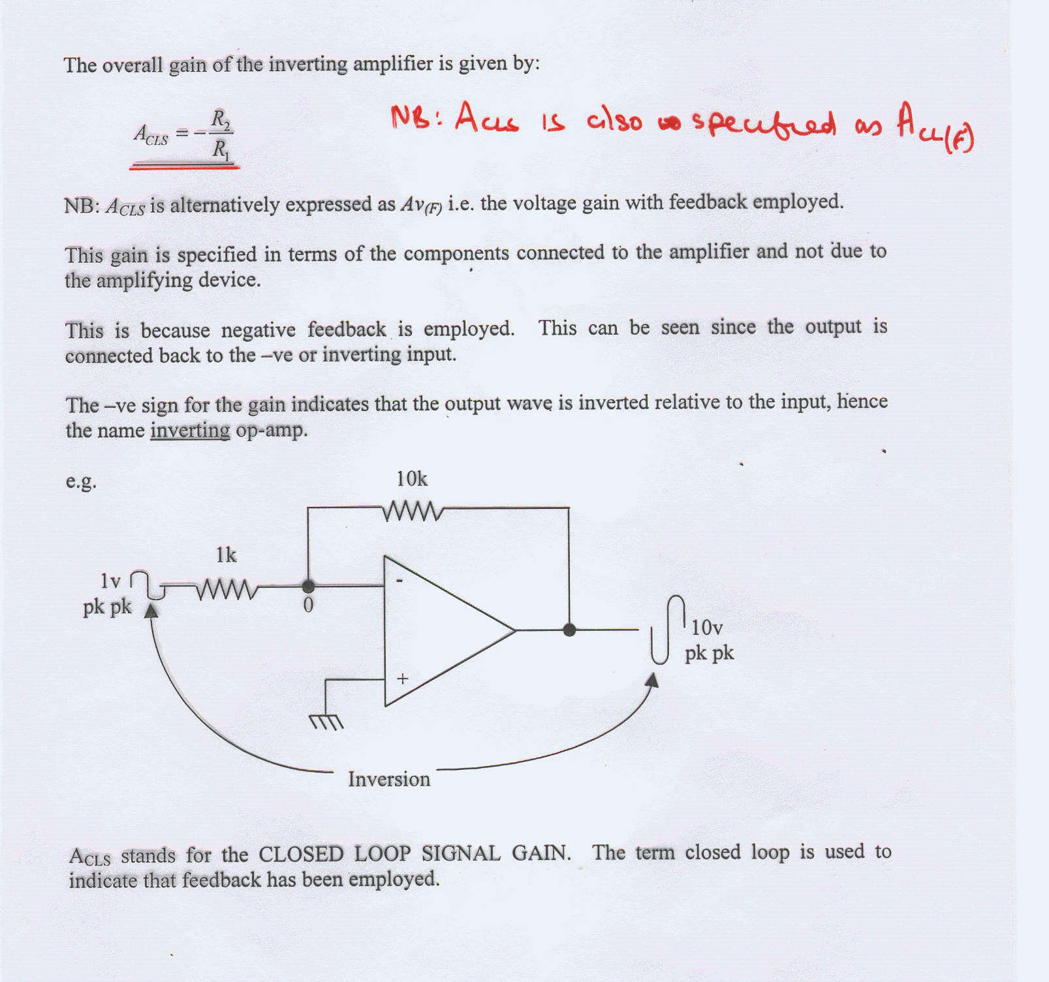

Slide 7
OVERALL GAIN: What are we going to call it?
NOTE WELL:
ALL of the following term may be seen to describe Vout/Vin
Closed Loop Gain (A_{CL})
Closed Loop Gain with feedback ( A_{CL(F)})
Closed Loop Signal Gain ( A_{CLS})
Voltage gain with feedback ( A_{V(F)})
From now on just call the overall gain Aov

Slide 8
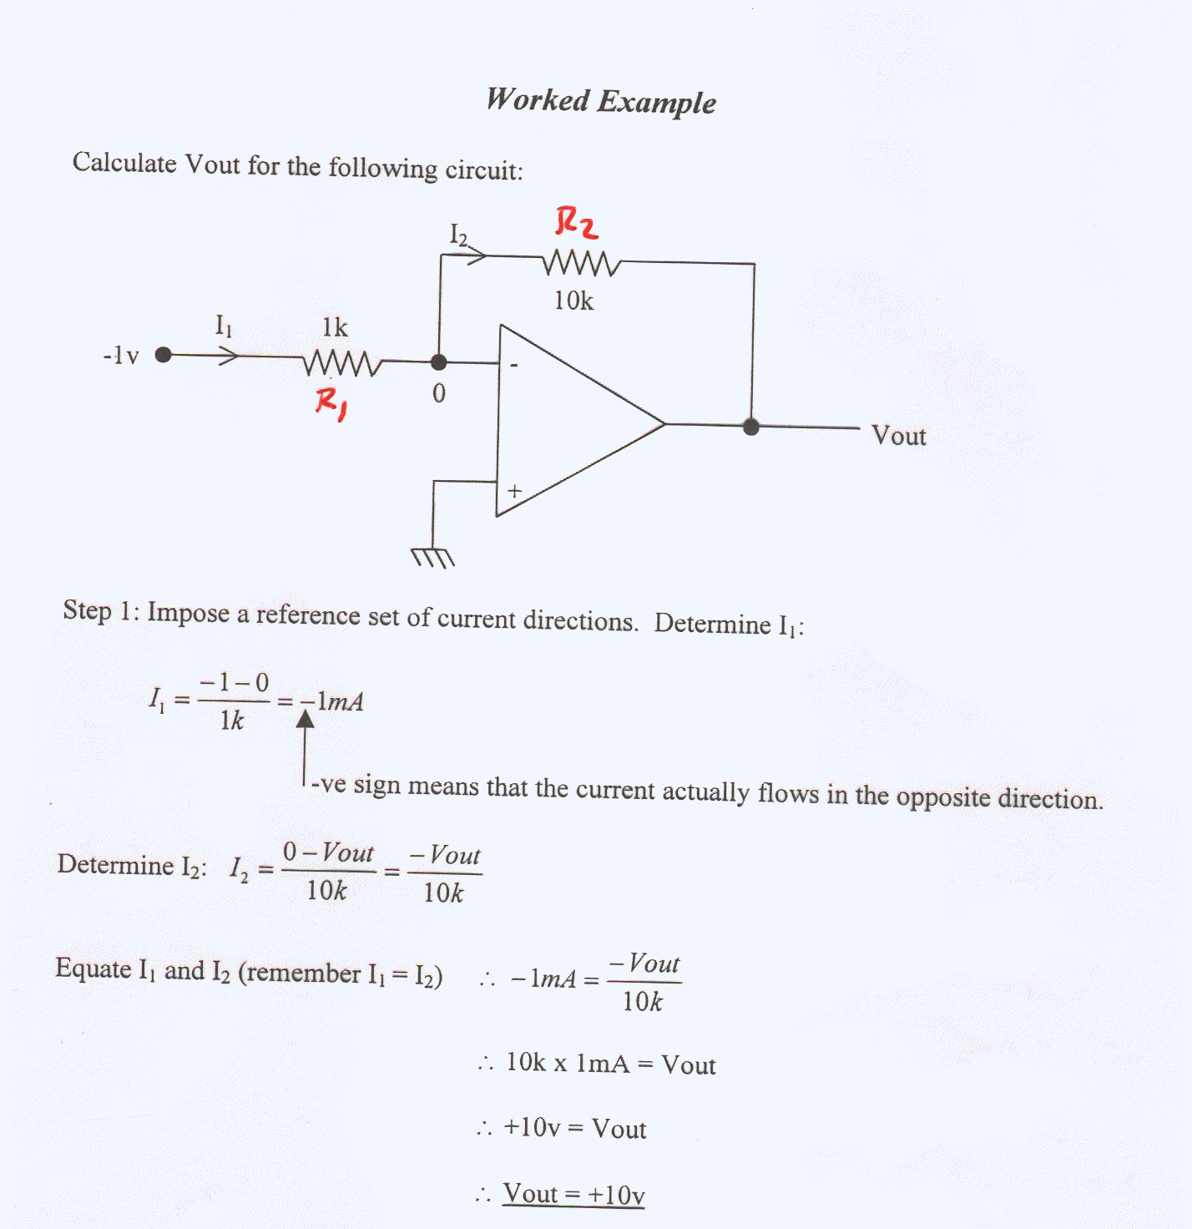

Slide 9
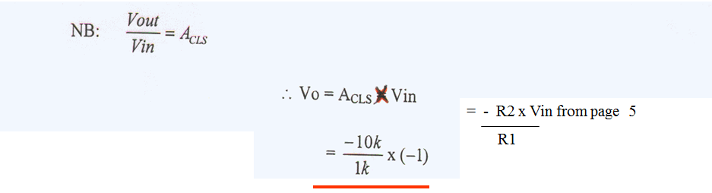

Slide 10
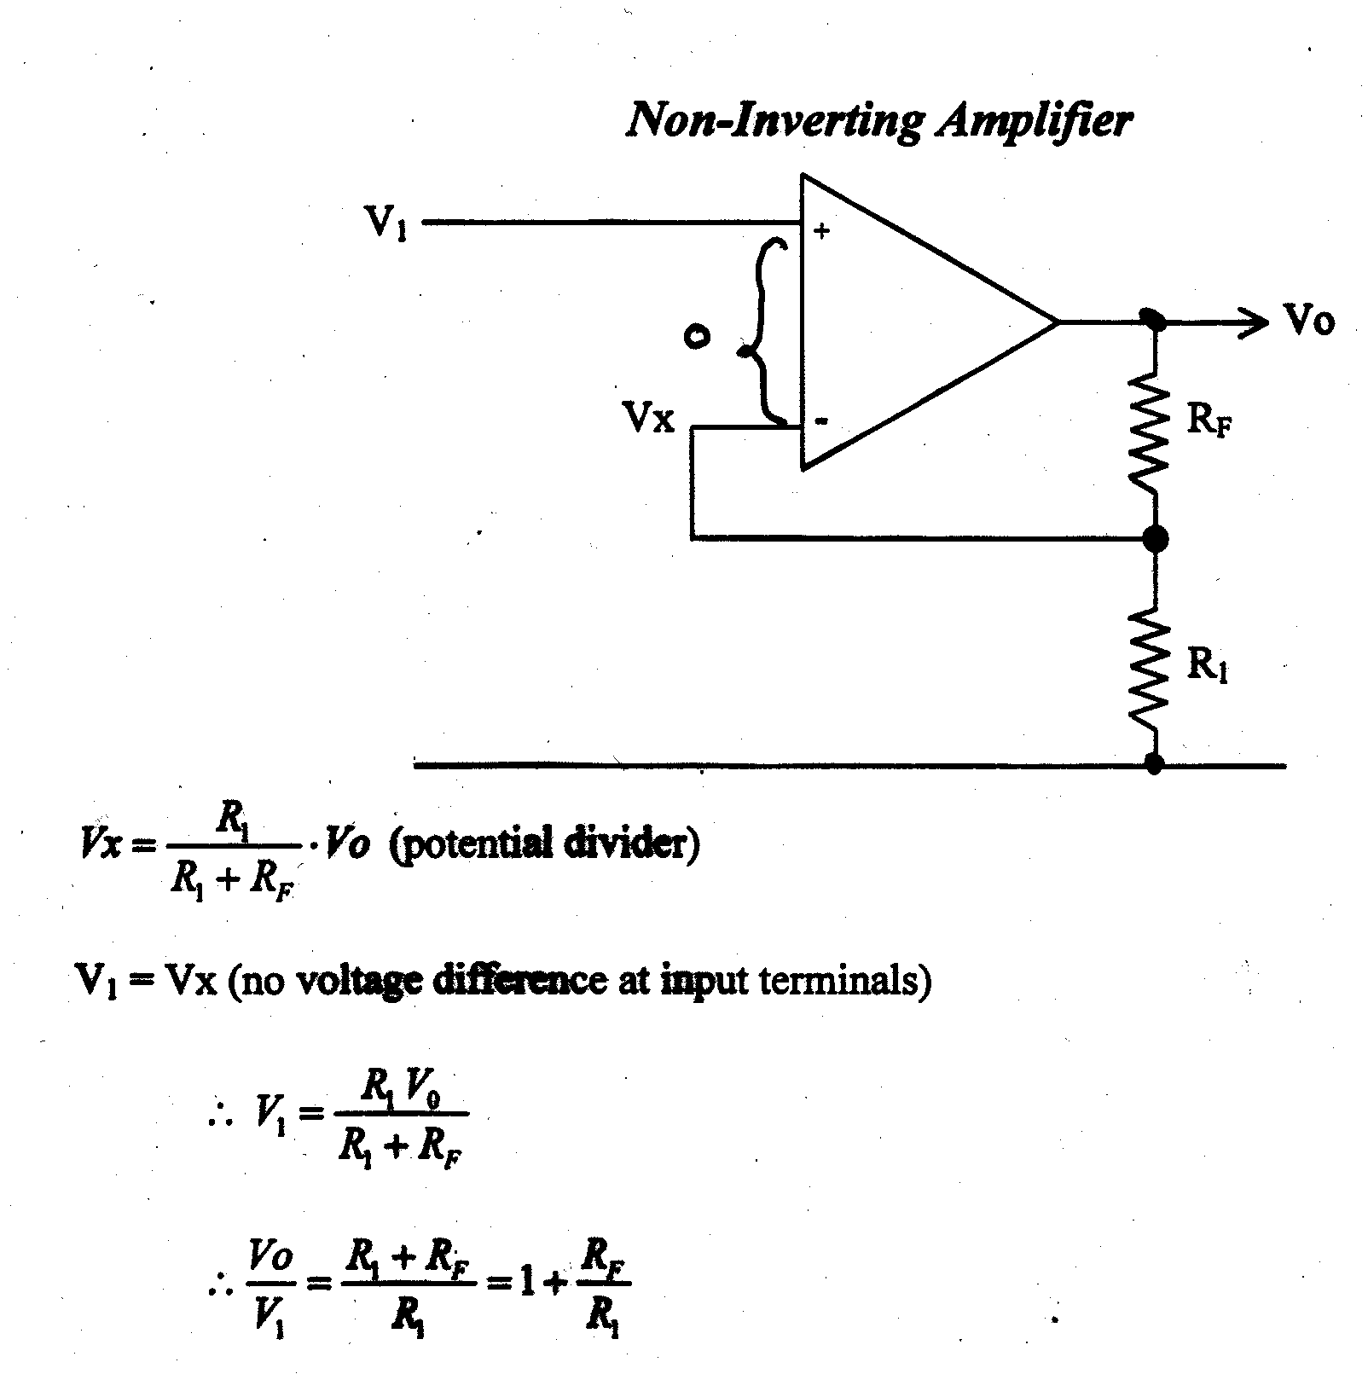
Remember: no voltage drop across the input terminals, therefore V1 = Vx, hence V1 – Vx = 0V.

Slide 11
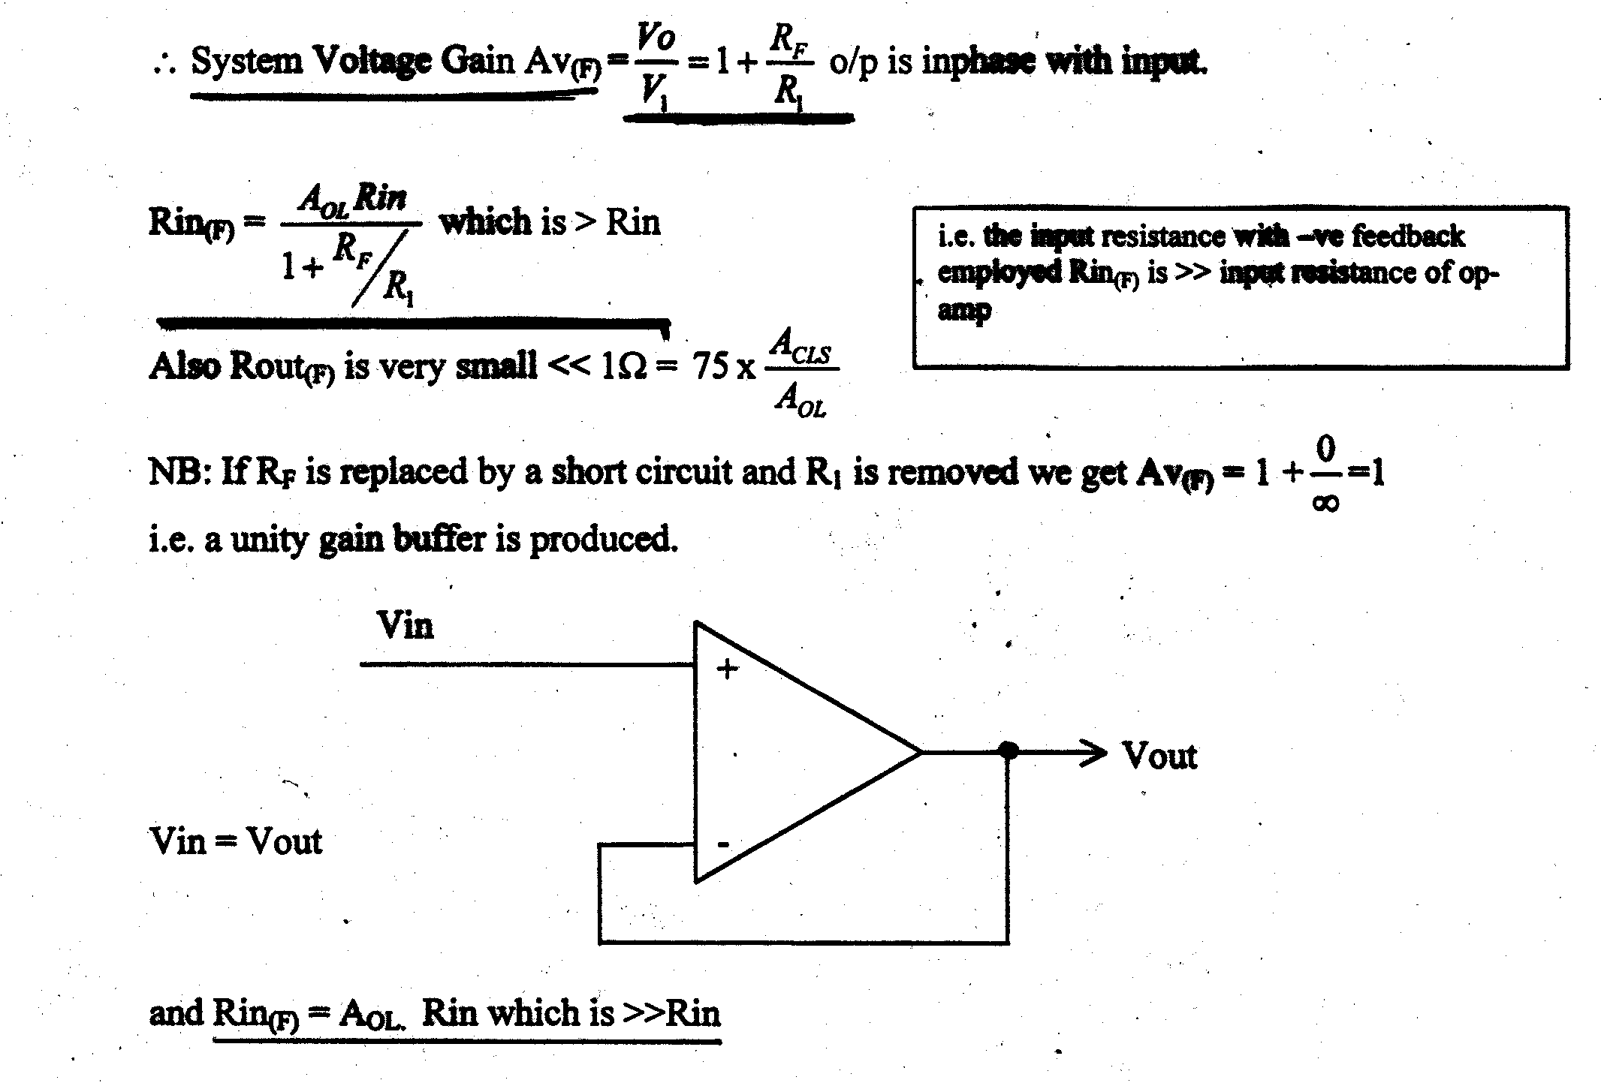

Slide 12
The Summing Amplifier
The inverting amplifier can be extended to give an output proportional to the sum of the inputs, and is an adding circuit.
The non-inverting input is at earth potential, and therefore the inverting input is a virtual earth.
Connecting the resistors to the virtual earth is equivalent to connecting them to actual earth, in particular the presence of V₁,
I₁ and R₁ has no effect on V₂, 1₂, and R₂ etc.

Slide 13
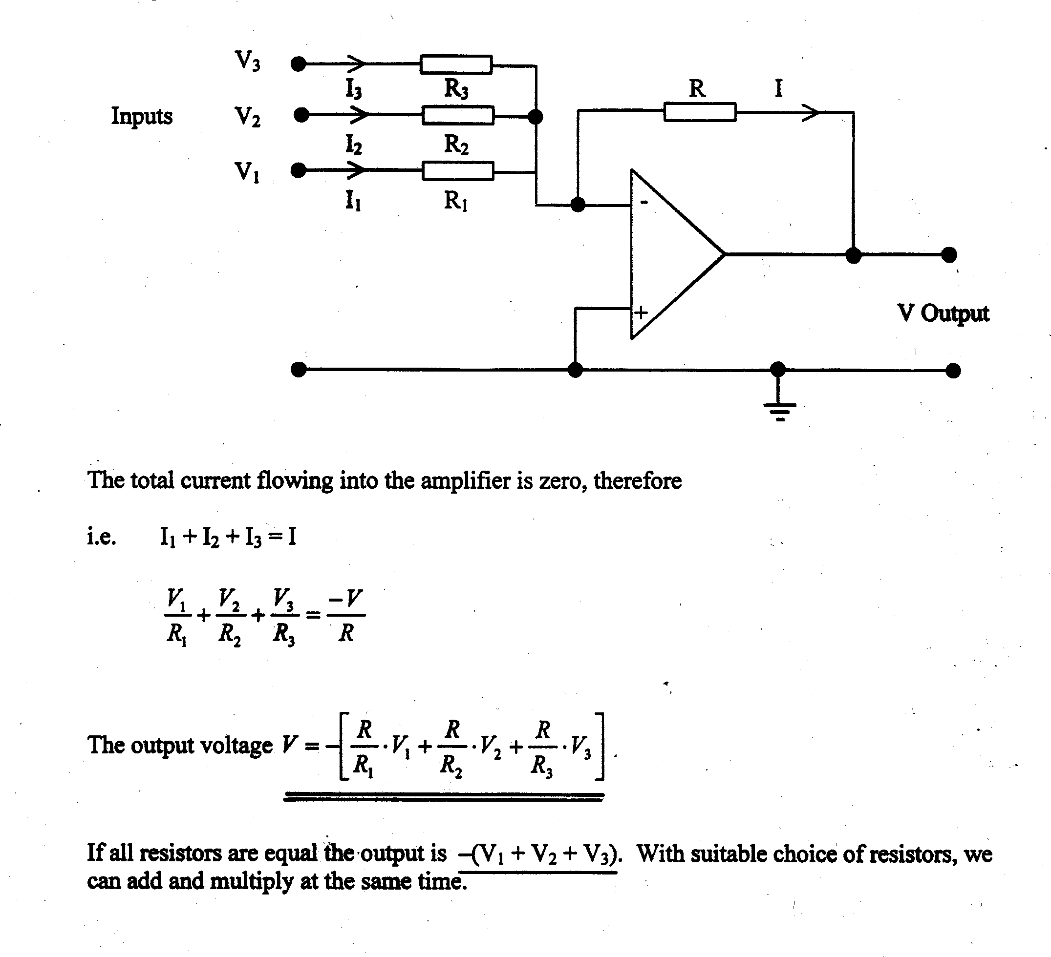

Slide 14
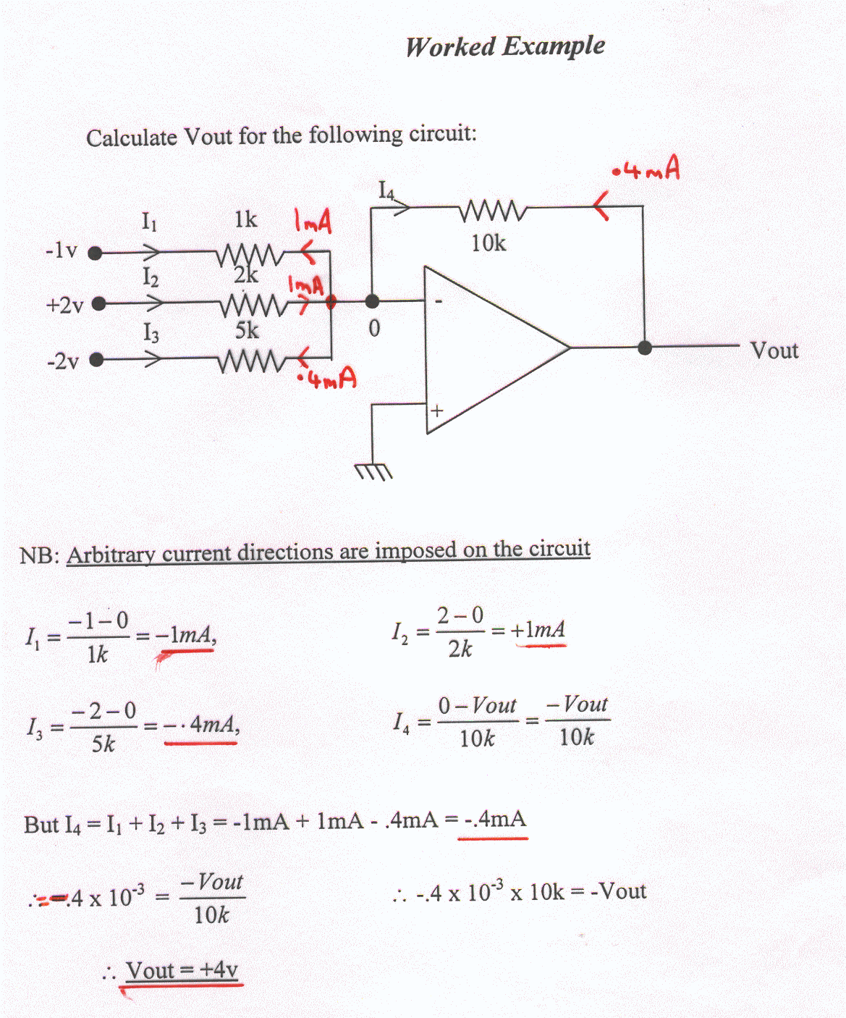
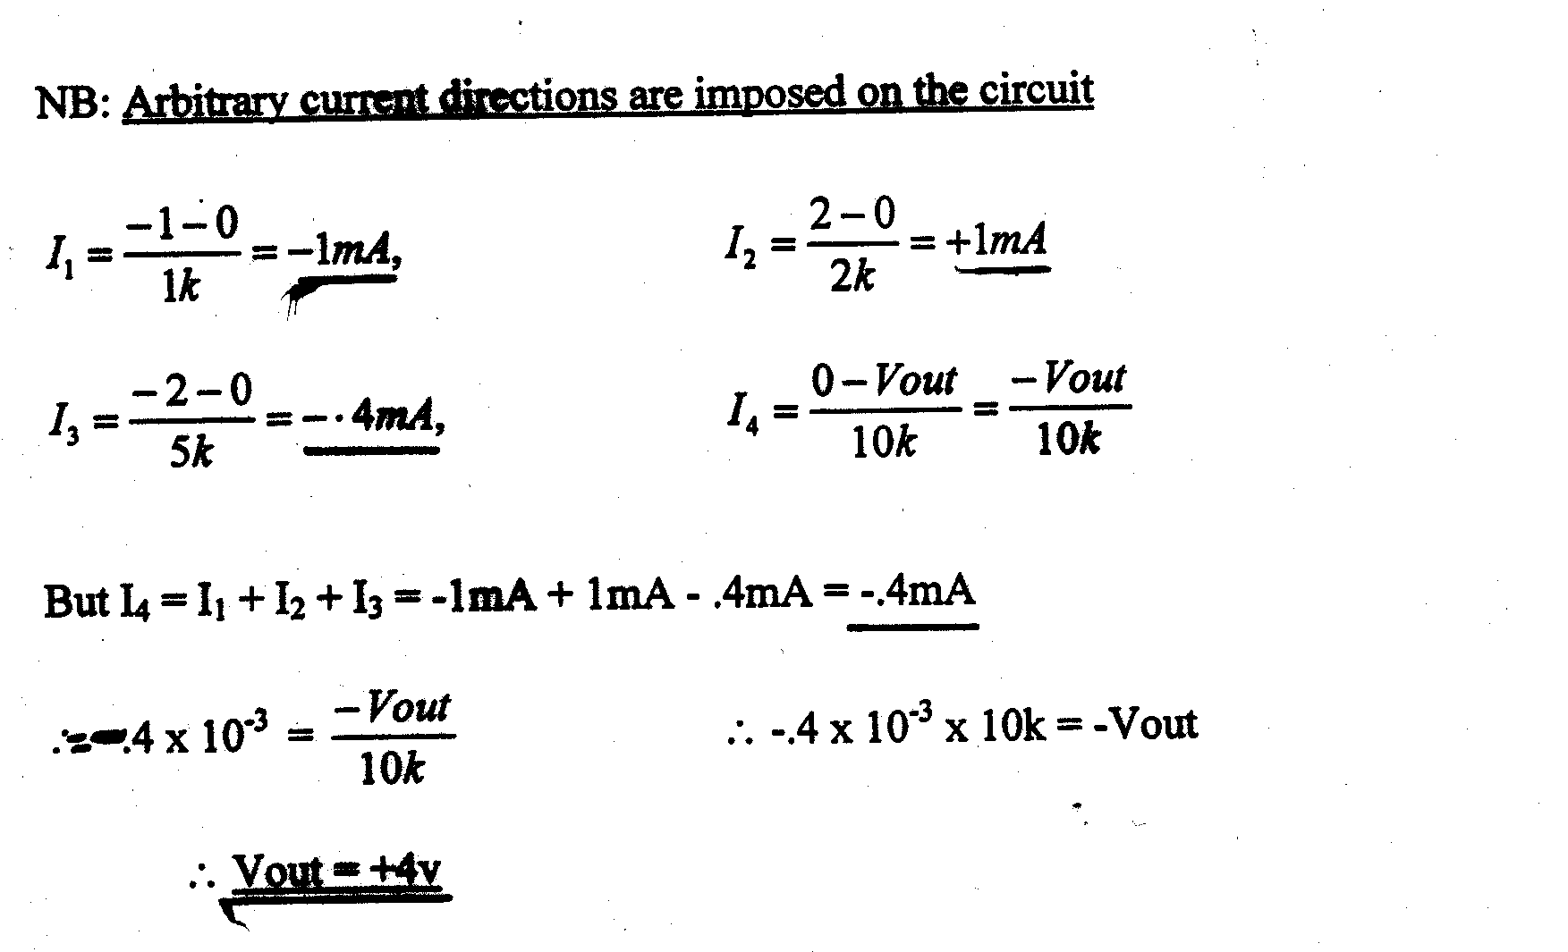

Slide 15
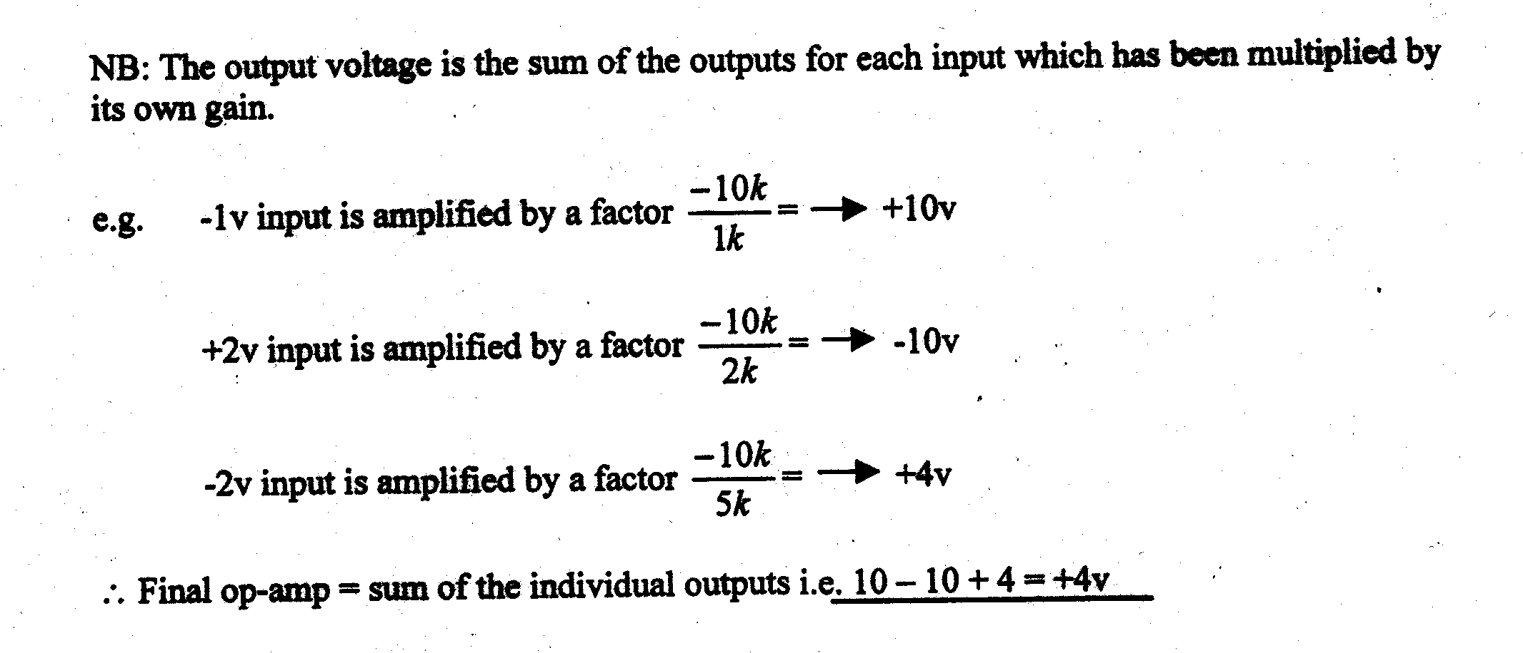

Slide 16
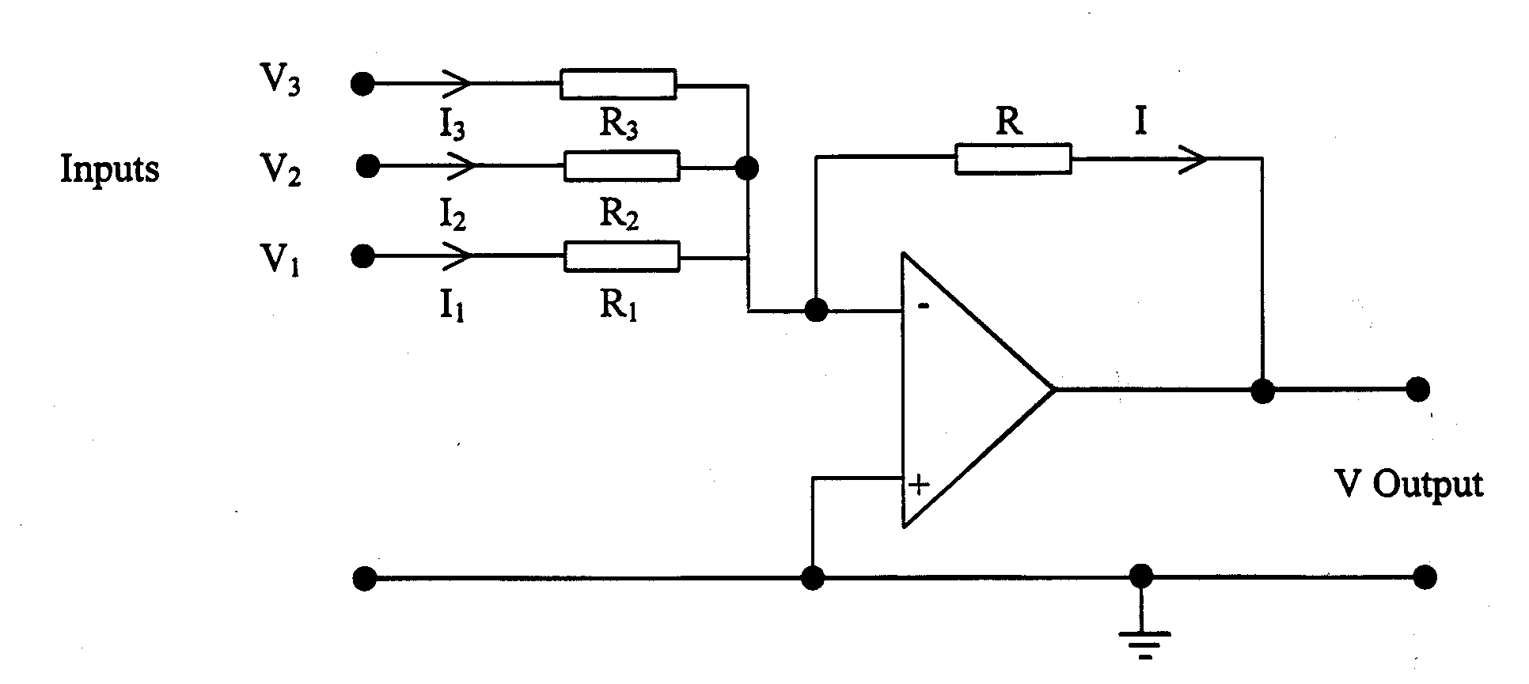
SIMPLER APPROACH TO ABOVE EXAMPLE.
Since we know the actual voltages at the inputs we can put in the current directions as they are actually going to flow i.e. from + to - , as shown below:
I₃
-1
+2
-3
<
I₂
<
I₁
0
In this example the current directions are chosen to match the input voltage polarities

Slide 17
I₃ = 0 – (-1) / R₃ = 1/ 1k = 1 mA
I₂ = (2 - 0 ) / R₂ = 2/ 2k = 1 mA
I₁ = ( 0 – (-3)) / R1 = 3/ 5k = 0.4 mA
I = I₂ – I₁ – I₃ = (1 – 0.4 – 1) mA = -0.4 mA
This means that the assumed current direction for I was incorrect.
It will actually flow from Vout to the virtual earth.
Therefore, (Vout – 0)/ 10k = .4mA
Hence Vout = .4mA x 10k = +4 V

Slide 18
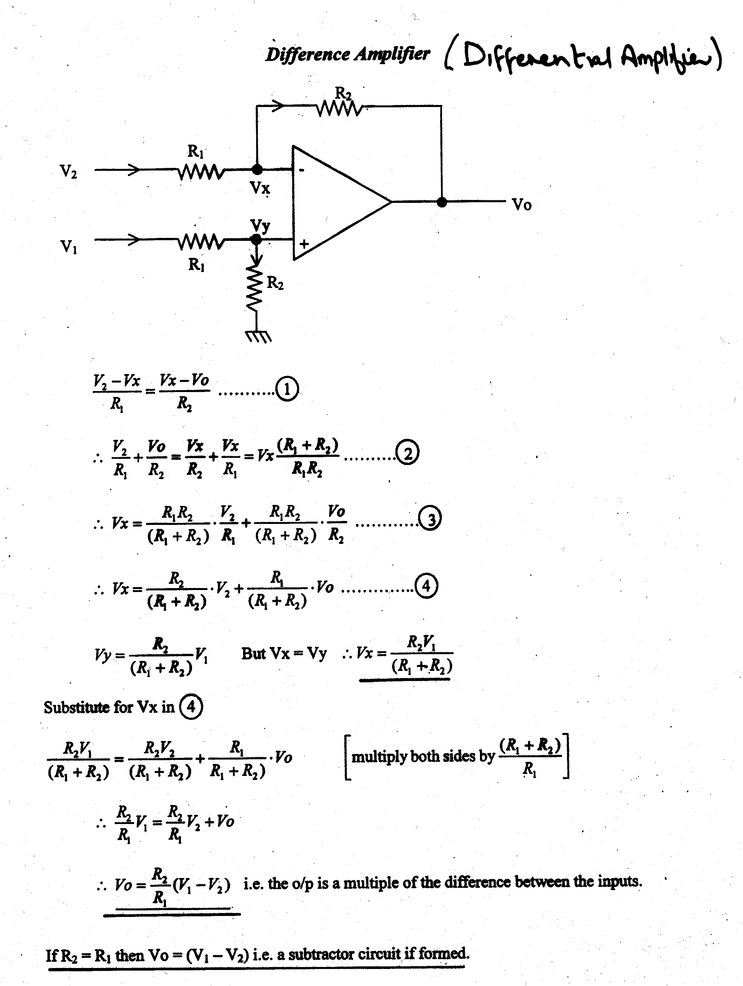

Slide 19
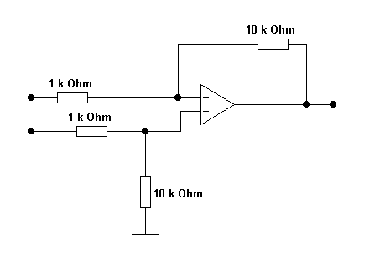
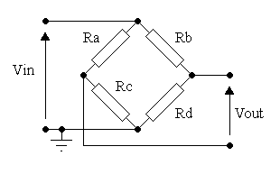
Assuming Ra, Rb, Rc and Rd are not loaded by the differential amplifier, calculate Vout if Ra = Rb = Rc = 1Ω and Rd = 1.5 Ω when Vin = 20 mV
I1
9k
V4
V2
Vout
V1
V3
9k
V1 = (Rc/ (Ra + Rc))* 20mV = 10 mV
V2 = ((Rd / ( Rd + Rb ))* 20 mV = 12 mV
Therefore V3 = ( 9k / 10k) x V1 = 9 mV
V4 = V3 = 9 mV
I1 =( V2 –V4) / 1k = (12mV – 9 mV) / 1k = 3 mV / 1k = 3μA
Hence V4 - Vout = I1 x 9k
Hence Vout = V4 - (I1 x 9k) = 9mV -( 3μA x 9k)
Therefore Vout = -18 mV

