Slide 1
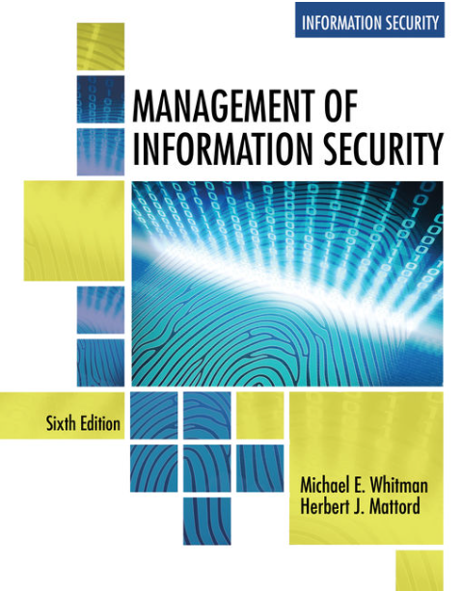
Compliance: Law and Ethics
Data Security, Governance & Compliance
Lecture 2
Lecturer: Assoc. Prof. Carlene Campbell
Email: carlene.campbell@uwtsd.ac.uk
Website: https://www.knowledgewithprofit.com/
Adapted Text
Notes:
In law a man is guilty when he violates the rights of others.
In ethics he is guilty if he only thinks of doing so.
~Immanuel Kant (1724 – 1804)

Slide 2
Learning Outcome
Differentiate between law and ethics
Describe the ethical foundations and approaches that underlie modern codes of ethics
Discuss relevant professional security organizations and their role and relationship to organizational InfoSec
Describe why ethical codes of conduct are important to InfoSec professionals and their organizations
Identify significant national and international laws that relate to the practice of InfoSec
Explain the challenges and methods associated with the management of digital forensics in an organization
Notes:
As a future information security professional, you will be required to understand the scope of an organization’s legal and ethical responsibilities
To minimize the organization’s liabilities, the information security practitioner must understand the current legal environment and keep apprised of new laws, regulations, and ethical issues as they emerge
By educating employees and management about their legal and ethical obligations and the proper use of information technology and information security, security professionals can keep an organization focused on their primary mission
The InfoSec professional has a unique position within the organization, entrusted with the organization information
Not only are they responsible for protecting the information, they are privy to the secrets and structures of the systems that store, transmit, use, and protect that information
Thus, they must be beyond reproach, with the highest ethical and moral standards

Slide 3
Ethics in InfoSec
Some define ethics as the organized study of how humans ought to act
Others define it as a set of rules we should live by
An InfoSec student is not expected to study the topic of ethics in a vacuum, but within a larger ethical framework
However, those employed in the area of information security may be expected to be more articulate about the topic than others in the organization, and often must withstand a higher degree of scrutiny

Slide 4
Ethics in InfoSec (Continued)
The foundations and frameworks of ethics include the following:
  Normative ethics
  Meta-ethics
  Descriptive ethics
  Applied ethics
  Deontological ethics
Notes:
• Normative ethics—The study of what makes actions right or wrong, also known as moral theory that is, how should people act?
• Meta-ethics—The study of the meaning of ethical judgments and properties that is, what is right?
• Descriptive ethics—The study of the choices that have been made by individuals in the past that is, what do others think is right?
• Applied ethics—An approach that applies moral codes to actions drawn from realistic situations; it seeks to define how we might use ethics in practice.
• Deontological ethics—The study of the rightness or wrongness of intentions and motives as opposed to the rightness or wrongness of the consequences; also known as duty-based or obligation-based ethics. This approach seeks to define a person’s ethical duty.

Slide 5
Ethics in InfoSec (Continued)
From these fairly well-defined and agreed-upon ethical frameworks come a series of ethical standards as follows:
  Utilitarian approach
  Rights approach
  Fairness or justice approach
  Common good approach
  Virtue approach
Notes:
• Utilitarian approach—Emphasizes that an ethical action is one that results in the most good, or the least harm; this approach seeks to link consequences to choices.
• Rights approach—Suggests that the ethical action is the one that best protects and respects the moral rights of those affected by that action; it begins with a belief that humans have an innate dignity based on their ability to make choices. The list of moral rights is usually thought to include the right to make one’s own choices about what kind of life to lead, the right to be told the truth, the right not to be injured, and the right to a degree of privacy. (Some argue that nonhumans have rights as well.) These rights imply certain duties—specifically, the duty to respect the rights of others.
• Fairness or justice approach—Founded on the work of Aristotle and other Greek philosophers who contributed the idea that all persons who are equal should be treated equally; today, this approach defines ethical actions as those that have outcomes that regard all human beings equally, or that incorporate a degree of fairness based on some defensible standard. This is often described as a “level playing field.”
• Common good approach—Based on the work of the Greek philosophers, a notion that life in community yields a positive outcome for the individual, and therefore each individual should contribute to that community. This approach argues that the complex relationships found in a society are the basis of a process founded on ethical reasoning that respects and has compassion for all others, most particularly the most vulnerable members of a society. This approach tends to focus on the common welfare.
• Virtue approach—A very ancient ethical model postulating that ethical actions ought to be consistent with so-called ideal virtues that is, those virtues that all of humanity finds most worthy and that, when present, indicate a fully developed humanity. In most virtue-driven ethical frameworks, the virtues include honesty, courage, compassion, generosity, tolerance, love, fidelity, integrity, fairness, self-control, and prudence. Virtue ethics asks all persons to consider if the outcome of any specific decision will reflect well on their own and others’ perceptions of them.
These ethical standards or approaches offer a set of tools for decision making in the era of computer technology. People remain responsible for the choices they make, whether a choice affects only themselves or many others as well.

Slide 6
The Ten Commandments of Computer Ethics
(Computer Ethics Institute)
  Thou shalt not use a computer to harm other people
  Thou shalt not interfere with other people's computer work
  Thou shalt not snoop around in other people's computer files
  Thou shalt not use a computer to steal
  Thou shalt not use a computer to bear false witness
  Thou shalt not copy or use proprietary software for which you have not paid
  Thou shalt not use other people's computer resources without authorization or proper compensation
  Thou shalt not appropriate other people's intellectual output
  Thou shalt think about the social consequences of the program you are writing or the system you are designing
  Thou shalt always use a computer in ways that ensure consideration and respect for your fellow humans
  (Source: Computer Professionals for Social Responsibility)
Notes:
Key studies reveal that the overriding factor in leveling the ethical perceptions within a small population is education
Employees must be trained and kept up-to-date on InfoSec topics, including the expected behaviors of an ethical employee
Proper ethical and legal education, training and awareness are vital to creating an informed, well-prepared, and low-risk system user
It is the responsibility of InfoSec personnel to deter unethical and illegal acts, using policy, education and training, and technology as controls or safeguards, in order to protect the organization’s information and systems
There are three general categories of unethical behavior that organizations and society should seek to eliminate:
Ignorance
Accident
Intent
Deterrence is the best method for preventing an illegal or unethical activity
Laws, policies, and technical controls are all examples of deterrents
However, laws and policies and their associated penalties only deter if three conditions are present:
Fear of penalty
Probability of being caught
Probability of penalty being administered

Slide 7
Professional Organizations and Their Codes of Ethics
A number of professional organizations have established codes of conduct and/or codes of ethics that members are expected to follow
Codes of ethics can have a positive effect on an individual’s judgment regarding computer use
It remains the individual responsibility of security professionals to act ethically and according to the policies and procedures of their employers, their professional organizations, and the laws of society

Slide 8
Association of Computing Machinery
The ACM is a respected professional society, originally established in 1947, as the world's first educational and scientific computing society
ACM is one of the few organizations that strongly promotes education and provides discounted membership for students
The ACM’s code of ethics requires members to perform their duties in a manner befitting an ethical computing professional

Slide 9
International Information Systems Security
Certification Consortium, Inc. (ISC)²
The code of ethics put forth by (ISC)² is primarily designed for information security professionals who have earned one of their certifications
This code includes four mandatory canons:
  Protect society, the commonwealth, and the infrastructure
  Act honorably, honestly, justly, responsibly, and legally
  Provide diligent and competent service to principals
  Advance and protect the profession
Notes:
SAN:
Founded in 1989, SANS is a professional research and education cooperative organization with a large membership, dedicated to the protection of information and systems
The SANS GIAC Code of Ethics requires:
Respect for the public
Respect for the certification
Respect for my employer
Respect for myself
ISACA:
ISACA is a professional association with a focus on auditing, control, and security
The membership comprises both technical and managerial professionals
ISACA also has a code of ethics for its professionals and requires many of the same high standards for ethical performance as the other organizations and certifications
Information Systems Security Association (ISSA)
ISSA is a nonprofit society of information security professionals
Its primary mission is to bring together qualified practitioners of information security for information exchange and educational development
ISSA provides conferences, meetings, publications, and information resources to promote information security awareness and education
ISSA also promotes a code of ethics, similar to those of (ISC)², ISACA, and the ACM, “promoting management practices that will ensure the confidentiality, integrity, and availability of organizational information resources”

Slide 10
Information/Data Security and Law

Slide 11
Types of Law
Types of laws can be categorized based on their origins:
  Constitutional law
  Statutory law
  Regulatory or administrative law
  Common law, case law, and precedent
Within statutory law, laws can be further divided into their association with individuals, groups, and the state:
  Civil law—including contract law, employment law, family law and tort law
  Criminal law
Notes:
• Constitutional law—Originates with the U.S. Constitution, a state constitution, or local constitution, bylaws, or charter.
• Statutory law—Originates from a legislative branch specifically tasked with the creation and publication of laws and statutes.
• Regulatory or administrative law—Originates from an executive branch or authorized regulatory agency, and includes executive orders and regulations.
• Common law, case law, and precedent—Originates from a judicial branch or oversight board and involves the interpretation of law based on the actions of a previous and/or higher court or board.
• Civil law embodies a wide variety of laws pertaining to relationships between and among individuals and organizations. Civil law includes contract law, employment law, family law, and tort law. Tort law is the subset of civil law that allows individuals to seek redress in the event of personal, physical, or financial injury. Perceived damages within civil law are pursued in civil court and are not prosecuted by the state.
• Criminal law addresses violations harmful to society and is actively enforced and prosecuted by the state. Criminal law addresses statutes associated with traffic law, public order, property damage, and personal damage, where the state takes on the responsibility of seeking retribution on behalf of the plaintiff, or injured party.

Slide 12
Types of Law (Continued)
Yet another distinction addresses how legislation affects individuals in society and is categorized as:
  Private law—a subset of civil law that encompasses family law, commercial law, and labor law
  Public law—includes criminal law, administrative law, and constitutional law

Slide 13
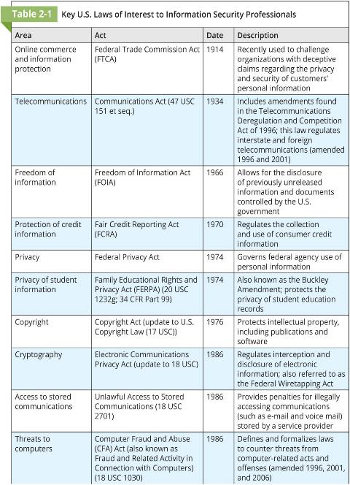
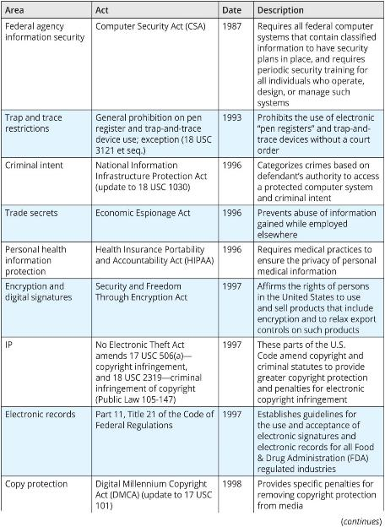

Slide 14
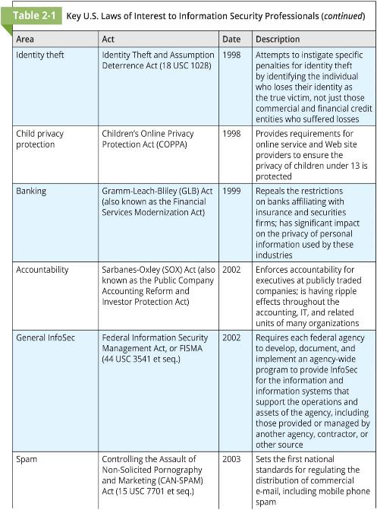
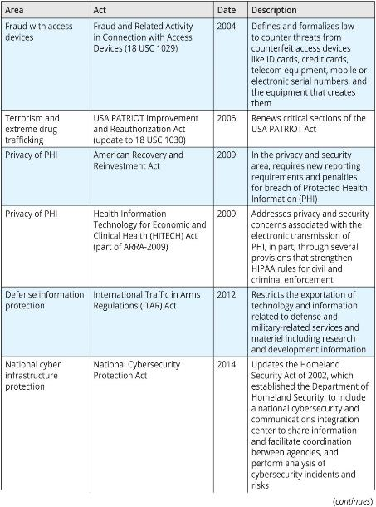

Slide 15
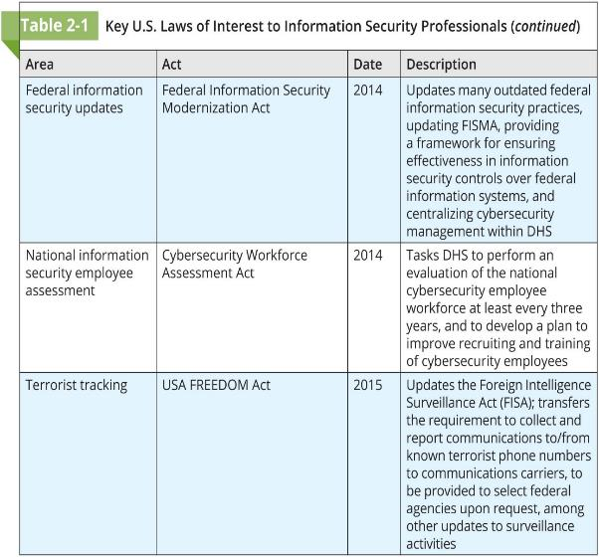

Slide 16
General Computer Crime Laws
The Computer Fraud and Abuse (CFA) Act of 1986 is the cornerstone of many computer-related federal laws
It was amended by the National Information Infrastructure Protection Act of 1996
Punishment for offenses include fines and/or imprisonment for up to 20 years and depends on the value of the information obtained and whether the offense is judged to have been committed for:
  purposes of commercial advantage;
  private financial gain; or
  in furtherance of a criminal act
Notes:
The CFA Act was further modified by the USA PATRIOT Act of 2001—“Uniting and Strengthening America by Providing Appropriate Tools Required to Intercept and Obstruct Terrorism Act” providing law enforcement agencies with broader latitude to combat terrorism-related activities after the 9/11 attacks on the New York World Trade Center
The USA PATRIOT Act of 2001 was updated and extended, in many cases permanently, through the USA PATRIOT Improvement and Reauthorization Act of 2005
In May 2015, the U.S. Senate failed to extend the USA PATRIOT Act, resulting in the expiration of many of its components on June 1, 2015
The controversy over a section that allowed the National Security Agency (NSA) to collect metadata, resulted in modification and incorporation of those components in the USA FREEDOM Act (Uniting and Strengthening America by Fulfilling Rights and Ending Eavesdropping, Dragnet-collection and Online Monitoring Act), which was signed into law in June 2015
The Computer Security Act (CSA) of 1987 was one of the first attempts to protect federal computer systems by establishing minimum acceptable security practices
The Computer Security Act established a Computer System Security and Privacy Advisory Board within the Department of Commerce
Another provision requires mandatory periodic training in computer security awareness and accepted computer security practice for all users of federal computer systems
The CSA charged the National Bureau of Standards (now NIST) and the National Security Agency with the development of:
Standards, guidelines, and associated methods and techniques for computer systems
Uniform standards and guidelines for most federal computer systems
Technical, management, physical, and administrative standards and guidelines for the cost-effective security and privacy of sensitive information in federal computer systems
Guidelines for use by operators of federal computer systems that contain sensitive information in training their employees in security awareness and accepted security practice
Validation procedures for, and evaluation of the effectiveness of, standards and guidelines through research and liaison with other government and private agencies

Slide 17
U.K. Computer Security Laws
Computer Misuse Act 1990: Defined three “computer misuse offenses”:
  Unauthorized access to computer material.
  Unauthorized access with intent to commit or facilitate commission of further offenses.
  Unauthorized acts with intent to impair, or with recklessness as to impairing, operation of computer, etc.
Privacy and Electronic Communications (EC Directive) Regulations 2003: Focuses on protection against unwanted or harassing phone, e-mail, and SMS messages
Police and Justice Act 2006: Updated the Computer Misuse Act, modified the penalties, and created new crimes defined as the “unauthorized acts with intent to impair operation of computer, etc.”

Slide 18
Privacy Laws
Many organizations collect, trade, and sell personal information as a commodity, and many individuals are becoming aware of these practices and looking to the governments to protect their privacy
Today, information aggregation from multiple sources permits unethical organizations to build databases with alarming quantities of personal information
Privacy in this context is not absolute freedom from observation; rather, it is defined as the “state of being free from unsanctioned intrusion”
Notes:
The Federal Privacy Act of 1974 regulates the government’s use of private information and was created to ensure that government agencies protect the privacy of individuals’ and businesses’ information and makes them responsible if any portion of this information is released without permission
The Electronic Communications Privacy Act (ECPA) of 1986 is a collection of statutes that regulates the interception of wire, electronic, and oral communications and is commonly referred to as the “wiretapping act”
The ECPA works in cooperation with the Fourth Amendment of the U.S. Constitution, which prohibits search and seizure without a warrant
The Health Insurance Portability and Accountability Act (HIPAA) of 1996, also known as the Kennedy-Kassebaum Act, attempts to protect the confidentiality and security of health care data by establishing and enforcing standards and by standardizing electronic data interchange
HIPAA requires organizations that retain health care information to use information security mechanisms to protect this information, as well as policies and procedures to maintain them
It also requires a comprehensive assessment of the organization's information security systems, policies, and procedures
HIPAA provides guidelines for the use of electronic signatures based on security standards ensuring message integrity, user authentication, and nonrepudiation
HIPAA has five fundamental privacy principles:
Consumer control of medical information
Boundaries on the use of medical information
Accountability for the privacy of private information
Balance of public responsibility for the use of medical information for the greater good measured against impact to the individual
Security of health information

Slide 19
Other Laws and ACT
General Data Protection Regulation (GDPR)
ARRA and HITECH
Gramm-Leach-Bliley (GLB) Act of 1999
Export and Espionage Laws
U.S. Copyright Law
Freedom of Information Act (FOIA) of 1966
Sarbanes-Oxley (SOX) Act of 2002
Breach Laws
International Laws and Legal Bodies
European Council Cybercrime Convention
Digital Millennium Copyright Act (DMCA)
Australian High Tech Crime
State and Local Regulations
Notes:
General Data Protection Regulation (GDPR):
The Guide to the GDPR is part of our Guide to Data Protection. It is for DPOs and others who have day-to-day responsibility for data protection.
It explains the general data protection regime that applies to most UK businesses and organisations. It covers the General Data Protection Regulation (GDPR) as it applies in the UK, tailored by the Data Protection Act 2018.
It explains each of the data protection principles, rights and obligations. It summarises the key points you need to know, answers frequently asked questions, and contains practical checklists to help you comply.
Where relevant, this guide also links to more detailed guidance and other resources, including ICO guidance, statutory ICO codes of practice, and European guidance published by the European Data Protection Board (EDPB).
https://ico.org.uk/for-organisations/guide-to-data-protection/guide-to-the-general-data-protection-regulation-gdpr/
ARRA and HITECH:
Enacted in 2009, the American Recovery and Reinvestment Act (ARRA) was designed to provide a response to the economic crisis in the United States
The act was specifically focused on providing tax cuts and funding for programs, federal contracts, grants, and loans
The Health Information Technology for Economic and Clinical Health (HITECH) Act, enacted as part of ARRA, and in cooperation with HIPAA, also requires that covered entities notify information owners of breaches
Gramm-Leach-Bliley (GLB) Act of 1999
The Financial Services Modernization Act or Gramm-Leach-Bliley (GLB) Act of 1999 contains a number of provisions that affect banks, securities firms, and insurance companies
The act requires all financial institutions to disclose their privacy policies, describing how they share nonpublic personal information, and describing how customers can request that their information not be shared with third parties
The act also ensures that the privacy policies in effect in an organization are fully disclosed when a customer initiates a business relationship and distributed at least annually for the duration of the professional association
Export and Espionage Laws
In an attempt to protect intellectual property and competitive advantage, Congress passed the Economic Espionage Act (EEA) in 1996
This law attempts to protect trade secrets
“from the foreign government that uses its classic espionage apparatus to spy on a company, to the two American companies that are attempting to uncover each other's bid proposals, or to the disgruntled former employee who walks out of his former company with a computer diskette full of engineering schematics”
The Security and Freedom through Encryption Act of 1997 provides guidance on the use of encryption, and institutes measures of public protection from government intervention
Specifically, the act reinforces an individual’s right to use or sell encryption algorithms, without concern for the impact of other regulations requiring some form of key registration
The act prohibits the federal government from requiring the use of encryption for contracts, grants, and other official documents, and correspondence
U.S. Copyright Law:
Extends protection to intellectual property, which includes words published in electronic formats
The doctrine of fair use allows material to be quoted for the purpose of news reporting, teaching, scholarship, and a number of other related activities, so long as the purpose is educational and not for profit and the usage is not excessive
Proper acknowledgement must be provided to the author and/or copyright holder of such works, including a description of the location of source materials by using a recognized form of citation
Freedom of Information Act (FOIA) of 1966:
All federal agencies are required under the Freedom of Information Act (FOIA) to disclose records requested in writing by any person
The FOIA applies only to federal agencies and does not create a right of access to records held by Congress, the courts, or by state or local government agencies
Each state has its own public access laws that should be consulted for access to state and local records
Sarbanes-Oxley (SOX) Act of 2002:
Designed to enforce accountability for financial record keeping and reporting at publicly traded corporations
The law requires that the CEO and CFO assume direct and personal accountability for the completeness and accuracy of a publicly traded organization’s financial reporting and record-keeping systems
As these executives attempt to ensure that the integrity of recording and reporting systems is sound—often relying upon the expertise of CIOs and CISOs to do so—they must also maintain the availability and confidentiality of information
Breach Laws:
A breach law specifies a requirement for organizations to notify affected parties when they have experienced a specified type of loss of information
Most of these laws also require some form of after-breach support from the organization, such as free or discounted credit monitoring, progress reports, and a description of actions taken to rectify the incident and prevent reoccurrence
Although the United States currently does not have a national breach law, several bills and proposals are being reviewed by the U.S. Congress
International Laws and Legal Bodies:
Many domestic laws and customs do not apply to international trade, which is governed by international treaties and trade agreements
Because of the political complexities of the relationships among nations and cultural differences, there are currently few international laws relating to privacy and information security
European Council Cybercrime Convention:
Empowers an international task force to oversee a range of Internet security functions and to standardize technology laws internationally
It also attempts to improve the effectiveness of international investigations into breaches of technology law
The overall goal of the convention is to simplify the acquisition of information for law enforcement agents in certain types of international crimes as well as the extradition process
Digital Millennium Copyright Act (DMCA):
The Digital Millennium Copyright Act (DMCA) is a U.S.-based international effort to reduce the impact of copyright, trademark, and privacy infringement, especially via the removal of technological copyright protection measures
The European Union created Directive 95/46/EC that increases individual rights to process and freely move personal data
The United Kingdom has already implemented a version of this directive called the Database Right
Australian High Tech Crime:
High tech crimes are defined and prosecuted in Australia under its Commonwealth legislation Part 10.7—Computer Offences of the Criminal Code Act 1995
That law specifically includes:
data system intrusions (such as hacking);
unauthorized destruction or modification of data;
actions intended to deny service of computer systems to intended users, such as denial of-service (DoS) attacks and distributed denial of service (DDoS) attacks using botnets; and
the creation and distribution of malicious software
State and Local Regulations:
It is the responsibility of information security professionals to understand state laws and regulations and ensure that their organization’s security policies and procedures comply with the laws and regulations
The Georgia Computer Systems Protection Act has various computer security provisions and establishes specific penalties for use of information technology to attack or exploit information systems in organizations
The Georgia Identity Theft Law requires that a business may not discard a record containing personal information unless it shreds, erases, modifies, or otherwise makes the information irretrievable

Slide 20
The GDPR
The General Data Protection Regulation (GDPR) replaces the Data Protection Directive 95/46/EC and has the following objectives[1], [2]:
  To harmonise data privacy laws across Europe
  To protect and empower all EU citizens data privacy
  To reshape the way organisations across the region approach data privacy
It comes into law on 25 May 2018 and will is part of UK law post-Brexit
[1] https://www.eugdpr.org/
[2] https://ico.org.uk/for-organisations/uk-gdpr-guidance-and-resources/
Accessed 07/10/2025

Slide 21
Standards Versus Law
A variety of groups have created standards that offer guidance on how information security could or should be applied to industry segments or geographic areas
Some industries have security requirements defined at least in part by government regulations; banking, health care, and education come to mind
Other industries impose binding requirements on themselves that include significant enforcement mechanisms—for example, the credit card processing requirements from the Payment Card Industry Security Standards Council

Slide 22
PCI DSS
The Payment Card Industry Data Security Standard (PCI DSS) is a set of industry standards that are mandated for any organization that handles credit, debit, and specialty payment cards in an effort to reduce credit card fraud
The current standard (3.2) is presented by the PCI Security Standards Council as focusing on 12 requirements in six areas:

Slide 23
PCI DSS (Continued)
Secure Network and Systems Development and Maintenance
  1. Firewall installation and operation (protection of cardholder data)
  2. Modification of default system passwords and configurations
Cardholder Data Protection
  3. General protection of cardholder data storage
  4. Use of encryption when transmitting cardholder data across open, public networks
Vulnerability Management Program Maintenance
  5. Use of maintained and updated malware and anti-virus protection
  6. Secure systems and application development and maintenance
Strong Access Control Measure Implementation
  7. Use of need-to-know access controls for cardholder data
  8. Formal access controls for system components emphasizing effective identification and authentication procedures
  9. Management of physical security for cardholder data access
Network Monitoring and Testing
  10. Network resources and cardholder data monitored, tracked, and audited
  11. Security systems and processes periodically tested
Information Security Policy Maintenance
  12. Effective and comprehensive information security policy developed and implemented for all personnel
Notes:
The benefits of PCI DSS compliance, as promoted by the PCI Security Standards Council, include:
An assertion that systems processing payment cards are secure, promoting trust in customers
Improved reputation with payment card issue and payment processing organizations
Prevention of security breaches
Assistance in complying with other security standards, such as HIPAA, SOX, and GLB
Support for organizational security strategies
Increased efficiency of the information infrastructure

Slide 24
Policy Versus Law
Because policies function like laws, they must be crafted with the same care as laws to ensure that the policies are complete, appropriate, and fairly applied to everyone in the workplace
The key difference between policy and law is that while ignorance of the law is not an excuse (ignorantia juris non excusat), ignorance of policy is a viable defense, thus policies must be:
  Distributed to all individuals who are expected to comply with them
  Read by all employees
  Understood by all employees, with multilingual translations and translations for visually impaired or low-literacy employees
  Acknowledged by the employee, usually by means of a signed consent form
  Uniformly enforced, with no special treatment for any group (e.g., executives)
Notes:
Most organizations develop and formalize policies as descriptions of acceptable and unacceptable employee behavior (policies are covered in detail in Chapter 4). Properly defined and enforced policies function in an organization the same way as laws, complete with penalties, judicial practices, and sanctions. Because policies function like laws, they must be crafted with the same care as laws to ensure that the policies are complete, appropriate, and fairly applied to everyone in the workplace.ost organizations develop and formalize policies as descriptions of acceptable and unacceptable employee behavior (policies are covered in detail in Chapter 4). Properly defined and enforced policies function in an organization the same way as laws, complete with penalties, judicial practices, and sanctions. Because policies function like laws, they must be crafted with the same care as laws to ensure that the policies are complete, appropriate, and fairly applied to everyone in the workplace.

Slide 25
key regulations by region and type (Privacy Law, Security Standard, Sector-Specific, etc.).
Region | Name & Acronym | Type | Key Scope & Jurisdiction | Core Principle / Focus | Official Link
Global Framework | ISO/IEC 27001 | International Security Standard | Global (Certification) | Establishing an Information Security Management System (ISMS). Risk-based, comprehensive controls. | ISO Website
Global Framework | NIST Cybersecurity Framework (CSF) | Voluntary Framework | Global (Widely adopted, especially in US) | Identify, Protect, Detect, Respond, Recover. Risk management and resilience. | NIST CSF Website
European Union | General Data Protection Regulation (GDPR) | Privacy Law | EU & EEA; extraterritorial (any co. processing EU data) | Lawful processing, data subject rights, privacy by design, breach notification. | EUR-Lex
European Union | Network and Information Systems Directive 2 (NIS2) | Cybersecurity Directive | EU Member States (critical sectors) | Improves resilience & incident reporting across essential sectors (energy, transport, health, etc.). | EUR-Lex
European Union | Digital Operational Resilience Act (DORA) | Sector-Specific (Finance) | EU Financial Sector | Ensures the financial sector can withstand ICT-related disruptions. | EUR-Lex
United Kingdom | UK GDPR & Data Protection Act 2018 | Privacy Law | United Kingdom | Largely mirrors EU GDPR but is a separate UK law post-Brexit. | ICO UK
United States (Federal) | NIST SP 800-53 | Security Control Catalog | U.S. Federal Agencies; widely used as a benchmark | Provides a catalog of security and privacy controls for all federal information systems. | NIST SP 800-53
United States (State) | California Consumer Privacy Act (CCPA/CPRA) | Privacy Law | California, USA; extraterritorial | Consumer rights to know, delete, and opt-out of sale of personal information. | State of CA
China | Personal Information Protection Law (PIPL) | Privacy Law | China; extraterritorial | Similar to GDPR: consent, data minimization, rights to access/correct/delete. Data localization. | China Law Translate
China | Cybersecurity Law (CSL) | Cybersecurity Law | China | Multi-level protection scheme (MLPS), data localization, and critical information infrastructure (CII) protection. | NPC China
South America | Lei Geral de Proteção de Dados (LGPD) | Privacy Law | Brazil; extraterritorial | Heavily inspired by GDPR. Establishes principles, rights, and legal bases for data processing. | Planalto (PT)
Africa | Protection of Personal Information Act (POPIA) | Privacy Law | South Africa | Conditions for lawful processing, regulator established, rights of data subjects. | SA Govt.
Caribbean | Data Protection Act, 2020 | Privacy Law | Jamaica | Governs the collection, use, and disclosure of personal information by organizations. | JIS
Sector-Specific (Global) | Payment Card Industry Data Security Standard (PCI DSS) | Sector-Specific (Finance) | Global (Any org handling card data) | 12 requirements to secure credit cardholder data. | PCI SSC

Slide 26
Organizational Liability and the Management of Digital Forensics
Compliance: Law and Ethics

Slide 27
Organizational Liability and the Need for Counsel
If an employee, acting with or without authorization, performs an illegal or unethical act, causing some degree of harm, the organization can be held financially liable for that action
An organization increases its liability if it refuses to take measures—due care—to make sure that every employee knows what is acceptable, what is not acceptable, and the consequences of illegal or unethical actions
Due diligence requires that an organization make a valid and ongoing effort to protect others
Notes:
due care Measures that an organization takes to ensure every employee knows what is acceptable and what is not.
due diligence Reasonable steps taken by people or organizations to meet the obligations imposed by laws or regulations.
jurisdiction The power to make legal decisions and judgments, typically an area within which an entity such as a court or law enforcement agency is empowered to make legal decisions.
liability An entity’s legal obligation or responsibility.
long-arm jurisdiction The ability of a legal entity to exercise its influence beyond its normal boundaries by asserting a connection between an out-of-jurisdiction entity and a local legal case.
restitution A legal requirement to make compensation or payment resulting from a loss or injury.

Slide 28
Key Law Enforcement Agencies
The Federal Bureau of Investigation’s InfraGard Program promotes efforts to educate, train, inform, and involve the business and public sector in information security
Every FBI field office has established an InfraGard chapter and collaborates with public and private organizations and the academic community to share information about attacks, vulnerabilities, and threats
InfraGard’s dominant contribution is the free exchange of information to and from the private sector in the subject areas of threats and attacks on information resources
Notes:
The National Security Agency (NSA) coordinates, directs, and performs highly-specialized activities to protect U.S. information systems and produce foreign intelligence information, and it is also responsible for the security of communications and information systems at many federal government agencies associated with national security
The NSA’s Information Assurance Directorate (IAD) provides information security “solutions including the technologies, specifications and criteria, products, product configurations, tools, standards, operational doctrine, and support activities needed to implement the protect, detect and report, and respond elements of cyber defense”
In addition to its well-known mission to protect key members of the U.S. government, the U.S. Secret Service is also charged with the detection and arrest of any person committing a U.S. federal offense relating to computer fraud as well as false identification crimes
The Secret Service was transferred from the Department of the Treasury to the Department of Homeland Security in March 2003
Since that time, the DHS has added to its critical infrastructure defense strategies the protection of the nation’s cyber infrastructures

Slide 29
Managing Digital Forensics
When—not if—an organization finds itself having to deal with a suspected policy or law violation, it must appoint an individual to investigate it
How the internal investigation proceeds will dictate whether or not the organization has the ability to take action against the perpetrator if in fact evidence is found that substantiates the accusation
In order to protect the organization, and to possibly assist law enforcement in the conduct of an investigation, the investigator (CISO or other individual) must act to document what happened and how
Notes:
affidavit Sworn testimony that certain facts are in the possession of the investigating officer and that they warrant the examination of specific items located at a specific place. The facts, the items, and the place must be specified in the affidavit.
digital forensics Investigations involving the preservation, identification, extraction, documentation, and interpretation of computer media for evidentiary and root cause analysis. Like traditional forensics, digital forensics follows clear, well-defined methodologies but still tends to be as much art as science.
digital malfeasance A crime against or using digital media, computer technology, or related components; in other words, a computer is the source of a crime or the object of a crime.
e-discovery The identification and preservation of evidentiary material related to a specific legal action.
evidentiary material (EM) Also known as “items of potential evidentiary value,” any information that could potentially support the organization’s legal or policy-based case against a suspect. evidentiary material policy (EM policy) The policy document that guides the development and implementation of EM procedures regarding the collection, handling, and storage of items of potential evidentiary value, as well as the organization and conduct of EM collection teams.
forensics The coherent application of methodical investigatory techniques to collect, preserve, and present evidence of crimes in a court or court-like setting. Forensics allows investigators to determine what happened by examining the results of an event—criminal, natural, intentional, or accidental.
search warrant Permission to search for evidentiary material at a specified location and/ or to seize items to return to the investigator’s lab for examination. An affidavit becomes a search warrant when signed by an approving authority.

Slide 30
Digital Forensics
Forensics is the coherent application of methodical investigatory techniques to present evidence of crimes in a court or court-like setting
Digital forensics involves the preservation, identification, extraction, documentation, and interpretation of digital media for evidentiary and/or root cause analysis
Like traditional forensics, it follows clear, well-defined methodologies, but still tends to be as much art as science
Notes:
Evidentiary material (EM), also known as an item of potential evidentiary value, is any information that could potentially support the organization’s legal- or policy-based case against a suspect
An item does not become evidence until it is formally admitted to evidence by a judge or other ruling official

Slide 31
Digital Forensics (Continued)
Digital forensics can be used for two key purposes:
  To investigate allegations of digital malfeasance—a crime against or using digital media, computer technology, or related components
  To perform root cause analysis—if an incident occurs and the organization suspects an attack was successful, digital forensics can be used to examine the path and methodology used to gain unauthorized access as well as to determine how pervasive and successful the attack was
Notes:
Most organizations cannot sustain a permanent digital forensics team
Even so, there should be people in the InfoSec group trained to understand and manage the forensics process
This expertise can be obtained by sending employees to a regional or national InfoSec conference with a digital forensics track or to dedicated digital forensics training

Slide 32
Affidavits and Search Warrants
Many investigations begin with an allegation or an indication of an incident
In law enforcement, the investigating agent would create an affidavit, which when signed by an approving authority becomes a search warrant and grants permission to search the specified location and to seize items to return to the investigator’s lab for examination
In corporate environments, the names of these documents may change and in many cases may be verbal in nature, but the process should be the same

Slide 33
Digital Forensics Methodology
In digital forensics, all investigations follow the same basic methodology:
  Identify relevant items of evidentiary value (EM)
  Acquire (seize) the evidence without alteration or damage
  Take steps to assure that the evidence is at every step verifiably authentic and is unchanged from the time it was seized
  Analyze the data without risking modification or unauthorized access
  Report the findings to the proper authority

Slide 34
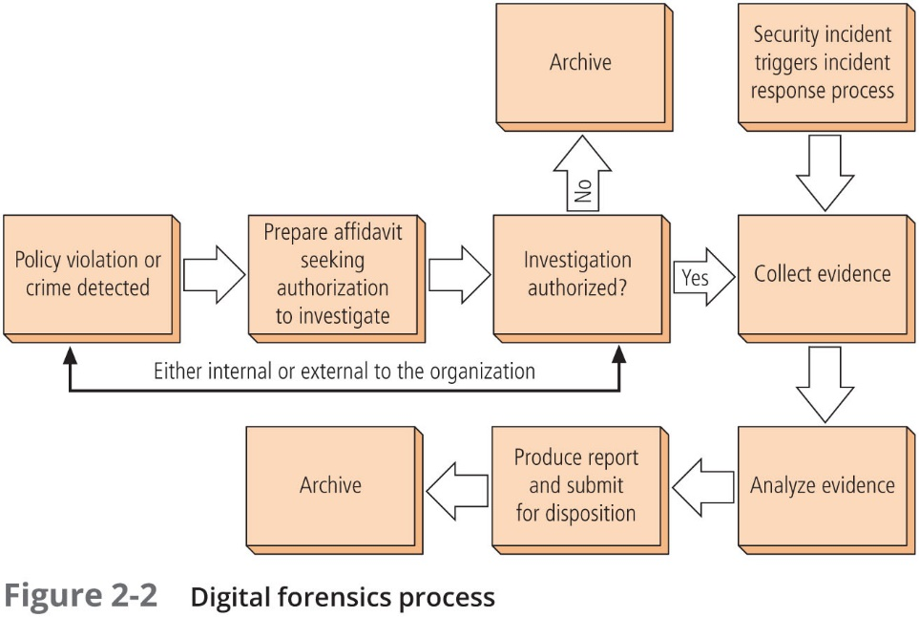
Notes:
Evidentiary Policy and Procedures
Organizations should develop specific digital forensics procedures, along with policy providing guidance on the use of these procedures
EM policy should specify:
Who may conduct an investigation
Who may authorize an investigation
What affidavit-related documents are required
What search warrant-related documents are required
What digital media may be seized or taken offline
What methodology should be followed
What methods are required for chain of custody or chain of evidence
What format the final report should take and to whom it should it be given
Law Enforcement Involvement
When an incident or disaster violates civil or criminal law, it is the organization’s responsibility to notify the proper authorities. Selecting the appropriate law enforcement agency depends on the type of crime committed. As described earlier, the Federal Bureau of Investigation (FBI), for example, handles computer crimes that cross state lines and investigates terrorism and cyberterrorism, which can include attacks against businesses and other organizations. The U.S. Secret Service examines crimes involving U.S. currency, counterfeiting, credit cards, and identity theft. The U.S. Treasury Department has a bank fraud investigation unit, and the Securities and Exchange Commission has investigation and fraud control units as well. Each state, county, and city in the United States has its own law enforcement agencies
Involving law enforcement agencies has both advantages and disadvantages:
Such agencies are usually much better equipped to process evidence than a business and are also prepared to handle the warrants and subpoenas necessary when documenting a case
The disadvantages of law enforcement involvement include possible loss of control over the chain of events following an incident—for example, the collection of information and evidence and the prosecution of suspects
A very real issue is the confiscation of vital equipment as evidence

Slide 35
Summary
Deterrence can prevent an illegal or unethical activity from occurring. Successful deterrence requires the institution of severe penalties, the probability of apprehension, and an expectation that penalties will be enforced
As part of an effort to sponsor positive ethics, a number of professional organizations have established codes of conduct and/or codes of ethics that their members are expected to follow
Laws are formally adopted rules for acceptable behavior in modern society. Ethics are socially acceptable behaviors. The key difference between laws and ethics is that laws bear the sanction of a governing authority and ethics do not

Slide 36
Summary (Continued)
Organizations formalize desired behaviors in documents called policies. Unlike laws, policies must be distributed, read, understood, explicitly agreed to by employees and uniformly enforced before they are enforceable
Civil law encompasses a wide variety of laws that regulate relationships between and among individuals and organizations. Criminal law addresses violations that harm society and that are prosecuted by the state. Tort law is a subset of civil law that deals with lawsuits by individuals rather than criminal prosecution by the state
U.S. copyright law extends intellectual property rights to the published word, including electronic publication
A number of key U.S. federal agencies are charged with the protection of American information resources and the investigation of threats or attacks against these resources

Slide 37
Summary (Continued)
Digital forensics involves the preservation, identification, extraction, documentation, and interpretation of computer media for evidentiary and root cause analysis. E-discovery is the identification and preservation of evidentiary materials related to a specific legal action
Most organizations cannot sustain a permanent digital forensics team. Even so, people in the InfoSec group should be trained to understand and manage the forensics process
In digital forensics, all investigations follow the same basic methodology: identify relevant items of evidentiary value, acquire (seize) the evidence without alteration or damage, take steps to assure that the evidence is verifiably authentic at every stage and is unchanged from the time it was seized, analyze the data without risking modification or unauthorized access, and report the findings to the proper authority

Slide 38
Questions

Slide 39
References
M. E Whitman, H. J. Mattford, Management of Information Security, Cengage Learning, 6th ed 2019.

