Slide 1
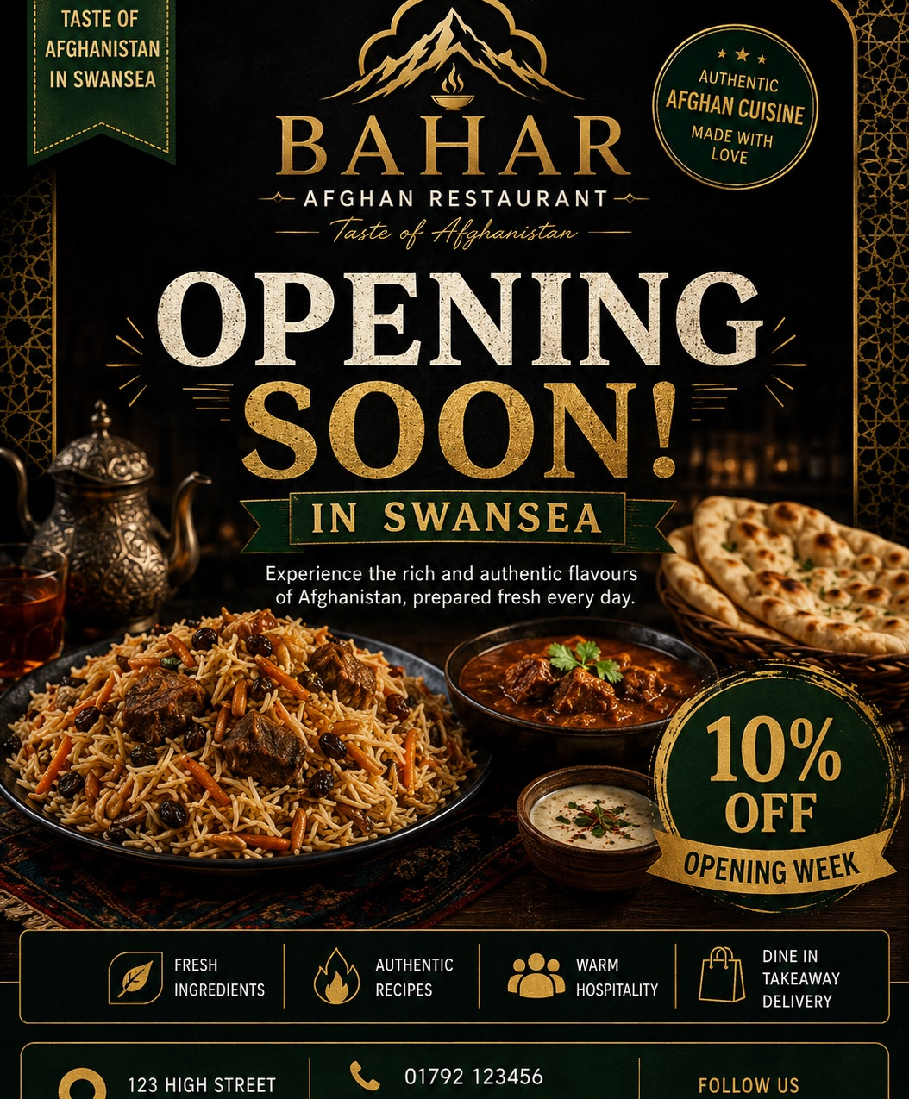
Yasir Hanif
Student Id number: 2516965
Managing Enterprise

Slide 2
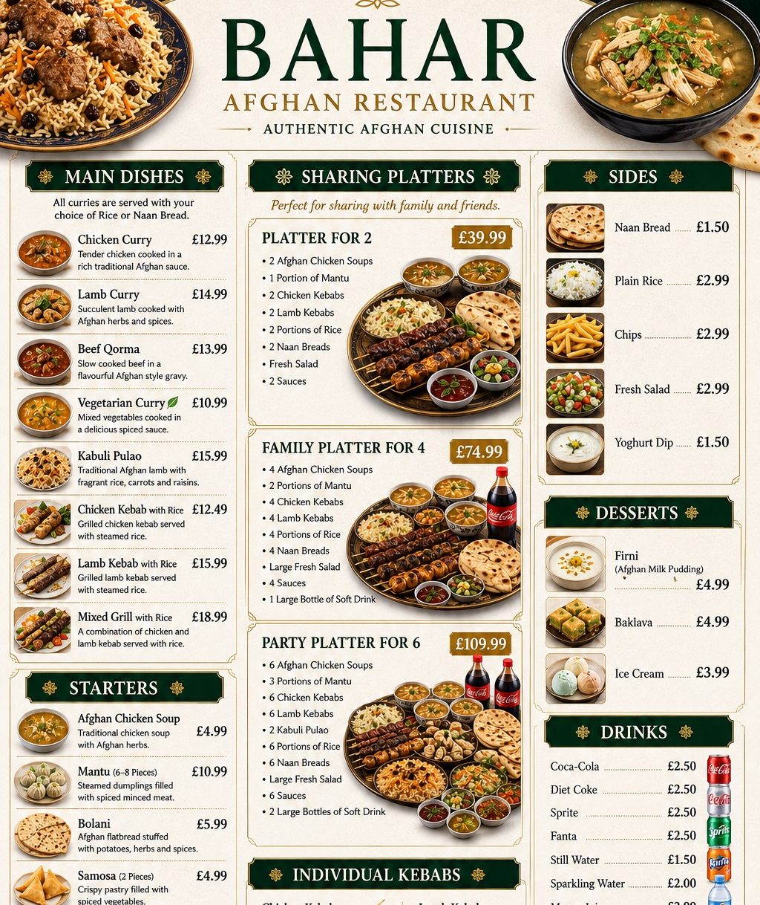
Business Proposition
Business description.
Name Bahar Afghan Restaurant.
Product & Service. Authentic Afghan food.
Story behind the business.
Biginas et al, 2022, p.2)

Slide 3

Mission statement
Mission.
Business aims.
Objectives. 40-60 customer within 6 months sell £18000-27000 and 60-80 customers 6 months sell £27000-£35000 and good customer satisfaction rate
USP.
(Duong et al, 2023).

Slide 4
Legal Structure
LTD Limited Company.
Shareholders have limited liability.
Personal assets are protected.
Supports future business growth and investment.
(Tennent and Friend, 2005, p.256)

Slide 5
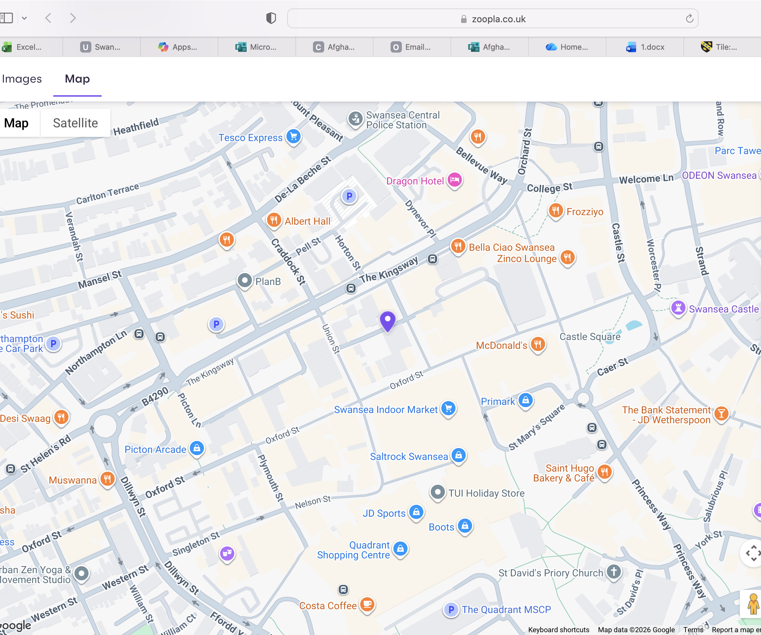

3
Business Location.
Park Street Swansea city Center.
Bezovski (2023)

Slide 6

Human Resource Management strategy
Recruit 1 experienced chef and assistant.
Provide training in food hygiene and customer service.
Create a positive and supportive working environment.
Increase staff numbers as the business grows. Ze et al, (2024)
Owner / Manager
│
┌────────────┴────────────┐
│ │
Head Chef Kitchen Assistant

Slide 7
Brief financial overview
Start-up cost £17,000.GOV.UK (2025)
Funding £17,000 government start up loan.
Fixed Monthly cost:£1198
Variable costs: £5000-£19400 per month
Financial forecast: 12-month cash flow forecast prepared.
Net cash flow £131,453.60
(Enriquez-Diaz and Castro-Santos, 2021, pp.13).

Slide 8
Swot analysis
Strengths. First Afghan restaurant, City centre location
Weaknesses. New business, limited customer awareness, £17000 Start up loan repayments.
Opportunities. Growing interest in international cuisine, delivery and takeaway services
Threats. Competition
(Swansea Council, 2025).

Slide 9
Market Research
Primary research.
Created questionnaire.
Collected 24 responses .
Secondary research.
Used sources such as Swansea Council.
Researched Swansea population, demographics and existing restaurants.
Searched map and google.
(Stokes and Wilson, 2021).

Slide 10

12 months marketing strategy and branding.
Promote online and offline. I have designed a logo, business cards, flyers and social media posts for Facebook, Instagram and TikTok
Use pay adds.
Handed over leaflets in local area.
Partner with Just Eat, Uber Eats and Deliveroo to Increase online orders.
Offer opening promotions, seasonal discounts.
(Kotler, Armstrong and Balasubramaian, 2024, p.638)

Slide 11
Pitch to angel investors
Strengths.
Entrepreneurial traits.
Achievements.
Experience.
Passion for Business.
(Finch, 2022, p.103).

Slide 12
References list
Biginas, K., Sindakis, S., Koumproglou, A. and Wubben, E. (2022) Small business management and control of the uncertain external environment. Emerald Publishing Limited.
Stokes, D. and Wilson, N. (2021) Small Business Management and Entrepreneurship. 8th edn. Cengage Learning.
Finch, B. (2022) How to Write a Business Plan: Win Backing and Support for Your Ideas and Ventures. 7th edn. London: Kogan Page.
Ze, Y. van Asselt, E.D. Focker, M. and van der Fels-Klerx, H.J. (2024) Risk factors affecting the food safety risk in food business operations for risk-based inspection: A systematic review. Comprehensive Reviews in Food Science and Food Safety, 23(5), e13403.
https://librarysearch.uwtsd.ac.uk/discovery
Duong, A.T.B. Nguyen, T.T.B. Li, D. and Quang, H.T. (2023) Unleashing food business’s potential: the mediating role of food safety management on the relationship between critical success factors and business performance. Operations Management Research, 16(4), pp. 2064–2080.
https://librarysearch.uwtsd.ac.uk/discovery

Slide 13
References List
Enríquez-Díaz, J. and Castro-Santos, L. (2021) Financial management and risk analysis strategies for business sustainability. PA: IGI Global.
Kotler, P., Armstrong, G. and Balasubramanian, S. (2024) Principles of Marketing. 19th Global edn. Pearson.
Tennent, J. and Friend, G. (2005) Guide to Business Modelling. London:
Bezovski, Z. (2023) Must-Know Sources of Business Ideas for Entrepreneurs: Examples Included. Bizizly. Available at: (Accessed: 18 June 2026).
https://biizly.com/sources-of-business-ideas/
Swansea Council (2025) Title of the webpage. Available at: URL (Accessed: 18 June 2026).
https://www.swansea.gov.uk/business
GOV.UK (2025) Apply for a Start Up Loan for your business. Available at: Accessed: 18 June 2026).
https://www.gov.uk/apply-start-up-loan

