Slide 1
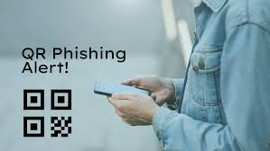
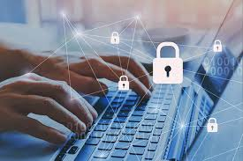
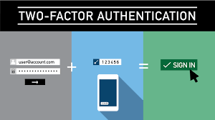
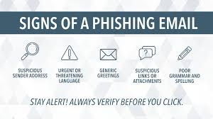
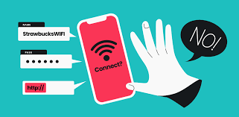
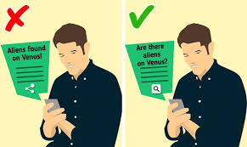
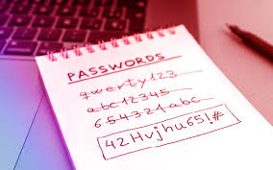
Basic Digital Safety
Name: Emanuela
Basic Digital Safety: Protect Yourself Online….!
Digital safety in this modern interconnected globe is highly significant (Riaz et al. 2024). Whether leveraging social media platforms, sending emails, or looking into the browser, being safe online seems very important in order to safeguard individual data and prevent risks of cyber scams.
Giving 2FA (Two-Factor Authentication):
Adding extra security layer in accounts by allowing two-factor authentication is important (Riaz et al. 2024).
Keep your Devices Updated:
Antivirus system, applications, and the operating system should be updated on regular basis (Riaz et al. 2024). The updates generally comprise patches in terms of security susceptibilities which hackers exploit.
Stay Alert from Phishing Scams:
Being cautious about messages or emails that requires sensitive data or asks to click on third-party links (Epstein and Zankich, 2022). Verification of the sender and prevent from downloading from fishy links is important.
Avoid Public Wi-Fi for Sensitive Tasks:
Networks used by common public such as Public Wi-Fi are generally unsecured. Avoid online shopping or logging into bank accounts when utilising these public Wi-Fi (Epstein and Zankich, 2022).
Utilisation of Strong Passwords:
Making complicated passwords utilising symbols, numbers, and mix of letters is very important (Al-Ameen et al. 2022). Avoid giving individual data such as birthdate is also a concern. Password manager can be used in order to monitor passwords securely.
Careful about sharing things online:
Everyone should think before they made any post on social media. Sensitive and individual information such as workplace, school, or address details could be utilised by cyber scammers (Al-Ameen et al. 2022). Making adjustments in privacy settings is very important to regulate social media handles.
Back Up your Data:
Important files should be protected on regular basis through backing up them into a secured external drive or cloud-system (Epstein and Zankich, 2022).
References
Al-Ameen, M.N., Marne, S.T., Fatema, K., Wright, M. and Scielzo, S., 2022. On improving the memorability of system-assigned recognition-based passwords. Behaviour & Information Technology, 41(5), pp.1115-1131.
Epstein, R. and Zankich, V.R., 2022. The surprising power of a click requirement: How click requirements and warnings affect users’ willingness to disclose personal information. Plos one, 17(2), p.e0263097.
Riaz, Q., Ayub, N. and Idrees, H.S., 2024. Interconnected Realms: Exploring the Nexus of International Relations, Trade Dynamics, and Digital Transformation. Traditional Journal of Law and Social Sciences, 3(01), pp.36-46.

