Slide 1
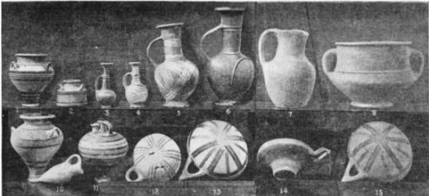

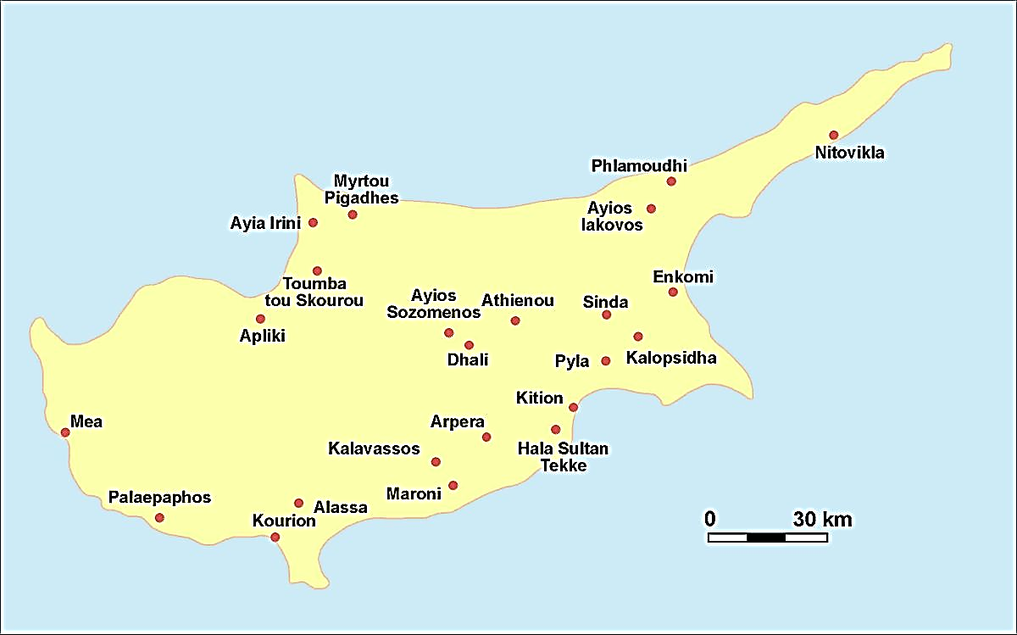
Mycenaeans and Phoenicians Artefacts Found in Cyprus
Flavia Stevens
HPAR5005
1.Introduction
This report attempts to discover when Mycenaean and Phoenician settlements occurred on Cyprus in the Late Bronze Age and Early Iron Age by comparing burial tomb styles with ceramics. It concludes that this is very difficult to discover because whereas there is a lot of evidence for Mycenaean settlements the Phoenicians are archaeologically invisible because of their use of other cultures material culture. Contra to Myres (1897), who claims the Phoenicians arrived in Early Iron Age, Boardman (1980) argues for later Phoenician arrival in the Middle Iron Age (Boardman.1980: 35).
4.Discussion
To find Phoenician evidence in Kalopsida and Larnaka was difficult, Perhaps, it is difficult, because the material evidence was not in Late Bronze age and Early Iron Age in these two sites. The ceramic evidence was found in middle to later Iron Age. The trade that Cyprus had with Al Mine and Egypt were not possible to compare when it was just one city to take the data. In contrast, the Mycenaean was easier because the type of tombs had on Cyprus, again not much ceramics because of the limitation of period that made it difficult to have data to compare. Also, Mycenaean pottery were found in Al Mine in large quantities. Some pottery styles were found across all tomb styles e.g. plain white ware lamps. This means that ceramics are not a good indicator of specific cultures but tomb styles are.
Kalopsida
Larnaka
2.Aims and Objectives
The focus here is on the burial and the ceramics found in the tombs at Kalopsida (see Table 1) and Larnaka (see Table 2). This report considers Mycenaean settlements, their colonization in Cyprus and their influence in ceramics with the Cypriots and Phoenicians in Late Bronze Age and Early Iron Age.
 | Red/black Ware slip (LBA) | White painted Ware (LBA) | Plain White Ware (LBA) | Plain white/Red (LBA) | Bichrome (EIA)
Tomb 1 (Beehive style) | 1 Possibly a base ring | NA | NA | NA | NA
Tomb 2 (Cave style) | 1 Kraters 1 Bowls | NA | NA | NA | NA
Tomb 3 (Cave style) | 1 Possible base ring | 1 Possibly base ring | 1 Possibly bowl | NA | NA
Tomb 4 (Beehive style) | 1 krater | 3bowl 4 base rings | 2 cups 2 kraters 1 jug with a lip | NA | 3 kraters
Tomb 5 style (Dromos style) | 1 possibly slab of polished red ware (possibly from Libya or Cyprus)? | NA | 1 Possibly ring-vase | NA | NA
 | Red Ware/black slip (LAB) | White painted Ware (LAB) | Plain White Ware (LAB) | Plain White Ware (LAB) | Bichrome (LAB)
Tombs Cypriot 42,43,47,47a Communicate To each other | 2 amphoras | NA | NA | 1 lamp | NA
Tomb 44(Long barrel-roofed chamber Mycenaean | NA | NA | NA | 1 lamp handle-plate | NA
Tomb 53 (small tomb style) Cypriot | 1 plate or saucer with black line | NA | 1 jug with handle geom.design | NA | NA
Tomb 60 (beehive style) Mycenaean | 2 jugs flat-rimmed | 2 amphora type 1 | 2 amphora type 2 | 1 Bottle 2 lamps | NA
Tomb 56 Mycenaean/Phoenician separated with door-jambs of masonry | 2 jugs | NA | 3 amphoras | 2 lamps | NA
Graeco-Phoenician Sanctuary (Votive Terracotta Style) | NA | NA | NA | 19 figurine funnel-bodied | NA
5.Conclusion
To find Phoenician evidence in Kalopsida and Larnaka was difficult, Perhaps, it is difficult, because the material evidence was not in Late Bronze age and Early Iron Age in these two sites. The ceramic evidence was found in middle to later Iron Age. The trade that Cyprus had with Al Mine and Egypt were not possible to compare when it was just one city to take the data. In contrast, the Mycenaean was easier because the type of tombs had on Cyprus, again not much ceramics because of the limitation of period that made it difficult to have data to compare. Also, Mycenaean pottery were found in Al Mine in large quantities.
3.Methods and Results
The data collection was supported using two sites from Cyprus, Kalopsida and Larnaka. Therefore, the subject of this study is largely broad to discuss just in two sites only. The data presents the Mycenaean, Cypriot and Phoenician tomb styles in relation to the ceramic styles: Red/Black Ware, Plain White Ware, White Painted Ware, and Bichrome Ware.
Table 1. Ceramics styles in Kalopsida Burial through Late Bronze Age and Iron Age
Table 2. Ceramics styles in Larnaka Burial through in Late Bronze Age and Iron Age
References List:
-Boardman J. (1980). The Greeks Overseas: Their early Colonies and Trade. New Ed. London. Thames and Hudson Ltd.
-Knapp, A.B. (1997)The Archaeology of Late Bronze Age Cypriot Society: The Study of Settlement, Survey and Landscape. University of Glasgow Department of Archaeology.
-Myres, J. (1894). Excavation in Cyprus 1894. Available from: https://about.jstor.org.terms [Accessed at: 08/11/2018].

