Slide 1
A Comparison Study on Flexible and Rigid Pavements
By Jacob Passmore

Slide 2
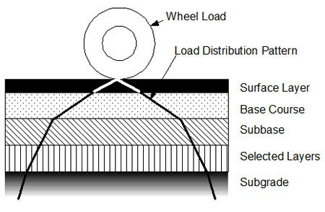
Flexible Pavement Design
This type of pavement design is made with asphalt for the surface finish, the main purpose of the pavements surface is to distribute loads to the lower layer which transfers the stress through contact points of the granular structure.
Distribution of the loads depend on the characteristics of the component layers.

Slide 3
Layers in Flexible Pavements
Capping layer – Used to strengthen resistance of the subgrade (if the subgrade is strong enough then there is no need for this)
Sub Bade – Protection for the capping layer or sub grade from any damage from the plant used on site and weather – this must be compacted in sub layers and no more than 250mm
Road Base – Main layer for load distribution and has to be well compacted, thickness depends on the load of distribution

Slide 4
Pros and Cons on Flexible Pavements
Advantages | Disadvantages
Low completion costs | Maintenance costs are high
There are no thermal stresses | Low life span (10 years)
^ Why there’s no expansion joints needed | Damaged by oils and some chemicals
Resistance to the formation of ice glaze
Easy to be opened and patched
Can be used within 24 hours

Slide 5
Rigid Pavement Design
Mostly made by concrete slabs – thickness changes depending on loads that need supported
Characteristics of rigidity
Can distribute loads over a wide area of subgrade soil – lower layers needs to support smaller stress
Stress transmitted is reduced as these pavements are not developed in so many layers

Slide 6
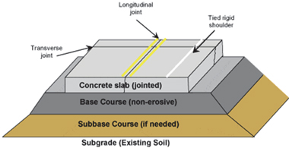

Slide 7
Pros and Cons Of Rigid Pavements
Advantages | Disadvantages
Low repairing costs | Completion costs are high
Long term life span (50 years) | Vulnerable to thermal stress
Surface can be laid on sub grade | ^ Why expansion joints are needed
Doesn’t get damaged from oils and greases | Rough riding quality
Strong edges | Cannot be used until 14 days

Slide 8
Characteristics between Flexible and Rigid Pavements
Deformation in the subgrade – deformation in flexible pavement subgrade transfers to the upper layer but rigid pavements do not transfer to the subsequent layers
Design – Flexible pavements are based on loading distribution, having low flexural strength and the load is transferee by grain to grain contact but rigid are based on high flexural strength but with no grain to grain load trasfer

Slide 9
Conclusion
To conclude flexible pavements differ to rigid pavements in terms of the load distribution and layers under the surface layer play a more important role in flexible pavements. It is also very important to analyse the pavement design and construction as you need to consider the terrain it’s going to be placed, weather conditions, traffic loads and operating conditions.

