Slide 1
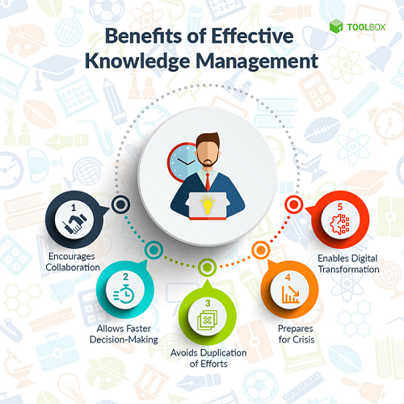
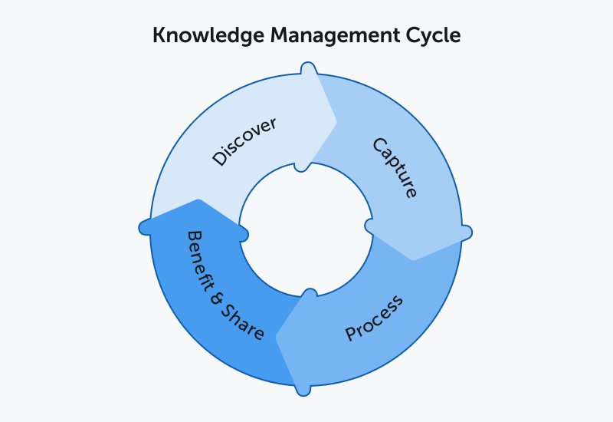
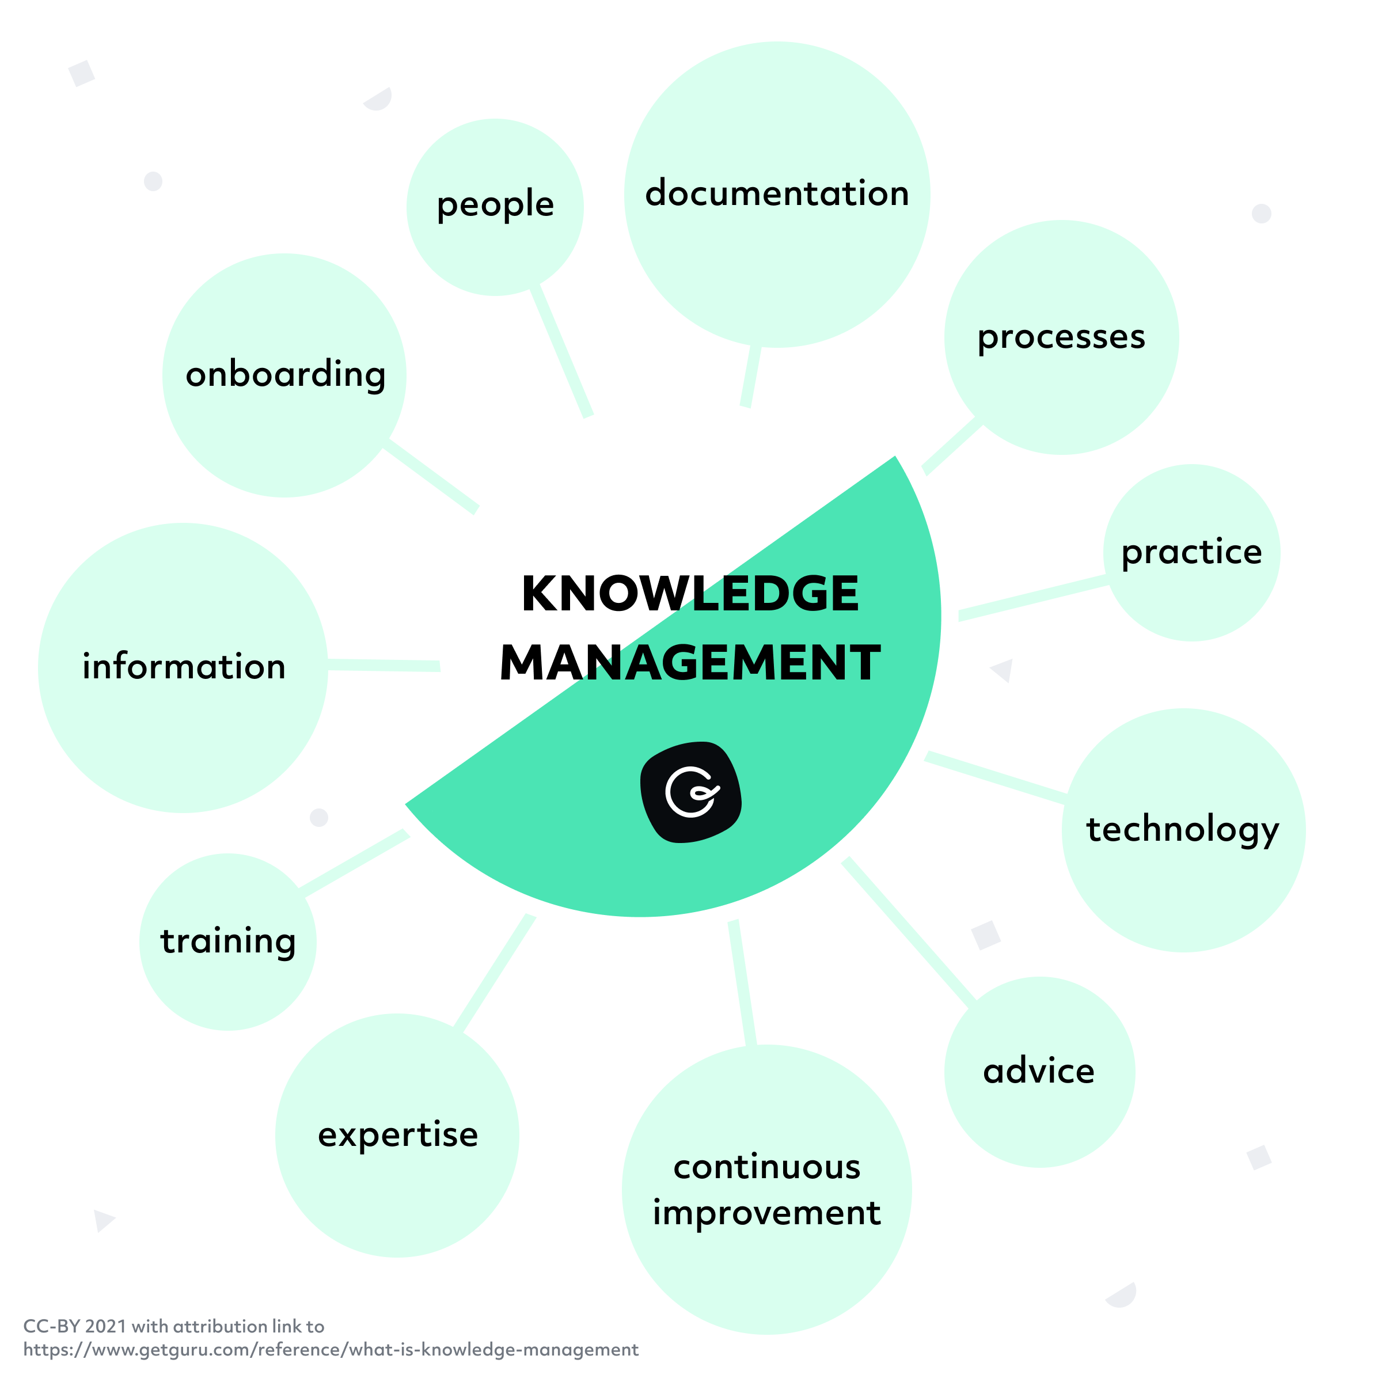
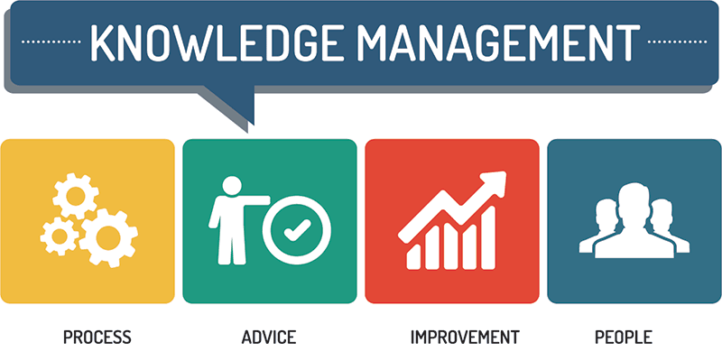
Knowledge Management (KM) System in practice at Tesco
Student : Alexandra Mintoiu (2111131)
Introduction:
Knowledge management (KM) is the process of identifying, capturing, storing, sharing, and utilizing knowledge and expertise within an organization. Effective KM enables organizations to make informed decisions, improve processes, and innovate in response to changing market trends. In the highly competitive retail industry, KM plays a critical role in enabling companies to stay ahead of their competitors by leveraging their collective knowledge and expertise. Tesco's approach to KM is focused on creating a culture of continuous learning and development, where employees are empowered to share their knowledge and expertise, and innovation is encouraged at all levels of the organization.
Implementing a Low-Cost KM System for Tesco
To implement the KM system without spending too many organizational resources, Tesco can adopt a phased approach. This involves starting with a small pilot program to test the system's effectiveness and gather feedback from employees. Once the system has been refined, it can be scaled up gradually over time. Additionally, Tesco can leverage open-source software and cloud-based solutions to minimize costs.
Demonstrating how it will be used or accessed:
The KM system can be accessed through a web-based interface that is accessible to all employees. The interface should be simple and intuitive, with clear navigation and search functions to facilitate easy access to information. Security restrictions can be implemented to ensure that only authorized employees can access sensitive data. Additional security measures, such as two-factor authentication and encryption, can also be implemented to ensure the security of the system.
Various KM tools and technologies that Tesco can use to support its KM initiatives:
Commercialization Potential: Ways to Monetize the Knowledge Accumulated:
1. Document Management Systems (DMS): A DMS is a software system that allows Tesco to create, store, track, and manage documents in a centralized location. It can help in organizing different types of files such as policies, procedures, training manuals, and other important documents.
2. Collaboration Tools: These tools allow employees to work together on projects and share knowledge and expertise. Examples include online forums, video conferencing, and instant messaging systems.
3. Data Analytics: Tesco can use data analytics tools to analyze large volumes of data and gain insights into its operations, customer behavior, and emerging market trends.
4. Artificial Intelligence and Machine Learning: AI and ML can be used to analyze data, generate insights, and automate processes. For example, AI chat bots can answer customer queries and provide personalized recommendations based on their purchase history.
5. Learning Management Systems (LMS): An LMS is a software application that is used to deliver and manage employee training programs. It can help Tesco ensure that employees have the necessary skills and knowledge to perform their jobs effectively.
The knowledge accumulated through the KM system can be commercialized in several ways.
Firstly, Tesco can use the insights gained from data analytics to develop new products or services that meet emerging market trends.
Secondly, the company can monetize its expertise by offering consulting services to other companies or by licensing its intellectual property to third parties.
Finally, Tesco can use the knowledge accumulated through the KM system to improve its operations, reduce costs, and increase efficiency, which can ultimately lead to increased profitability.
KM system interaction with other ongoing systems:
The KM system can be integrated with existing systems such as HR, customer relationship management (CRM), and supply chain management systems. This can help Tesco leverage data from these systems to gain a more holistic view of its operations and identify new opportunities for innovation and growth. For example, if Tesco's HR system is already configured to capture data related to employee skills and knowledge, the KM system could be integrated with it to access this data and create a centralized repository of knowledge assets. This would enable employees to easily search for and access relevant knowledge and expertise, improving their productivity and performance. Similarly, the KM system could be integrated with Tesco's CRM system to capture customer feedback and insights, which could then be used to improve product design and service delivery. The KM system could also be integrated with supply chain management systems to capture supplier and vendor knowledge and best practices, enabling Tesco to optimize its supply chain operations.
Conclusion:
In conclusion, Tesco must use knowledge management to stay ahead in the competitive retail market. Tesco can make better decisions, enhance processes, and adapt to market changes by recognizing, capturing, storing, sharing, and using its information and expertise. Document management, collaboration, data analytics, and AI can help these objectives. Tesco should phase the KM system's implementation to save resources. KM system knowledge can be commercialized to boost innovation, profitability, and expertise.
References:
Choo, C.W., 1996. The knowing organization: How organizations use information to construct meaning, create knowledge and make decisions. International journal of information management, 16(5), pp.329-340.
Fowler, A., 2000. The role of AI-based technology in support of the knowledge management value activity cycle. The Journal of Strategic Information Systems, 9(2-3), pp.107-128.
Greco, M., Grimaldi, M. and Hanandi, M., 2013. How to select knowledge management systems: a framework to support managers. International Journal of Engineering Business Management, 5, p.6.
Johannessen, J.A., 2008. Organisational innovation as part of knowledge management. International Journal of Information Management, 28(5), pp.403-412.
Wiig, K., 2012. People-focused knowledge management. Routledge.

