Slide 1
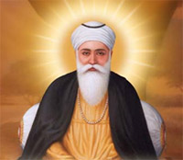
The Life of the First Guru, Nanak, and the Nature and Importance of his Contribution to the Sikh tradition
Luca Horton
Level 4 Student
BBC (2018) The founder of Sikhism: Guru Nanak, Available at: http://www.bbc.co.uk/religion/religions/sikhism/people/nanak.shtml (Accessed: 20th April 2018).

Slide 2
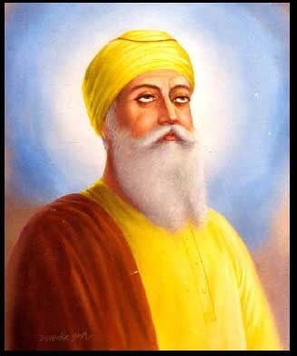
Contents
The Life of Guru Nanak
His Divine Revelation
His teachings and Scriptures
Guru Nanak’s Theology
Guru Nanak today and different Views
Bibliography
Questions
V Samarasan, MAeSI. (2017) Who was the Guru of Guru Nanak Dev Ji?, Available at: https://www.quora.com/Who-was-the-Guru-of-Guru-Nanak-Dev-Ji (Accessed: 10th April 2018).

Slide 3
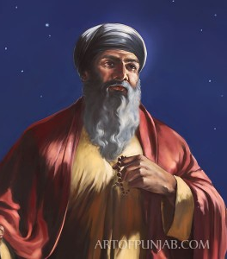
The Life of Guru Nanak
Birth and Early Life
Early Talents
Nanak’s issue
artofpunjab: Paintings by Kanwar Singh (2017) Guru Nanak's Odyssey, Available at: https://artofpunjab.com/product/guru-nanaks-odyssey/ (Accessed: 12th April 2018).

Slide 4
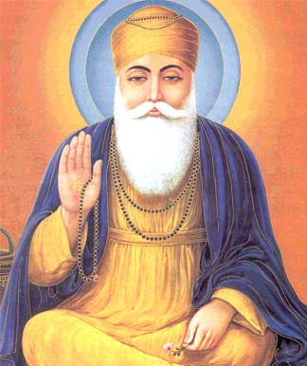
His Divine Revelation
Nanak’s disappearance and divine revelation
Nanak’s new philosophy
Nanak’s journey and his true message
Pinterest (2018) Explore Spiritual Teachers, Kundalini Yoga and more!, Available at: https://www.pinterest.co.uk/pin/92112754852295319/ (Accessed: 18th April 2018).

Slide 5
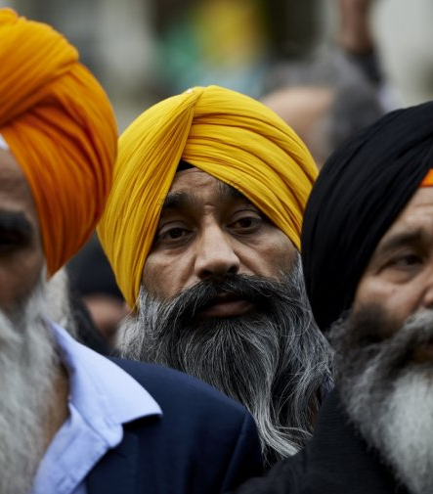
His Theology, Teachings and Scriptures
Mul Mantar
Guru Nanak’s theology
The Three Pillars of Sikhism
Mogul, Priyanka (2016) India Supreme Court considers banning websites for jokes that mock Sikhs, Available at: https://www.ibtimes.co.uk/india-supreme-court-considers-banning-websites-jokes-that-mock-sikhs-1536119 (Accessed: 27th April 2018).

Slide 6
‘Make your mind the plough and your deeds the farming, Let your body be the field and steady work the watering. Let the Nam be the seed you plant’ (AG 595: First Guru)
‘If my body were a vat and the crimson of the Nam Were poured onto it, And if the dyer were my Master, Such a brilliant colour you would never have seen’ (AG 721: First Guru)

Slide 7
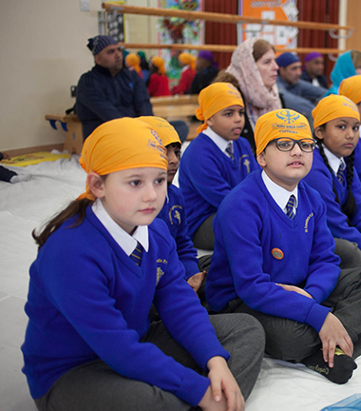
Guru Nanak’s Community
Community of Kartapur and their discipline
Nam Simran and Divine Service
The Nanak-Panth
Beckfoot Heaton (2017) Sikhism: School, Available at: www.heaton.bradford.sch.uk/year-4-at-the-sikh-gurdwara/y4-sikh-6/ (Accessed: 6th April 2018).

Slide 8
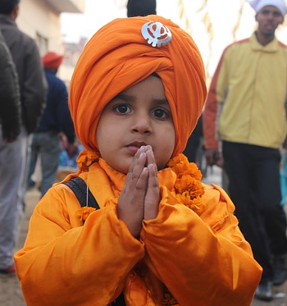
Guru Nanak Today and different Views
NiranKari
Guru Nanak Worship Within the Gurdwara
Concluding Thoughts
SikhismLR (2017) Sikhism: Learning Resources , Available at: https://alldonemonkey.com/2017/08/25/sikhism-learning-resources-for-kids/ (Accessed: 16th April 2018).

Slide 9

Bibliography
Nesbitt, Eleanor (2005) Sikhism: A very Short Introduction, 1st edn., 198 Madison Avenue, New York, NY 10016, USA: Oxford University Press.
McLeod, W. H., (1989) The Sikhs: History, Religion and Society, 1st edn, Guildford: Columbia University Press.
(2017) Three Days in the River, Available at: http://fateh.sikhnet.com/sikhnet/register.nsf/p/Story1 (Accessed: 19th April 2018).
(2018) The First Master Guru Nanak (1469 - 1539), Available at: https://www.sikhs.org/guru1.htm (Accessed: 25th April 2018).
(2018) Who is Guru Nanak?, Available at: http://www.world-religions-professor.com/gurunanak.html (Accessed: 25th April 2018).

Slide 10

Any Questions?
If I did my presentation again, what could I improve on?
Any particularly interesting aspects of the presentation?
Would you say Guru Nanak is the highest authoritative figure in Sikhism history?
Would Guru Nanak accept Sikhism during and post – Guru Gobind Singh?
Wiki (2018) Outline of Sikhism, Available at: https://en.wikipedia.org/wiki/Outline_of_Sikhism (Accessed: 28th April 2018).

