Slide 1
BMBM5024
Marketing in Practice
Lecturer: Gwyneth Jones

Slide 2
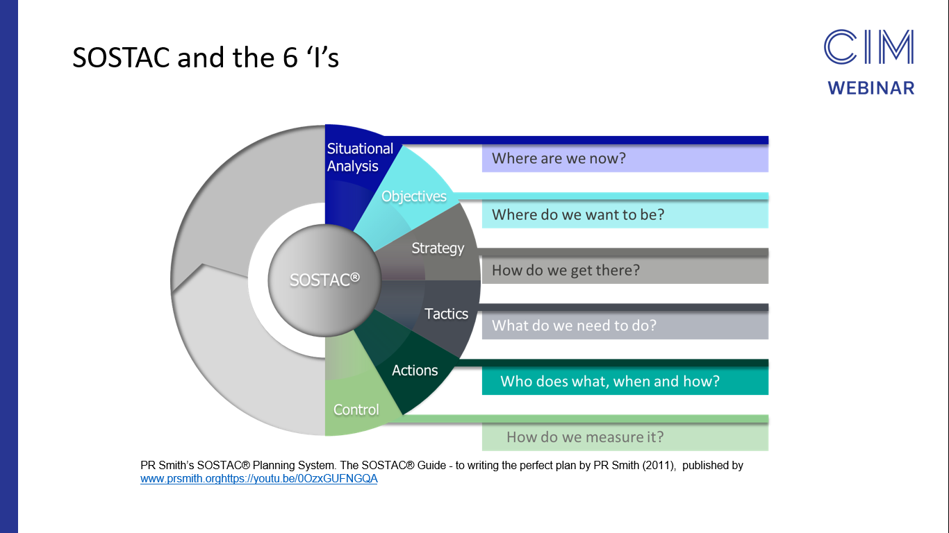
SOSTAC Planning Model

Slide 3
Lecture 4
The Marketing Audit
In our last lecture we looked at the MACRO environmental audit using a PESTEL ANALYSIS
Today we will explore tools used for the MICRO environmental audit:
Porter’s Five Forces

Slide 4
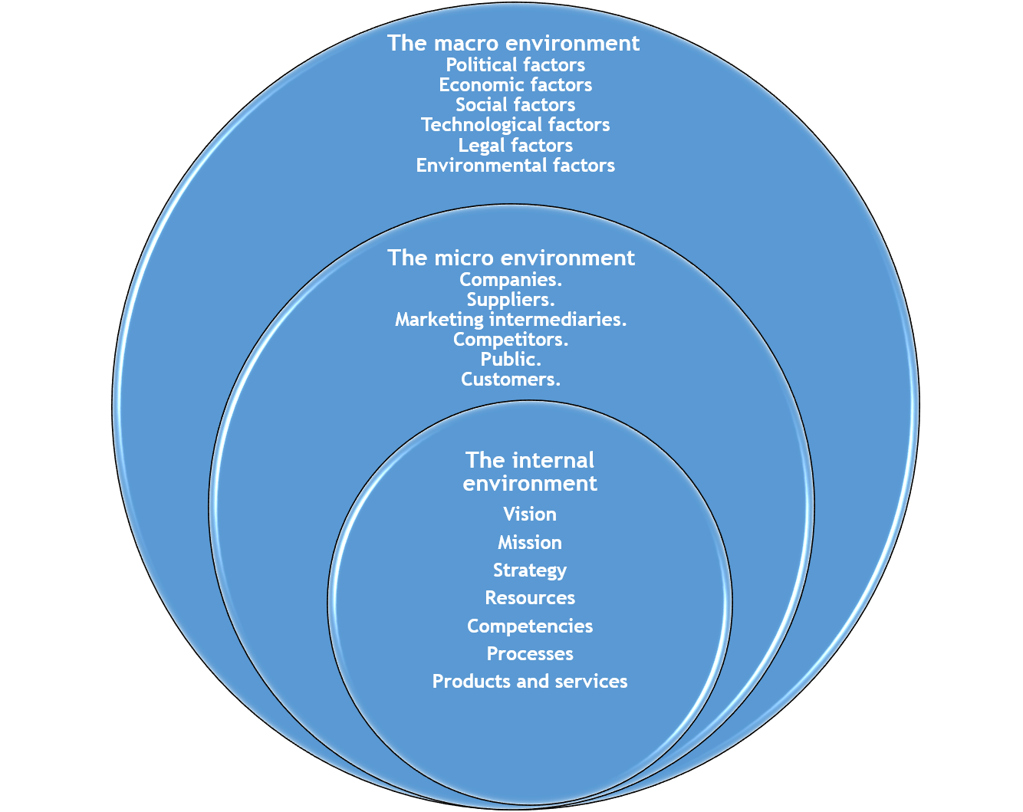

Slide 5

The Micro Environment Audit

Slide 6
Porter’s Five Forces Analysis
This is a useful analytical framework both in understanding:
The strength of an organisation’s current competitive position.
The strength of a position that an organisation may look to move into.

Slide 7


Slide 8
Porter’s Five Forces Analysis
Porter’s Five Forces analysis is a framework that helps analyse the level of competition within a certain industry.
It is especially useful when starting a new business or when entering a new industry sector.
According to this framework, competitiveness does not only come from competitors but from five forces
The collective strength of these forces determines the competitive intensity and profit potential of an industry and thus its attractiveness.
If the five forces are intense, almost no company in the industry earns attractive returns on investments. If the forces are mild however, there is room for higher returns.

Slide 9
Porter’s Five Forces Analysis
PROFIT
PRICE
Businesses generate profit by selling goods for more than the cost of producing them.
When competitive forces are weak a healthy profit can be made.
When competitive forces are high, increased costs and competitive pricing force profit down.

Slide 10
High Competition = Lower Profitability
WEAK COMPETITION
STRONG COMPETITION
PROFIT
COSTS
PROFIT
COSTS Increased costs of advertising and promotions due to competitive pressure. PRICE Competitive pricing may force the company to reduce the selling price

Slide 11
Porter’s Five Forces Analysis
What benefits does Porter’s Five Forces analysis provide?
Five forces analysis helps organisations to understand the factors affecting profitability in a specific industry.
It can help to inform decisions relating to:
  Whether to enter a specific industry
  Whether to increase capacity in a specific industry
  Developing competitive strategies.

Slide 12
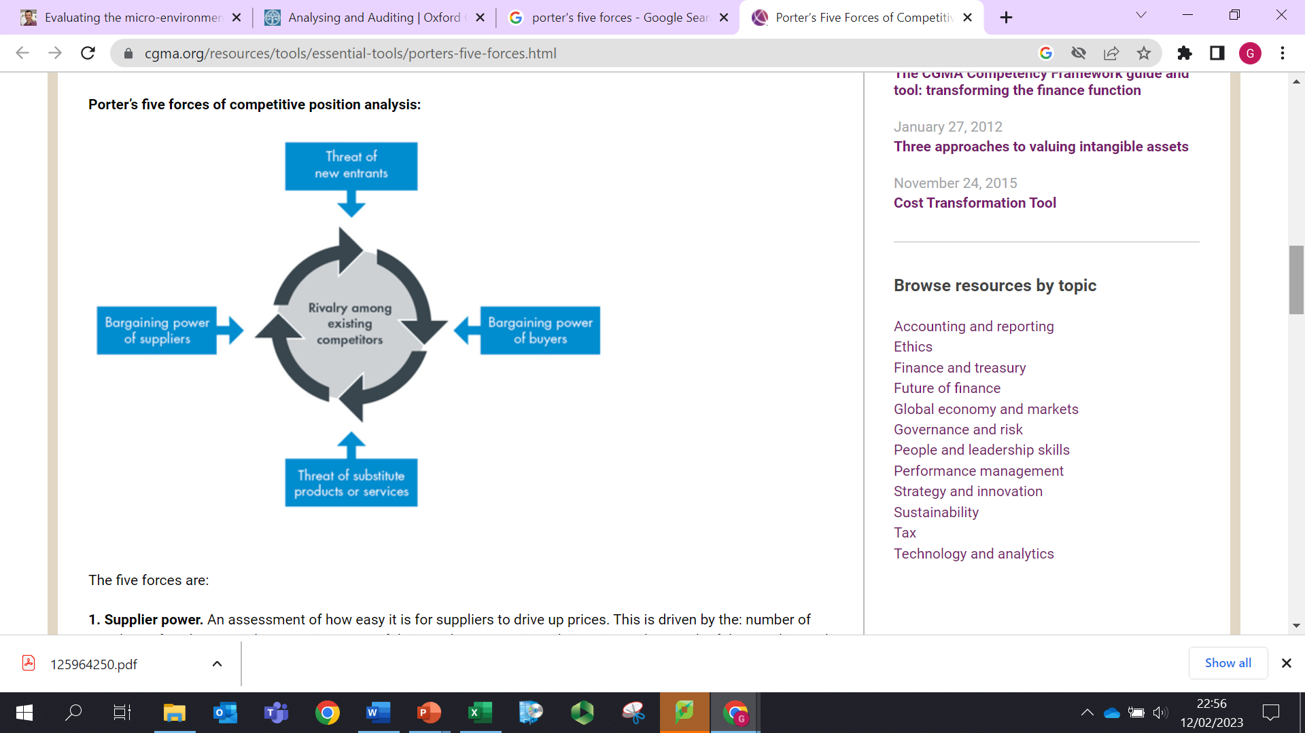
Porter’s Five Forces

Slide 13

The Five Forces – Threat of New Entrants
New entrants in an industry bring new capacity and the desire to gain market share.
If new entrants enter a market profitability will decline to a competitive rate.
The seriousness of the threat depends on the barriers to enter a certain industry. The higher these barriers to entry, the smaller the threat for existing players.
Examples of barriers to entry are the need for economies of scale, high customer loyalty for existing brands, patents, large capital requirements (e.g. large investments in marketing or R&D), the need for cumulative experience, government policies, and limited access to distribution channels.

Slide 14
The following factors will affect the strength of the threat of new entrants:
Economies of scale
Product differentiation
Brand identity/loyalty
Access to distribution channels
Capital requirements
Access to latest technology
Access to necessary inputs
Experience and learning effects
Government policies
Switching costs
Expected retaliation from existing players

Slide 15
Class Exercise
Work in small groups
Choose an organisation with which you are familiar
Discuss the ‘Threat of New Entrants’ in relation to that organisation’s industry
Make a bullet point list of key factors
Evaluate if the ‘Threat of New Entrants’ is a high, moderate or low threat.
Share your views with the class

Slide 16

The Five Forces – Bargaining Power of Buyers
This force analyses the extent the customers can put the company under pressure.
The customers have a lot of power when there aren’t many of them and when the customers have many alternatives to buy from. Also, if it is easy for them to switch from one company to another.
Buying power is low when the seller’s product is very different from any of its competitors or when switching is difficult or costly.
The internet has allowed customers to become more informed and therefore more empowered. Customers can easily compare prices online, get information about a wide variety of products and get access to offers from other companies instantly.
Companies can reduce buyer power by implementing loyalty programs or by differentiating their products and services.

Slide 17
Class Exercise
Continue to work in your group with the same organisation
Discuss the ‘Power of Buyers’ in relation to that organisation’s industry
Make a bullet point list of key factors
Evaluate if the ‘Power of Buyers’ is a high, moderate or low threat.
Share your views with the class

Slide 18
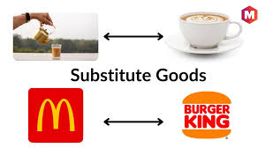
The Five Forces –
Porter’s Five Forces – The Threat of Substitutes Products
A substitute product is one that serves the same purpose as another product in the market.

Slide 19

The Five Forces – Threat of Substitutes
Where close substitute products exist in a market, it increases the likelihood of customers switching to alternatives in response to price increases. This reduces both the power of suppliers and the attractiveness of the market.
Substitutes increase the chance of customers switching to alternatives. As well as similar products that are branded differently by competitors - every product that serves a similar need for customers should be considered a substitute
Example: Energy drinks like Redbull are usually not considered a competitor of coffee brands such as Starbucks. However, since both coffee and energy drink fulfil a similar need (i.e. staying awake/getting energy), customers might be willing to switch from one to another if they feel that prices increase too much in either coffee or energy drinks. This will ultimately affect an industry’s profitability and should therefore also be taken into account when evaluating the industry’s attractiveness.

Slide 20
The Five Forces –
The Threat of Substitutes Will Depend On:
Number of substitute products available
Buyer’s propensity to substitute
Relative price performance of substitutes
Perceived level of product differentiation
Switching costs
Substitute producer’s profitability & aggressiveness

Slide 21
Class Exercise
Continue to work in your group with the same organisation
Discuss the ‘Threat of Substitutes’ in relation to that organisation’s industry
Make a bullet point list of key factors
Evaluate if the ‘Threat of Substitutes’ is a high, moderate or low threat.
Share your views with the class

Slide 22

The Five Forces – Bargaining Power of Suppliers
This force analyses how much power and control a company’s suppliers have to raise prices or to reduce the quality of purchased goods or services, which in turn would lower an industry’s profitability potential.
The concentration of suppliers and the availability of substitute suppliers are important factors in determining supplier power.
Fewer Suppliers = More Power
Businesses are in a better position when there are a multitude of suppliers.
Supplier power also includes:
Switching costs of companies in the industry, availability of substitutes, the strength of their distribution channels and the uniqueness or level of differentiation in the product or service the supplier is delivering.

Slide 23
Class Exercise
Continue to work in your group with the same organisation
Discuss the ‘Power of Suppliers’ in relation to that organisation’s industry
Make a bullet point list of key factors
Evaluate if the ‘Power of Suppliers’ is a high, moderate or low threat.
Share your views with the class

Slide 24
The Five Forces – Competitor Rivalry
How intense the current competition is in the marketplace is determined by the number of existing competitors and what each competitor is capable of doing.
Rivalry is high when there are a lot of competitors that are roughly equal in size and power, when the industry is growing slowly and when consumers can easily switch to a competitors offering for little cost.
When rivalry is high, competitors are likely to actively engage in advertising and price wars, which can hurt a business’s profit margin. In addition, rivalry will be more intense when barriers to exit are high, forcing companies to remain in the industry even though profit margins are declining. These barriers to exit can for example be long-term loan agreements and high fixed costs.
Many competitors, offering undifferentiated products and services, will reduce market attractiveness.

Slide 25
The Level of Competitor Rivalry Will Depend On:
Number of competitors
Differentiation of competitors
Industry growth
Quality differences
Brand identity/loyalty
Switching costs
Barriers to exit

Slide 26
Class Exercise
Continue to work in your group with the same organisation
Discuss the level of ‘Competitive Rivalry’ in relation to that organisation’s industry
Make a bullet point list of key factors
Evaluate if the level of ‘Competitive Rivalry’ is a high, moderate or low threat.
Share your views with the class

Slide 27
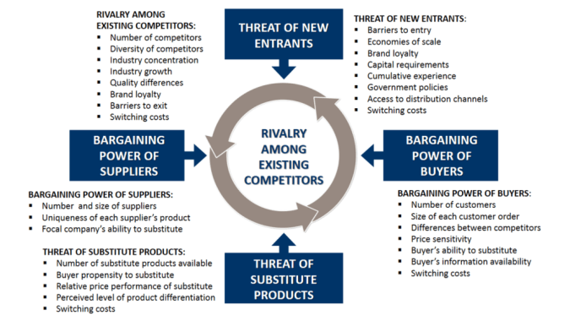

Slide 28
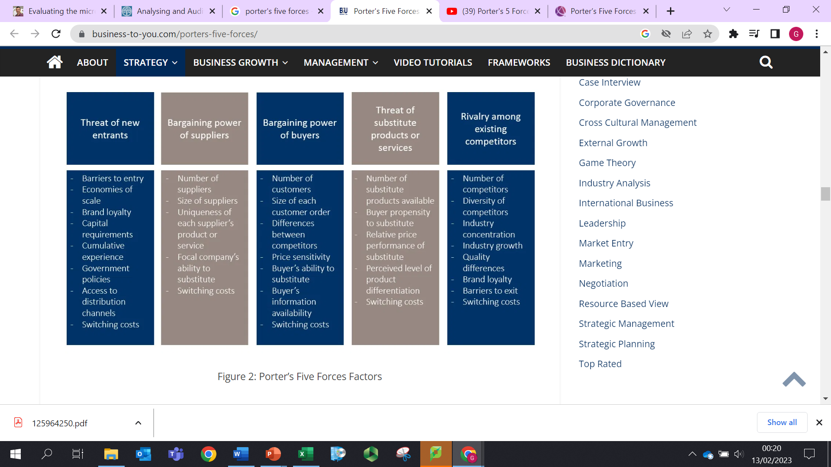

Slide 29


Slide 30
Class Exercise
Make an overall evaluation of the competitive forces in your chosen example company
Do you consider the overall competitive forces to be high, moderate or low.
Consider how this would impact on strategies followed by the company
Share your views with the class

Slide 31

Example:
Porter’s Five Forces Analysis of the Airline Industry

Slide 32
Airline Industry – Threat of New Entrants
Low to Medium Threat
High upfront investments – aircraft purchase
New entrants need insurance, licences, qualifications, access to flight routes
Existing airlines will have gained experience to operate more efficiently so a new entrant would have a competitive disadvantage
New entrants have entered the market with cost cutting business models

Slide 33
Airline Industry – Power of Suppliers
Very High Threat.
When looking at the major inputs that airline companies need, we see that they are especially dependent on fuel and aircrafts. These inputs however are very much affected by the external environment over which the airline companies themselves have little control.
The price of aviation fuel is subject to the fluctuations in the global market for oil, which can change wildly because of geopolitical and other factors.
In terms of aircrafts for example, only two major suppliers exist: Boeing and Airbus. Boeing and Airbus therefore have substantial bargaining power on the prices they charge.

Slide 34
Airline Industry – Power of Buyers
High Threat.
Customers are able to check prices of different airline companies fast through the many online price comparisons websites such as Skyscanner and Expedia.
In addition, there aren’t any switching costs involved in the process. Customers nowadays are likely to fly with different carriers to and from their destination if that would lower the costs.
Brand loyalty therefore doesn’t seem to be that high. Some airline companies are trying to change this with frequent flyer programs aimed at rewarding customers that come back to them from time to time.

Slide 35
Airline Industry – Threat of Substitutes
Medium to High Threat
In terms of the airline industry, it can be said that the general need of its customers is traveling.
It may be clear that there are many alternatives for traveling besides going by airplane.
Depending on the urgency and distance, customers could take the train or go by car. Especially in Asia, more and more people make use of highspeed trains such as Bullet Trains and Maglev Trains.
Furthermore, the airline industry might get some serious future competition from Elon Musk’s Hyperloop concept in which passengers will be traveling in capsules through a vacuum tube reaching speed limits of 1200 km/h.

Slide 36
Airline Industry – Competitive Rivalry
High Threat
When looking at the airline industry we see that the industry is extremely competitive because of a number of reasons:
The entry of low cost carriers,
The tight regulation of the industry wherein safety become paramount leading to high fixed costs and high barriers to exit, and the fact that the industry is very stagnant in terms of growth at the moment.
The switching costs for customers are also very low and many players in the industry are similar in size leading to extra fierce competition between those firms.

Slide 37

Competitor Analysis

Slide 38
Competitor Analysis
A competitor analysis is an assessment of your competitors’ products, services and sales tactics, evaluating their strengths and weaknesses relative to your own.
It’s good business practice to conduct a full competitive analysis at least once a year.
Conducting a competitor analysis will help an organisation identify areas of competitive advantage and also threats from competitors
Performing a competitor analysis enables organisations to:
  Identify your USP
  Identify gaps in the market
  Develop new products and services
  Market and sell more effectively

Slide 39
Competitor Analysis
A competitor analysis will enable your organisation to:
Identify your product's USP and what makes your product different from the competitors', which can inform future marketing efforts.
Enables you to identify what your competitor is doing right. This information is critical for staying relevant and ensuring both your product and your marketing campaigns are outperforming industry standards.
Tells you where your competitors are falling short — which helps you identify areas of opportunities in the marketplace, and test out new, unique marketing strategies they haven't taken advantage of.
Learn through customer reviews what's missing in a competitor's product, and consider how you might add features to your own product to meet those needs.
Provides you with a benchmark against which you can measure your growth

Slide 40
Stages in A Competitor Analysis
Identify your competitors
    Direct Competitors – offer similar products, targeted at the same customers in the same geographic area
    Indirect Competitors – offer slightly different products but competing for the same customers
Gather information about your competitors
    Look at areas of their marketing mix
    Market share & sales
Analyse your competitors’ strengths and weaknesses compared to yours
    Compare the competitive categories
Determine your competitive advantage
    Identify your strengths and competitive advantage as well as your areas of weakness. advantage and weakness
Develop competitive strategies

Slide 41
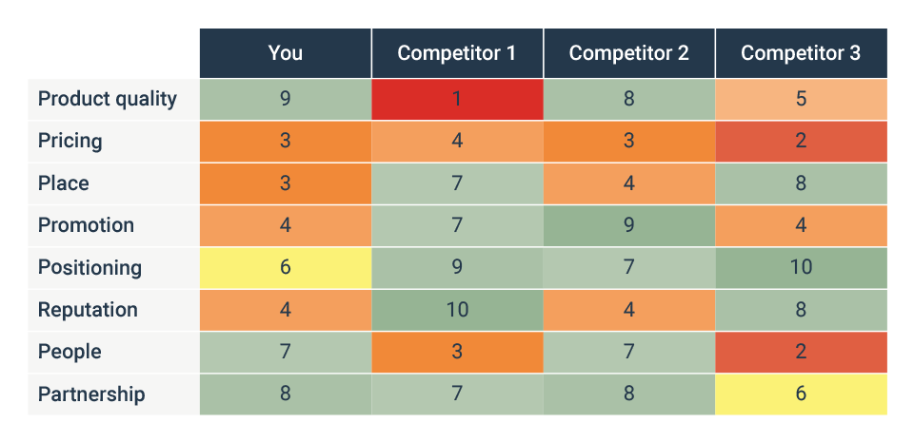
Example Competitive Analysis Table

