Slide 1
Methods and Search Strategy Academic Poster
Student name: Yasmeen Akhtar
Student ID: 2233492
Module name: Independent Project
Module code: BMHP6020
Lecturer: Chloe Harries

Slide 2
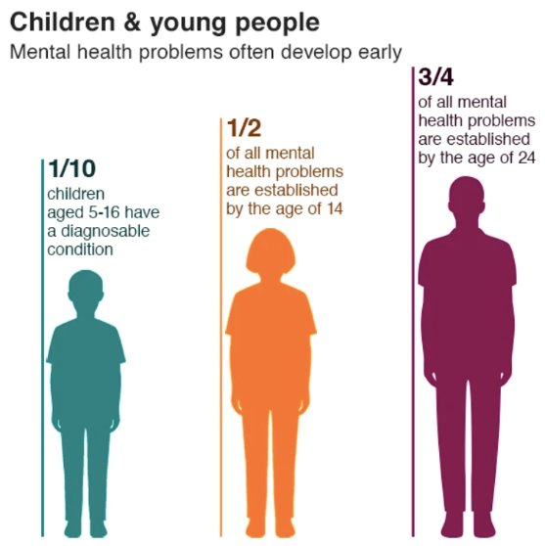
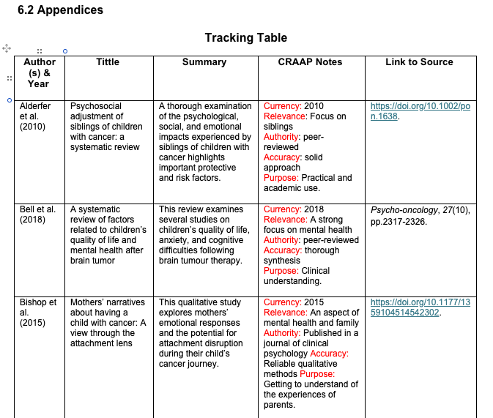
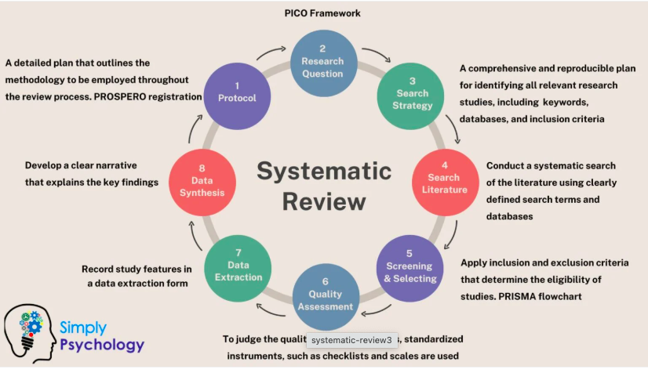
An investigation into How Cancer Diagnosis Affects
Mental Health Outcomes in Children
01 Introduction and Research Aim
This study used a secondary, desk-based approach to explore how a cancer diagnosis affects children’s mental health. According to Greenblatt and Saini (2019), scoping reviews provide a structured and systematic method of mapping evidence, supporting the use of a literature-focused methodology in this study. Building on Chapter 3 of the dissertation, the poster highlights the search strategy, validation of sources, inclusion and exclusion criteria, and ethical considerations. A systematic approach ensured credibility, reliability, and transparency, while the aim was to critically examine existing literature and identify themes for analysis in Chapter 4.
Figure 1: 1 in 10 children face a diagnosable mental health condition, often starting before age 14 Screenshot (Triggle, 2018).
02 Search Strategy
A systematic search was used to identify relevant literature (Gusenbauer & Haddaway, 2020). Keywords included: children, mental health, cancer diagnosis, emotional wellbeing, psychosocial impact, and child oncology. Boolean operators refined results: AND linked concepts, OR captured synonyms, and NOT excluded irrelevant material. Databases included PubMed, Google Scholar, and the UWTSD Library. Filters applied included peer-reviewed sources, publication date, and UK relevance. All searches were documented, and sources evaluated using the CRAAP test for credibility, accuracy, and relevance.
Figure 2: CRAAP Test Table Screenshot
03 Searching for Information
The UWTSD Library, PubMed, and Google Scholar were used to locate relevant literature, selected for their credibility, peer-reviewed collections, and relevance to child cancer and mental health (White, 2020). Filters applied included peer-review status, publication date, and UK relevance. Boolean operators refined searches: AND linked key concepts, OR captured synonyms, and NOT excluded irrelevant material. Search terms, combinations, and filters were recorded to ensure replicability. Iterative refinements, including alternative terminology, enhanced accuracy and reduced irrelevant results. The CRAAP tracking table (see Figure 2) and the source tracking table (Appendix A) documented the process comprehensively.
(Triggle, 2018)
04 systematic
(Simply Psychology, 2024).
Figure 3: Key stages of the systematic review process (Simply Psychology, no date.).

Slide 3
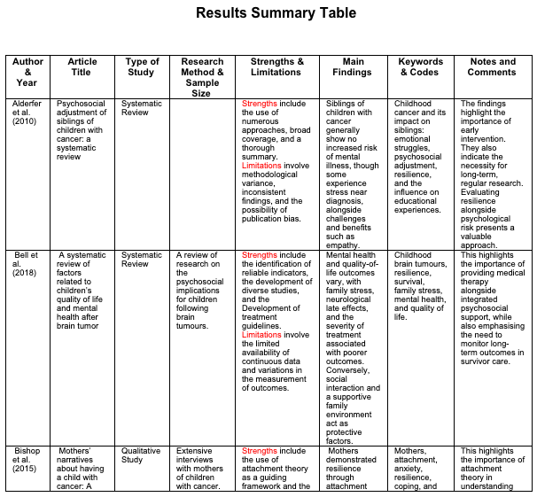
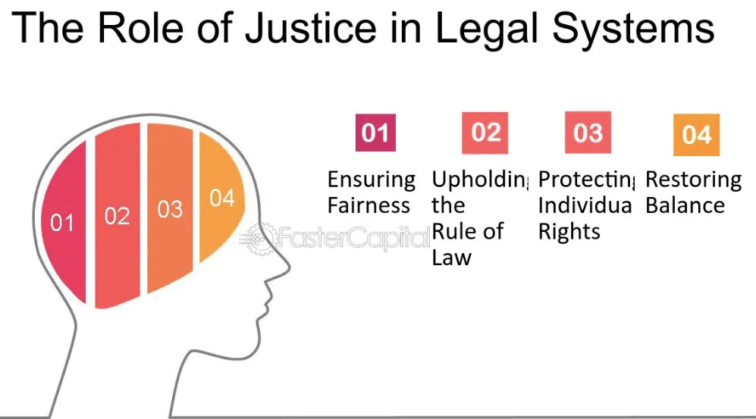
05 Research Validation and Analysis
Initial skimming of titles, abstracts, introductions, and conclusions determined relevance to mental health, emotional wellbeing, and childhood cancer (Esparrago-Kalidas, 2021). Sources deemed unsuitable, outdated, or irrelevant were excluded. The CRAAP test (Currency, Relevance, Authority, Accuracy, Purpose) ensured quality. Priority was given to recent, credible, and contextually relevant sources.
Figure 4: Results Summary Table Screenshot Thematic coding identified recurring ideas and grouped them into themes, which formed the basis for Chapter 4. Colour-coded spreadsheets and tables ensured organisation and transparency.
06 Inclusion Criteria
Peer-reviewed journals, government/NHS policy documents, and clinical guidelines
Published within the last 20 years
Focus on children’s mental health outcomes following cancer diagnosis
UK-based, English language, and fully accessible online
These guidelines ensured that sources were relevant, reliable and aligned with the study objectives (Gusenbauer &Haddaway, 2020).
07 Exclusion Criteria
These rules ensured that sources remained relevant, reliable, and focused (Esparrago-Kalidas, 2021).
Publications over 20 years old
Opinion-based works, non–peer-reviewed materials, or irrelevant sources
Studies conducted outside the UK or not published in English
Sources that were not fully accessible
08 Ethical Considerations
Accurate Harvard referencing was used to respect intellectual property, and GDPR alongside confidentiality guidelines were followed, with no participants being involved in the research process. According to Krauth, Woodruff and Bero (2013), applying inclusion and exclusion criteria while validating sources is an effective way to reduce research bias. A documented search strategy was also employed to ensure transparency, and particular care was taken in addressing the sensitive focus on children’s mental health.
Figure 5: Justice in legal systems representing fairness, rights, and balance in ethical research(Legal, 2024).
(Legal, 2024).

Slide 4
References
Esparrago-Kalidas, A.J., 2021. The effectiveness of CRAAP test in evaluating credibility of sources. International Journal of TESOL & Education, 1(2), pp.1-14.
Greenblatt, A. and Saini, M. (2019) ‘Experiences of adolescents with cancer from diagnosis to post-treatment: a scoping review’, Social work in health care, 58(8), pp. 776–795. Available at: https://doi.org/10.1080/00981389.2019.1640338.
Gusenbauer, M. and Haddaway, N.R. (2020) ‘Which academic search systems are suitable for systematic reviews or meta‐analyses? Evaluating retrieval qualities of Google Scholar, PubMed, and 26 other resources’, Research synthesis methods, 11(2), pp. 181–217. Available at: https://doi.org/10.1002/jrsm.1378.
Krauth, D., Woodruff, T.J. and Bero, L. (2013) ‘Instruments for Assessing Risk of Bias and Other Methodological Criteria of Published Animal Studies: A Systematic Review’, Environmental health perspectives, 121(9), pp. 985–992. Available at: https://doi.org/10.1289/ehp.1206389.
Legal, I. (2024). The Role Of Justice In Legal Systems – Faster Capital. [online] Faster Capital. Available at: https://fastercapital.com/topics/the-role-of-justice-in-legal-systems.html/1.
Simply Psychology. (2024). Doing a Systematic Review: A Student’s Guide. [online] Available at: https://www.simplypsychology.org/systematic-review.html.
Triggle, N. (2018). Mental health: 10 charts on the scale of the problem. BBC News. [online] 4 Dec. Available at: https://www.bbc.co.uk/news/health-41125009.
White, J. (2020) ‘PubMed 2.0’, Medical reference services quarterly, 39(4), pp. 382–387. Available at: https://doi.org/10.1080/02763869.2020.1826228.

