Slide 1

Community Care and Management of Long-Term Conditions
Introduction to Public Health Principles
Models of Health
Week 1

Slide 2
Introductions
Why are we here?

Slide 3



GROUND RULES
Classroom conduct
Attendance & Punctuality
Mobile Phones
Mutual Respect
Confidentiality
Plus?

Slide 4
Module Summary
To develop understanding of the theories, values and policies in managing patients (people) with longer term conditions in different healthcare settings.
To gain an understanding of healthcare work across traditional primary/secondary/social care boundaries and collaborate with patients (people)/carers and other professionals within the NHS, social and private/voluntary sector to continuously improve the information, support, care, and person-centred approaches to treatment of people living with long term conditions.

Slide 5
Learning Outcomes
On successful completion of this module, you should be able to:
Critically evaluate the physical, psychological, and social impact on individuals and families living with a long-term condition(s) and its treatment.
Critically assess the key areas of local and national political, health and social care agendas and initiatives relating to long term conditions.
Critically evaluate the skills, values and behaviours required to provide co-productive and traditional models of care as appropriate.
Critically analyse the contribution of empirical evidence and local, national, and international guidelines to informing the delivery of ‘whole person’ care and self-management support for individuals with long term conditions.

Slide 6
Aims of the Session
To develop an understanding of
Concepts of health,
Different models of health,
Advantages and disadvantages of different models of health,
The application of a model of health.

Slide 7

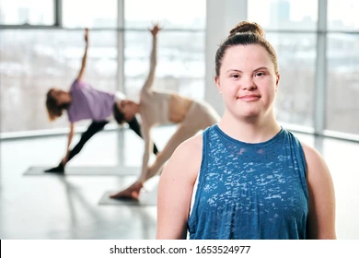
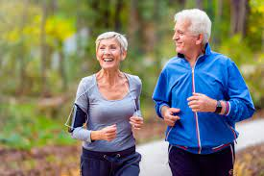

Individual Activity
What does health mean to you?
How can you achieve it?
Notes:
Explain that before we can understand how to promote health we need to understand the important concepts of health & well being.
Record these ideas on the white board. (shared page on zoom)

Slide 8
What is health?
What does health mean to you
Notes:
If running out of time this can be missed – students can watch in their own time
Health means different things to different people.
How can this impact on the care/support we provide?

Slide 9

What is health?
Health is a contested term
It can mean different things to different people depending on culture, profession, background, social class, family.
Individuals may have different views in different circumstances.
Naidoo & Wills 2016

Slide 10
Summary: Definition of health
Health is a contested term that can mean different things to different people.
It is a broad concept that can embody a range of meanings.
It is important to understand personal and professional views of health and how these views impact on the delivery care.

Slide 11
Concepts of health
We can define health as….
‘the absence of disease or impairment’
(Scriven 2010)
a state of complete physical, mental and social well-being (WHO 1948)
‘the ability to adapt to changing circumstances’
(Dubos 1960)
‘The foundations for achievement of potentials’
(Seedhouse 1986)

Slide 12
Models of health
A model is a conceptualised framework or way of thinking about something.
The models develop the definitions of health into ethical and philosophical ways of promoting health.
Models of health include:
Medical/western scientific
(Biomedical)
Social
Biopsychosocial
Lay views
Salutogenesis
Holistic
Plus……………..

Slide 13

WHAT IS BIOPSYCHOSOCIAL MODEL OF HEALTH?

Slide 14
Biopsychosocial model of health
The biopsychosocial model of health and illness is a framework developed by George L. Engel in 1977 that states that interactions between biological, psychological, and social factors determine the cause, manifestation, and outcome of wellness and disease.
The biopsychosocial model states that health and illness are determined by a dynamic interaction between biological, psychological, and social factors.
Each component on its own is insufficient to lead definitively to health or illness.

Slide 15
Biopsychosocial model of health
The biopsychosocial model views health and illness behaviours as products of
Biological characteristics (such as genes),
Behavioural factors (such as lifestyle, stress and health beliefs), and
Social conditions (such as cultural influences, family relationships, and social support).
Think back to some of the LTC we have discussed and give examples

Slide 16
Biopsychosocial model of health
Health psychologists work with healthcare professionals and patients to help people deal with the psychological and emotional aspects of health and illness.
This can include developing treatment protocols to increase adherence to medical treatments, weight loss programs, smoking cessation, for example
Their research often focuses on prevention and intervention programs designed to promote healthier lifestyles (e.g., exercise and nutrition programs).

Slide 17
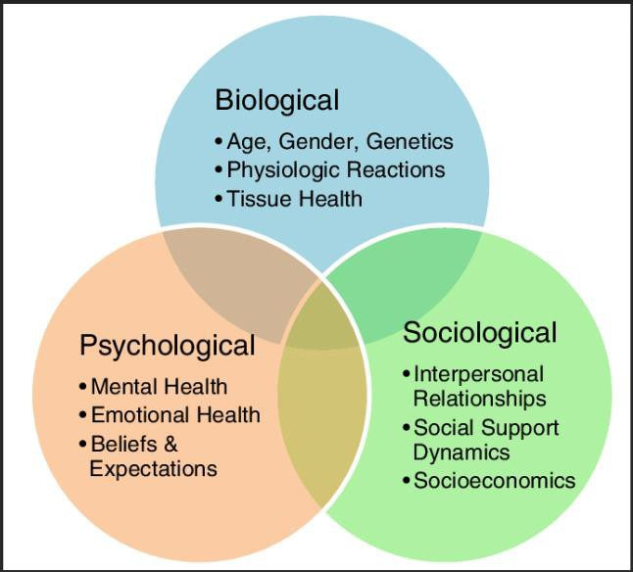
Diagram of Biopsychosocial model of health

Slide 18
Biopsychosocial model of health
The psychological component of the biopsychosocial model seeks to find a psychological foundation for a particular symptom or array of symptoms (e.g., impulsivity, irritability, overwhelming sadness, etc.).
Social and cultural factors are conceptualised as a particular set of stressful events (being laid off, for example) that may differently impact the mental health of people from different social environments and histories.

Slide 19
WHAT ARE THE ISSUES WITH THE BIOPSYCHOSOCIAL MODEL?

Slide 20
Seminar Session
Research the biopsychosocial model of health and identify a minimum of four academic sources which critically appraise this model.

Slide 21
Extension Activity
Working independently, read Engel’s paper on the VLE and make a note of his key critiques of the medical model
Feedback your findings to the whole class

Slide 22
Issues with the biopsychosocial model
Despite its usefulness, there are issues with the biopsychosocial model, including
The degree of influence that each factor has,
The degree of interaction between factors,
And variation across individuals and life spans.

Slide 23
WHAT DOES THE BIOPSYCHOSOCIAL MODEL DO?
Notes:
Session 2 starts here

Slide 24
Biopsychosocial model of health
The biopsychosocial model is an inter- disciplinary model that looks at the interconnection between biology, psychology, and socio-environmental factors.
The model specifically examines how these aspects play a role in topics ranging from health and disease, to human development.

Slide 25
Biological Influences on Health
Biological influences on health include an individual’s genetic makeup and history of physical trauma or infection.
Many disorders have an inherited genetic vulnerability.
The greatest single risk factor for developing schizophrenia, for example is having a first-degree relative with the disease (risk is 6.5%); more than 40% of monozygotic twins of those with schizophrenia are also affected.

Slide 26
Psychological Influences on Health
The psychological component of the biopsychosocial model seeks to find a psychological foundation for a particular symptom or array of symptoms (e.g., impulsivity, irritability, overwhelming sadness, etc.).
Individuals with a genetic vulnerability may be more likely to display negative thinking that puts them at risk for depression;
Alternatively, psychological factors may exacerbate or aggravate a biological predisposition by putting a genetically vulnerable person at risk for other risk behaviours.

Slide 27
Psychological Influences on Health
For example, depression on its own may not cause liver problems, but a person with depression may be more likely to abuse alcohol, and, therefore, develop liver damage.
Increased risk-taking leads to an increased likelihood of disease.

Slide 28
Social Influences on Health
Social factors include socioeconomic status, culture and religion.
For instance, losing one’s job or ending a romantic relationship may place one at risk of stress and illness.
Such life events may predispose an individual to developing depression, which may, in turn, contribute to physical health problems.

Slide 29
Social Influences on Health
The impact of social factors is widely recognised in mental disorders like anorexia nervosa (a disorder characterised by excessive and purposeful weight loss despite evidence of low body weight).
The fashion industry and the media promote an unhealthy standard of beauty that emphasises thinness over health.
This exerts social pressure to attain this “ideal” body image despite the obvious health risks.
Take five minutes to think about how Instagram might impact young people?

Slide 30
Cultural Factors
Also included in the social domain are cultural factors.
For instance, differences in the circumstances, expectations, and belief systems of different cultural groups contribute to different prevalence rates and symptom expression of disorders.
Alternative practitioners may offer treatments or therapies based on cultural views. For example traditional Chinese medicine is based on Yin and Yang. In other cultures disease may be seen as divine and simply accepted.

Slide 31
Cultural Factors
Culture can vary across a small geographic range, such as from lower-income to higher-income areas, and rates of disease and illness differ across these communities accordingly.
Culture can even change biology, as research on epigenetics is beginning to show.
Specifically, research on epigenetics suggests that the environment can actually alter an individual’s genetic makeup.
For instance, research shows that individuals exposed to over- crowding and poverty are more at risk for developing depression with actual genetic mutations forming over only a single generation.

Slide 32
WHAT IS THE APPLICATION OF THE BIOPSYCHOSOCIAL MODEL?

Slide 33
Application of the Biopsychosocial Model
Health promotion activities must address all three factors, as a growing body of empirical literature suggests that it is the combination of health status, perceptions of health, and sociocultural barriers to accessing health care that influence the likelihood of a patient engaging in health-promoting behaviours, like taking medication, proper diet or nutrition, and engaging in physical activity.

Slide 34
WHAT IS THE HOLISTIC MODEL?

Slide 35
Holistic Model of health
A holistic view of health is an approach to wellbeing that considers how the individual functions in their environment, instead focussing on a singular competence, disability or pathology.
Rather than judging a person’s condition by the presence of pathology or even of a particular competence, a holistic health and wellbeing perspective considers the extent to which the person has adapted to thrive in their environment despite their range of physical and mental capabilities. (Kafaji 2020).

Slide 36
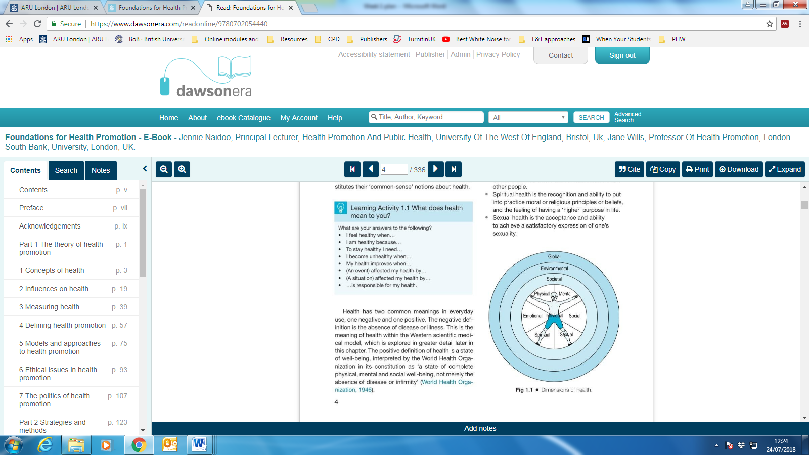
Dimensions of a holistic concept of health
Individual:
  Physical
  Mental
  Emotional
  Social
  Spiritual
  Sexual health
Societal
Environmental
Global
Naidoo & Wills, 2016 p 4-5
Notes:
This can be used to recap and see where the different models possible work is aimed

Slide 37

Models
Consider which model, or combination of models, is most likely to be successful at addressing the issues of obesity.
Justify your answer
Is the holistic approach important?
Notes:
Once students have seen others tables.
Discuss as a group the different approaches and which they feel is the most likely to have an impact. It is hopeful that they will see that a holistic approach is beneficial.

Slide 38
Seminar Session
Find Ritchie’s case study
Discuss some of the influences on Ritchie’s health from an individual, societal, environmental and Global perspective.
What are the implications of a holistic model of health for professional practice?
Notes:
Be specific to Ritchie . The aim is to consider how the holistic approach needs to consider the wider view of health and how this may impact on his health problems
This can be done if here is still time

Slide 39
Knowledge check
Are you able to….
identify and explain different models of health?
understand how a model an be applied to a health issue?
explain the importance of a holistic approach to health?

Slide 40
Extension Activity
Watch the video below then discuss and
https://www.youtube.com/watch?v=bf0TZ5OzF5 https://www.youtube.com/watch?v=6rjS_GisaM0
Feedback your findings to the whole class

Slide 41

What did you learn today?

Slide 42
Extension Activity
Watch the video below then discuss and
https://www.youtube.com/watch?v=eN6pCOMewNY
https://www.youtube.com/watch?v=SpIVZazDV98
Feedback your findings to the whole class

Slide 43
Additional reading
What is a good doctor and how can we make one?

Slide 44
Glasgow https://www.youtube.com/watch?v=aS3-MZZyVNI

Slide 45
References
Adler, R.H., 2009. Engel's biopsychosocial model is still relevant today. Journal of psychosomatic research, 67(6), pp.607-611.
Almeida, V.C., Pereira, L.C.D., da Cunha Machado, S., dos Santos Maciel, L.Y., de Farias Neto, J.P. and de Santana Filho, V.J., 2024. The use of a biopsychosocial model in the treatment of patients with chronic. Patient Education and Counseling, 121, p.108117.
Dubos, R. 1960 Mirage of Health. London, Allen & Unwin
Evans, R.G. and Stoddart, G.L., 2017. Producing health, consuming health care. In Why are some people healthy and others not? (pp. 27-64). Routledge.
Haugan, G. and Eriksson, M., 2021. Health promotion in health care–vital theories and research. Mirzaei, M., Aspin, C., Essue, B., Jeon, Y.H., Dugdale, P., Usherwood, T. and Leeder, S., 2013. A patient-centred approach to health service delivery: improving health outcomes for people with chronic illness. BMC health services research, 13(1), p.251.
Krahn, G.L., Robinson, A., Murray, A.J., Havercamp, S.M., Havercamp, S., Andridge, R., Arnold, L.E., Barnhill, J., Bodle, S., Boerner, E. and Bonardi, A., 2021. It's time to reconsider how we define health: Perspective from disability and chronic condition. Disability and health journal, 14(4), p.101129.
Laprise, C., 2023. It's time to take a sustainable approach to health care in the face of the challenges of the 21st century. One Health, 16, p.100510.
Lin E, Tsai SJ. Epigenetics and Depression: An Update. Psychiatry Investig. 2019 Sep;16(9):654-661. doi: 10.30773/pi.2019.07.17.2. Epub 2019 Aug 29. PMID: 31455063; PMCID: PMC6761788.
Penner-Goeke, S. and Binder, E.B. (2019) “Epigenics and depression” in Dialogues in Clinical Neuroscience. Vol 21. No. 4. 2019 pp 397-405 available at [https://www.tandfonline.com/doi/epdf/10.31887/DCNS.2019.21.4/ebinder?needAccess=true&role=button] accessed on 12/4/2023
Ricciardi, W. and Boccia, S., 2017. New challenges of public health: bringing the future of personalised healthcare into focus. The European Journal of Public Health, 27(suppl_4), pp.36-39.
Sartorius, N., 2006. The meanings of health and its promotion. Croatian medical journal, 47(4), p.662.
Schramme, T., 2023. Health as complete well-being: The WHO definition and beyond. Public Health Ethics, 16(3), pp.210-218.
Schwarz, T., Schmidt, A.E., Bobek, J. and Ladurner, J., 2022. Barriers to accessing health care for people with chronic conditions: a qualitative interview study. BMC health services research, 22(1), p.1037.
Scriven, A. 2010 Promoting Health: A Practical Guide. 6th ed. Elsevier Health Sciences; p. 3-57.
Seedhouse, D. 1986 Health: Foundations of Achievement. John Wiley & Sons
Van der Linden, R. and Schermer, M., 2022. Health and disease as practical concepts: exploring function in context-specific definitions. Medicine, Health Care and Philosophy, 25(1), pp.131-140.
Van Druten, V.P., Bartels, E.A., Van de Mheen, D., De Vries, E., Kerckhoffs, A.P.M. and Nahar-van Venrooij, L.M.W., 2022. Concepts of health in different contexts: a scoping review. BMC health services research, 22(1), p.389.
World Health Organisation. 1946 Constitution. Geneva, WHO

