Slide 1
BUSINESS PLAN
BMSW 4006: Managing Enterprise in the 21st Century
Name of the Students and ID Numbers
Ionut Rotaru
Lecturer Name: Zhaida Khan
Restcon Restaurants Ltd: Restaurant Industry

Slide 2

Introduction
This presentation gives an overview of a planned restaurant business called Restcon.
The business will be founded and owned by three people.
Each owner is an expert in various aspects of the business.
I will be the CEO and I hold a degree in business management with a key focus on enterprise management.
The other two owner are experts in marketing and financial management respectively.
Notes:
The plan gives an overview of the products and operations of the business. Moreover, it explains the legal format of the business and its target customers. The business plan will also assess the idea of establishing Restcon using SWOT analysis and evaluate various business environment factors that will influence the business.

Slide 3

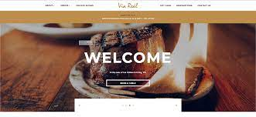
Overview of the Business Idea
Restcon restaurants Ltd will be a restaurant chain business that will be established in London and later expand to other UK cities and towns.
The business will be established by renting spacious rooms in East London and another room near London Heathrow Airport.
The business will have two operative locations: physical restaurants and a website where food orders will be made.
Notes:
After the Covid-19 pandemic, many customers are eating in restaurants. The demand for eating out now exceeds the supply. There are many passengers at the airport who want to get restaurant services. A restaurant outlet will be located close to the airport to target passengers. Another restaurant will be located on the eastern side of the city. Food deliveries will be made across London.

Slide 4
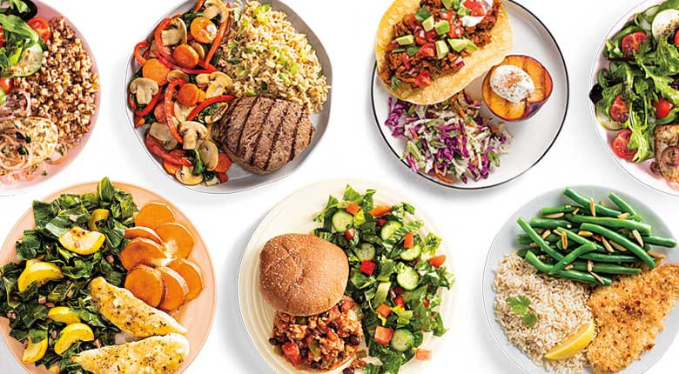
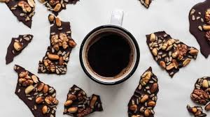
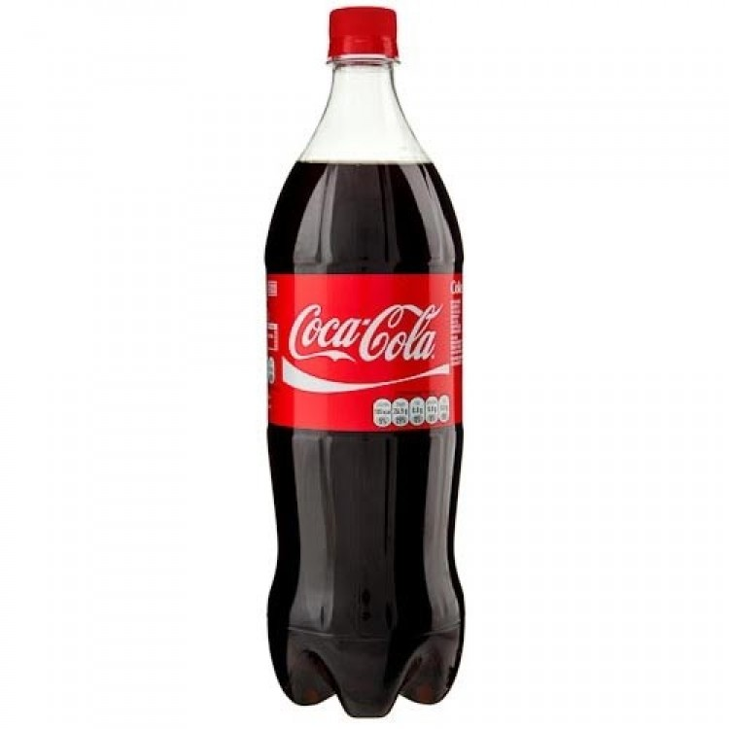
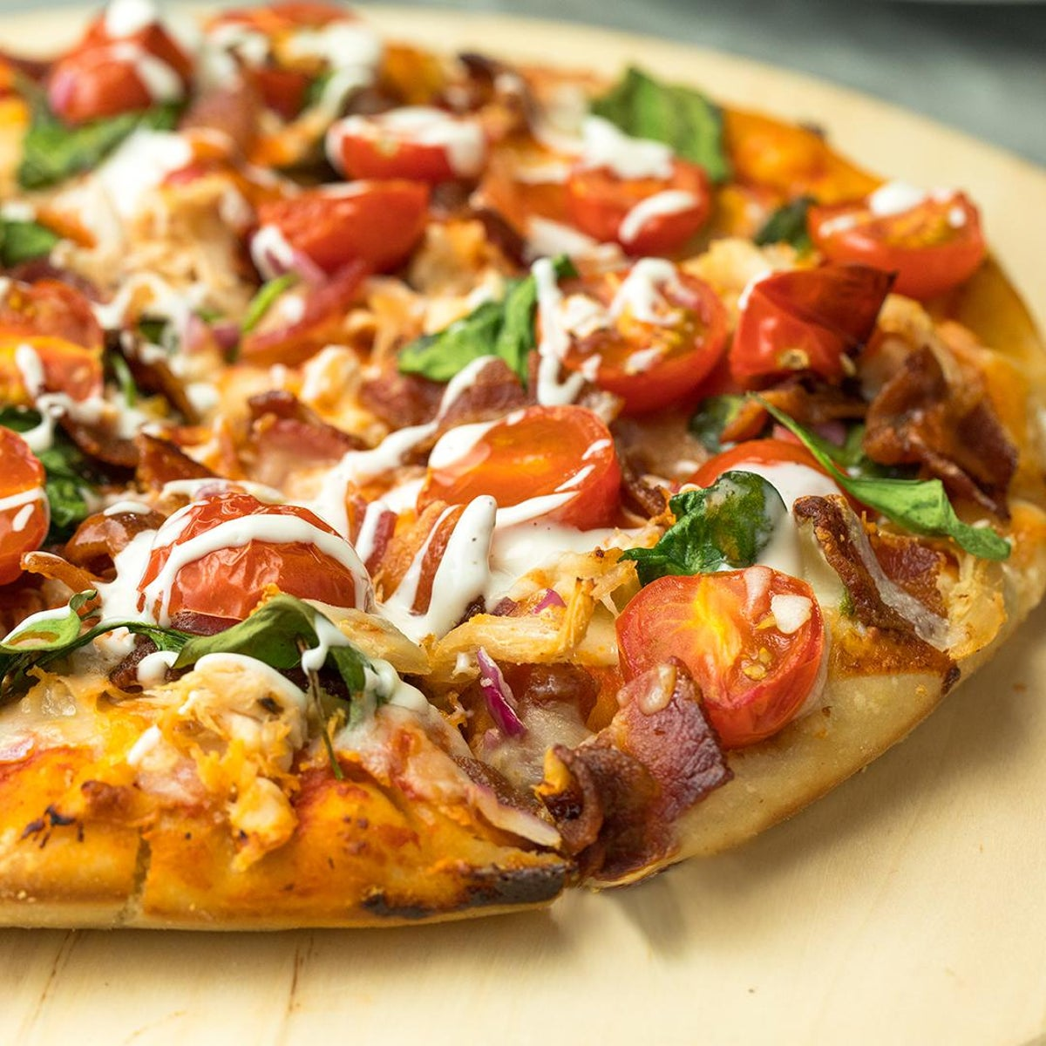
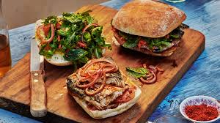
Products
The business will be selling meals, coffee, pizza, snacks, soft drinks, and sandwiches.
Source: Hi5mart, 2023)
Notes:
The business will ensure that there is wide variety in the restaurant so that it can have a wide range of customers. All the products of the businesses, except some soft drinks. Will be prepared in the restaurant.

Slide 5

Legal Format
Restcon will be registered as a limited liability company.
This legal format will be chosen to make the business a separate legal entity from owners.
The owners of the business will be its directors.
source: (Singh, 2023)
Notes:
As a limited liability company, the business will be a separate legal person. In case of a debt default, the owners of the company will not have to pay the debt using their personal property. If an owner has sole trading business, its assets will be safe and separate from those of the company (Singh, 2023).

Slide 6

Management
The company will be headed by a CEO.
The CEO will also be in charge of the company’s operations.
One of the owner will be the finance manager and also be in charge of human resources management.
The other owner will be the marketing manager.
The company will hire two restaurant managers.
Notes:
At first, some departments will be merged to avoid having many managers when the business is starting (Negulescu, 2019). The finance director will undertake HR management roles before the business grows. Each restaurant will be headed by a manager who will supervise all activities within the restaurant.

Slide 7
Management
The management team has high expertise in managing enterprises.
The CEO has been running a sole trade restaurant business and has a degree in business management.
The marketing direct has a degree in marketing.
The other owner has a degree in finance.
Notes:
All the managers of the business have good academic background. The business will be managed by experts at the top. Since none of the owners has experience in HR management, the business will outsource the recruitment process to a firm as recommended by Easterby-Smith et al., (2021). Moreover, an experienced IT expert will be hired as a website administrator.

Slide 8
SWOT Analysis
Good customer service
Strategic Location
Small Market Share
The brand is not well known in the market.
Strengths
Weaknesses
Restcon SWOT Analysis
expanding within the UK by having more outlets
Online orders and food delivery
High inflation
Competition from established brands
Opportunities
Threats
Notes:
The business will find strategic locations for easy access by customers. It will offer the best customer service. As consumer prefer online food orders, it is an opportunity to grow sales. There is high inflation that has raised the cost of living. Some consumers may reduce their spending on restaurant products leading to poor sales. The weakness of the business will be having as small market share as it enters the market. Moreover, the brand will be new. Having a small market share gives rivals a competitive advantage. However, the restaurant will stabilize this weaknesses by having a website that will be useful to all residents of London. It will ensure that orders can be delivered across the city. The new brand will require the business to increase marketing activities so that consumers can be well-versed with the new brand.

Slide 9

Target market and marketing strategies
The target market involves:
  Workers
  Students
  International Visitors
Notes:
Most workers in London and students are likely to use food apps. International visitors are likely to rely on travel agents and company’s to get direction on where to eat. The main target age group will be customers between 18 and 55 years.

Slide 10
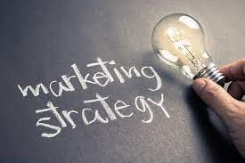
Target market and marketing strategies
Market strategies will involve:
  Social marketing
  Liaising with travel agents
  Website ads
  Using leaflets
Notes:
The target group has high internet usage. Social media and the internet will be used to market the business. Liaising with travel agents will help the business reach international visitors especially after arriving at the airport and when set to leave the country.

Slide 11
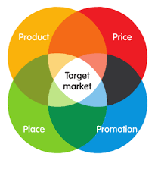
4Ps of marketing
Product: The business will be selling meals, coffee, pizza, snacks, soft drinks, and sandwiches.
Wide variety will be offered.
Price: psychological pricing strategy.
bundle pricing strategies
Notes:
The business will ensure that there is wide variety in the restaurant so that it can have a wide range of customers. All the products of the businesses, except some soft drinks. Will be prepared in the restaurant. psychological pricing strategy will make products appear cheaper and encourage completing orders (Ali & Anwar, 2021). Bundle pricing will encourage customers to buy many items once they visit the restaurant.

Slide 12
4Ps of marketing
Place: Online
    Physical restaurants
Promotion: Social media marketing
        Liaising with travel agents
        Website ads
        Using leaflets
Notes:
The website will facilitate online operations. Physical restaurants will be spacious to contain many customers. The company will create several social media accounts to offer cheap and effective marketing. The business will liaise with travel companies to bring guests to the restaurant. The website will also be used as a marketing channel.

Slide 13
Funding
The starting capital will be £50,000.
Each owner will contribute a third of the required capital.
The business will also get funding from bank loans.
The capital will pay rent, buy furniture and equipment, and be used in marketing the business.
The company will be profitable in the first year.
Notes:
Getting funding from bank and owners contribution will ensure that the initial owners remain the owners of the business rather that selling a stake to investors. The business through the finance manager will ensure that the loan is manageable.

Slide 14
References
Singh, S. (2023). Difference between Limited Liability Company (LLC) and Limited Liability Partnership (LLP) Read more: Difference between Limited Liability Company (LLC) and Limited Liability Partnership (LLP). Available at http://www.differencebetween.net/business/difference-between-limited-liability-company-llc-and-limited-liability-partnership-llp/
Hi5mart, (2023). Drinks and Beverages. https://www.hi5mart.com/drinks-and-beverages/soft-drinks/coca-cola-soft-drink.html
Ali, B. J., & Anwar, G. (2021). Marketing Strategy: Pricing strategies and its influence on consumer purchasing decision. Ali, BJ, & Anwar, G.(2021). Marketing Strategy: Pricing strategies and its influence on consumer purchasing decision. International journal of Rural Development, Environment and Health Research, 5(2), 26-39.
Negulescu, O. H. (2019). Entrepreneurial competences in the process of starting-up a business.
Easterby-Smith, M., Jaspersen, L. J., Thorpe, R., & Valizade, D. (2021). Management and business research. Sage.

