Slide 1
How Wheel Load Distribution Affects Car Handling Balance

Slide 2
A definition of handling
“Handling” is different to maximum steady state lateral acceleration (“grip”) Slightly awkward to define
Prodrive’s working definition
  “a quality of a vehicle that allows or even
  encourages the operator to make use of all
  the available grip”

Slide 3
Typical Tyre Behaviour
Fzi Fzs Fzo

Slide 4
Increasing Weight transfer
The greater the weight transfer the greater the difference in vertical loads between inner and outer wheels .
This leads to a loss
of lateral force
and grip
Fzi Fzs Fzo

Slide 5
Traction Circle

Slide 6
Traction Circle (another version)
Lateral Force
Traction Force

Slide 8
Review of One Definition of Oversteer and Understeer

Slide 9
Neutral Steer
The SAE defines neutral steer as :
A vehicle is neutral steer at a given trim if the ratio of the steering wheel angle to the overall steering ratio [ie the actual steered wheel angle] equates to the Ackerman steering angle for a given radius of turn.

Slide 10
Which means ...
If the amount you have to turn the steering wheel to go round a particular corner at speed is the same as when travelliing at very low speed then that is neutral steer

Slide 11
Understeer
A vehicle is understeer at a given trim if the ratio of the steering wheel angle to the overall steering ratio is greater than the Ackerman steering angle for a given radius of turn

Slide 12
Which means....
If the amount you have to turn the steering wheel to go round a particular corner at speed is greater than when travelling at very low speed then the car is understeering

Slide 13
Oversteer
A vehicle is oversteer at a given trim if the ratio of the steering wheel angle to the overall steering ratio is less than the Ackerman steering angle for a given radius of turn

Slide 14
Which means
If the amount you have to turn the steering wheel to go round a particular corner at speed is less than when travelling at very low speed then that is neutral steer

Slide 15
Wheel load distribution as a guide to potential handling behaviour

Slide 16
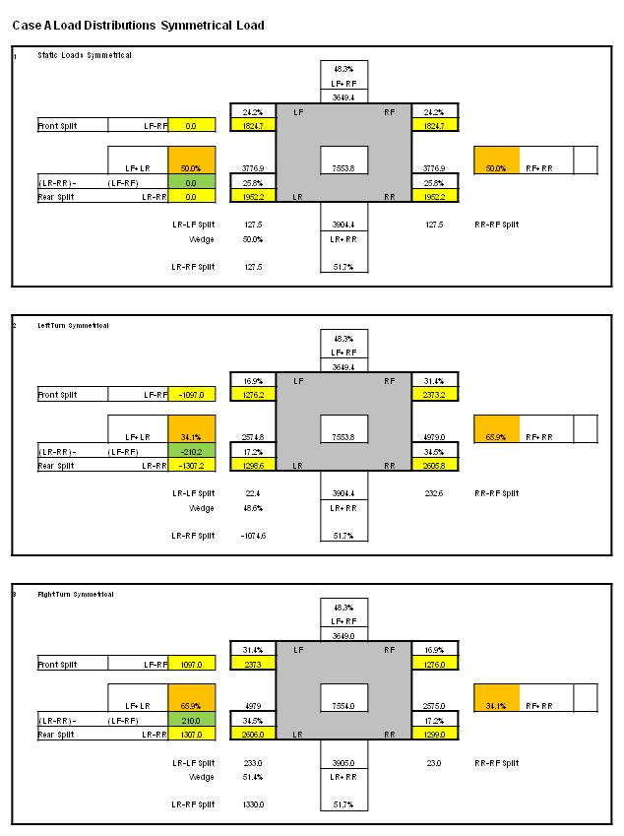
Rowley Load Split Calculator

Slide 17
Summary of behaviour that could be predicted from the Rowley Load Split Calculator
      .
The car will behave in the same way on left and right hand turns
Straight line braking and acceleration are achieved best due to equal wheel loads when travelling straight
The handling balance of the car will be influenced by the difference between Front and Rear Splits
In this symmetrical case the Front Split is1097 N and the rear Split is 1307 N for both left and right hand turns. The difference between front and rear splits is 210 N in each case indicating oversteer.
The overall grip of the car will be influenced by the magnitude of the difference between Left and Right splits. In this case the difference is 31.8 %
(34.1% and 65.9% in each direction of turn )

