Slide 1
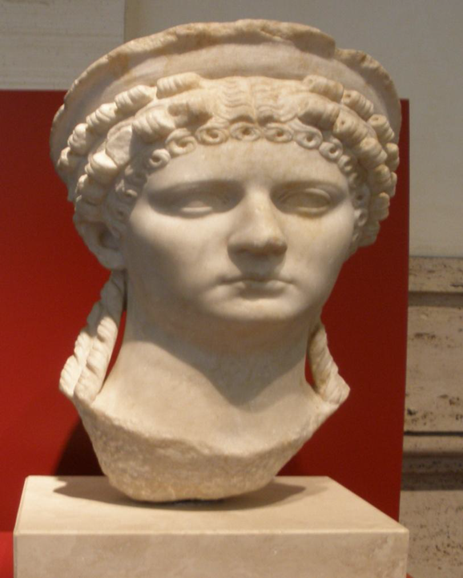
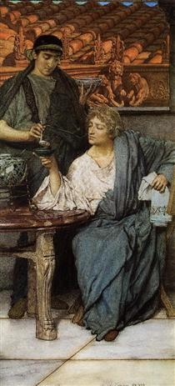
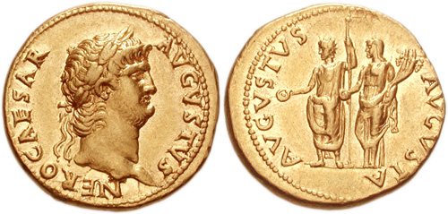
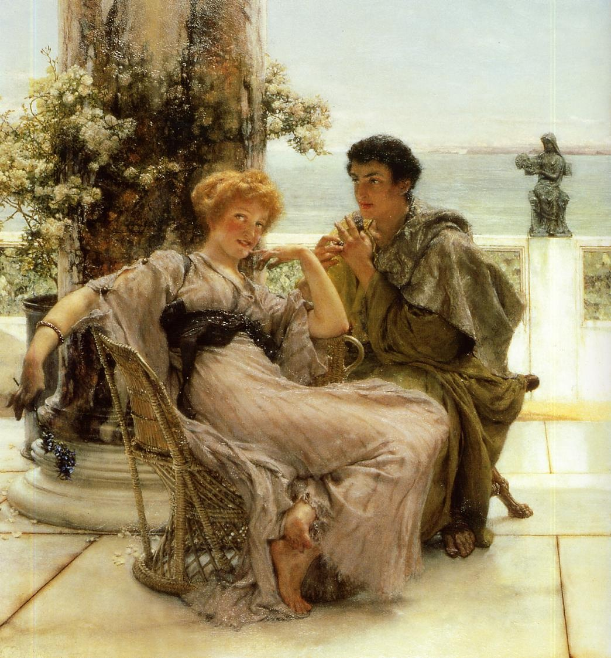
Literature and Culture in the Reign of Nero
CLCS5010
Tyranny and Debauchery Unchecked
The Roman Wine Tasters, Lawrence Alma-Tadema
Courtship The Proposal, Sir Lawrence Alma-Tadema

Slide 2
End of the “Golden Years”
Rise of Poppaea Sabina AD 58 – “Henceforward Nero sought no veil for his debaucheries and crimes.” – Tac. Ann. 13.47.
Death of Burrus, Seneca‘s departure from public life, and the rise of the Praetorian Prefect Tigellinus - Tac. Ann. 14.51-52.
Suetonius lists without chronological precision various virtues and condemnatory acts, though he emphases a decline in behaviour – “At last, after nearly fourteen years of Nero‘s misrule, the earth rid herself of him.” – Nero 40.
Death of Agrippina, freed from constraints – Dio 61.19-21.
“When the tribune made his report in the presence of Poppaea and Tigellinus — the emperor's privy council in his ferocious moods — Nero demanded if Seneca was preparing for a voluntary death.” – Tac. Ann. 15.61. (AD 65)
“Sabina on learning of this persuaded Nero to get rid of his mother, alleging that she was plotting against him.” – Dio Cassius 62.12. (AD 59)

Slide 3

Poppaea Sabina
Wife of the future emperor Otho (second marriage).
Becomes Nero’s mistress in AD 58.
Allegedly instigated the death of Agrippina and Octavia.
Marriage to Nero in AD 62, gave birth to a daughter Claudia in 63.
“Otho, possibly by an amorous indiscretion, began to praise the looks and the graces of his wife in presence of the emperor; or, possibly, his object was to inflame the sovereign's desire, and, by the added bond of joint ownership in one woman, to reinforce his own influence… to prevent his acting as Nero's rival in Rome, he was appointed to the province of Lusitania; where, till the outbreak of the civil war…” – Tac. Ann. 13.46.
“Thus it was to Otho, the person privy to his lusts, that Nero had entrusted the imperial whore Poppaea Sabina, until he could get ride of Octavia.” – Tac. Hist. 1.13.
Museo Nazionale Romano

Slide 4
Divorce of Octavia (AD 62)
“On the reception, therefore, of the senatorial decree, since it was evident that his crimes each and all passed muster as eminent virtues, he rejected Octavia on the pretext of sterility, then consummated his union with Poppaea. Long time lover of Nero, and dominating him first as an adulterer, then as a husband, she incited one of the domestics of Octavia to accuse her of a love affair with a slave… She was removed, however, first under facade of a civil divorce… A little later, she was banished to Campania and put under military supervision…” – Tac. Ann. 14.60.
“The measure led to general and undisguised protests from the common people, endowed with less discretion than their superiors, and — thanks to their humble station — faced by fewer perils. Then came a rumour that Nero had repented of his outrage and recalled Octavia to his side.” – Tac. Ann. 14.60.
“He tried to strangle her on several occasions, but finally announced her barren and divorced her. This act made him so unpopular and caused so great a scandal that he banished Octavia and finally had her executed on a charge of adultery.” – Suet. Nero 35.

Slide 5
Death of Poppaea (AD 65)
“After the conclusion of the games Poppaea died from a casual outburst of rage in her husband, who knock her down with a kick when she was pregnant.” – Tacitus Annals 16.6.
“Though devoted to Poppaea, whom he married twelve days after his divorce from Octavia, he kicked her to death while she was pregnant and feeling ill, because she dared complain that he came home late from the races.” – Suetonius Nero 35.
Mourning
“Those who are most familiar with these matters, declare that this country [Arabia Felix] does not produce, in a whole year, so large a quantity of perfumes as was burnt by the Emperor Nero at the funeral rites of his wife Poppaea.” – Pliny NH 12.41.83-84.
“…She had, however, a public funeral, and Nero himself from the rostra eulogized her beauty, her fate in having been the mother of a deified child, and fortune's other gifts, as though they were virtues.” – Tac. Ann. 16.6.

Slide 6
Rise of Tigellinus
Gaius Ofonius Tigellinus.
Exiled for adultery with Caligula‘s sisters in AD 39.
Made joint Praetorian Prefect with Faenius Rufus in AD 62.
Forced to commit suicide under Otho – Tac. Hist. 1.72.
“Tigellinus, who had outstripped all his contemporaries in licentiousness and blood-thirstiness, succeeded Burrus. He won Nero away from the others and made light of his colleague Rufus.” – Dio Cassius 62.13.3.
“With Seneca brought low, it was a simple matter to undermine Faenius Rufus, the charge in his case being friendship with Agrippina. Tigellinus, too, growing stronger with every day, and convinced that the mischievous arts, which were his one source of power, would be all the more acceptable, could he bind the emperor to himself by a partnership in crime…” – Tac. Ann. 14.57.

Slide 7
Debauchery and Excess

Slide 8
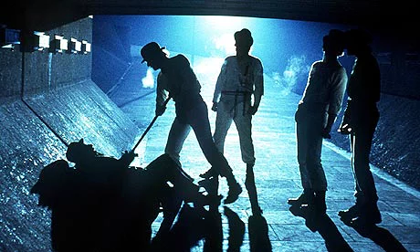
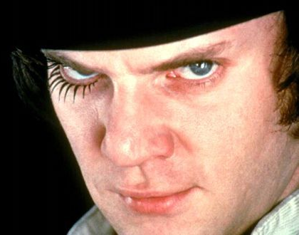
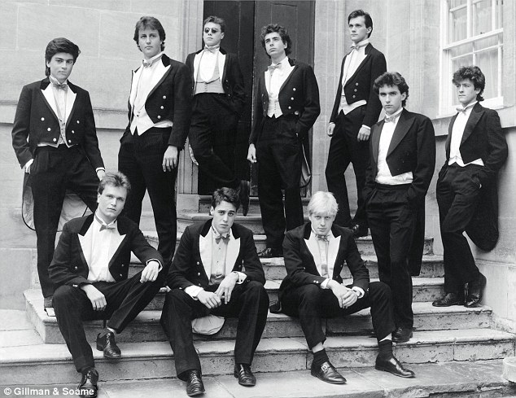
Hooliganism
“The consulate of Quintus Volusius and Publius Scipio [AD 56] was marked by peace abroad and by disgraceful activities at home, where Nero — his identity hidden under the dress of a slave — roamed the streets, brothels, and wine-shops of the capital, with an escort whose duties were to snatch wares exhibited for sale and to assault all persons they met, the victims having so little clue of the truth that he himself took his beats with the rest and bore their marks on his face... Julius Montanus, a member of the senatorial order, though he had not yet held office, met the emperor casually in the dark, and, because he repelled his offered violence with spirit, then recognized his antagonist and asked for pardon, was forced to suicide, the apology being construed as a reproach.” – Tac. Ann. 13.25.

Slide 9
“Even the licence of the actors and of the theatrical claques he converted into something like pitched battles by waiving penalties, by offering prizes, and by viewing the riots himself, sometimes in secret, very often openly; until, with the populace divided against itself and still graver turmoil threatened, no other cure appeared but to expel the actors from Italy and to have the soldiers again take their place in the theatre.” - Tacitus Annals 13.25.

Slide 10
Extravagance and Nero’s Circle of Vice
Common topoi of “bad” emperors being profligate and decadent.
  Gaius (Caligula) – spends ten million sesterces on one dinner – Seneca De Consolatione ad Helviam Matrem 10.
  Elegabalus – feeding parrots to lions - SHA Elagabalus 20-21.
“[Nero] believed that fortunes were made to be squandered and whoever could keep track of his expenses seemed to him a stingy miser; ‘True gentlemen’, he said, ‘always throw their money about’.” – Suet. Nero 30.1.
“He also forced his friends to provide him with dinners; one of them spent four million sesterces on a cena mitellita, and another on a rose banquet.” – Suet. Nero 27.
“120,000,000 sesterces had been squandered by Nero in gifts. It was voted that individuals should be summoned, and that a tenth part of the gifts which Nero had made them should be left with each. But Nero's favourites had hardly one-tenth left, for they had wasted the money of others on the same extravagances as they had their own; the most greedy and depraved had neither lands nor principal, but only what would cater to their vices.” – Tac. Hist. 1.20.

Slide 11
Petronius as Elegantiae Arbiter
Gaius or Titus. Petronius? Author of the Satyricon?
“Petronius calls for a brief retrospect. He was a man whose day was passed in sleep, his nights in the social duties and amenities of life: others industry may raise to greatness — Petronius had idled into fame. Nor was he regarded, like the common crowd of spendthrifts, as a debauchee and wastrel, but as the finished artist of extravagance… he was adopted into the narrow circle of Nero's intimates as his Arbiter of Elegance…” – Tacitus Annals 16.18.
“T. Petronius, a personage of consular rank, intending, from his hatred of Nero, to disinherit the table of that prince, broke a murrhine basin, which had cost him no less than three hundred thousand sesterces.” – Pliny Natural History 37.7.20.

Slide 12
“He himself, to create the impression that no place gave him equal pleasure with Rome, began to serve banquets in the public places and to treat the entire city as his palace. In point of extravagance and notoriety, the most celebrated of the feasts was that arranged by Tigellinus… He constructed, then, a raft on the Pool of Agrippa, and superimposed a banquet, to be set in motion by other craft acting as tugs. The vessels were adorned with gold and ivory, and the oarsmen were catamites marshalled according to their ages and their libidinous attainments. He had collected birds and wild beasts from the ends of the earth, and marine animals from the ocean itself. On the quays of the lake stood brothels, filled with women of high rank; and, opposite, naked harlots met the view…” - Tacitus Annals 15.37.

Slide 13
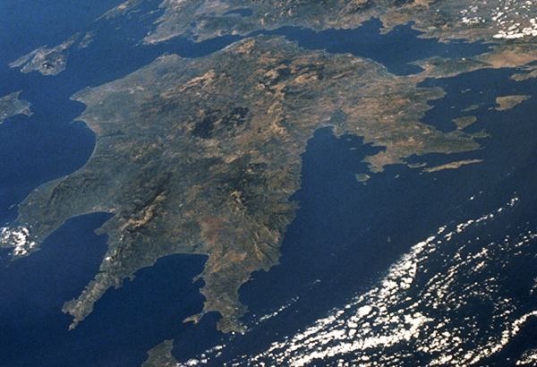
Acts of “Megalomania”
“The Gulfs… are known as the Corinthian and the Saronic Gulfs… the frontiers of this narrow passage, which thus necessitates a wearisome and perilous circumnavigation for vessels as a result of their enormity cannot be carried across by land on vehicles. For this reason it is that both King Demetrius, Caesar the Dictator, the prince Gaius, and Domitius Nero, have at different times made the attempt to cut through this neck by forming a navigable canal; a blasphemous design, as may be clearly seen by the result in every one of these instances.” – Pliny NH 4.4.10.
“Nero‘s unreasonable craving for immortal fame made him change a number of well-known names in his own favour. The month of April, for instance, became ‘Neroneus’, and Rome was on the point of being renamed ‘Neropolis’.” – Suet. Nero 55.
Month of Neroneus mentioned on an inscription from Pompeii – ILS 6326.

Slide 14
Sexual Depravity
“Not satisfied with seducing freeborn boys and married women, Nero raped the Vestal Virgin Rubria… Having tried to turn the boy Sporus into a girl by castration, he went through a wedding ceremony with him – dowry, bridal veil and all – which the whole court attended, then brought him home and treated him as a wife.” - Suetonius Nero 28.
“Nero himself, defiled by every natural and unnatural lust had left no abomination in reserve with which to crown his vicious existence; except that, a few days later, he became, with the full rites of legitimate marriage, the wife of one of that herd of degenerates, who bore the name of Pythagoras. The veil was drawn over the imperial head, witnesses were despatched to the scene; the dowry, the couch of wedded love, the nuptial torches, were there: everything, in fine, which night enshrouds even if a woman is the bride, was left open to the view.” – Tacitus Annals 15.37.

Slide 15
Executions and Erratic Behaviour

Slide 16
Executions and Exiles
Faustus Cornelius Sulla Felix – grandson of Antonia the Elder, husband of Claudia Antonia (daughter of Claudius) – exiled in AD 58, assassinated in 62.
Gaius Rubellius Plautus – son of Julia, great-grandson of Tiberius, exiled in AD 60, killed in 62.
Decimus Junius Torquantus Silanus – son of Aemilia Lepida, great-great-grandson of Augustus, compelled to commit suicide in AD 64.
“This was what was going on in Greece. Is it worthwhile adding that Nero ordered Paris, the pantomimic dancer, to be slain because the emperor had wished to learn dancing from him but had not the aptitude? Or that he banished Caecina Tuscus, the governor of Egypt, for bathing in the bath that had been specially constructed for the emperor's intended visit to Alexandria?” – Dio Cassius 63.18.1.

Slide 17
“In Rome during this same period Helius committed many terrible deeds. Among other things he put to death one of the foremost men, Sulpicius Camerinus, together with his son, the complaint against them being that they would not give up their title of Pythicus, received from some of their ancestors, but showed irreverence toward Nero's Pythian victories by their use of this same title. And when the Augustans proposed to make a statue of the emperor weighing a thousand pounds, the whole equestrian order was compelled to help to defray the expense they had undertaken. As for the doings of the senate, it would be a task to describe them all in detail; for so many sacrifices and days of thanksgiving were announced that the whole year would not hold them all.” – Dio Cassius 63.18.2-3.

Slide 18
Cause of Nero’s Downfall?
Was Nero‘s downfall caused by extravagance and cruelty?
“[Speech of Galba] ―It was not Vindex with a powerless province at his back, nor I with a single legion, that freed Rome‘s shoulders of that burden: it was his own barbarity and profligacy. And that was before there was an precedent for conviction of an emperor.” – Tacitus Histories 1.16.2.

Slide 19
Petronius’ Satyricon

Slide 20
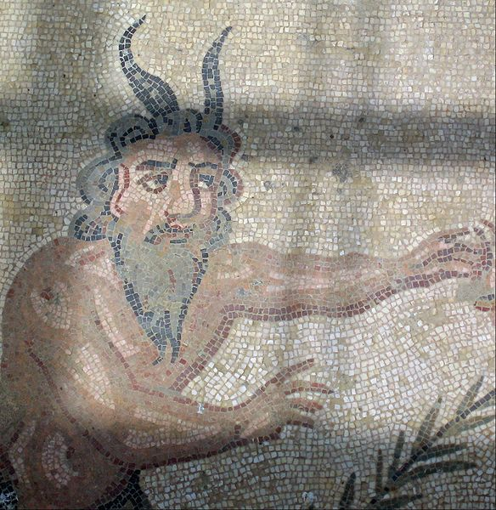
The Roman “Novel”
Satyricon or Satyrica – adventures of Satyrs – phallus is the focal point.
Main character Encolpius (Greek for “In-crotch”) who acts as the narrator. Other characters are:
  Giton (Matey) - his boyfriend
  Ascyltos (not tired)
  Eumolpus (singing nicely)
Originally 16 books - only book 15 and parts of books 14 and 16 survive.
Plot probably an Odyssean style adventure about restoring Encolpius’ virility.
Mixture of genres: epic, mime, romantic novel, comedy, Menippean satire.
Villa Romana del Casale, Piazza Armerina

Slide 21
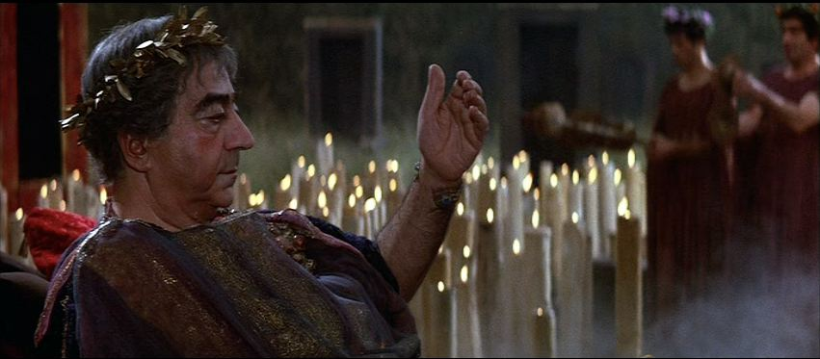
The Figure of Trimalchio
Encolpius and his companions invited as a scholars - ensnared in the elaborate banquet of Trimalchio (the cook is called Daedalus).
Public praising and private scorn – hypocrisy of moral judgement?
Simply mocking? or challenging the supercilious reader/audience?

Slide 22
Bibliography
Dalby, A. 2000: Empire of Pleasure Luxury and Indulgence in the Roman World. London: Routledge.
Edwards, C. 1993: The Politics of Immorality in Ancient Rome. Cambridge: Cambridge University Press.
Kragelund, P. 2000: ‘Nero’s Luxuria, in Tacitus and the Octavia’, The Classical Quarterly 50 (2): 494-515.
Murgatroyd, T. 2013: ‘Petronius’ Satyrica’, in A Companion to the Neronian Age (Buckley, E. and Dinter, M. T. eds.), Wiley-Blackwell: 241-257.

