Slide 1
The Modern World
ACAA4005
Lara Hopkinson

Slide 2
Outline across 2 sessions
What are the key sustainability issues of the day?
  Group feedback – what are your key issues?
Climate Change
Building certification schemes
National differences (Wales v England)
The problem with plastics…
Although this is subject to your top 3 issues…

Slide 3

What are your Top 3 issues?
This Photo by Unknown Author is licensed under CC BY-NC-ND

Slide 4

Climate change agenda

Slide 5
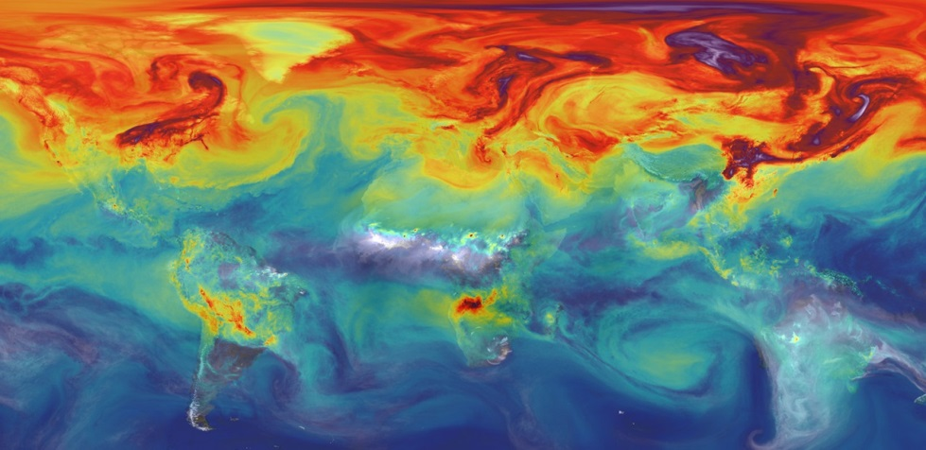
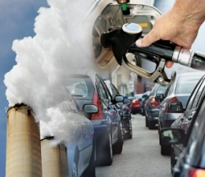
What’s the issue with CO₂?
Climate change
Increases in anthropogenic CO₂ & other gases
Cause?
  Related to combustion of fossil fuels
  Increased reliance since industrial revolution
  Fossil fuels contain carbon & other atoms
  Create CO₂ upon combustion
Sources: American Chemical Society / NASA

Slide 6
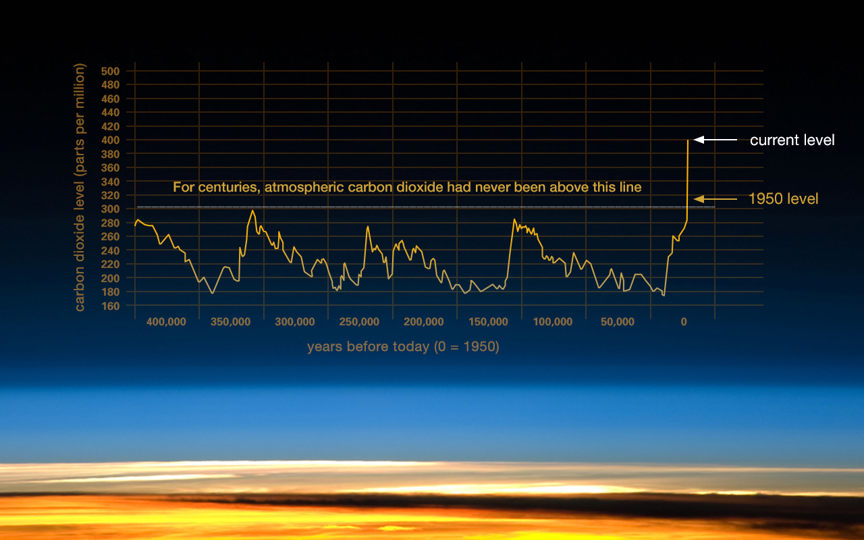
Source: NASA

Slide 7
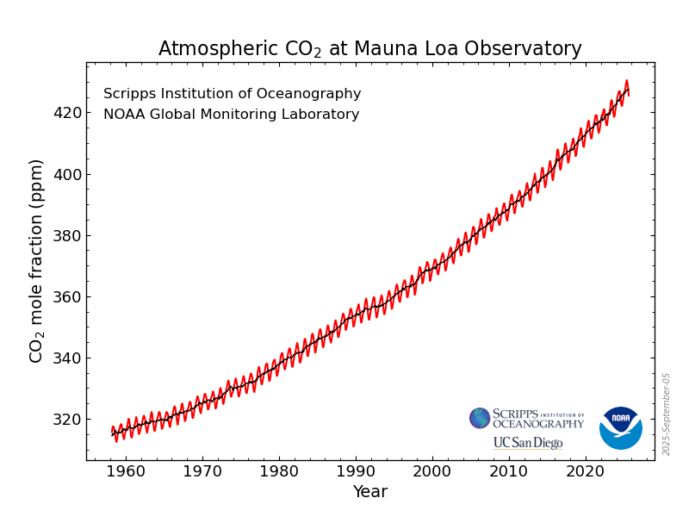
CO₂ concentrations
August 2025: 425.48 ppm
August 2025: 422.99 ppm
Source: National Oceanic and Atmospheric Administration, US

Slide 8
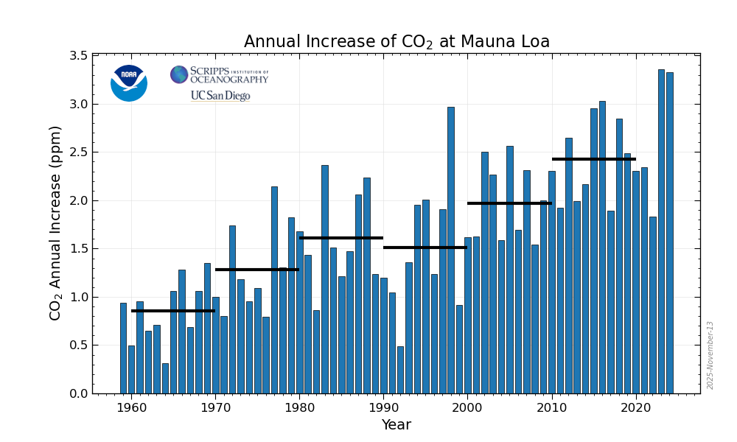
Year | Growth (ppm)
1959 | 0.94
1966 | 1.24
1973 | 1.22
1980 | 1.68
1988 | 2.16
1996 | 1.22
2003 | 2.27
2010 | 2.32
2011 | 1.92
2014 | 2.19
2015 | 2.99
2016 | 3.01
2019 | 2.46
Source: National Oceanic and Atmospheric Administration, US

Slide 9
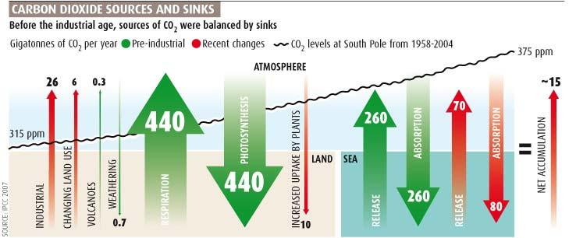
Natural CO₂ flows
Biosphere & oceans emit CO₂ into atmosphere
BUT there are equal flows back out of the atmosphere
Source: New Scientist, 2007

Slide 10
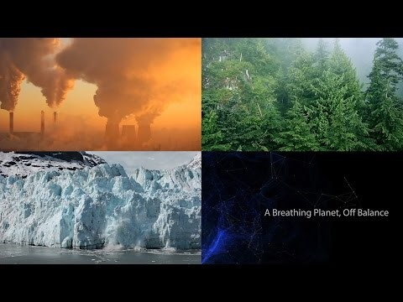
NASA video
https://youtu.be/xk11DVaAjEA

Slide 11
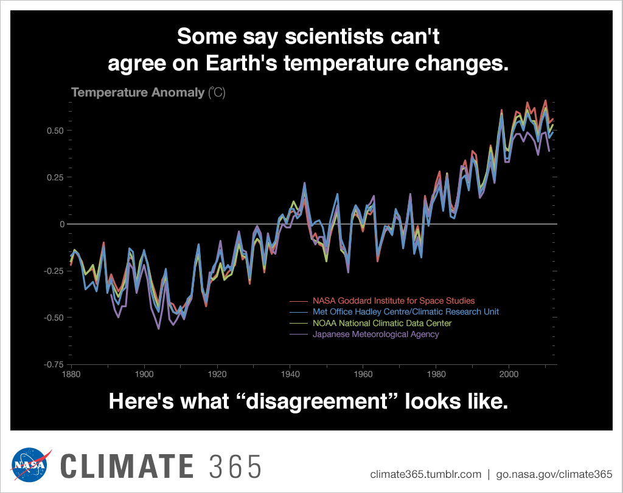
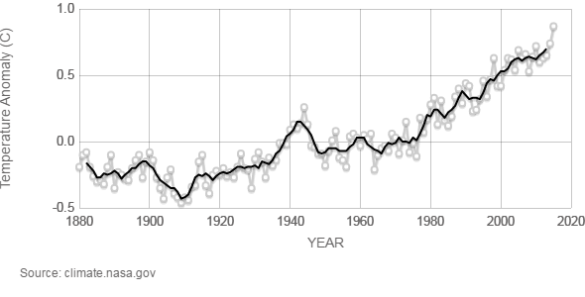
Effects – Rising global temp
Average increase:
1.5°C
Rising global temperatures
Average global rise – 0.87˚C

Slide 12
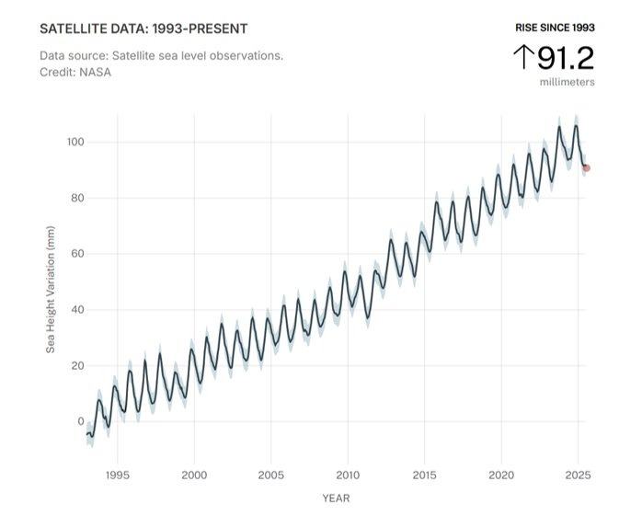
Rising sea levels
Rate of change - +3.3mm/year
Latest measurement – 101mm (+/- 4mm)
Source: NASA, August 2025

Slide 13
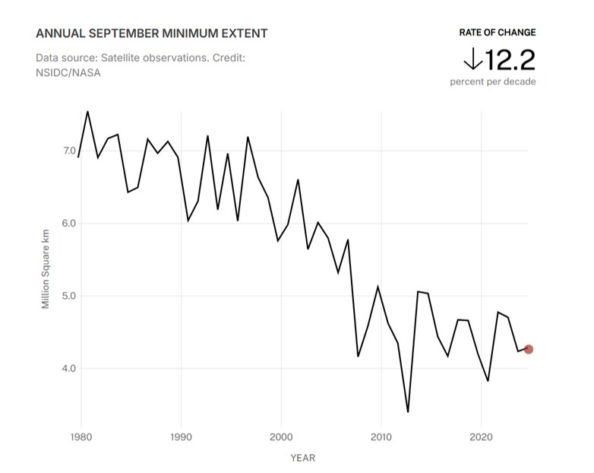
Arctic Sea Ice Minimum
Rate of change – 13.1% LESS per decade
Source: NASA, August 2025

Slide 14
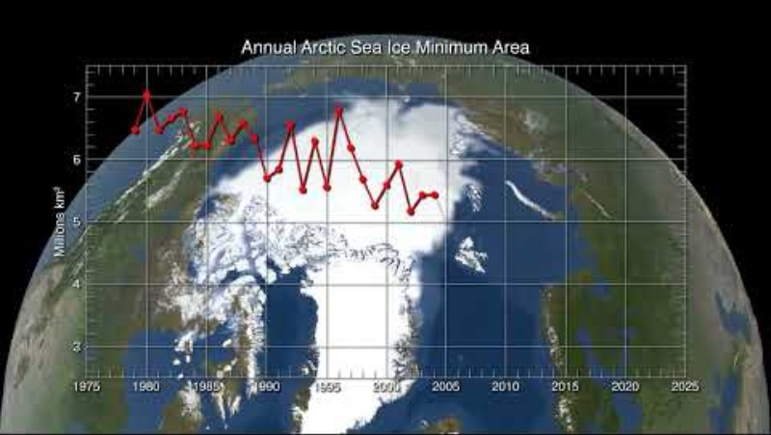
Arctic Sea Ice Video
https://www.youtube.com/watch?v=UageQJS8yDI

Slide 15
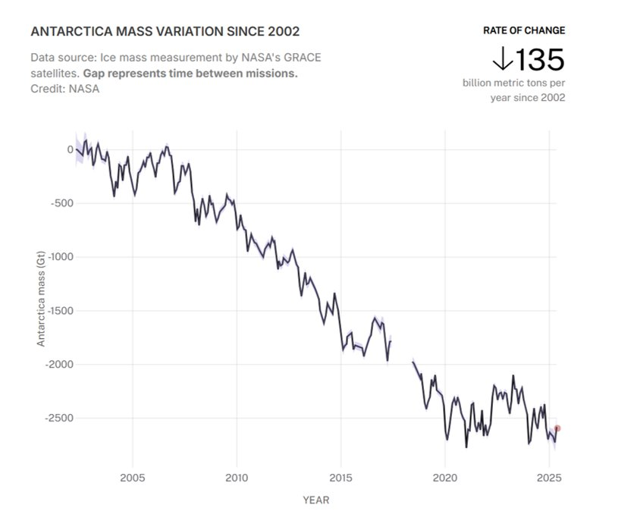
Land Ice (Antarctic)
Source: NASA, August 2025

Slide 16
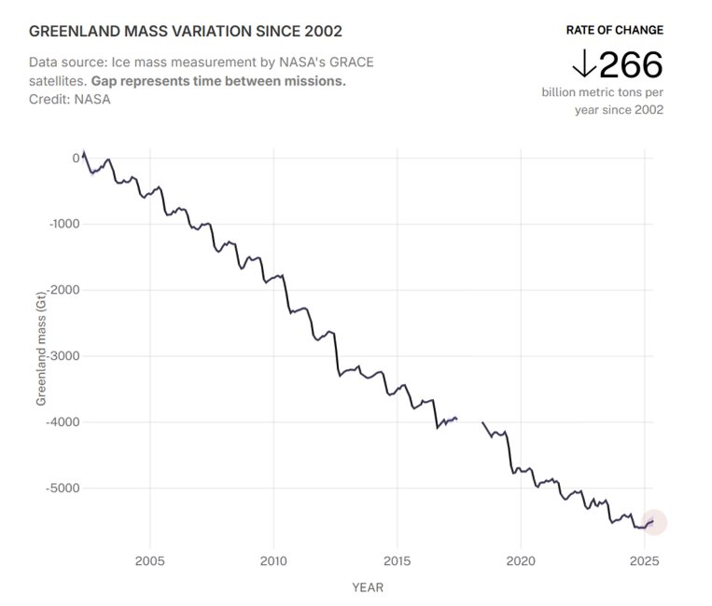
Land Ice (Greenland)
Source: NASA, 2025

Slide 17
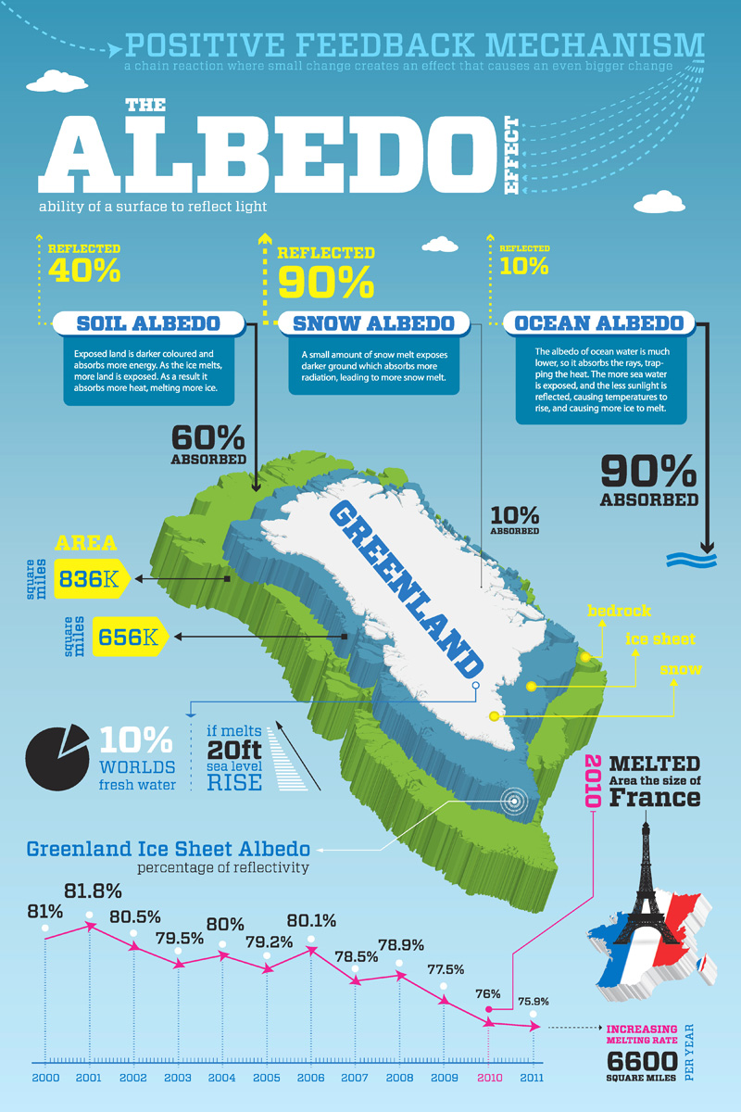
Albedo effect

Slide 18
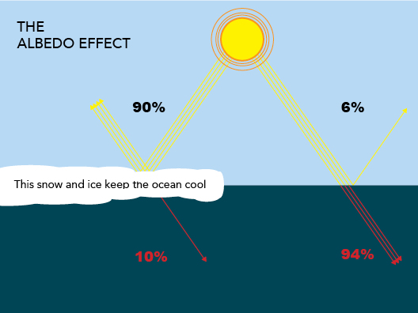

Slide 19
Who is responsible?
This Photo by Unknown Author is licensed under CC BY-NC-ND

Slide 20
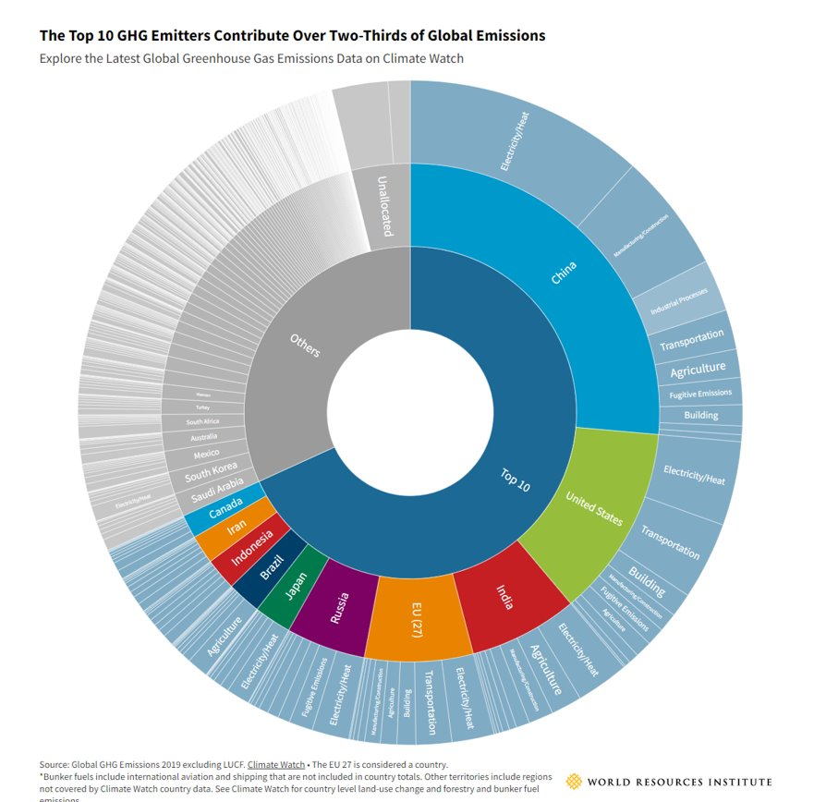
Interactive chart at:
World’s Top Emitters Interactive Chart I World Resources Institute (wri.org)

Slide 21
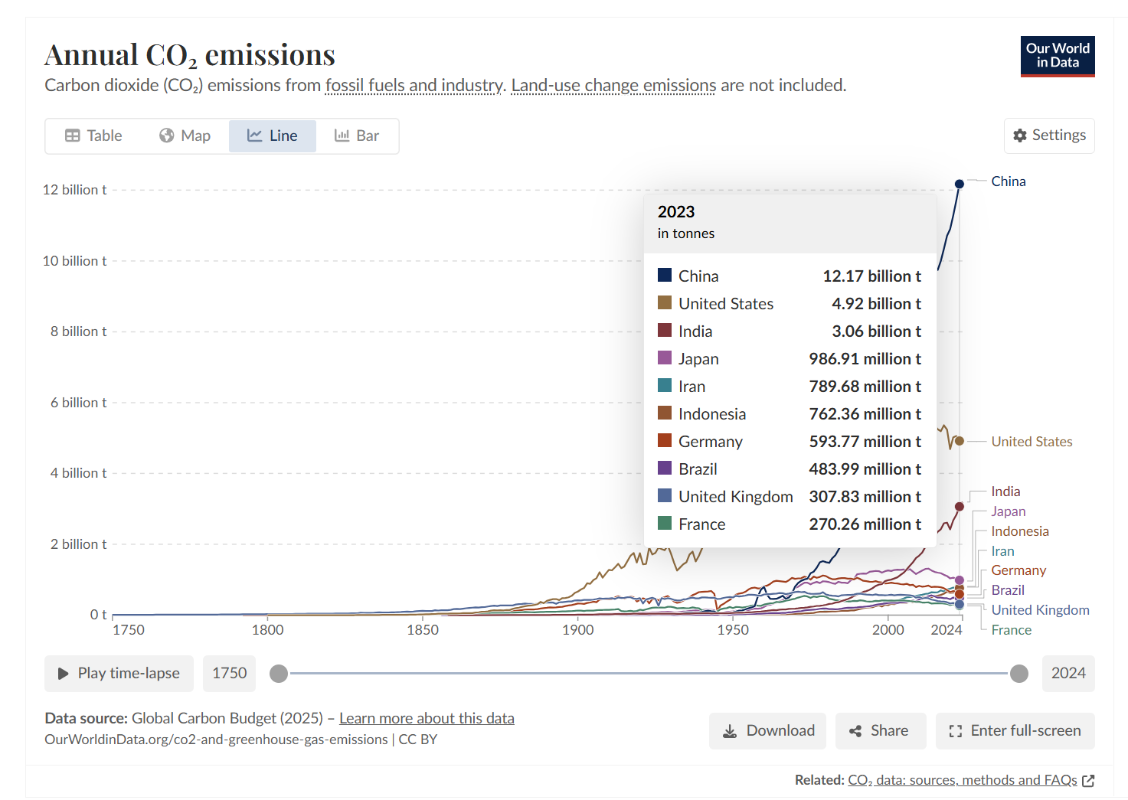
https://ourworldindata.org/grapher/annual-co2-emissions-per-country?time=1750..2024&country=USA~GBR~IND~CHN~FRA~DEU~BRA~JPN~IDN~IRN
Source: Our World in Data, 2025

Slide 22
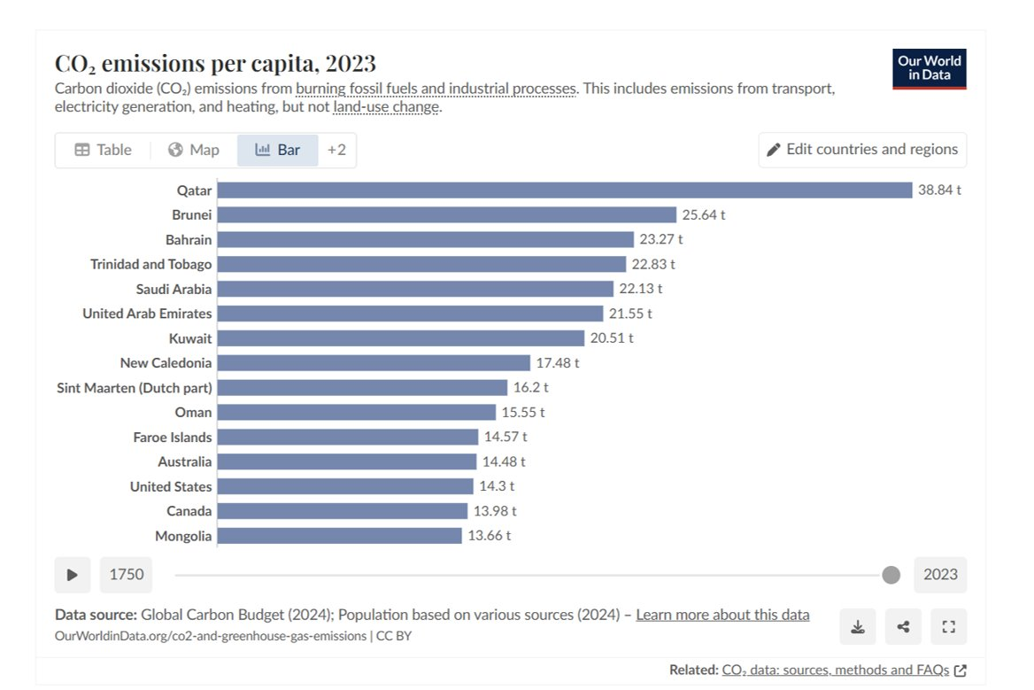
CO₂ emissions per capita
Data source: Our World in Data, 2025

Slide 23
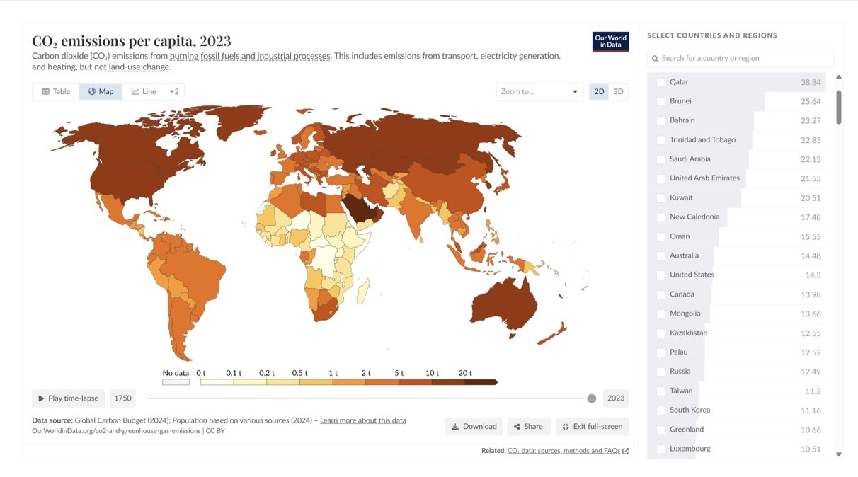
https://ourworldindata.org/grapher/co-emissions-per-capita?tab=map&country=QAT~BRN~BHR~TTO~SAU~ARE~KWT~NCL~SXM~OMN~FRO~AUS~USA~CAN~MNG

Slide 24
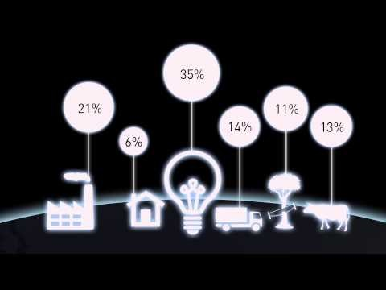
A Final Perspective
https://youtu.be/Zq1CSfddlgU

Slide 25
Why is this important for buildings?
This Photo by Unknown Author is licensed under CC BY-NC-ND

Slide 26
Source: Climate Change: Everyone’s business. Implications for buildings, 2014

Slide 27
What can be done?
Source: Climate Change: Everyone’s business. Implications for buildings, 2014

Slide 28
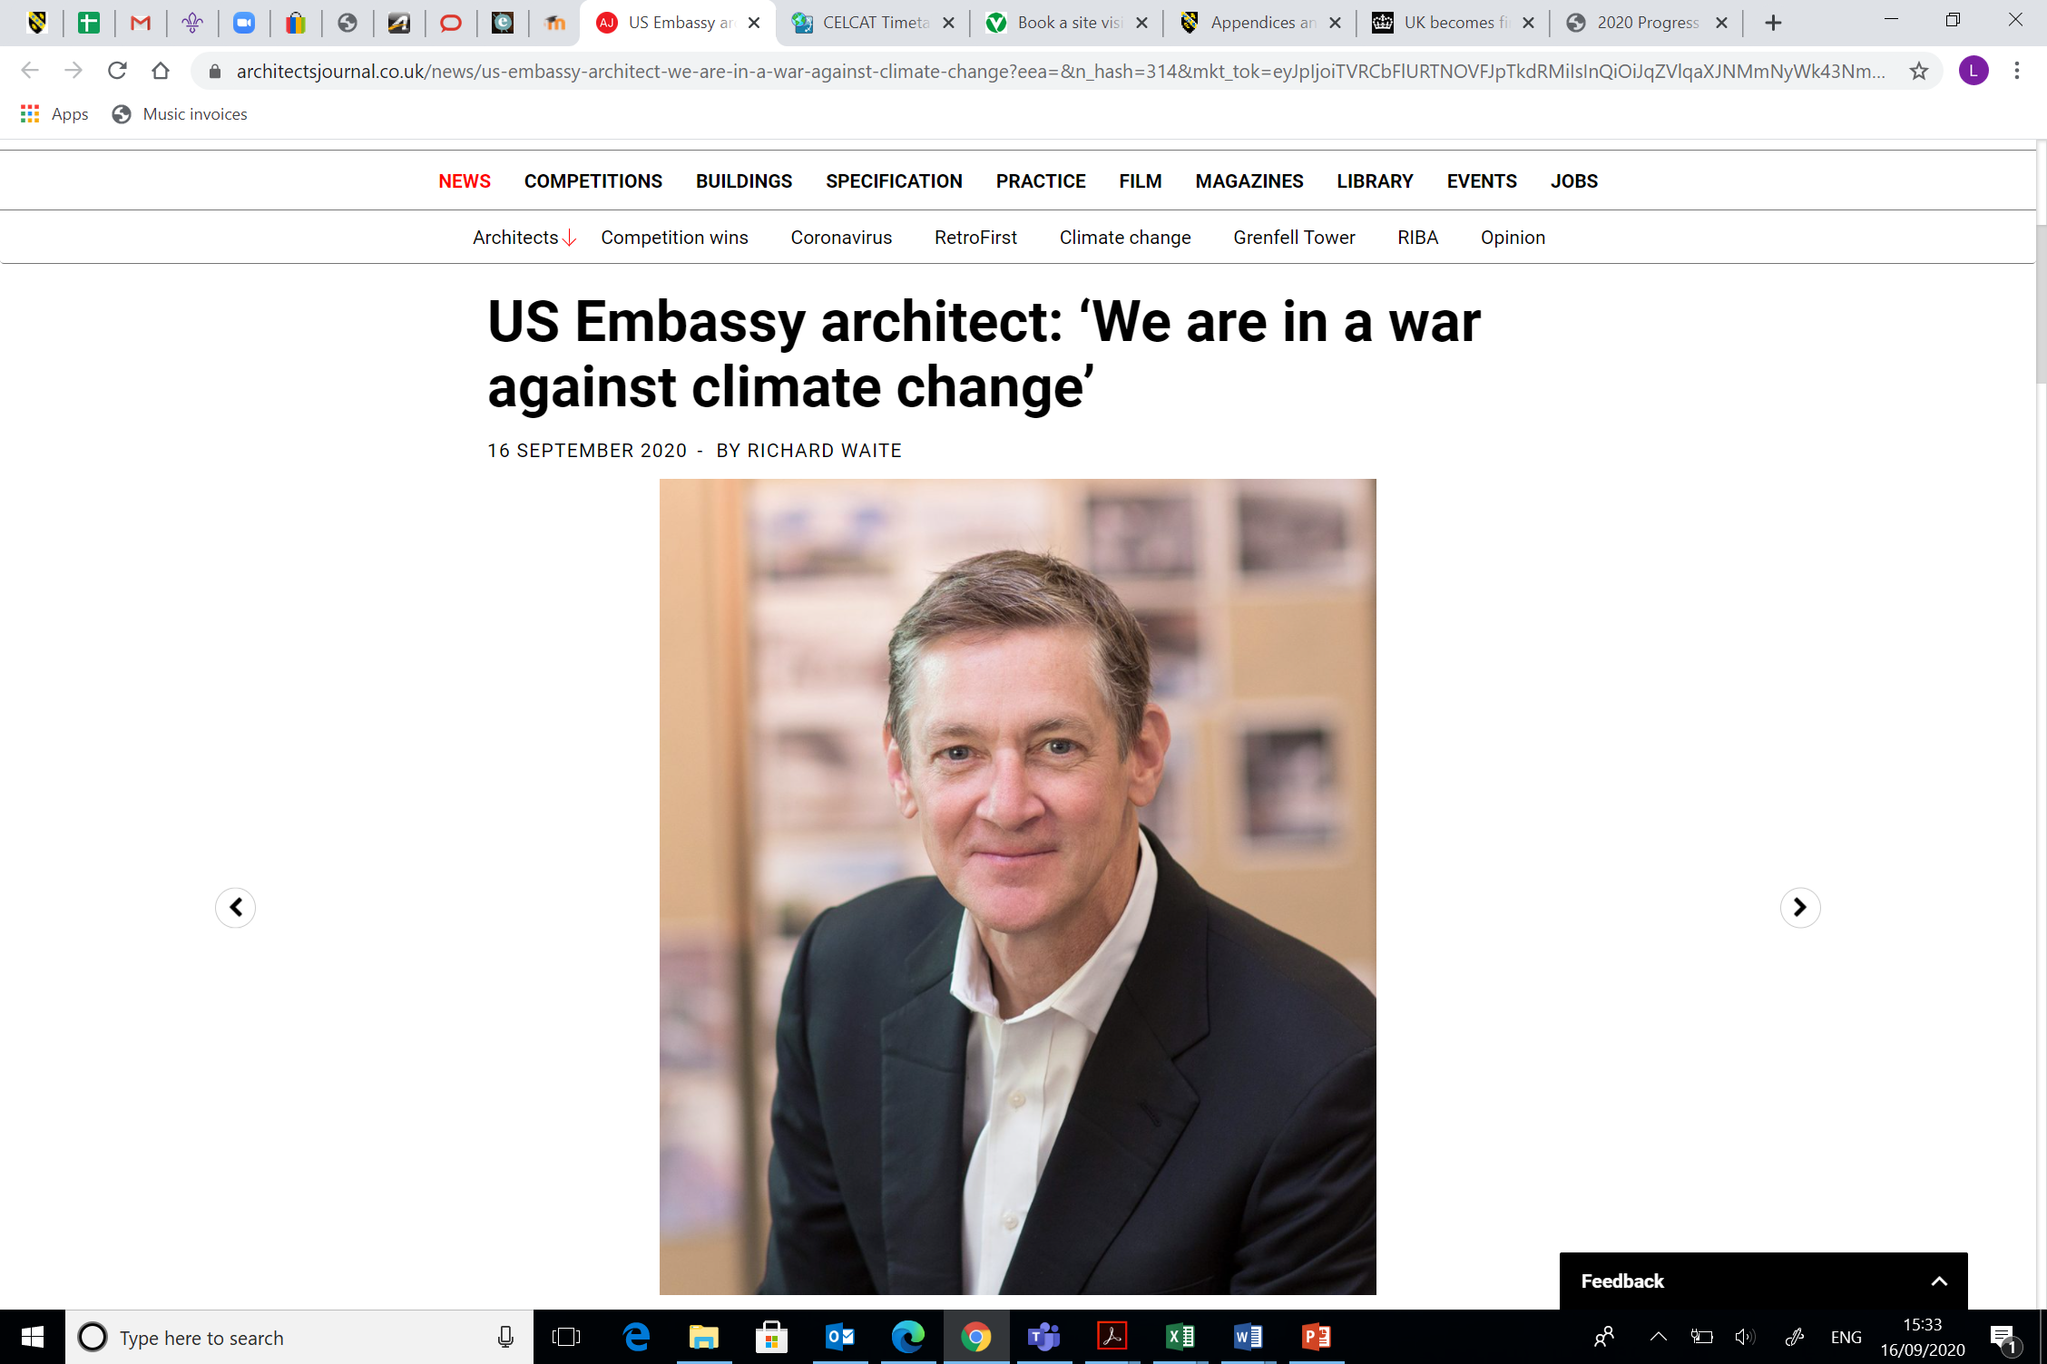

Slide 29

Building Certification schemes

Slide 30
What are they?
This Photo by Unknown Author is licensed under CC BY-NC-ND

Slide 31
Building Certification Schemes
Voluntary schemes
Focus on sustainability
Used to focus agenda on sustainability in construction
Differing types with differing foci
  Social, environmental, economic

Slide 33
Types and examples
Type | Investigates | Example
Single attribute product certification | Single sustainability aspect / quality e.g. energy efficiency rating | Energy Star
Multiple attribute product certification | Multiple aspects e.g. life cycle costs, energy usage | Nordic Swan
Multiple attribute building certification | Address the building / assembly as a whole looking at multiple criteria | BREEAM

Slide 34
BREEAM
Building Research Establishment Environmental Assessment Method
Developed in the 1980s and used in 1990 for office buildings
First scheme to assess, rate & certify sustainability of buildings
6 levels (outstanding to acceptable)

Slide 35
Example
Fornebu S, Oslo
BREEAM Outstanding
60% reduction in energy (passive design, technology)
Responsibly sourced materials
All C&D waste recycled
Sustainable transport
Green roof
Biodiversity considerations

Slide 36
Nordic Swan
Environmental & social dimensions
Ecolabel, concentrating on reducing toxic materials & resource consumption
Introduced in 1989, Nordic countries only
Pass or fail
New residential / school building focus

Slide 37
Example
Krøyers Plads, Copenhagen
105-unit apartment block
Recycled materials, green roof, insulated envelope
Natural light & ventilation
First Danish apartment block to achieve certification

Slide 38
Why sustainability?

Slide 39
What IS Sustainable Development?
This Photo by Unknown Author is licensed under CC BY-NC-ND

Slide 40
Definition
“Meeting the needs of the present without compromising the needs of future generations”
Balance different, and often competing needs
Environment
Society
Economy

Slide 41
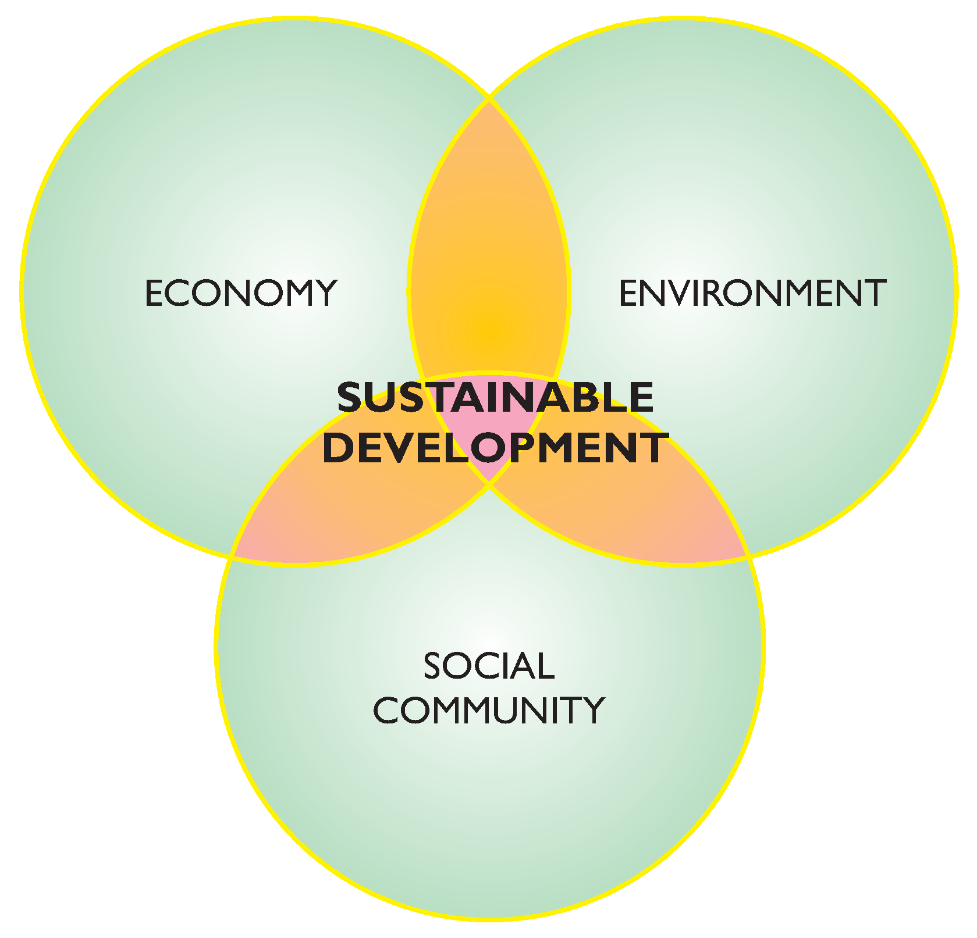

Slide 42
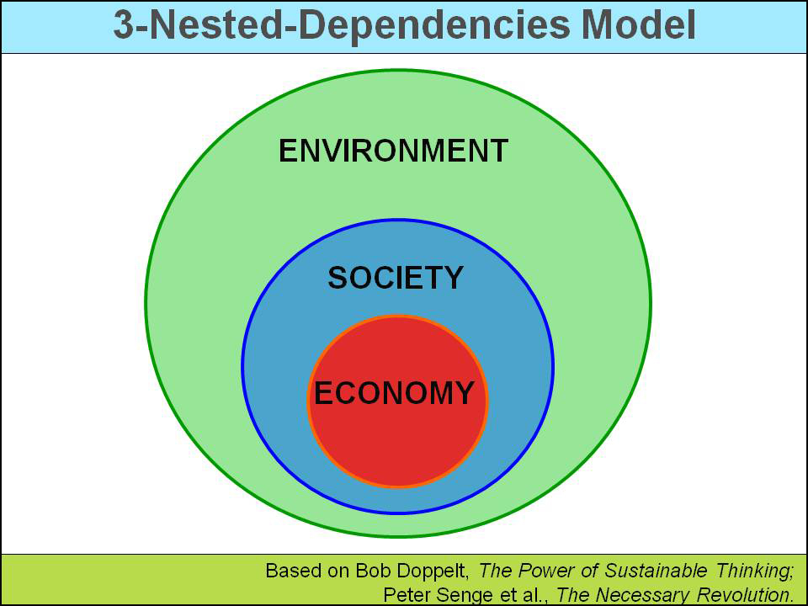

Slide 43
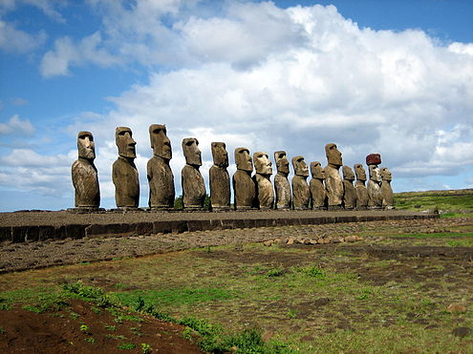
Unsustainable living: a new problem?
Source: Creative Commons

Slide 44
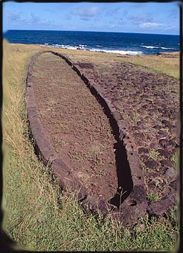
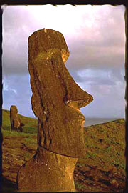
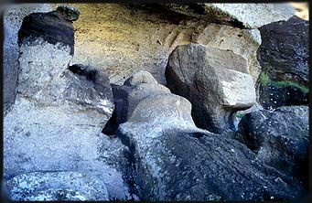
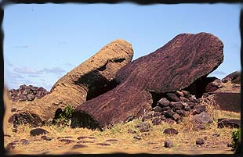

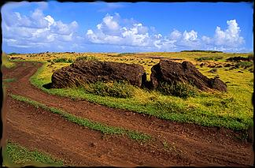
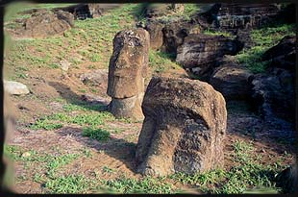

Slide 45


Slide 46

Is this our future?

Slide 47
Why is this so important in Wales?
This Photo by Unknown Author is licensed under CC BY-NC-ND

Slide 48
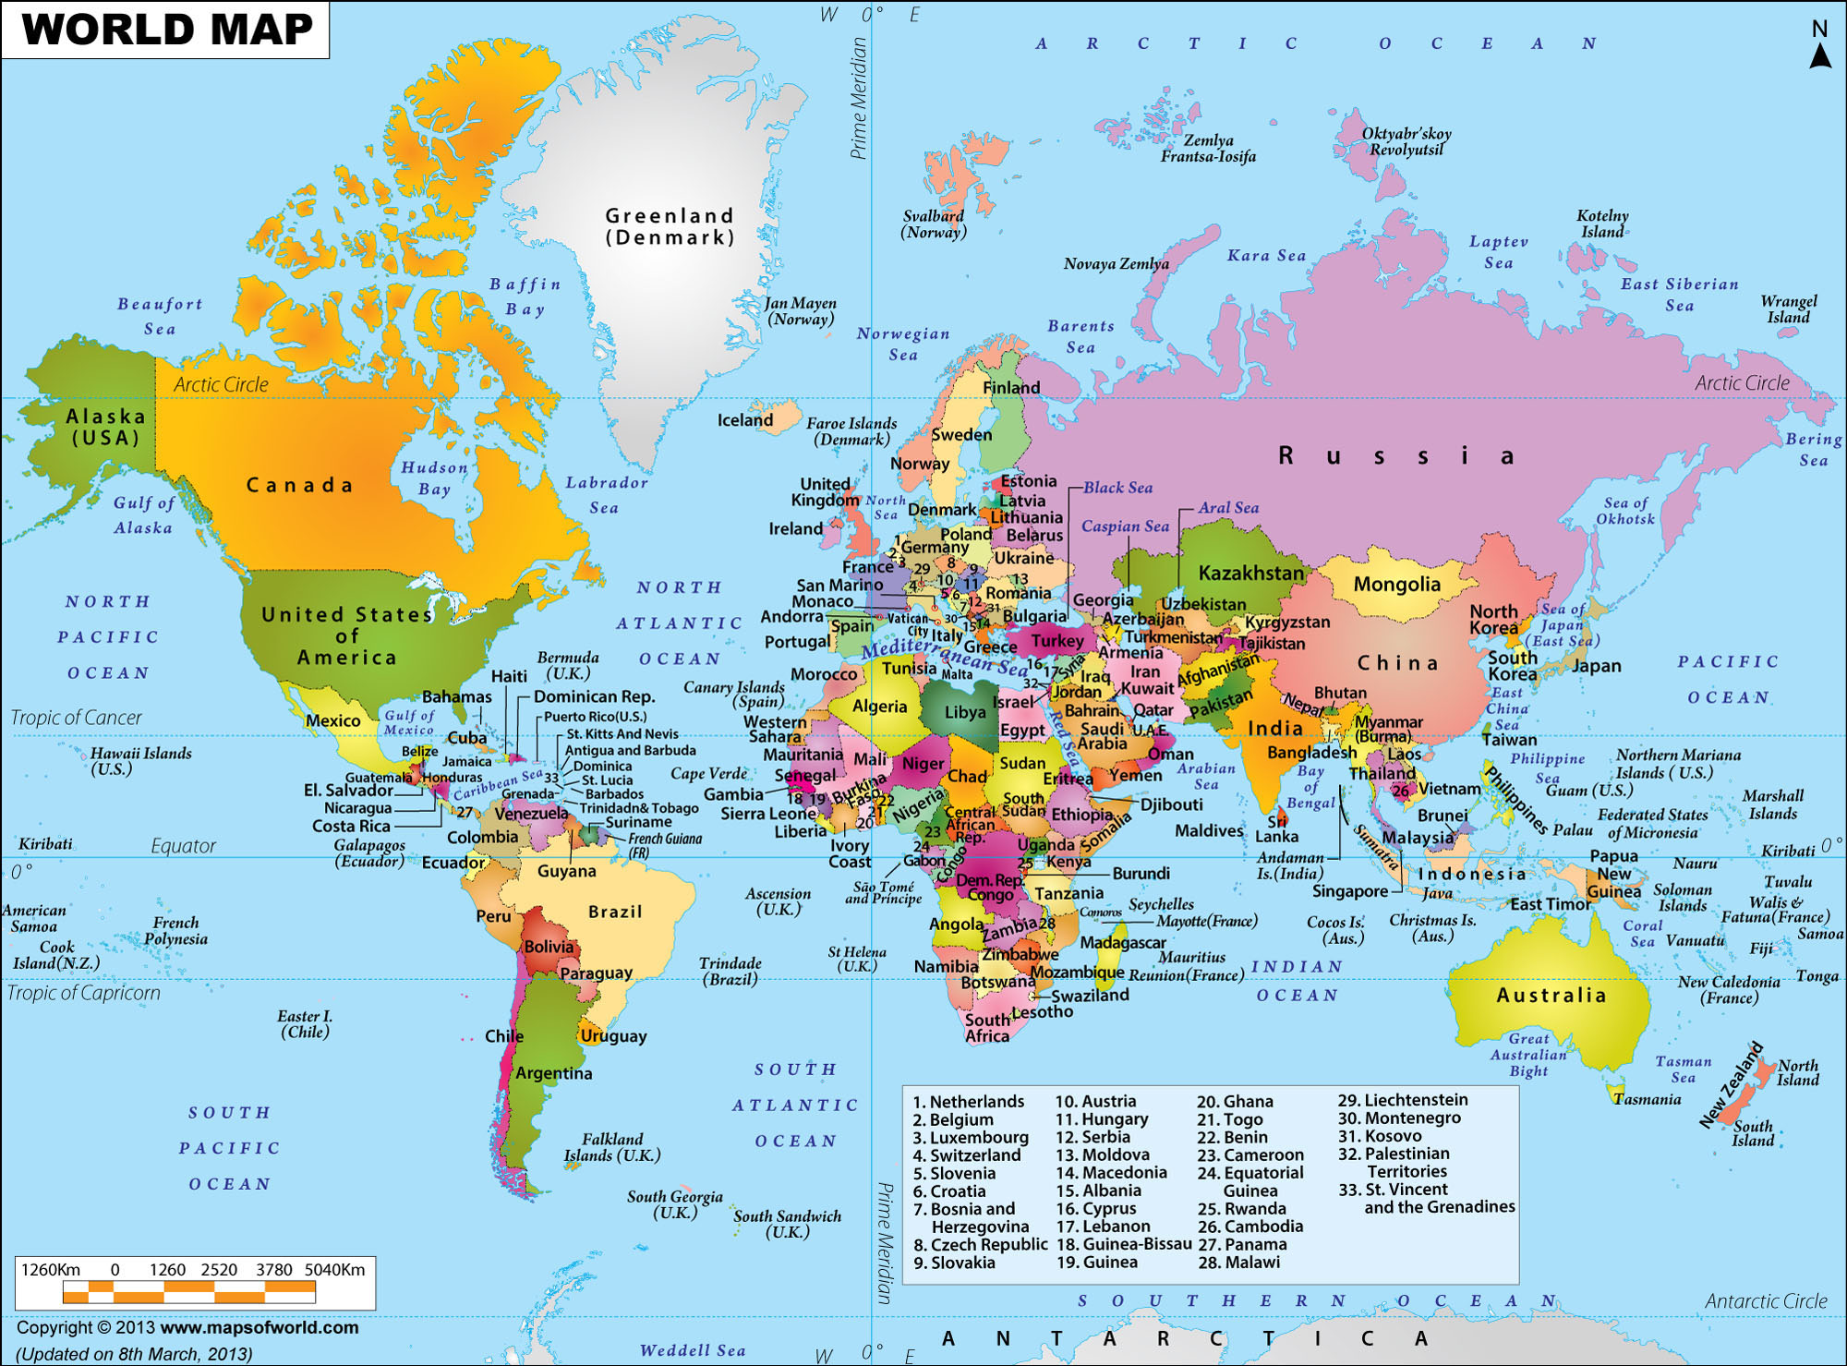

Slide 49
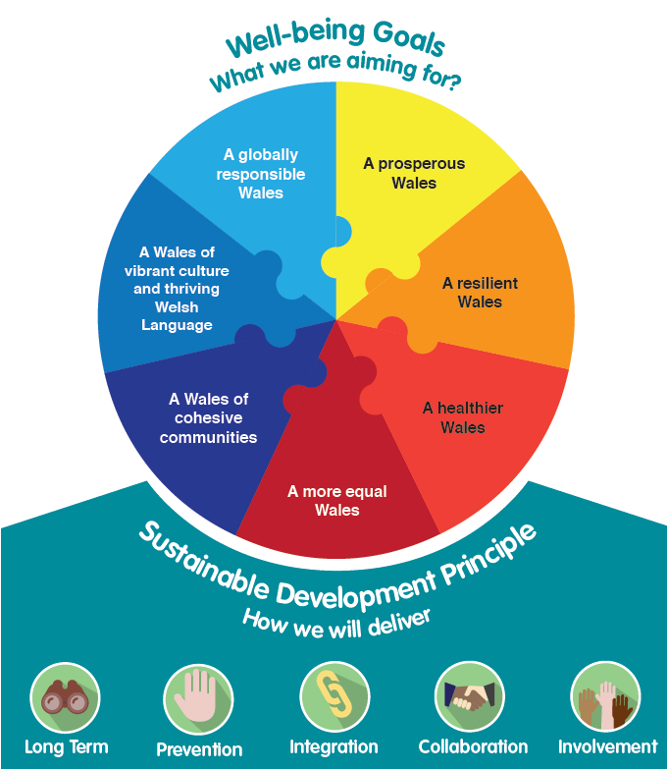
Source: Public Health Network Wales

Slide 50
“What Wales is doing today the world will do tomorrow”
“Action, more than words, is the hope for our current and future generations”
United Nations, 2015

Slide 51

The problem with plastics…

Slide 52
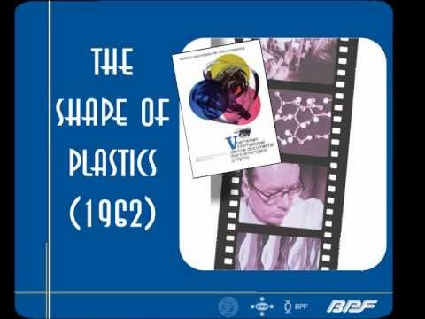
History of plastics use
https://www.youtube.com/watch?v=IBFMLMxGANc

Slide 53
Why is it a concern?
Growth in single-use plastics
It does NOT decompose
Accumulation in the environment is increasing concern
Total amount of resins and fibres manufactured 1950-2015 is 7800 Mt
Half of this (3900 Mt) is in the last 13 years…

Slide 54
Source: Geyer R (2017) Production, use and fate of all plastics ever made, Science Advances, 3, e1700782

Slide 55
Source: Geyer R (2017) Production, use and fate of all plastics ever made, Science Advances, 3, e1700782

Slide 56
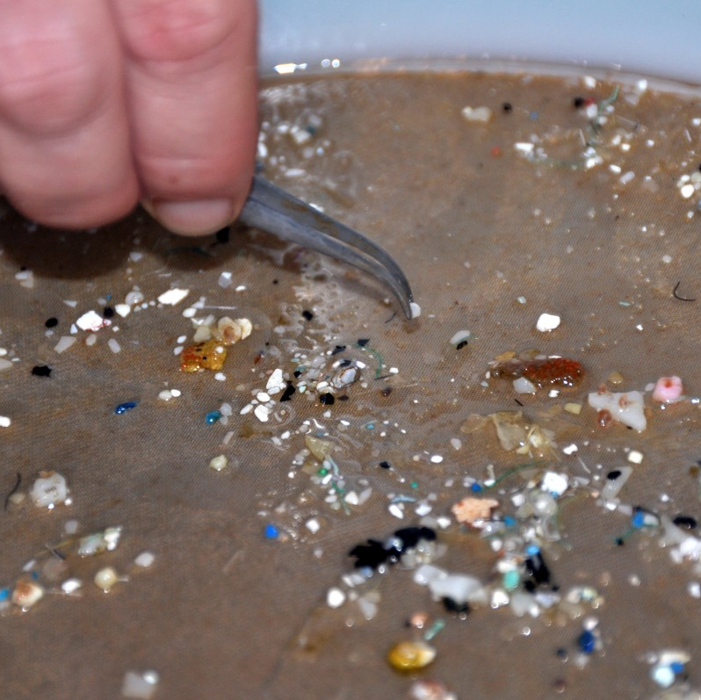
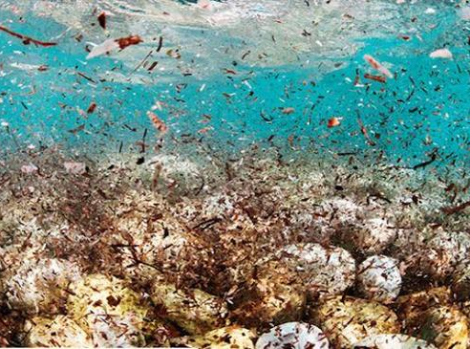
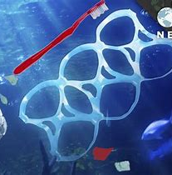
Sources: CBS News / NCEAS / YouTube

Slide 57
Plastics in construction
2nd highest sector user (after packaging)
Uses include:
  Piping & conduit
  Cladding & profiles
  Insulation
  Seals & gaskets, etc.
As we build ‘smarter’ buildings, will plastic use increase?

Slide 58
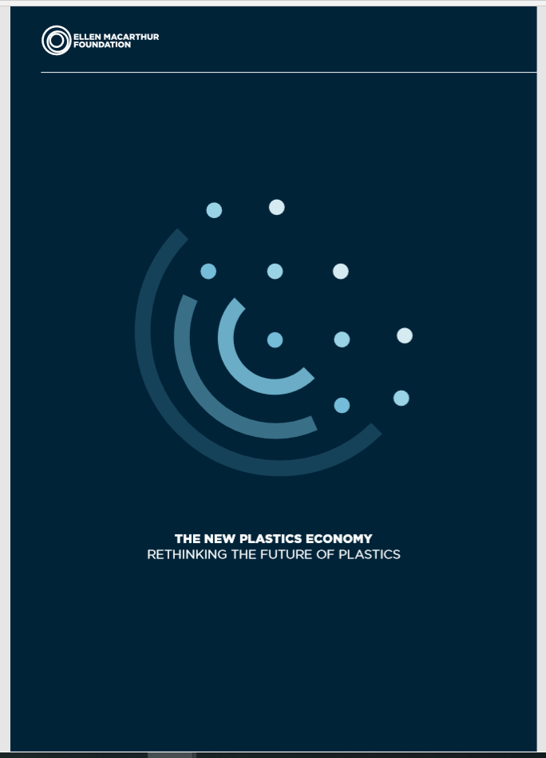
Key suggestions:
Create an effective ‘after-use’ economy
Reduce leakage of plastics into the natural environment
Decouple plastics from fossil feedstocks
Source: WEF, EMF and McKinsey & Co. (2016) The New Plastics Economy – Rethinking the future of plastics. Available at http://www.ellenmacarthurfoundation.org/publications, accessed 19/11/2018

Slide 59
Useful information
National Oceanic and Atmospheric Administration (NOAA) (www.noaa.gov)
Nasa Climate (www.climate.nasa.gov)
CAIT Climate Data Explorer (www.cait.wri.org)
World Bank (www.worldbank.org)
Chalmers P (2014) Climate Change: Implications for Buildings. Available at www.cisl.cam.ac.uk/ipcc (Accessed 09 November 2018).
Public Health Network Wales (www.publichealthnetwork.cymru)
British Plastics Federation (www.bpf.co.uk)
Ellen MacArthur Foundation (www.ellenmacarthurfoundation.org)

