Slide 1

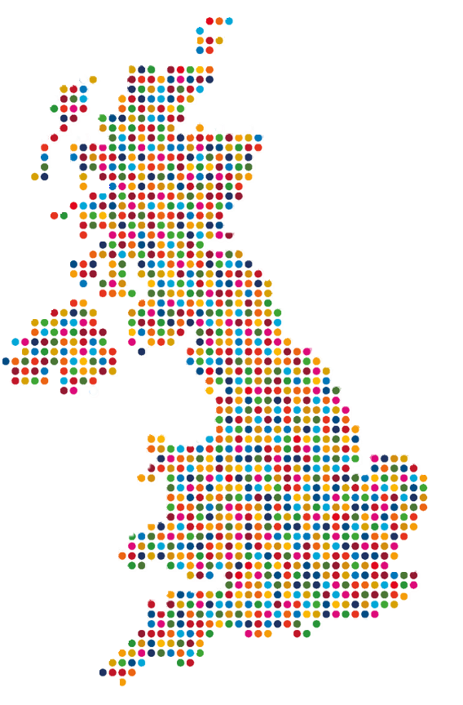
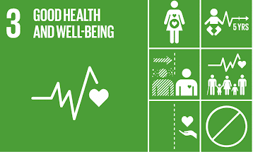


Health, Wellbeing and Sustainable Development – SDGs in UK
Component 1: Presentation
Module: BMHP6030 – Health, Wellbeing and Sustainable Development
Student Name: Mariana Cristina Tudor
Student ID: 2242927
Lecturer Name: Zakiyyah Ahmed

Slide 2



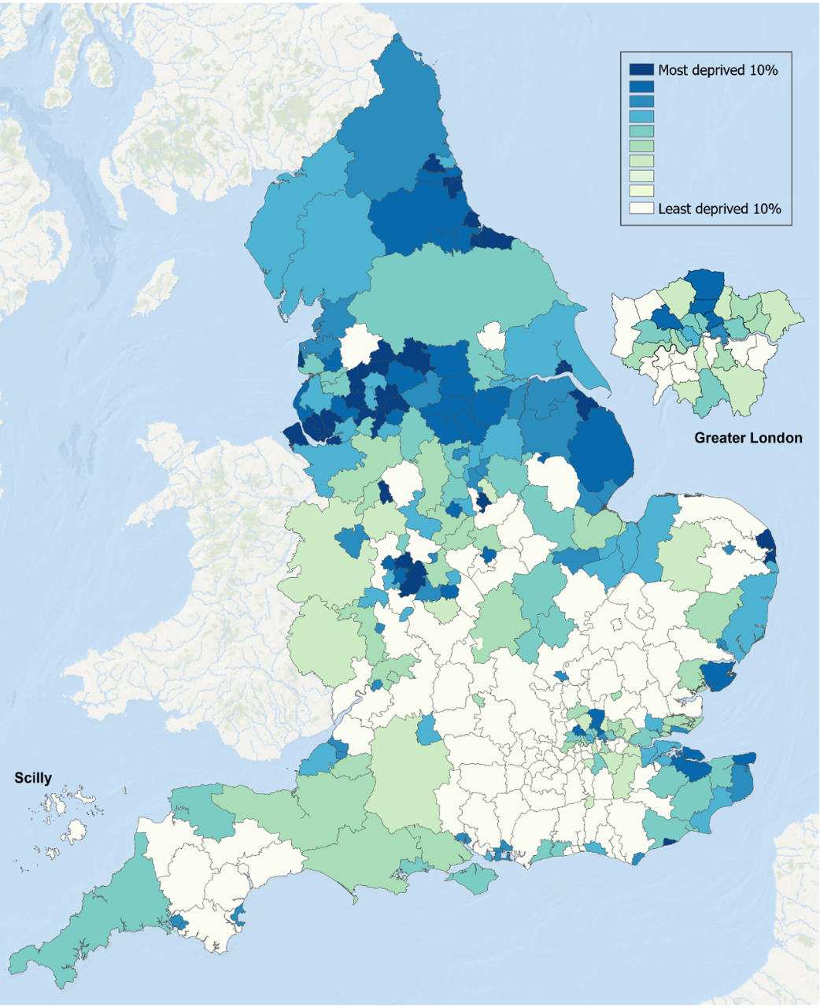
Introduction
Health, wellbeing and sustainable development are central priorities within UK health and social care policy, particularly through SDG 3 and its emphasis on prevention and population health (UK Government, 2019; United Nations, 2026).
However, despite policy commitment, a clear gap exists between these ambitions and the consistent integration of health, wellbeing and sustainability into service delivery (Alderwick, Hutchings and Mays, 2024; Oliviera et al., 2022; Reed et al., 2021).
In the absence of meaningful progress on SDG 10, this gap is experienced unequally, with disadvantaged groups disproportionately affected by reactive, uneven and inequitable outcomes across areas such as mental health, cancer prevention and long-term conditions (Oliviera et al, 2022; Clark et al., 2024).
This presentation critically evaluates this gap using theory, policy and UK-based case studies.
(UN, 2026)
(UK Government, 2025)

Slide 3
Definitions
Sustainable development refers to progress that addresses current societal needs while safeguarding the capacity of future generations to fulfil their own, incorporating long-term social, economic and health priorities (UN, 2023).
In health systems, sustainability extends beyond environmental concerns to include a fit-for-purpose workforce, adequate funding and system capacity (Anderson et al., 2021).
Short-term planning, workforce shortages and reliance on temporary solutions undermine sustainability, limiting the system’s ability to deliver prevention-focused care over time. (Anderson et al., 2021).
Wellbeing is defined as more than the absence of ill health, but acknowledge no single agreed definition, instead using indicators such as anxiety, loneliness and perceived fairness. (NHS Digital, 2022; ONS, 2025).
Wellbeing measurement is scale-dependent and incomplete, with wide variation across tools, meaning some context-specific dimensions are overlooked. (Ong et al., 2021).
ONS data indicates no mainly no progress (e.g. loneliness 7.7% in 2025 vs 6.9% in 2023; unfair treatment 19.2% in 2025 vs 12.6% in 2023). (ONS, 2025).
Health is commonly defined as encompassing physical, mental and social functioning (World Health Organization, 2026); however, alternative perspectives conceptualise health more narrowly as the absence of disease, leading to differing priorities in service delivery (Armitage, 2023; Huber et al, 2011).

Slide 4
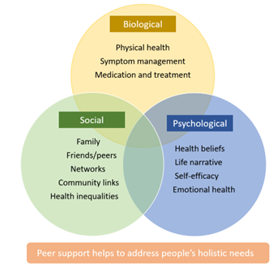
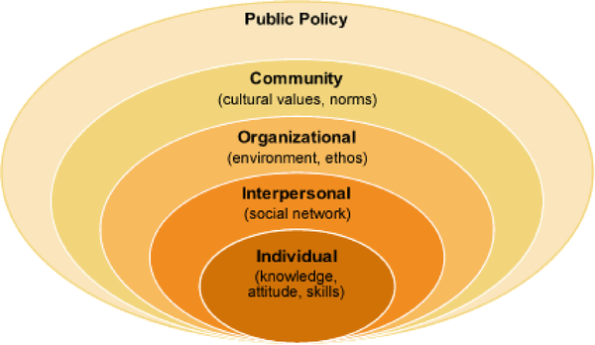
Models and Theories
The Biopsychosocial Model recognises that health impacts are influenced by biological, psychological and social factors (Engel, 2012), supporting prevention-focused and holistic care aligned with SDG 3 (UN, 2026).
The Socio-Ecological Model emphasises multiple levels of influence on health, including individual, community and structural determinants (McLeroy et al., 1988) , highlighting the relevance of SDG 10 in addressing health inequalities (UN, 2026).
In practice, while these models underpin UK health policy, service delivery often prioritises individual-level interventions, limiting full integration of prevention and equity resulting in uneven prevention outcomes and continued health inequalities (Oliviera et al., 2022).
(NHS England, 2023)
(Coroiu et al., 2020)

Slide 5
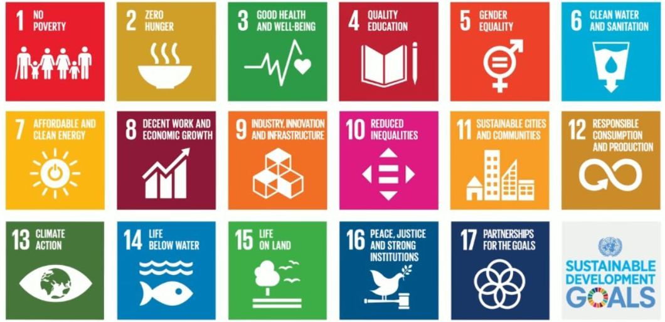
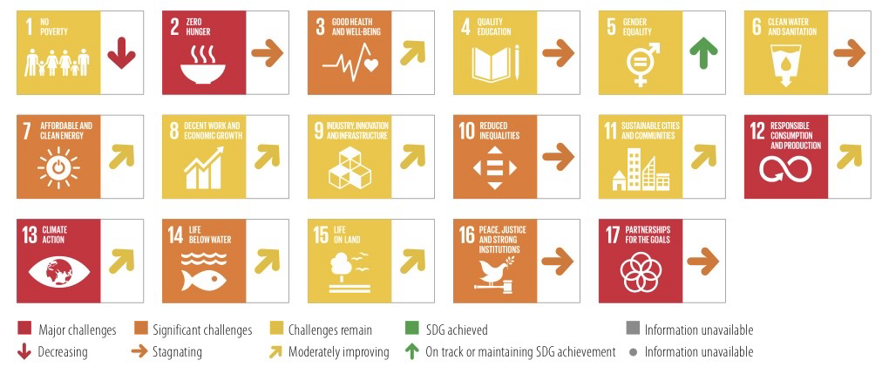
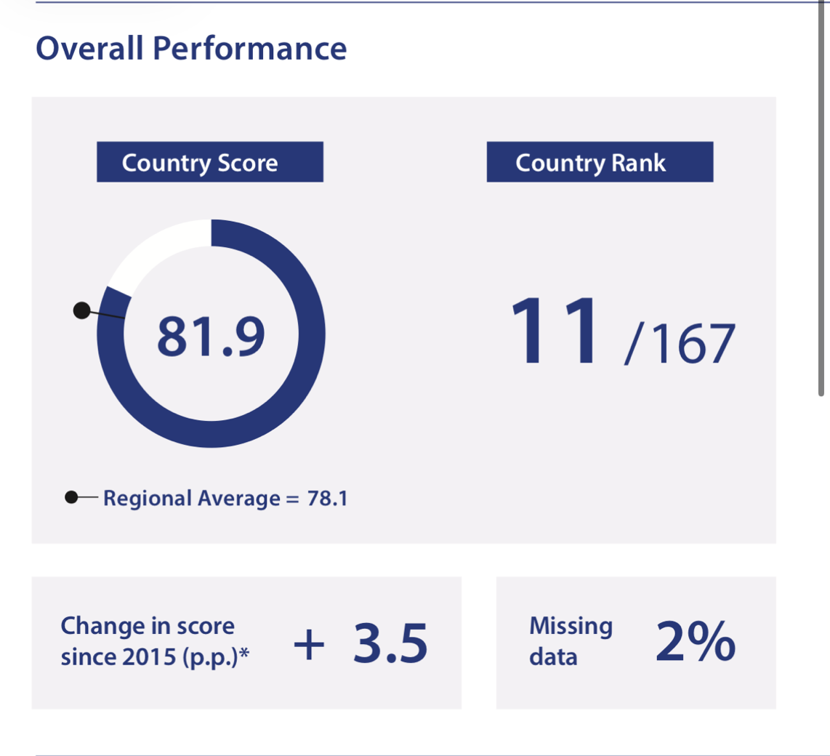
Sustainable Development Goals
The Sustainable Development Goals (SDGs) consist of 17 internationally agreed objectives established by the United Nations to advance sustainable social, economic and environmental development (UN, 2026).
They provide a shared framework for integrating health, wellbeing and sustainability into national policies, emphasising long-term outcomes rather than short-term gains (UN, 2026).
SDG 3 (Good Health and Wellbeing) prioritises prevention, early intervention and population health, aiming to reduce avoidable illness and pressure on health systems (UN, 2026).
In the UK, SDG 3 is reflected in prevention-led initiatives such as the NHS Diabetes Prevention Programme, Antimicrobial Resistance National, and Digital Weight Management Programme (NHS England, 2026a).
SDG 10 (Reduced Inequalities) complements SDG 3 by recognising that health outcomes are socially patterned, informing targeted approaches such as Core20PLUS5 and NHS Long Term Plan to address unequal access and outcomes (NHS England, 2026a).
Together, SDG 3 and SDG 10 frame UK health and social care around preventative, equitable and sustainable service delivery, though progress remains uneven across regions and populations (Parkinson et al., 2024; NHS England, 2026b).
(UN, 2026)
(Sustainable Development Report, 2026)
(Sustainable Development Report, 2026)

Slide 6
Policy & Governance
The NHS Long Term Plan prioritises prevention, population health and reducing health inequalities (UK Government, 2019), aligning closely with SDG 3 (UN, 2026); however, delivery remains constrained by acute service pressures and workforce capacity, resulting in limited progress towards prevention-led service redesign (Parkinson et al., 2024).
Core20PLUS5 provides a targeted national strategy to address health inequalities (NHS England, 2026c), in line with SDG 10 (UN, 2026) though its effectiveness depends on consistent local implementation and adequate resourcing, resulting in variable impact and persistent inequality between regions (Elliot et al., 2025).
The Health and Care Act 2022 implemented Integrated Care Systems to support collaboration, population health management and reduced health inequalities (UK Government, 2022), aligning with SDG 3 and SDG 10 (UN, 2026); however, while statutory integration has been strengthened, progress remains limited by variable local capacity, unclear accountability and continued pressures on acute services (Elliot et al., 2025).
NHS service delivery has improved in productivity and activity levels, but rising demand and system pressures mean access and waiting time targets remain largely unmet (NHS England, 2026d).

Slide 7
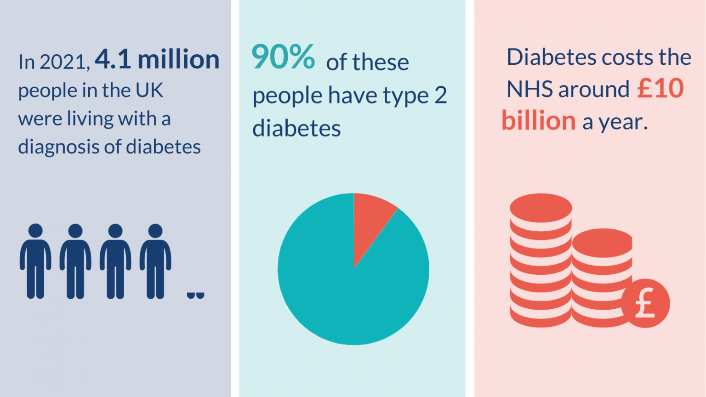

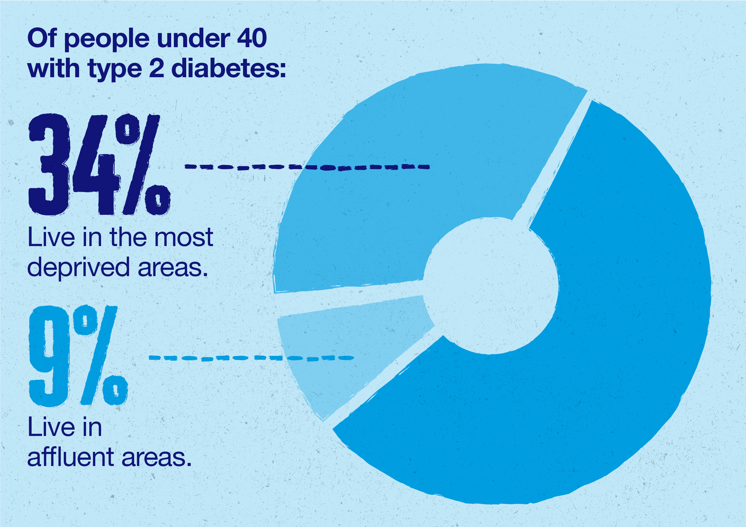
Case studies
However, evidence of lower uptake among deprived, region and some ethnic minority groups (Chatzi et al., 2023) demonstrates challenges in achieving SDG 10 (UN, 2026), which Core20PLUS5 seeks to address through targeted inequality-focused delivery (NHS England, 2026c).
Although the NHS DPP over-represents ethnic minority groups at the identification stage (35% vs 13% in the general population), participation drops at completion (19%), and individuals living in the most deprived areas are progressively under-represented (20% in the general population vs 13% at completion), suggesting a risk of widening socioeconomic inequalities (Chatzi et al., 2023).
Referral to the NHS Diabetes Prevention Programme was associated with a 20% lower 3-year risk of developing Type 2 diabetes (127 vs 154 per 1,000) (Ravindrarajah et al., 2023).
Programme design evidence suggests a 26% reduction in progression compared to usual care (Ravindrarajah et al., 2023).
The NHS Diabetes Prevention Programme is prioritised within the NHS Long Term Plan, aiming to reduce Type 2 diabetes risk through lifestyle intervention (NHS England, 2026b), directly supporting SDG 3 through prevention and population health (UN, 2026).
The programme reflects the Biopsychosocial Model by addressing behavioural, psychological and social risk factors (Engel, 2012), aligning with the NHS Long Term Plan’s focus on prevention and population health (UK Government, 2019) , Core20PLUS5’s emphasis on health inequalities (NHS England, 2026c), and the Health and Care Act 2022’s shift towards integrated care (UK Government, 2022).
(Kwint, 2022)
(Healthier You, 2026)
(Diabetes UK, 2026)

Slide 8
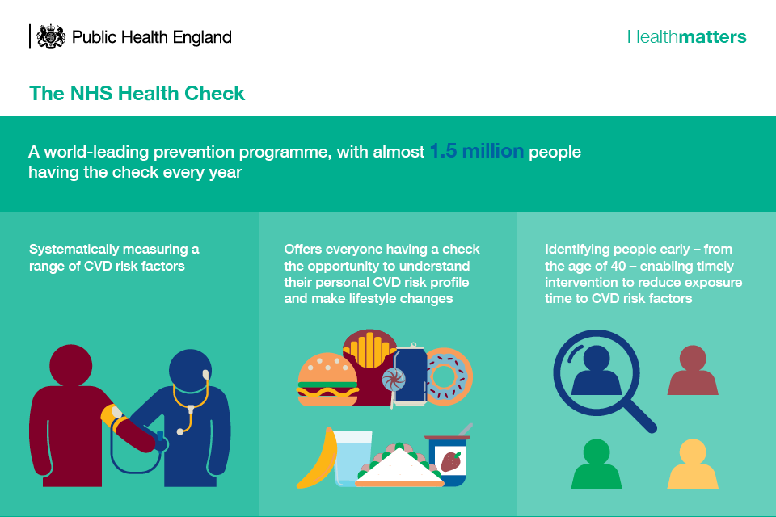
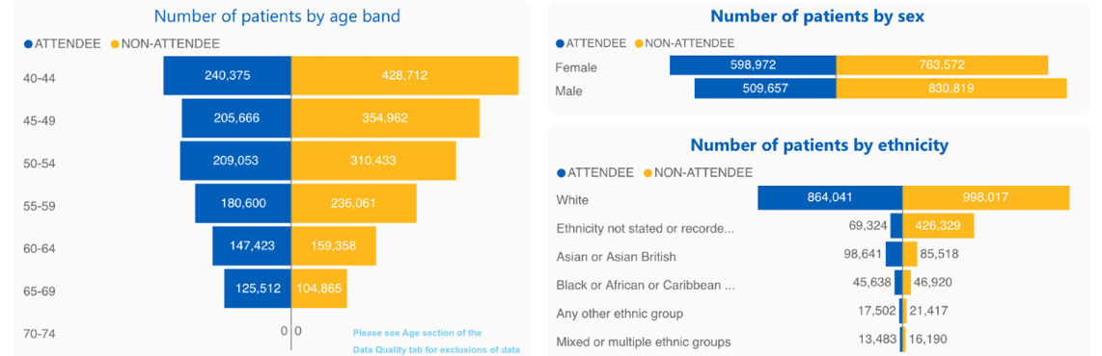
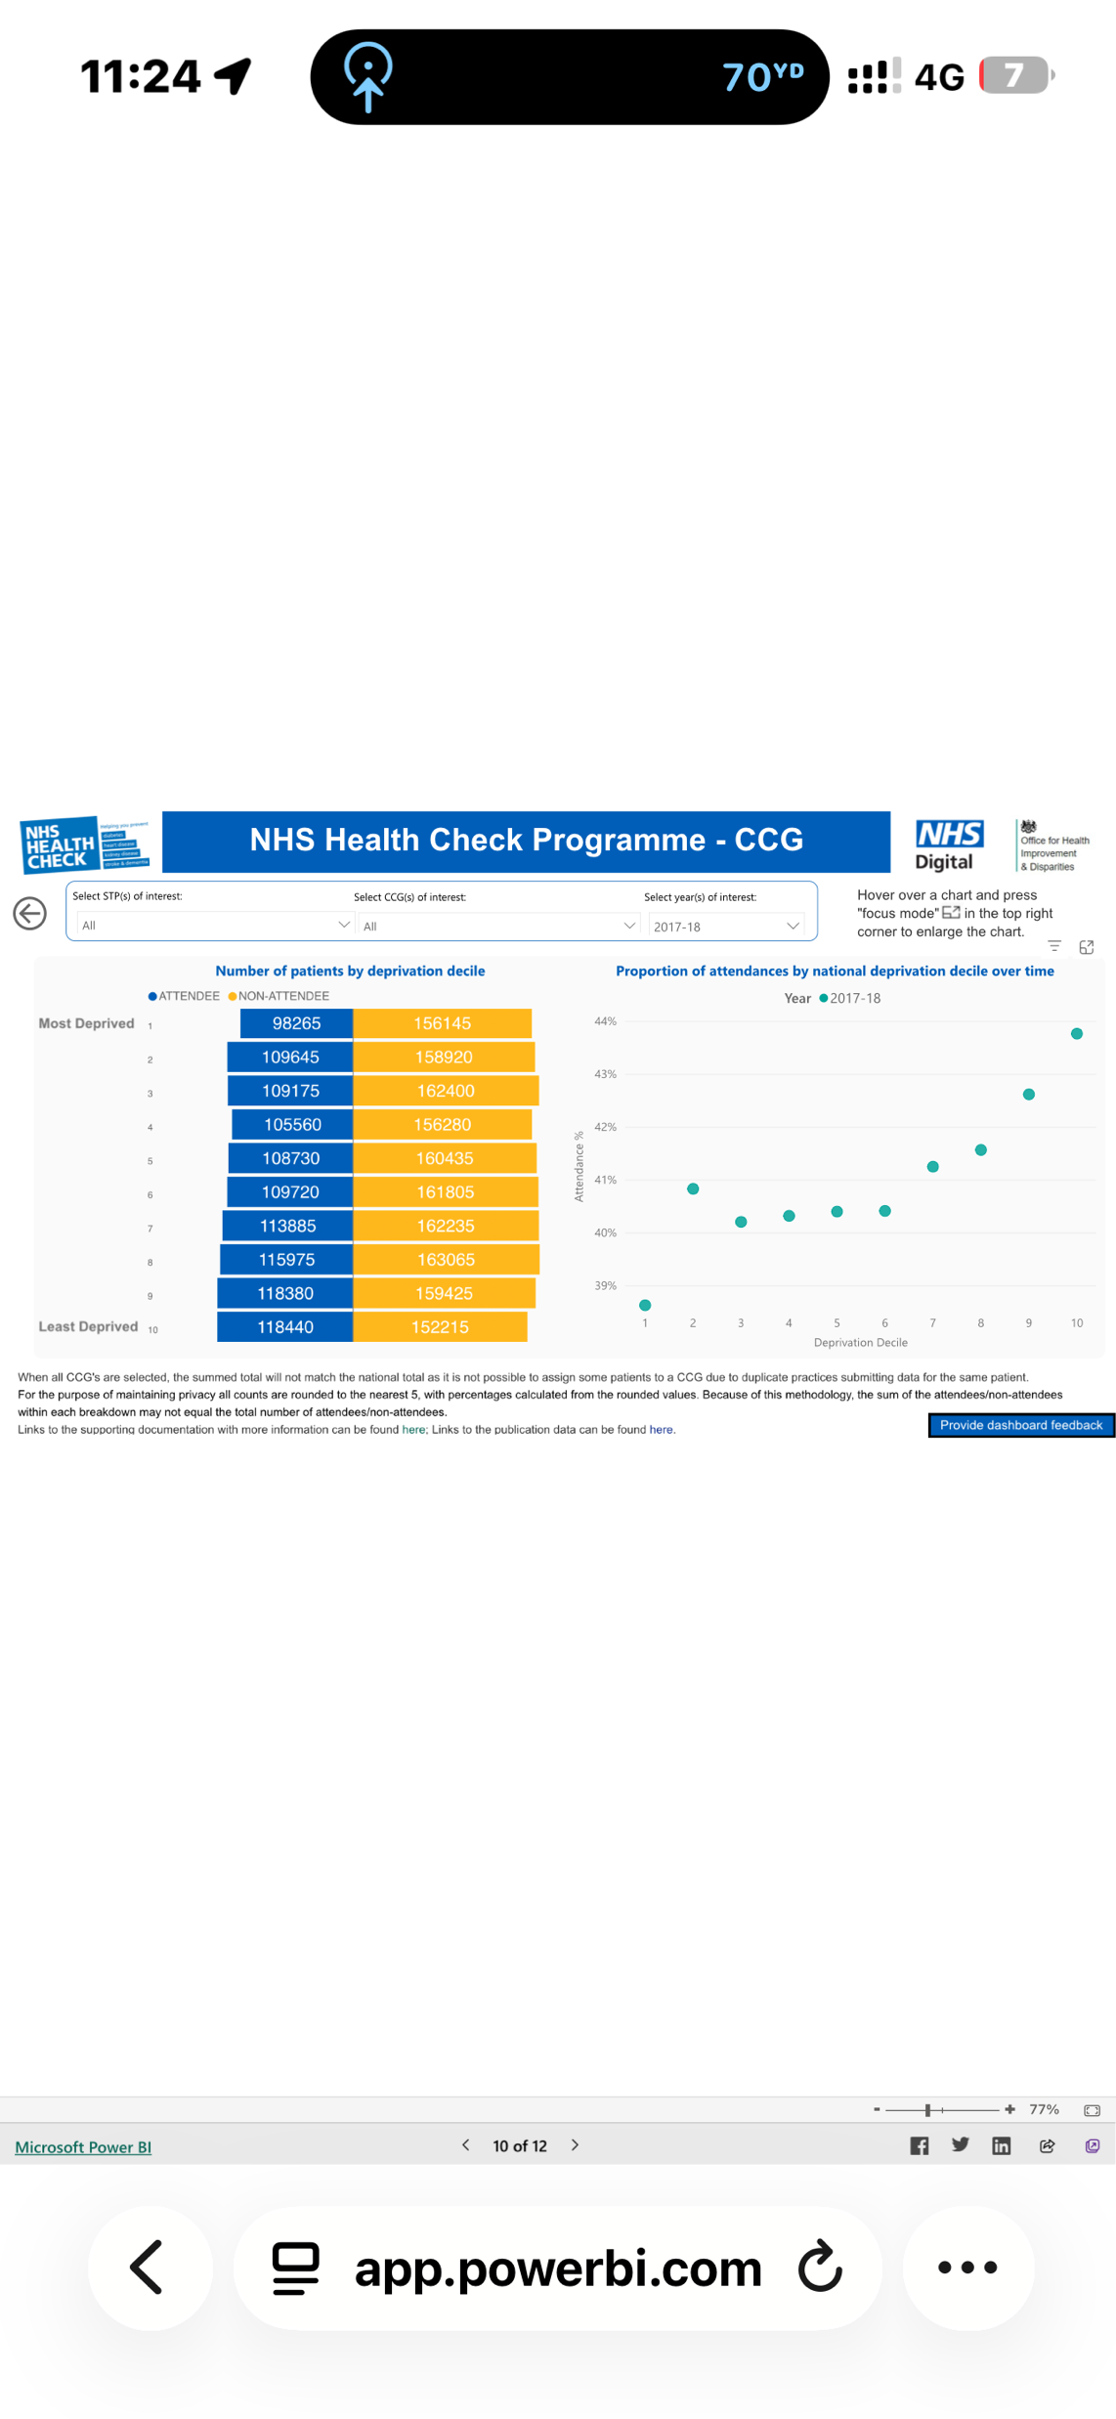
Case studies
Between 2015–2020, 41% of eligible people completed an NHS Health Check (15.7 million eligible; 88% invited; 47% uptake). Completion varied widely across local authorities (10%–80%). People in the most deprived areas have lower attendance rate, yet are more likely to have a >20% 10-year CVD risk detected (UK Government, 2021).
Long-term follow-up shows NHS Health Check recipients had a 23% lower risk of cardiovascular and all-cause mortality, a 15% lower risk of myocardial infarction, a 19% lower risk of dementia, and a 44% lower risk of liver cirrhosis compared to non-attenders (McCracken et al., 2024).
The NHS Health Check is a national prevention programme targeting adults aged 40–74 or at risk of health conditions, aligning with SDG 3 through early detection and risk reduction (NHS, 2023).
The NHS Health Check programme (NHS, 2023) operationalises the NHS Long Term Plan’s prevention and population health agenda (UK Government, 2019) and supports Core20PLUS5 priorities, enabled by the Health and Care Act 2022, by shifting focus from acute treatment towards early identification and risk reduction in high-risk populations (NHS England, 2026c; UK Government, 2022)
However, uptake is lower among men and varies significantly by region and level of deprivation (Eberhardt et al., 2025; UK Government, 2021), highlighting persistent challenges in achieving SDG 10, despite alignment with Core20PLUS5 inequality priorities (UN, 2026; NHS England, 2026c).
(NHS England Digital, 2021)
(UK Government, 2018)

Slide 9
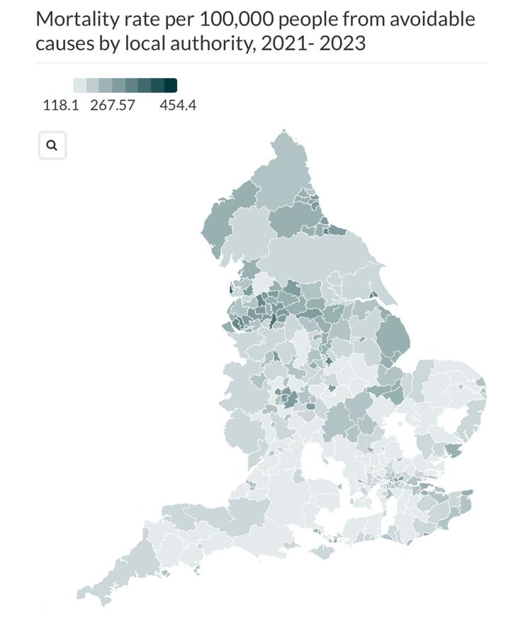
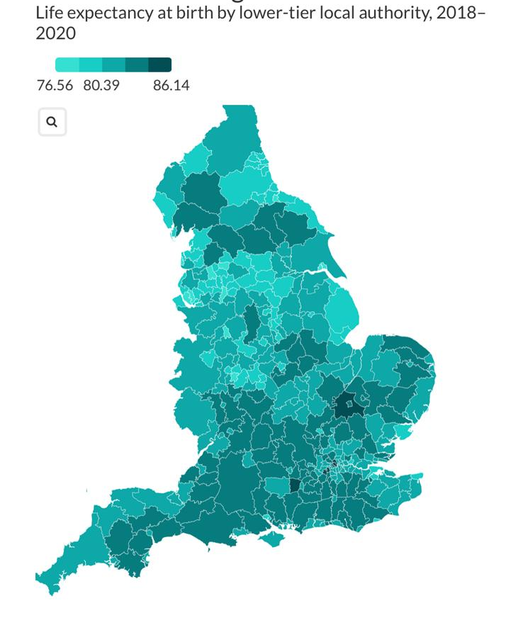
Access and Equity
Prevention uptake is socially patterned, shaped by deprivation, ethnicity, gender and awareness (Eberhardt et al., 2025; UK Government, 2021; Chatzi et al., 2023)
Evidence from the NHS Diabetes Prevention Programme and NHS Health Check demonstrates lower uptake among disadvantaged groups, limiting progress towards SDG 10 despite alignment with SDG 3 Eberhardt et al., 2025; UK Government, 2021; Chatzi et al., 2023).
Core20PLUS5 seeks to address these disparities; however, variable local implementation and resource constraints continue to shape unequal access (Anderson et al., 2021).
Without addressing structural barriers, prevention initiatives risk improving overall population health while widening relative inequalities (Anderson et al., 2021; Chatzi et al., 2023; Eberhardt et al., 2025).
(King’s Fund, 2025)
(King’s Fund, 2024)

Slide 10

Conclusion
This presentation has demonstrated that UK health and social care policy aligns with SDG 3 through prevention-focused programmes such as the NHS Health Check and the NHS Diabetes Prevention Programme (UK Government, 2019; NHS England, 2026e; United Nations, 2026).
However, evidence suggests that prevention initiatives can risk widening inequalities if structural determinants are not fully addressed (Chatzi et al., 2023; Ravindrarajah et al., 2023). Persistent socioeconomic and regional disparities remain evident in deprivation data and health inequality analyses (UK Government, 2025; King’s Fund, 2024).
Research highlights that uptake of NHS Health Checks and prevention services varies by deprivation and ethnicity (Eberhardt et al., 2025; Stone et al., 2019; Gidlow et al., 2019), despite evidence that attendance is associated with improved health outcomes (McCracken et al., 2024).
Theoretical models indicate that health is shaped by both individual behavioural factors and wider social and ecological determinants (Engel, 2012; McLeroy et al., 1988). Therefore, reducing inequalities requires system-level approaches embedded within policy implementation (Alderwick, Hutchings and Mays, 2024; Clark et al., 2024).

Slide 11
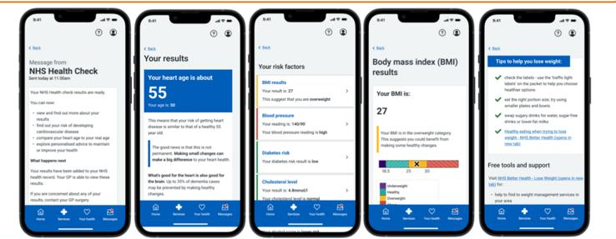

Recommendations
Telephone invitations significantly increase NHS Health Check uptake compared with standard letters (Gidlow et al., 2019).
Telephone outreach can improve engagement in deprived and minority ethnic communities (Stone et al., 2019; Brangan et al., 2018).
Cultural and language matching between outreach workers and patients enhances trust and communication (Brangan et al., 2018; Stone et al., 2019).
Targeted outreach supports more equitable access to prevention services (Stone et al., 2019).
Risk-personalised letters provide modest improvements over standard letters (Gidlow et al., 2019).
Effective implementation requires integration within primary care systems and clear role definition (Stone et al., 2019).
Adequate funding, workforce capacity and long-term planning are essential for sustainable prevention delivery (Anderson et al., 2021).
(NHS Health Check, 2025)

Slide 12
References
Alderwick, H., Hutchings, A. and Mays, N. (2024) ‘Solving poverty or tackling healthcare inequalities? Qualitative study exploring local interpretations of national policy on health inequalities under new NHS reforms in England’, BMJ Open, 14(4). Available at: https://doi.org/10.1136/bmjopen-2023-081954.
Anderson, M., O’Neill, C., Macleod Clark, J., Street, A., Woods, M., Johnston-Webber, C., Charlesworth, A., Whyte, M., Foster, M., Majeed, A., Pitchforth, E., Mossialos, E., Asaria, M. and McGuire, A. (2021) ‘Securing a sustainable and fit-for-purpose UK health and care workforce’, The Lancet, 397(10288), pp. 1992–2011. Available at: https://doi.org/10.1016/S0140-6736(21)00231-2
Armitage, R. (2023) ‘The WHO’s definition of health: a baby to be retrieved from the bathwater?’, British Journal of General Practice, 73(727), pp. 70–71. Available at: https://doi.org/10.3399/bjgp23X731841.
Brangan, E., Stone, T.J., Chappell, A., Harrison, V. and Horwood, J. (2019) ‘Patient experiences of telephone outreach to enhance uptake of NHS Health Checks in more deprived communities and minority ethnic groups: A qualitative interview study’, Health Expectations, 22(3), pp. 364–372. Available at: https://doi.org/10.1111/hex.12856
Chatzi, G., Whittaker, W., Chandola, T., Mason, T., Soiland-Reyes, C., Sutton, M. and Bower, P. (2023) ‘Could diabetes prevention programmes result in the widening of sociodemographic inequalities in type 2 diabetes? Comparison of survey and administrative data for England’, Journal of Epidemiology & Community Health, 77(9), pp. 565–570. Available at: https://doi.org/10.1136/jech-2022-219654.
Clark, C., McSweeney, L., Lally, J. and Sowden, S. (2024) ‘How can health systems approach reducing health inequalities? An in-depth qualitative case study in the UK’, BMC Public Health, 24(2168). Available at: https://doi.org/10.1186/s12889-024-19531-5.
Coroiu, A., Moran, C., Campbell, T. and Geller, A.C. (2020) ‘Barriers and facilitators of adherence to social distancing recommendations during COVID-19 among a large international sample of adults’, PLoS ONE, 15(10). Available at: https://doi.org/10.1371/journal.pone.0239795.
Diabetes UK (2026) Tackling inequity strategy. Available at: https://www.diabetes.org.uk/about-us/our-impact/tackling-inequity-strategy (Accessed: 14 February 2026).
Eberhardt, J., Kane, L., Portman, R., Ling, J., Goddard, T., Johnston, M., Robinson, C., Reay, A., Divers, A. and Newbury-Birch, D. (2025) ‘Barriers and facilitators of NHS Health Checks in socioeconomically deprived communities in the North East of England: A qualitative study with peer researchers’, Health Expectations, 28(2). Available at: https://doi.org/10.1111/hex.70199.

Slide 13
References
Elliott, H., Tozer, C., Fenton, A., Powers, C., Lines, C., Hill, M., Owolabi, B. and Ford, J.A. (2025) ‘From policy to action: a document content analysis reviewing the adoption of the healthcare inequalities programme in local health system plans in England’, BMJ Open, 15(10). Available at: https://doi.org/10.1136/bmjopen-2025-102163 (Accessed: 14 February 2026).
Engel, G.L. (2012) ‘The Need for a New Medical Model: A Challenge for Biomedicine’, Psychodynamic Psychiatry, 40(3), pp. 377–396. Available at: https://www.proquest.com/docview/1041810547?accountid=130472&parentSessionId=BXynSiCY4TcgNkc%2FqqLSnmEqoI%2FLh0tWTmyIF0EMmt8%3D&pq-origsite=primo&sourcetype=Scholarly%20Journals (Accessed: 12 February 2026).
Gidlow, C.J., Ellis, N.J., Riley, V., Chadborn, T., Bunten, A., Iqbal, Z., Ahmed, A., Fisher, A., Sugden, D. and Clark-Carter, D. (2019) ‘Randomised controlled trial comparing uptake of NHS Health Check in response to standard letters, risk-personalised letters and telephone invitations’, BMC Public Health, 19(224). Available at: https://doi.org/10.1186/s12889-019-6540-8
Healthier You (2026) Healthier You: NHS Diabetes Prevention Programme. Available at: https://healthieryou.org.uk (Accessed: 14 February 2026).
Huber, M., Knottnerus, J.A., Green, L., van der Horst, H., Jadad, A.R., Kromhout, D., Leonard, B., Lorig, K., Loureiro, M.I., van der Meer, J.W.M., Schnabel, P., Smith, R., van Weel, C. and Smid, H. (2011) ‘How should we define health?’, BMJ, 343. Available at: https://doi.org/10.1136/bmj.d4163.
King’s Fund (2024) Health inequalities in a nutshell. Available at: https://www.kingsfund.org.uk/insight-and-analysis/data-and-charts/health-inequalities-nutshell (Accessed: 14 February 2026).
King’s Fund (2025) What are health inequalities?. Available at: https://www.kingsfund.org.uk/insight-and-analysis/long-reads/what-are-health-inequalities (Accessed: 14 February 2026).
Kwint, J. (2022) ‘Diabetes: putting people at the heart of services’, Diabetes, Metabolics and Hormones. Available at: https://doi.org/10.3310/nihrevidence_52026.
McCracken, C., Raisi-Estabragh, Z., Szabo, L., Robson, J., Raman, B., Topiwala, A., Roca-Fernández, A., Husain, M., Petersen, S.E., Neubauer, S. and Nichols, T.E. (2024) ‘NHS Health Check attendance is associated with reduced multiorgan disease risk: a matched cohort study in the UK Biobank’, BMC Medicine, 22(1). Available at: https://doi.org/10.1186/s12916-023-03187-w.

Slide 14
References
McLeroy, K.R., Bibeau, D., Steckler, A. and Glanz, K. (1988) ‘An Ecological Perspective on Health Promotion Programs’, Health Education Quarterly, 15(4), pp. 351–377. Available at: https://www.jstor.org/stable/45049276 (Accessed: 12 February 2026).
NHS (2023) NHS Health Check. Available at: https://www.nhs.uk/tests-and-treatments/nhs-health-check/ (Accessed: 14 February 2026).
NHS Digital (2022) Health Survey England Additional Analyses, Ethnicity and Health, 2011–2019: Experimental statistics. Available at: https://digital.nhs.uk/data-and-information/publications/statistical/health-survey-england-additional-analyses/ethnicity-and-health-2011-2019-experimental-statistics/wellbeing-copy (Accessed: 14 February 2026).
NHS England (2023) Supported self-management: peer support guide. Available at: https://www.england.nhs.uk/long-read/peer-support/ (Accessed: 14 February 2026).
NHS England (2026a) About the prevention programme. Available at: https://www.england.nhs.uk/ourwork/prevention/about-prevention-programme/ (Accessed: 14 February 2026).
NHS England (2026b) Consultant-led Referral to Treatment Waiting Times Data 2024-25. Available at: https://www.england.nhs.uk/statistics/statistical-work-areas/rtt-waiting-times/rtt-data-2024-25/ (Accessed: 14 February 2026).
NHS England (2026c) Core20PLUS5 (adults) – an approach to reducing healthcare inequalities. Available at: https://www.england.nhs.uk/about/equality/equality-hub/national-healthcare-inequalities-improvement-programme/core20plus5/ (Accessed: 14 February 2026).
NHS England (2026d) Performance report. Available at: https://www.england.nhs.uk/long-read/performance-report-24-25/ (Accessed: 14 February 2026).
NHS England (2026e) NHS Diabetes Prevention Programme (NHS DPP). Available at: https://www.england.nhs.uk/diabetes/diabetes-prevention/ (Accessed: 14 February 2026).
NHS England Digital (2021) NHS Health Check programme. Available at: https://digital.nhs.uk/data-and-information/data-tools-and-services/data-services/general-practice-data-hub/nhs-health-check-programme (Accessed: 14 February 2026).
NHS Health Check (2025) Overview of the NHS Health Check Online. Available at: https://www.healthcheck.nhs.uk/seecmsfile/?id=2634 (Accessed: 14 February 2026).
Office for National Statistics (2025) UK Measures of National Well-being Dashboard: an overview of well-being in the UK on an individual, community and national level. Available at: https://www.ons.gov.uk/peoplepopulationandcommunity/wellbeing/articles/ukmeasuresofnationalwellbeing/dashboard (Accessed: 14 February 2026).

Slide 15
References
Olivera, J.N., Ford, J., Sowden, S. and Bambra, C. (2022) ‘Conceptualisation of health inequalities by local healthcare systems: A document analysis’, Health & Social Care in the Community, 30(6), pp. e3977–e3984. Available at: https://doi.org/10.1111/hsc.13791.
Ong, Z.X., Dowthwaite, L., Perez Vallejos, E., Rawsthorne, M. and Long, Y. (2021) ‘Measuring online wellbeing: a scoping review of subjective wellbeing measures’, Frontiers in Psychology, 12. Available at: https://doi.org/10.3389/fpsyg.2021.616637
Parkinson, B., Cullum, N., Sutton, M., Checkland, K., Bower, P., Bramwell, D. and Meacock, R. (2024) ‘Regional variation in the community nursing and support workforce in England: A longitudinal analysis 2010–2021’, Journal of Nursing Management. Available at: https://doi.org/10.1155/2024/7513374
Ravindrarajah, R., Sutton, M., Reeves, D., Cotterill, S., McManus, E., Meacock, R., Whittaker, W., Soiland-Reyes, C., Heller, S., Bower, P. and Kontopantelis, E. (2023) ‘Referral to the NHS Diabetes Prevention Programme and conversion from nondiabetic hyperglycaemia to type 2 diabetes mellitus in England: A matched cohort analysis’, PLOS Medicine, 20(2). Available at: https://doi.org/10.1371/journal.pmed.1004177.
Reed, S., Oung, C., Davies, J., Dayan, M. and Scobie, S. (2021) Integrating health and social care: A comparison of policy and progress across the four countries of the UK. Available at: https://www.nuffieldtrust.org.uk/research/integrating-health-and-social-care-a-comparison-of-policy-and-progress-across-the-four-countries-of-the-uk (Accessed: 14 February 2026).
Stone, T.J., Brangan, E., Chappell, A., Harrison, V. and Horwood, J. (2019) ‘Telephone outreach by community workers to improve uptake of NHS Health Checks in more deprived localities and minority ethnic groups: a qualitative investigation of implementation’, Journal of Public Health, 42(8). Available at: https://doi.org/10.1093/pubmed/fdz063.
Sustainable Development Report (2026) United Kingdom. Available at: https://dashboards.sdgindex.org/profiles/united-kingdom/ (Accessed: 14 February 2026).
UK Government (2018) Health matters: preventing Type 2 diabetes. Available at: https://www.gov.uk/government/publications/health-matters-preventing-type-2-diabetes/health-matters-preventing-type-2-diabetes (Accessed: 14 February 2026).
UK Government (2019) NHS Long Term Plan. Available at: https://www.gov.uk/government/publications/10-year-health-plan-for-england-fit-for-the-future (Accessed: 14 February 2026).

Slide 16
References
UK Government (2021) Annex B: a summary of analyses and evidence on the current NHS Health Check programme. Available at: https://www.gov.uk/government/publications/nhs-health-check-programme-review/annex-b-a-summary-of-analyses-and-evidence-on-the-current-nhs-health-check-programme (Accessed: 12 February 2026).
UK Government (2022) Health and Care Act 2022. Available at: https://www.legislation.gov.uk/ukpga/2022/31/contents (Accessed: 14 February 2026).
UK Government (2025) English indices of deprivation 2025: statistical release. Available at: https://www.gov.uk/government/statistics/english-indices-of-deprivation-2025/english-indices-of-deprivation-2025-statistical-release (Accessed: 14 February 2026).
United Nations (2023) What is sustainable development?. Available at: https://www.un.org/sustainabledevelopment/blog/2023/08/what-is-sustainable-development/ (Accessed: 14 February 2026).
United Nations (2026) 17 Goals to Transform Our World. Available at: https://www.un.org/sustainabledevelopment/ (Accessed: 14 February 2026).
World Health Organization (2026) Constitution. Available at: https://www.who.int/about/governance/constitution (Accessed: 14 February 2026).

