Slide 1
Wellbeing
Claire Thomson Student No: 1603261

Slide 2
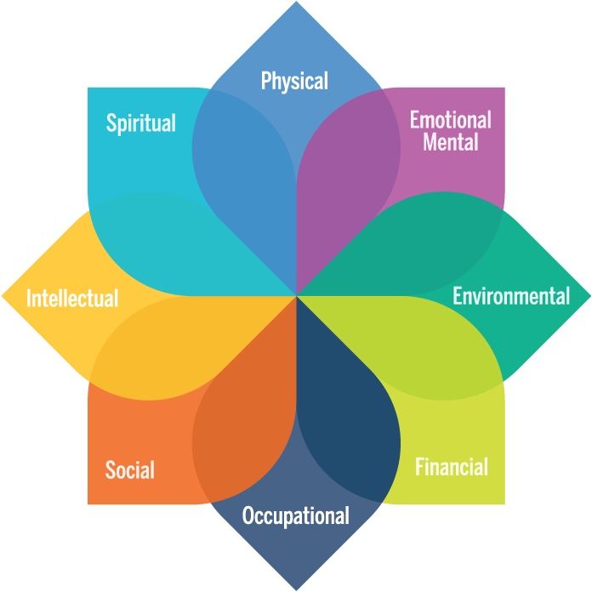
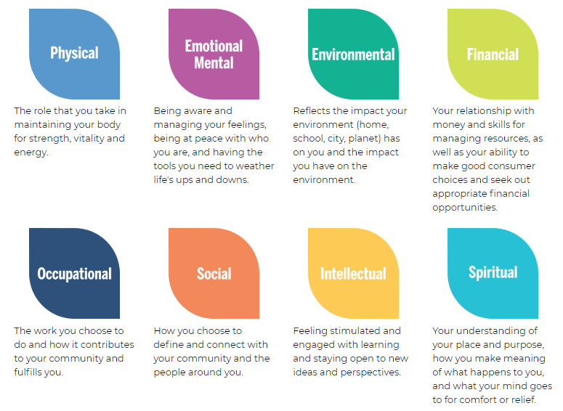
What is Wellbeing?
“a state of well-being in which every individual realizes his or her own potential, can cope with the normal stresses of life, can work productively and fruitfully, and is able to make a contribution to her or his community” (WHO, 2019)
(Michigan University, 2019)

Slide 3
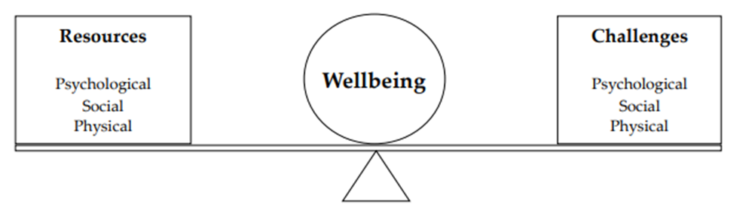
Theories of Wellbeing
(Dodge et al, 2012)
Wellbeing is dynamic and can change over time influenced by outside events. There is a set point for wellbeing but can fluctuate between challenges and resources.
“Stable wellbeing is when people have the psychological, social and physical resources they need to meet a particular psychological, social and/or physical challenge”.
When individuals have more challenges than resources, the see-saw dips, along with their wellbeing, and vice-versa.

Slide 4

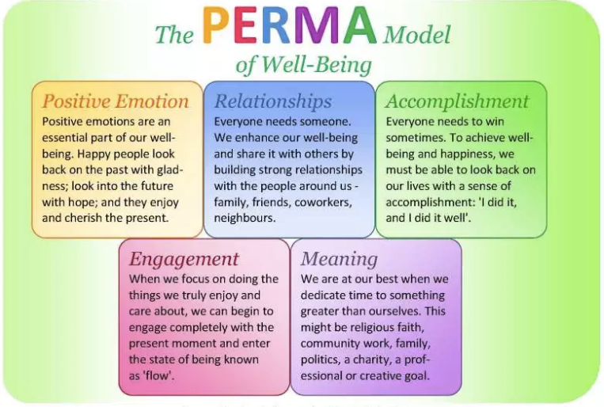
Theories of Wellbeing
Models of wellbeing are often complex and difficult to follow.
(Steve Scott, 2018; Seligman, 2012)
(PERMAculture, 2019, Scott, 2018)

Slide 5
UK Wellbeing Policy
UK wide: Localism Act 2011, Education Act 2011 and The Social Action, Responsibility and Heroism Act 2015.
England: The Care Act (England) 2014 and The Health and Social Care Act 2012
Introduction of Health and Wellbeing Boards in LA’s across England in 2013.
Scotland: Scotland Performs and Community Empowerment Act (Scotland) 2015.
Wales: Social Services and Well-being (Wales) Act, 2014 , The Well-being of Future Generations (Wales) Act 2015.
All of these legislation place responsibility on the public sector to consider and provide for the wellbeing of citizens.
It presents opportunities across the board, for policy makers, purchasers and providers of services at all levels.
(WhatWorksWellbeing, 2015)

Slide 6
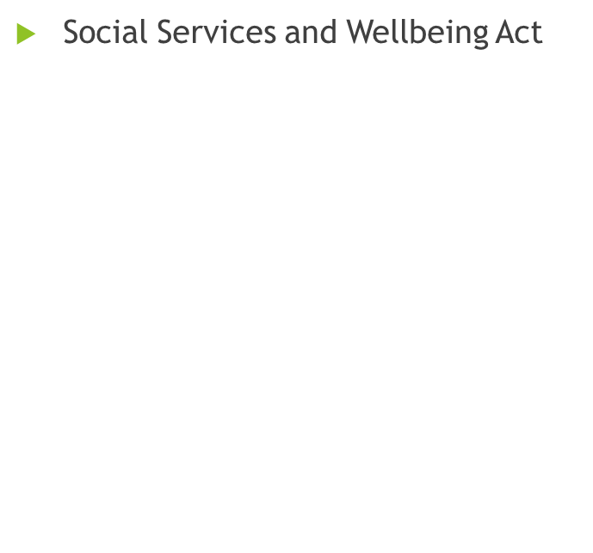
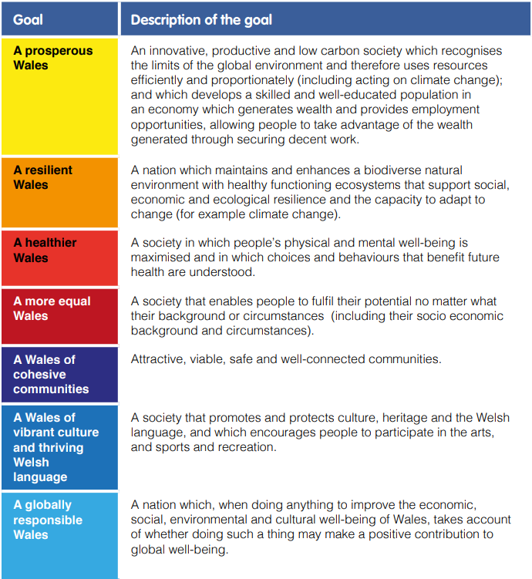
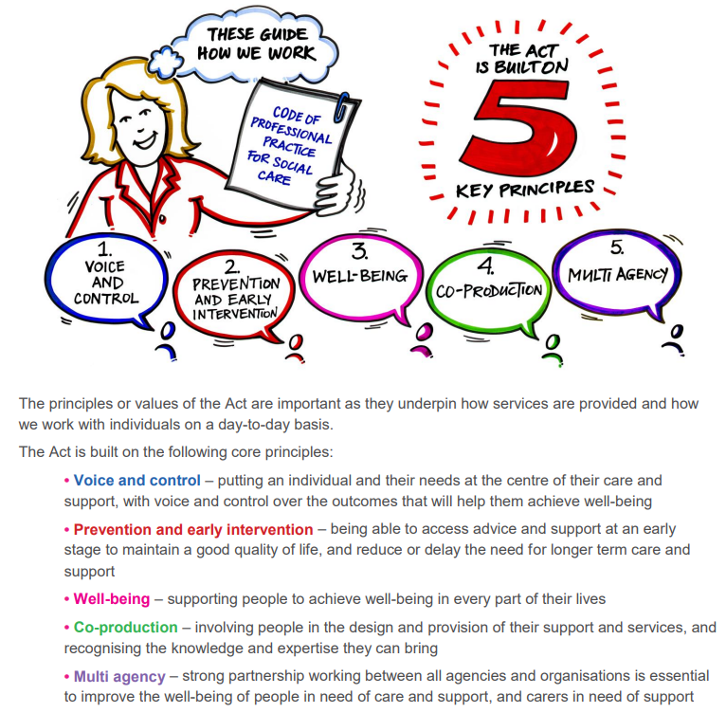
Wales Policy for Wellbeing
The Wellbeing of Future Generations(Wales) Act (2015)
(Wales.Gov.UK, 2015)
(Social Care Wales, 2018)

Slide 7
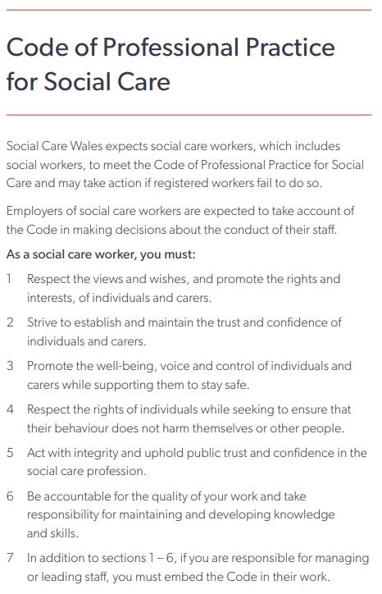
Wellbeing in Practice
You have a responsibility to promote the wellbeing of individuals and carers.
Care Act 2014 introduced the promotion of individual wellbeing as a duty for workers.
(Social Care Wales, 2017)

Slide 8

Social Work move away from relationship based work in the 80’s and 90’s
Social work practice is rooted in the belief that people want to experience a sense of belonging and inclusion and that those feelings are central to people’s wellbeing.
Community social work was once a mainstream part of social workers’ training and role description.
1990’s - Modern pressures of the job pushed social work towards form filling and bureaucracy – ruining relationships between social workers and individuals who need help and support
Social work became processing of individuals.
00’s saw growth of person-centred planning but still concentrated on needs assessment.
(T.L.A.P.,2016)

Slide 9
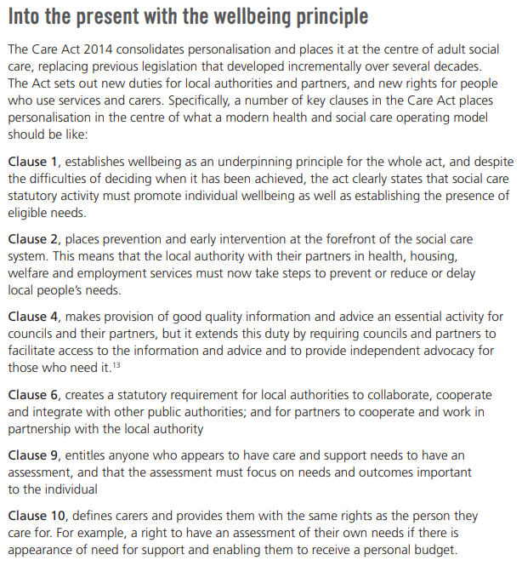
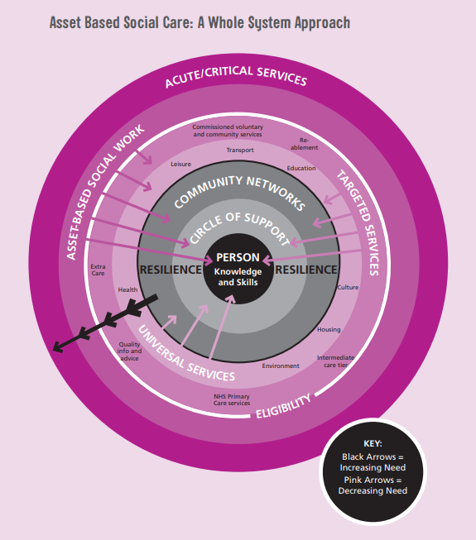
DEVELOPING A WELLBEING AND STRENGTHS-BASED APPROACH TO SOCIAL WORK PRACTICE
“If social work policy and practice were directed more to the support and strengthening of informal networks, to caring for the carers and less to the rescue of casualties when networks fail, it is likely that the need for such referrals would be reduced” (Barclay, 1982).

Slide 10
References
Barclay, L., (1982). The Barclay Report: Social Workers, their Roles and Tasks.
Dodge, R., Daly, A., Huyton, J., & Sanders, L. (2012). The challenge of defining wellbeing. International Journal of Wellbeing, 2(3), 222-235. doi:10.5502/ijw.v2i3.4
Michigan University (2019). What is Well-being? | Well-being. [online] Wellbeing.studentlife.umich.edu. Available at: https://wellbeing.studentlife.umich.edu/what-well-being [Accessed 18 Jun. 2019].
PERMAculture (2019). Welcome to PERMAculture. [online] P.E.R.M.Aculture. Available at: https://permastuff.wordpress.com/about/ [Accessed 14 Jun. 2019].
Scott, S. (2018). How to be Happy. [online] Happier Human. Available at: https://www.happierhuman.com/book-review-flourishing/ [Accessed 14 Jun. 2019].
Seligman, M.E., (2012). Flourish: A visionary new understanding of happiness and well-being. Simon and Schuster.
Social Care Wales (2017). The social worker- Practice guidance for social workers registered with Social Care Wales. [online] Socialcare.wales. Available at: https://socialcare.wales/cms_assets/file-uploads/The-social-worker-April-2017.pdf [Accessed 18 Jun. 2019].
Social Care Wales (2018). What does the Act mean for me? A learning resource for direct care and support workers about the Social Services and Well-being (Wales) Act 2014. [online] Socialcare.wales. Available at: https://socialcare.wales/cms_assets/hub-downloads/Workbook-What-does-the-Act-mean-for-me.pdf [Accessed 14 Jun. 2019].
T.L.A.P., (2016). Developing a Well-Being and Strengths Based Approach to Social Work Practice. [online] www.thinklocalactpersonal.org.uk Available at: https://www.thinklocalactpersonal.org.uk/_assets/Resources/TLAP/BCC/TLAPChangingSWCulture.pdf [Accessed 16 Jun. 2019].
Wales.Gov.UK (2015). Well-being of Future Generations (Wales) Act 2015. [online] Legislation.gov.uk. Available at: http://www.legislation.gov.uk/anaw/2015/2/contents/enacted [Accessed 14 Jun. 2019].
WhatWorksWellbeing (2015). Wellbeing in UK legislation | What Works Centre for Wellbeing. [online] Whatworkswellbeing.org. Available at: https://whatworkswellbeing.org/case-study/wellbeing-in-uk-legislation/ [Accessed 14 Jun. 2019].
Who.int. (2019). WHO | Mental health: a state of well-being. [online] Available at: https://www.who.int/features/factfiles/mental_health/en/ [Accessed 5 Jun. 2019].

