Slide 1
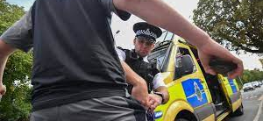

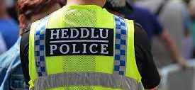
Response Policing
Lecture 4:
Police & Criminal Evidence Act 1984
Section 1. Stop & Search

Slide 2
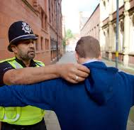
Learning Outcomes
Lecture & Workshop
Describe stop and search as stipulated by Section 1 of PACE 1984 Stop and Search and the individual meaning of the elements within the definition.
Outline the importance of employing an ethical, fair and effective use of stop and search in line with the, “Best Use of Stop and Search,” “HMIC Stop & Search Powers: Are the Police using them effectively and fairly?”and the College of Policing guidelines.
Identify appropriate circumstances of when to conduct a stop and search.
Explain the information that must be provided prior to a stop and search taking place.
Describe the limitations of a search when conducting one in both a public and private place.

Slide 3
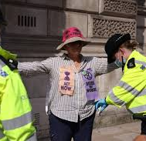
Learning Outcomes
Lecture & Workshop
Identify what constitutes, “reasonable grounds” and other options available if reasonable grounds do not exist.
Identify how conscious/unconscious bias can impact on a stop and search.
Explain how to deal with a young person during a search and identify any vulnerabilities.
Outline the procedure to be carried out post search including the recording of information.
Outline other search powers as stipulated by S60/60AA of the Criminal Justice and Public Order Act 1994 and S47A of the Terrorism Act 2000
Practice a stop and search during the workshop

Slide 4
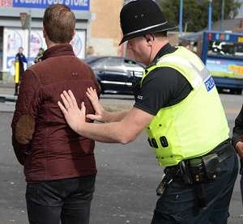
Discuss: Why do Police Officers use stop and search powers?
Code A
Section 1 Police and Criminal Evidence Act 1984
Why?
Before they have been arrested
To enable officers to allay or confirm suspicions about individuals
Without exercising their power of arrest to do so.

Slide 5
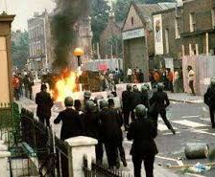
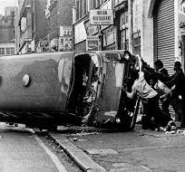
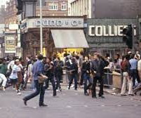

What do you already know?
The background to PACE 1984?
Past events and how they’ve influence stop & search powers?

Slide 6
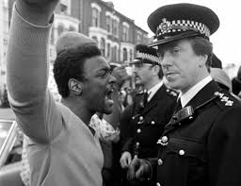
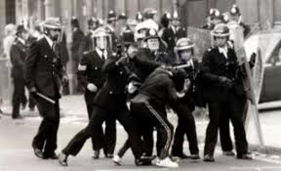
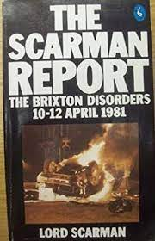
1981 Brixton Riots
&
PACE 1984
Met Police used S & S powers in Operation ‘SWAMP’ in Brixton in 1981 to target street crime
Between 10th & 11th April Brixton Riots
25th Nov 1981 Lord Scarman Report – critical of the disproportionate & indiscriminate use of S & S
1984 PACE introduced

Slide 7

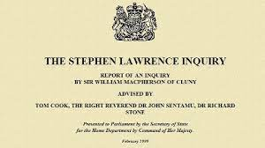

Rec 60 : S & S powers should remain
Rec 61: a record must be made of all S & S and a copy must be given to the person stopped
Rec 62: search records should be monitored & the information should be analysed & published
Rec 63: the police Authorities have a duty to raise public awareness on S & S

Slide 8
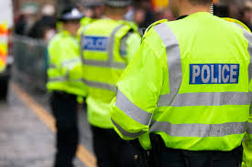
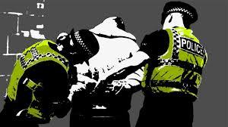
Current Stop & Search Powers
There are 20 different Sections from 16 different Acts
PACE provides statutory guidance
In most cases an officer must have reasonable grounds for suspicion
There must be some objective basis for suspicion based on facts
Officers cannot use ethnicity to help form their grounds for suspicion

Slide 9

Section 1 PACE 1984 Stop & Search
What things do you think are included in the definition of stop and search?

Slide 10


Section 1 PACE
A police constable may detain any person or vehicle or anything which is in or on a vehicle, in any place to which the public has access
If he or she has reasonable grounds for suspecting that stolen or prohibited articles, prohibited fireworks or bladed or sharply pointed articles will be found
Any such article found during a search may be seized

Slide 11
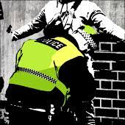
Detain
“detain powers allow Constables to hold people to carry out a procedure…”

Slide 12


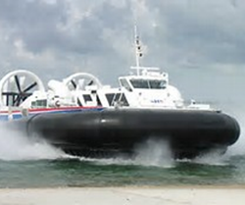
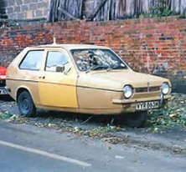
Vehicle
…a means of conveyance, usually with wheels, for transporting people, goods etc such as a car, cart, truck, carriage, sledge etc.
Any means of carriage or transport (includes vessels, aircraft and hovercraft)

Slide 13
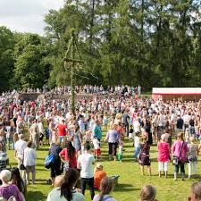

Any Place to which the Public have Access
Any public place or place which the public have permission to be there through payment or otherwise
Includes places to which only a section of the public would have access
Does not include their dwelling or one which they have expressed or implied permission by the person that resides there

Slide 14
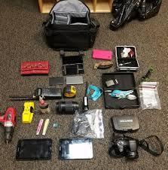
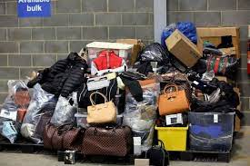
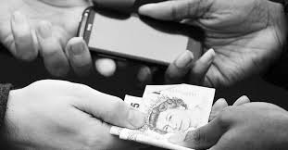
Stolen Items
Any item obtained dishonestly from another.
Any item which directly or indirectly represent a stolen item (includes the proceeds of stolen goods)

Slide 15
Prohibited Articles
Any offensive weapon:
Made
Adapted
Intended

Slide 16


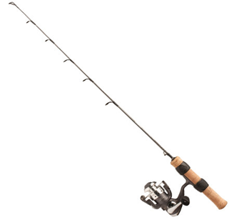

Prohibited Articles
Or, any article made or adapted for use in the course of or in connection with:
Burglary, Theft, TWOC, Fraud, Criminal Damage
Or intended by the person having it with them for such use by them, or some other person

Slide 17



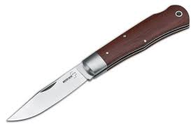
Section 1 PACE 1984
Bladed or sharply pointed article or
prohibited firework
Any such article found during a search may be seized

Slide 18


‘Reasonable Grounds’ – What does it mean to you?
Know
Believe
Suspect
Learn: B A I T K

Slide 19
Code A of PACE
states reasonable grounds for suspicion could be based on:
Behaviour of the person or those with him or her
Article suspected of being carried
Intelligence accurate & current
Time & place where the person or vehicle is
Knowledge - something you have been told by someone else (police colleague – witness – or even anonymous information)

Slide 20

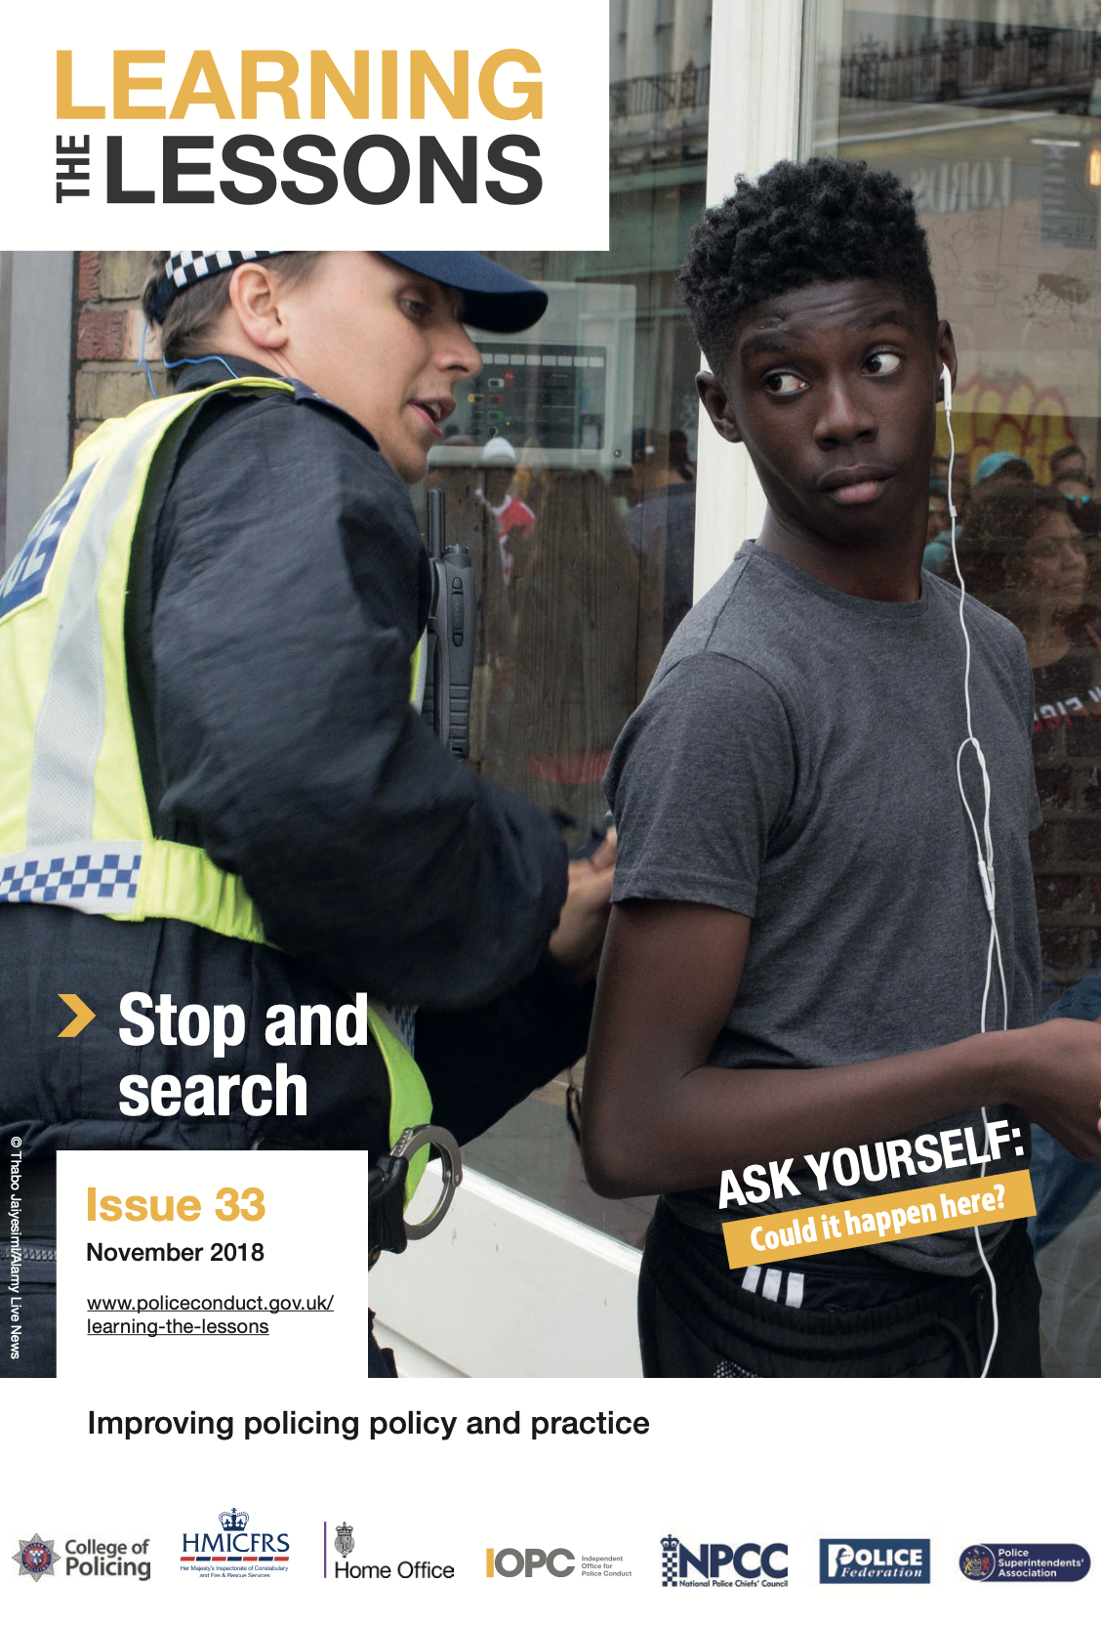
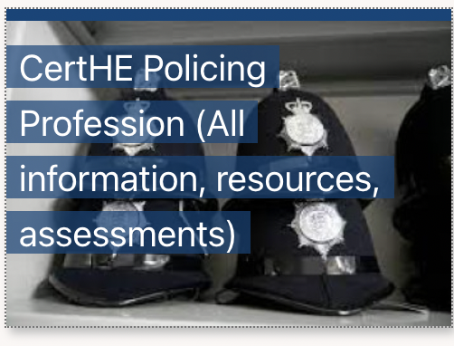
Task
Independent Reading (Week 4)
By Next Thursday’s workshop

