Slide 1
Student Name: Mohammad Ayyaz
Student Number: 2329250
BMHP6029_BIRM – Component 1 – Poster Presentation
Title of Poster: Depression Disorder

Slide 2
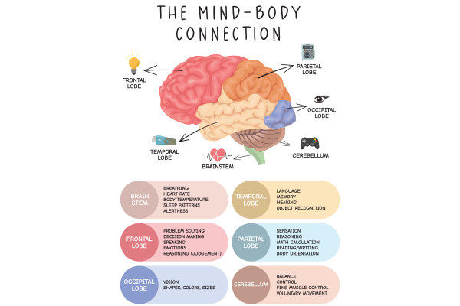
Depression Disorder- ICD-11
  [An overview of depression]
[Historical understanding and treatment]
[Text]
[Text]
Depression is a mental health condition that causes low mood, loss of passion in activities and changes in behaviour (World Health Organization 2019). ICD-11 describes single episode depressive disorder as a condition where a person experiences one depressive episode lasts at least two weeks, with low mood or loss of interest occurring nearly every day (World Health Organization, 2019).
Depression was historically known as melancholia, described by Hippocrates as prolonged sadness caused by an imbalance of “black bile” (Jackson, 1986). During the middle ages, symptoms were often linked to supernatural causes. By 19th-20th century, depression became recognised as a medical condition influenced by psychological factors (Shorter, 1997).
Historical Treatment included institutionalisation, rest cures and experimental biological methods such as insulin coma therapy and early ECT (Shorter, 1997). By the late 20th century, treatment shifted towards evidence based psychological therapies
Depression affects 1 in 6 UK Adults and shows higher rates in young people (NHS England, 2019). It can be mild, moderate or severe and has a major impact on education, work and relationships (NHS ENGLAND, 2019)
UK policy NHS Long Term Plan prioritises early intervention, youth mental health and digital access. Service pressures and long waiting times continue to affect treatment availability (NHS England, 2019)
Contemporary Treatment: Modern treatment include CBT, interpersonal therapy, behavioural activation and antidepressant medication 9NICE, 2022). Digital mental health tools, online CBT, lifestyle changes and social support play key roles (NHS England, 2023)

Slide 3

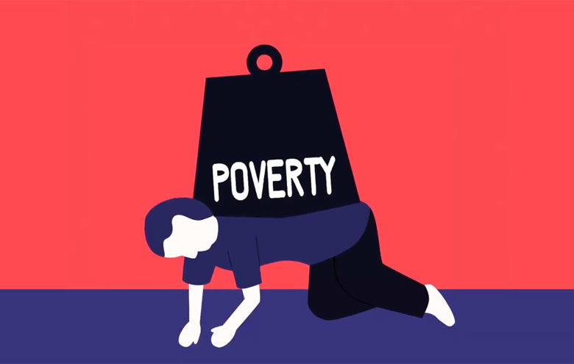
Social, political and cultural influences
Social and factors include: Poverty increases risk Social isolation Family stress (Marmot, 2020). Post COVID rise in depression (Office for national statistics, 2021).
Recommendations
Cultural factors and stigma include: Cultural beliefs shape symptoms Depression seen as “weakness” in some groups Stigma delays help seeking (Corrigan and Watson, 2022). Media portrays influence
Early intervention Better Therapy access Integrated care Anti-stigma work Reduce inequality Community support
Political Factors and inequality: Funding shortages Service inequalities Digital exclusion Government prioritises shape access (Mental Health Foundation, 2023).

Slide 4
Reference List
World Health Organization (2025). Depressive disorder (depression). [online] World Health Organization. Available at: https://www.who.int/news-room/fact-sheets/detail/depression.
‌NHS England (2015). NHS England» Children and young people. [online] England.nhs.uk. Available at: https://www.england.nhs.uk/mental-health/cyp/.
‌Jackson, S.W., 1986. Melancholia and depression: From hippocratic times to modern times. Yale University Press.
Shorter, E., 1998. A History of Psychiatry: From the Era of the Asylum to the Age of Prozac. John Wiley & Sons.
National Institute for Health and Care Excellence (2022). Depression in adults: Treatment and Management. [online] www.nice.org.uk. Available at: https://www.nice.org.uk/guidance/ng222.
NHS England Digital. (2023). Improving Access to Psychological Therapies (IAPT). [online] Available at: https://digital.nhs.uk/services/data-access-request-service-dars/dars-products-and-services/data-set-catalogue/improving-access-to-psychological-therapies-iapt.
‌Marmot, M., 2020. Health equity in England: the Marmot review 10 years on. Bmj, 368.
‌Office for National Statistics (2021). Coronavirus and depression in adults, Great Britain - Office for National Statistics. [online] www.ons.gov.uk. Available at: https://www.ons.gov.uk/peoplepopulationandcommunity/wellbeing/articles/coronavirusanddepressioninadultsgreatbritain/januarytomarch2021.

