Slide 1
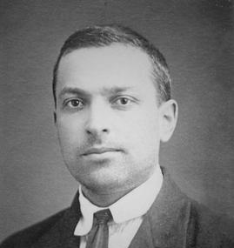
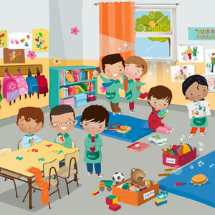
VYGOTSKY’S SOCIAL-CULTURAL THEORY IN A YEAR 1 CLASSROOM
Wikipedia.org (n.d)
Tahlia Morris 2507178
clker.com (n.d)

Slide 2
Vygotsky’s theory
Psychologist Lev Vygotsky’s (1896-1934) work focused on psychology and education. His theory emphasised the role of social interaction in developing children’s learning. (The Voice of Early Childhood, 2025.
Zone of proximal development: The zone of proximal development is what the difference between what a student can do with and without help. Vygotskys understanding of the zone of proximal development is the distance between development independently through problem solving and ability to develop with a more knowledgable other. (Open edu, n.d)
More knowledgable other: Vygotsky believed that learning was a social interaction that could only be done with the guidance of a more knowledgable other. This refers to someone who has more knowledge on the subject than the child. This can be a teacher, student, fellow peer and the internet. (Gowrie NSW)
Scaffolding: Scaffolding is the temporary guidance given to a learner, allowing them to progress through the zone of proximal development. This support is given by a more knowledgable other, such as a teacher, parent or peer. This support is then slowly removed as the learner gains confidence and understanding in the subject. (Simply psychology, 2018)

Slide 3
Its importance in education
How does it support students?
As its centered around social interactions, Vygotsky’s theory encourages communication between students and teachers. (London childcare studies, n.d)
Promotes the development of problem-solving by engaging with tasks that require guided support known as scaffolding.
How does it support teachers?
Allows the teacher adapt learning through scaffolding ensuring each child gets the support to progress within their individual zone of proximal development.
Allows teachers to read down learning into smaller more manageable steps (scaffolding), gradually withdrawing support over time, encouraging independence.

Slide 4

How its used in in literacy
Peer based
A strong reader is paired with a developing reader. Together they use letter blocks to build an decode words, taking it in turn to read aloud and reinforce each others learning.
Teacher based
Teachers introduce phonic sounds such as ‘sh’ models blending it into words for example ‘shout’ using letter cards or phonic games like matching games, until the students are able to read them aloud independently.
(Open university, n.d)

Slide 5

How its used in numeracy
Peer based
A confident student is paired with a less confident student to work together using counting bears. The more confident student groups the bears, helping them recognise patterns and practicing addition and subtraction.
Teacher based
Teacher uses number blocks to demonstrate subtraction by removing blocks from a group while using language such as ‘take away’, then asks the students to try similar problems with guidance before moving them onto more independent work.
(Istock, n.d)

Slide 6
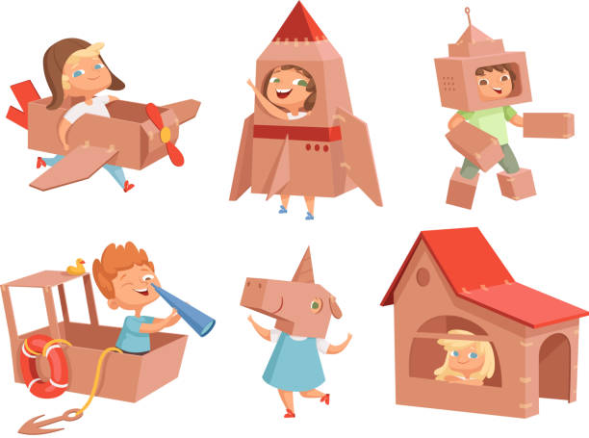
Learning through imaginative play
Peer based
Children engage in role play such as shopkeeping to practice skills like counting money, developing mathematic skills, and expanding their vocabulary through communication.
Teacher based
Teacher hides letter cards around the classroom mimicking a ‘treasure hunt’ and gives the students clues as to where the letter cards are. The students must work together to find the cards that match and then must sound the word. This strengthens teamwork and vocabulary.
(Istock, n.d)

Slide 7
How it aligns with the Welsh Curriculum
The Welsh curriculum emphasises the importance of scaffolding and progression, recognising when students are developmentally ready with the guidance of teachers. This reflects Vygosky’s concept of scaffolding, where the support given to the students enables them to achieve tasks they were unable to achieve independently gradually building their confidence. (Welsh Government, 2015)

Slide 8
Theories limitations in the classroom
Although scaffolding is mentioned in the Welsh curriculum Vygotsky’s theory is not used in active practice it can be linked to many areas of education.
Difficult to measure the zone of proximal development: This can be difficult to measure, meaning teachers may struggle to form scaffolding suitable for individual students needs.
Vygotskys theory relies on a more significant other: Classrooms can get busy and a more significant other such as a teacher may not be able to provide consistent support allowing students to progress through the zone of proximal development effectively.
Too much scaffolding: Teachers providing too much support can create a lack of independence. Teachers must carefully curate scaffolding with the child’s needs in mind, this is not always straightforward.
Limited attention to children’s individual needs: The emphasis that Vygotsky puts on social interactions may be challenged due to students individual needs. Some learners may need far more support from a more significant other, whereas some students may work better individually. (Gowrie NSW, n.d)

Slide 9
Conclusion

Slide 10
Reference list
Clker.com (N.D) ‘clipart: Cartoon Classroom’. Available at https://www.clker.com/clipart-457873.html (Accessed: 25 November 2025)
Wikipedia contributors (N.D) ‘Lev Vygotsky’. Available at https://en.wikipedia.org/wiki/Lev_Vygotsky. (Accessed: 23 November 2025)
The Voice of Early Childhood (2025) ‘An introduction to Lev Vygotsky.’ Written by Celinska. A. Available at https://thevoiceofearlychildhood.com/introduction-lev-vygotsky/ (Accessed: 25 November 2025)

Slide 11
Reference list
Gowrie NSW (N.D) ‘Lev Vygotsky’s Theory of Child Development.’ Available at https://www.gowriensw.com.au/thought-leadership/vygotsky-theory (Accessed: 25 November 2025)
The Open University (N.D) ‘Vygotskian principle on the ZPD and scaffolding.’ Available at https://www.open.edu/openlearncreate/8f/0d/8f0dadc31356b941f01191a927e556a703ca8c89 (Accessed: 25 November 2025)
Simply psychology (2018) ‘Lev Vygotsky’s Socialcultural theory’ Written by McLoed. S Available at https://www.simplypsychology.org/zone-of-proximal-development.html (Accessed: 25 November 2025)

Slide 12
Reference list
London childcare studies (N.D) ‘The Lev Vygotsky Education approach’ Available at: https://childcarestudies.co.uk/blog/the-lev-vygotsky-education-approach/ (Accessed: 25 November 2025)
Open University (N.D) ‘Digital and information literacy.’ Available at: https://university.open.ac.uk/library/services-for-staff/digital-and-information-literacy (Accessed: 26 November 2025)
Istock (N.D) ‘Math tree’ Available at: https://www.istockphoto.com/illustrations/math-tree (Accessed 26 November 2025)

Slide 13
Reference list
Welsh Government (2015) ‘Foundation Phase Framework.’ Available at: https://hwb.gov.wales/storage/d5d8e39c-b534-40cb-a3f5-7e2e126d8077/foundation-phase-framework.pdf (Accessed 26 November 2025)

