Slide 1

Digital Skills and Research Methods
LCHS4007
Assessment 1:
Group 7 Presentation
Programme: Certificate of Higher Education in Health and Social Care
Lecturer Name:
Dr Md Sadeque Shaikh

Slide 2
Case Study:
Greenfield Home Care Agency
Student Name | Student Number
Maritess Aguas Noverio | 2530441
Maryjane Pantaleon Pasquale | 2532182
Maria Elena Cajigas | 2528752

Slide 3

Acknowledgement of the use of AI
I acknowledge the use of Grammarly (https://www.grammarly.com/) on ADD DATE OF ACCESS HERE to support to check my work using the prompt(s):
Please check the following text for readability, grammar and syntax.
I confirm that I have not presented any AI generated text as my own work. I confirm I have copies of my drafts, notes, and other resources I used before, and after the use of AI tools which I may be asked to provide in evidence.

Slide 4
Content
Introduction - Explanation of the chosen
MS 365 application
Benefits and Limitations within Greenfield Home Care Agency
Impact of Limited Digital skills or Literacy
Checklist for Digital Safety Practices
Conclusion
Evaluation of the chosen communication or collaboration tool
Benefits and Limitations within Greenfield Home Care Agency

Slide 5
Introduction
Greenfield Home Care Agency delivers a tailored assistance to seniors residing independently in the community. Employing a workforce of care coordinators, visiting carers, nurses, and administrative staff.
Handwritten and verbal reporting were the primary data methods at the Home Care, leading to operational problems due to these informal practices.
Inconsistent informal communication often confuses new staff, leading to protocol misunderstanding and extended training time.
The current tool and system proves ineffective, risking further problems specially in patient safety, instead of improvement.

Slide 6
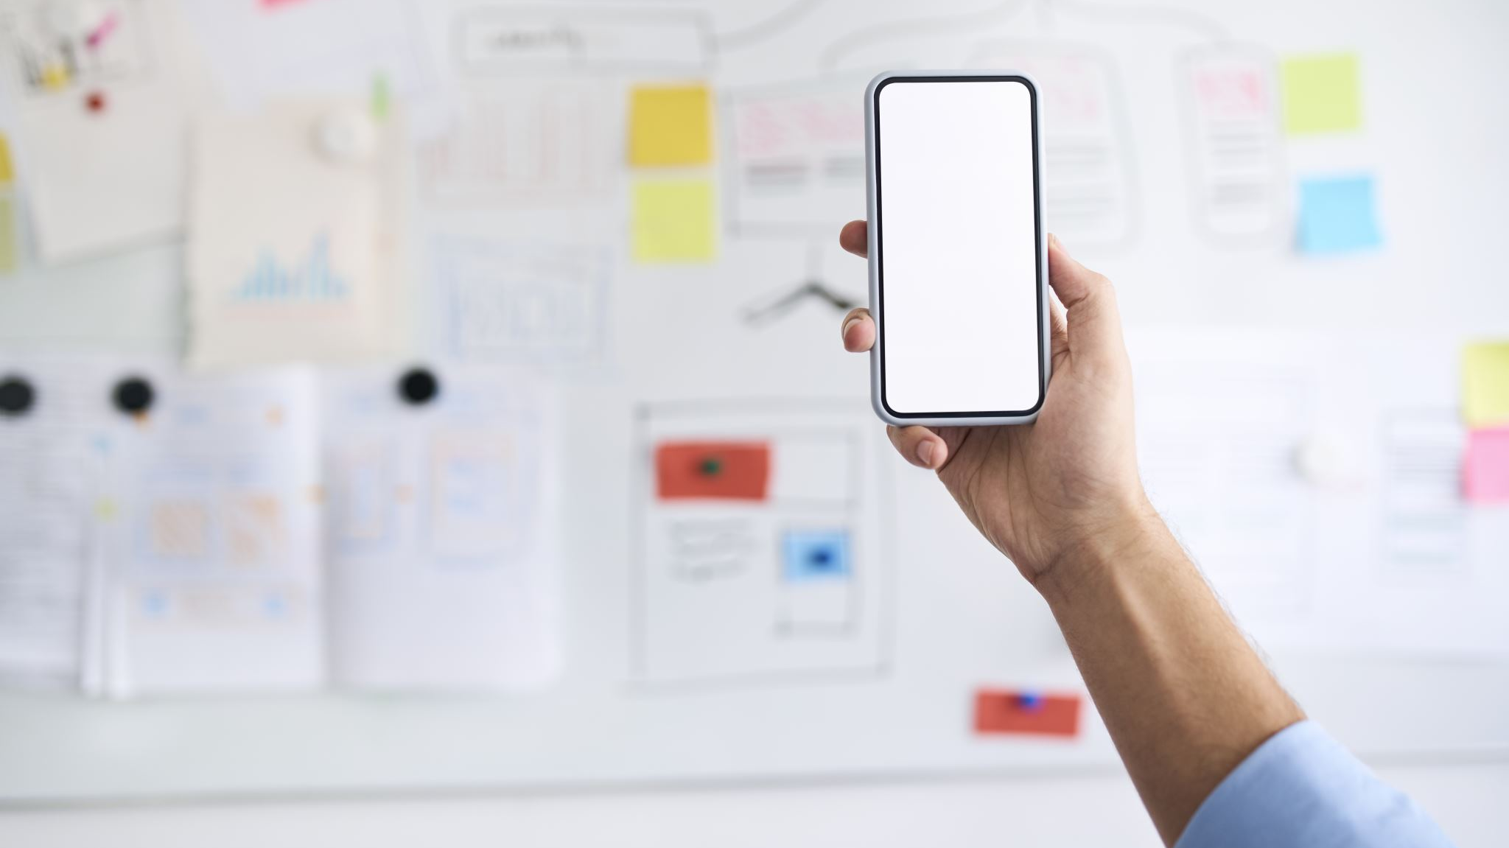
The Use of PowerPoint in the
Nursing Home Settings
Effective and Accessible Education Tool
Staff Training and Professional Development
Support for Complex Clinical Interventions
Versatility and Adaptability for Various Needs
Enhance Patient Learning and Engagement

Slide 7

Benefits & Limitations of Using PowerPoint
Benefit | Description
Standardized Training Delivery | PowerPoint offers a reliable structure for sharing a standardized training across multiple locations, guaranteeing that all staff members get identical information regardless of their geographic location
Increased Knowledge Retention | Integrating practice exercises and video demonstrations into PowerPoint based training greatly enhances staff knowledge retention

Slide 8
Benefits & Limitations of Using
PowerPoint (Continuation)
Benefits | Description
Positive Reception From Staff | Workers respond better to PowerPoint training when they can practice skills and see how it applies to real situations
Resource Accessibility | Home care agencies can freely access and customize professional PowerPoint resources for their training needs

Slide 9
Benefits & Limitations of Using
PowerPoint (Continuation)
Limitations | Description
Risk of Non-Interactive Learning | Over-relying on explanation without active participation can undermine both staff engagement and long-term knowledge retention
Diminished Impact In Large Settings | When delivered to big groups, PowerPoint can make it harder for staff to interact and stay personally involved

Slide 10
Impact of Limited Digital Skills or Literacy
Limited digital skills significantly impede care home agency, creating operational fragility and negatively impacting resident well-being.
This “digital poverty” prevents staff from effectively using workforce tools, leading to invisible strain and burnout as they rely on manual workarounds (Brant,2024).Consequently, home care agency miss efficiency gains from technologies like Digital Social Care Records, and staff cannot support residents in using technology for social connection (Hepworth,2024).This creates inequitable care, as residents are denied cognitive stimulation and family contact (Good Things Foundation,2023).
Ultimately, without targeted investment in digital leadership and training, the sector cannot deliver sustainable, person-centred care in an increasingly digital world.

Slide 11

Communication and Collaboration Tool
Outlook is particularly beneficial in a nursing home setting of Greenfield because it centralizes communication, streamlines coordination among a multidisciplinary -team, and helps manage the complex regulatory and scheduling demands unique to long-term care.
Here is a detailed breakdown of why Outlook is an effective tool for communication and collaboration in Greenfield Home Care Agency:
1.Centralized Communication to Combat Fragmentation
According to Kroeber et al.(2021),the transfer of information between nursing homes and outside providers are often poorly coordinated and relies on obsolete methods

Slide 12
2. Optimizing Staff Coordination and Schedules
Although targeted research on Outlook’s calendar features is limited, the broader requirement for enhanced coordination is well established
(Shephered,2012)
3.Enhanced Care Coordination (Multidisciplinary Team)
The multidisciplinary character of care requires strong information sharing as illustrated in the Japanese study “Cooperation between Hospital and Nursing Home by E-mail”(Kroeber et.al 2012)
4.Professional Communication with Families and External Providers
Email acts as essential connection to the outside world as demonstrated in the German survey by Kroeber et al (2012)

Slide 13
5.Task Management and Follow-Up
Implementation research provides evidence for importance of reminders and task tracking in nursing home contexts
(Feldman et al.(2005)
6.Data Security and Compliance
Despite the absence of research results specifically examining Outlook’s security features, the finding serve to illuminate the prevailing risk landscape

Slide 14

Advantages and Disadvantages of Using Outlook
Advantages | Description
Enhanced Inter-Professional Collaboration | Email facilities information sharing and instruction on policies among staffs, reducing reliance on fragmented verbal reports and paper systems. Shephered et.al (2012)
Structured Communication with External Providers | Email provides a documented channel for communication with general practitioners and hospitals potentially reducing inefficient or unspecific visit requests. Kroeber et.al,(2021)
This Photo by Unknown Author is licensed under CC BY-SA-NC

Slide 15
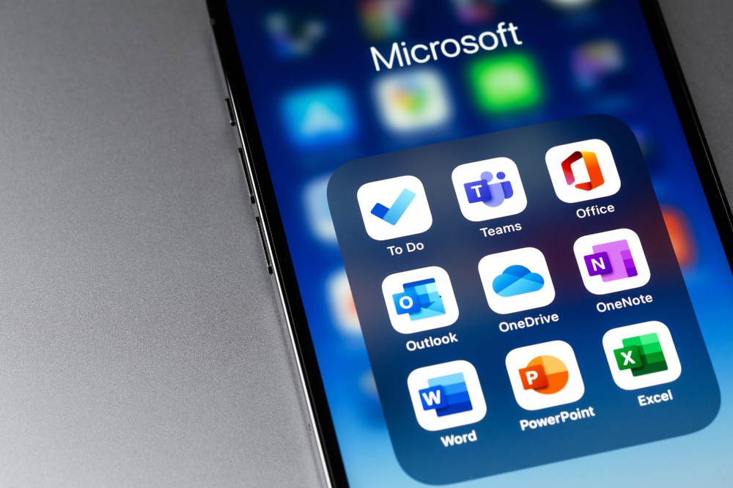
Support for Care Coordination | Electronic messaging systems enable the integration of medical and nursing information between hospitals, nursing homes and families, promoting mutual understanding. Kroeber et.al (2021)
Clinical Reminder Capability | Email can serve as a just-in-time reminder system, successfully influencing nurse behaviours and improving adherence to clinical protocols. ( Feldman et.al 2005)
Disadvantages
Persistent Communication Gaps | Despite digital tools, problems such as lack of role clarity, diverging expectation, and missing information and continue to hinder effective nurse to nurse collaboration Vandewaa et.al( 2016)

Slide 16

Ineffective Information Sharing | Poorly structured electronic communication and hierarchical structures can limit the effectiveness of information sharing among nursing staff. ( Vandewaa et.al 2016)
Risk of Informal Channels | Staff may bypass formal email systems and rely on informal, undocumented methods (e.g.,personal texting) for efficiency, creating compliance and documentation risks. ( Sibona,2025)
Training and Competency Gaps | Without mandatory training and regular audits, staff may lack the skills to use email effectively and securely for professional communication. ( MacDonnell,2021) as cited in previous responses
This Photo by Unknown Author is licensed under CC BY-SA

Slide 17
Digital Safety Practice Checklist for Greenfield Home Care Agency
A. Secure Logins, Email Safety, and Safe Document Storage
Checklist Item | Compliance Criteria
1.Multi-Factor Authentication(MFA) | -MFA is enabled for all staff accessing systems containing personal or sensitive data -Authentication methods include one-time codes, authentication apps, or biometric verification ( Protherough,K.(2025)
2.Strong Password Policy | -Passwords are 15-20 characters with mixed case, numbers, and special characters. -Password reuse is prohibited. -Password manager is used to store credentials securely

Slide 18
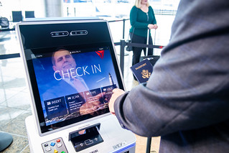
3. Unique User Identification | -Shared logins are prohibited -Each staff member has a unique identifier. -Access is immediately revoked upon staff departure (Protherough,K.,2005)
4.Role-Based Access Control (RBAC) | -Access permissions are granted on a strict “need-to-know” basis. -Caregivers access only assigned clients; managers access compliance data. -Access matrix is reviewed quarterly. ( Protherough,K.,2025)
5.Secure Email Configuration | -Email is encryption is enforced for all personal data transmission -Personal email accounts(e.g.,Hotmail, Gmail) are prohibited for work-related personal data. -Staff verify recipient addresses before sending. ( NHS Lothian,2026)
6.Cyber Essentials (Plus) Certification | -Certification is current and displayed in assurance pack
This Photo by Unknown Author is licensed under CC BY

Slide 19

7.Data Protection Impact Assessments (DPIAS) | -DPIAS are all completed for all high-risk processing activities with named owner and review date. ( Protherough,K.(2025)
8.Encrypted Document Storage | Data transit encrypted with TLS Data at rest encrypted Documents containing personal data stored only in approved system ( Protherough,K.(2025)
9.Automated Backup Systems with Testing | -Regular automated backups of all data are performed -Backups are tested at least quarterly -Last successful restore test is documented with screenshots ( Knowledge Now (2024)
10.Mobile Device Security | All mobile devices used for work have passcode locks and auto-lock timers. Remote wipe capability is enabled where feasible Screenshots of client information are prohibited

Slide 20

B.Staff Training and Awareness on Digital Safety Procedures
Checklist Item | Compliance Criteria
1.Mandatory Induction Training | -Complete data security training on all new staff before accessing the system. -UK GDPR basics, PHI definition, secure communication rules, breach and reporting must be covered during training.. (Knowledge Now(2024)
2.Annual Refresher Training | -Security and cyber awareness training must be completed annually by all of the staff. -Updated current threats and regulatory changes must reflect in every training
3.Phishing and Social Engineering Awareness | -Training includes real-world examples of phishing emails and scam tactics -Staff understand they must never share passwords or click suspicious links
This Photo by Unknown Author is licensed under CC BY

Slide 21

4.Secure Communication Protocols | Staff are trained that PHI must never be sent via personal text message, unsecured messaging apps,or personal email. -NHSmail or equivalent secure systems are the only permitted channels (NHS Lothian(2020)
5.Mobile Device and Remote Work Safety | -Staff understand requirements for device locks, secure Wi-Fi for accessing PHI.
6.Breach Reporting and Incident Reporting | -Staff know how to recognise a data breach (e.g.,misdirected email, lost device, unauthorised access. -Staff know the immediate steps to report incidents to the designated lead. (Protherough,K.(2005)
7.Clear Definition of PHI | -Staff can identify what constitutes PHI:names, addresses,medical records,diagnoses,photos, Biometric data,that identify an individual
This Photo by Unknown Author is licensed under CC BY-NC

Slide 22

8.Positive Reporting Culture | -Staff are encourage to report mistakes without fear of blame. -Near-misses are logged and used as learning opportunities -Lessons learned are shared across the team. Protherough,K.(2005)
9.Training Records and Audit Readiness | -Completion records for all staff training are maintained and readily accessible -Training logs include dates, content, covered, & assessment results -Records are retained for CQC inspection purposes Protherough,K.(2005)
10.Designanted Data Protection Lead | A designated Data Security and Protection is responsible for overseeing, training, policies, and incident response This role stays informed of regulatory updates through networks.
This Photo by Unknown Author is licensed under CC BY-SA

Slide 23
Conclusion
The integration of PowerPoint and Digital Literacy in Greenfield Home Care Agency represents critical development in contemporary adult social care. PowerPoint serves as a valuable tool for staff training and quality improvement, enabling consistent care standards across the sector ( Healthwatch Network 2025)
For Care Professionals, digital competence is increasingly recognised as essential.The government has committed £150 million to digital transformation and published a digital skills framework to address varying technology confidence levels ( Department of Health and Social Care 2023).
Concurrently, resident digital literacy determines quality of life.Pioneering projects have equipped care homes with Smart Chatta TVs,enabling video calls via familiar televisions rather than complicated tablets.Research found that 94% of elderly residents do not own smartphones,highlighting the importance of adopting technology to residents’ need (NHS Lanarkshire 2025)
Ultimately,fostering digital literacy across the entire nursing home community is fundamental to person-centered care in an increasingly digital healthcare environment

Slide 24
Reference List
Brant, H. (2024).Digital social care: harnessing technology for resident wellbeing. London: The King’s Fund
Department of Health and Social Care (2023) ‘Future proofing care ‘, GOV.UK blogs.
Feldman, P.H., Mutaugh,C.M., Pezzin, L.E., McDonald, M V., & Peng, T.R (2025), ‘Just-in-time evidence-based e-mail “reminders” in home health care: impact on nurse practice s’, Health Services Research, 40(3),pp 849-864
Good Things Foundation (2023). Digital inclusion in health and social care: A blueprint for action. Shefield: Good Things Foundation
Healthwatch Network (2025) ‘Enter and View for residential and nursing care homes training ‘, Healthwatch Network.

Slide 25
Reference List
Hepworth, M. (2024).Care homes must bridge the digital skills gap to improve retention. Technology and Innovation in Social Care, 12(2), pp.45-49
Hull York Medical School (2024)SUPPORTED Training resources for homecare workers and managers
Knowledge Now (2024)’ Data and Cyber Security’. NHS North Wales
Kroeber, E.S., Bauerrnschmidt,D., de Fallios, J.,Ebert, J., Dorks, M. and Hoffmann, F. (2021)’Communication and nursing homes: a qualitative study’.

Slide 26
Reference List (Continuation)
Luiselle,J.K.BassJ.D and Whitcomb, S.A (2010) ‘ Teaching applied behavior analysis knowledge competencies to direct-care service providers :outcome assessment and social validation of training program’, Behavior Modification,34(5),pp.403-414.
McDonell, J (2021) ‘Evaluating service user & carer experience of videoconferencing software during COVD-19 pandemic ‘, BJPsych Open, 7(SI),p.S38
NHS Lanarkshire (2025) ‘Pioneering digital inclusion project inclusion project transforms connection in care homes ’,
NHS Lothian (2026)’Secure Email Accounts Care Homes’.
Petersen et.al (2021)

Slide 27
Reference List ( Continuation)
Protherborough, K.(2005) ‘Care Is Built on Trust: Plain-English Cybersecurity for Social Care’,
Shephered, J (2012) ‘The role of information and Communication and technology in nursing home care’, Journal of Nursing Education and Practice, 2(3),pp.128-135
Sibona, E. (2025) ‘Should nurses text with patients and families ’, Nursing Made Incredibly Easy!,23(1) pp.55-56
Vandewaa,E.A., Turnipseed, D.L and Cain, G.L (2016) ‘Panacea or placebo? An evaluation of the value of electronic health records in hospitals and nursing homes ’, The Health Care Manager, 35(4) pp.308-317

