Slide 1


Student Name: Robert Nzeyimana
Student ID Number: 2329949
Module: Psychological Classifications and Provisions
Module code: BMHP6029
Lecturer Name:: Kennedy Obohwemu
Assignment Title: Component 1: Individual Presentation (Academic Poster)
Submission Deadline:6 July 2026
POSTER Title: A Critical Examination of Historical and Contemporary Treatment, Care Provision, and Future Directions of Impulse Control Disorders

Slide 2
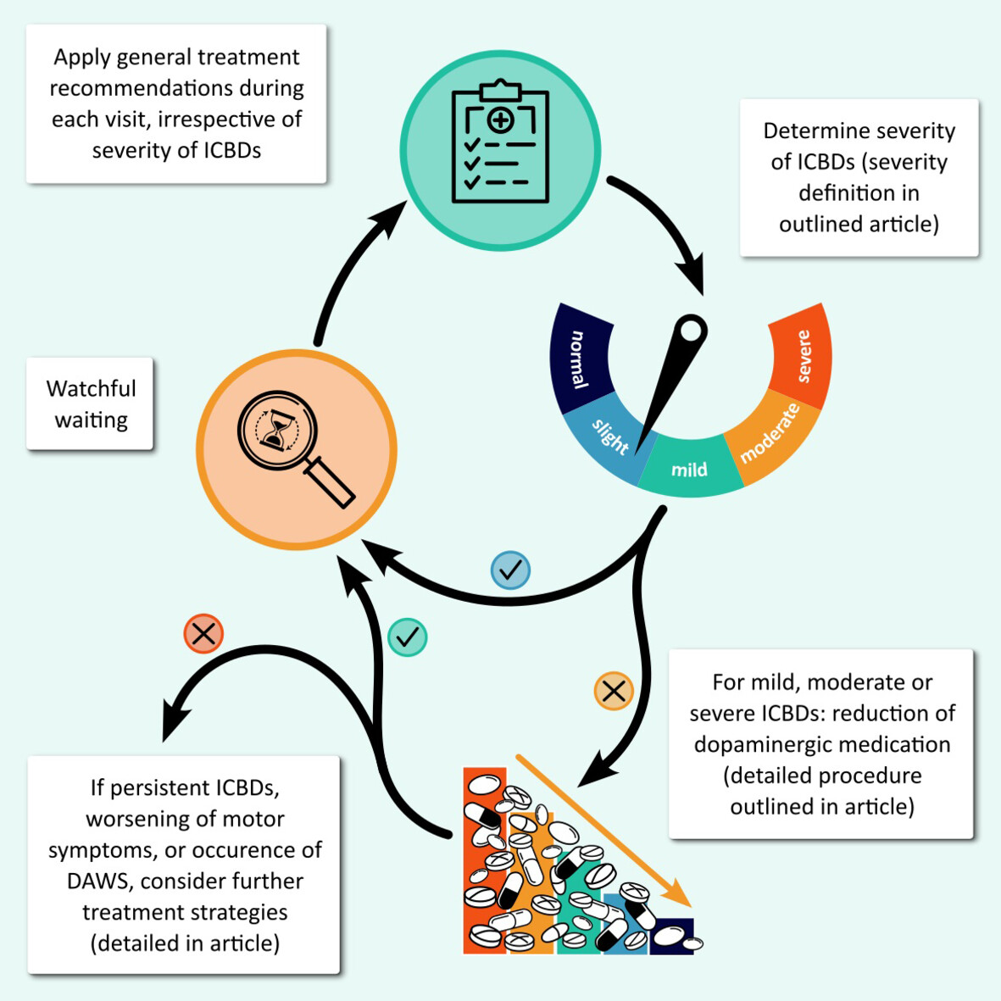
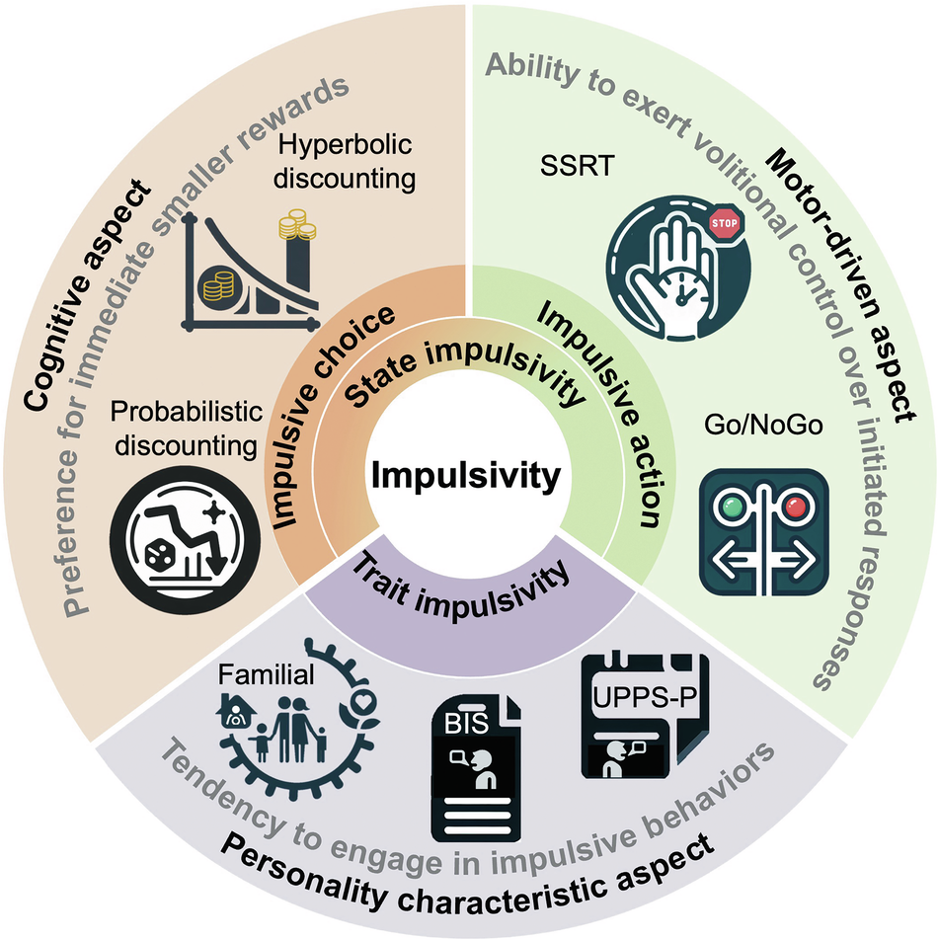
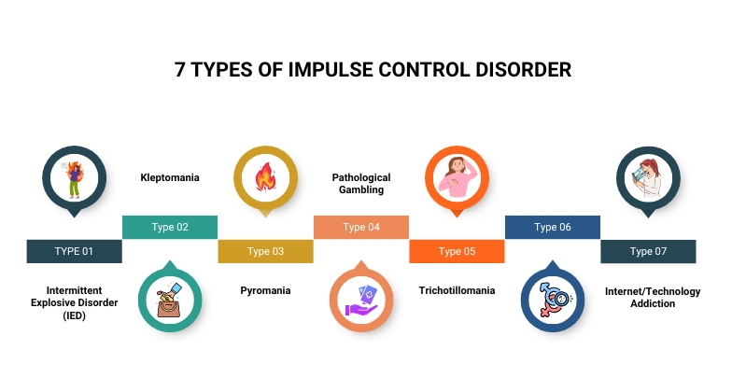
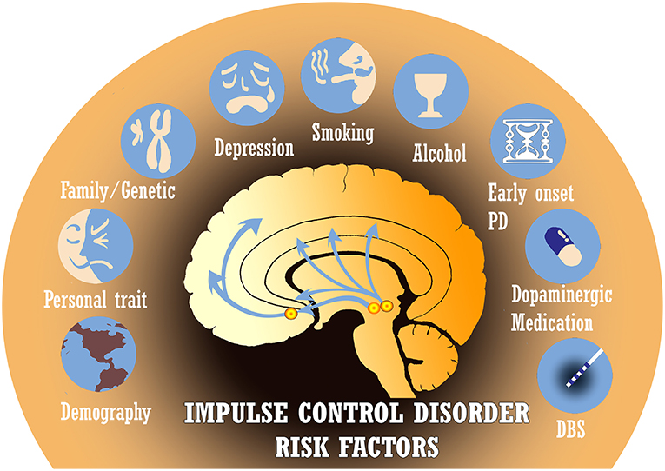
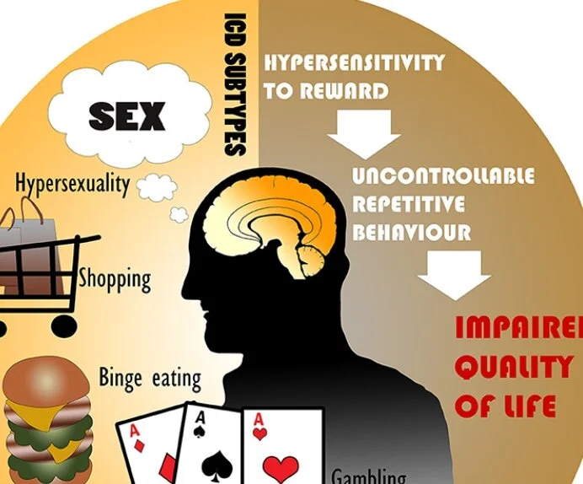
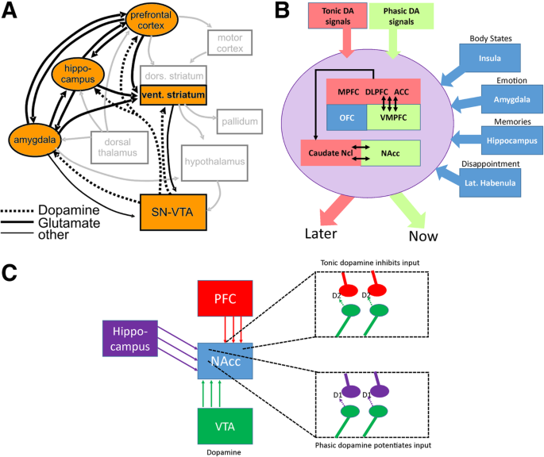
A Critical Examination of Historical and Contemporary Treatment, Care Provision, and Future Directions of Impulse Control Disorders
1. Introduction
Impulse Control Disorders involve repeated inability to resist harmful urges. Biological, psychological, and environmental factors contribute to their development.
2. Understanding Impulse Control Disorders
Impulse Control Disorders involve difficulty resisting harmful urges despite consequences (Zhang et al., 2025; Zaks, 2024; Health Research Authority, 2020).
3. Historical Understanding and Treatment of Impulse Control Disorders
Historically, impulse control disorders were seen as moral failings and criminal behaviour, treated through punishment and containment (Osama et al., 2023; Health Research Authority, 2020; Atewologun et al., 2025; Ullah et al., 2023).
4. Contemporary Understanding and Care Provision
Diagnosis uses clinical assessment and symptom severity; treatment includes CBT, psychoeducation, family support, and multidisciplinary care (Chengoden et al., 2023; Ross et al., 2022; NHS, 2025).
8. Recommendations for Future Policy and Practice
The recommendations are as follows:
Early screening, practitioner training, community funding, access to CBT, public education, and equitable policies are needed to improve impulse control disorder care.
Figure 2: Transdiagnostic neuromodulation of impulsivity
(Source: Zhong et al., 2025)
Figure 1: Management of Impulse Control Disorders
(Source: Debove et al.,2024)
Figure 3: Seven types of Impulse Control Disorders
(Source: Microgility, 2025)
6. Stigma, Discrimination, and Inequality
Impulse control disorders face stigma and discrimination, harming relationships and treatment access, especially among disadvantaged groups (NHS, 2025; Bagga et al., 2022; Health Research Authority, 2020).
7. Critical Analysis of Historical and Contemporary Approaches
Progress in impulse control disorders has shifted from punishment and moral judgement to psychological treatment, medication, and community care, though barriers still limit adequate support (Zhang et al., 2025; Osama et al., 2023).
5. Social, Cultural, and Political Influences
Social, cultural, and political factors influence diagnosis, stigma, and help-seeking, while policies improve patient rights (Guo et al., 2026; Wei et al., 2025).
Figure 6: Risk factors of Impulse Control Disorders
(Source: Rodríguez-Violante and Antonini, 2019)
Figure 5: Neurobiology and Clinical features of Impulse Control failures
(Source: Matthieu Béreau, Krack et al., 2019)
9. Conclusion
It is to be concluded that Impulse Control Disorders affect behaviour, emotion, and decision-making. Historical punishment and stigma were ineffective, while modern approaches use scientific psychological and medical treatments.
Figure 4: Tips for Impulse Control Disorder
(Source: Tips, 2021)
Notes:
Introduction
The poster is designed to give information about Impulse Control Disorders (ICDs) to those who might be interested in learning about them, especially concerning psychiatric disorders where a person has difficulty resisting urges, impulses, or temptations that they know can be harmful to themselves or others. It clarifies that the ICD-11 classification from the World Health Organisation contains kleptomania, pyromania and intermittent explosive disorder.
Understanding Impulse Control Disorders
The poster provides information about what Impulse Control Disorders are, and distinguishes them from the mental and behavioural conditions characterised by impaired self-control. People may do something bad without really thinking of the implications. Common symptoms are increased anxiety before the behaviour, loss of control during the behaviour and satisfaction/euphoria afterwards.
Historical Understanding and Treatment of Impulse Control Disorders
The poster explores the history of confusion in the diagnosis of impulse control disorders. In many of the earlier-mentioned societies, people with affected individuals had been thought to be morally weak, criminals, deviants or lacking in discipline, rather than suffering from mental illness. In the eighteenth and nineteenth centuries, things like stealing, being violent and setting fires were mostly dealt with by punishment and legal action.
Contemporary Understanding and Care Provision
The poster emphasises the paradigm change regarding the scientific and clinical aspects of impulse control disorders. Treatment today emphasises better self-control, decreased negative behaviour and quality of life. Various interventions are mentioned that are important in supporting people to identify triggers and learn coping strategies, such as Cognitive Behavioural Therapy (CBT).
Social, Cultural, and Political Influences
The poster presents the theory of how social and cultural beliefs impact the recognition and management of impulse control disorders. In many societies, behaviours related to these disorders were traditionally thought of as a lack of morals, a failure to live up to them. Help-seeking behaviours and family reactions are influenced by cultural values, and the political landscape in the field of mental health policy has moved toward ensuring the rights of the patient and enhancing access.
Stigma, Discrimination, and Inequality
The stigma of people with impulse control disorder is pointed out as a major problem in the poster. Manifestations of behaviour including aggression, theft and arson, are often considered intentional misconduct and often result in discrimination against the child in social, educational and employment environments. The concern of what they may face if they seek professional assistance may be enough to stop them.
Critical Analysis of Historical and Contemporary Approaches
Compare and contrast past and current methods on the poster. The traditional argument against the use of drugs was punishment and exclusion, which frequently did more damage than good for patients. Can't control urges is a legitimate mental health disorder that needs evidence-based treatment, in contrast. Treatment has been stepped up with psychological therapies, medicine and community care packages, but there remains a lack of equal access to services, delayed diagnosis and stigma, which brings problems with treatment.
Recommendations for Future Policy and Practice
There are a number of recommendations to enable better care in the future. This includes establishing early screening programs, offering specialist training for healthcare staff, improving the funding for community mental health services, providing more access to CBT services, public awareness campaigns to help change stigma and policies that provide equal treatment opportunities to all without social or economic barriers.
Conclusion
The poster concludes that Impulse Control Disorders are important psychological disorders that can strongly impact behaviour, emotions and decision-making. In the past, the treatment was predominantly based on punishment and institutionalisation, but in modern times, a humanisation of care through evidence-based treatments is used. Even with the advances, further work and collaboration are required to reduce stigma, enhancing early identification and equal access to mental health services in the future.

Slide 3
Reference List
Atewologun, F., Adigun, O.A., Okesanya, O.J., Hassan, H.K., Olabode, O.N., Micheal, A.S., Ahmed, M.M., Ukoaka, B.M., Idris, N.B., Oso, T.A. and Lucero-Prisno III, D.E. (2025). A comprehensive review of mental health services across selected countries in sub-Saharan Africa: assessing progress, challenges, and future direction. Discover mental health, 5(1), pp.49. Available at: https://link.springer.com/article/10.1007/s44192-025-00177-7 [Accessed on: 2nd June 2026]
Bagga, P., Das, A.K., Chamola, V. and Guizani, M. (2022). Blockchain-envisioned access control for internet of things applications: a comprehensive survey and future directions. Telecommunication Systems, 81(1), pp.125-173. Available at: https://link.springer.com/article/10.1007/s11235-022-00938-7 [Accessed on: 2nd June 2026]
Chengoden, R., Victor, N., Huynh-The, T., Yenduri, G., Jhaveri, R.H., Alazab, M., Bhattacharya, S., Hegde, P., Maddikunta, P.K.R. and Gadekallu, T.R. (2023). Metaverse for healthcare: a survey on potential applications, challenges and future directions. IEEE Access, 11, pp.12765-12795. Available at: https://ieeexplore.ieee.org/abstract/document/10034994/ [Accessed on: 2nd June 2026]
Debove, I., Paschen, S., Amstutz, D., Cardoso, F., Jean‐Christophe Corvol, Victor S.C. Fung, Lang, A.E., Pablo Martinez Martin, Rodríguez‐Oroz, M.C., Weintraub, D., Krack, P. and Günther Deuschl (2024). Management of Impulse Control and Related Disorders in Parkinson’s Disease: An Expert Consensus. Movement Disorders. Available at: https://doi.org/10.1002/mds.29700. [Accessed on: 2nd June 2026]
Guo, S.B., Liu, D.Y., Fang, X.J., Meng, Y., Zhou, Z.Z., Li, J., Li, M., Luo, L.L., Li, H.L., Cai, X.Y. and Huang, W.J. (2026). Current concerns and future directions of large language model ChatGPT in medicine: a machine-learning-driven global-scale bibliometric analysis. International Journal of Surgery, 112(2), pp.2805-2822. Available at: https://journals.lww.com/international-journal-of-surgery/fulltext/2026/02000/current_concerns_and_future_directions_of_large.52.aspx [Accessed on: 2nd June 2026]
Health Research Authority. (2020). Impulse control disorders and dopamine agonists in Parkinson’s disease. [online] Available at: https://www.hra.nhs.uk/planning-and-improving-research/application-summaries/research-summaries/impulse-control-disorders-and-dopamine-agonists-in-parkinsons-disease/ [Accessed on: 2nd June 2026]
Matthieu Béreau, Krack, P., Brüggemann, N. and Münte, T.F. (2019). Neurobiology and clinical features of impulse control failure in Parkinson’s disease. Neurological Research and Practice, 1(1). Available at: https://doi.org/10.1186/s42466-019-0013-5. [Accessed on: 2nd June 2026]
Microgility (2025). Impulse Control Disorder: Types, Causes & Treatment. [online] Faith behaviroal Health. Available at: https://faithbehavioralhealth.com/impulse-control-disorder/. [Accessed on: 2nd June 2026]
NHS (2025). NHS. [online] NHS. Available at: https://www.nhs.uk/. [Accessed on: 2nd June 2026]
Osama, M., Ateya, A.A., Sayed, M.S., Hammad, M., Pławiak, P., Abd El-Latif, A.A. and Elsayed, R.A. (2023). Internet of medical things and healthcare 4.0: Trends, requirements, challenges, and research directions. Sensors, 23(17), pp.7435. Available at: https://www.mdpi.com/1424-8220/23/17/7435 [Accessed on: 2nd June 2026]

Slide 4
Rodríguez-Violante, M. and Antonini, A. (2019). Editorial: Impulse Control Disorders, Impulsivity and Related Behaviors in Parkinson’s Disease. Frontiers in Neurology, 10. Available at: https://doi.org/10.3389/fneur.2019.00972. [Accessed on: 2nd June 2026]
Ross, S., Agrawal, M., Griffiths, R.R., Grob, C., Berger, A. and Henningfield, J.E. (2022). Psychedelic-assisted psychotherapy to treat psychiatric and existential distress in life-threatening medical illnesses and palliative care. Neuropharmacology, 216, pp.109-174. Available at: https://www.sciencedirect.com/science/article/pii/S0028390822002337 [Accessed on: 2nd June 2026]
Tips (2021). Parkinson Secrets. [online] Parkinson Secrets. Available at: https://www.parkinsonsecrets.com/blog/2021/4/19/tips-for-impulse-control-disorder-disorder-icd-and-parkinsons-disease-pkks5. [Accessed on: 2nd June 2026]
Ullah, H., Manickam, S., Obaidat, M., Laghari, S.U.A. and Uddin, M. (2023). Exploring the potential of metaverse technology in healthcare: Applications, challenges, and future directions. IEEE Access, 11, pp.69686-69707. Available at: https://ieeexplore.ieee.org/abstract/document/10153590/ [Accessed on: 2nd June 2026]
Wei, Q., Pan, S., Liu, X., Hong, M., Nong, C. and Zhang, W. (2025). The integration of AI in nursing: addressing current applications, challenges, and future directions. Frontiers in medicine, 12, pp.1545420. Available at: https://www.frontiersin.org/journals/medicine/articles/10.3389/fmed.2025.1545420/full [Accessed on: 2nd June 2026]
World Health Organisation (2025). World Health Organisation. [online] Who.int. Available at: https://www.who.int/. [Accessed on: 2nd June 2026]
Zaks, Z. (2024). Changing the medical model of disability to the normalisation model of disability: Clarifying the past to create a new future direction. Disability & Society, 39(12), pp.3233-3260. Available at: https://www.tandfonline.com/doi/abs/10.1080/09687599.2023.2255926 [Accessed on: 2nd June 2026]
Zhang, M., Liu, C., Tu, J., Tang, M., Ashrafizadeh, M., Nabavi, N., Sethi, G., Zhao, P. and Liu, S. (2025). Advances in cancer immunotherapy: historical perspectives, current developments, and future directions. Molecular cancer, 24(1), pp.136. Available at: https://link.springer.com/article/10.1186/s12943-025-02305-x [Accessed on: 2nd June 2026]
Zhong, G., Chen, T., Zhong, N., Rezapour, T., Haghparast, A., Jiang, H., Su, H., Yuan, T., Robbins, T.W., Du, J. and Zhao, M. (2025). Transdiagnostic neuromodulation of impulsivity: current status and future trajectories. Translational Psychiatry, 15(1). Available at: :https://doi.org/10.1038/s41398-025-03415-2. [Accessed on: 2nd June 2026]

