Slide 1

SafeguarDing Policies and procedures in schools
”Safeguarding means protecting children from harm, abuse and neglect” (Educators Wales, 2026).
(Leontura, 2025)

Slide 2
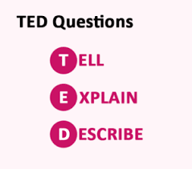
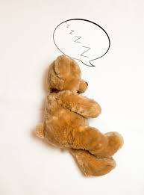

The 4 R’s
TED talk
recognise
respond
report
record
(Mitchell, 2026)
(MStudioImages, 2025)
Helpful tips to remember

Slide 3
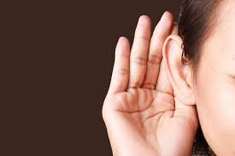



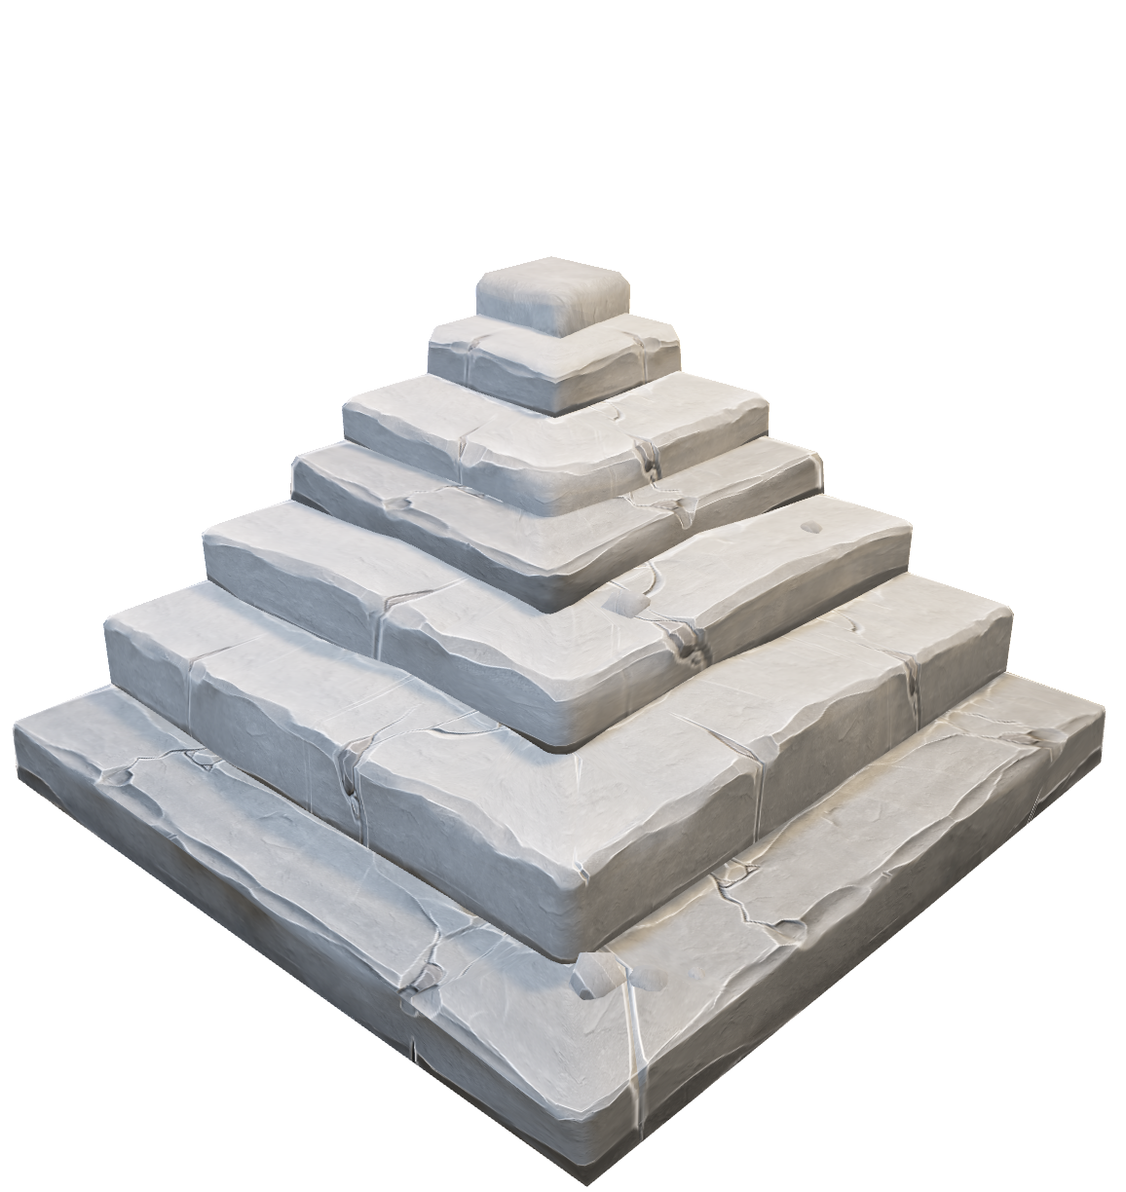
Steps to take
(Telecarecrisisandcaringline, 2022)
(Freepik, N.d)
(Novakovic, 2019)
(Paveley, 2018)

Slide 4
Reference
Page
Reference page
-Educators.wales. (2026). What is Safeguarding Blog | Educators wales. [online] Available at: https://educators.wales/safeguarding [Accessed 6 Apr. 2026].
‌-Freepik (N.d) Cute brown teddy bear with speech bubble – Freepik. [online] Available at https://www.freepik.com/premium-photo/cute-brown-teddy-bear-with-speech-bubble-lying-floor_14948348.htm [Accessed 6 Apr. 2026].
--Freepik (N.d) Adult typing business research information – Freepik. [online] Available at https://www.freepik.com/premium-photo/young-adult-typing-business-research-information-laptop-browsing-internet-work-remotely-home-startup-employee-using-computer-working-remote-handheld-shot-close-up_30498273.htm [Accessed 6 Apr. 2026].
-Leontura (2025). Child Talking To Adult Silhouette Illustrations, Royalty-Free Vector Graphics & Clip Art - iStock. [online] Istock by Getty Images. Available at: https://www.istockphoto.com/search/2/image?mediatype=illustration&phrase=child+talking+to+adult+silhouette&tracked_gsrp_landing=https%3A%2F%2Fwww.istockphoto.com%2Fillustrations%2Fchild-talking-to-adult-silhouette [Accessed 23 Mar. 2026].
-Mitchell,C. (2026). 15 TED Questions for Customer Service – With Examples. [online] Available at: https://www.callcentrehelper.com/ted-questions-customer-service-examples-202868.htm [Accessed 6 Apr.2026].
-MStudioImages (2025). Child Listening To Adult Stock Photos, Pictures & Royalty-Free Images - iStock. [online] Istockphoto.com. Available at: https://www.istockphoto.com/search/2/image-film?phrase=child+listening+to+adult&tracked_gsrp_landing=https%3A%2F%2Fwww.istockphoto.com%2Fphotos%2Fchild-listening-to-adult [Accessed 6 Apr. 2026].
-Novakovic, A. (2019). Difficult Conversations With Employees: 9 Crucial Rules To Remember - Insperity. [online] Insperity. Available at: https://www.insperity.com/blog/difficult-conversations-with-employees/ [Accessed 6 Apr. 2026].
-NSPCC (2024). History of Child Protection in the UK. [online] NSPCC Learning. Available at: https://learning.nspcc.org.uk/child-protection-system/history-of-child-protection-in-the-uk [Accessed 23 Apr. 2026].
-NSPCC (2025). 4Rs of Safeguarding and Child Protection | NSPCC Learning. [online] NSPCC Learning. Available at: https://learning.nspcc.org.uk/safeguarding-child-protection/4rs-safeguarding-child-protection [Accessed 19 Apr. 2026].
-Paveley, R. (2018). Younger children in care in the UK ‘often don’t know why they are there’. [online] Available at: https://www.churchtimes.co.uk/articles/2018/23-november/news/uk/younger-children-in-care-in-the-uk-often-don-t-know-why-they-are-there [Accessed 6 Apr. 2026].
-SAA Show Community. (2019). All You Need to Know About Safeguarding in Schools. [online] Available at: https://blog.schoolsandacademiesshow.co.uk/all-you-need-to-know-about-safeguarding-in-schools [Accessed 23 Apr. 2026].
-Safeguarding Network (2022). Dealing with a disclosure. [online] Safeguarding.network. Available at: https://safeguarding.network/content/dealing-with-a-disclosure#asking-questions [Accessed 19 Apr. 2026].
-Safeguarding Procedures Wales. (2011). Safeguarding Wales. [online] Available at: https://www.safeguarding.wales/en/chi-i/chi-i-c1/ [Accessed 19 Apr. 2026].
-Telecarecrisisandcaringline. (2022). Become a Good Listener. [online] Available at: https://www.telecarebc.com/become-a-good-listener [Accessed 6 Apr.2026].

