Slide 1
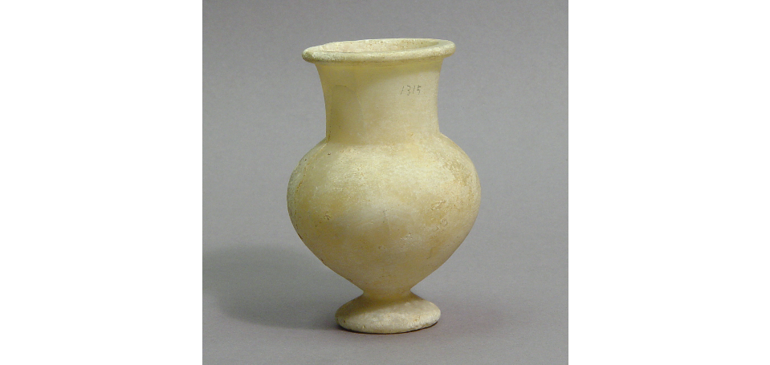
Egyptian pottery from Enkomi
Matthew French
1905094
(cup | British Museum, 2022)

Slide 2
The Egyptian Cup
An Egyptian stone vessel:
  Diameter of the cup 6.20cm
  Height of the cup 9cm
  Width of the cup 6cm
  Base of the pot has a drilled concave nature
Acquired in 1897 with the Emma Tourna Turner excavations in Enkomi.
The cup is made from travertine is a type of limestone. The cup is a stemmed cup with a flat rim tapered upward cylindrical neck on the top.
New Kingdom (1550BC-1200BC) pot found in a late Cypriot II tomb (1650BC-1050BC)
(cup | British Museum, 2022)
(cup | British Museum, 2022)

Slide 3
Enkomi
Enkomi was a late bronze age town in eastern Cyprus which is now in the Turkish occupied area of Cyprus.
In 1897 the British museum excavated 100 tombs in the area. (Crewe, L., 2009)
It was here that the cup was found unfortunately due to the fact that the tomb was excavated in 1897 not much context about where it was found is known. (cup | British Museum, 2022) (Crewe, L.,2009)
Many grave goods have been found in the area including this cup among many other gold ivory and other prestigious products. (cup | British Museum, 2022) (Crewe, L.,2009)

Slide 4
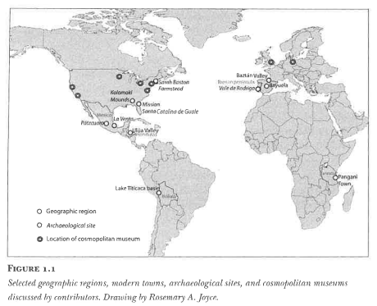
Itinerary of objects, Things in Motion
Archaeology and anthropology has been focused on things rather than the movement of things.
Objects are always involved in “intra-action”, undergoing change in value, and agency.
This requires models of mapping flow and movement. Sometimes called the “life history” approach to the creation and usage of an object.
An Itinerary of objects includes the objects manufacture, use and then flowing movements of the object. Which has ended up with the object being deposited in the archaeological record. (Rosemary, A., et al. 2015)
(Rosemary, A., et al. 2015)

Slide 5
How this relates to the Egyptian cup
This Egyptian cup was made from travertine presumably in the Egyptian mines.
Then the raw travertine was transported across Egypt and manufactured into a cup.
Then traded possibly a few times until it ended up in Enkomi crossing the Mediterranean sea.
There it was left for thousands of years until in 1897 it was dug up by the British Museum and brought to the British Museum where it remains to this day in the archive.
Further metamorphoses of the object have occurred as explained by Rosemary A. have occurred to the object such as the objects’ further transformation into the digital world such as photos. (Rosemary, A., et al. 2015)

Slide 6
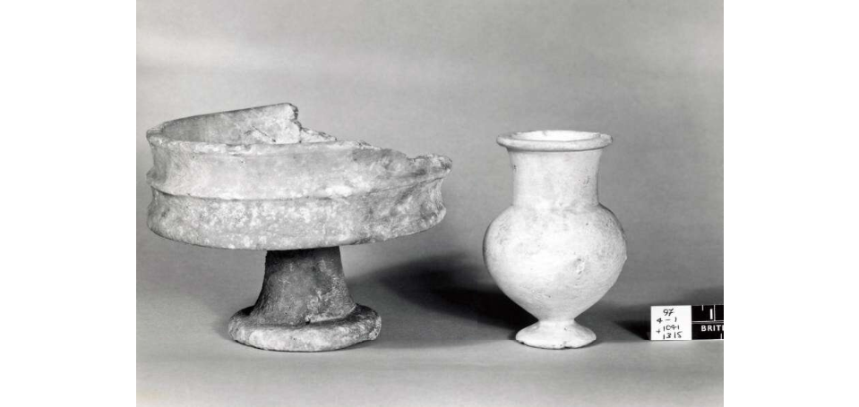
Conclusion
The object made its way from Egypt to Enkomi and from there to the British Museum.
Found among other objects that were from outside of Cyprus including other cups, gold, and ivory carvings.
Object went from a tradable commodity to an object in a museum, not on display. Which shows the objects transforming agency.
(cup | British Museum, 2022)

Slide 7
Bibliography
Crewe, L., 2009. Feasting with the dead? Tomb 66 at Enkomi. British Museum Press
The British Museum. 2022. cup | British Museum. [online] Available at: <https://www.britishmuseum.org/collection/object/G_1897-0401-1315> [Accessed 2 March 2022].
Rosemary, A., Joyce and Susan D. Gillespie. 2015 Things in Motion Object itineraries in Anthropological Practice. School for Advanced Research Press
Pendlebury, J D S. Egypt and the Aegean in the Late bronze Age The Journal of Egyptian Archaeology , May, 1930, Vol. 16, No. 1/2 (May, 1930), pp. 75-92
Ingold, T., 2013. Making. Abingdon: Routledge.
Shaw, I., 2004. Ancient Egypt. Oxford: Oxford University Press.

