Slide 1

Hamstring tendinopathy

Slide 2
Contents
What is hamstring tendinopathy?
What and who is affected?
Signs and symptoms
Diagnosis
Using MRI to diagnose
Palpation
The bent knee test
Management and treatment
When and how to return to exercise
References

Slide 3
What is hamstring tendinopathy?
Degradation of collagen
Micro-tears
Tendinitis or tendinosis

Slide 4
What and who is affected?
hamstring – semimembranosus, semitendinosus, biceps femoris with 3 tendons inserting in the ischial tuberosity.
The tendons run across the hip, pelvis and knee
Pain is often reported in the knee, pelvis and thigh.
Commonly affects long distance runners and jumpers
Pain starts mild but progresses rapidly

Slide 5
Signs and symptoms
Pain in the knee, pelvis and thigh
Swelling
Pain during exercise
Difficulty or pain using the joint

Slide 6
Diagnosis
MRI
Palpation
Bent knee test

Slide 7
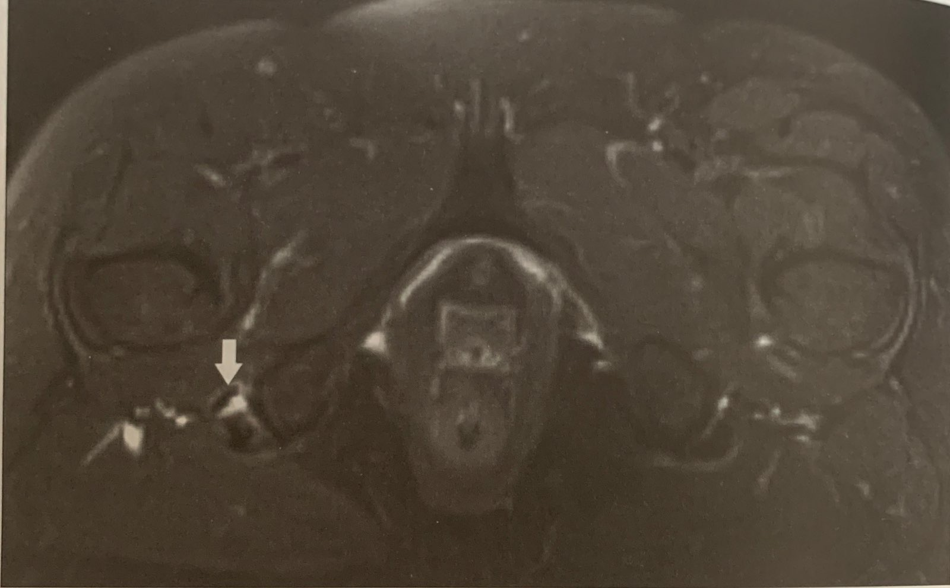
Using MRI to diagnose hamstring tendinopathy
The Sports Therapist will look for:
Tears
Thickening or swelling around the ischial tuberosity
Fig. 1

Slide 8
Using palpation to diagnose hamstring tendinopathy
The Sports therapist will:
Palpate the upper leg
Look for swelling

Slide 9
Using the modified bent knee test to diagnose hamstring tendinopathy
To perform the test the sports therapist will:
Lay the patient in supine on a bed
Bend the knee as close to a 90° as possible, ensuring the hip is also in flexion at 90°.
They will fully extend the patient’s leg while maintaining hip flexion.
They will look for painful spots and ask the patient to identify when it occurs.

Slide 10
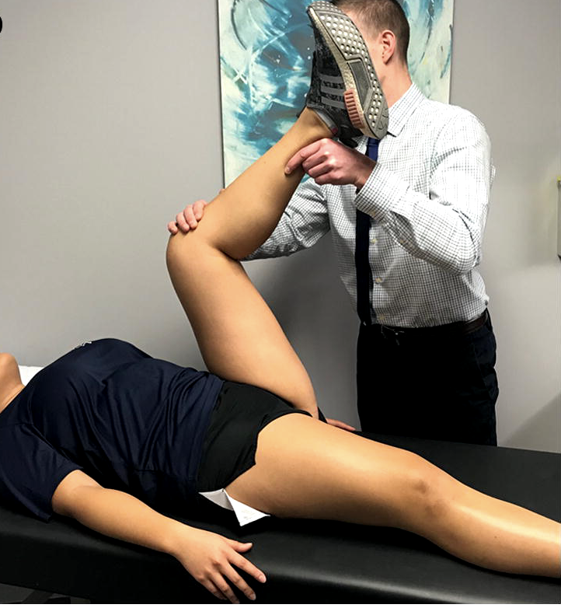
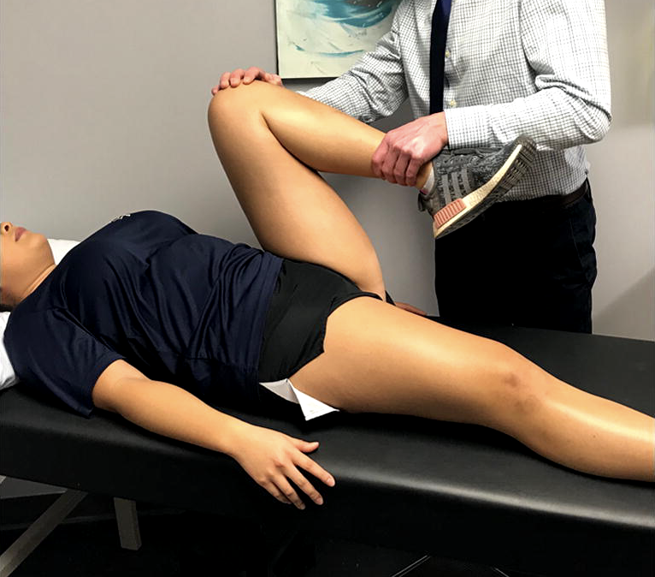
Fig. 2

Slide 11
Management/treatment
Rest
Reduce compression of the ischial tuberosity
Avoid stretching upper leg muscles
Avoid prolonged positions requiring hip flexion
Relieve symptoms by:
Applying ice
Taking painkillers

Slide 12
When and how to return to exercise
Isometric exercises
Can be performed early in the injury stages to provide an analgesic effect and maintain a manageable and pain-free level of exercise.
Each exercise must last between 45 and 60 seconds at maximal force ensuring the pain level is no higher than 5/10 with 10 being the worst possible pain.
The patient should perform 3-5 reps of each exercise regularly through the day ensuring there are long periods of rest between each set as not to overload the tendon.

Slide 13
Eccentric resistance exercises
The isometric exercises will allow the tendon to get stronger and more resistant to pain.
This allows for the patient to progress to eccentric resistance exercises to build a higher tolerance for greater forces.
They may also introduce concentric muscle contractions at this stage but it is still vital to avoid compressing the tendons.

Slide 14
Final stage
The final stage of the rehabilitation plan should include high speed and intensity ballistic movements
This stage allows the tendon to get used to rapid change in muscle length during eccentric and concentric contractions.
The patient should not progress to this stage unless the therapist is absolutely sure that the patient is ready and not experiencing any pain in the previous stages.
After these stages the patient may return to what is their normal activity but should avoid high-intensity activities, long duration activities, training on hills and over striding because they all pose risk for reinjury.

Slide 15
References
Bruckner P and Khan K, January 1st (2012), Bruckner & Khan's Clinical Sports Medicine Injuries, Vol 1. Australia: McGraw-Hill Medical.
Roemer, F and Crema, F, (2016), Imaging in sport specific musculoskeletal injuries, Springer International, Switzerland.
Degen, R (2019), Proximal hamstring injuries: management of tendinopathy and avulsion injuries, Springer International, Switzerland.

