Slide 1
The World’s Our Lecture Theatre
Corey Crockett 1802907

Slide 2

The Sustainability of Cardiff Airport
A presentation analysing their Masterplan 2040 and the effects on the airport

Slide 3
Things to Discuss Today
Introduction of Cardiff Airport
Methodology
Discussion of Findings
Recommendations for the Future
Conclusions

Slide 4

Introduction to Cardiff Airport
“The Gateway to Wales” (Cardiff Airport, 2020)
Handles over a million passengers a year
Existed for over 70 years
History- used as RAF Base for World War 2 (early 1940s)
First transatlantic flight in 1971
Cardiff Airport bought by Welsh Government in 2013

Slide 5

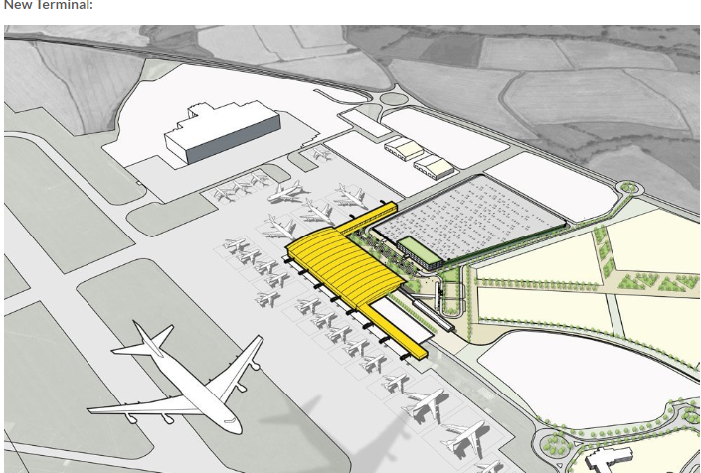
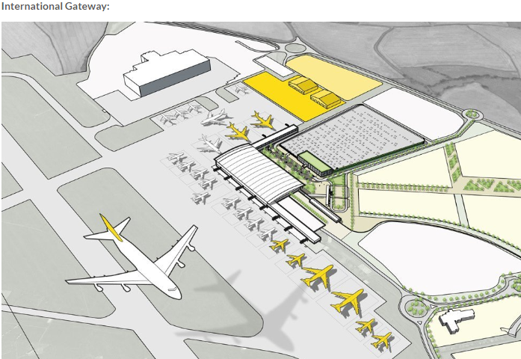
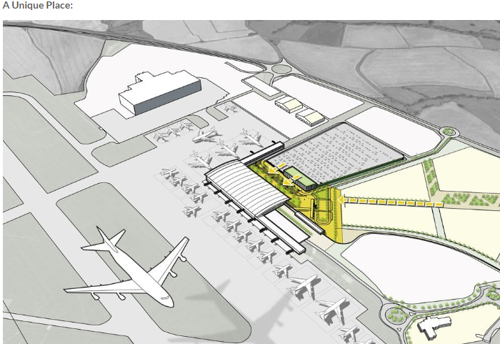
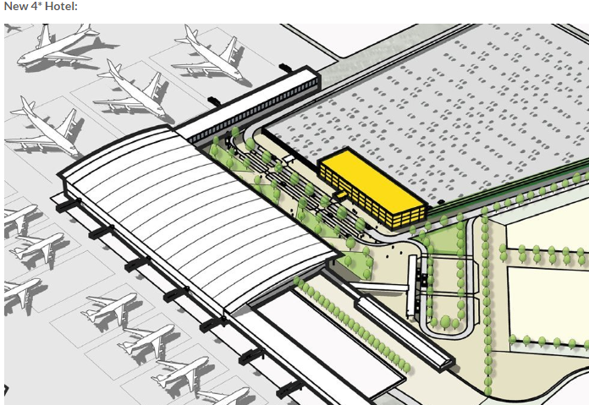
Masterplan 2040
“Connecting Wales to the World and the World to Wales” (Cardiff Airport, 2040)
UK Government recommends all airports have masterplans
Closely linked to Aviation Policy Framework 2013
Provide a clear statement to Government before developments can start (GovUK, 2013)
New links with Qatar Airways
Sustainable business and airport- economic benefit for Wales
Full plans shown here
(Cardiff Airport, 2020)

Slide 6
Methodology
Usage of Secondary Resources
No usage of Primary Resources- Social Distancing
Cardiff Airport not prepared to release information directly
Findings will be backed up by relevant theorists
Various models to be discussed, highlighting the choices made by Cardiff Airport
Research availability of Financial benefits and limitations (if any)

Slide 7

Discussion of Findings
Using the methodology discussed we will investigate the findings that have been discovered

Slide 8
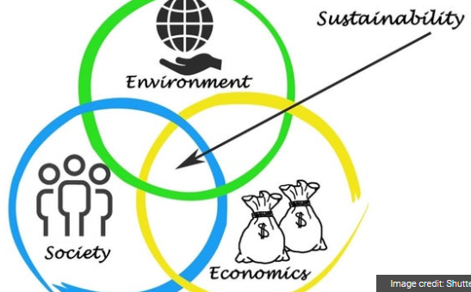
Sustainability
Sustainable business and airport- economic benefit for Wales
Manage sustainability to improve processes and to add value (Mckinsey, 2011)
Fulfill all areas- All satisfied
(Jain,2015)

Slide 9
Lewin’s Force Field Analysis
FOR
Against
Tourism for Wales
Cost- Risky Investment
Carbon neutral airport
Masterplan 2040
All airports following same changes
More passengers
Heathrow airport adding runway
Creates Jobs
Loans outstanding in future
Innovation and Growth
More legislation to follow
(Lewin,1948)

Slide 10
Environmental Impacts
Discussing the Environmental impacts of Masterplan 2040

Slide 11
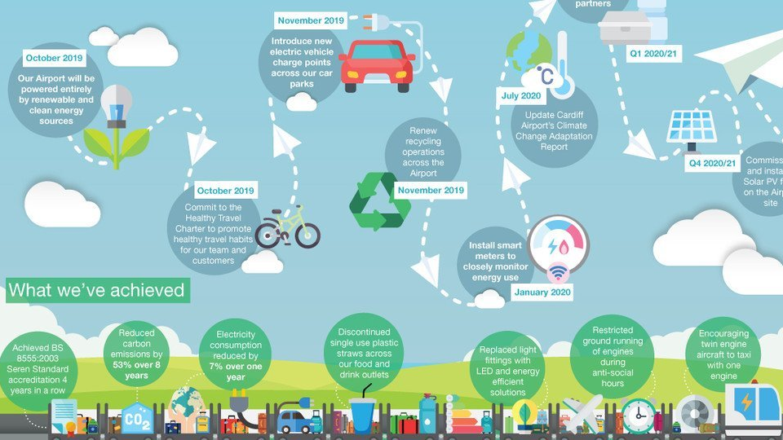
Environmental Flight Path
(Cardiff Airport, 2019)

Slide 12
Extra Environment Factors
Aiming to be a Carbon Neutral Airport (IAR, 2019)
Solar PV farm, Sustainable Building Materials
Attracts to younger groups, climate change

Slide 13
Economical Impacts
Discussing the Economical impacts of Masterplan 2040

Slide 14
Loans
High level of loans- risky
Currently: £21.2m (Thomas, 2019)
Requested: £6.8m (Martin, 2020)
Total at the end: £28m (Repayable over 25 years)
Error- Flybe in Administration- close to accepting loan request
Waiting for loan to be accepted

Slide 15
Other Economical Factors
Increase Welsh Economy due to planned increase in tourists
Renewable energy and building materials, save costs within company
Balance out spending with income- not a loss
The city deal, investing in; Connectivity, Skills, Innovation and Growth
Total investment £1.28bn (CCR, 2016)

Slide 16
Societal Impacts
Discussing the Societal impacts of Masterplan 2040

Slide 17
Facts and Statistics since Masterplan 2040
Passenger numbers have increased 7% in the last year
18 Airlines use Cardiff Airport Regularly
50 direct routes from Cardiff
Over 900 connections
11 routes to major hub airports
1.6 million customers choose to fly from Cardiff annually

Slide 18
New links with Qatar Airways
Connecting Wales to the world
Announced the new airline in 2018
Qatar Airways are “transformational” (Reid, 2019)
5 flights a week to Doha
From May 31st until September 1st- daily flights
Accessible way to see the world
Doha, Qatar is the central hub for the whole world (ORTG, 2020)

Slide 19
Recommendations for Cardiff Airport
Keep focussing on being a sustainable business and airport
Economic benefits for Wales will happen, but the time period is unknown
Look for other potential methods to receive income without requesting more loans
Consider paying off a percentage of loans to keep debt at a steady level

Slide 20
Conclusion
Middle of a transformational period with Masterplan 2040
Increased passenger numbers the last few years
Positive impact on Environment
Short term negative impact on economy
Long term positive impact on economy
Positive impacts on society
Future looks great for Cardiff Airport
A sustainable business

Slide 21
Bibliography
AirportGuides, 2020. Airport Guides. [Online]
Available at: http://www.airportguides.co.uk/guides/cardiff/factsandfigures.html [Accessed 5 March 2020].
Barrett, T., 2020. Revealed: every UK airport has plans to expand. Air Quality News, 18 February, p. 1.
BusinessWales, 2020. Business Wales. [Online]
Available at: https://businesswales.gov.wales/enterprisezones/zones/cardiff-airport-and-bro-tathan/support-and-incentives-cardiff-airport-and-bro-tathan
[Accessed 5 March 2020].
CardiffAirport, 2019. Cardiff Airport 2040 Masterplan, Cardiff: Welsh Government.
CardiffAirport, 2019. Environmental Flight Path. Cardiff Airport News, 20 September, p. 1.
CardiffAirport, 2020. Cardiff Airport Media. [Online]
Available at: https://www.cardiff-airport.com/media/
[Accessed 3 March 2020].
CardiffAirport, 2020. Cardiff Airport Need for a Masterplan. [Online]
Available at: https://www.cardiff-airport.com/need-for-a-masterplan/
[Accessed 3 March 2020].
Carradice, P., 2010. A brief history of Cardiff Airport. BBC News, 30 June, p. 1.
CCR, 2016. Cardiff Capital Region. [Online]
Available at: https://www.cardiffcapitalregion.wales/about/
[Accessed 5 March 2020].

Slide 22
Bibliography
Donavan, O., 2020. Senedd roundup: Government look at all options to expand coronavirus isolation facilities. Nation Cymru, 11 March, p. 1.
GovUK, 2013. Aviation Policy Framework, London: UK Government.
IAR, 2019. Environmental Flight Path. International Airport Review, 24 September, p. 1.
Jain, S., 2015. Sustainability. Entrepreneur India, 23 October, p. 1.
Lewin, K., 1948. Forcefield Analysis. [Online]
Available at: https://www.change-management-coach.com/force-field-analysis.html
[Accessed 12 March 2020].
Martin, P., 2020. Wales Politics. BBC News, 2 March, p. 1.
Mckinsey, 2011. Mckinsey & Company. [Online]
Available at: https://www.mckinsey.com/business-functions/sustainability/our-insights/the-business-of-sustainability-mckinsey-global-survey-results
[Accessed 4 March 2020].
ORTG, 2020. Online Regional Travel Group. [Online]
Available at: https://www.justtheflight.co.uk/airline-guides/QR-qatar-airways.html
[Accessed 12 March 2020].
Porter, M. E., 1985. Competitive Advantage: Creating and Sustaining Superior Performance. 1st ed. New York: The Free Press.
Reid, J., 2019. Cardiff Airport says Qatar Airways services have been 'transformational'. Business Traveller, 9 May, p. 1.
Thomas, N., 2019. Welsh Government to Loan Cardiff Airport £21m. South Wales Argus, 21 October, p. 1.
TransportNewsWales, 2019. Transport News Wales. Business News Wales, 13 November, p. 1.

Slide 23

Thanks for Listening
See you again soon

