Slide 1
WELCOME BACK ☺

Slide 2
Who am I?
Dr Amit Naik
Education
  BEng Electronics and Telecommunication
  MSc Information security
  PhD Information Security Governance
Professional qualifications
  CISSP (In progress)
  CCSP
  CCNA (Security)
  CCNA
Work experience over 15 years in the IT industry

Slide 3
Format for delivery
Lecture
Labs

Slide 4
Indicative contents
• Introduction the module and Fundamentals of networking and Packet tracer Lab(Week 1)
• Communication on a network and Packet tracer Lab (Week 1)
• Client server model and Packet tracer Lab (Week 2)
• OSI and TCP/IP Models and Packet tracer Lab (Week 2)
• Types of Networks –LAN, WAN, MAN and Packet tracer Lab (Week 3)
• Physical and logical addressing and Packet tracer Lab (Week 4)
• Wireless networks and standards and Packet tracer Lab (Week 5)
• Cyber Security –attacks, access control, encryption, cryptography with Packet tracer Lab (Week 6 and 7)
• Importance of data security with Wireshark and Packet tracer Lab (Week 8)
• System security –firewalls, threats, intruders and malicious software with Wireshark and Packet tracer Lab (Week 9)
Revision (Week 10)

Slide 5
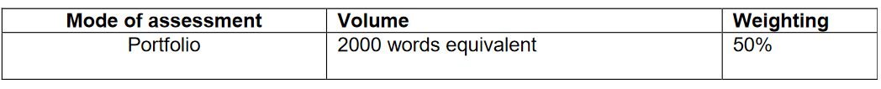
Assessment Types
Assessment Component 1 (Coursework's )
Assessment Component 2 (Written Exam)

Slide 6
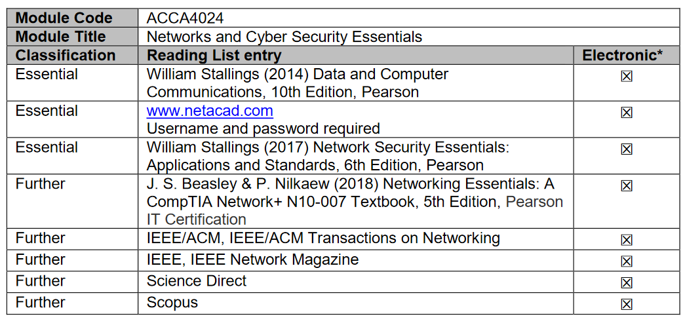
INDICATIVE READING LIST

Slide 7
ACTIVITY: WHO YOU ARE?

Slide 8
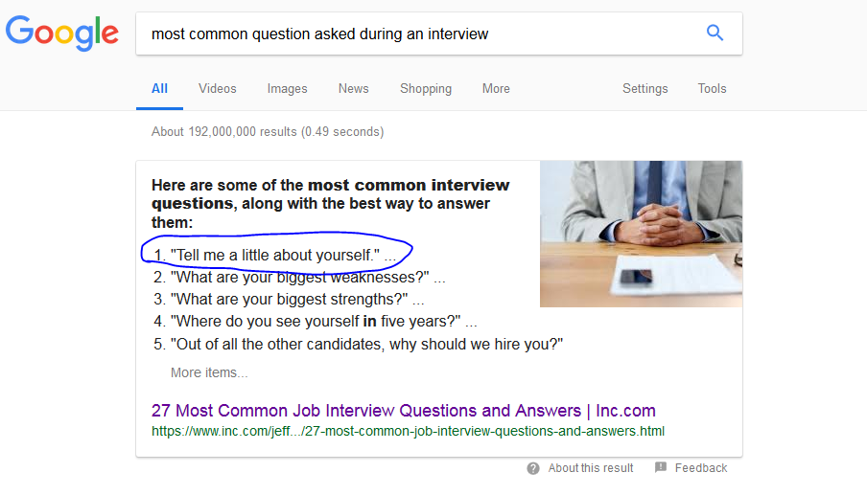
Why do this activity?

Slide 9
Individual Activity
Compose a 1 min introduction about yourself.
Answer these questions:
  Who are you?
  Where are you from?
  Why did you choose UWTSD?
  Why did you choose this Program to study?
  One fact about you, that you would like to share?
Rules:
  Be professional
  Time limit to prepare - 15 mins

Slide 10
Thank you

