Slide 1

Enhancing Housekeeping Training for Consistent Brand Standards
Student name: Adina Cirmaciu |  | Student number: 2233579
Programmes: |  | BA International Hotel Management
Module: | Operating Hotel Facilities | Module code: | BMIH4006

Slide 2
Table of Contents
Slide 1:
Slide 2: Table of Contents
Slide 3: Introduction
Slide 2: The Importance of Brand Standards
Slide 3: Training Objectives
Slide 4: Employee Engagement Model - The R.A.C.E. Framework
Slide 5: Practical Application of R.A.C.E.
Slide 6: The Training Process
Slide 7: Best Industry Practices
Slide 8: Case Study - Marriott International
Slide 9: Health and Safety Procedures
Slide 10: Conclusion
Slide 11: Thank You and Q/A
Slide 12: References

Slide 3

Introduction
The presentation aims to enhance housekeeping training to maintain brand standards, focusing on a comprehensive training program and integrating the R.A.C.E. framework for enhanced team performance and strict adherence to health and safety protocols.
Notes:
Introduction
This presentation will focus on improving housekeeping training with the goal of maintaining consistent brand standards. In order to ensure that the housekeeping staff continuously provides outstanding quality and complies with the exacting standards established by the brand, it will investigate a thorough training programme. In order to maximise team performance and maintain tight adherence to health and safety protocols, it will also explore the integration of an employee engagement model called the R.A.C.E. framework.

Slide 4
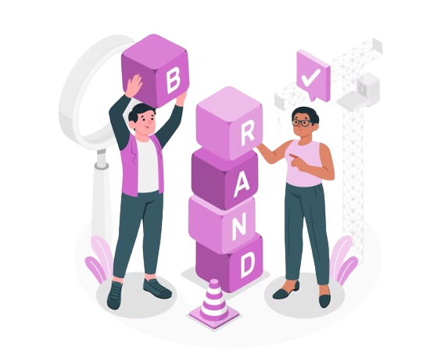
The Importance of Brand Standards
Our hotel's reputation is built on our brand standards, which define excellence, reliability, and calibre (Joydeep Das Gupta, 2023).
Following these guidelines ensures a positive visitor experience, while deviating can lead to negative experiences, discontent, and business loss.
Notes:
The Importance of Brand Standards
Our reputation in the hotel sector is built on our brand standards. They specify the standards of excellence, reliability, and calibre that our visitors identify with our facility. Saying that our brand guidelines represent the core of who we are is not hyperbole (Joydeep Das Gupta, 2023). When we follow these guidelines, we provide our visitors an experience that makes a good impression that lasts. Deviating from these guidelines, however, might have detrimental effects. Negative visitor experiences may ensue, resulting in discontent and even loss of business. Maintaining brand standards consistently is essential to our business and the happiness of our guests.

Slide 5

Training Objectives
To achieve consistent brand standards, our training program should focus on associates' understanding of brand guidelines, practical cleaning skills, health and safety protocols, and employee engagement (Goel and R Kumar, 2021).
By integrating team and individual objectives with brand standards, a well-rounded training program and motivated, proficient cleaning staff ensure brand conformity.
Notes:
Training Objectives
We should concentrate our training programme on the following goals in order to attain consistent brand standards. First and foremost, it is crucial that associates fully comprehend brand guidelines and are knowledgeable about the particular demands of our lodging. In order to carry out their duties properly and efficiently, they need also acquire practical cleaning skills (Goel and R Kumar, 2021). Thirdly, team members need to be very well-versed in applying health and safety protocols, since they are non-negotiable. In order to integrate team and individual objectives with brand standards, we will lastly promote employee engagement. The combination of a well-rounded training programme and a motivated and proficient cleaning staff guarantees brand conformity.

Slide 6

Employee Engagement Model - The R.A.C.E. Framework
Respect: It is the ability to recognise and value each team member's distinct contribution. (McCown et al., 2023).
Alignment: Keeping team and individual goals in line with our brand values.
Communication: Encouraging cooperation, idea exchange, and problem-solving via open, sincere, and efficient communication (Quick, 2020).
Empowerment: This is the process of giving team members the freedom and power to own their responsibilities, which improves output and work satisfaction.
Notes:
Employee Engagement Model - The R.A.C.E. Framework
To improve our training on housekeeping, we use the R.A.C.E. employee engagement approach. R.A.C.E. stands for four essential components:
Respect: It is the ability to recognise and value each team member's distinct contribution. This cultivates a feeling of worth and inclusion, which is necessary for drive and dedication (McCown et al., 2023).
Alignment: Keeping team and individual goals in line with our brand values. This alignment fosters a commitment to excellence across all parties and establishes a common vision.
Communication: Encouraging cooperation, idea exchange, and problem solving via open, sincere, and efficient communication (Quick, 2020).
Empowerment: This is the process of giving team members the freedom and power to own their responsibilities, which improves output and work satisfaction.

Slide 7

Practical Application of R.A.C.E.
Respect: A pleasant work atmosphere is fostered by acknowledging each person's efforts. (Raghubalan and Raghubalan, 2016).
Alignment: Team objectives are inextricably related to our service quality.
Communication: Team members have a forum to discuss issues and exchange best practices. (Pulliam, 2020).
Empowerment: Giving team members the freedom to decide how to do their work gives.
Notes:
Practical Application of R.A.C.E.
The R.A.C.E. methodology for employee engagement may greatly improve our cleaning team's performance while upholding brand standards. Now let's look at some real-world uses:
Respect: A pleasant work atmosphere is fostered by acknowledging each person's efforts. During team meetings, acknowledging exceptional work and celebrating accomplishments fosters a feeling of community (Raghubalan and Raghubalan, 2016).
Alignment: Team objectives are inextricably related to our service quality when performance goals are defined in line with our brand standards.
Communication: Team members have a forum to discuss issues and exchange best practises at regular feedback meetings. Collaboration is facilitated by open communication (Pulliam, 2020).
Empowerment: Giving team members the freedom to decide how to do their work gives them a sense of ownership over their jobs, which inspires initiative and positive attitude.

Slide 8

The Training Process
A systematic training program is crucial for meeting brand requirements.
It covers basic brand standards, practical cleaning techniques, safety procedures, and health and safety (Ibraiz Tarique, 2022).
The R.A.C.E. model's tenets are incorporated to promote staff involvement and align individual and group objectives with brand guidelines.
Notes:
The Training Process
A systematic training procedure is essential to meeting unified brand requirements. It should cover the basic brand standards training that new team members get during onboarding. Practical training includes instruction on cleaning techniques and product use via hands-on experience (Ibraiz Tarique, 2022). Team members are guaranteed to be knowledgeable about safety procedures and processes via health and safety training. In addition, we will include the R.A.C.E. model's tenets into the training to promote staff involvement and harmonise individual and group objectives with brand guidelines. This strategy develops a comprehensive training programme that gives our housekeeping staff the abilities and attitude they need to continuously uphold our brand standards.

Slide 9

Best Industry Practices
To ensure a training programme aligns with industry best practices, compare the approach to competitors, commit to continuous improvement, and learn from industry leaders.
Comparing your training to top hotels can provide valuable insights into market trends and opportunities for development (Tyagi et al., 2023).
Acquiring expertise from these leaders can further enhance your training program.
Notes:
Best Industry Practices
We need to consider a number of important tactics to make sure our training programme complies with industry best practises. Initially, comparing yourself to prosperous rivals might provide insightful information about what makes the market tick. We can pinpoint opportunities for development by comparing our training approaches with those of top hotels.
Secondly, a dedication to ongoing improvement is essential. The hotel sector is ever-changing, and so are brand norms. We must update our training curriculum to reflect the most recent industry requirements if we want to remain in the forefront (Tyagi et al., 2023).
Finally, acquiring expertise from industry leaders, like well-known hotels with flawless brand standards, provides a plethora of insights to improve our own training programmes.

Slide 10

Case Study - Marriott International
Marriott International, a leader in the hotel industry, upholds brand values through extensive training, worker involvement, and strict health and safety regulations. Their R.A.C.E. model, emphasizing Respect, Alignment, Communication, and Empowerment, has led to high employee satisfaction and brand loyalty.
Notes:
Case Study - Marriott International
In the hotel sector, Marriott International is a shining example of upholding constant brand values. Their remarkable accomplishments stem from a well-balanced combination of extensive training initiatives, steadfast dedication to worker involvement, and strict observance of health and safety regulations. Marriott International has achieved remarkable levels of employee satisfaction and steadfast brand loyalty via its unshakable commitment to the R.A.C.E. model, which emphasises Respect, Alignment, Communication, and Empowerment (Barreto and Mayya, 2022). We can improve our training programme and make sure that our cleaning staff not only meets but constantly surpasses the high standards of our brand by imitating Marriott's best practises.

Slide 11
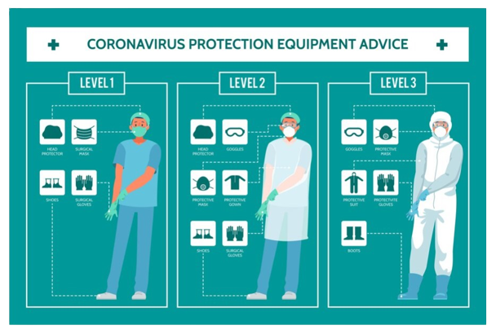
Health and Safety Procedures
Handling and storing cleaning supplies safely.
Appropriate handling and upkeep of cleaning supplies.
Emergency response protocols, such as evacuation and fire safety measures (Angelo and Apking, 2023).
Personal protective equipment (PPE) training.
Frequent safety exercises and audits to ensure compliance and preparedness.
Notes:
Health and Safety Procedures
It is imperative to protect the health and safety of our visitors and team members. Comprehensive health and safety regulations, such as safe handling of chemicals, operating equipment, and emergency procedures, must be included in our training programme. Regular safety inspections will be conducted to strengthen these protocols.
Safety protocols will address:
Handling and storing cleaning supplies safely.
Appropriate handling and upkeep of cleaning supplies.
Emergency response protocols, such as evacuation and fire safety measures (Angelo and Apking, 2023).
Personal protective equipment (PPE) training.
Frequent safety exercises and audits to ensure compliance and preparedness.
This dedication to health and safety preserves the stellar reputation of our company while safeguarding our workforce.

Slide 12
Conclusion
Marriott International's training program, based on the R.A.C.E. model and industry best practices, ensures housekeeping staff meet brand requirements, promotes engagement, and maintains health and safety.
This strategy ensures exceptional visitor experiences, builds a productive team, and honors dignity and autonomy, demonstrating Marriott's commitment to continuous development and benchmarking.
Notes:
Conclusion
Finally, our thorough training programme, which is based on the R.A.C.E. model and industry best practises, enables our housekeeping staff to reliably accomplish brand requirements. In addition to promoting staff engagement and maintaining health and safety, this strategy guarantees outstanding visitor experiences. We build a driven and productive team by equating individual and group objectives, encouraging communication, and honouring dignity and autonomy. Marriott International and other industry leaders serve as excellent examples of our dedication to continuous development and benchmarking.

Slide 13
THANK YOU
Q/A

Slide 14
References
Angelo, A.P. and Apking, T. (2023). Common Workplace Safety Issues Uncovered During Audits and How to Address Them - Advanced Consulting and Training. [online] Advanced Consulting and Training. Available at: https://advancedct.com/common-workplace-safety-issues-uncovered-during-audits-and-how-to-address-them/ [Accessed 30 Oct. 2023].
Barreto, N. and Mayya, S. (2022). SWOC Analysis of Marriott International- A Case Study. International Journal of Case Studies in Business, IT, and Education, 169(65), pp.877–889. doi:https://doi.org/10.47992/ijcsbe.2581.6942.0238.
Goel, S.L. and R Kumar (2021). Hospital administration and management : theory and practice. 22nd ed. New Delhi: Deep & Deep Publications.
Ibraiz Tarique (2022). Seven trends in corporate training and development : strategies to align goals with employee needs. 17th ed. New Jersey, N.J.: Pearson.
Joydeep Das Gupta (2023). Hospital Administration and Management. 7th ed. Jaypee Brothers Medical Publishers Pvt Limited.
McCown, N., Linjuan Rita Men, Jiang, H. and Shen, H. (2023). Internal Communication and Employee Engagement. 12th ed. Taylor & Francis.
Pulliam, R.M. (2020). Practical Application of Critical Race Theory: A Social Justice Course Design. Journal of Social Work Education, 53(3), pp.414–423. doi:https://doi.org/10.1080/10437797.2016.1275896.
Quick, L. (2020). Managing Events. Real Challenges, Real Outcomes. 1st ed. SAGE.
Raghubalan, G. and Raghubalan, S. (2016). Hotel Housekeeping : Operations and Management. 3rd ed. New Delhi, India: Oxford University Press.
Tyagi, P.K., Nadda, V., Bharti, V. and Kemer, E. (2023). Embracing Business Sustainability Through Innovation and Creativity in the Service Sector. 4th ed. IGI Global.
Notes:
References
Angelo, A.P. and Apking, T. (2023). Common Workplace Safety Issues Uncovered During Audits and How to Address Them - Advanced Consulting and Training. [online] Advanced Consulting and Training. Available at: https://advancedct.com/common-workplace-safety-issues-uncovered-during-audits-and-how-to-address-them/ [Accessed 30 Oct. 2023].
Barreto, N. and Mayya, S. (2022). SWOC Analysis of Marriott International- A Case Study. International Journal of Case Studies in Business, IT, and Education, 169(65), pp.877–889. doi:https://doi.org/10.47992/ijcsbe.2581.6942.0238.
Goel, S.L. and R Kumar (2021). Hospital administration and management : theory and practice. 22nd ed. New Delhi: Deep & Deep Publications.
Ibraiz Tarique (2022). Seven trends in corporate training and development : strategies to align goals with employee needs. 17th ed. New Jersey, N.J.: Pearson.
Joydeep Das Gupta (2023). Hospital Administration and Management. 7th ed. Jaypee Brothers Medical Publishers Pvt Limited.
McCown, N., Linjuan Rita Men, Jiang, H. and Shen, H. (2023). Internal Communication and Employee Engagement. 12th ed. Taylor & Francis.
Pulliam, R.M. (2020). Practical Application of Critical Race Theory: A Social Justice Course Design. Journal of Social Work Education, 53(3), pp.414–423. doi:https://doi.org/10.1080/10437797.2016.1275896.
Quick, L. (2020). Managing Events. Real Challenges, Real Outcomes. 1st ed. SAGE.
Raghubalan, G. and Raghubalan, S. (2016). Hotel Housekeeping : Operations and Management. 3rd ed. New Delhi, India: Oxford University Press.
Tyagi, P.K., Nadda, V., Bharti, V. and Kemer, E. (2023). Embracing Business Sustainability Through Innovation and Creativity in the Service Sector. 4th ed. IGI Global.

