Slide 1
CertHE Applied Leadership and Management in the Workplace
Module: BMSK4015
Academic and Research Skills

Slide 2
Blended Learning ​
Session 6

Slide 3
Today’s Session
Data, Information, Knowledge,
Understanding and Wisdom

Slide 4
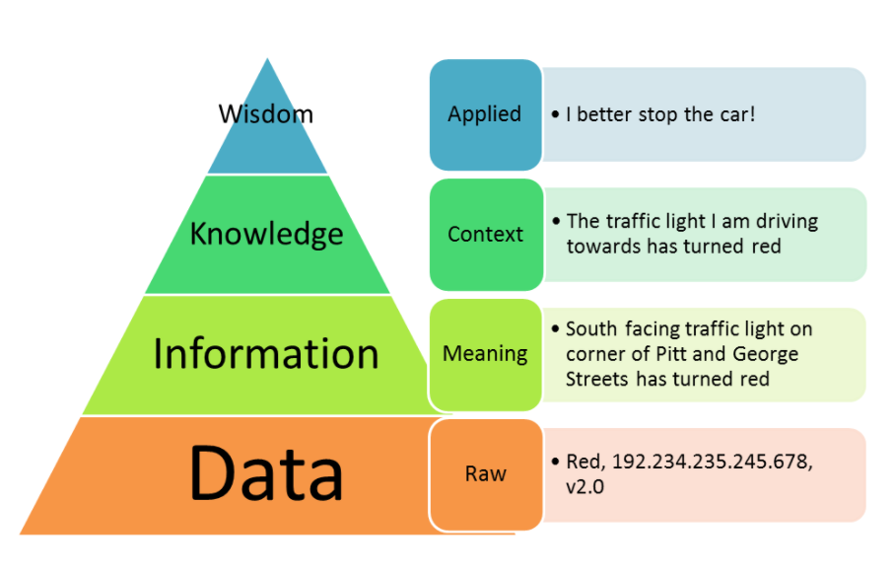
Urmeneta (2011)

Slide 5
Data: Symbols
Data is raw. It simply exists and has no significance beyond its existence (in and of itself).
Information:
Data that are processed to be useful; provides answers to "who", "what", "where", and "when" questions.

Slide 6
Knowledge: application of data and information; answers "how" questions
Understanding: appreciation of "why”
Wisdom: evaluated understanding.
Ackoff (1989)

Slide 7
Data
What do the numbers (123424331911)
(211192) or perhaps the letters 'aab' mean to you?
Probably nothing - this is because they have no specific meaning or application. They are examples of DATA.

Slide 8
Data
Data consist of raw facts and figures
- they do not have any meaning until they are processed and turned into something useful
Data comes in many forms, the main ones being letters, numbers and symbols

Slide 9
Data
It is essential that DATA is available because it is the first step in creating meaningful INFORMATION
The three data items on the earlier slide could represent some useful information:
DATA | INFORMATION
123424331911 ----→ aab -----------------→ | Your winning lottery ticket number Your A level results
211190 --------------→ | Your date of birth

Slide 10
There are two kinds of data
Qualitative data uses words or images to describe something.
  Not in numerical form e.g. open-ended questionnaires ‘What did you think of our service?’
Quantitative data uses numbers, or categories, that can be labelled with a number.
  This type of data can be used to construct graphs and tables of raw data.

Slide 11
Information
Information is data that has been processed in such a way as to become meaningful to the person who receives it.
INFORMATION = DATA + CONTEXT + MEANING
An example of Information:
Data: 21041926 - this has no meaning or context
Context: It is a British date

Slide 12
Information
This allows us to register it as 21st April 1926, but it still has no meaning and is therefore not information.
Meaning: The birth date of Queen Elizabeth II
This gives us all the elements required for it to be called 'information'

Slide 13
Knowledge
Scenario: Sales of widgets are 25% down on last year.
Data gathered: for example, from competitor analysis, or a PEST (Political, Economic, Social and Technological) analysis.
Data is processed to become information:

Slide 14
Knowledge
Information: loss of sales is due to a competitor launching a rival product at a cheaper price.
Knowledge: the price of our widgets is too high in the current market or climate.
Knowledge is having an understanding of the "rules".
Action: reduce the selling price of our widgets.

Slide 15
Knowledge
Information is the underpinning of Knowledge
The difference between information and knowledge is certainty.
Information is largely based on fact that cannot be disputed (as long as the data is correct!).

Slide 16
Knowledge
However, knowledge is based on probabilities - what are the chances of a course of action being the best alternative, given a set of information....?
The reason for this uncertainty is that there are many possible outcomes for a given set of information.

Slide 17
Understanding
Understanding: An appreciation of Why
“The difference between understanding and knowledge is the difference between "learning" and "memorising".

Slide 18
Wisdom
Wisdom: evaluated understanding.
“Wisdom is the process by which we also discern or judge between right and wrong, good and bad.”
Should we do this?
Is this the right thing to do?
Wisdom can be defined as “the right use of knowledge.”

Slide 19
Example
“Knowledge is knowing a tomato is a fruit. Wisdom is knowing not to put it in the fruit salad.”
“Knowledge is knowing what to say. Wisdom is knowing when to say it.”
Knowledge is knowing you have right of way. Wisdom is not getting in an accident to prove it.

Slide 20
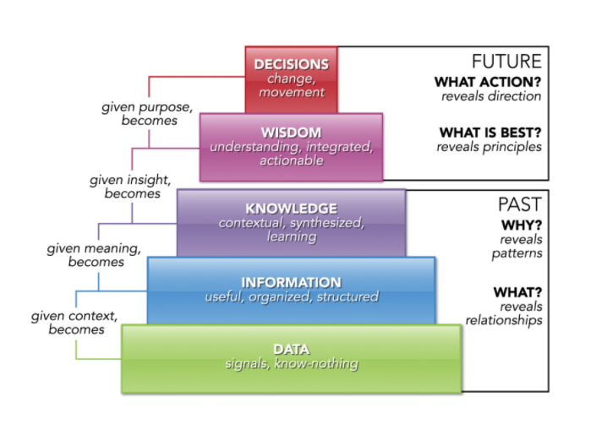
Swindoll (2011)

Slide 21
Summary
Data is the collection of raw measurements
Information is the result of processing raw data
Knowledge is a conclusion of what to do when a particular set of information presents itself.
Wisdom is knowing when to use that knowledge

Slide 22
References
Ackoff, R. L., (1989) "From Data to Wisdom", Journal of Applied Systems Analysis, Volume 16, 1989 p 3-9.
Bellinger, G et al. (2004), Data, Information, Knowledge and Wisdom, [online] available at http://www.systems-thinking.org/dikw/dikw.htm accessed Mar 2023
Jakubik, M. and Müürsepp, P. (2022), "From knowledge to wisdom: will wisdom management replace knowledge management?", European Journal of Management and Business Economics, Vol. 31 No. 3, pp. 367-389.
Urmeneta, M.A. DIKW diagram [online] available at http://www.allthingy.com/data-information-knowledge-wisdom/ accessed Mar 2023
Weinberger, D. (2010), The Problem with the Data-Information-Knowledge-Wisdom Hierarchy, [online] available at https://hbr.org/2010/02/data-is-to-info-as-info-is-not accessed Mar 2023

