Slide 1

Programme: Msc Public Health And Social Care In Practice
Module: Social Epidemiology And Public Health Development
Module Code: LCHS7000
Assignment Title: Component 1 Group Presentation (Practice Intervention)
Student ID | Student Name
2603852 | Dhara Barot
2605356 | Hiral Khunti
2614884 | Melina Bishwakarma

Slide 2

Introduction
Campaign Title: “PeakPerformance: Optimising Cognitive & Metabolic Nutrition for UK University Students”

Slide 3
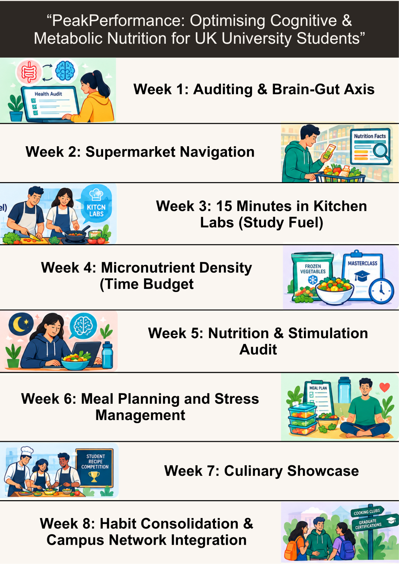
Campaign Overview and Activities
Aim: To bridge the gap between UK university students’ nutritional knowledge and practical execution by strengthening culinary self-efficacy and embedding proper dietary habits.
Content of the Activities
Week 1 - 2
Interactive workshops to diagnose Brain-Gut health
Supermarket safaris with food label decoding
Week 3 - 4
Hands-on batch-cooking masterclasses
Use of frozen products on a budget
Week 5 - 6
Workshop on managing exam anxiety
Sleep architecture through stimulant audits
Week 7 - 8
“Brain-Booster” recipe competition
Signposts to cooking clubs

Slide 4
Task 1: Rationale
Group Member 1:

Slide 5
Rationale for the Campaign
UK university students consume a poor quality diet that affects long-term health (Sprake et al., 2018).
19% of UK young adults in their twenties experience micronutrient deficiencies like vitamin A, Calcium, Magnesium, Potassium and others (Derbyshire, 2018).
According to the National Diet and Nutrition Survey, nearly 96% of people did not meet the required fibre recommendations (GOV.UK, 2025).
Poorer dietary and fast food consumption patterns create nutritional risk among university students (Vázquez-Aguilar et al., 2026).
Thus, the “PeakPerformance: Optimising Cognitive & Metabolic Nutrition for UK University Students” will be reliable to shape students’ eating patterns and provide relief from lifelong chronic disease risks.

Slide 6
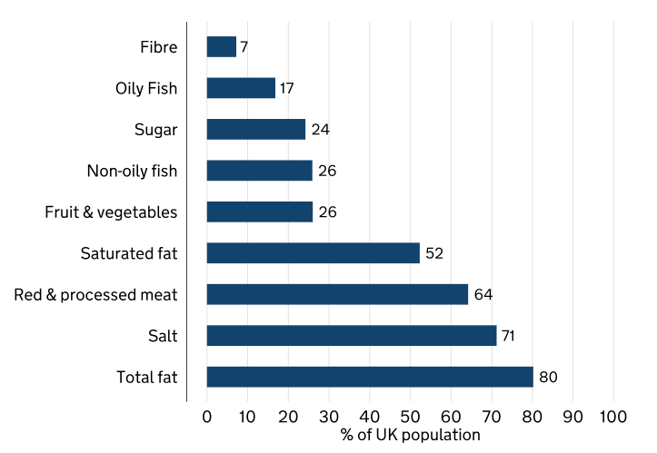
National Guidelines and Statistics
Introducing the Eatwell Guide, the UK Government encourages people to consume a balanced diet that prevents malnutrition (GOV.UK, 2023).
It also influences people to avoid unhealthy foods from the meal and lead a healthy lifestyle (GOV.UK, 2024).
Similarly, the British Nutrition Foundation also encourages university students to eat a healthy diet to measure sustainable progress (British Nutrition Foundation, 2026).
The NHS shares eight healthy eating tips to keep people active and at a healthy weight (NHS, 2026).
Consuming a healthier diet, 47% of students acknowledge that they have good knowledge about nutrition (Brown, 2022).
Figure: Eatwell recommendations
to avoid unhealthy foods
(Source: GOV.UK, 2024)

Slide 7
Short-term And Long-term Consequences
Short-term Consequence
Long-term Consequence
Malnutrition causes bone density deficits and impaired intellectual development (BAPEN, 2026).
Poor nutritional habits increase the risk of obesity which leads to the development of non-communicable diseases (Roberts et al., 2025).
Around 52% of university students in England confront substantial weight gain (Savage et al., 2024).
Over the years, poor dietary habits have increased the risk of chronic diseases, such as Type 2 Diabetes and cardiovascular diseases (Al-Awwad et al., 2021).
A lack of nutrient absorption also results in immune dysfunction (QMUL, 2016).
The prevalence of malnutrition and dietary habits causes cognitive decline that leads to permanent deficits (Feng et al., 2022).

Slide 8
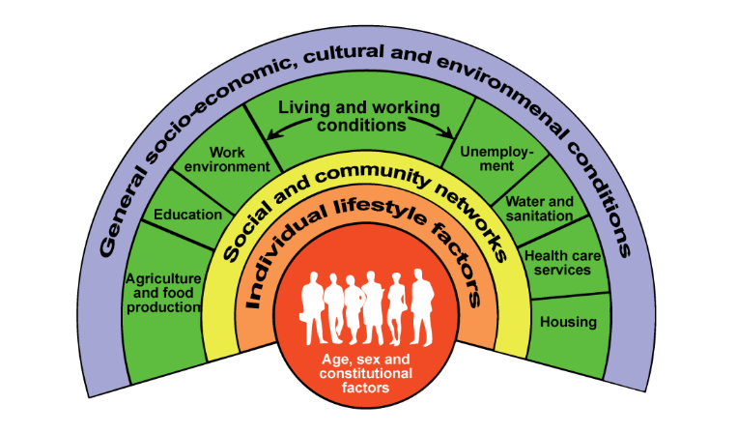
Theoretical Framing: The Social Determinants Of Health
According to the Social Determinants of Health, non-medical conditions affect health outcomes (CDC, 2024).
Socioeconomic disparities prohibit a person from consuming nutritious foods, which frequently leads to skipping meals and causes malnutrition (Almoraie et al., 2025).
Unequal distribution of student accommodation is another constraint for UK students to access nutrition or comfort (Morris, 2025).
Lastly, structural time poverty and easy access to campus food significantly drive learners’ poor dietary habits.
Figure: Model of Social Determinant of Health
(Source: INFRA4NEXTGEN, 2026)

Slide 9
Campaign Aim 1: Enhancing Nutritional
& Culinary Literacy
Specific Aim
To improve university students’ practical understanding related to micronutrient density and upskill knowledge of budget-friendly meal preparation by 65% within an 8-week period.
Measurable Indicators
Pre and post-intervention knowledge assessment scores will measure the outcome.
Benefit
It will help to bridge the UK university students’ nutritional knowledge and practical gap.

Slide 10
Campaign Aim 2: Optimising Cognitive Energy
& Snack Profiles
Specific Aim
To reduce at least 50% of sugar-dense snack habits and fast-food consumption with whole-food alternatives and sustained energy by an 8 weeks’ campaign intervention.
Measurable Indicators
Reduction in self-reported weekly sugary snack frequency and energy drink consumption.
Benefit
It will stabilise the Glycemic Index (GI) which boosts cognitive function in adults (Philippou et al., 2019).

Slide 11
Campaign Aim 3: Streamlining Meal Prep
For Time-poor Schedules
Specific Aim
To increase 80% of students’ participation in practical 15-minutes batch-cooking strategies which prep sustained meals within time.
Measurable Indicators
Usage of meal-prep tracking logs on a weekly basis and analysis of self-assessment on post-programme on nutritional cooking habits.
Benefit
It will increase time efficiency and ensure the accessibility of a balanced meal at home.

Slide 12
Task 2: Campaign
Group Member 2:

Slide 13
Operationalisation of the “PeakPerformance” Campaign
To reduce malnutrition and poor dietary habits among UK university students, the “PeakPerformance” campaign highlights an 8 week-based public health intervention.
The campaign is structured through three operational pillars: tailored marketing practices, evaluation of multidimensional outcomes and cross-sectional institutional partnerships.
Based on the campaign benefits, the study will highlight measurable outcomes which impact UK university students.

Slide 14
8 Week Intervention Roadmap (Weeks 1-4)
Week 1: Auditing & Brain-Gut Axis
Conduct digital health audit via university portal
Week 2: Supermarket Safari
Virtual guidance on “Supermarket Navigation”
Week 3: Kitchen Labs (15 Minutes Study Fuel)
Week 4: Micronutrient Density
Masterclasses joining
Affordable frozen products usage
Hands-on cooking experiences
Making slow-release breakfast and lunch
Food labels decoding as per nutrition
Designing of pop-up workshop

Slide 15
8 Week Intervention Roadmap (Weeks 5-8)
Week 5: Stimulation Audit
Workshops participation
Week 6: Meal Planning and Stress Management
Acquire required batch-cooking strategies
Week 7: Culinary Demonstration
Week 8: Campus Networking
Signpost campus cooking clubs
Compete student-led competition
Graduate certifications-based networking
Embrace peer-led recipe hacks
Stress management learning
Sleep cycle and dietary habits management

Slide 16
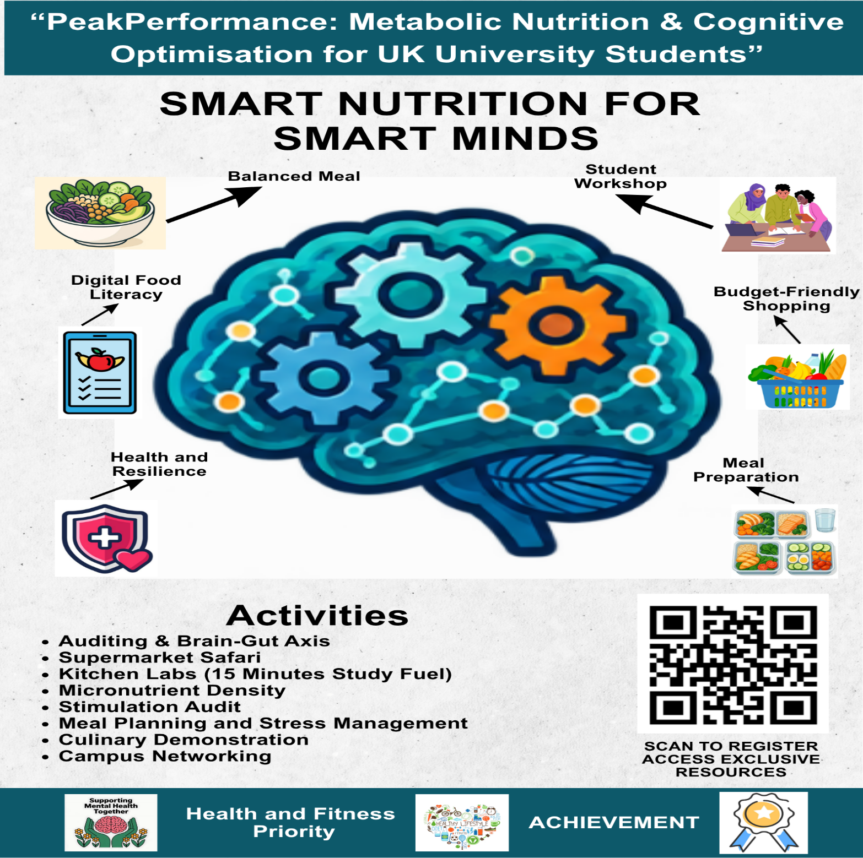
Marketing Strategy of the Campaign
Strategic Branding: Allow UK university students to develop their cognitive and psychological functions.
Inclusive Design: Usage of QR codes will grant learners instant access to dietary-restricted recipes.
Omnichannel Deployment: Participating students will access to digital campus signage and conduct personal branding through social media platforms.

Slide 17
Theoretical Underpinning: RE-AIM Framework
Reach: The “PeakPerformance” campaign facilitates monitoring different demographic groups (18 to 24 years) of university students’ participation (Biggs et al., 2023).
Effectiveness: Usage of “Food Frequency Questionnaires" measures the cognitive focus of participating students.
Implementation: Fidelity across different university campuses will assess the campaign outcomes.
Adoption: Number of student associations and universities that embed the programme.
Maintenance: Post-intervention follow-ups will assess students’ dietary habits (Schaafsma et al., 2025).

Slide 18
Comprehensive Campaign Evaluation
Process Evaluation
Assess the campaign implementation among target audiences (Leask et al., 2019).
Monitor the reach of “PeakPerformance” campaign activities.
Impact Evaluation
Assessment of self-efficacy highlights the impact of “PeakPerformance”.
Qualitative feedback collection determines participants’ interest towards the campaign.
Outcome Evaluation
Collection of participants’ responses via post-intervention.
Assessment of UK university students' good dietary habits and nutrition intake.

Slide 19





Multi-agency Partnership Ecosystem
Logo | Organisation Name | Initiative | Aim | Link to Campaign
 | NHS England (UK) | Eatwell Guide | Encourage healthy eating by following a balanced diet (NHS, 2026a). | As an evidence-based foundation, the “Eatwell Guide” explains the importance of balanced diets that improve learners’ meal planning habits.
 | British Dietetic Association (BDA) (UK) | Eat Well, Spend Less | Improve physical and mental health by consuming good nutrition and following a healthy diet (BDA, 2026). | BDA’s dietetic guidance is relevant for cooking demonstrations that encourage healthy eating behaviour.
 | The Food Foundation (UK) | Good Food Neighbourhoods | Introduction of “Good Food Neighbourhoods” encourages every resident to access affordable and healthy foods (The Food Foundation, 2026). | Accessibility of affordable healthy foods helps the “PeakPerformance” campaign consider supermarket navigation.
 | Food Cardiff (Cardiff, UK) | #GoodFoodCardiff | Create resilient communities across Cardiff through good food (Cook, 2022). | Food Cardiff’s community-based approach helps to integrate campus networking into the “PeakPerformance” campaign.
 | Bristol Food Network (Bristol, UK) | Good Food 2030 | Connecting people within a resilient food system and encouraging them to eat fresh and nature-friendly food (Andrews, 2023). | The “Good Food 2030” initiative enables the campaign to consolidate habits and improve the Brain-Gut axis.

Slide 20
Resources Replication and Adaptation from Existing Campaigns
NHS Better Health: Barcode scanning facility (NHS, 2026b). It will help to instantly decode food labels and measure micronutrient density.
BDA Food Fact Sheets: Consist of nutritional information (BDA, 2026a). Evidence-based outcomes will empower learners’ digital food literacy.
GOV UK: Health promotion toolkit (GOV.UK, 2026a). It will go with the meal planning process and supermarket navigation during critical times, such as exam periods.

Slide 21
Task 3: Benefits and Challenges
Group Member 3:

Slide 22
Transition to Task 3
The final section outlines the theoretical underpinning of the “PeakPerformance” campaign.
It will also discuss the physiological, psychological and sociological benefits that underlie the actual benefits of sustainable dietary habits.
Based on changing behaviour, some challenges will be demonstrated with tailored solutions.

Slide 23
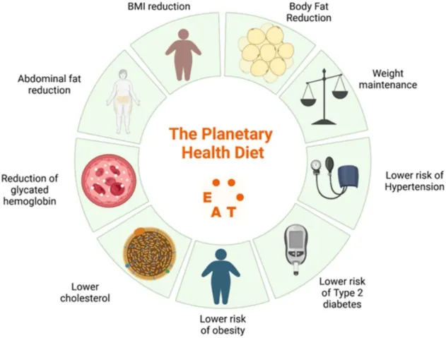
Benefits: Physiological & Metabolic Mechanisms
The “PeakPerformance” campaign will improve participants' physical performance.
Proper nutritional intake stabilises GI and maintains blood sugar levels (Vlachos et al., 2020).
GI stabilisation also replicates slow-release carbohydrate patterns that prevent brain fog.
Moreover, dietary fibre intake reduces long-term risks such as Type 2 diabetes and cardiovascular morbidity (Chen, Tao and Wang, 2025).
Figure: Planetary healthy diet impact on physiological & metabolic mechanisms
(Source: Alblaji, 2026)

Slide 24
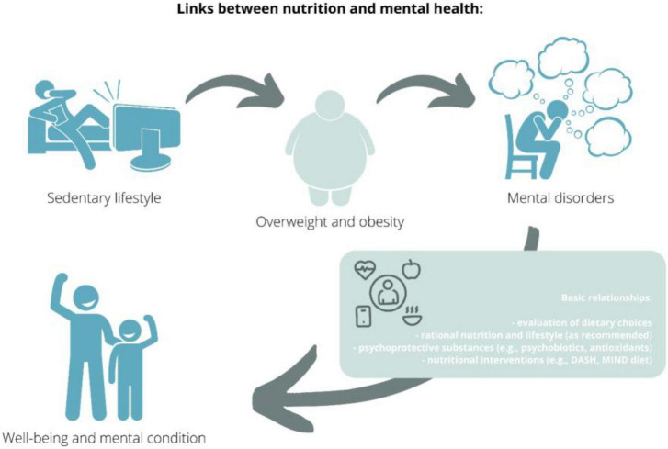
Benefits: Psychological & Sociological Well-being
The "PeakPerformance" campaign also plays an important role in embracing psychological resilience and sociological capital.
Sustained focus on nutrition and good dietary patterns will enhance students’ cognitive function and reduce stress.
As a sociological benefit, shared cooking experiences will facilitate building a strong peer support network.
Higher culinary knowledge is connected with better dietary choices and supports people's long-term lifestyle modifications (Sandri et al., 2025).
Figure: Relationship between nutrition and mental health
(Source: Grajek et al., 2022)

Slide 25
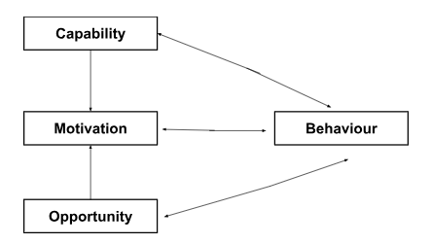
Theoretical Application I: The COM-B Model
To acquire modified dietary patterns, the COM-B model influences individual healthy eating behaviours (Timlin, McCormack and Simpson, 2020).
However, psychological deficits impair individuals' psychological capabilities, leading to stress and diminished interoceptive awareness.
Academic deadlines create opportunity barriers for university students and influence their saturated and cheap ultra-processed food consumption.
Lastly, prolonged fasting, irregular meal patterns, and high snack consumption cause motivational barriers among university students (Jurado-Gonzalez et al., 2025).
Figure: COM-B Model
(Source: Self-created)

Slide 26
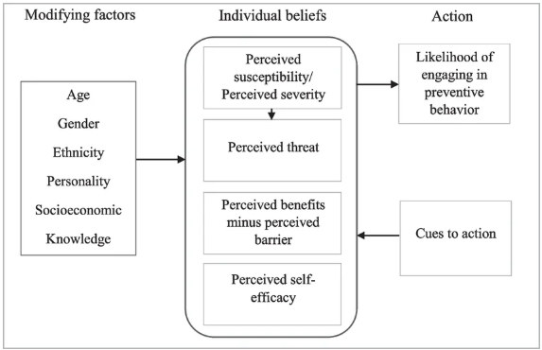
Theoretical Application II – Health Belief Model (HBM)
The Health Belief Model describes how cognitive constructs create challenges to university learners’ behavioural changes (Kim, Ahn and No, 2012).
According to perceived susceptibility and severity, young adults experience a strong optimism bias based on their chronic health conditions.
Perceived barriers also highlight students’ heavy reliance on daily habits.
Thus, this lack of awareness triggers UK university students to make healthier nutrition choices.
Figure: Health Belief Model
(Source: Subedi, Filho and Adedji, 2023)

Slide 27
Critical Analysis of Structural Barriers
Based on individual concerns, some potential challenges are identified.
Firstly, academic workload pushes university students to consume ultra-processed snacks or fast-food items.
Capability deficits also increase stress levels and reduce individuals' self-confidence to cook for themselves.
Next, biased optimism regarding physiological health increases the risk of chronic diseases.
Lastly, a lack of support hinders the progress of sustained action to follow good dietary habits.

Slide 28
Evidence-based Mitigation Strategies
& Tailored Solutions
Mitigating capability deficit, the “PeakPerformance” will offer 15 minutes of “Study Fuel” that provides practical knowledge on cooking and boosts self-efficacy.
To grab academic opportunities and minimise time barriers, the campaign will introduce its shopping navigation and stimulation audit.
Addressing optimism bias and perceived susceptibility, it will consider the quick meal preparation process that eliminates brain fog and reduces stress.
Moreover, habit consolidation will be the appropriate solution to normalise structured eating habits and lead to a healthy lifestyle.

Slide 29
References
Al-Awwad, N.J., Al-Sayyed, H.F., Zeinah, Z.A. and Tayyem, R.F. (2021) ‘Dietary and lifestyle habits among university students at different academic years’, Clinical nutrition ESPEN, 44, pp.236-242.
Alblaji, M. (2026) ‘Plant-based diets for human health with implications for cardiometabolic health, gut microbiome, and nutritional adequacy’, Frontiers. Available at: https://doi.org/10.3389/fnut.2026.1830797
Almoraie, N.M., Alothmani, N.M., Alomari, W.D. and Al-Amoudi, A.H. (2025) ‘Addressing nutritional issues and eating behaviours among university students: a narrative review’, Nutrition research reviews, 38(1), pp.53-68. Available at: https://doi.org/10.1017/S0954422424000088
Andrews, R. (2023) Bristol Food Network: who are we and what is Bristol Good Food 2030?. Available at: https://www.feedingbristol.org/bristol-food-network-who-are-we-and-what-is-bristol-good-food-2030/ (Accessed: 9 October 2026).
BAPEN (2026) What are the consequences of malnutrition?. Available at: https://www.bapen.org.uk/malnutrition/introduction-to-malnutrition/what-are-the-consequences-of-malnutrition/ (Accessed: 8 October 2026).
BDA (2026) Adolescent food facts - BDA - British Dietetic Association. Available at: https://www.bda.uk.com/food-health/food-facts/adolescent-food-facts.html (Accessed: 9 October 2026).
BDA (2026a) Food Facts. Available at: https://www.bda.uk.com/food-health/food-facts/all-food-fact-sheets.html (Accessed: 9 October 2026).
Biggs, B.K., Rodgers, K.V., Nayman, S.J., Hofschulte, D.R., Loncar, H., Kumar, S., Lynch, B.A., Rajjo, T.I. and Wilson, D.K. (2023) ‘Translation of a family-based behavioral intervention for adolescent obesity using the RE-AIM framework and common steps from adaptation frameworks’, Translational behavioral medicine, 13(9), pp.700-709. Available at: https://doi.org/10.1093/tbm/ibad022
British Nutrition Foundation (2026) Nutrition for Students. Available at: https://www.nutrition.org.uk/nutrition-for/students/ (Accessed: 8 October 2026).

Slide 30
References
Brown, J. (2022) ‘Do students really eat that badly?’, BBC. Available at: https://www.bbc.com/future/article/20221128-do-students-really-eat-that-badly (Accessed: 8 October 2026).
CDC (2024) Social Determinants of Health (SDOH). Available at: https://www.cdc.gov/about/priorities/why-is-addressing-sdoh-important.html (Accessed: 8 October 2026).
Chen, X., Tao, L and Wang, Y. (2025) ‘Association of dietary fiber intake with all-cause and cardiovascular mortality in diabetes and prediabetes’, PubMed Central, 18;17:231. Available at: https://doi.org/10.1186/s13098-025-01810-9
Cook, J. (2022) PRESS RELEASE: Pledges Wanted To Make Cardiff One Of The UK’s Most Sustainable Food Places. Available at: https://foodcardiff.com/press-release-pledges-wanted-to-make-cardiff-one-of-the-uks-most-sustainable-food-places/ (Accessed: 9 October 2026).
Derbyshire, E. (2018) ‘Micronutrient intakes of British adults across mid-life: a secondary analysis of the UK National Diet and Nutrition Survey’, Frontiers in nutrition, 5, p.55. Available at: https://doi.org/10.3389/fnut.2018.00055
Feng, L., Chu, Z., Quan, X., Zhang, Y., Yuan, W., Yao, Y., Zhao, Y. and Fu, S. (2022) ‘Malnutrition is positively associated with cognitive decline in centenarians and oldest-old adults: A cross-sectional study’, EClinicalMedicine, 47. Available at: https://doi.org/10.1016/j.eclinm.2022.101336
GOV.UK (2023) Healthy eating: applying All Our Health. Available at: https://www.gov.uk/government/publications/healthy-eating-applying-all-our-health/healthy-eating-applying-all-our-health (Accessed: 8 October 2026).
GOV.UK (2024) United Kingdom Food Security Report 2024: Theme 4: Food Security at Household Level. Available at: https://www.gov.uk/government/statistics/united-kingdom-food-security-report-2024/united-kingdom-food-security-report-2024-theme-4-food-security-at-household-level (Accessed: 8 October 2026).
GOV.UK (2025) National Diet and Nutrition Survey 2019 to 2023: report. Available at: https://www.gov.uk/government/statistics/national-diet-and-nutrition-survey-2019-to-2023/national-diet-and-nutrition-survey-2019-to-2023-report (Accessed: 8 October 2026).

Slide 31
References
GOV.UK (2026a) Preventing avoidable disease, Protecting health, Promoting wellbeing resilience. Available at: https://vivbennett.blog.gov.uk/wp-content/uploads/sites/90/2018/03/LCAV-3Ps-TOOLKIT-2018-FINAL.pdf (Accessed: 9 October 2026).
Grajek, M., Krupa-Kotara, K., Białek-Dratwa, A., Sobczyk, K., Grot, M., k., O. and Staśkiewicz, W. (2022) ‘Nutrition and mental health: A review of current knowledge about the impact of diet on mental health’, Front Nutr, 9, pp.943998. Available at: https://doi.org/10.3389/fnut.2022.943998
INFRA4NEXTGEN (2026) The Health and Wellbeing of People in Europe. Available at: https://infra4nextgen.com/resources/data-summaries/healthy/2-theoretical-model/ (Accessed: 8 October 2026).
Jurado-Gonzalez, P., López-Toledo, S., Bach-Faig, A. and Medina, F. (2025) ‘Barriers and Enablers of Healthy Eating Among University Students in Oaxaca de Juarez: A Mixed-Methods Study’, Nutrients, 17(7), pp.1263. Available at: https://doi.org/10.3390/nu17071263
Kim, H., Ahn, J. and No, J. (2012) ‘Applying the Health Belief Model to college students' health behavior’, Nutr Res Pract. 6(6), pp.551–558. Available at: https://doi.org/10.4162/nrp.2012.6.6.551
Leask, C.F., Sandlund, M., Skelton, D.A., Altenburg, T.M., Cardon, G., Chinapaw, M.J., De Bourdeaudhuij, I., Verloigne, M., Chastin, S.F. and GrandStand, Safe Step and Teenage Girls on the Move Research Groups (2019) ‘Framework, principles and recommendations for utilising participatory methodologies in the co-creation and evaluation of public health interventions’, Research involvement and engagement, 5(1), p.2. Available at: https://doi.org/10.1186/s40900-018-0136-9
Morris, K. (2025) ‘Another brick in the wall: The student housing crisis in the UK and the ICESCR’, Netherlands Quarterly of Human Rights, 43(1), pp.12-30. Available at: DOI: 10.1177/09240519251318141
NHS (2026) 8 tips for healthy eating. Available at: https://www.nhs.uk/live-well/eat-well/how-to-eat-a-balanced-diet/eight-tips-for-healthy-eating/ (Accessed: 8 October 2026).
NHS (2026a) Eating a balanced diet. Available at: https://www.nhs.uk/live-well/eat-well/how-to-eat-a-balanced-diet/eating-a-balanced-diet/ (Accessed: 9 October 2026).

Slide 32
References
NHS (2026b) Better Health. Available at: https://www.nhs.uk/healthier-families/food-facts/nhs-food-scanner-app/
Philippou, E., Pot, G.K., Heraclides, A., Richards, M. and Bendayan, R. (2019) ‘Dietary glycaemic index and cognitive function: prospective associations in adults of the 1946 British birth cohort’, Public health nutrition, 22(8), pp.1415-1424. Available at: https://doi.org/10.1017/S136898001800352X
QMUL (2016) Malnutrition results from more than just poor diet. Available at: https://www.qmul.ac.uk/news/latest-news/2016/smd/malnutrition-results-from-more-than-just-poor-diet.html (Accessed: 8 October 2026).
Roberts, C.J., Ryan, D., Campbell, J. and Hardwicke, J. (2025) ‘Changes in Dietary Habits and Reported Barriers to Healthy Eating Amongst UK University Students’. Available at: doi: 10.20944/preprints202504.0057.v1
Sandri, E., Capoferri, M., Piredda, M. and Micheluzzi, V. (2025) ‘Culinary Habits and Health: Analyzing the Impact of Cooking Practices and Knowledge Among Spanish Young Adults’, Nutrients, 17(10), pp.1635. Available at: https://doi.org/10.3390/nu17101635
Savage, M.J., Procter, E.L., Magistro, D., Hennis, P.J., Donaldson, J., Leslie-Walker, A., Jones, B.A. and James, R.M. (2024) ‘Characterising the activity, lifestyle behaviours and health outcomes of UK university students: an observational cohort study with a focus on gender and ethnicity’, BMC Public Health, 24(1), p.3501. Available at: https://doi.org/10.1186/s12889-024-20911-0
Schaafsma, H., Caruso, O., Diaconita, S., McEachern, L., Seabrook, J. and Gilliland, J. (2025) ‘Enhancing Postsecondary Students' Dietary Behaviours: A Systematic Review of Mobile Health Interventions’, Journal of Human Nutrition and Dietetics, 38(5), p.e70130. Available at: https://doi.org/10.1111/jhn.70130
Sprake, E.F., Russell, J.M., Cecil, J.E., Cooper, R.J., Grabowski, P., Pourshahidi, L.K. and Barker, M.E. (2018) ‘Dietary patterns of university students in the UK: a cross-sectional study’, Nutrition Journal, 17(1), p.90. Available at: https://doi.org/10.1186/s12937-018-0398-y

Slide 33
References
Subedi, S., Filho, L. W. and Adedji, A. (2023) ‘An assessment of the health belief model (HBM) properties as predictors of COVID-19 preventive behaviour’, Journal of Public Health, 33(6), pp.1329-1339. Available at: https://doi.org/10.1007/s10389-023-02109-7?urlappend=%3Futm_source%3Dresearchgate.net%26utm_medium%3Darticle
The Food Foundation (2026) Good Food Neighbourhoods: food security through place-making. Available at: https://foodfoundation.org.uk/news/good-food-neighbourhoods-food-security-through-place-making (Accessed: 9 October 2026).
Timlin, D., McCormack, M. J. and Simpson, EA. E. (2020) ‘Using the COM-B model to identify barriers and facilitators towards adoption of a diet associated with cognitive function (MIND diet)’, Public Health Nutr., 24(7), pp.1657–1670. Available at: https://doi.org/10.1017/S1368980020001445
Vázquez-Aguilar, A., Ballesteros-Torres, J.M., Escalante-Aburto, A., Huerta-Canseco, C., Jiménez-López, K.L. and Caballero-Prado, C.J. (2026) ‘Dietary trends and lifestyle habits among university students: analysis of consumption patterns and nutritional risks’, Nutrients, 18(3), p.532.
Vlachos, D., Malisova, S., Lindberg, A. F. and Karaniki, G. (2020) ‘Glycemic Index (GI) or Glycemic Load (GL) and Dietary Interventions for Optimizing Postprandial Hyperglycemia in Patients with T2 Diabetes: A Review’, Nutrients, 12(6), pp.1561. Available at: https://doi.org/10.3390/nu12061561

