Slide 1

PowerPoint Presentation Tipsips
Alex Scott
HPFY3001 Academic Survival Skills
11 May 2021

Slide 2
Presentation: by Monday 22 May
(25% module grade)
Prepare and deliver a 5-minute presentation reflecting on your experiences of the foundation year as a whole. Assessment will be based on an oral presentation and visual accompaniments (using appropriate software e.g. PowerPoint, Prezi, etc.).
The presentation should address:
Your learning ‘journey’ over the course of the foundation year: where you started from and where you are now
Aspects of the course that you have enjoyed the most and/or found the most useful
Aspects of studying and university life where you feel you have demonstrated the most improvement and/or gained more confidence
Whether your impressions of university life have changed over the course of the academic year
Your next steps, and what you are looking forward to next year.

Slide 3

What is the point of PowerPoint?

Slide 4
What is the point of PowerPoint?
What are some of the pros and cons of PowerPoint?

Slide 5

PowerPoint

Slide 6

PowerPoint presentations COMPLEMENT what you say, but shouldn’t be an exact replica

Slide 7
PowerPoint presentations COMPLEMENT what you say, but shouldn’t be an exact replica
PowerPoint presentations can convey your ideas in a VISUALLY APPEALING (and, sometimes, memorable) fashion

Slide 8


Aims of a PowerPoint presentation
To present information accurately and memorably
To send a clear, informative message confidently
To engage your audience
To the audience see what you say

Slide 9

Ros’s ABC of PowerPoint Presentations
Accuracy
  Spelling, content etc.
Brevity
  Slides’ points should be brief - bare min.
Clarity
  Neat, simple, uncluttered

Slide 10
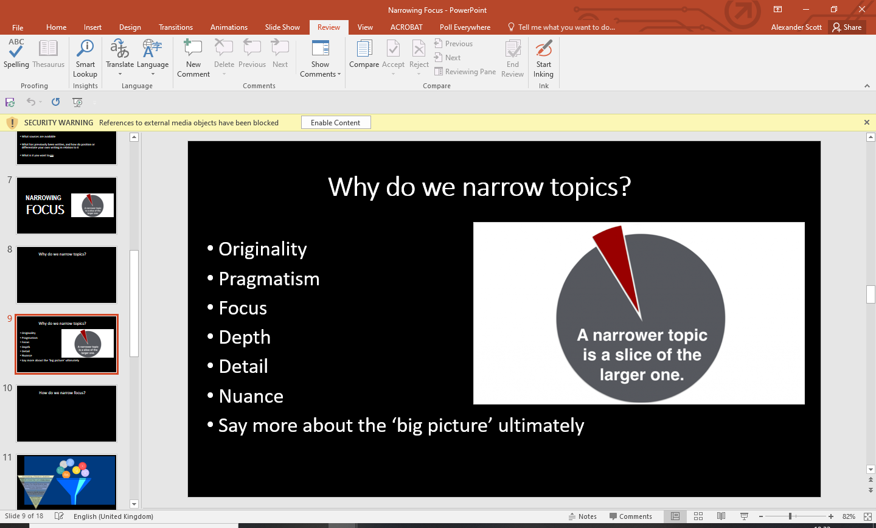

Slide 11
Slide Design
Consistency
Readability/‘scan-ability’
Limit text (except when using quotations to illustrate points)
Size and clarity of font

Slide 12

Poor slides
Text written over the picture so that you can’t see it
Background colour not contrasted enough with text’s colour
Text too small
Font too florid

Slide 13
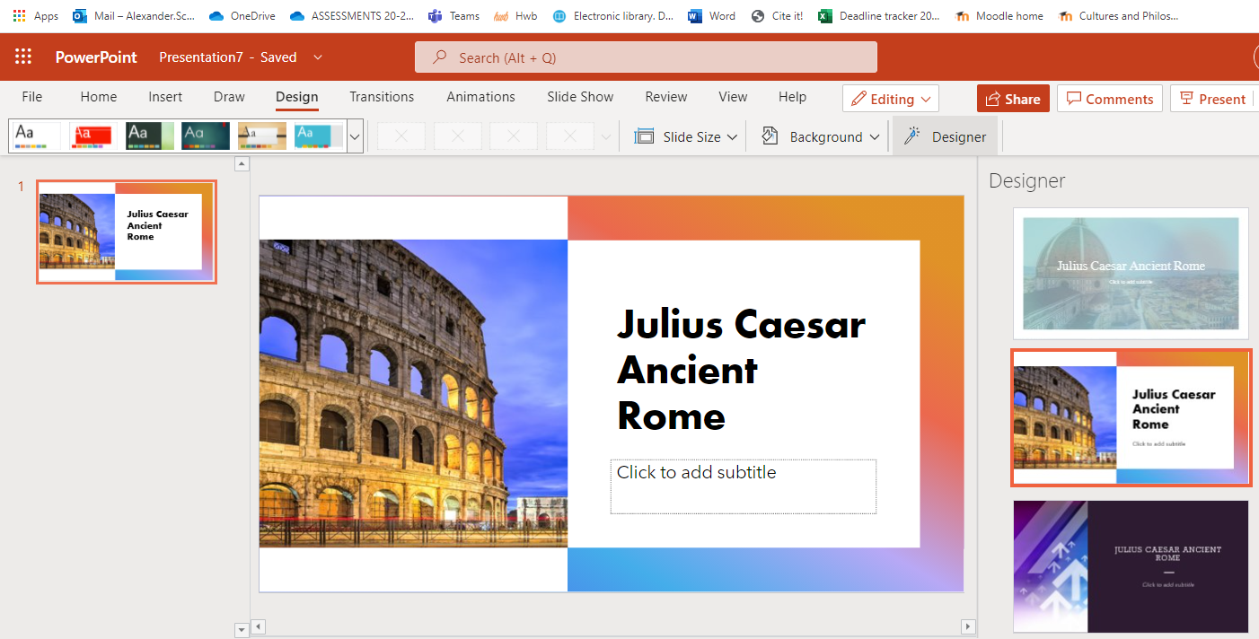
Tip:
Use ‘Design Ideas’ function on UWTSD Office version of PowerPoint to help with layout https://support.microsoft.com/en-us/office/create-professional-slide-layouts-with-powerpoint-designer-53c77d7b-dc40-45c2-b684-81415eac0617

Slide 14
Structure Tips
Include title slide
Follow the bullet-point list in the assignment brief
Otherwise, feel free to be creative!

Slide 15

Vocal Presentation Tips (aka 'Oral Hygiene')
Breathe!
Take your time
Don’t worry if you stumble … it’s natural
Try not to just read from the slides
Try not to be monotone – vary vocal emphasis; try to use energy and enthusiasm

