Slide 1
Poetry and skills
2018-9
Notes:
Most commonly used

Slide 2

Poetry
Reading and Writing

Slide 3
Definitions
What is your definition of Poetry?

Slide 4
I AM THE SONG
I am the song that sings the bird.
I am the leaf that grows the land.
I am the tide that moves the moon.
I am the stream that halts the sand.
I am the cloud that drives the storm.
I am the earth that lights the sun.
I am the fire that strikes the stone.
I am the clay that shapes the hand.
I am the word that speaks the man.
(Charles Causley)

Slide 5

Aims of the Session
 | Aim | Link to QTS
 | They teach clearly structured lessons or sequences of work which interest and motivate learners; employ interactive teaching methods and collaborative group work; and promote active and independent learning that enables learners to think for themselves, and to plan and manage their own learning. | S3.3.3
 | They have a secure knowledge and understanding of the subject(s) they are trained to teach. | S2.1
 | They can teach the required or expected skills, knowledge, and understanding relevant to the curriculum for learners in the age range for which they are trained. | S3.2.2
 | They are able to support those learning English or Welsh where this is the language in which they are being taught and is different from the language or form of language of their home, with the help of an experienced teacher where appropriate. | S3.3.5

Slide 6
Poems expand our views of what it is to be human, to feel joy, pain and affection for people, places and events… they engage our emotions and our sense of wonder and fun.
Susan Hill
(Poems not to be missed (1990))

Slide 7
Pedagogies
Teacher questioning
Dialogic talk
Imitate, invent, innovate,
listen-retell-tell
Visualising
Summarising
Phonics
Guided reading
Scaffolding
Shared reading
Shared writing
Modelling
Which are literacy specific?

Slide 8
Poetry – in READING
Poetry – as a stimulus for WRITING

Slide 9
…thoughts….
How can poetry develop Oracy?
Listening to poetry read aloud
Discussion
New vocabulary and words used in interesting and novel ways
Use of figurative language – metaphor, simile, etc.
Performance of poetry – clarity of diction
Attention to AURAL qualities of language, e.g. alliteration, assonance, onomatopoeia….

Slide 10

What is poetry?
Attempting to express the essence of something
Concentration and reduction of language
Verbal images – unconventional similes and metaphors (‘lonely as a cloud’)
Sound qualities – onomatopoeia / rhythm
Appearance on the page – structure (or lack of), length
“songs without music”

Slide 11
Definitions
Art or work of the poet; elevated expression of elevated thought or feeling in metrical or rhythmical form.
(Concise Oxford Dictionary)
In poems, words are made to work harder than they do in prose and poets use a number of linguistic and structural devices to squeeze as much labour from them as they can. (Medwell et al, 2001)

Slide 12
Definitions
The spontaneous overflow of powerful feelings: it
takes its origin from emotion recollected in
tranquillity.
(William Wordsworth)
The best words in the best order.
(Samuel Coleridge)
The sort of stuff that doesn’t reach the end of the
page when you write it down.
(Michael Rosen)

Slide 13
Types of Poem for Children’s Writing
Acrostic
Calligram or concrete poem
Cinquain
Clerihew
Haiku
List poems (young children)
Nonsense poem
Performance poems
Rap
Riddle - kennings
Thin poem
Limerick
Jingle
Free verse
Notes:
People are often put off getting children writing poems with structure because of their own lack of confidence – it is important that unless you are teaching syllables, rhyme etc. to not be too religious about getting the form of the poems right. Higher ability children could be challenged to redraft to fit a given form more closely.

Slide 14



The curriculum
Language, Literacy and Communication Skills Area of Learning
Key Stage 2 English Programme of Study

Slide 15


Learning Wales….

Slide 16
Teaching Strategies
1. Start with a stimulus
Sensory experience – walk in the woods
Music - instrumental
Image (could be drawn or photographed by the child)
Objects – multiple potential uses / origins – not obvious
Ask them to think of a theme e.g. birthdays
2. Children verbalise
Describe experience or drawing
List words / phrases
Thoughts and feelings of participants if writing about an event

Slide 17
Teaching Strategies
3. Adult scribes
Elicit more detail if necessary through questioning
Record discussion – child’s own words
If generating lists of words, children could write themselves
4. Turn into a poem
Words or phrases on cards for children to arrange
May need pictures as visual prompt
Add details or line starter / ending

Slide 18
Poetic Language
Figurative Language
Personification
Simile
Metaphor
Alliteration
Assonance
Onomatopoeia
“In poems, words are made to work harder than they do in prose and poets use a number of linguistic and structural devices to squeeze as much labour from them as they can.” (Medwell et al, 2001)

Slide 19
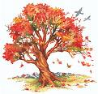
Poetic Language
Personification
The bare branches of the tree clawed at the sky…
The bees played hide and seek amongst the flowers.

Slide 20
Can you think of your own example of personification for leaves falling to the ground from the tree?

Slide 21
The leaves danced to the ground
The leaves hopped off the tree
The leaves waved goodbye to the tree
The leaves cried out in pain as they fell from the tree

Slide 22


Poetic Language
Poetic Devices – simile (like/as)
... as brave as a lion..
..shaking like a leaf ...
(When? Where?)
Notes:
Similes can be improved by adding where and when details e.g. as dark as a cave in the depths of winter, deep in the forest

Slide 23
beetle
tank
flower
lion
diamond
storm
river
thorn
thunder
needle
flame
star
Notes:
Get the students to find pairs of words and construct similes e.g. the beetle trundled along like a tank; the river was as loud as thunder

Slide 24
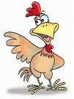
Poetic Language
Metaphor (is)
He is such a chicken!
Her face was a picture!
It was a blue day.
You are a star!
My teacher is a dragon!
A story is a key to another world.
Notes:
Children can often get the idea by creating a simile with ‘like’ and then replacing the ‘like’ with ‘is’.
He is like a bear in the morning – he is a bear in the morning

Slide 25
Find matches to create metaphors e.g. the library was a maze of shelves
shop
library
assistant
bare branches
life
insult
heart
story
stone
claws
journey
treasure trove
dagger
slave
magic spell
maze

Slide 26

Poetic Language
Alliteration – repeated initial sound
The weeping willow tree
Assonance – repeated (similar) vowel rhyme
The river flowed, slowly along below the ground.
Notes:
ELDORADO by Edgar Allan Poe (1849)
Alliteration game: Have one person start by saying (or perhaps singing) that they are going on a trip to a particular place. They will take with them some object that starts with the same letter as the place. Example for the letter P: I am going to Paris and I am taking a poodle.
Have the other players take turns adding to the list of objects being taken by thinking of something else that starts with that letter. Example continued: I am going to Paris and I am taking a poodle and a pen.
Continue the game until someone is unable to think of a word or makes a mistake.
Results: That person then drops out of the alliteration game.
Continue until only one person is left after everyone else has dropped out.
Results: That person is the winner!

Slide 27
Poetic Language
Onomatopoeia
Boom!
Zap!
Game
Notes:
Do an A-Z of onomatopoeia words.

Slide 28
Performance Poetry
We need to consider:
Rhythm and Beat (What’s the difference?)
Expression
Tone of voice
Volume of your voice
The speed that you say the words (tempo)
The mood of the poem
The characters in the poem
Repetition
Performance Poetry
Michael Rosen – Perform a poem

Slide 29
Ten Things Found in a Wizard’s Pocket
A dark night.
Some words that nobody could ever spell.
A glass of water full to the top.
A large elephant.
A vest made from spider’s webs.
A handkerchief the size of a car park.
A bill from the wand shop.
A bucket full of stars and planets, to mix with the dark night.
A bag of magic mints you can suck for ever.
A snoring rabbit.
Ian McMillan
Notes:
Share the lines out around the group and ask students to plan in detail how children should perform their line.

Slide 30
Poetry: Writing
Poetry Does Not Have To Rhyme!
Young children (3+)
list poems: “I like…”
image poems
6 – 7 year olds suggestions
Acrostics, Haiku, Poetry machines for structure*
Understand syllables (clapping)
Introduce rhyme but not a requirement in poems
Nonsense / made up words
8 + suggestions
Simple rhyming poetry – couplets, ABAB structure
Continue to provide structures
Provide the rhyming words for the end of lines

Slide 31
Haiku
Japanese
17 syllables over 3 lines
Line 1: 5 syllables
Line 2: 7 syllables
Line 3: 5 syllables
2 clear sensory images (domestic / natural)
Basho
Activity
Moonlight slants through
The vast bamboo grove:
A cuckoo cries
The old pond
A frog jumps in
The sound of water.
Notes:
The blue arrow is an hyperlink to more information

Slide 32
Brown leaves _____ and ________
They _____ underneath my __________
Autumn is here now.
Young birds _______ and ________
Mother rushes to ______ ________
They always ______ _______.
The school day drags on,
The teacher looks at _____ _______
It is __________ soon.
Notes:
One activity for learning Haiku is to give the children missing word examples to complete – HA children have to get the number of syllables right.

Slide 33
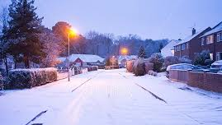
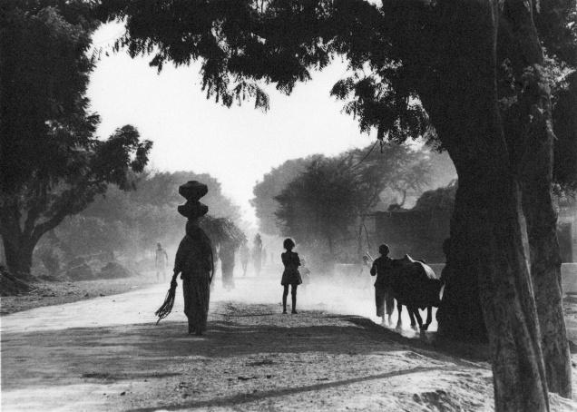
Write your own
Use these images to write your own haiku

Slide 34
Roger McGough
Shirley Hughes
Michael Rosen
Carol Ann Duffy
Benjamin Zephaniah
Edward Lear
Spike Milligan
Allan Ahlberg
https://www.booktrust.org.uk/books/childrens-laureate/former-laureates/
Dylan Thomas
Gillian Clarke
Mab Jones
Dave Boyce
Roald Dahl
Kate Roberts
Dafyyd ap Gwilym (1320-1380)
Sarah Waters
C.S.Lewis
https://poetrywales.co.uk/wp/date/2016/02/
http://www.literaturewales.org/our-projects/national-poet-wales/
http://www.bbc.co.uk/news/uk-wales-35686908
http://www.literaturewales.org/our-projects/wales-book-year/2016-short-list/

Slide 35
Further reading and points of reference:
http://www.poetrysoc.com/
http://www.poetryclass.net/lesindex.htm (lesson ideas and poems)
http://www.poeticbyway.com/glossary.html (associated vocab)
http://www.bbc.co.uk/schools/teachers/offbyheart/video/index.shtml Reading poetry aloud - famous people, famous poems.
https://www.google.co.uk/search?client=safari&rls=en&q=welsh+poets+tp+use+in+school+primary+age&ie=UTF-8&oe=UTF-8&gfe_rd=cr&ei=k63LWOXsJIuBtgf5nofIDg#q=famous+welsh+poems+for+children&*

Slide 36
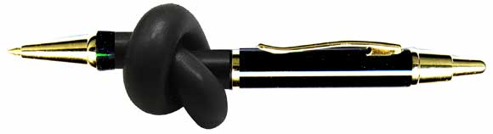
Go for it………..

Slide 37
Types of Poetry
Three main types of poetry:
Visual
Structured
Free Verse
Notes:
Knowing this helps us to get ideas for poems that children can write and hopefully gets rid of some preconceptions about what poetry is.

Slide 38
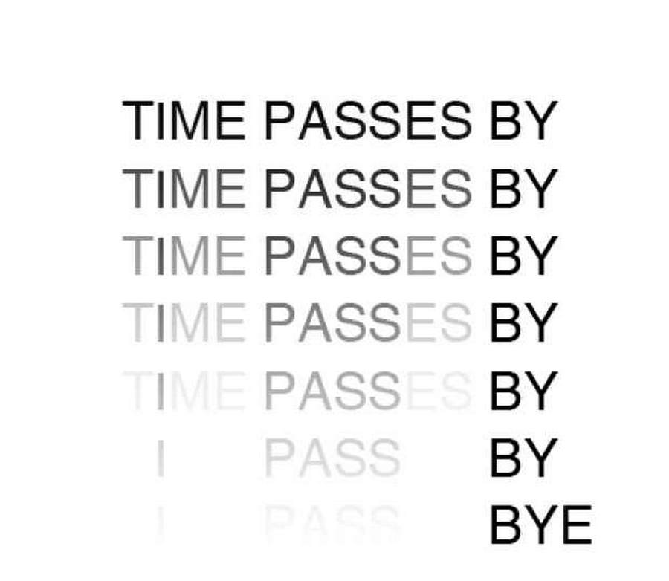
Visual Poetry
Visual Poetry
This is a concrete poem: its layout on the page is as much part of its effect as the words

Slide 39
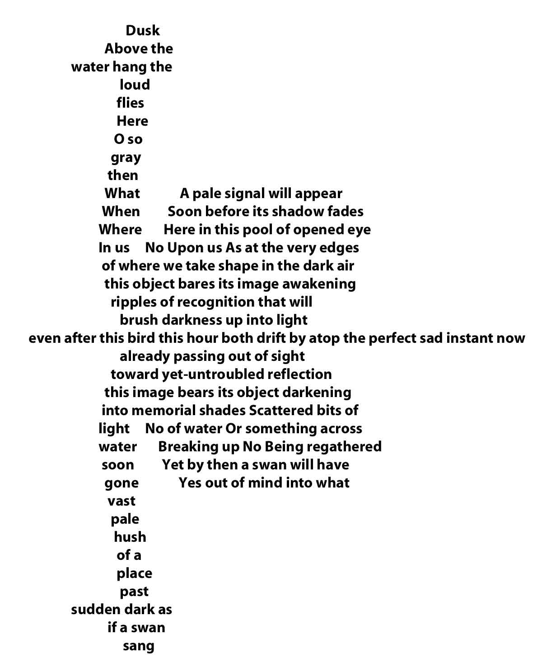
Visual Poetry
This a shape poem or calligram: the text forms a shape directly related to the subject matter of the poem.

Slide 40
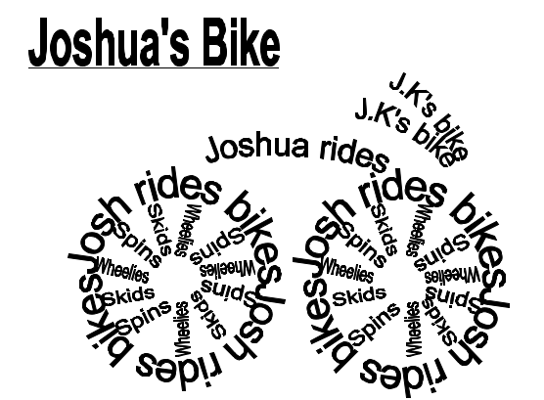
Visual Poetry for Children: Shape Poems / Calligrams

Slide 41
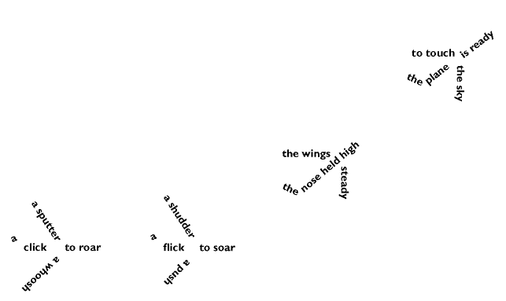
Visual Poetry for Children: Shape Poems / Calligrams

Slide 42
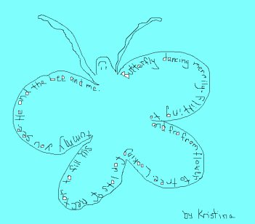

Slide 43
Straws
Straws
are
good
to
drink,
sip
or
slurp
but
if
you
drink
too
much
it
may
make
you
burp
Thin Poems

Slide 44
Structured Poetry
Follows a framework based on some or all of the following:
Verse / stanza and chorus
Line length / syllable count
Rhyme pattern
Rhythm or metre

Slide 45
Haiku
Japanese
17 syllables over 3 lines
Line 1: 5 syllables
Line 2: 7 syllables
Line 3: 5 syllables
2 clear sensory images (domestic / natural)
Basho
Activity
Moonlight slants through
The vast bamboo grove:
A cuckoo cries
The old pond
A frog jumps in
The sound of water.
Notes:
The blue arrow is an hyperlink to more information

Slide 46
Cinquain (sin-kane)
Ice Cream
Ice cream.
Cold and yummy.
I love its sweet richness
as it finds its way into my
tummy.
2
4
6
8
2

Slide 47
Clerihew
A four line, humorous, biographical poem with the rhyme scheme AABB.
The first line names the subject at the end of the line.
The enemy of Harry Potter
Was a scheming plotter.
I can't tell you what he's called; I'd be ashamed
To name "he who must not be named."

Slide 48
Free Verse
No framework
Possible to create structure linked to the subject of the poem
Allows freedom of expression but lack of structure can be challenging
Puts extra emphasis on word choice

Slide 49
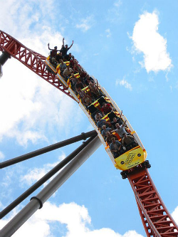
Thrill Ride
Up. Up.
Click, click.
Wind blows
sharp in my ears.
My heart jumps. Skips.
It’s up. It’s up higher.
It’s up, up the highest.
Hands grasp at the clouds.
Then a forever pause. Still. Waiting.
Finally. Whoosh!
Steep drop
down,
down,
down.
Free Verse

Slide 50
Poetry Machines
Poetry machines can help children cope with the challenge of free verse by providing prompts for composition. They take the form of a list of questions which, once answered create a poem.
Write the name of what you are writing about
Write down three words to describe it
Write something you know about it
Write some thing good about it
Write something bad about it
Write down how it makes you feel
Notes:
Students should use the poem machine to write their own poem

Slide 51
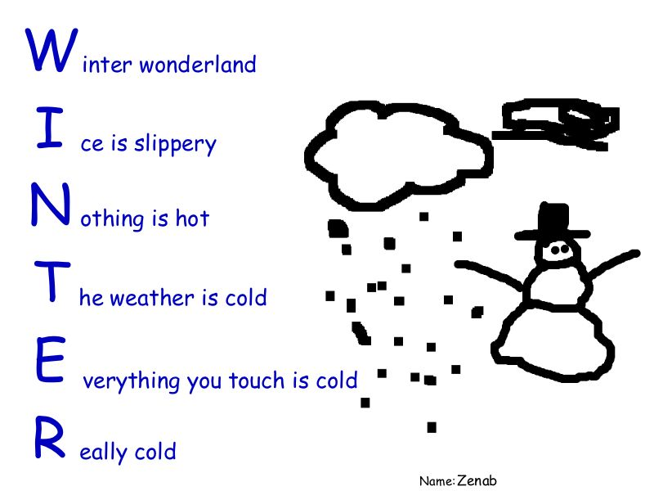
Acrostics

Slide 52
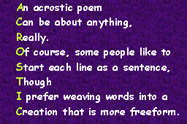
Acrostics

Slide 53
Acrostics
Y
O
U
R
N
A
M
E
P
G
C
E
/
T
A
R
(Choose one)

Slide 54

Kennings
Lipsmackin' thirstquenchin'
acetastin' motivatin' goodbuzzin'
cooltalkin' highwalkin' fastlivin'
evergivin' coolfizzin'
Notes:
1970’s famous Kenning - Pepsi

Slide 55
Kennings: Names and Riddles
Wind-rider,
Wave-dancer,
Ocean-strider,
Storm-runner.
Life-giver,
Skin-burner,
Day-bringer,
Night-slayer,
Light-maker.
Skin-cutter,
Bread-slicer,
Wound-maker,
Fruit-peeler,
Blood-letter,
Life-saver.
Now create your own for a neighbour to solve

Slide 56
Responding to Poetry
It is important that poetry is not used purely to highlight phonics (sounds) or to emphasise the use of similes or metaphors.
Poetry needs to be appreciated and responded to.
Personal response requires personal engagement.

Slide 57
Hands (Peter Young)
Hands
Handling
Dangling in water
Making and shaking
Slapping and clapping
Warming and warning
Hitting and fitting

Slide 58
Grabbing and rubbing
Peeling and feeling
Taking and breaking
Helping and giving
Lifting
Sifting sand
Hand holding
Hand.

Slide 59
Hands (Peter Young)
Teaching and Learning Sequence
Appreciation - read twice within one session, asking children to listen carefully.
Activities– re-read, explore sounds, “perform” with different voices, mime actions, examine own hands, prepare version for display (on backdrop of handprints).

Slide 60
Using Reading as a Way into Writing
Writing poetry is difficult, and can overwhelm pupils. It is important to provide suitable support for poetry writing.
One way to provide support is to provide a structure. One such structure could be a poem that has been read and studied as a class.
For example, using “Hands” as the structure, the pupils could write (as a class, as groups or as individuals) a poem relating to another body part.

Slide 61
Task
Write a poem about “FEET” that follows the same pattern as “Hands”.
Include actions that feet can achieve.
Copy the same rhyming pattern and rhythm.
Try to include internal rhyme (rhyme within one line of poetry).

Slide 62
Creative v Technical
Activities suggested rely on a creative response to the poem. However, the technical aspects (talking about sounds, rhyme patterns, themes, etc) will emerge from the creative approaches to the text.
AVOID using poetry merely as a way of demonstrating a spelling pattern or a figurative device.

Slide 63
Poetry and Rhyme
Although poets often use rhyme to create an effect within their work, rhyme and children don’t mix!
If you want the children to use rhyme in their own poems, help them by not only providing a “rhyme bank” (a word bank consisting of words that rhyme) but also by ensuring that the suggested words can be mixed and still make sense.

Slide 64
Lesson Planning
When planning a lesson for poetry, ensure that you have:
Suitable, focused learning outcomes;
Clear introduction that provides the children with the information they need to succeed at the task set;
Interesting, well-supported tasks for the children to complete independently or in groups;
Extension activities that are self-explanatory;
A plenary that draws the lesson to a satisfactory close.

Slide 65
Poetry Lesson
By the end of the session, the children will be able to:
Share their response to the poem “Hands” with their peers, providing clear opinions with supporting evidence;
Use the form of “Hands” to write a similar poem to celebrate their feet.

Slide 66
Introduction
Read an enlarged version of “Hands” to the class.
Ask them to provide their initial responses to the class – discuss in pairs during “thinking time” and report back to the whole class.
Repeat the poem together – separating the class into smaller groups to recite individual sections of the poem.
Ask children to consider whether their opinions have changed following the second reading.

Slide 67
Teaching Activity
Introduce the task to the children.They are going to write a poem to celebrate their feet.
Ask the class to identify the shape of the poem, significant language choices (e.g. ing ending) and style (e.g. hitting and fitting).
Ask children to suggest actions that the feet can carry out, and write these on the board to act as a word bank.

Slide 68
Teaching Activity
Ask children to write their poems independently.
Group Coch will compose directly onto the computers.
This task will take approximately 20 minutes.

Slide 69
Extension Activity
If the children finish quickly, ask them to read their poems to their neighbour, and make any alterations that are suggested.
Following this, the children can begin to prepare their presentation of the poem by creating an effective border for their work.

Slide 70
Plenary
Ask individuals to share their poems with the class. (You will have recognised effective poems as you monitored the children’s progress through the activity phase.)
Ask the rest of the class to comment on the poems that have been read out. Remind them to use the two stars (positive comments) and one wish (constructive criticism) process.

