Slide 1
Assignment (Portfolio of three elements)
Part 1- 1,500 words Discuss critically different approaches (e.g. Meta-analysis, systematic reviews, narrative reviews….. )
Part 2- 3,500 words - a broad overview of the relevant field and close examination of key concepts and end with some tentative indications of the gaps in the field and some draft research questions.
Part 3- 2,500 words
Total word limit : 7,500 (+/- 10%)
Please refer to Module handbook for details

Slide 2
LCDB 7009 Critical Literature Review
Steps for conducting a literature review
Defining the research question
Determining inclusion/exclusion criteria
Choosing databases and conducting the search
Reviewing your results
Synthesising the information gathered
Analysing the information gathered
Writing the literature review
Mention it in part 1
Work out item 2&3 and compile your results in Part 2
Part 3

Slide 3
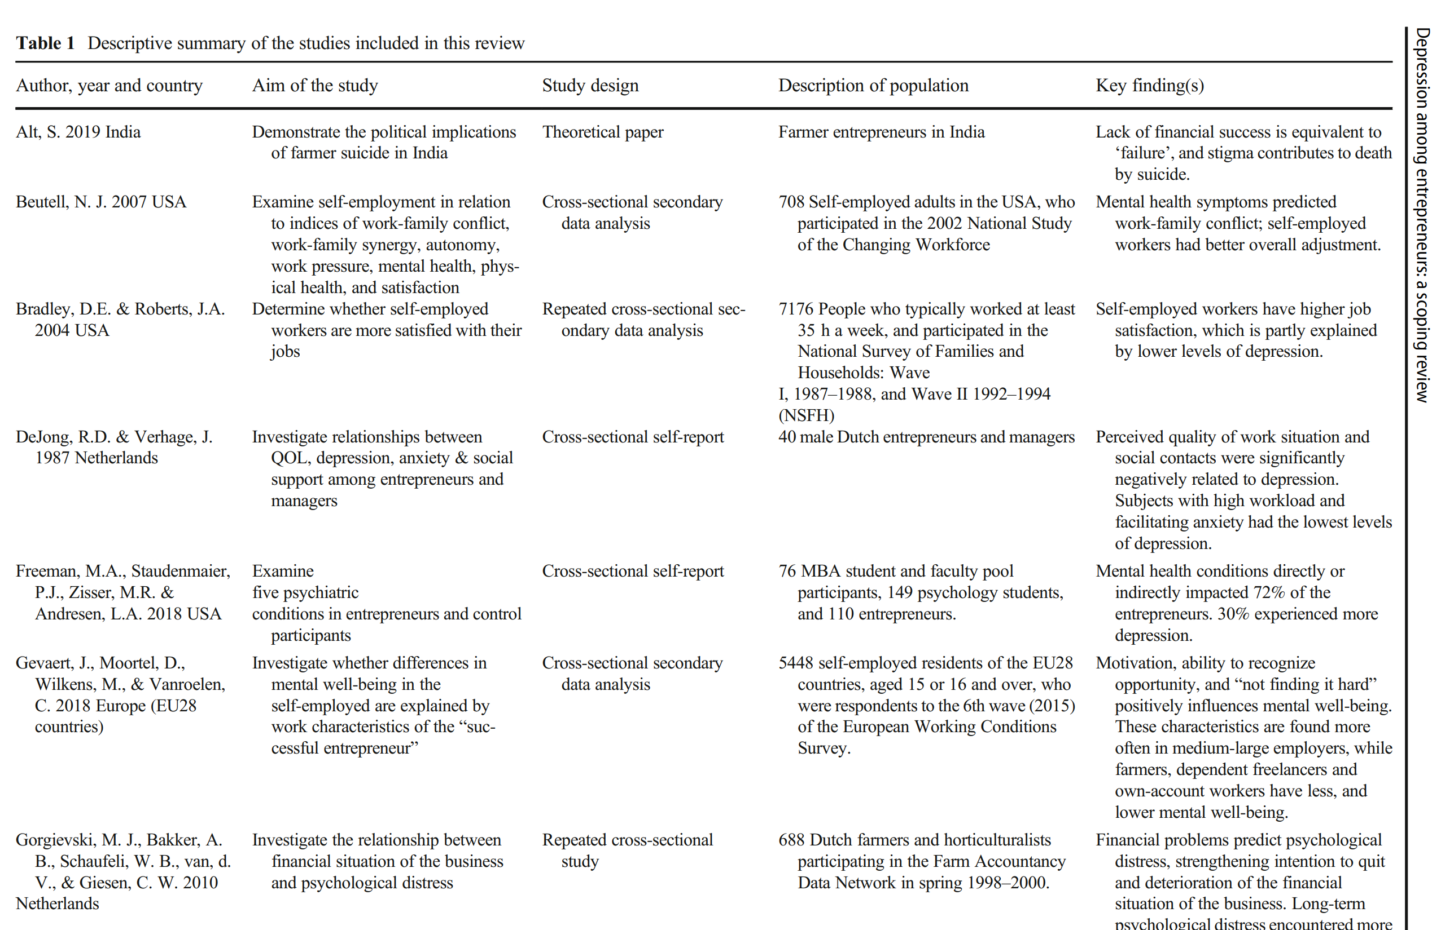
Title : Depression among entrepreneurs: a scoping review
W5_Scoping review and enterpreneurship_example.pdf

Slide 4
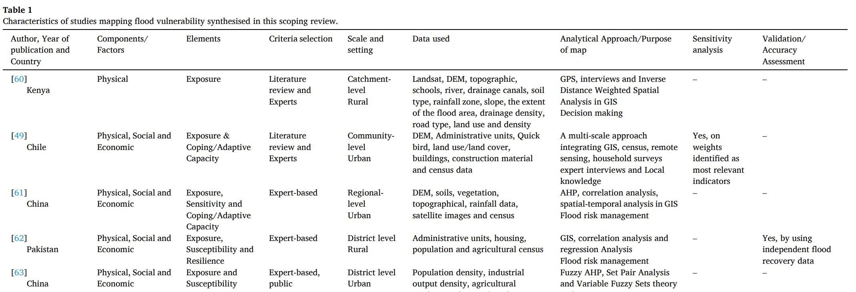
Topic : Examining flood vulnerability mapping approaches in developing
countries: A scoping review
Lit_Flooding and developing_Scoping review_mapping_For assignment illustration.pdf

Slide 5
Topic : Examining flood vulnerability mapping approaches in developing
countries: A scoping review
Lit_Flooding and developing_Scoping review_mapping_For assignment illustration.pdf

Slide 6
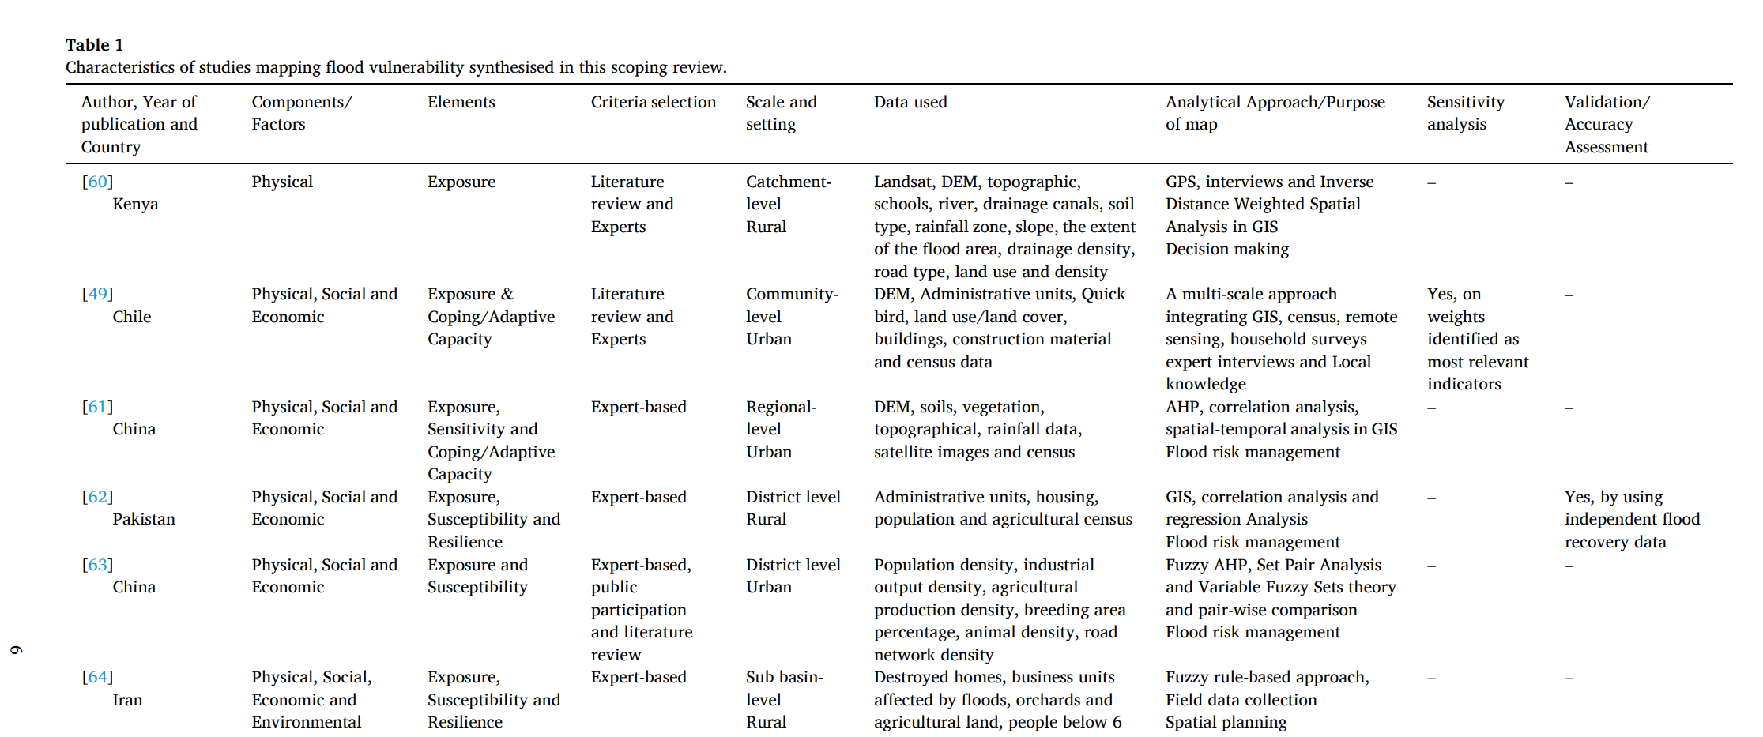
Topic : Examining flood vulnerability mapping approaches in developing countries: A scoping review
Membele, al et. (2022) Examining flood vulnerability mapping approaches in developing countries: A scoping review, International Journal of Disaster Risk Reduction, Volume 69, 2022,
102766, ISSN 2212-4209,https://doi.org/10.1016/j.ijdrr.2021.102766
Lit_Flooding and developing_Scoping review_mapping_For assignment illustration.pdf

Slide 7
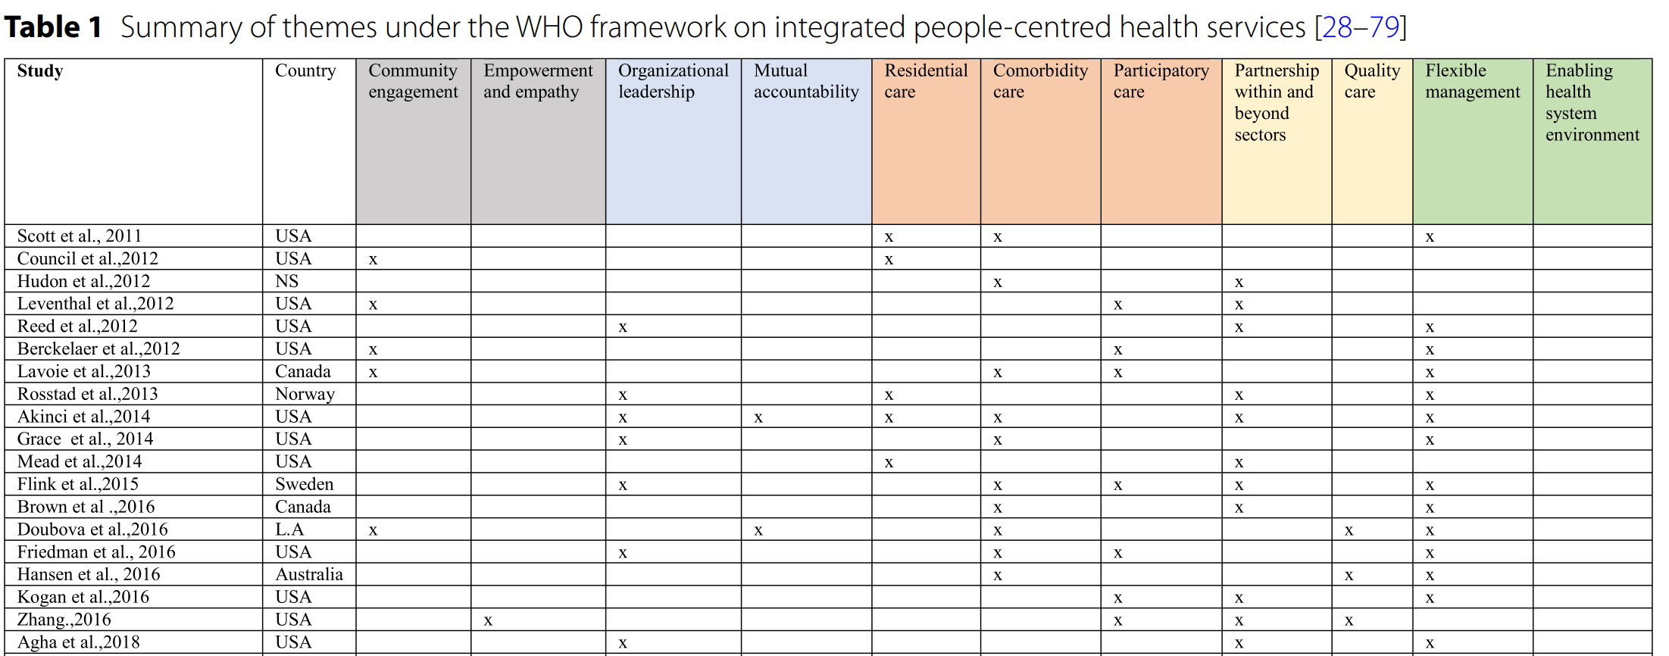
Topic : People-centred primary health care: a scoping review
Source : https://doi.org/10.1186/s12875-023-02194-3

Slide 8
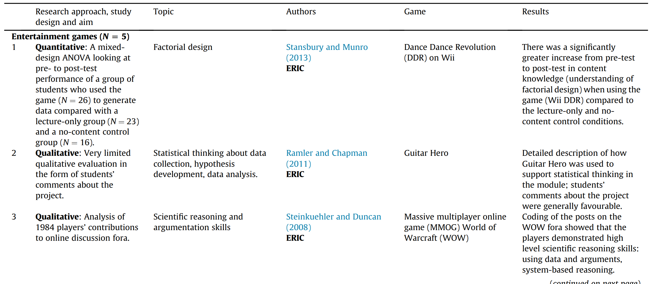
Topic : A narrative literature review of games, animations and simulations to teach research methods and statistics
Boyle, et al. (2014)
http://dx.doi.org/10.1016/j.compedu.2014.01.004

Slide 9
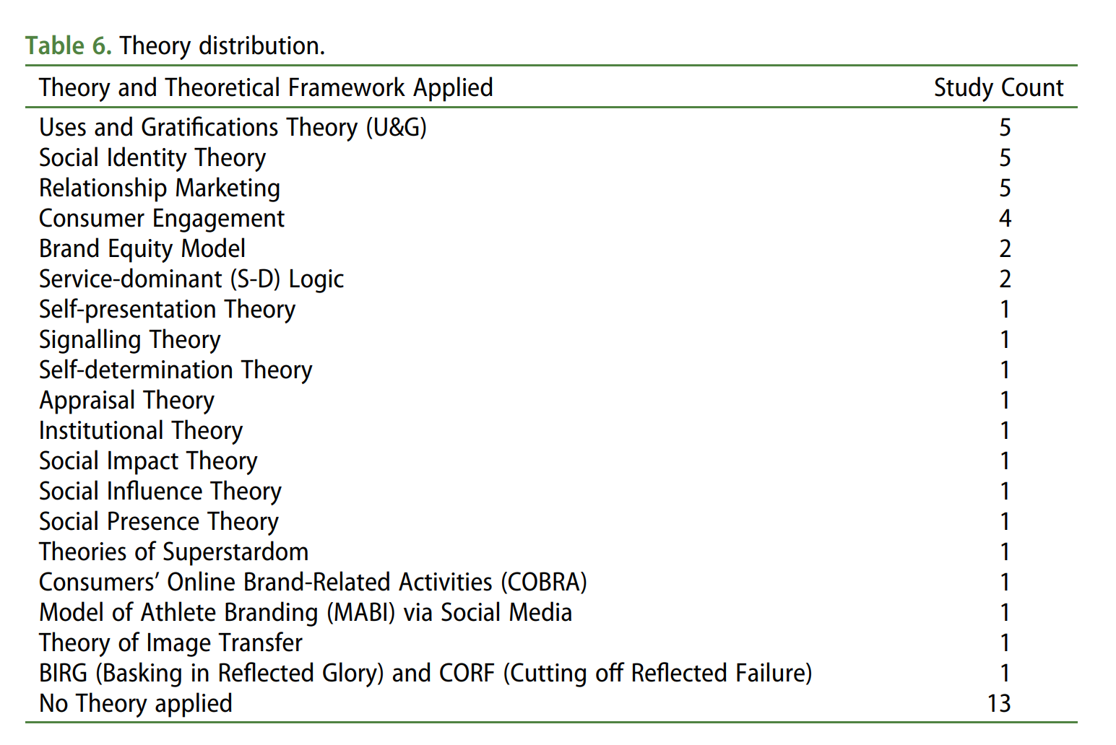
Topic : Consumer engagement on social media in the sport context: a scoping review
RQ2: What were the theories applied to support prior studies?
Boyle, et al. (2014) http://dx.doi.org/10.1016/j.compedu.2014.01.004

Slide 10
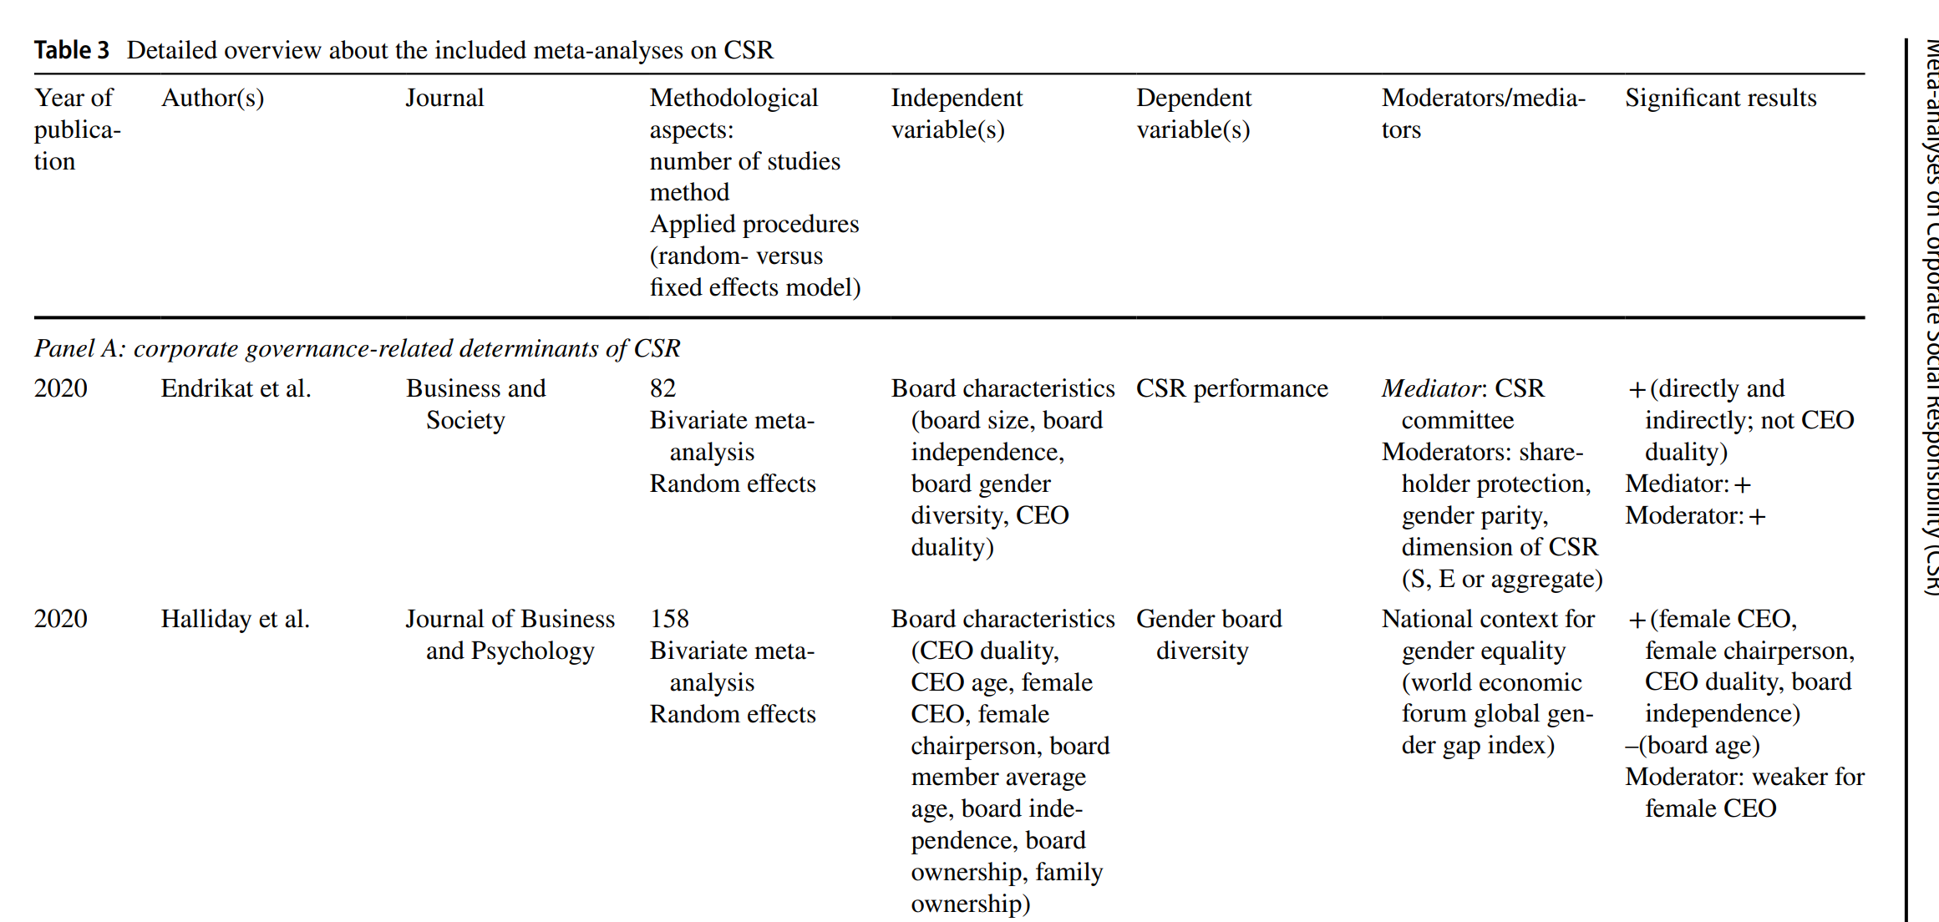
Topic : Meta‑analyses on Corporate Social Responsibility (CSR): a literature review
Velte (2021) https://doi.org/10.1007/s11301-021-00211-2

Slide 11
Some fundamental fields in the excel file
Developed by Dr. Caroline Jawad
Ready for your downloading on Moodle :

Slide 12

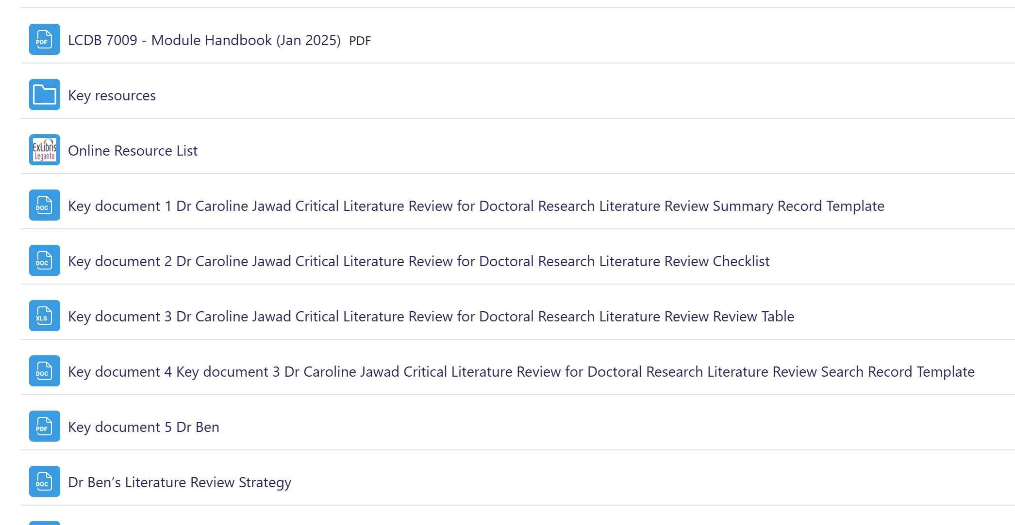
Files for downloading
…. On Moodle

Slide 13
Part 2 – excel file
1. Fundamental fields
Author
Year of publication
Title / area
Aim/objective
Results / Contribution
2. Customised fields (depending upon your topic)

