Slide 1


Utilising Police Powers
of Arrest
Notes:
On successful completion of this module, learners will be able to:
Explain the ways in which a person can be brought before a court.
Outline the differences between a summary, either way or indictable offence.
State the difference between common and statute law.
Describe the elements required for a lawful arrest, including S24 PACE and preserved powers.
Identify the arrest necessity criteria under SOCAPA 2005.
Identify alternatives to arrest.
Outline the procedure for de-arresting individuals.
Outline considerations relating to vulnerability when making an arrest.

Slide 2

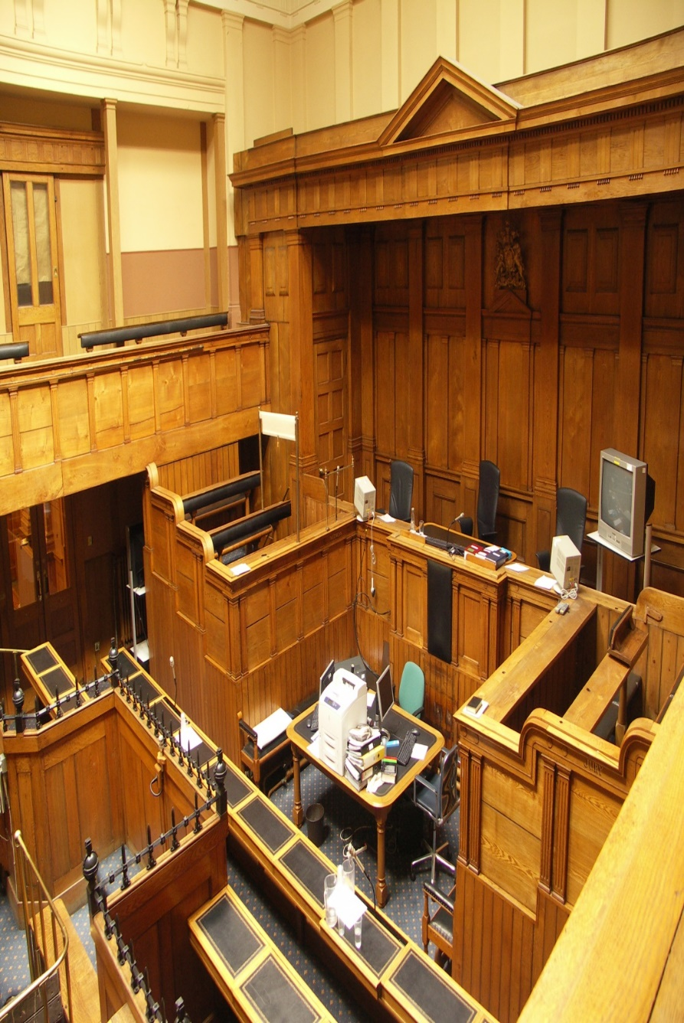
Introduction
Summons
Arrest on warrant
Arrest without warrant
Notes:
There are three ways in which a person may be brought before a criminal court.
The three ways are:
By summons
By arrest on warrant
By arrest without a warrant
None of these three methods is better than any other one.
Each has a use in the appropriate circumstances.
Remember that arrest should not be a form of punishment; it is merely one of the ways to bring a person before the court.
Basically, a summons is a document that tells the accused to attend the court at some date in the future.
A warrant, on the other hand, is a court order that tells the police officer to actually go and arrest the person.
When there is no warrant, officers must be sure that they have a power to arrest the person without such a warrant.

Slide 3

What is a Summons?
It is a written order signed by a justice, magistrate or clerk of the court addressed to the accused person, directing them to appear at a specified time and place to answer the offence(s) detailed in it
(or to give evidence or to produce exhibits)
Notes:
A summons orders a person to attend court and in some cases, it is used as an alternative to arrest. A summons does not necessarily indicate that an individual has committed an offence - they may not be accused or suspected of an offence, or the offence may only be minor.
The sequence of events leading to the issue of a defendant summons can be broken down as follows:
A person is seen committing an offence, or an allegation is made that the person has committed an offence
A police officer informs the offender that he or she will be reported for the offence
A police officer completes a pocket notebook entry
A written report is submitted to a supervisory officer.
A decision is made whether to prosecute, caution or take no further action. If the decision is made to prosecute, an application is made for a summons.

Slide 4
Obtaining a Summons
Summary Offence Occurs
Report offender (‘now’ caution)
Complete process file
Decision made to prosecute
Information laid for summons
Summons issued
Notes:
The sequence of events leading to the issue of a defendant summons can be broken down as follows:
A person is seen committing an offence, or an allegation is made that the person has committed an offence
A police officer informs the offender that he or she will be reported for the offence
A police officer completes a pocket notebook entry
A written report is submitted to a supervisory officer.
A decision is made whether to prosecute, caution or take no further action. If the decision is made to prosecute, an application is made for a summons
The information required for a summons includes: full name & address (including post code), date of birth, wherever possible, a national insurance number.
The address can be a private or business address - it must be where person will be for a sufficiently long period to enable summons to be served, or at which another specified person will accept the summons on behalf of the accused.

Slide 5

Witness Summons
A court can issue a summons to ensure that a witness attends court if:
a person is likely to be able to give material evidence, or produce any document or thing likely to be material evidence, for the purpose of any criminal proceedings before the court
the court is satisfied that it is in the interests of justice to do so.
Notes:
In certain cases this will allow the court to issue a witness summons early in the proceedings, to pre-empt the likely non-attendance of a witness.
The witness summons can be applied for by both the defence and prosecution.
In many cases the summons will also act as a measure of protection for a witness whose employer is reluctant to release them, or who faces some degree of discouragement or low-level intimidation in the community.

Slide 6
What is a Warrant?
A written document issued by a magistrate
or a judge which instructs the specified
persons (normally a constable)
to whom it is addressed to do a
particular act.’
Notes:
Types of warrants
Commitment warrant – found guilty of an offence without their presence and have been sentenced to imprisonment – take the person to prison
Arrest for an offence. Where certain offences have been committed or are alleged to have been committed, or the defendant’s address is not sufficiently established for a summons to be served, an arrest warrant may be issued.
Failure to answer a summons. A magistrate may issue a warrant for the arrest of a person who in certain circumstances has failed to appear at court in response to a summons.
Arrest for non-payment of a fine. Where a person has failed to pay a fine following a conviction, a magistrate may issue an arrest warrant. If the subject of a non payment warrant provides payment for the outstanding balance of the warrant they should not be arrested. The warrant should be endorsed that the outstanding balance has been obtained and signed along with any receipt references. The warrant is then returned to the court via your administration processes.
Arrest with bail conditions. When executing a warrant of arrest that has bail conditions, the same procedure should be followed as an arrest warrant, except that after arrest, the person can be released, subject to a requirement to attend a specified Magistrates’ Court at a specified time.
European Arrest Warrant The Extradition Act 2003 simplifies procedures between member states of the European Union. It will be increasingly likely for officers conducting person checks on the PNC to find that the subject of the check is wanted for extradition to another country.
Officers must only arrest for extradition where there is a clear direction to do so on the PNC.
When executing any arrest warrant you should proceed as follows:
Make sure that you read the warrant and understand it and confirm it has been signed by a Justice.
Select an appropriate time to execute the warrant - consider, for example, the impact on other family members if the individual is arrested during a meal time
Check that you have identified the right person (and not a child or relative with the same name). It may also be useful to check photograph records and the PNC for any warning markers.
Identify yourself, establish the identity of the accused, arrest and caution them.
Explain, in ordinary language, the charge and the reason for the arrest. Then, show the relevant person the warrant, if you have it with you (but do not hand the document over) or tell the relevant person where the warrant is and what arrangements can be made to let the person inspect it. It must be shown to the person arrested, if he demands it, as soon as practicable.
Endorse the back of the warrant
Make a record of the event in your pocket notebook
Return the warrant to the court according to your local instructions
A warrant must not be used in order to arrest a suspect simply for the purpose of an interview.
It may also be necessary to ensure, if the person is shown on PNC as ‘wanted on warrant’, that this is also cancelled on PNC to show that the warrant has been executed and the requirements of the warrant have been discharged.
Be guided by your own force policy on how warrants shown on PNC are cancelled and also who is responsible for doing it.

Slide 7

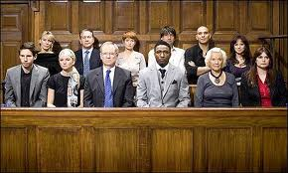
Types of Offence
Summary
Either Way
Triable on Indictment (Indictable)
Notes:
There are three types of offence.
The first is the ‘summary’ offence.
These offences are triable only in Magistrates Court and this accounts for 95% of all cases.
A magistrates court is made up of either 3 lay magistrates or a circuit judge.
There is no jury in a magistrates court.
Next are offences ‘triable on indictment’ also referred to as ‘indictable’.
These offences can only be tried at a Crown Court where a judge sits and a jury decides the verdict.
In the middle are ‘either way’ offences only and they can be tried either at Magistrates or Crown Court depending on the seriousness of the crime committed.
Theft is an ‘either way’ offence. Summary if someone stole a packet of sandwiches, indictable if they stole a million pounds from a bank.
A Constable can arrest for any offence.
The power of arrest without warrant for other persons relate only to offences that are ‘indictable’ or ‘either way’

Slide 8


Common and Statute Law
Common Law
Statute Law
Notes:
Common Law
The common law of this country, gave the power of arrest ‘to any person’ for many offences.
Later, with the creation of statute law, which includes powers of arrest for certain offences, the common law powers were largely replaced.
There are however, still a few common law powers of arrest without warrant in common usage, for example an offence of outraging public decency.
The common law power that you will deal with on a more regular basis relates to ‘breaches of the peace’.
Statute Law
A power of arrest, which is given in an Act of Parliament, is called a ‘statutory power of arrest’
The Police and Criminal Evidence Act 1984 provides both the police and any other person the power to arrest.
These powers fall into two groups:
‘Indictable offences’ – Under the Police and Criminal Evidence Act (PACE) 1984 (offences triable at Crown Court)
Powers contained in other Acts – The powers of arrest which were contained in numerous Acts have mostly been abolished, although they will still specify that it is an offence under that Act.
These are preserved powers of arrest and they are mostly contained within Schedule 2 of PACE 1984.
These are discussed later on in the lesson

Slide 9
Meaning of Arrest
An arrest is the taking of a person’s liberty and preventing them from going about their lawful business
‘An arrest occurs when a police officer states to a individual that they are arresting them or when they use force to restrain the individual concerned’
It occurs also when, by words or conduct, they make it clear that they will, if necessary, use force to prevent the individual from going where they may want to go.’
But the arrest must be necessary…
Notes:
The purpose of an arrest is to make a suspect submit to the criminal justice system.
The information on this slide shows the concept of arrest as explained in Murray v Ministry of Defence 1988 in which the House of Lords quoted three different definitions of which they approved.
The elements of an arrest are, therefore:
actual physical restraint (e.g. holding firmly by the arm) or
words/conduct making it clear that the person will be restrained by force if necessary.
The PACE codes of practice state:
Everyone arrested, shall be informed of the reasons, in a language that they understand
They shall be brought, promptly before a judge or authorised officer.
If the grounds for detaining that person cease, then that person shall be released.
If a police officer makes an arrest which is not compliant with the principles laid down by the European Convention on Human Rights then the arrested person’s Convention Rights will have been unlawfully infringed upon and they are entitled to seek redress (eg compensation).
An unlawful arrest can give rise to disciplinary action against the arresting officer, and any evidence gained as a result of the arrest can be excluded by the courts. It is vitally important to get it right.
Any loss of evidence (and/or loss of a case in court) can lead to the loss of confidence in the police, allegations of corruption.

Slide 10
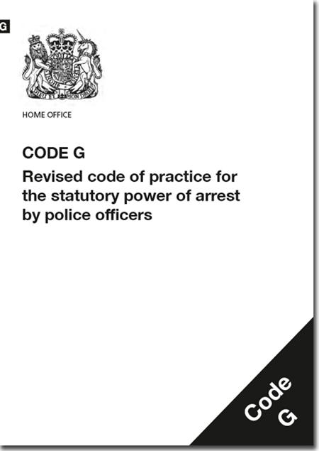
Considerations
Is there a power to arrest?
Are there grounds to arrest?
Is there a necessity to arrest?
Notes:
Police and Criminal Evidence Act 1984 (PACE) and the accompanying PACE codes of practice, establishes the powers of the police to combat crimes while protecting the rights of the public.
The Power to Arrest is given to officers by S24 PACE and is governed by Code G of the Codes of Practice.
In any arrest an officer is responsible for protecting a suspect’s rights. They should ask themselves:-
Are my actions Proportionate? Is this the minimum action I can carry out at this time?
Are my actions Lawful? What offence do you suspect the person to be involved in?
Am I Accountable for this course of action?
Are my actions Necessary & Justifiable? The only option available is to arrest the suspect? Why is this the only option?
Are my actions non-discriminatory and Ethical? Would I carry out this action whomever I was intending to arrest?
The mnemonic JPLANE can be used to assist in remembering this.
The exercise of this power is an obvious and significant interference with the Right to Liberty & Security under Article 5 of ECHR set out in the Human Rights Act 1998, all persons have the. Each time a person is arrested, this Article is engaged and the individual’s human rights are infringed.
Officers must use their power fairly, responsibly & with regard to an individuals equality, diversity & human rights.
The Equality Act 2010 makes it unlawful for officers to discriminate against, harass or victimise any person on grounds of the ‘protected characteristics’ – age, disability, gender reassignment, race, religion or belief, sex & sexual orientation, marriage & civil partnership, pregnancy & maternity.

Slide 11
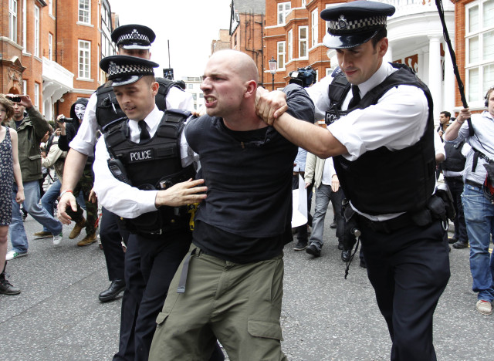

Elements Required for a Lawful Arrest
A person’s involvement
or
suspected involvement
or
attempted involvement
in the commission of a criminal offence
AND
reasonable grounds for believing that the person’s arrest is ‘necessary’
Notes:
PACE Code G states that these two elements must be satisfied for a Sec 24 arrest to be lawful:
If the provisions of the Act and this Code are not observed, both the arrest and the conduct of any subsequent investigation may be open to question.
The law requires a person is informed of the 'grounds for the arrest'
(e.g. "I am arresting you on suspicion of stealing a stereo from a Ford Fiesta car in Acacia Ave yesterday").

Slide 12

Making a Lawful Arrest
Information to be given:
That they are under arrest (even if it is obvious)
The grounds for the arrest (offence for which they have been arrested)
AND
The Necessity for the arrest
Caution - ‘When Questioned’
Notes:
Under Sec 28 PACE & Code G (Codes of Practice) an arrest is not lawful unless at the time, or as soon as practicable (the officer) informs the person they are under arrest.
The person must be given the information promptly and in simple non technical language so that they can understand that they have been deprived of their liberty and the essential legal and factual grounds for their arrest in accordance with the Human Rights Act 1998 Schedule 1 Article 5(2).
In addition to the Human Rights issue, it is important that these things are considered by officers as Forces pay out a considerable amount of money as a result of claims made by individuals for unlawful arrest. These claims arise in most cases due to officers failing to consider whether the arrest they make is actually necessary.
Remember to give the ‘when’ questioned caution if it was not given just prior to the arrest taking place.

Slide 13
Reasonable Grounds
Knowing
Believing
Suspecting
Notes:
‘Reasonable’ is a conclusion that one or more people would reach in an agreement as a result of a personal experience or understanding.
It is practical, level headed and a logical result.
‘Grounds’ for something include a reason for a thought to exist:-
To ‘know’ something is to be certain (10/10)
To ‘believe’ something is a stronger and more concrete conclusion (7/10)
To ‘suspect’ something is to think that it is probably true, although you are not certain (3/10)
To decide whether there are reasonable grounds to suspect: consider the component parts of the offence and whether a like-minded person would draw the same conclusions about the suspect and the offence?
Suspicion must be related to both the likelihood that the offence has been committed and whether that person is liable to arrest (Code G)
Examples:
You are on patrol when you see a male spraying graffiti on a wall. Because you have seen it with your own eyes you know it to be true.
You are on patrol and you see a male standing beside a wall with graffiti on it, the paint is wet and he has a can in his hand. No-one else is around. You believe that he has committed the offence OR
You are on patrol and you see a wall with graffiti on it, the paint is wet. You walk a little way along the street and you see a male hiding behind a wall. No-one else is around. You suspect that he has committed the offence

Slide 14

Reasonable Grounds
Behaviour
Actions
Intelligence
the Time
or Place
Notes:
Suspicion is required to make an arrest under s24 PACE which must contain reasonable, objective grounds which must be based on known facts and information.
Their BEHAVIOUR, in addition to their ACTIONS including any property they are carrying and/or INTELLIGENCE including any information gained from a witness and/or the TIME or PLACE where they are found
A good test of whether you have reasonable grounds to suspect is whether an independent person would come to the same conclusion as you if they looked objectively at all the facts, even if it later turned out that your impression of what was happening was incorrect.
Consideration could also be given to:
Information received from a colleague or from a member of the public,
Information an officer receives via radio/telephone or they see in a document or they receive from an informant
Circumstances that are observed by the officer themselves or
Information received from PNC
Information an officer sees in a document/receives from an informant
Circumstances are observed by the officer themselves

Slide 15
Section 24(1) PACE 1984
A constable may arrest without a warrant anyone who:
is about to commit an offence.
is in the act of committing an offence.
They have reasonable grounds to suspect to be:
a) about to commit an offence or
b) in the act of committing an offence.
Notes:
Offence means any Statutory or Common Law Offence for which a person may be tried by Magistrates or Crown Court and punished if convicted (e.g. assaults, criminal damage, RTA offences, Local Authority byelaws, etc).
Common Law offences include Murder, Manslaughter, Kidnapping, False imprisonment and Perverting the course of justice.
There are other less used powers which fall outside S.24 and do not require us to justify ‘necessity to arrest’. Here are some of the more common ones
Breach of the Peace powers.
Mental Health Act powers (S.136 Mental Health Act 1983).
Breach of bail and/or Breach of conditions of Bail powers (S.46A PACE & S.7(3) Bail Act 1976).
Court Arrest Warrant & other Court Order powers.
Arresting a driver following a positive roadside Breath Test or failure to provide a sample IF the officer suspects alcohol or drugs in the body (S.6D RTA 1988).
Arresting a person on suspicion of driving, or being in charge of a MPV, when under influence of drink or drugs
(S.4(6) RTA 1988).
About to commit – You see a woman, who is obviously not a member of staff, walk up to a display of batteries, select a multi-pack, and put it under her coat. She then walks towards the exit of the shop, making no attempt to pay. You, as an officer, stop her as she is about to leave the shop.
In the act of committing – You see a man walk up to a display of I-pods, cut a security link, pick up an I-pod and walk towards the door of the shop, past the check outs, without paying for the device. The store alarm is activated and the man continues to walk out of the shop. You conclude that the man is stealing the I-pod and stop him just outside the shop.
Reasonable grounds for suspecting to be about to commit – You see a man walk up to a display of mobile phones. He appears to be extremely nervous. You see him take a metal cutter out of his pocket and reach towards the security chain and appear to be about to cut the chain, but he is disturbed. He puts the tool back in his pocket and walks away. A few seconds later the same man returns to the display of mobiles, takes out the same tool, places it around the security chain and sets off the alarm. At this moment you decide you have reasonable grounds for suspecting the man is about to commit an offence.

Slide 16
Section 24(2) PACE 1984
If an officer has reasonable grounds for suspecting
that an offence has been committed
they may arrest anyone whom they have
reasonable grounds to suspect
of being guilty of it.

Slide 17
Section 24(3) PACE 1984
If an offence has been committed, an officer may arrest anyone who:
a. Is guilty of the offence
b. they have reasonable grounds for suspecting
to be guilty of it.
Notes:
Section 24 PACE also caters for situations in which it will be clear that an offence has definitely been committed.
In such circumstances, the officer (if it is also necessary) could arrest any person who is guilty of the offence.
However, the power of arrest at 1, 2 or 3 above, is only exercisable if the constable has reasonable grounds for believing that it is necessary to arrest the person because one or more of the reasons supporting the need for arrest is satisfied.
Trainer to facilitate discussion around the scenarios on the next 3 PPT slides.

Slide 18
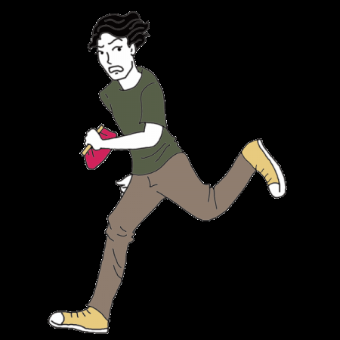
Group Task 1
PC JONES is on patrol with her tutor when they hear a woman shout, ‘Stop that man he has just stolen my purse’.
What power of arrest do the officers have to deal with this situation?
Notes:
Both officers can arrest the man.
S24(2) If an officer has reasonable grounds for suspecting that an offence has been committed they may arrest anyone whom they have reasonable grounds to suspect of being guilty of it.

Slide 19
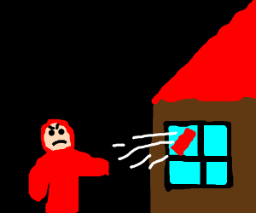
Group Task 2
Officers are on patrol when they see Eddie Smith with a brick in one hand about to throw it through the window of a local jewellers.
What power of arrest do the officers have to deal with this situation?
Notes:
They can arrest Eddie Smith.
Sec 24(1) An officer may arrest anyone whom they have reasonable grounds to suspect to be about to commit an offence

Slide 20
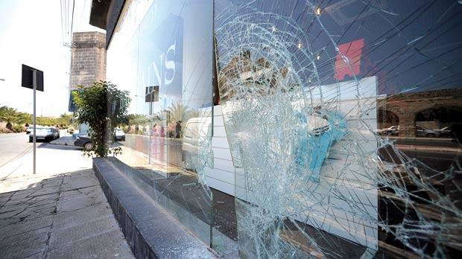
Group Task 3
Officers are on duty when they are called to a shop where a large display window has been smashed.
Five days later their enquiries reveal a witness who states that John Sawyer committed the offence by throwing a brick through the window.
What power of arrest do the officers have to deal with this situation?
Notes:
The officers can arrest John Sawyer
Sec 24(3) If an offence has been committed, officers may arrest anyone whom they have reasonable grounds to suspect to be guilty of it.

Slide 21
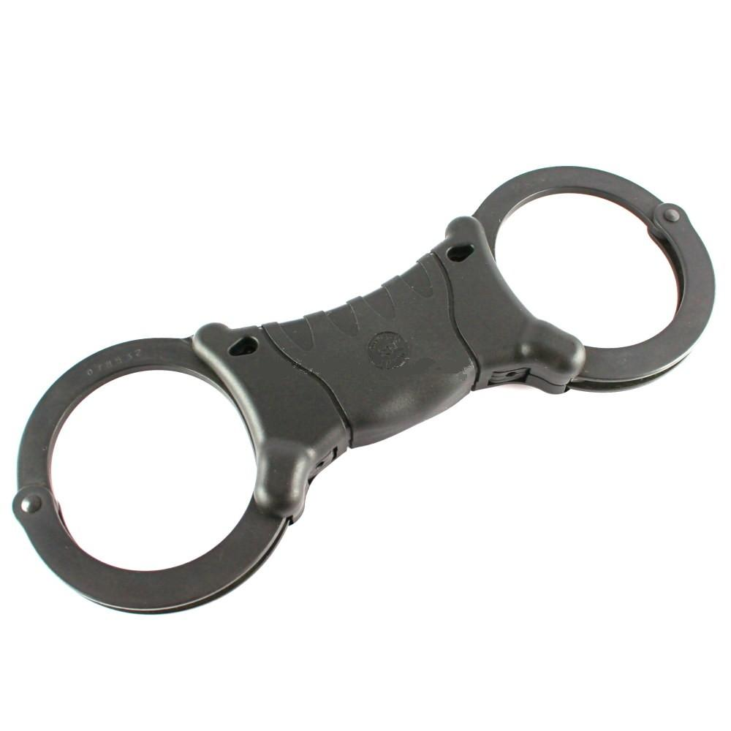
Section 24 PACE 984 & PACE Code G
Section 24 PACE 1984 & PACE Code G
Necessity to arrest
Notes:
There are two elements for a lawful arrest under Sec 24 PACE, involvement in the commission of an offence, as already discussed and that the arrest is ‘necessary’.
In 2005, the Serious Organised Crime and Police Act (SOCPA) amended Sec.24 of PACE so that now, when a constable makes an arrest, they must be able to show that it was necessary to do so. This brings Sec.24 in line with Article 5 of the European Convention on Human Rights (Human Rights Act 1998).
A number of officers have found themselves being unable to satisfy objective observers, including courts, when called upon to explain their use of the power in this respect.
For this reason, officers must understand the principles of the Code and, if called upon to do so, be able to argue their decision was in line with the principles set out in the Code.

Slide 22

Balancing Competing Rights & Needs
Right to
Liberty
Investigation
Objectives
Notes:
Code G of the Police and Criminal Evidence Act expects arresting officers to balance a suspect’s Right to Liberty against the needs of the police to investigate crime.
The police can only remove that Right if they can show that they were carrying out a criminal investigation and it was necessary to remove the Right for them to achieve the investigation’s objectives. If this is not shown then the arrest will be unlawful.
Code G identifies investigation objectives by stating that the police must have the widest possible considerations of all the circumstances during an investigation when deciding whether it is necessary to arrest a suspect or not.
There are other ways to process a suspect that has committed an offence – report for summons, granting street bail, issuing FPN, Advise/Persuade/Warn, and voluntary attendance at police station.
What constitutes necessity?
The Oxford Dictionaries Online defines it as;
‘The state or fact of being required.- The state of being unavoidable.- A situation enforcing a certain course of action.’
Code G provides the statutory criteria for what may constitute necessity
Importantly- it remains an operational decision at the discretion of the constable to decide:
• which one or more of the necessity criteria (if any) applies to the individual; and
• if any of the criteria do apply, what course of action is open to the officer

Slide 23




To allow the prompt and effective investigation of the offence
To prevent the disappearance of the person in question
To protect a child or other vulnerable person
To prevent causing unlawful obstruction of the highway
Notes:
To allow the prompt and effective investigation of the offence or of the conduct of the person in question.
An investigation might be hindered or delayed if suspect is not arrested.
E.g. may need to:
1. Interviewing the Suspect
2. Consider Specific Investigation Needs
3. Take Samples & Impressions
4. Search, Examine or Photograph
5. Class A drug testing.
Arresting for this purpose might be necessary if voluntary attendance for interview purposes is not considered to be a practical alternative, and questions need to be put about evidence gained during the investigation, or it is thought likely the person might steal or destroy evidence, collude or make contact with co-suspects or intimidate, threaten or make contact with witnesses, or there is a need to refer to Special Warning material in an interview (which can only be used when interviewing persons who have been arrested).
To gain evidence relating to the offence under investigation e.g. person search after arrest, entry & search of premises, delaying notification of arrest or access to legal advice, extending detention beyond 24hrs, release on bail (with or without conditions).
The police may need to take samples and impressions from the suspect for evidential or matching purposes.
Could be to search a person, vehicle or premises, or to examine them for distinguishing marks or to take a photograph of them (to identify them). This is useful if a person has refused to identify themselves or given a false name the police can search the person if they believe that there is a mark or scar which might identify that person. Carry out an intimate search on detained person (S.55 PACE). Carry out x- ray & ultrasound scans on detained person (S.55A PACE).
Arresting for this purpose might be necessary if a Class A drug misuse has caused or contributed to the commission of the Trigger Offence in question.
(Trigger offence are offences such as burglary, robbery, theft, TWOC, fraud, handling, going
equipped or drugs offences).
2. To prevent the disappearance of the person in question
Concern that person may fail to appear at court.
When it is likely that, if the person is not arrested, they may not attend Court, e.g. the person has previous convictions for failing to appear. Often used for motoring offences where a summons would normally be appropriate…
3. To protect a child or other vulnerable person
An arrest would be necessary if person was suspected of committing an offence which put health & safety of a child or vulnerable person at risk.
Child or other vulnerable person is directly or indirectly affected by the suspect and is thought likely that they may suffer either physical or psychological harm if the suspect is not arrested.
4. Causing unlawful obstruction of the highway
If the suspect of an offence also causes an unlawful obstruction of the highway which will continue if they are not arrested. This may lend itself to protest situations where the suspect of an offence is also causing an unlawful obstruction of the highway (begging might meet this criteria as might parking in the middle of the road).

Slide 24
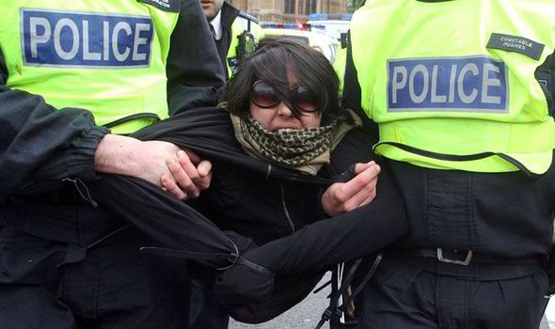
Why might you need to arrest someone?
Prevent causing injury to himself or others
Committing an offence against public decency
Causing loss or damage to property
Ascertain a persons name or address
Notes:
P. To prevent causing physical injury to himself or another
A reason for arresting someone could be to prevent the person:
Causing physical injury to himself or another could be the police officer or any other person. It could also be a person who may be a self harmer
Suffering physical injury - suggests a less deliberate act than the word causing. Could relate to the person being arrested suffering injury from others. Eg if the suspect has assaulted a person in the street and there is a real risk that they will suffer some harm from friends of the victim who were present when the assault took place.
P. Committing an offence against public decency
This criteria might apply when an offence against public decency is being committed in a public place and is thought likely that it will be repeated. It only applies, however, if the public cannot be reasonably expected to avoid the person in question.
L. Causing loss of or damage to property - this may cover situations where there is a risk that if the person is not arrested then they may cause further damage to property or perhaps dispose of property that has been stolen in the original offence.
This criteria might apply where the suspect has a history of serial offending against property and it is thought likely that they may continue offending if they are not arrested. Persistent shoplifters found in the town centre MAY lend themselves to this criteria – if you can justify an arrest.
A. & N. Ascertain a person’s name and address
If a person who is suspected of an offence refuses to provide name/address – officer must explain that it may lead to their arrest. This is not a power to arrest a person who simply refuses to give their name & address – it is just one of the reasons which would make an arrest necessary.
An officer may also arrest someone in a situation where there are reasonable grounds for doubting whether a name or address given by the person is real.
If you do not know and cannot readily ascertain a person’s name and/or address, or you have reasonable grounds for doubting details provided – e.g. failures/refusals/apparent reluctance to provide details or an Officer being unable to verify the details provided. If practicable, a person should be given an opportunity to prove their details before they are arrested and a warning that refusal may lead to arrest is good practice but it is not expressly required.

Slide 25
I | Investigation | To allow prompt and effective investigation of the offence or of the conduct of the person in question
D | Disappearance | To prevent any prosecution for the offence from being hindered by the disappearance of the person in question
C | Child | To protect a child or other vulnerable person from the relevant person
O | Obstruction | To prevent the relevant person causing an unlawful obstruction of the highway
P | Physical Injury | To prevent the relevant person causing physical injury to himself or any other person or Prevent him suffering physical injury
P | Public Decency | To prevent the relevant person committing an offence against public decency
L | Loss or Damage | To prevent the relevant person causing loss of, or damage to property
A | Address | To enable the address of the relevant person to be ascertained
N | Name | To enable the name of the relevant person to be ascertained
Notes:
Applying the Necessity criteria requires an Arresting Officer to consider all of the circumstances of the particular case that they are dealing with and to believe that there is no other way of achieving one or more of these objectives other than to remove a suspect’s Right to Liberty.
There is an acronym that may help:

Slide 26
Section 24A(3) Police & Criminal Evidence Act 1984
A person other than a constable may arrest without warrant anyone who:
Is in the act of committing an indictable or triable either way offence
OR
They have reasonable grounds for suspecting to be committing an indictable offence or triable either way offence.
Where such an offence has been committed, a person other than a constable, may arrest without warrant anyone who:
Is guilty of the offence
OR
They have reasonable grounds for suspecting
to be guilty of it.
Notes:
Section 24A(3) Police and Criminal Evidence Act 1984
The offence includes Indictable or triable either way offences
This is often referred to as an ‘any person’ power.
This power of arrest has its origins in Common Law – the oldest form of law in existence.
As we have already mentioned, the majority of Common Law has now been superseded by Statute Law, however some powers remain, e.g. Breach of the Peace.
What is missing from the any person power to arrest is the phrase about to commit.
A constable can arrest for past, present and future offences where as the ‘any person’ power only allows for past and present

Slide 27
When can a member of the public arrest someone?
The power of arrest is ONLY exercisable if:
It appears to the person making the arrest that it is not reasonable practicable for a Constable to make it instead
AND
The person making the arrest has reasonable grounds for believing that the arrest is necessary to prevent the person being arrested:-
Causing physical injury to themselves or any other person
Suffering physical injury
Causing loss of or damage to property or
Making off before a police officer can assume responsibility for them.

Slide 28
Schedule 2 Police & Criminal Evidence Act 1984
It provides the preserved powers of arrest under PACE.
Section 49 Prison Act 1952 (unlawfully at large)
Section 13 Visiting Forces Act 1955 (deserter / absentee)
Section 32 Children & Young Persons Act 1969 (detention of absentee)
Section 7 Bail Act 1976 (absconding from bail)
Section 18(return of patients),section 35(10) (remand to hospital for reports),section 36(8) (remand to hospital for treatment), section 38(7) (interim hospital orders), section 136(1) (mentally disordered persons in public place), and section 138 (retaking of escaped patients) Mental Health Act 1983.
Section 5(5) Repatriation of Prisoners Act 1984 (prisoner unlawfully at large).
Notes:
Section 49 Prison Act 1952 (unlawfully at large)
Any person who, having been sentenced to imprisonment, custody for life or youth custody or ordered to be detained in a detention centre or young offenders institution or a youth detention training centre, or having been committed to a prison or remand centre, is unlawfully at large, may be arrested by a constable without warrant and taken to the place in which he is required in accordance with law to be detained.
Section 13 Visiting Forces Act 1955 (deserter / absentee)
provides for the apprehension and detention of deserters and absentees of certain foreign forces visiting the UK, together with legal procedures concerning offenders from those forces.
Section 32 Children & Young Persons Act 1969 (detention of absentee)
provides for the arrest and detention of young people who are absent without consent from a place where they has been sent by a court. A warrant to search is also available if required.
Section 7 Bail Act 1976 (absconding from bail)
If a person who has been released on bail in criminal proceedings and is under a duty to surrender into the custody of a court fails to surrender to custody at the time appointed for him to do so the court may issue a warrant for his arrest
Section 18(return of patients),section 35(10) (remand to hospital for reports),section 36(8) (remand to hospital for treatment), section 38(7)
(interim hospital orders), section 136(1) (mentally disordered persons in public place), and section 138 (retaking of escaped patients) Mental Health Act 1983.
provides for patients who are liable to be detained in a hospital, but absent themselves without permission and have to be returned.
Section 5(5) Repatriation of Prisoners Act 1984 (prisoner unlawfully at large).

Slide 29

Preserved Power of Arrest Under PACE 1984
The arresting officer is required to record in his pocket book or by other methods used for recording information:
• the nature and circumstances of the offence leading to the arrest;
• the reason or reasons why arrest was necessary;
• the giving of the caution; and
• anything said by the person at the time of arrest.
Notes:
PACE states the Arresting Officer is required to provide information to the person arrested. This is usually done by creating a record in their PNB or their E-PNB, that the person is under arrest, the grounds of the arrest and the necessity for the arrest.
Remember, whichever of the ‘necessity criteria’ is used then the full details need to be recorded.
For example, if the officer uses ‘prompt and effective investigation’ then they must record which aspect of this criteria applies, i.e. interviewing the suspect; specific investigation needs etc.
Ensure the person under arrest is cautioned in line with PACE Code C unless impractical to do so, by reason of their condition or behaviour at the time.
The importance of documenting decisions are to:
Demonstrates compliance with legislation, policies and procedures – PACE Code C/G
Assists in demonstrating a reasonable approach was taken if any arrest is necessary(as per training in Conflict Management)
Demonstrates the rationale behind the use of force
Evidences that communication with the suspect is appropriate – any significant statements made have been understood and signed
Provides evidence of the behaviour of possible suspects including points to prove for offences committed
Provides evidence that the actions taken were justifiable/legal/proportionate and may be the subject of evidence in a court

Slide 30
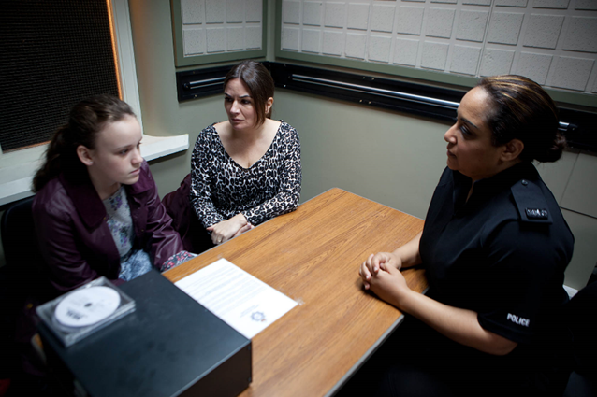
Alternatives to Arrest
No further action- discretion
Persuade, Advise & Warn
Caution
Out of court disposal (fixed penalty notice)
Youth Referral
Community Resolutions
Restorative Justice
Report for summons
Voluntary interview
Notes:
Where practicable, every effort should be made to deal with the matter without the need for arrest.
Individuals who are arrested may have lasting concerns in terms of employment opportunities, relationships, travel and the psychological impact of restraint - so it is important to consider whether an alternative to arrest might be more appropriate.
Any arrest for an offence where process for summons or other means of disposal could have been used could lead to the case being open to question and could even be found to be unlawful, making the officer liable to criminal or civil action and disciplinary procedures.
Report for summons- by using the reporting process
No further action- using your discretion
Out of court disposal (fixed penalty notice)- freeing up time in the courts
Voluntary interview- if considering arrest for the purposes of interviewing then arranging a voluntary is an alternative
If you intend to make an arrangement for an individual to attend on a voluntary basis as an alternative to arrest then you are obliged to provide them with certain information:
Voluntary Interviews- must be told;
- Need to be interview
- If they attend voluntarily- no need to arrest
- Time etc will be agreed
- Failure to attend will lead to arrest
Note: Arrest on arrival at the station prior to interview would only be justified if:
• new information coming to light after the arrangements were made ; and
• it was not reasonably practicable for the person to be arrested before they attended the station.
Note: The possibility that the person might decide to leave during the interview is therefore not a valid reason for arresting them before the interview has commenced.

Slide 31
De-Arrest
‘A person arrested by a constable at a place other than a police station shall be released without bail if a constable is satisfied at the time before the person reaches a police station that there are no grounds for keeping him or her under arrest releasing him/her on bail. The constable must record the fact that this has happened’
Sec 30(7) P.A.C.E.1984
Notes:
If the arrest no longer becomes necessary, the officer must de-arrest and release the suspect and consider alternative methods of prosecution.
Under PACE, this can only take place before arrival at a police station.
A note (usually in the PNB) must be made of the action taken and everything that has been said about the offence.
If the arrest reason under which the accused person is arrested no longer applies, then the person should be released and dealt with by other means
Reported for summons,
Issued a penalty ticket for disorder, if applicable or
Warned regarding their future conduct.

Slide 32
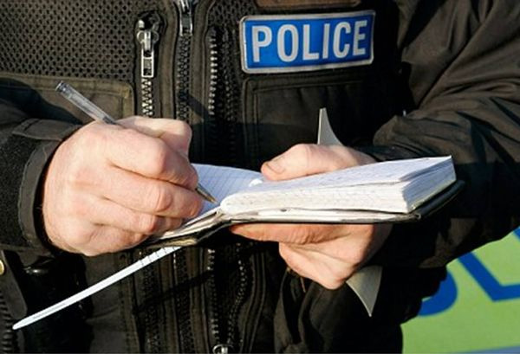
De-Arrest
Procedure following de-arrest:
• Explain that they are no longer under arrest
• Submit intelligence report (if appropriate)
• Complete PNB entry
• Inform PSC and other officers
• Record all details of persons
• Consider any vulnerability/age etc.
Notes:
Following de-arrest the following should be considered:
Explain to the person that they are no longer under arrest and explain the reasons for it.
Submit any intelligence reports that may be appropriate
Complete a full PNB entry – accurately document the officers’ actions at all times
Inform the PSC (control room) and other officers of your actions
Record details of the persons as they may be witnesses
Consider any vulnerability, age etc. regarding a duty of care - should they be taken home?
Consider if alternative action is appropriate (PND, summons or voluntary attendance)

Slide 33

Vulnerability
Officers must conduct a vulnerability assessment, accounting for:
Appearance
Behaviour of the detainee
Any signs of illness or injury
Their style and level of communication,
Collaborative information from all sources and
The circumstances and environment in which they were found.
Notes:
Vulnerability assessment should take account of the appearance and behaviour of the detainee, any signs of illness or injury, their style and level of communication, collaborative information from all sources and the circumstances and environment in which they were found.

Slide 34


