Slide 1

Storage Area Network Investigation
Lecturer: Koushik Modak
Author: Apostol George Adrian

Slide 2

Agenda
Storage Area Network Overview
Types of SAN
Basic SAN Network Architecture
SAN Management
Data Security Management

Slide 3
SAN Overview
SANs are dedicated, high-speed networks used to link data storage devices to wider networks. They allow interaction among computer systems by linking them to storage pools through SAN switches. [4]
A SAN network is comprised of a variety of devices, including disk arrays, switches, and servers, which provides the scalability and fault-tolerance in a virtualized data center.
Additionally, SANs are highly flexible, since more storage capacity may be added without disrupting the network.

Slide 4

Types of SAN
SANs come in a variety of sizes and difficulty levels. The optimal size of the SAN for a company is entirely dependent on the specific business requirements.
SANs operate on one of the following:
1) Fiber channel technique
2) The iSCSI
Since iSCSI is less costly than FC, it is desirable to SMBs. [2]
On the other hand, FC technology is quicker and more efficient, which makes it familiar with companies that need constant data access for project applications. [3]

Slide 5
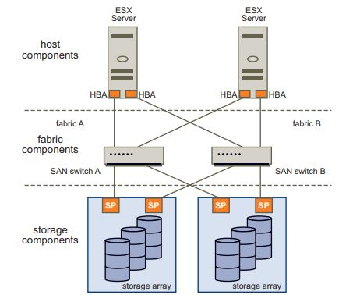
Basic SAN Network Architecture
There are 3 types of layers found inside the SAN network:
Host layer
Fabric layer
Data storage layer
In the SAN network, all the devices are interconnected using fibre channel, which is a standard for SANs.
This figure illustrates the redundancy provided in case a HBA or an entire switch fails. In this case, another HBA will support the SAN operations or if a switch fails, the other switch will take over the traffic.
Fig 1. SAN component Layers [1]

Slide 6
SAN Management
To maximize the benefits and features of SANs, such as efficiency, reliability, expense, scalability, and integration, both the SAN network and the connected storage systems should be handled efficiently. [5]
The SAN's administration may be classified according to the different disciplines described in Enterprise Storage Resources Management (ESRM):
Asset Management,
Capacity Management,
Configuration Management,
Performance Management,
Availability Management. [6]

Slide 7
Data Security Management
A stable, networked infrastructure must shield data at multiple levels or tiers and must avoid having a single point of failure (SPOF).
Controlling access can be accomplished using authentication and authorization techniques.
Regardless of whether the term "at-rest" or "in-flight" is used, data protection is defined by the confidentiality and integrity of data.
While zoning, masking, and binding are not considered security systems, merging their functions will significantly improve the SAN's security.
To achieve the required level of protection, you layer your SAN's security. Firstly, you begin by increasing the difficulty for an unauthorized user to obtain access to the data. Add to it the fact that private data is not stored in a format that is readable by humans. [3]
When it comes to storage traffic encryption, IP-based connectivity can enhance solid security mechanisms like IPSec.

Slide 8
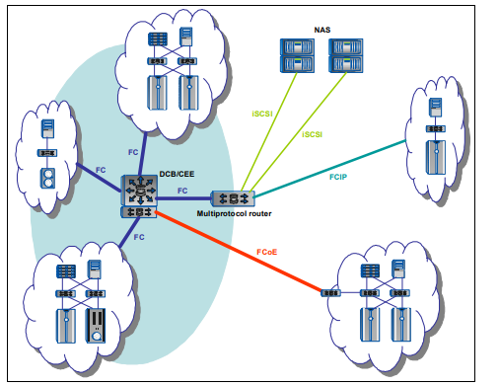
Infrastructure simplification
Infrastructure simplification significantly reduces the complexities that may increase prices, decrease reliability, and increase dependencies on specialized expertise.
The following sections outline the primary approach designs for simplifying infrastructure:
Storage pooling
Data Sharing
Clustering
Consolidation
Fig 2. SAN consolidation concept [3]

Slide 9
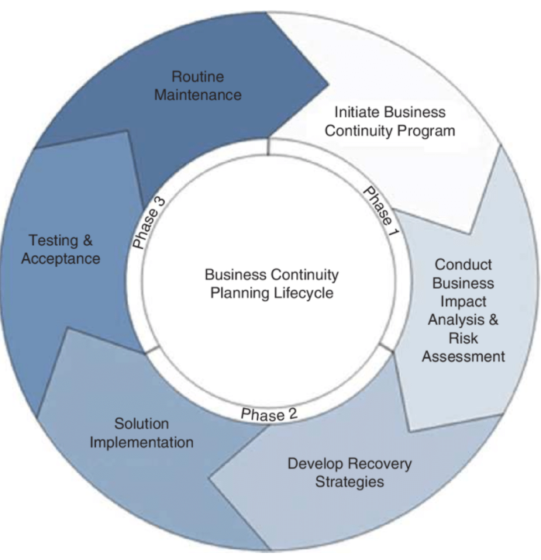
Business continuity
Businesses that operate on demand depend on their IT systems to run their operations. Everything should operate smoothly 24 hours a day.
High availability, near-continuous activities, and disaster recovery are all part of a systematic business continuity plan.
There are two backup and recovery frameworks in use these days:
local backup and recovery
network backup and recovery [3]
SANs are hybrids that integrate the best of both methods.
Fig 3. Business continuity planning [7]

Slide 10
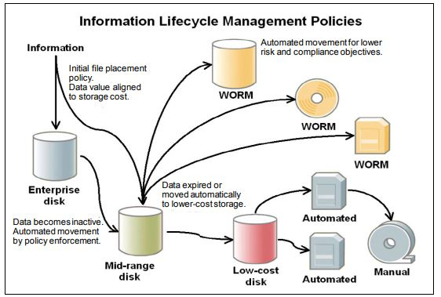
Information lifecycle management
Information lifecycle management (ILM) is a method of managing data throughout its life cycle in an efficient and cost-effective way.
The expected outcomes of information management with ILM are to significantly lower the overall cost of ownership (TCO) and to assist in the implementation of data protection and regulation policies.
ILM is designed to recognize that different types of information can have different value at different points in their lifecycle.
Fig 4. ILM Policies [3]

Slide 11
References
[1] Vmware.com. [Online]. Available: https://www.vmware.com/pdf/esx_san_cfg_technote.pdf. [Accessed: 18- Apr- 2021].
[2] "The Advantages of a Storage Area Network (SAN)", BECA, 2019. [Online]. Available: https://www.becacorp.com/the-advantages-of-a-storage-area-network/. [Accessed: 19- Apr- 2021].
[3] J. Tate, P. Beck, H. Ibarra, S. Kumaravel and L. Miklas, Introduction to storage area networks, 9th ed. IBM Corp., 2017, p. 24.
[4] S. Hajirostam, "Evaluation of Storage Area Network (SAN) security and performance", DIVA, 2013. [Online]. Available: https://www.diva-portal.org/smash/record.jsf?pid=diva2%3A677717&dswid=9347. [Accessed: 18- Apr- 2021].
[5] K. Nystrom, R. Khattar, M. Murphy and G. Tarella, "Introduction to storage area network, SAN", Library Technology Guides, 1999. [Online]. Available: https://librarytechnology.org/document/8923. [Accessed: 19- Apr- 2021].
[6] "Storage Network Management Working Group. - Free Online Library", Thefreelibrary.com, 1999. [Online]. Available: https://www.thefreelibrary.com/Storage Network Management Working Group.-a057778467. [Accessed: 17- Apr- 2021].
[7] A. Coviello and G. Trapani, The Risk Management and the Transfer to the Insurance Market. 2018, pp. 299-306.

