Slide 1
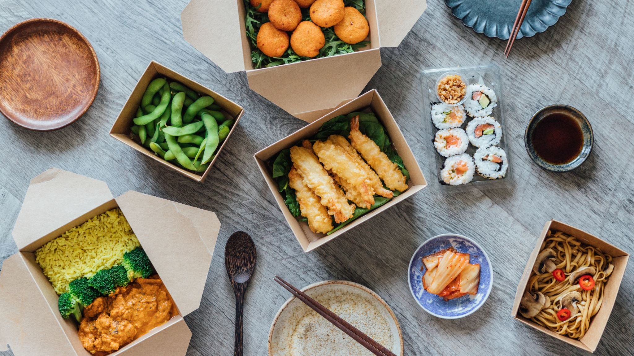
M&S FOOD ENGAGEMENT
WITH DIGITAL AND SOCIAL MEDIA
Presented By somir uddin

Slide 2

What is digital marketing?
Digital Marketing means using online platforms and tools to promote products and communicate with customers. M&S Food has become very active on social media, using websites like Instagram and TikTok to share attractive food content, work with influencers, and interact with customers.
This helps M&S Food build stronger relationships with shoppers and show what makes its products stand out.

Slide 3
Importance of digital marketing in customer relationship marketing (crm)
M&S Food must try to meet the 4Cs of customer needs: Customer solution, customer cost, convenience, and communication (Lauterborn, 1990).
Digital marketing can allow for proactive engagement. These types of engagement include reminder emails, loyalty program updates, and personalised offers as well.

Slide 4

Benefits on an organisation
Digital marketing allows businesses to reach a global audience, breaking geographical barriers. Even small business can gain international visibility.
Digital marketing allows for businesses to use demographic, behavioural, or interest-based targeting to reach the right audience.
Digital marketing campaigns can be adjusted quickly according to performance data or changing marketing goals, without the long lead times and costs of traditional marketing.
Businesses can respond to queries and offer personalised content.

Slide 5
Positive elements of using social media
Social media allows for companies and to interact directly with customers in real time. Ghazali, Rahim and Hasan (2016) also write that active social media interaction reduces customer churn, which means that customers who feel heard and valued on social platforms are more likely to stay loyal.
Companies can promote additional products or services based on observed behaviour (Ghazali, Rahim and Hasan, 2016).

Slide 6
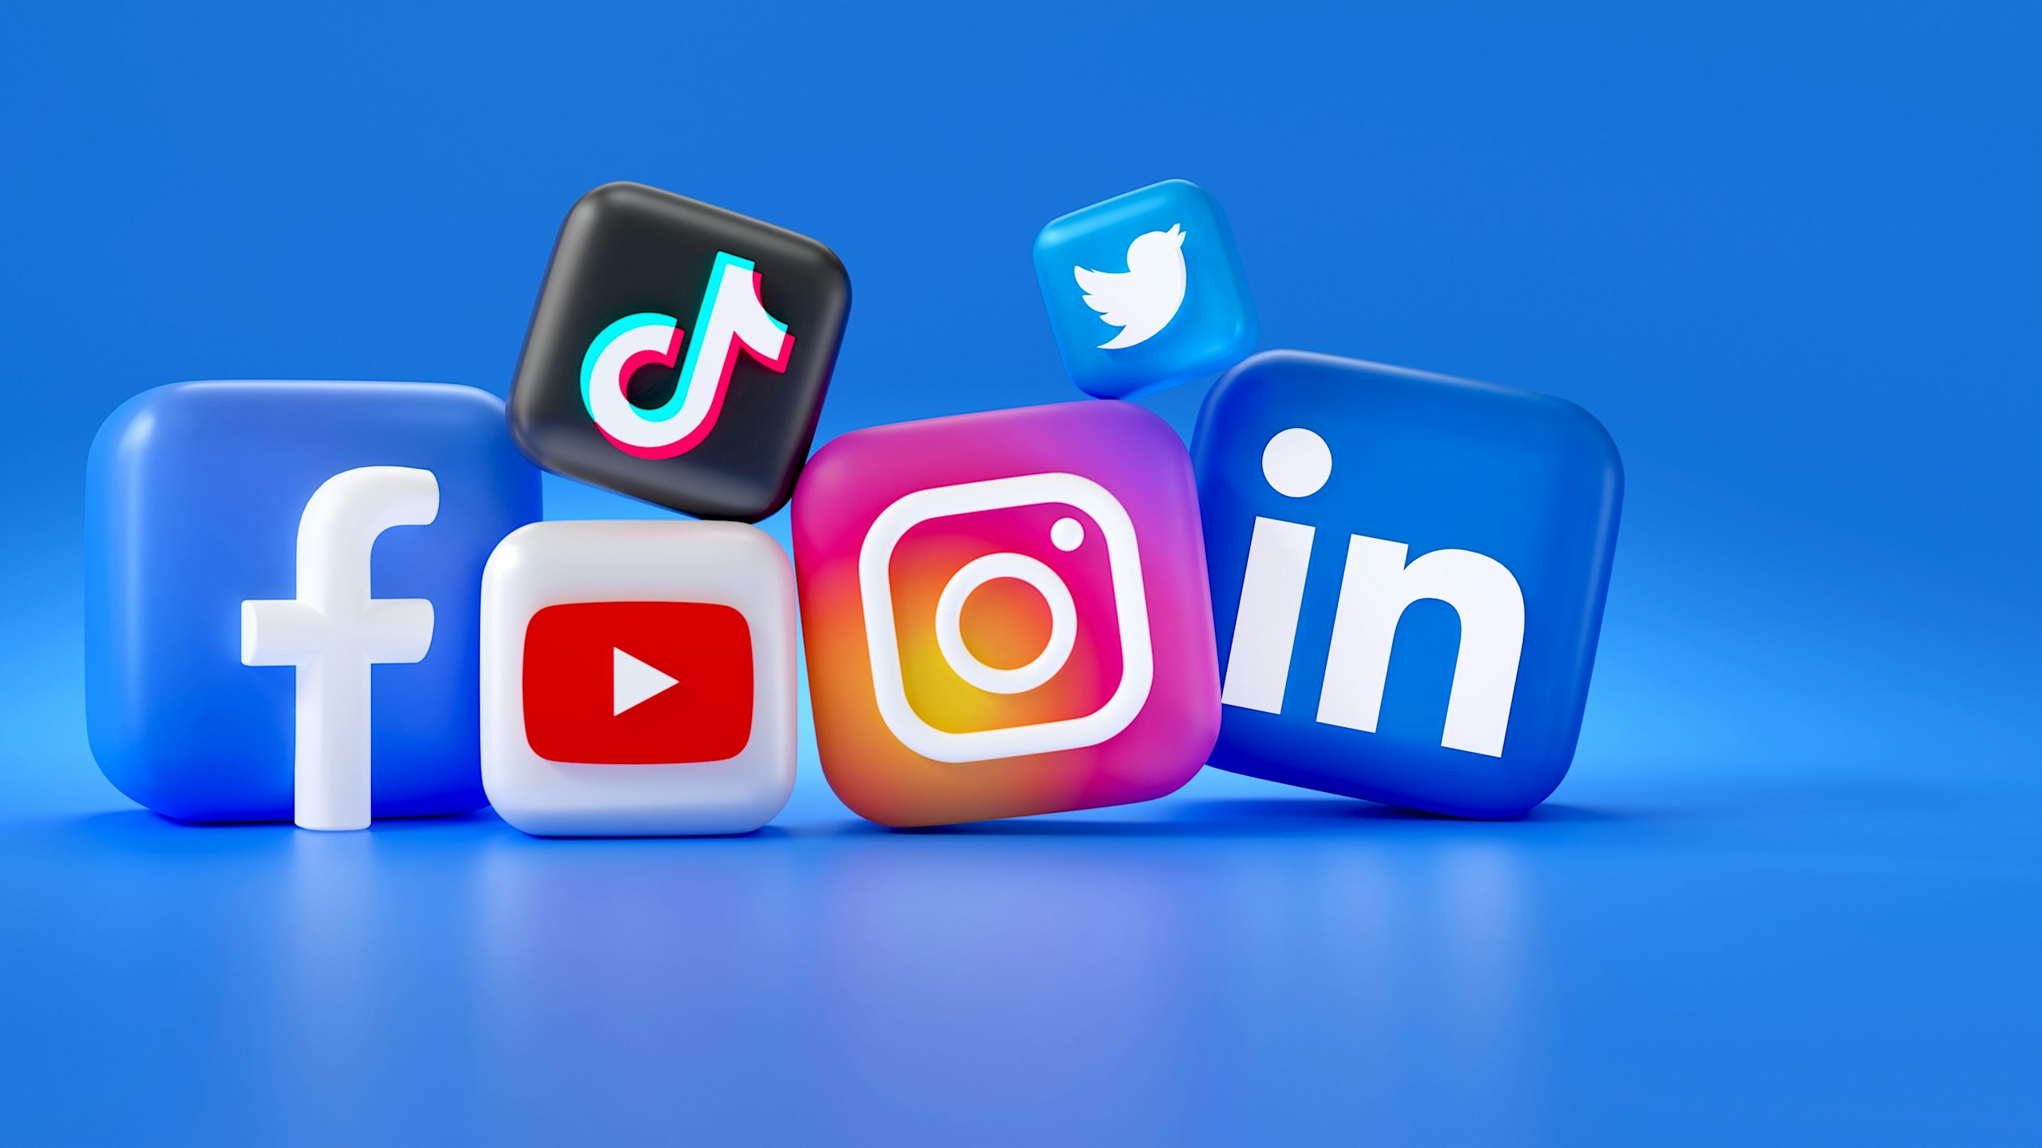
Research findings on social media
Ghazali, Rahim and Hasan, (2016) say that compared to traditional channels, social media allows large-scale customer communication at quite a low cost. They say that organisations can maintain strong CRM without too much spending.

Slide 7

Negative aspects of using social media
Once something is posted online the organisation can lose control of the message. Audiences can take content and things uploaded in very different ways. Things like comments or shares may spread the message way its original meaning. Negative feedback and things like customer complaints can also become public very quickly.

Slide 8
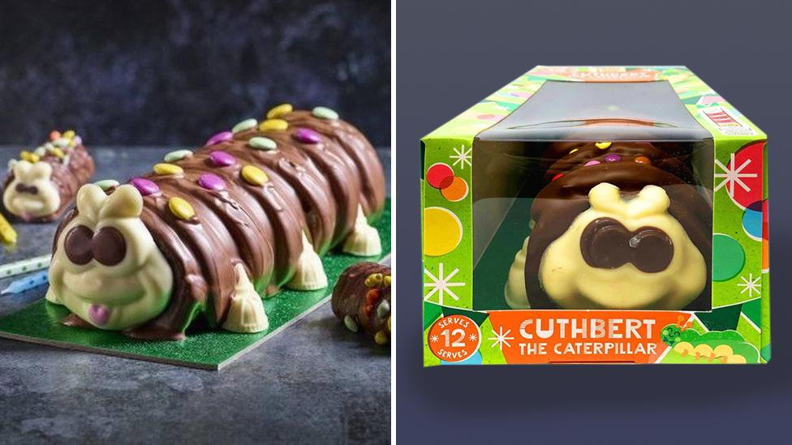
M&s case study
M&S took legal action against Aldi over the Colin vs. Cuthbert cake, and social media blew up. The two cakes were very similar and M&S claimed there was some copying involved.
The Independent (2021) wrote that many users joked about it and many actually took Aldi’s side because of Aldi’s humorous posts.

Slide 9
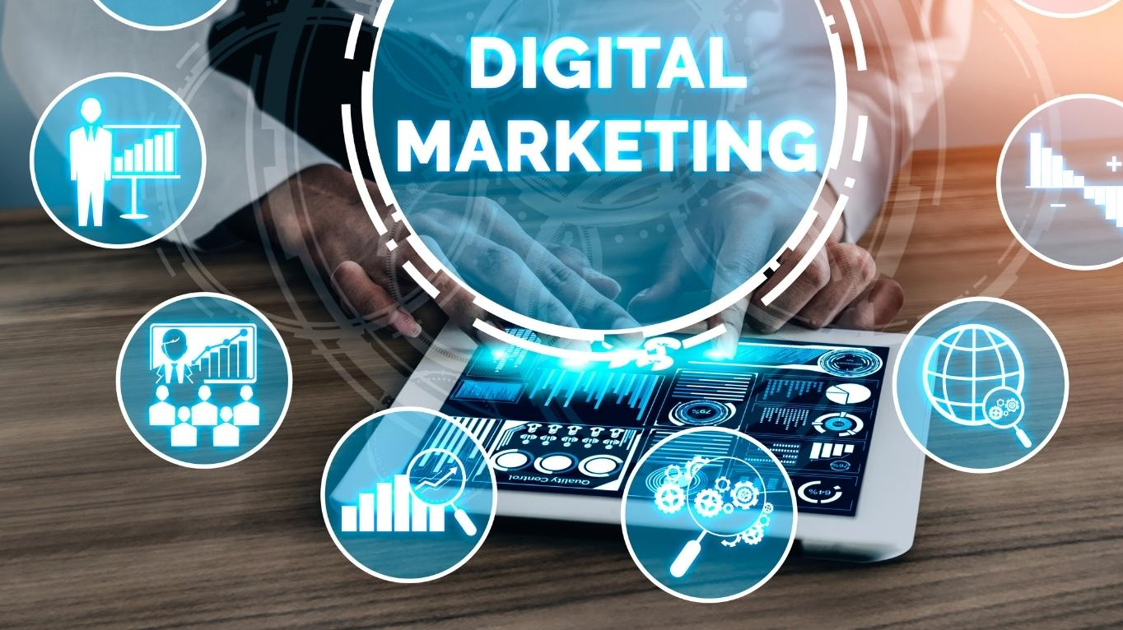
How digital marketing is delivered at m&s
M&S invests heavily in the online platform. The website and mobile app are designed for smooth user experiences with easy finding and detailed product information. This makes it easier for shopping to be done and customers can buy things quickly.

Slide 10

How digital marketing improves performance at m&s
One example of the benefit of digital marketing is increased customer retention. By personalising recommendations, sending new offers, and making online shopping easier, M&S Food encourages customers to return more often. This leads to higher repeat purchase rates, which directly improves sales and profitability.

Slide 11
Examples of m&s food’s digital marketing tools
Gilliand (2023) says M&S encourages individual stores to run their own social-media (TikTok/Instagram/Facebook) accounts. Staff members make videos to show off new products, engage local communities, and show real people behind the brand. Gilliand (2023) also says that M&S use staff members instead of big celebrities to promote their products and create videos and posts which allows for them to interact better with their customers.

Slide 12

conclusion
M&S shows how digital marketing can help a business connect with customers and boost sales. Their website and mobile app are easy to use, with clear navigation and detailed product information, which makes shopping faster and simpler for customers (Rezaid, 2025).
Once content is online, the company can lose control of how it is seen. Negative comments or jokes can spread quickly and hurt the brand, as happened in the M&S vs. Aldi Colin the Caterpillar case (The Independent, 2021). This shows that clear rules, trained staff, and careful monitoring are needed to use digital marketing successfully.

Slide 13
references
Lam, A. Y. C., Cheung, R. and Lau, M. M. (2013). The Influence of Internet-Based Customer Relationship Management on Customer Loyalty. Available at: https://cmr-journal.org/article/view/11095?utm_
Lauterborn, R. (1990). New Marketing Litany: 4Ps Passé. Advertising Age. Available at: https://www.researchgate.net/publication/372928173_Extending_Lauterborn's_4Cs_for_Social_Marketing
E‑worx (2025). 11 Key Benefits of Digital Marketing for Businesses. Available at: https://www.e-worx.co.uk/post/benefits-of-digital-marketing-for-businesses
Digital Flavour (2024). Disadvantages of Digital Marketing: Is It Always the Best Choice? Available at: https://digitalflavour.co/blog/disadvantages-of-digital-marketing/
Ghazali, E.M., Rahim, R.A., & Hasan, H. (2016). The Effect of social media interactions on customer relationship management. Journal of Business and Industrial Marketing. Available at: https://link.springer.com/article/10.1007/s40685-016-0027-6
Rezaid (2025). Marks and Spencer’s Digital Revolution: A Success Story. Available at: https://www.rezaid.co.uk/post/marks-and-spencers-digital-revolution-a-success-story/
The Independent (2021). Aldi makes Twitter jokes in reference to Marks and Spencer Colin the Caterpillar legal challenge. Available at: https://www.the-independent.com/life-style/food-and-drink/colin-the-caterpillar-m-s-aldi-twitter-b1832684.html
Retail Gazette (2024). How M&S aims to become a digital fashion leader. Available at: https://www.retailgazette.co.uk/blog/2024/09/ms-digital-fashion/
Gilliland, N. (2023). How Marks & Spencer has innovated its social media presence. [online] Econsultancy. Available at: https://econsultancy.com/marks-spencer-social-media-innovation/?utm_
Joseph, S. (2019). How Marks and Spencer uses Instagram Stories. Available at: Digiday https://digiday.com/media/marks-spencer-uses-instagram-stories/
Marks & Spencer. (2025). How we’re turbocharging online growth: Seven key changes to M&S.com over the past year. [online] Available at: https://corporate.marksandspencer.com/newsroom/blog/how-were-turbocharging-online-growth-seven-key-changes-mscom-over-past-year.
Marks & Spencer. (2022). OVER 300 M&S STORES NOW OFFER CHECKOUT-FREE SHOPPING: M&S TRIPLES THE NUMBER OF STORES OFFERING MOBILE PAY GO TECHNOLOGY THROUGH THE M&S APP. [online] Available at: https://corporate.marksandspencer.com/newsroom/press-releases/over-300-ms-stores-now-offer-checkout-free-shopping-ms-triples-number [Accessed 30 Nov. 2025].

