Slide 1
OSTEOARTHRITIS
Name: NAYI KRUPA
Student Number: 2540964
Module Title: Community care and management
Lecturer: Dr Hamdi Hussain
Module code - LCHS7003

Slide 2
Definition, Symptoms and Aetiology)
Definition
Osteoarthritis (OA) is a long-term condition affecting the whole joint, involving articular cartilage, bone, synovium and surrounding tissues.
It commonly affects the knees, hips and hands.
* OA causes pain, stiffness, reduced physical function and limitations in daily activities.
* OA is not simply an inevitable consequence of ageing.
* Symptoms and functional impact vary considerably between individuals.
Common symptoms
Activity-related joint pain,Joint stiffness,Swelling or tenderness,Crepitus/grating sensation,Reduced range of movement,Muscle weakness and reduced function
The NHS identifies pain, stiffness and difficulty moving the joint as the main symptoms.
(Hunter and Bierma-Zeinstra, 2019; NICE, 2022; WHO, 2023)

Slide 3
OA is a multifactorial condition influenced by biological, mechanical and lifestyle factors.
Key risk factors:
Increasing age,Previous joint injury or surgery
Overweight and obesity
* Family history and genetic factors
* Repetitive joint loading
* Muscle weakness
* Other joint conditions
Commonly affected joints:
Knee • Hip • Hand
(Blagojevic et al., 2010; Cui et al., 2020; Zhang, 2010)

Slide 4
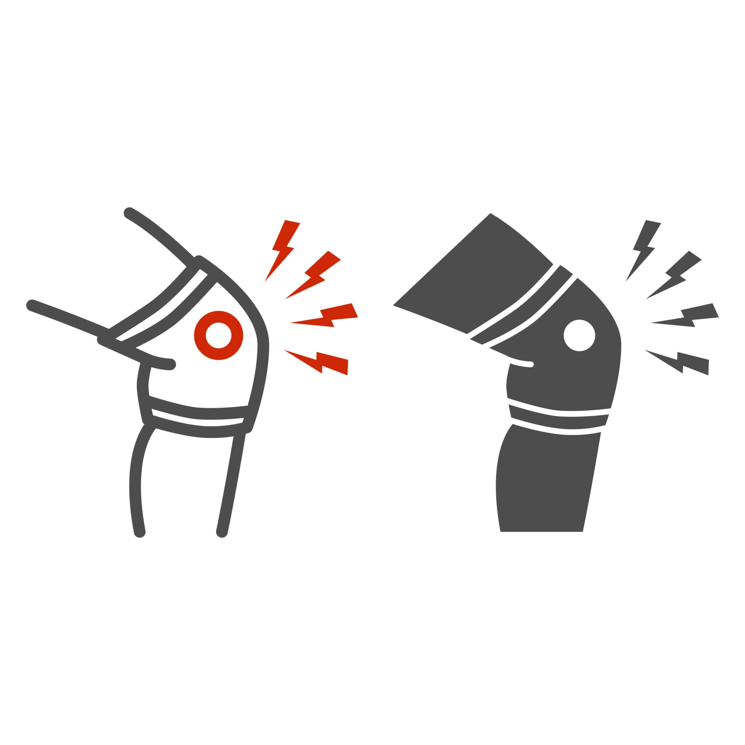
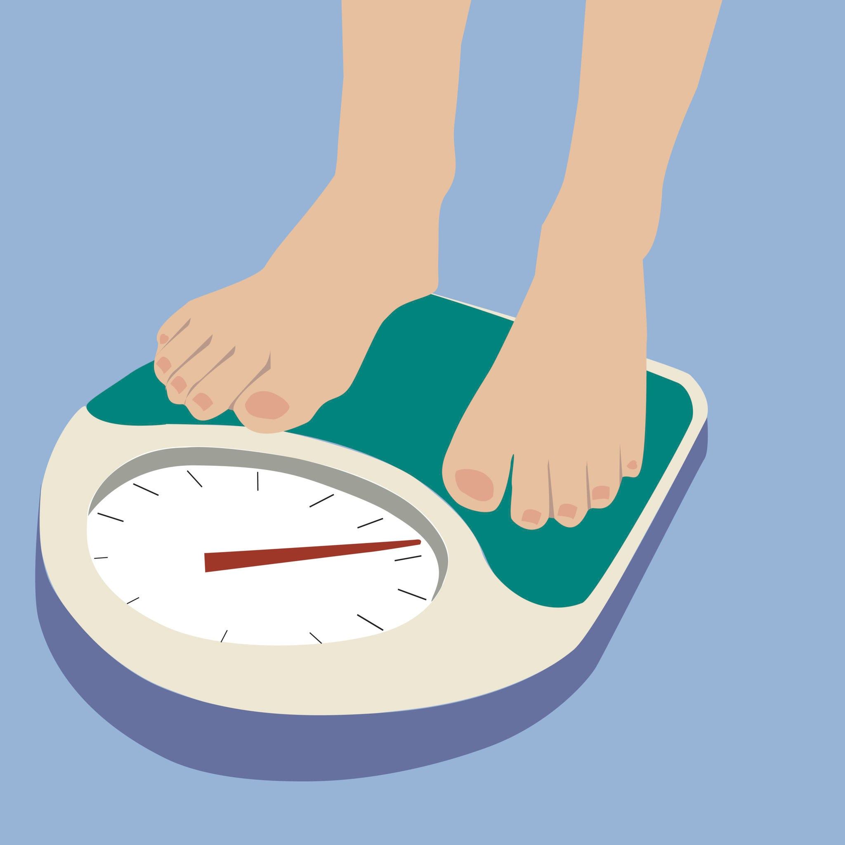
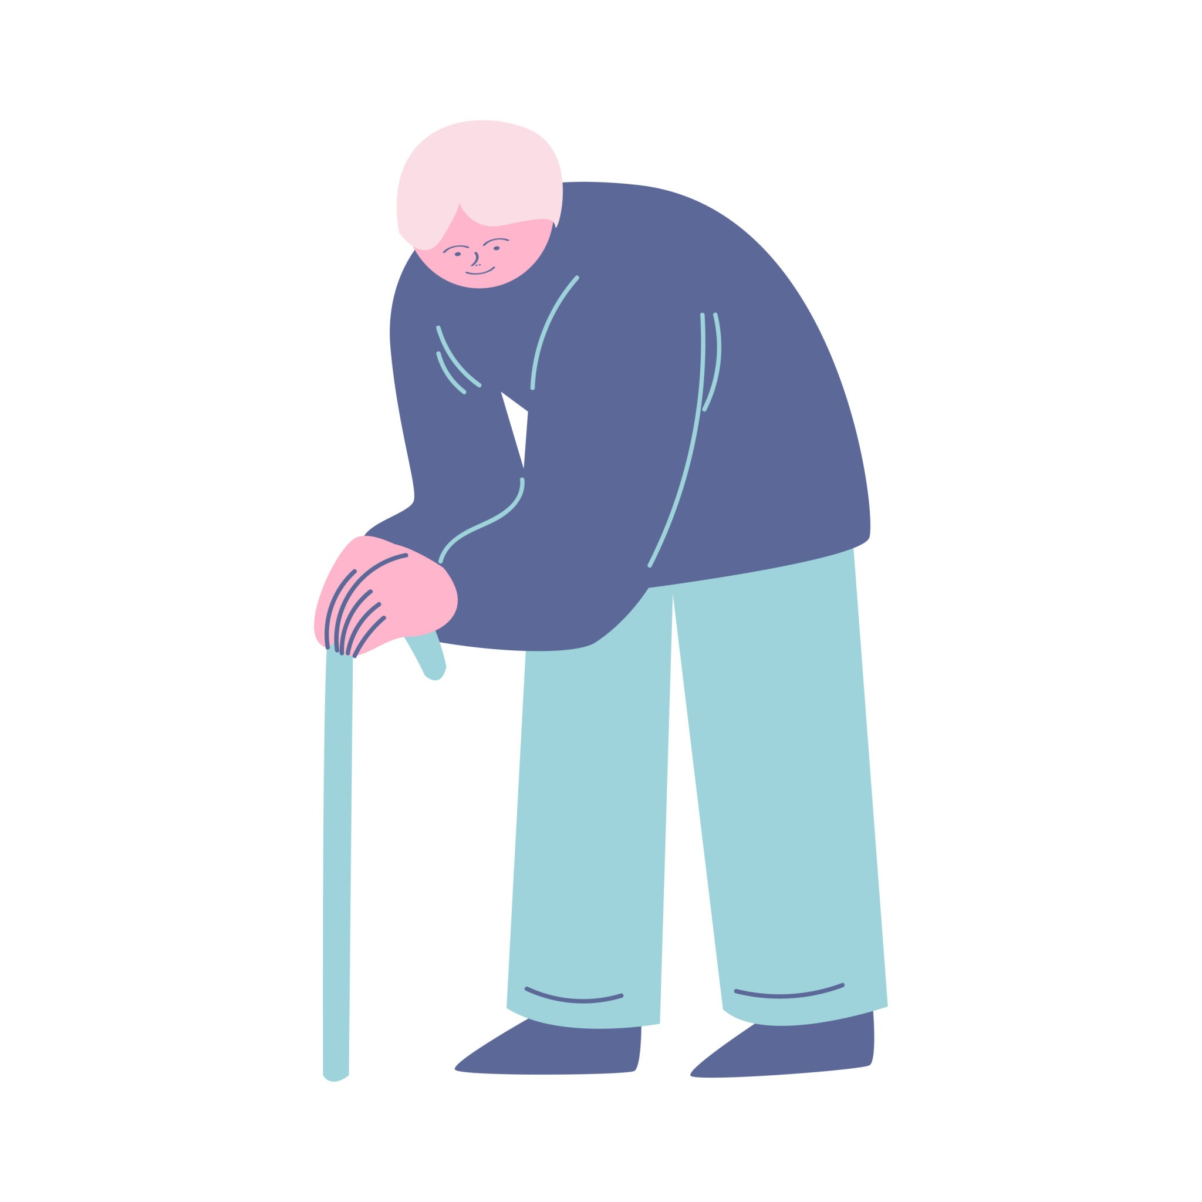
Aetiology and Risk Factors
* OA results from interaction between biological and mechanical factors.
Non-modifiable:
* Age, Female sex
* Genetics
* Previous joint abnormalities
Modifiable:
* Obesity
* Joint injury
* Physical inactivity
Repetitive joint loading
KNEE INJURY
OBESITY
Prevalence of Osteoarthritis
• Global: ~500 million people affected worldwide
• UK: ~10 million people live with OA
• Women are generally more affected than men
• Global OA prevalence is increasing
• Ageing populations and obesity contribute to the rising burden.
Cui et al. 2020; WHO 2023; Versus Arthritis 2024
(Blagojevic et al., 2010; Verbeek et al., 2017; Cui et al., 2020) )
AGEING POPULATION

Slide 5


Economic & social burden of OA
Economic Burden
Social burden
Healthcare costs: GP visits, meds, joint replacement
NHScost: ~£10.2 billion per year in the UK
Work absenteeism: Lost productivity & sick days
Reduced mobility: Difficulty walking, climbing stairs
Mental health: Pain, depression, social isolation
Quality of life: Daily activities become harder
(Cui et al., 2020; Swain et al., 2020; Safiri et al., 2020; WHO, 2023)

Slide 6

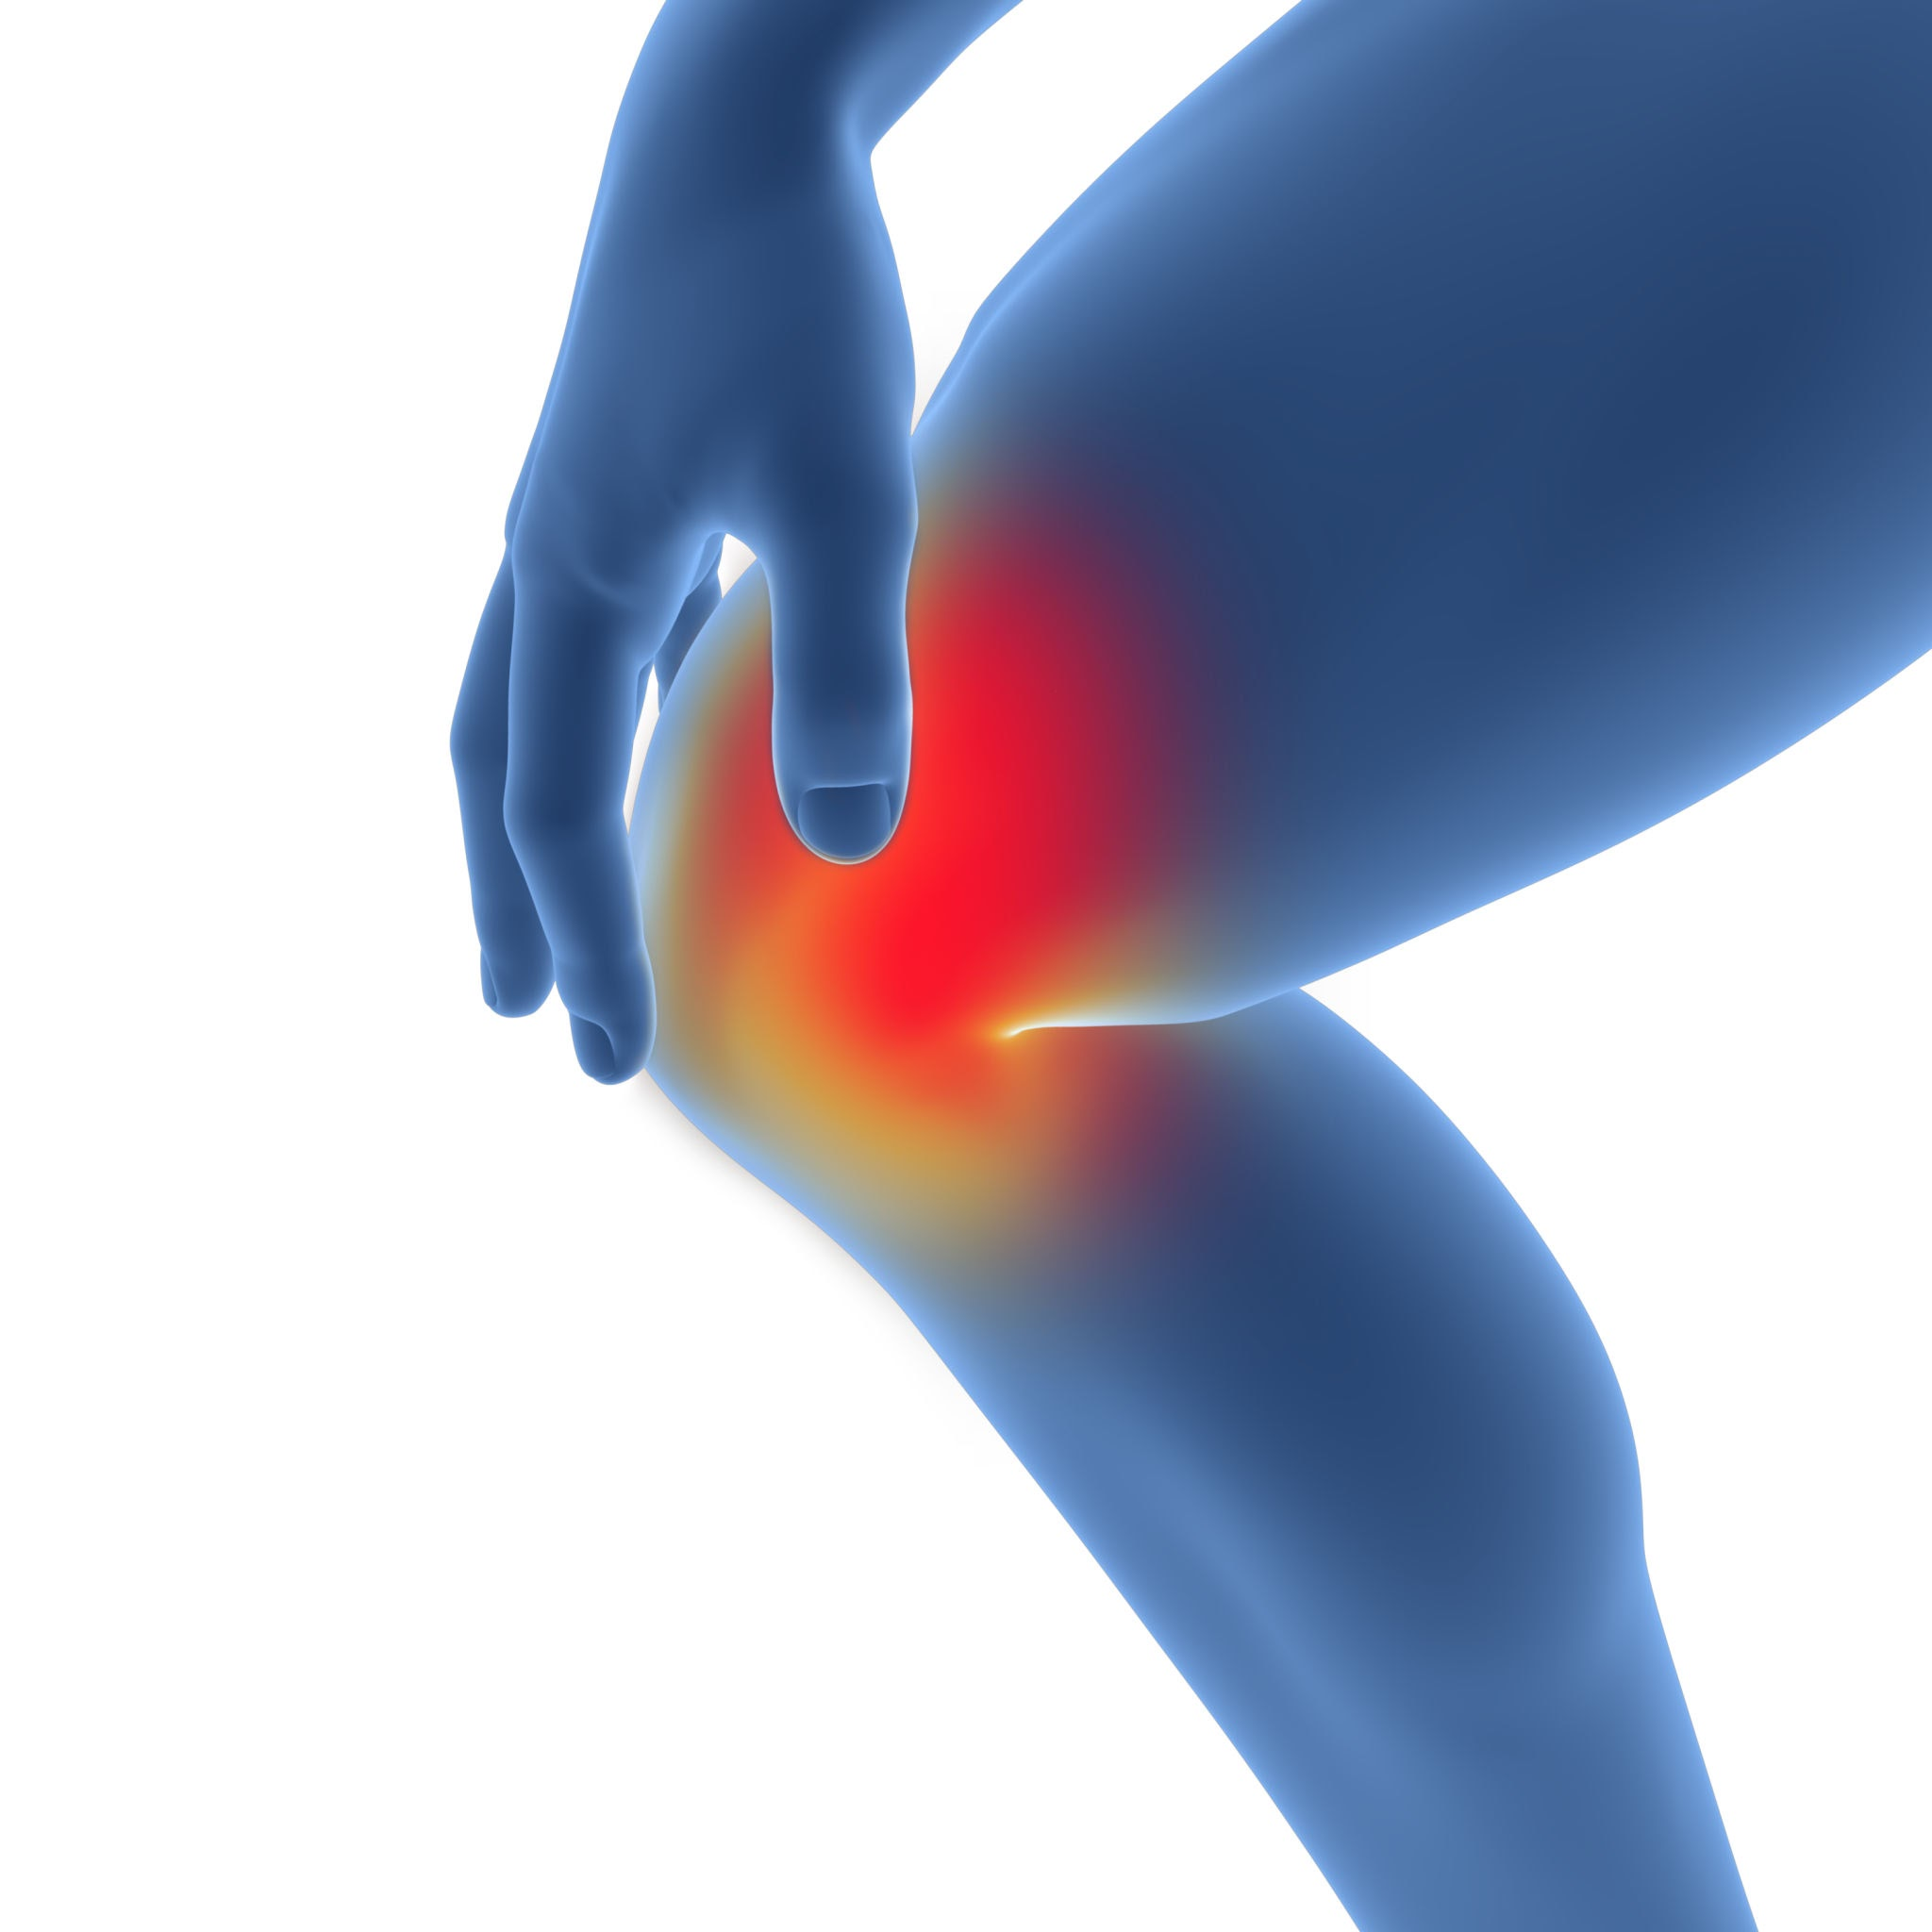
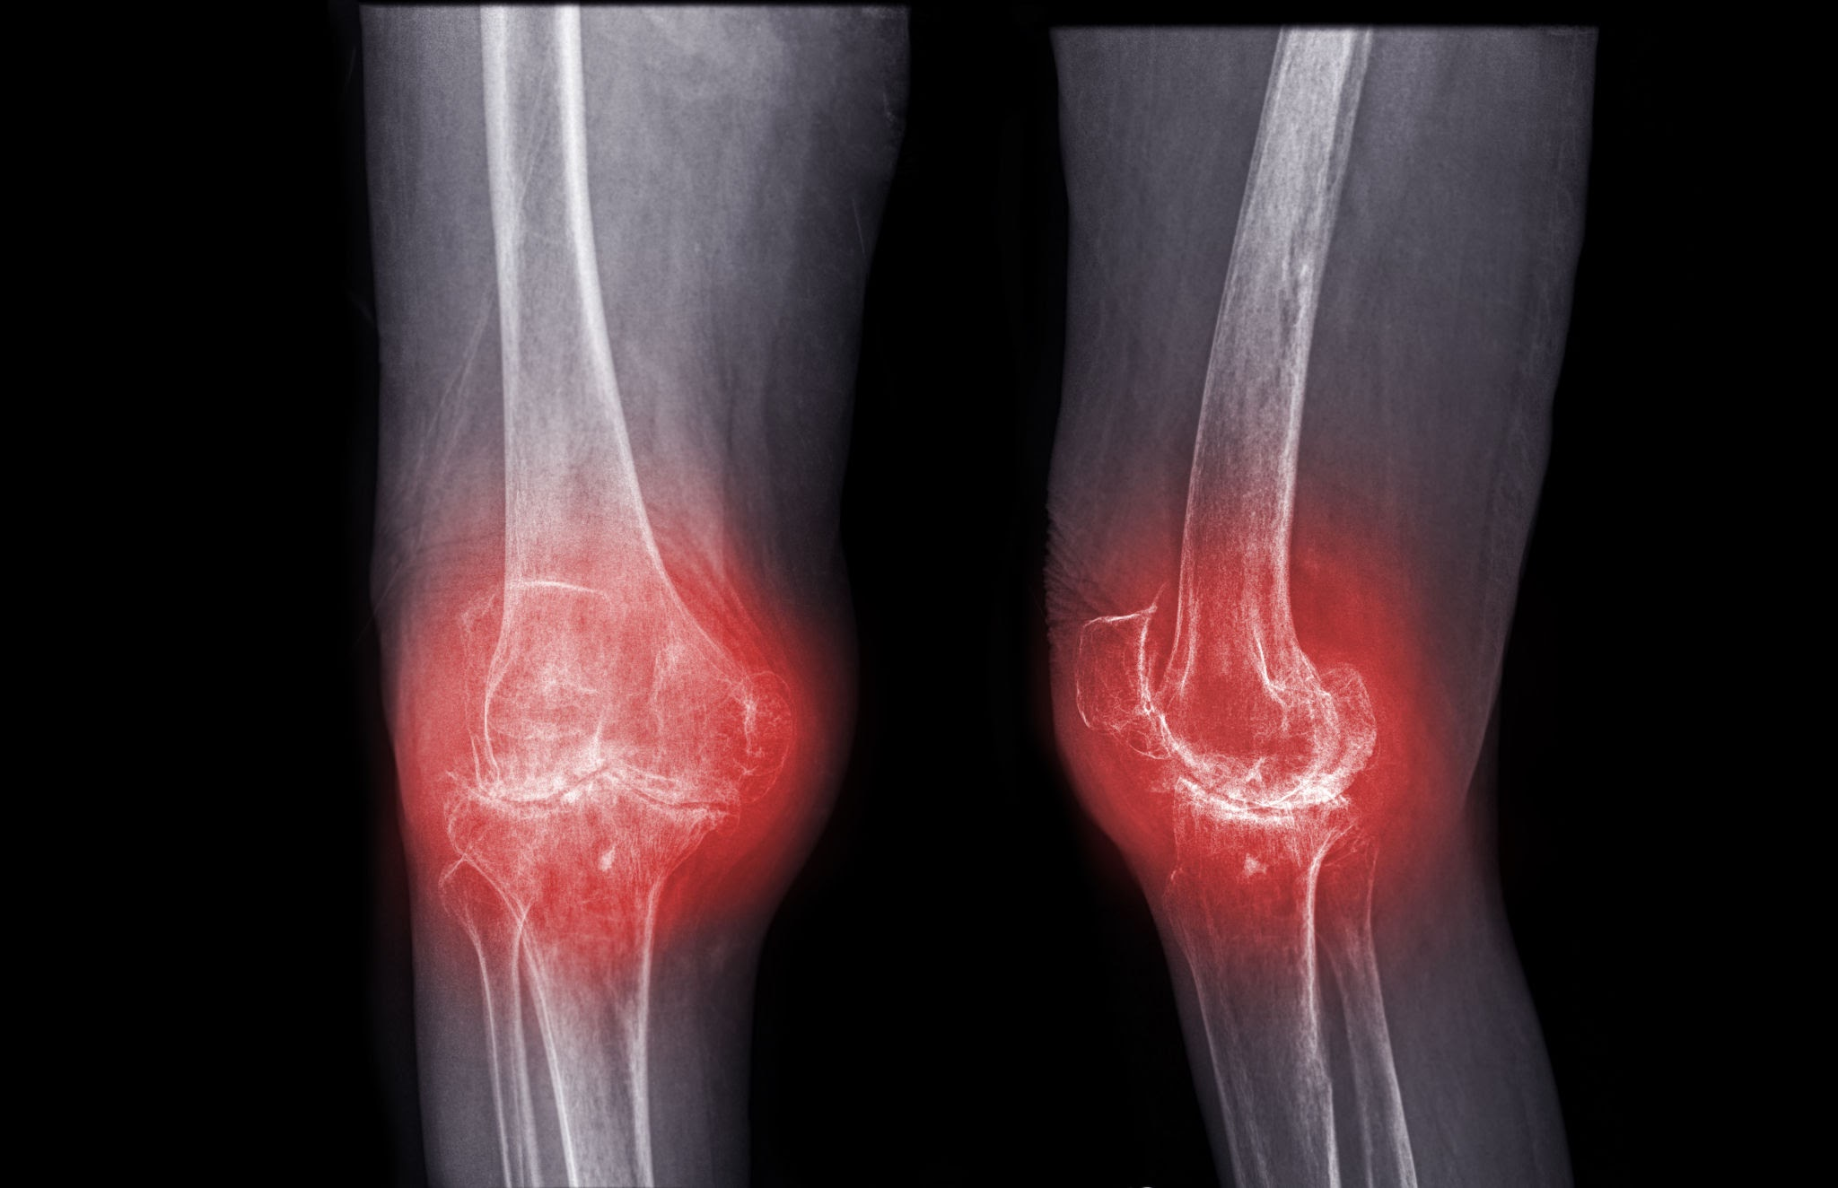
Diagnosis & Initial Assessment
Clinical
Based on history + physical exam
No blood test needed
How OA is Diagnosed
- Clinical assessment: Based on patient history + physical exam
- Key symptoms: Joint pain, stiffness, reduced movement
- No routine blood tests needed for OA
- Imaging: X-ray only if diagnosis is unclear or to rule out other causes
- Initial management starts at diagnosis: Education,
exercise, weight management
symptoms
Joint pain Stiffness
Reduced movement
Imaging + Initial Care
X-ray only if diagnosis unclear Education, exercise, weight management
(Gupta et al., 2005; Litwic et al., 2013; Cross et al., 2014; Safiri et al., 2020)

Slide 7


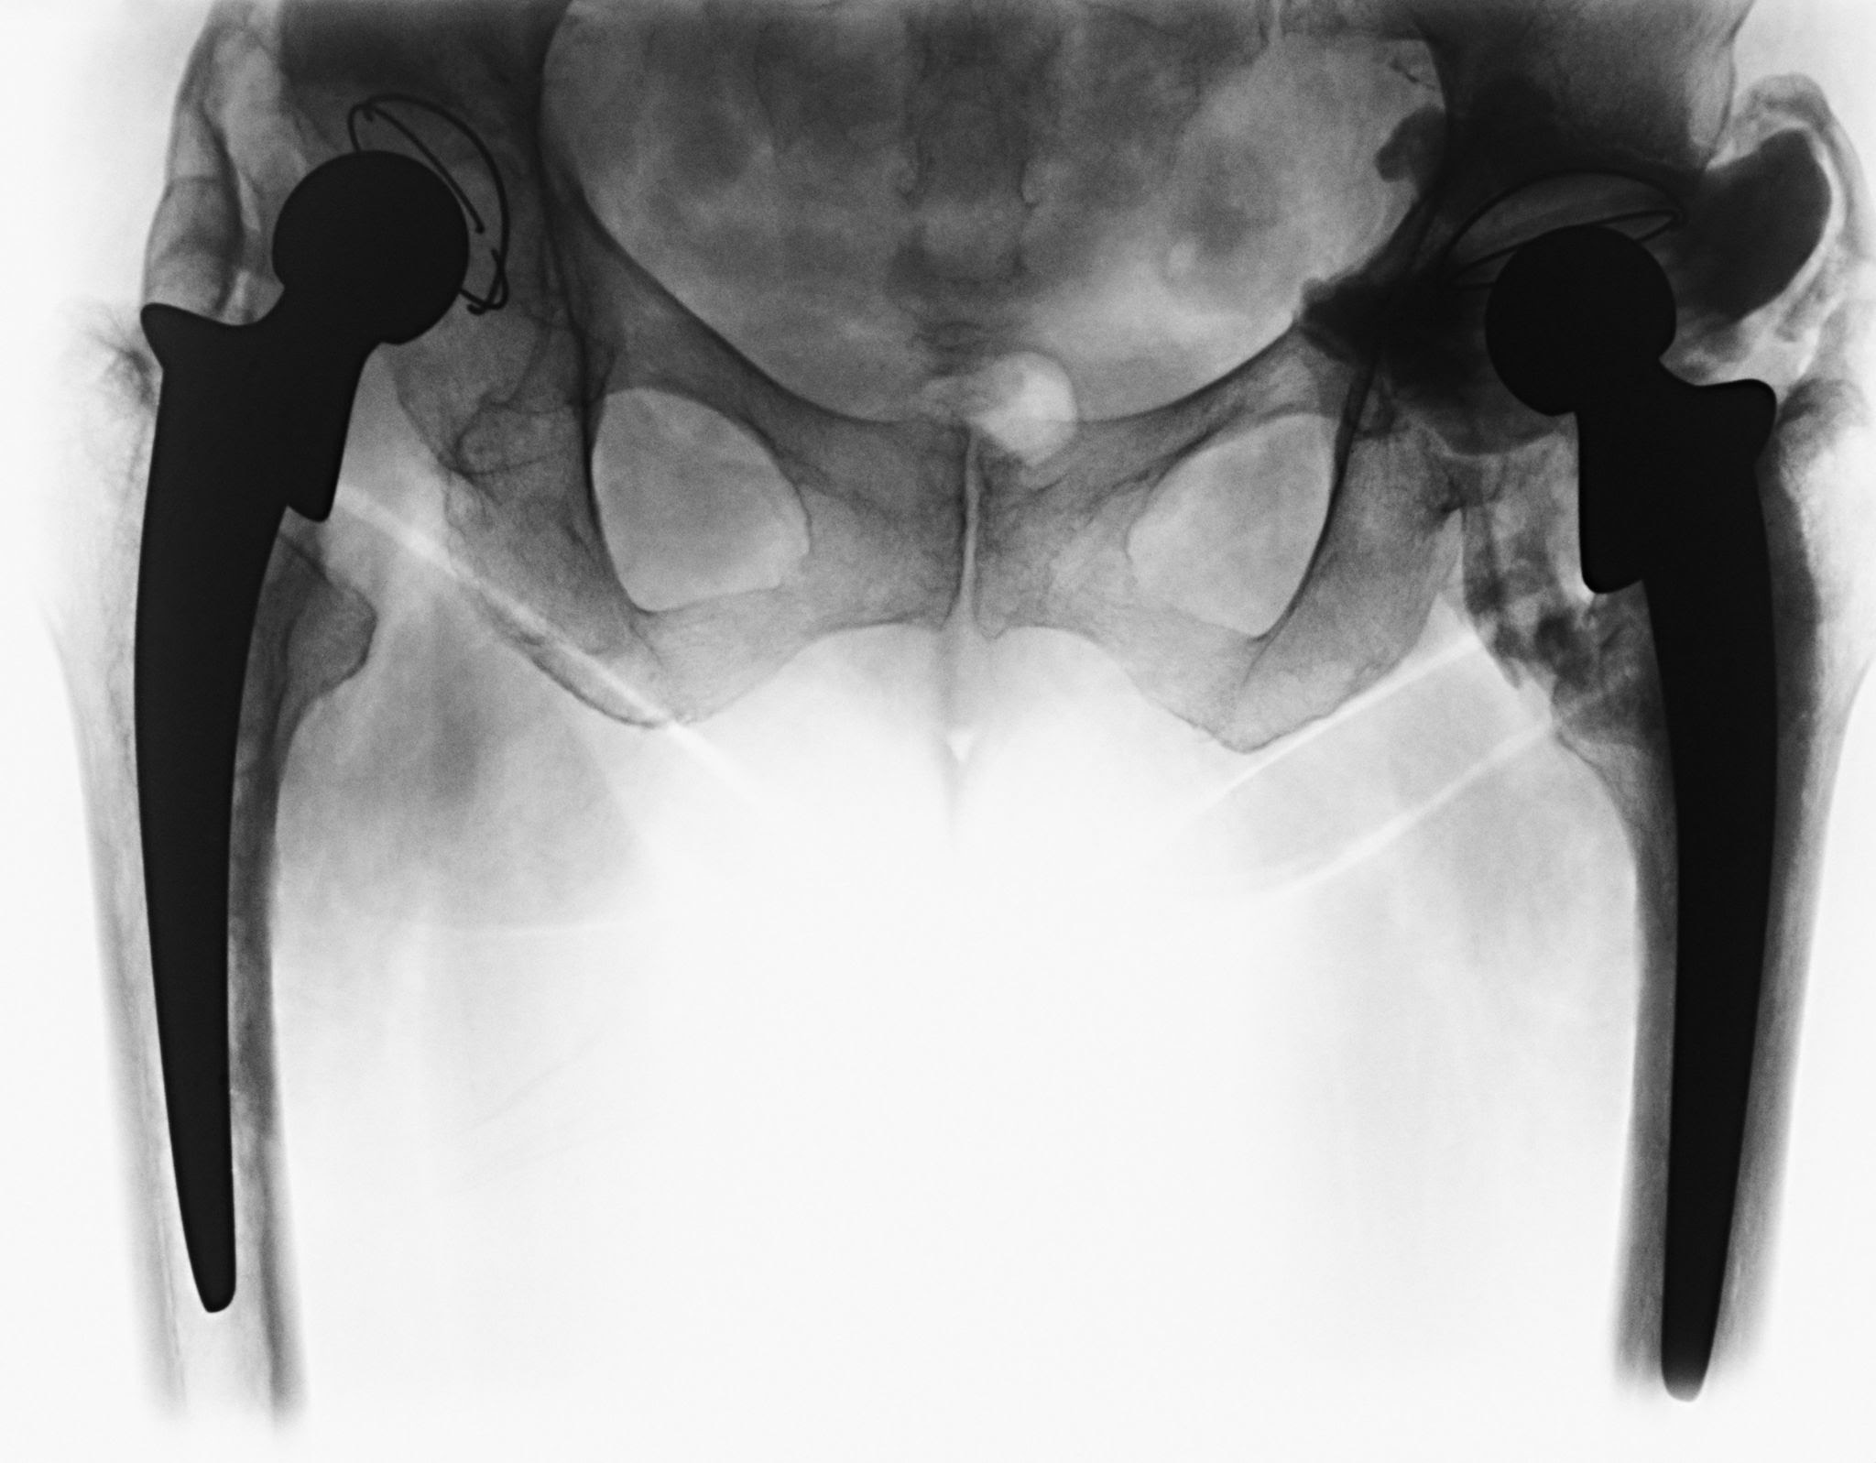

Management & Treatment Options
Pharmacological
Paracetamol as first-line
NSAIDs - oral and topical
Consider for pain relief
Non-pharmacological
Exercise & physical therapy
Weight management Education & self-management
Surgical
Consider for severe OA
Joint replacement surgery
When other treatments fail
(NICE, 2022; Katz et al., 2021; Hunter and Bierma-Zeinstra, 2019)

Slide 8


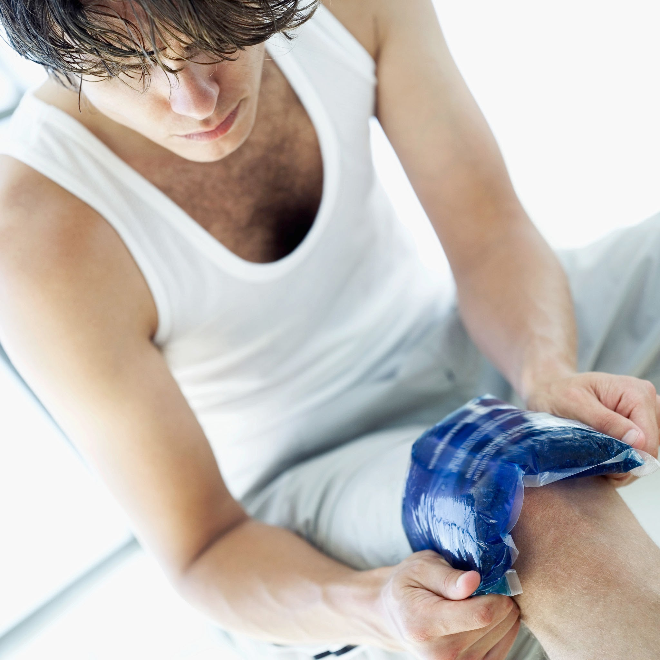

Patient Education & Self-Management
Understanding OA
OA is common and manageable
It is not "just wear and tear
"Pain ≠ more damage
Self-management
strategies Stay active - movement helps
Pace activities
Heat/cold therapy
Support
Peer support groups Versus Arthritis resources
Talk to GP/Physio
(NICE, 2022; EULAR, 2023; Bannuru et al., 2019)

Slide 9

Key Takeaways
OA is the most common form of arthritis, affecting 1 in 6 adults
Diagnosis is clinical - based on history + exam
First-line management: exercise, education, weight management
Treatment is stepped: non-pharmacological → pharmacological → surgical
Patient education and self-management are central to care
(Wagner et al., 2001; NICE, 2021; NHS England, 2019a)

Slide 10



NICE Guidelines Overview NG226
Assessment
Clinical diagnosis
Consider X-ray if uncertain
Core Treatments
Exercise programs
Weight management
Education & self-managemen
Pain
Management Paracetamol/NSAIDs
Topical NSAIDs first
Referral for surgery if needed
(NICE, 2022; Bannuru et al., 2019; Fransen et al., 2015; Katz et al., 2021)

Slide 11

Pharmacological Management in Detail
Paracetamol, Topical NSAIDs
Oral NSAIDs + PPI protection
Consider opioids for short term only
Avoid: Routine use of paracetamol alone for chronic pain
Note: Always consider risks vs benefits
(Swain et al., 2020; Cheraghi-Sohi et al., 2013)

Slide 12

Non-Pharmacological Management in Detail
Exercise:
Strength,
Aerobic,
Neuromuscular
Weight loss:
5-10% reduction helps symptoms
Aids:
Walking stick, insoles, braces
Psychological:
CBT, pain management programs
(NICE, 2022; WHO, 2023; Messier et al., 2013; Blagojevic et al., 2010)

Slide 13
Surgical Options
When to Consider
Surgery Severe pain not controlled by other
treatments Significant impact on daily activities Failed
conservative management for 3+ months
Types of Surgery Arthroscopy:
Rarely recommended for OAJoint
replacement: Hip, knee, shoulder
Osteotomy: For younger patients
Referral
Refer to orthopedics when appropriate Discuss risks, benefits, and recovery time Consider patient age and comorbidities.
(NHS England, 2019b; NICE, 2021)

Slide 14
Complications & Prognosis
Complications
Chronic pain and stiffness
- Reduced mobility and disability
- Increased risk of falls and fractures
- Impact on mental health: anxiety & depression
- Comorbidities: obesity, cardiovascular disease
Prognosis
OA is a long-term but manageable condition
- Symptoms can fluctuate over time
- Early intervention improves outcomes
- Most people live well with self-management
- Quality of life can be maintained
NHS England, 2019b; NICE, 2021; NHS England, 2019c)

Slide 15

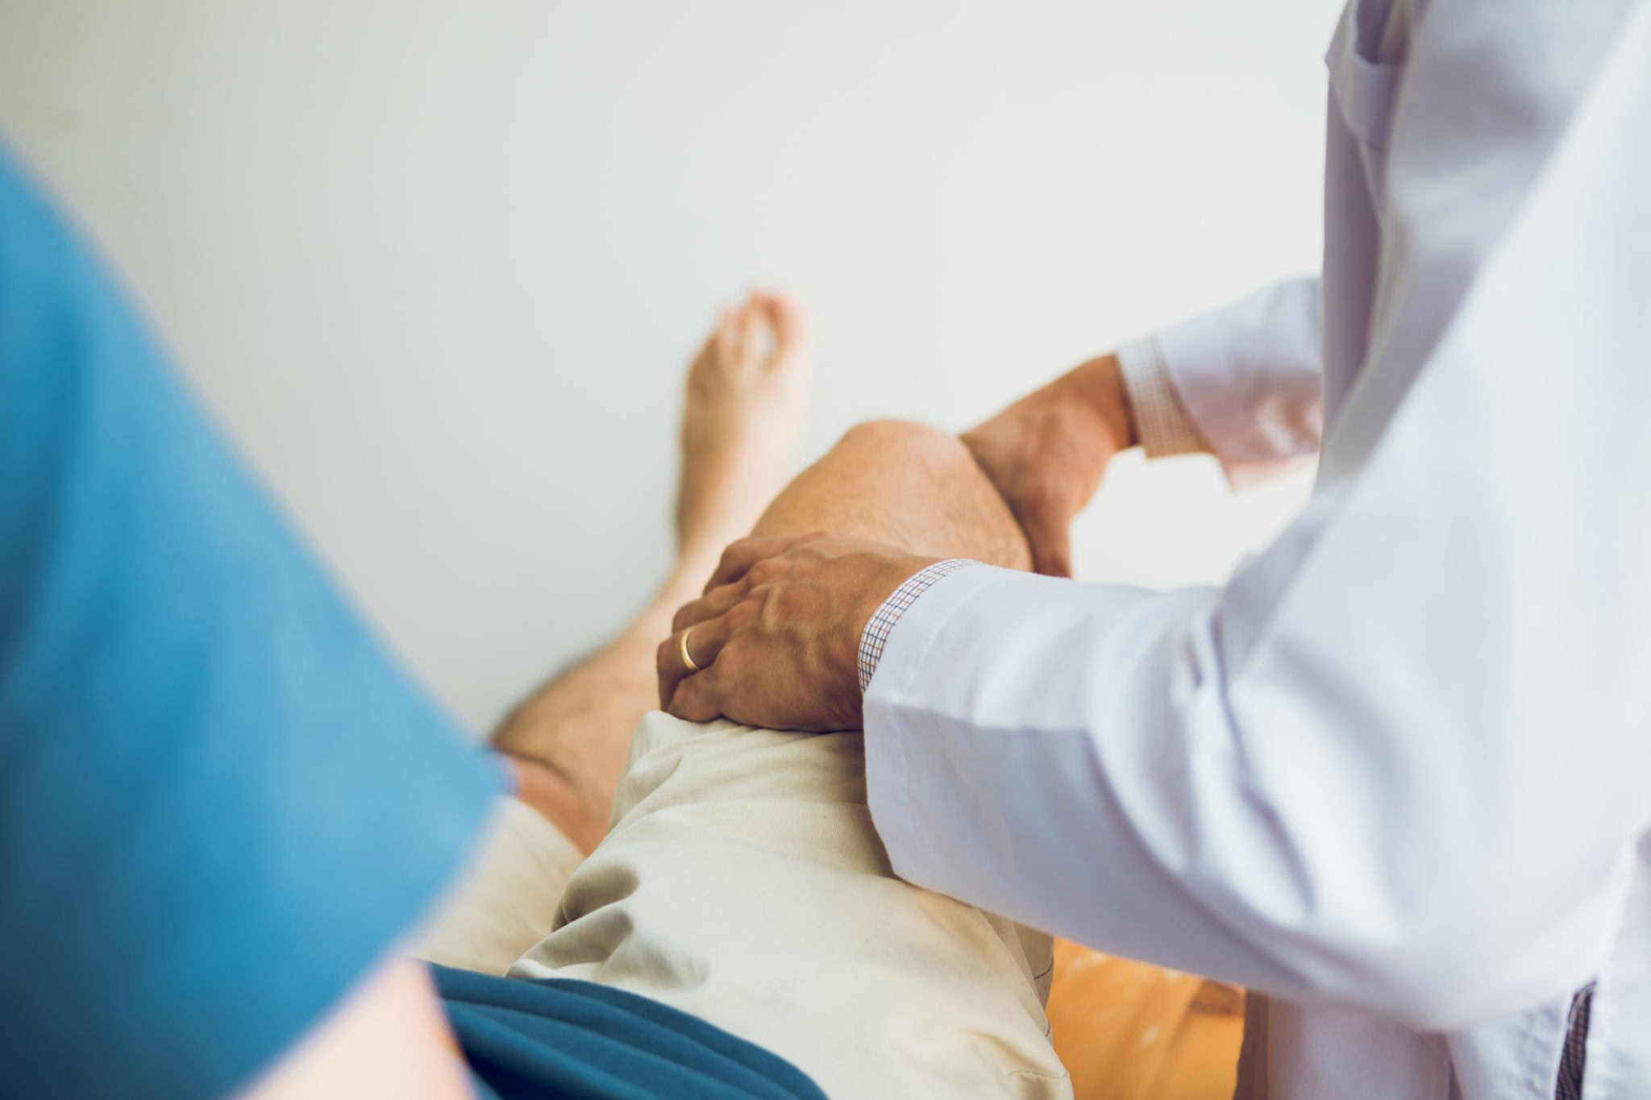
Case Study / Clinical Scenario
Patient: 65-year-old female
Presenting Complaint:
6-month history of knee pain, worse with activity and stairs
Examination:
- Crepitus on movement
- Reduced range of motion
- No significant swelling
X-ray Findings:
- Joint space narrowing
- Osteophytes present
4. Review in 6 weeksIcon: patient or case study
Citation: (NICE NG226, 2022)
Management Plan:
1. Education + structured exercise program
2. Weight management advice
3. Topical NSAID for pain relief
4. Review in 6 weeksIcon: patient or case study
Citation:
(NHS England, 2019a; NICE, 2021; NHS England, 2019d)

Slide 16



Future Directions & Research
New Treatments
Biologics targeting inflammation
Gene therapy research
Joint Preservation
Cartilage regeneration Stem cell therapy
Technology
Wearable activity
Monitors
AI for early detection
(Lorig and Holman, 2003; NHS England, 2019c; NICE, 2021)

Slide 17

Conclusion
Osteoarthritis is the most common joint condition, but it is manageable.
The evidence is clear:
Early diagnosis + Exercise + Education + Weight management = Better outcomes
Treatment should be stepped and patient-centered.
Every patient can live well with the right support and self-management tools.
Take Home: Move more, manage weight, and stay involved in your care
(NICE, 2022; NHS England, 2019a; EULAR, 2023; Bannuru et al., 2019)

Slide 18
References
1. NICE. Osteoarthritis in over 16s: diagnosis and management. NG226. 2022. https://www.nice.org.uk/guidance/ng2262. Versus Arthritis. Osteoarthritis. 2024. https://www.versusarthritis.org/about-arthritis/conditions/osteoarthritis/3. NHS. Osteoarthritis. 2023. https://www.nhs.uk/conditions/osteoarthritis/4. BMJ Best Practice. Osteoarthritis. 2023. https://bestpractice.bmj.com/topics/en-gb/255. Arthritis Foundation. Osteoarthritis. 2024. https://www.arthritis.org/diseases/osteoarthritis6. British Orthopaedic Association. BOA Standards. 2023. https://www.boa.ac.uk7. British National Formulary. BNF 85.2023.https://bnf.nice.org.uk8.WHO.MusculoskeletalConditions.2023.https://www.who.int/news-room/fact-sheets/detail/musculoskeletal-conditions9. Arthritis Research UK. State of OA Report. 2023. https://www.versusarthritis.org10. Cochrane Review. Exercise for OA. 2022. https://www.cochranelibrary.com11. Lancet Rheumatology. OA Epidemiology. 2022. https://www.thelancet.com/rheumatology12. RCGP. OA Toolkit. 2023. https://www.rcgp.org.uk13. EULAR Recommendations. OA Management. 2021. https://www.eular.org14. ACR Guidelines. OA Treatment. 2020. https://www.rheumatology.org15. Public Health England. OA Data. 2022. https://www.gov.uk/government/publications

Slide 19
16. J Rheumatol. NSAIDs in OA. 2023.17. Ann Rheum Dis. Weight loss and OA. 2022.18. Osteoarthritis Cartilage Journal. 2023.19. Physio Network. Exercise Therapy. 2023. https://www.physio-network.com20. CSP. Physiotherapy Guidelines. 2022. https://www.csp.org.uk21. BSR. Rheumatology Guidelines. 2023. https://www.rheumatology.org.uk22. SIGN Guidelines. OA Management. 2021. https://www.sign.ac.uk23. NICE CKS. Osteoarthritis. 2023. https://cks.nice.org.uk24. Patient.info. Osteoarthritis. 2024. https://patient.info25. WebMD. Osteoarthritis Overview. 2024. https://www.webmd.com/osteoarthritis26. Mayo Clinic. OA Treatment. 2023. https://www.mayoclinic.org/diseases-conditions/osteoarthritis27. Harvard Health. OA and Exercise. 2023. https://www.health.harvard.edu28. Cleveland Clinic. OA Guide. 2024. https://my.clevelandclinic.org29. Age UK. Living with OA. 2023. https://www.ageuk.org.uk30. Arthritis Society Canada. OA. 2023. https://arthritis.ca

