Slide 1


Name- Haneeyah Hussain
Student number-2435867
LECTURER- ANN MARIE
Module code -lclm 4004
Module name- problem solving and decision making
Component 1-green haven florist

Slide 2

My presentation
In my presentation I will:
  Provide an overview Green Havan Florists and the nature and scope of the problems they are encountering.
  Provide an application of the 5W2H model that summarises these issues.
  Provide a critique and application of the PESTEL framework.
  Provide a critique and application of the Cause-and-Effect model.
  And, finally, provide a summary of the key findings.

Slide 3
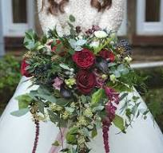
Who is green haven florist?
Small independent business
Founded by Liam and Priya in 2016
A bespoke flower arrangement
Located in Northwick.

Slide 4
GREEN HAVEN PROBLEMS
INTERNAL | EXTERNAL
 | COMPETIOTON
30% decline in in-store sales
the loss of foot traffic

Slide 5
PESTEL FRAMEWORK
Tool that helps business
Social | Economic | Political | Technological | Enviromnmeal

Slide 6
Pestel framwork
This is a tool used to analyze six external factors that could affect an organistion performace and decion making.
Factors include polictical, social, economical, techonological, social, legal and enviromnetal

Slide 7
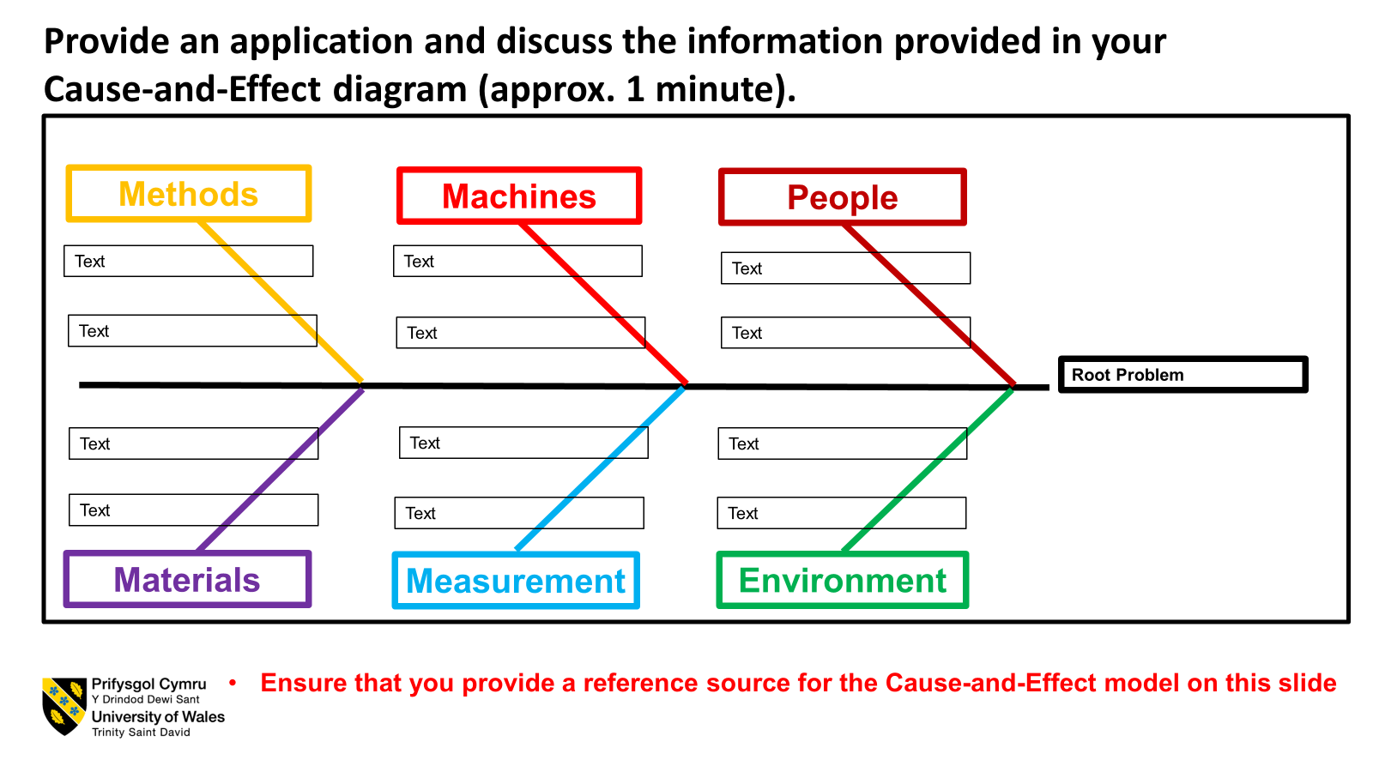
Fewer lorries to help transpot
Less staff in shop
Less support to pick flowers

Slide 8
REFRENCE LIST
Wesbite link--
2025 flower

Slide 9
THANK YOU FOR YOUR TIME
QUESTION ARE WELCOME

