Slide 1
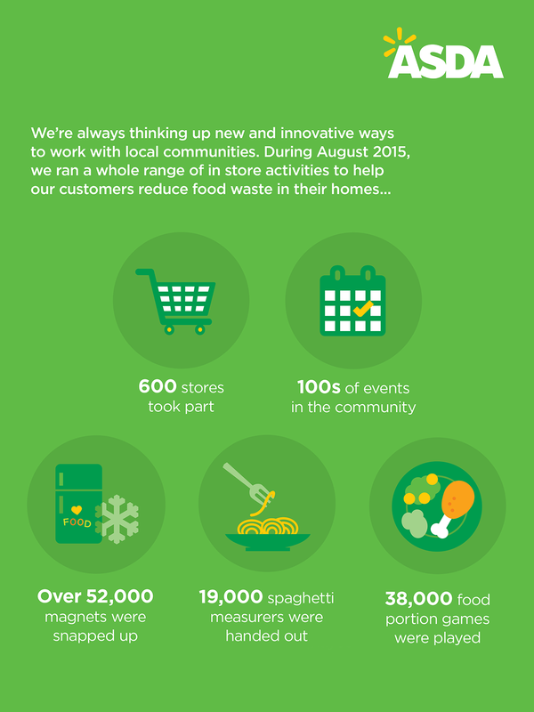
A critical perspective of ASDA in relation to its CRM, Ethics, Sustainability and Quality Policies and Operations

Slide 2
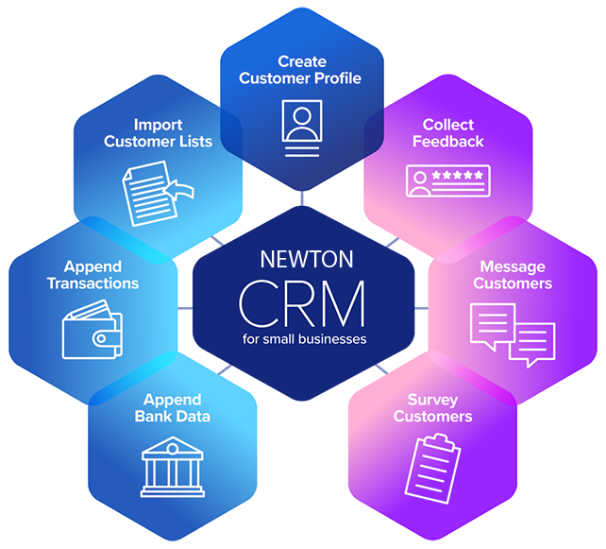
Customer Relationship Management (CRM)
It is the process or system of managing interactions and relationships with current and future customers
Utilizes purchase history and analyses customer information for enhancing the relationship between customers and business
CRM assists in customer retention and increasing of revenues

Slide 3
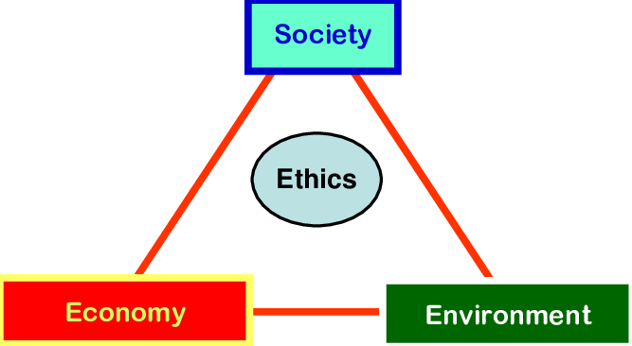
Sustainability/Ethics
Sustainability is all about preserving resources for the use of both existing and future generation
Ethics is about incorporation of morale with the processes of a business or organization

Slide 4
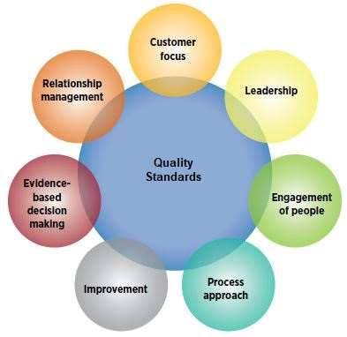
Quality
It is a particular standard against which approaches, products or services can be measured and improved.

Slide 5
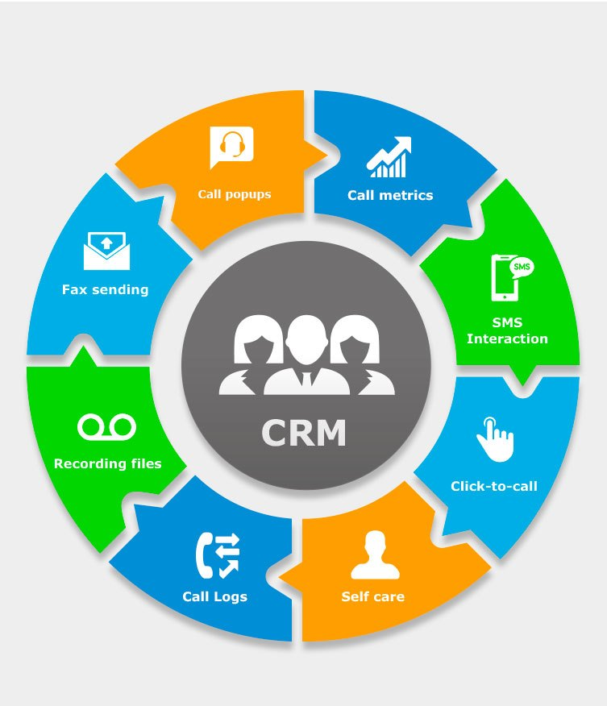
Benefits and Drawbacks of CRM
Benefits
Provides strategic advantages
Enhances customer related operations
Simplify sales and marketing
Increases profit generation
Attracts potential customers
Drawbacks
Related costs can increase
Poor leadership will lead to CRM failure
Poor business culture causes poor CRM

Slide 6
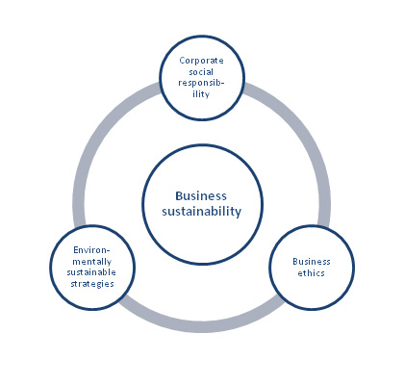
Benefits and Drawbacks of Sustainability/Ethics
Benefits
Enhances brand reputation
Increases brand acceptance
Prevents legal consequences
Increases customer base
Drawbacks
Sustainability maintenance costs can increase
Various situations lead to ethical dilemmas causing decision making slow

Slide 7
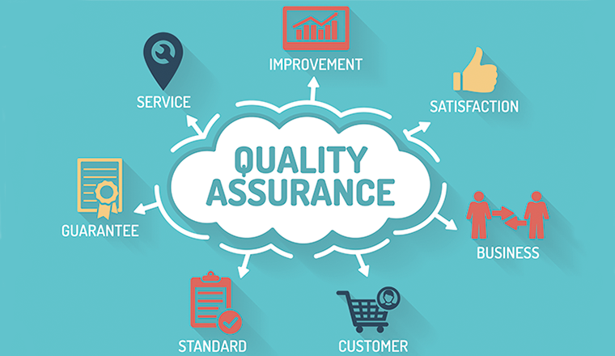
Benefits and Drawbacks of Quality System
Benefits
Effective quality management enhances profits and revenues
Maintains customer retention and loyalty
Drawbacks
Poor quality and improper quality planning will lead to business loss and failure

Slide 8
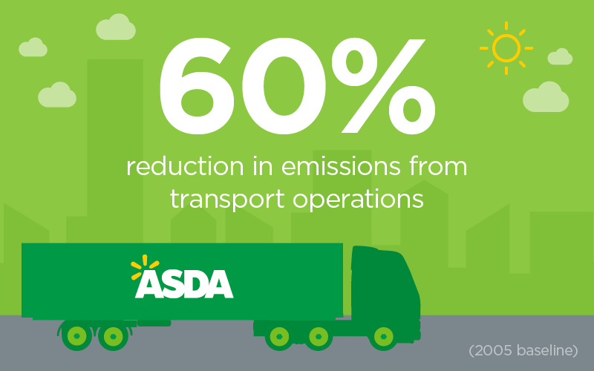
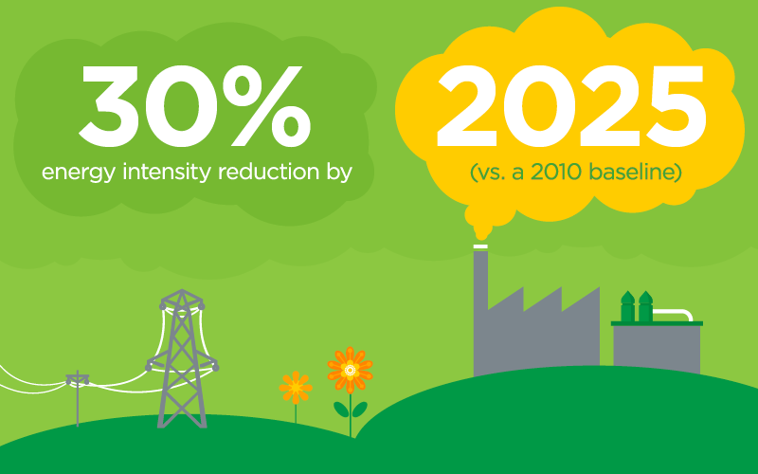
ASDA’s engagement with CRM, Ethics/Sustainability and Quality System (Compare with Sainsbury)
ASDA focuses on IDIC model of CRM in a same manner like other supermarkets for example, Sainsbury
Both ASDA and Sainsbury are members of ETI for ensuring ethical trading
It maintains transparency with respect to business transactions, services and products
ASDA is well aware of sustainable measures
Sainsbury has planned to make its operations completely carbon neutral by 2040, likewise ASDA has decided to become 100% recyclable by 2025

Slide 9
SWOT of ASDA
Strength | Weakness
Sustainability policies Ethical policies Social platforms Big global name | Increase in the waste products Plastic packaging Non renewable resources Criticism to the advertisement campaigns
Opportunity | Threat
Updated technologies High supply chains Secured market share DIY store in the market | Huge competition Presence of substitution products Growth of the small only retailers

Slide 10
SWOT analysis reveals the sustainability and the ethical policies as it is helpful to meet all organizational objectives
The social media such as television, YouTube, twitter, Instagram and Google are helpful in effective marketing of the sustainable products. With the help of social platforms, ASDA has earned a big name in the market
ASDA is also having different types of weakness as the waste materials are getting increased due to the plastic products
The organization had to use plastic packaging due to lack of alternative options and to keep the grocery materials safe
The non renewable resources are getting depleted which is affecting the environment and changing the attitude of the customers (Stout, 2017)
The customers are either switching brand and the sales rate of ASDA is getting reduced
The promotional activities are getting criticized in the market due to lack of sustainability policies

Slide 11
With the help of updated technologies and supply chains, ASDA is successful in developing the products which is improving customer relation management
The threat which is faced by ASDA in the UK market is huge competition due to substitution products
The small retail business which exists on the online platforms is affecting the sales rate ASDA
The customers are switching brands which is also affecting the brand image of ASDA in the market and failing to survive within the competition

Slide 12
References
Stout, P.A., ASDA Ltd, (2017). System and method for supporting operations in a retail store. U.S. Patent Application 15/519,967.
Santouridis, I. and Veraki, A., 2017. Customer relationship management and customer satisfaction: the mediating role of relationship quality. Total Quality Management & Business Excellence, 28(9-10), pp.1122-1133.
Trevino, L.K., Hartman, L.P. and Brown, M., (2019). Moral person and moral manager: How executives develop a reputation for ethical leadership. California management review, 42(4), pp.128-142.
Quak, H.J. and De Koster, M.B.M., (2017). Exploring retailers’ sensitivity to local sustainability policies. Journal of Operations Management, 25(6), pp.1103-1122.
Maheshwari, P. and Kushwah, B.S., (2019). Customer Loyalty Approach of CRM. Journal of the Gujarat Research Society, 21(16), pp.64-72.
marketingweek.com, (2018). Asda PUTS FOCUS ON IMPROVING BRAND TRUST AFTER SALES RISE. Available at: https://www.marketingweek.com/asda-sales-brand-trust/ [Accessed on: 10 January 2020]

Slide 13


