Slide 1
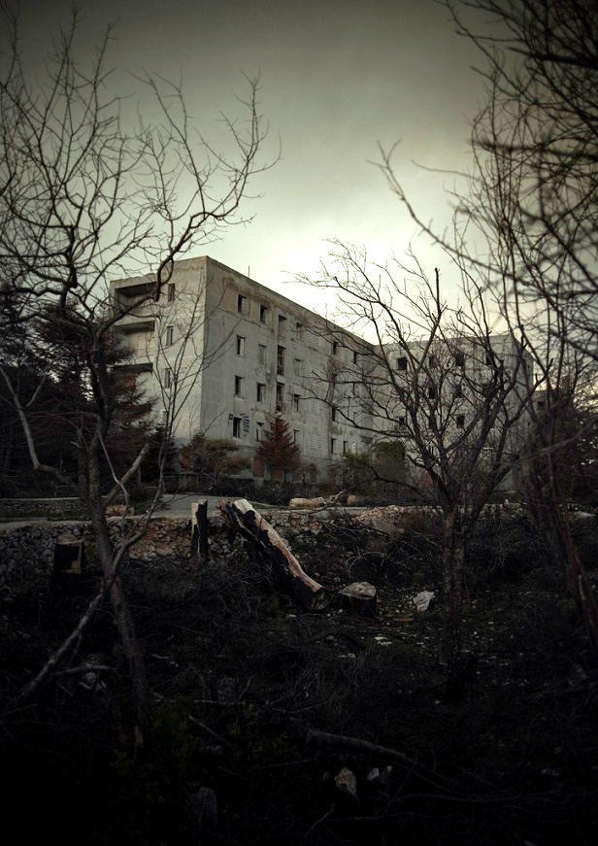
George Orwell Nineteen eighty-four, 1949
CSEN7029 Utopias, Dystopias & the functions of fictions
  ‘Who controls the past controls the future: who controls the present controls the past’

Slide 2
AIM(S)
To gain a detailed, theorised understanding of the narration of utopia and its relation to its dystopian alter ego within the political and cultural contexts of 19th and 20th century Anglophone literature.
LEARNING OUTCOMES
By the end of this module students should be able to:
demonstrate advanced and sustained knowledge and understanding of the cultural responses to the utopian impulse;
demonstrate a detailed and theorised understanding of a wide range of utopian and /or dystopian texts from the nineteenth and twentieth centuries;
show a sophisticated understanding of the emergence of the utopian and dystopian genres in their historical and cultural contexts;
explore and account for the relationship of utopian and dystopian fictions to developments within the novel as a form.

Slide 3
problems with utopia
Les utopies apparaissent bien plus réalisables qu'on ne le croyait autrefois. Et nous nous trouvons actuellement devant une question bien autrement angoissante: comment éviter leur réalisation définitive?… Les utopies sont réalisables. La vie marche vers les utopies. Et peut-être un siècle nouveau commence-t-il, un siècle où les intellectuels et la classe cultivée rêveront aux moyens d'éviter les utopies et de retourner à une société non utopique moins "parfaite" et plus libre. (Nicholas Berdiaeff Epigraph to BNW)
Utopias seem far more achievable than we believed them to be in the past. And we find ourselves today facing a much more agonizing question: how do we prevent them from coming into being? …Utopias are achievable . Life moves closer to utopia. Perhaps a new century will begin, a century in which intellectuals and the cultivated classes will dream of ways to avoid utopia and to return to a non-utopian society less ‘perfect’ and more free.
                (my translation)

Slide 4
Rethinking utopian models
Dystopian fiction, then, for all that it is set in futures of varying degrees of remoteness, reasserts the connection between the actual and the imagined which the traditional utopia so often obscures. In its parodic inversion, the essential identity between many features of utopia and those of the world to which it proposes an alternative re-emerges.
Where utopian satire on the existing order (such as Bellamy’s parable of the coach) stresses the disparity between the real world and its utopian alternative, that difference constituting the measure of the former’s deficiencies, dystopian fiction highlights the resemblances between our own world and the projected society of the future. Dystopia, in effect, satirizes both society as it exists, and the utopian aspiration to transform it.
Christopher S. Ferns, Narrating Utopia

Slide 5
A new order controlled by a class of technicians & bureaucrats
In "Second Thoughts on James Burnham" Orwell analyzes Burnham's political thought as it evolved in three works by that author, who was later an editor of The National Review. The works are The Managerial Revolution, written in 1940, The Machiavellians, written in 1942, and an article, "Lenin's Heir," published in the Partisan Review in 1945. Burnham's views, as Orwell explains them, are essentially these:
  "Capitalism is disappearing, but Socialism is not replacing it. What is now arising is a new kind " of planned, centralized society which will be neither capitalist nor, in any accepted sense of the word, democratic." This new order will be controlled by a class of technicians and bureaucrats that Burnham calls "managers"? that is to say those in control of the means of production.
Orwell, ‘Second Thoughts on James Burnham’

Slide 6
Utopia seen from within
What then follows is an account of life in the different society filtered through the consciousness, not of the admiring tourist, but of the inhabitant, living with it day-in, day-out, and lacking any other standards by which to judge it—unless one counts the rapidly fading memories of Offred and Winston Smith. The only visitor to dystopia, as such, is Huxley’s Savage, whose background is almost as alien to our own reality as the society he visits. Hence the details of dystopian society emerge, not in the course of the traditional guided tour, but in the process of an inherently far more dramatic narrative of oppositional struggle
Christopher S. Ferns, Narrating Utopia

Slide 7
linguistic degradation & denial of pleasure
Utopians tend to assume that there is one, and only one right method of doing everything and consequently that all other alternatives must be rigorously excluded by whatever methods the society has at its disposal’. It is this uniformism applied to language, the ‘linguistic result of utopian uniformism employed for life denying ends’ (Beauchamp, p.468) that is so prevalent in Orwell’s novel Nineteen Eighty-Four.
  Gorman L. Beauchamp, ‘Future Words: Language and the Dystopian Novel’, Politics and Style (Fall 1974), pp. 462-476,

Slide 8
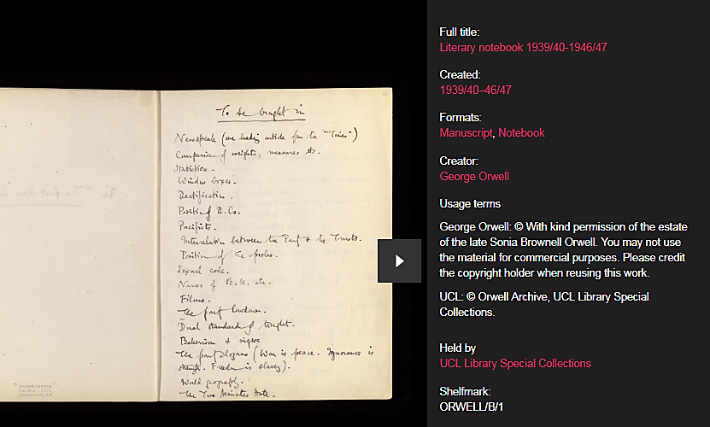
‘linguistic result of utopian uniformism employed for life denying ends’
Usage terms George Orwell: © With kind permission of the estate of the late Sonia Brownell Orwell. UCL: © Orwell Archive, UCL Library Special Collections

Slide 9
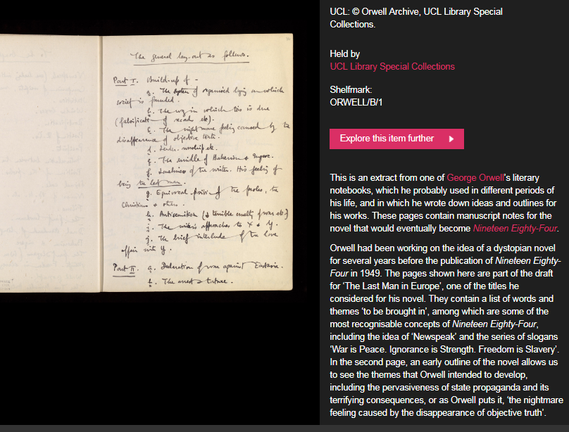

Slide 10
"The chief lesson of Orwell's life …is that what counts is not what you think but how you think.“
Christopher Hitchens rebutting Norman Podhoretz's article ‘If Orwell Were Alive Today’ which attempts to claim Orwell for the right:
Doublethink means the power of holding two contradictory beliefs in one’s mind simultaneously, and accepting both of them...... To tell deliberate lies while genuinely believing in them... to deny the existence of objective reality and all the while take account of the reality which one denies.
Narrating Utopia

Slide 11
Debating reality
Dystopian literature is not merely anti-utopian, the polar opposite of the literature of the perfect society; it is also an overtly didactic literature that warns of what may happen in the near future by extrapolating disturbing current trends to their logically fearsome conclusions.
  Peter Marbais, ‘Transformations of Language in Modern Dystopias’, Extrapolation (2012), Vol.39(2), pp.181-183
But I tell you, Winston, that reality is not external. Reality exists in the human mind, and nowhere else… only in the mind of the Party, which is collective and immortal. Whatever the Party holds to be truth, is truth. (1984, p. 270; 314)

Slide 12
All history was a palimpsest, scraped clean and reinscribed exactly as often as was necessary.
In no case would it have been possible, once the deed was done, to prove that any falsification had taken place. The largest section of the Records Department, far larger than the one on which Winston worked, consisted simply of persons whose duty it was to track down and collect all copies of books, newspapers, and other documents which had been superseded and were due for destruction. A number of 'The Times' which might, because of changes in political alignment, or mistaken prophecies uttered by Big Brother, have been rewritten a dozen times still stood on the files bearing its original date, and no other copy existed to contradict it. Books, also, were recalled and rewritten again and again, and were invariably reissued without any admission that any alteration had been made. Even the written instructions which Winston received, and which he invariably got rid of as soon as he had dealt with them, never stated or implied that an act of forgery was to be committed: always the reference was to slips, errors, misprints, or misquotations which it was necessary to put right in the interests of accuracy.

Slide 13
Orwell, ‘Politics & the English Language’
In our time, political speech and writing are largely the defence of the indefensible. Things like the continuance of British rule in India, the Russian purges and deportations, the dropping of the atom bombs on Japan, can indeed be defended, but only by arguments which are too brutal for most people to face, and which do not square with the professed aims of political parties. Thus political language has to consist largely of euphemism, question-begging and sheer cloudy vagueness. Defenceless villages are bombarded from the air, the inhabitants driven out into the countryside, the cattle machine-gunned, the huts set on fire with incendiary bullets: this is called pacification. Millions of peasants are robbed of their farms and sent trudging along the roads with no more than they can carry: this is called transfer of population or rectification of frontiers. People are imprisoned for years without trial, or shot in the back of the neck or sent to die of scurvy in Arctic lumber camps: this is called elimination of unreliable elements. Such phraseology is needed if one wants to name things without calling up mental pictures of them

Slide 14
The utopia of the ruling class
... the world of Nineteen Eighty-Four strongly resembles an administrative utopia, a social model developed by the communist regime in Russia. This kind of utopia involves the organization of utopian features by those in hold of power, by the ruling class. In this particular case the primary objectives are not focused on securing or developing means that should procure happiness or satisfaction but rationalizing life in three main functional categories: productivity, warfare and confinement. However opposing to the romantic idea of utopia these may seem, these categories contain specific utopian features, for they express “a desired order, an extreme rationalism, an outlet for the constructive imagination //of organizers who wish to build environments and move or control people like men on a chessboard” (Stites, 1989: 19)
Toma Sava, ‘Orwell’s Nineteen Eighty-Four. Deconstructing Dystopia’ Journal of Humanistic and Social Studies, 1 January 2012, Issue 2, 51-57: 55-56

Slide 15
Management theory & fascism
Orwell finds Burnham's views distressingly symptomatic of the kind of thinking "now so prevalent among intellectuals." …: "[T]hat a man of Burnham's gifts should have been able for a while to think of Nazism as something rather admirable, something that could and probably would build up a workable and durable social order, shows what damage is done to the sense of reality by the cultivation of what is now called 'realism' " ("Burnham," p.181). The significant point to see is that Orwell believed Burnham's theory to be symptomatic of a cult of power worship. It is not specifically the world view set forth in The Managerial Revolution or The Machiavellians that Orwell wished to satirize. Although an exaggerated version of Burnham's works is clearly intended, it must be remembered that Orwell believed that Burnham's views were dangerous because they appeared at first glance to offer an astute analysis, but on closer inspection are shown to be shallow and reductive; worst of all, they foster a kind of power worship that could lead to an open advocacy of totalitarianism.
R. B. Reaves, Orwell's "Second Thoughts on James Burnham" and 1984,’ College Literature, Vol. 11, No. 1 (1984): 13-21

Slide 16
Control & redirection of desire
Jean Baudrillard thinks people now live in a ‘state of fundamental incredulity’ and points to the logical outcome of a language based on questions of credibility: ‘Do people believe in information? Everyone pretends to. … But in the end, do people believe in it? I’m not so sure’.
This lack of trust, this inability to believe anything as other than an expression of self-interest, has clear and disastrous political outcomes. Baudrillard’s assessment is chilling: ‘People don’t know what they want anymore. People are only sure what they don’t want. The current processes are processes of rejection, of disaffection, of allergy’.
  Jeni Williams, ‘Translating Personal Words Into Public Language: Refugee Women’s Poetry’, My heart loves in my language (Hafan, 2017)

Slide 17
April 4th, 1984. Last night to the flicks. All war films. One very good one of a ship full of refugees being bombed somewhere in the Mediterranean. Audience much amused by shots of a great huge fat man trying to swim away with a helicopter after him, first you saw him wallowing along in the water like a porpoise, then you saw him through the helicopters gunsights, then he was full of holes and the sea round him turned pink and he sank as suddenly as though the holes had let in the water, audience shouting with laughter when he sank. then you saw a lifeboat full of children with a helicopter hovering over it. there was a middle-aged woman might have been a jewess sitting up in the bow with a little boy about three years old in her arms. little boy screaming with fright and hiding his head between her breasts as if he was trying to burrow right into her and the woman putting her arms round him and comforting him although she was blue with fright herself, all the time covering him up as much as possible as if she thought her arms could keep the bullets off him. then the helicopter planted a 20 kilo bomb in among them terrific flash and the boat went all to matchwood. then there was a wonderful shot of a child's arm going up up up right up into the air a helicopter with a camera in its nose must have followed it up and there was a lot of applause from the party seats but a woman down in the prole part of the house suddenly started kicking up a fuss and shouting they didnt oughter of showed it not in front of kids they didnt it aint right not in front of kids it aint until the police turned her turned her out i dont suppose anything happened to her nobody cares what the proles say typical prole reaction they never----

Slide 18
Intimate bonds in dystopia
[O’Brien is] larger and stronger than Winston, and, (as Gerald Fiderer points out) there is a distinctly masochistic element in Winston’s response. O’Brien treats him—even while torturing him—with an almost indecent intimacy. All the while Winston is being subjected to the most unspeakable agonies, O’Brien is there, hand on his shoulder, to reassure him that it is all for his own good :
  At sight of the heavy, lined face, so ugly and so intelligent, his heart seemed to turn over. If he could have moved he would have stretched out a hand and laid it on O’Brien’s arm. He had never loved him so deeply as at this moment … It made no difference. In some sense that went deeper than friendship, they were intimates. [p.217]
O’Brien even invades Winston’s dreams, which had hitherto been primarily about his mother, and on this unconscious plane re-enacts the triumphant suppression of the female by the male. By the end, Winston has betrayed and forgotten not only his lover, but also his mother—both have been replaced by males.
Christopher S. Ferns, Narrating Utopia

Slide 19
A politics of twisted sexual pleasure
  The Party seeks power entirely for its own sake. We are not interested in the good of others; we are interested solely in power. Not wealth or luxury or long life or happiness; only power, pure power. What pure power means you will understand presently. We are different from all the oligarchies of the past in that we know what we are doing. All the others, even those who resembled ourselves, were cowards and hypocrites. The German Nazis and the Russian Communists came very close to us in their methods, but they never had the courage to recognize their own motives,
….
But always- do not forget this, Winston always there will be the intoxication of power, constantly increasing and constantly growing subtler. Always, at every moment, there will be the thrill of victory, the sensation of trampling on an enemy who is helpless. If you want a picture of the future, imagine a boot stamping on a human face forever
R. B. Reaves, Orwell's "Second Thoughts on James Burnham" and 1984,’ College Literature, Vol. 11, No. 1 (1984): 13-21

Slide 20
The power of hate
Don’t you see that the whole aim of Newspeak is to narrow the range of thought? In the end we shall make thoughtcrime literally impossible, because there will be no words in which to express it. Every concept that can ever be needed, will be expressed by exactly one word, with its meaning rigidly defined and all its subsidiary meanings rubbed out and forgotten.
Do you begin to see, then, what kind of world we are creating? It is the exact opposite of the stupid hedonistic Utopias that the old reformers imagined. A world of fear and treachery and torment, a world of trampling and being trampled upon, a world which will grow not less but more merciless as it refines itself…If you want a picture of the future, image a boot stamping on a human face – for ever.
Orwell, 1984

