Slide 1
Hospitality & Guest Services
(BMIH4003)
Student Name: Diana Valerica Paul
Student number: 2221008
Lecturer’s name: Luciana Suardi

Slide 2
Table of content
Introduction
Overview of Moxy hotel
Target customers and guest
Guest services, facility, nature and scope of Moxy Hotels
Role and function of guest services
Importance of hospitality
Conclusion
References

Slide 3
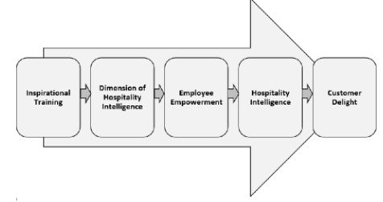
Introduction
Hospitality is the types of services Company or brand provide to their guest or customers in the conduct of hotel, resort, and restaurant and inn business.
The aim of every hotel is to provide a best services and hospitality to their customers.
Report also provides the detailed information about the nature, facilities and customers of the Moxy.
It also has the importance of the hospitality.
Notes:
This report includes the service provide by the hotel brand Moxy.

Slide 4
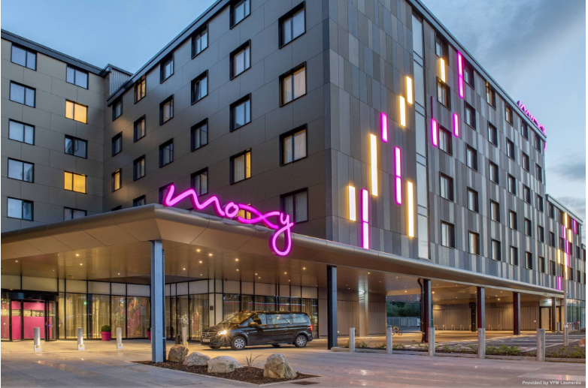
Overview of Moxy Hotels
In the Marriott international, Moxy is one their luxury and newest brand.
The very first Moxy Hotel was started in Milan in year 2014.
It is opened in partnership with Swedish very famous furniture brand IKEA. After that Moxy hotels are become highly successful.
Presently Moxy has a total of about 70 branches opened in all over the world on three continents (Nicholas, 2022).
Notes:
It is a high budget hotel with so many luxury and premium facilities which act as a little disadvantage to brand. Moxy provides a great communal space for socializing and working.

Slide 5
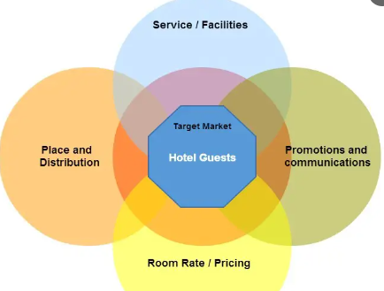
TARGET CUSTOMERS and guest
The main guest or customers of the MOxy hotel brand is young travel friendly people.
The digital travellers who like to perform adventures and are eager to meet new people are likely to visit Moxy.
As it has common spaces for the peoples who like to socialize with each other.
The cheif target customers of the Moxy are the millennial travellers, who are modern, young, fun-loving and experimental personality peoples.
Notes:
As Moxy hotel provides the service of the umbrella so the individuals who are fun loving likes to visit their hotel (Andi, 2021). Hotel also attracts the guests who have a youthful spirit and young heart people. Free independent travellers are also likes to enjoy the services of the Moxy (George, 2021). The mark guests are the persons who don’t take their life seriously, enjoy the life to the fullest and live in the moment. The people who like to have a party and fun are also the chief customers of their Hotel brand.

Slide 6
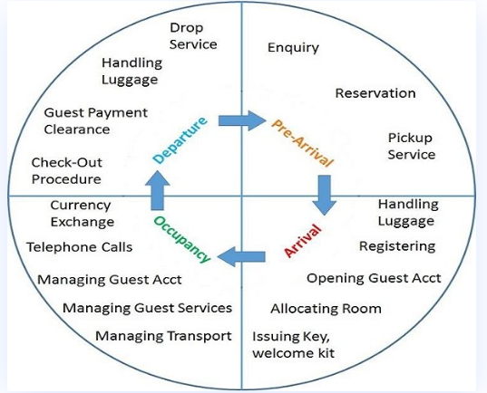
Guest services, facilities, nature and scope of Moxy hotels
Moxy is the playful, stylish and a luxury brand of Marriott hotels.
The nature of the Moxy brand is friendly, easygoing, adventures and fun-full.
They offer so many unique facilities to their customers.
They provides the best umbrella services to their guest like pool party and some other fun, enjoyable, playful and relaxing facilities to their customers.
Some other facilities like room service, spa, walk-in shower, open wall closet, high thread count bedding, etc.
Notes:
They also have a extra features to allow the pet in the customers room (Abrudan, Pop, and Lazăr, 2020). The rooms are very spacious, fresh and modern design. This hotel is most suitable to the party and adventurous king of customers. They have the board games facility for their guest so that they enjoy their trip and have more fun. They also value the confidentiality of the guest by maintain the privacy of their guest in the hotel premises. They also have the complimentary breakfast facilities and free parking. Moxy also has the 24 by 7 open bar service for their guest so that they can fun and enjoy services of their brand. They also offer the good working space and rooms to the customers (Guo, 2021). The scope of the Moxy hotels is to put their guest at the core of the regular marketing operation.

Slide 7
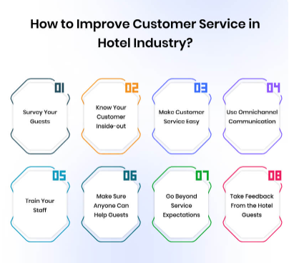
Role and function of the guest services
It is crucial for every hospitality industry to provide the best service and facility that every guest expects (Weinstein, 2022).
Guest also recommended the hotel to their relatives and friends if they enjoy and like the services.
The satisfied and excellent guest service results in increase the revenue of the hotel business.
It also promoted the brand name. The good guest service results in increase the profit level of the hotel
Notes:
The guest services include the services and facilities from the check-in to check-out of the customers. It is the responsibility of the every hotel to provide the appropriate service to their every guest so that they fully enjoy their stay. The guest should be fully satisfied from the services as they are paying for that (Andi, 2021). The hotel should accommodate guest during their whole stay. They must serve their customers in the friendly manner and provides the service information. They need assist their guest if they have problem during their stay. . The hospitality is known for its services so every hotel must provide the best services to their guest. . The hospitality is known for its services so every hotel must provide the best services to their guest. Is the guest is satisfied with the hotel services then they also consider the hotel for their next stay or vacation.

Slide 8
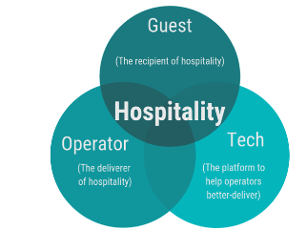
Importance of hospitality
The importance of the hospitality results in the excellence growth of the business.
Hospitality fulfils the basic needs of customers like accommodation, entertainment, food, fun, etc.
It is important to give the best services to the guest because they are paying for that.
As the hospitality industry is fully dependent on their customers and guest so it is important to fulfil the every demand of the customers.
Notes:
Guest wants to enjoy their vacation and relaxing time so it is the duty of the hotel management to take care of the whole guest (Kandampully, and Solnet, 2020). For meeting the expectation hotel should properly asked about the facilities guest wants. They should treat all their guests equally whether it’s a common person or celebrity. Hotel should follow the order and service pattern of the customers so that they can also provide some extra facilities (Secchi, Roth, and Verma, 2019). Every hotel must explain the rules and regulations of the company properly so the guests don’t face any confusion. They also provide some discounts and extra service offers which helps in attracting more guests (Rather, and et.al. 2019). All these things help a hotel to develop and grow its brand. It also helps in increasing the revenue of the business.

Slide 9
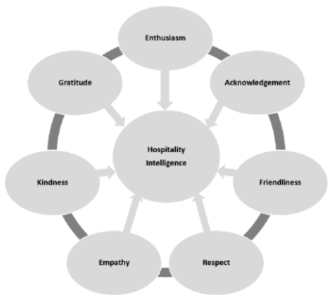
CONCLUSION
The presentation clearly explains about the services of the Hotel brand Moxy.
From the repost it is clear that Moxy provides the best umbrella services which help in enjoy and have more fun in their hotel.
This also tells about the service, facilities, nature and scope of the Moxy.
Notes:
The report also provides the information about the role and function of guest and services in hotel business. Report also includes the importance of hospitality and the fulfilment of the guest expectations by the hotels.

Slide 10
References
Abrudan, I.N., Pop, C.M. and Lazăr, P.S., (2020). Using a general ordered logit model to explain the influence of hotel facilities, general and sustainability-related, on customer ratings. Sustainability, 12(21), p.9302.
Andi, B.B., (2021). THE IMPACT OF BRAND IMAGE ON CUSTOMER LOYALTY IN MOXY BANDUNG HOTEL (Doctoral dissertation, Poltekpar NHI Bandung).
Andi, B.B., (2021). THE IMPACT OF BRAND IMAGE ON CUSTOMER LOYALTY IN MOXY BANDUNG HOTEL (Doctoral dissertation, Poltekpar NHI Bandung).
George, R., (2021). Market Segmentation, Targeting, and Positioning. In Marketing Tourism and Hospitality: Concepts and Cases (pp. 221-246). Cham: Springer International Publishing.
Guo, Y., (2021). The exploration of innovative experiences in the hotel industry: How are hotel organisations marketing innovative experiences to target the Millennial generation? (Doctoral dissertation, Auckland University of Technology).
Kandampully, J. and Solnet, D.,( 2020). Competitive advantage through service in hospitality and tourism: a perspective article. Tourism Review. 75(1). pp.247-251.
Notes:
Nicholas, A., (2022). ANALISIS STRATEGI PROMOSI HOTEL MOXY BANDUNG DI ERA PANDEMIK (Doctoral dissertation, Poltekpar NHI Bandung).
Rather, R.A., and et.al. (2019). Customer brand identification, affective commitment, customer satisfaction, and brand trust as antecedents of customer behavioral intention of loyalty: An empirical study in the hospitality sector. Journal of Global Scholars of Marketing Science. 29(2). pp.196-217.
Secchi, E., Roth, A. and Verma, R., (2019). The impact of service improvisation competence on customer satisfaction: Evidence from the hospitality industry. Production and Operations Management. 28(6). pp.1329-1346.
Weinstein, A.T., (2022). Customer obsession–the springboard for a value creation strategy. Journal of Business Strategy, (ahead-of-print).

Slide 11


