Slide 1
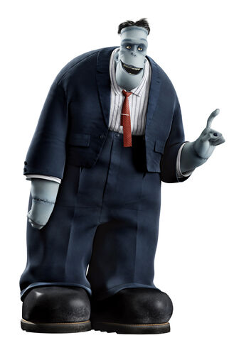
Rebuilding Frankenstein’s Monster
Notes:
What do we think of when we hear the name Frankenstein?

Slide 2
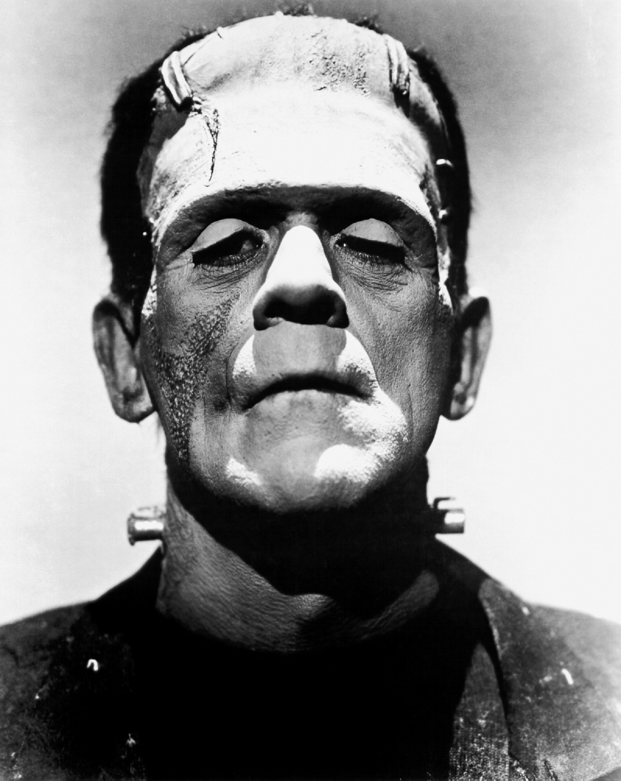
Notes:
Usually this…
Boris Karloff as Frankenstein’s Monster. What we most associate what he should look like

Slide 3
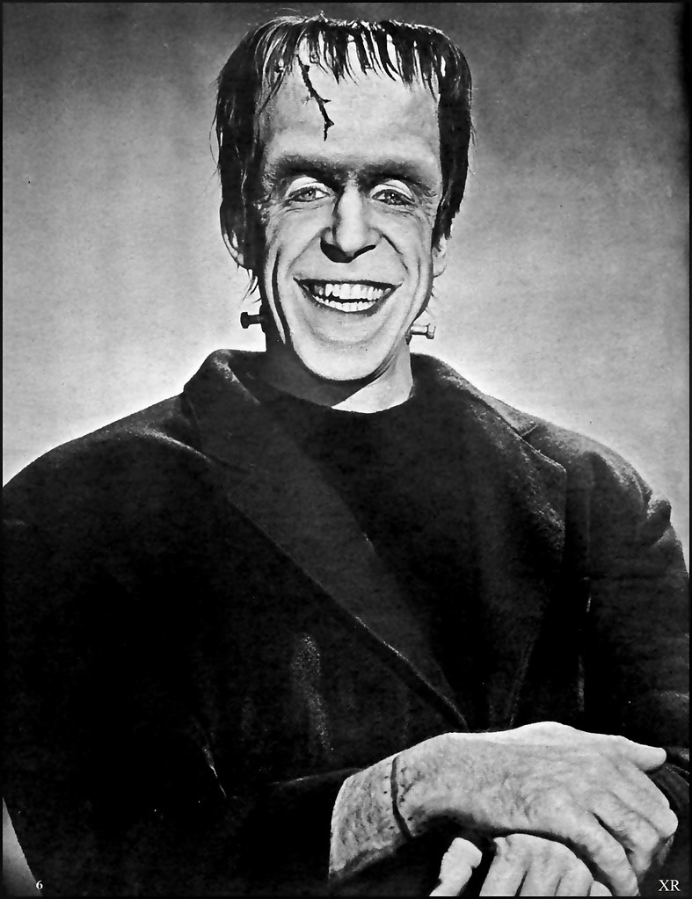
Notes:
Herman Munster. A charicature of Boris Karloff version

Slide 4
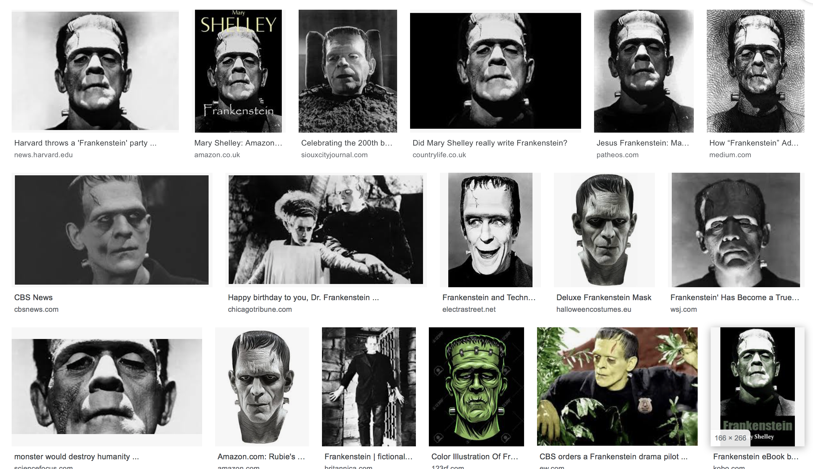
Notes:
Our preconceived ideas of what Frankenstein looks like. Influenced by the Hammer Horror movies/ Boris Karloff.
Enters into popular culture

Slide 5
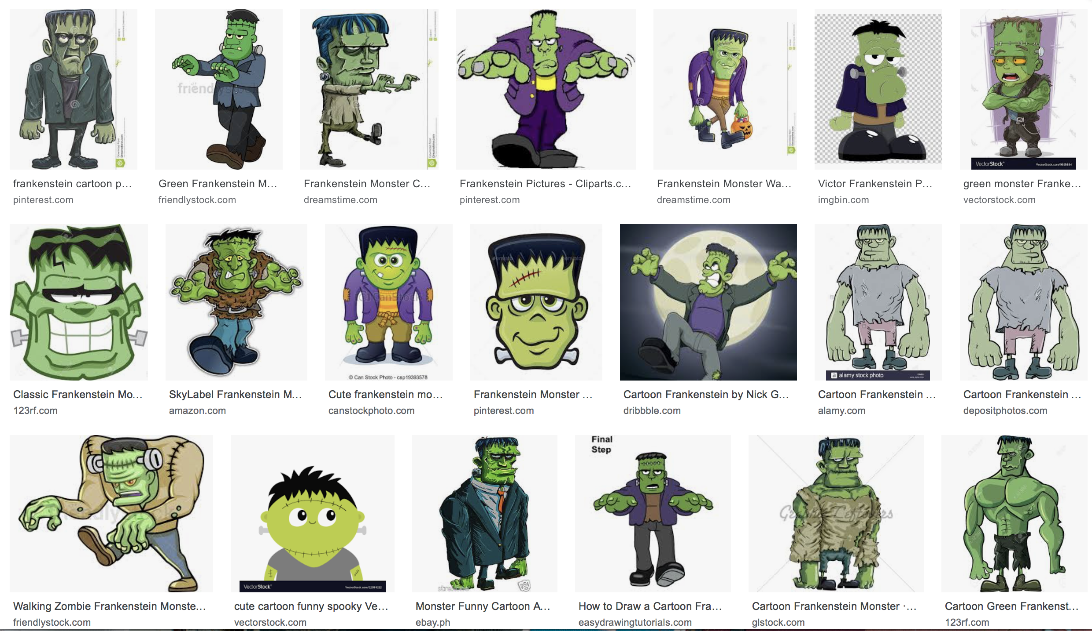
Notes:
Google image search for Frankenstein- this is what you get

Slide 6
“His limbs were in proportion, and I had selected his features as beautiful. Beautiful! Great God! His yellow skin scarcely covered the work of muscles and arteries beneath; his hair was of a lustrous black, and flowing; his teeth of a pearly whiteness; but these luxuriances only formed a more horrid contrast with his watery eyes, that seemed almost of the same colour as the dun-white sockets in which they were set, his shrivelled complexion and straight black lips.”
Notes:
Mary Shelley’s Original text.

Slide 7
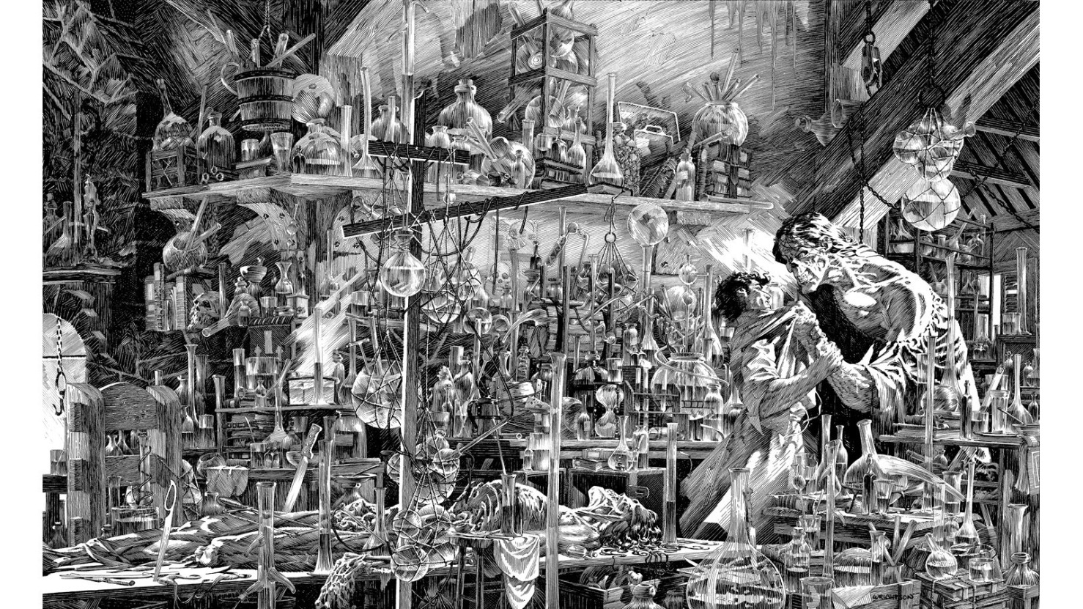
Bernie Wrightson
Notes:
Berni Wrightson-Graphic novel Stays true to the description from the original text

Slide 8
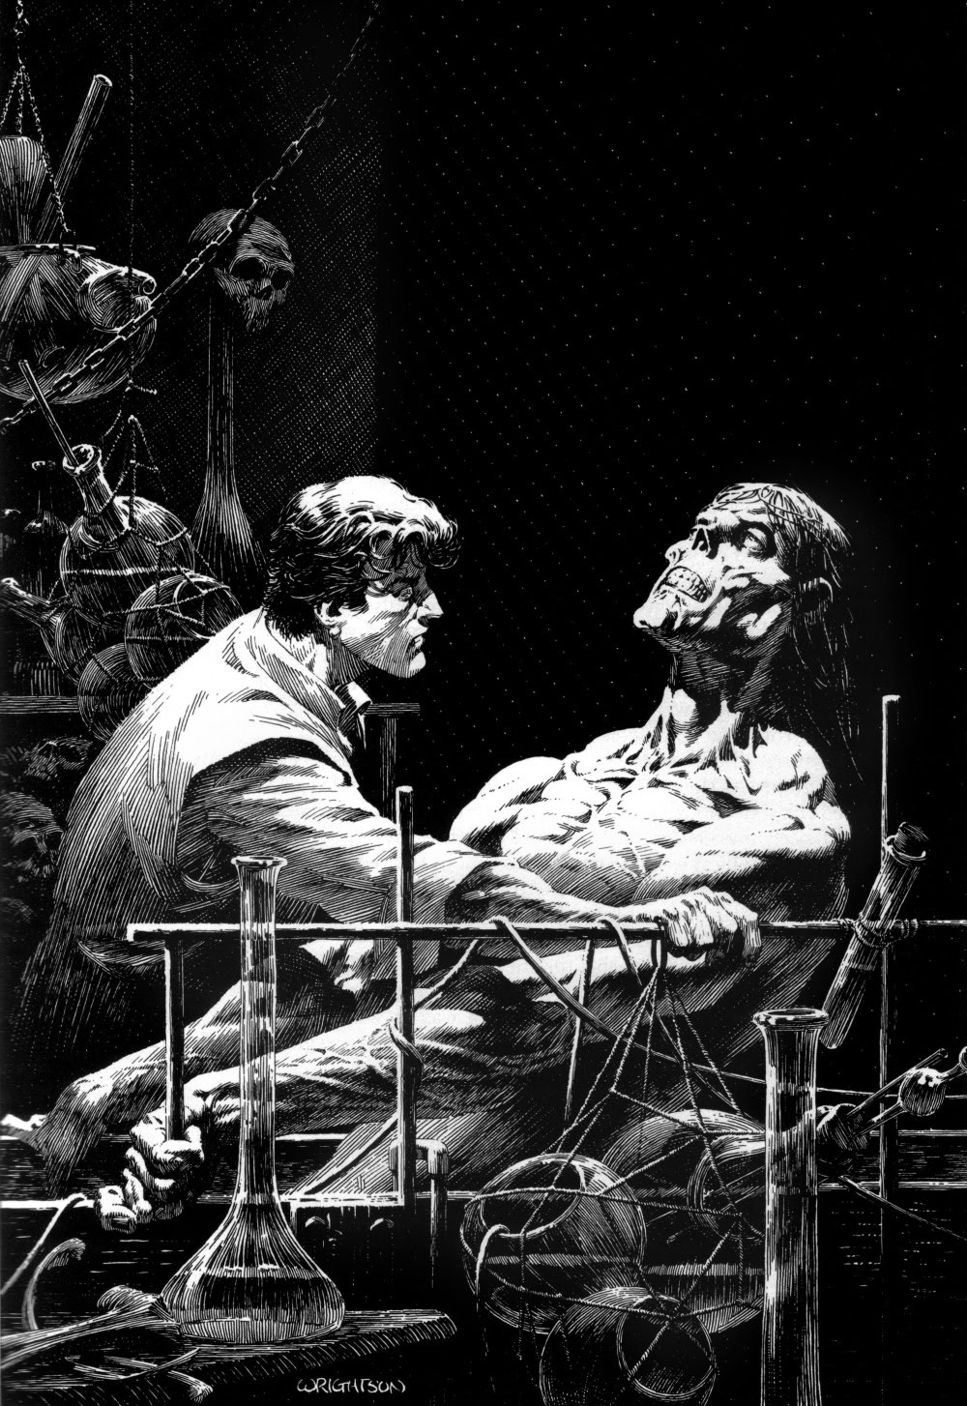
Bernie Wrightson

Slide 9
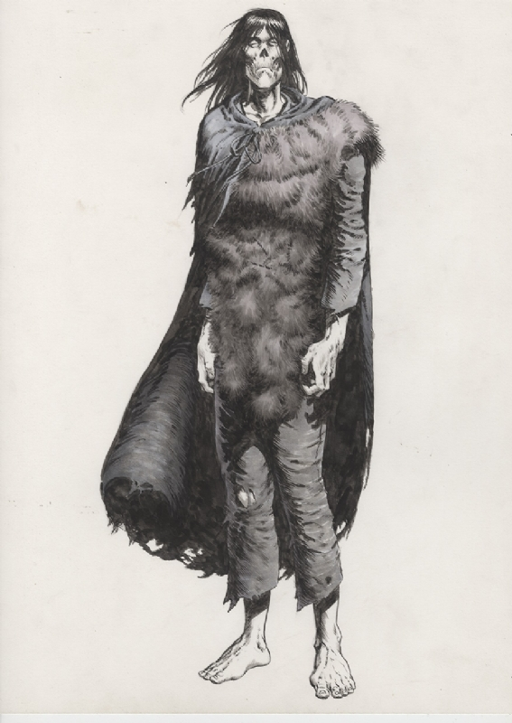
Bernie Wrightson

Slide 10
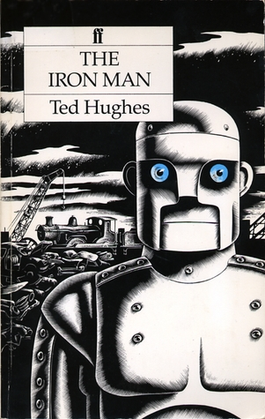
Notes:
Examples of other iconic/ recognisable characters from literature

Slide 11
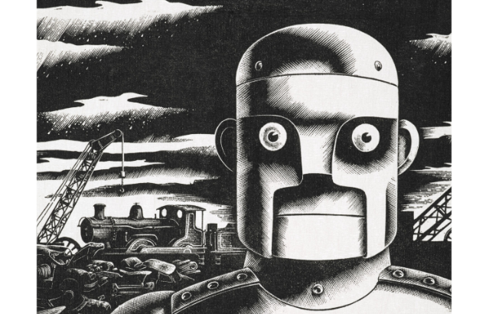
Andrew Davidson
Notes:
Art work that I (Chris) most associates with Ted Hughes’ The Iron Man, from reading it as a child. *Iwan you may have different take on this.

Slide 12
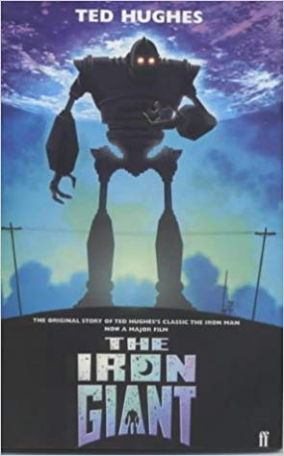

Slide 13
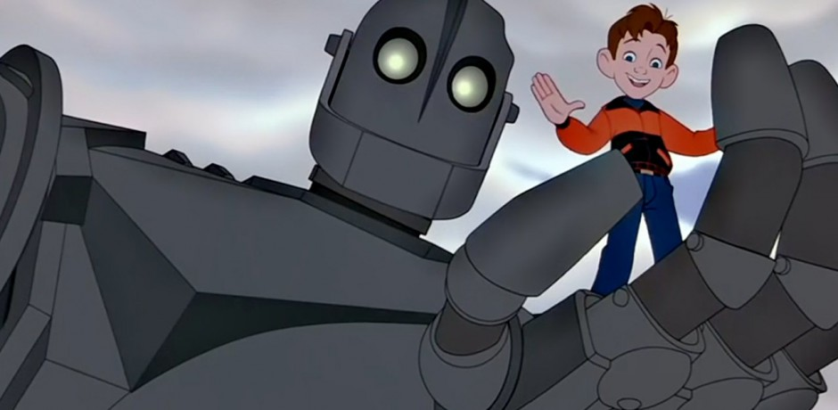

Slide 14
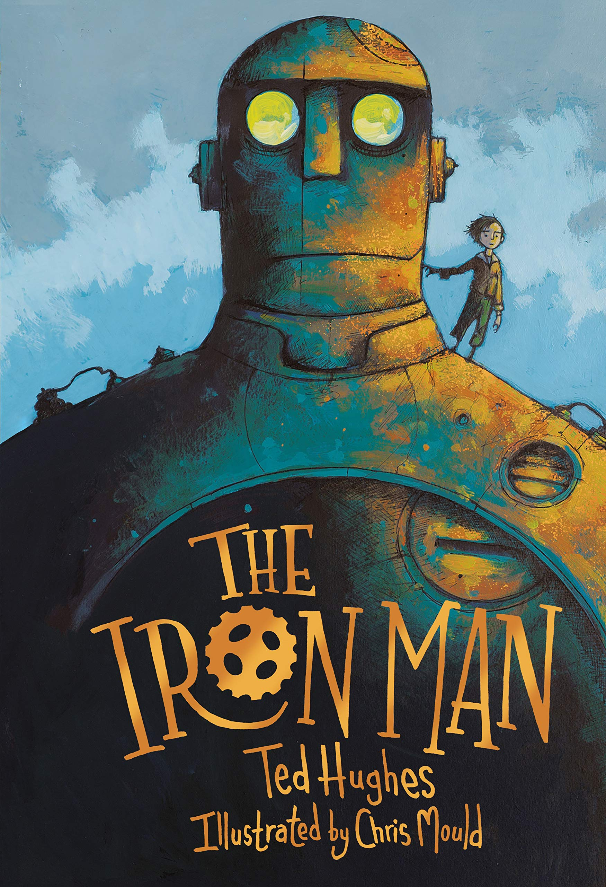

Slide 15
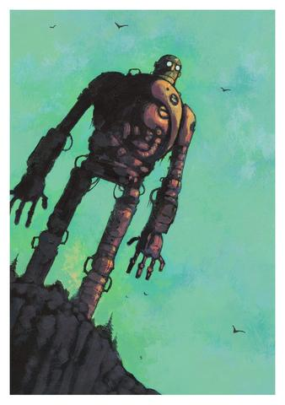
Chris Mould

Slide 16
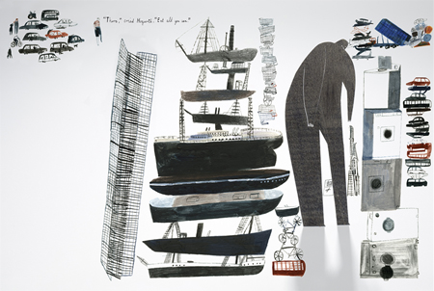
Laura Carling

Slide 17
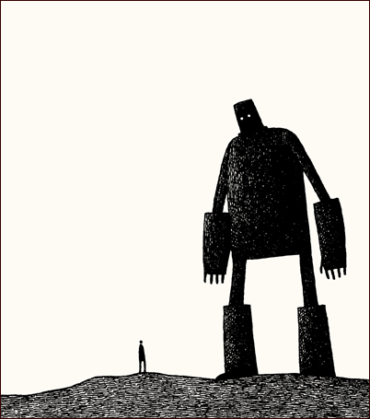
Tom Gould

Slide 18
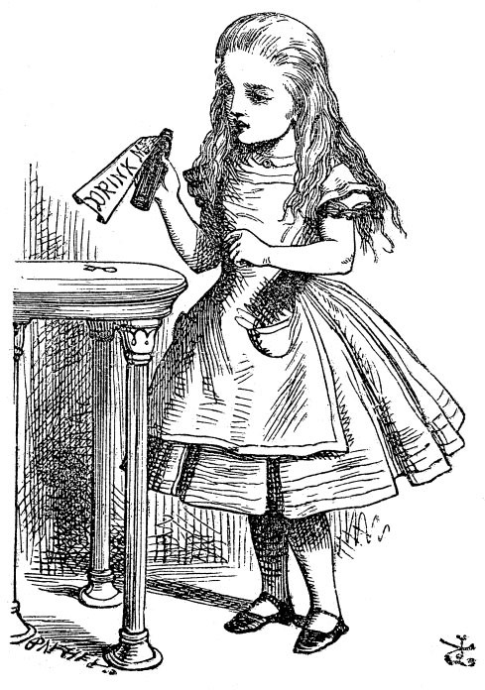
Sir John Tenniel
Notes:
Alice in Wonderland. Most associated from original publication (though Lewis Carroll did illustrate his own text originally)

Slide 19
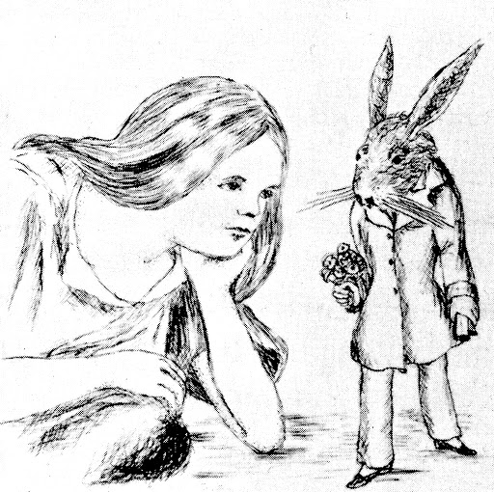
Lewis Carroll

Slide 20
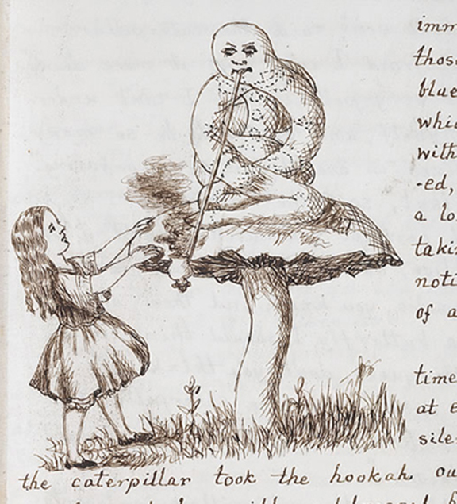
Lewis Carrol

Slide 21
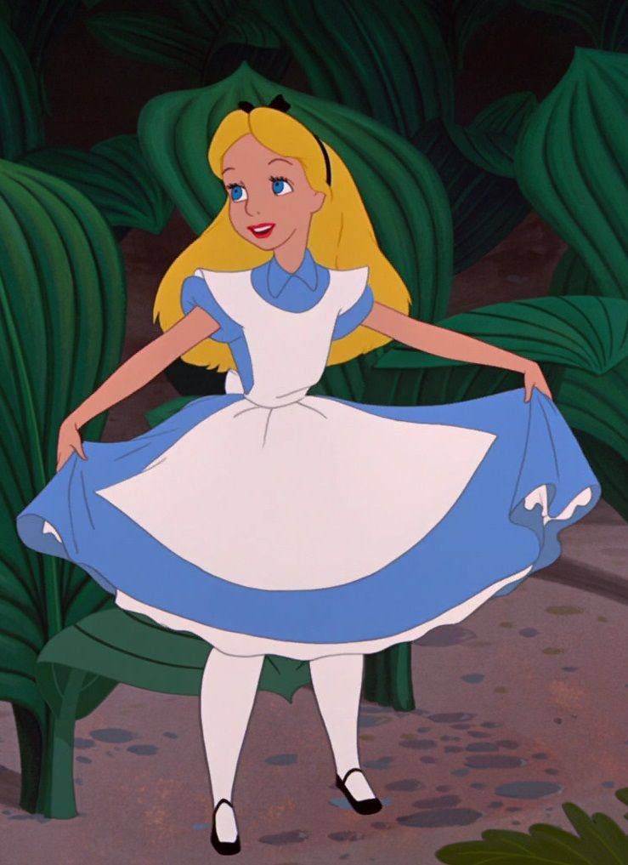
Notes:
Disney-Probably most people will identify this as what Alice should look like

Slide 22
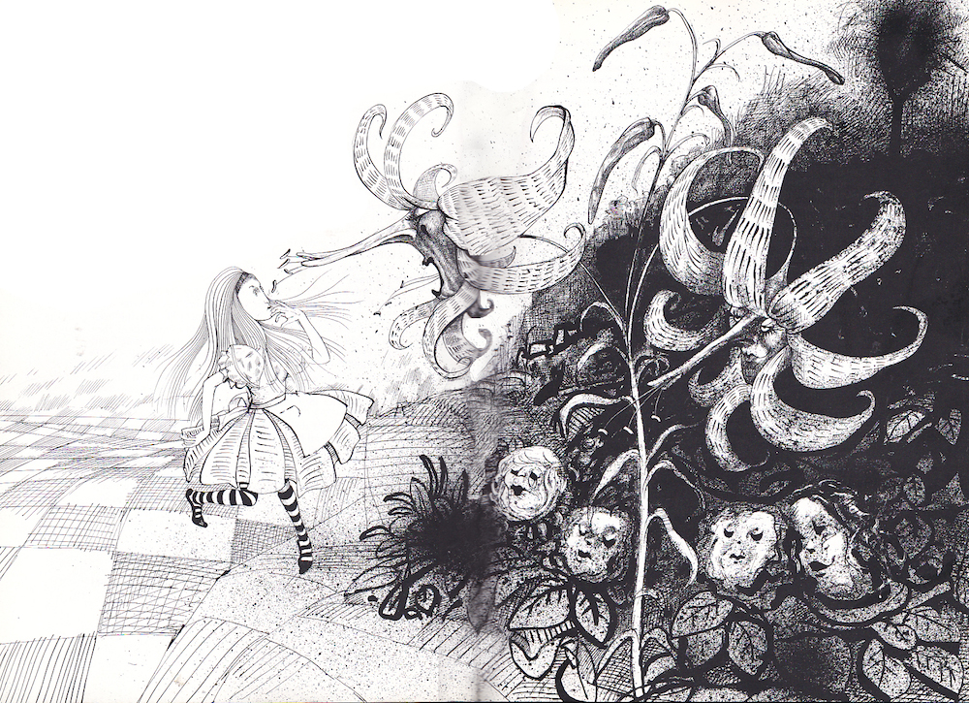
Ralph Steadman
Notes:
Ralph Steadman

Slide 23
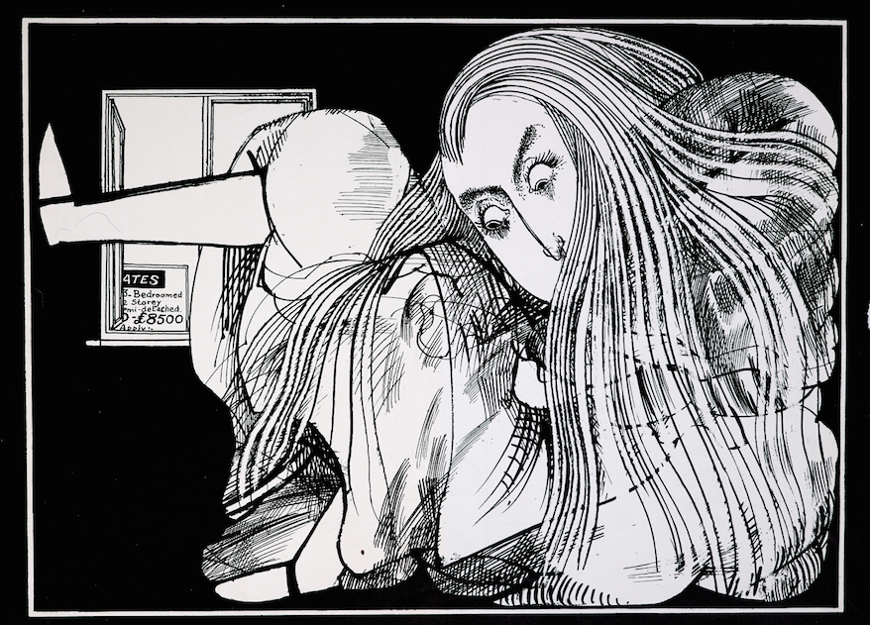
Ralph Steadman

Slide 24
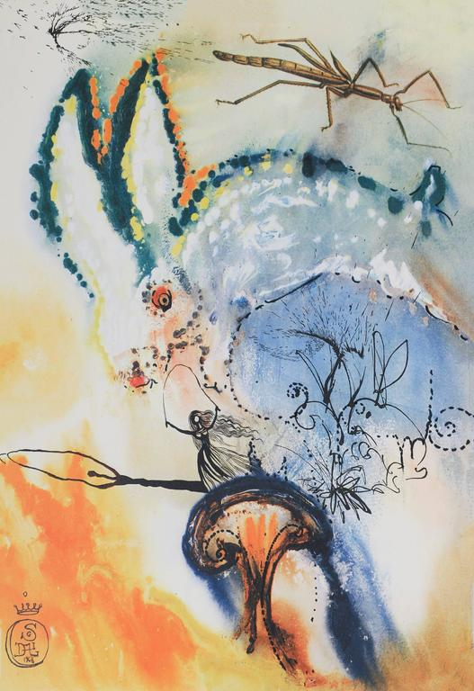
Salvador Dali
Notes:
Unexpected variations

Slide 25
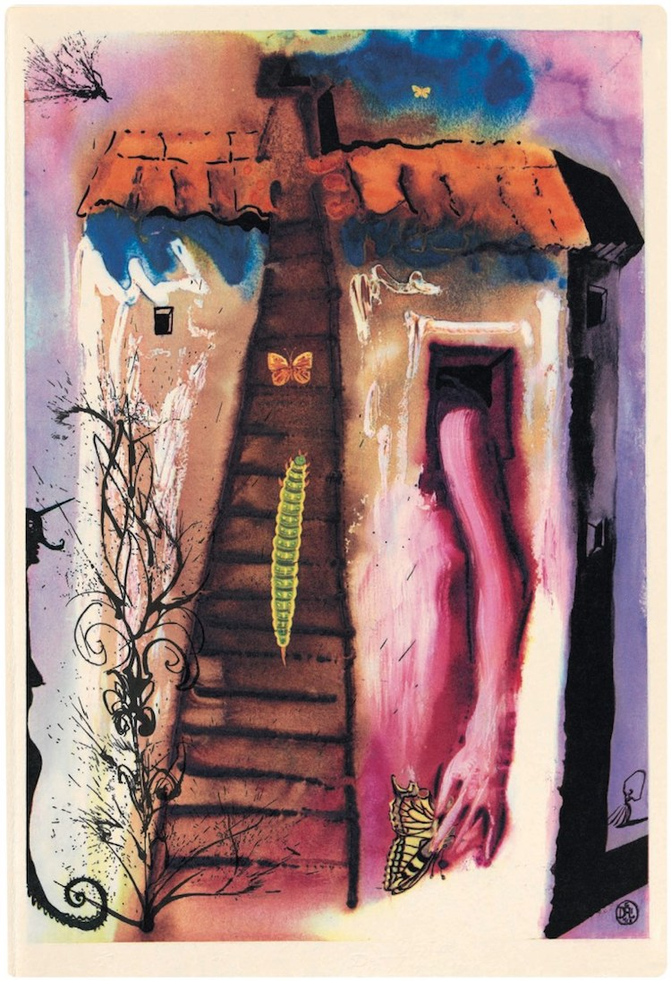
Salvador Dali

Slide 26
Task
As part of your research and development for this narrative module, you would have been looking at characters and producing developmental studies and ‘turn arounds’ for those characters.
For this task you are to find and redesign an existing character from literature.
Things to consider:
Does your concept/illustration stay true to the original character?
Is it a fresh and original approach of the subject?
Is your final outcome recognisable as the chosen subject?

