Slide 1
Problem solving and decision making
Module name:Problem solving and decision making
Module code: bmsw4004_birm
Module Lecturer: Chijioke uba
Student Name: anic virgil bica
Student ID:2123311

Slide 2
Nhs England
Promoting high quality health and care for everyone
Supporting NHS organisations to work together for better outcomes
Enabling patients to benefit from world-leading researches and advanced technology
Supporting local integrated care systems, which are made up of public services
Improving the care quality and health of the population. (England, 2022)

Slide 3
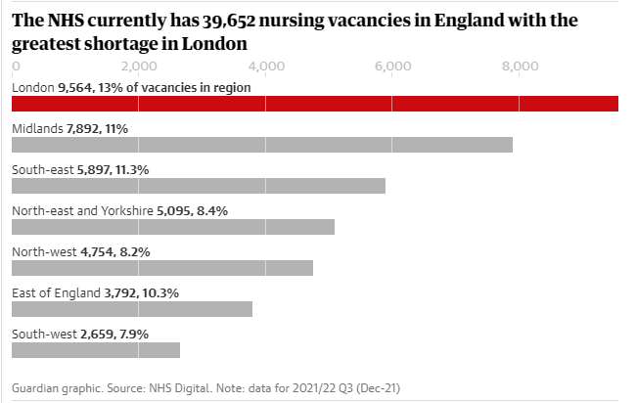
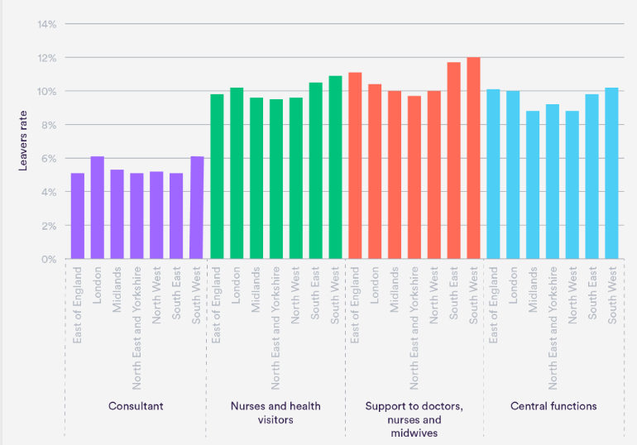
Addressing the problem
Staffing crisis deepens in NHS England with 110,000 posts unfilled
This includes 39,652 nurses and 8,158 doctors
According to NHS Digital, one in 10 nursing posts are empty, and one in 17 doctors’ posts.
Staff fearing that low pay and burn out from heavy workload and pressure may lead to quitting. (Campbell, 2022)
Around 140,000 of care staff left active service in the first 3 quarters of 2021. (The long goodbye? Exploring rates of staff leaving the NHS and social care, 2022)

Slide 4
The impact of staff shortage
On the individual:
- Ongoing personnel shortages are harming the attempts to address the backlog in patient treatment and meet the rapidly increasing demand for care.
- Longer wait times are a sign that more individuals require treatment than the NHS can provide
- Significantly increase 'burnout' and affect staff morale (NHS workforce shortage has "serious and detrimental" impact on services, 2022)
On the organisation
- Low level of patients satisfaction
- Increased spending/lower revenue
- Reduced faith and trust in the organisation

Slide 5
pestle
Political factors:
- after Brexit, between 2017 and 2018, 1,584 EU nurses have left NHS
- increased uncertainties on how EU medication and equipment will be brought into the UK.
Economic factors:
- Pre-pandemic funding plans insufficient to meet demand
- Difficulties for the NHS to provide sufficient care
- Serious lack of qualified staff due to mediocre salaries

Slide 6
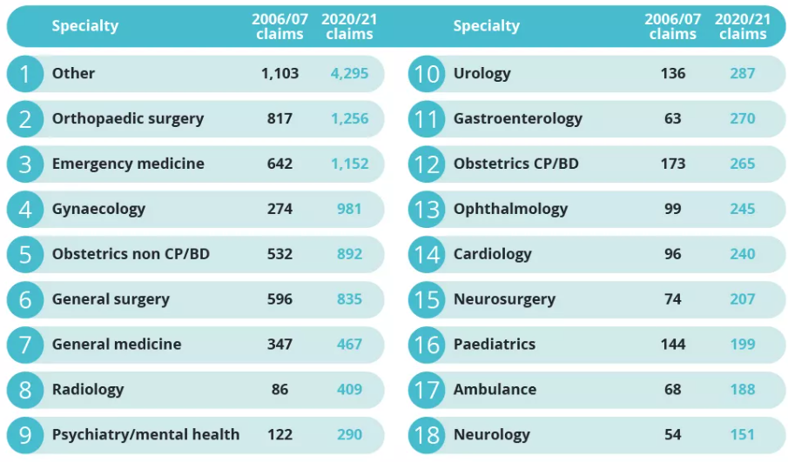
Sociocultural factors:
- additional pressure on NHS due to UK’s aging population, one in fifth was aged 65 or over in 2019
- according to IGD, UK population is expected to grow by 2.0m over 2021 to 2031
Technological factors:
- healthcare is being improved due to technologies being in continuous development
- opening new doors to a better health care education (Bush, 2022)
Legal factors:
- the number of healthcare related law-suits is continuously growing
- in 2020/21, 1,256 orthopaedic surgery claims; 1,152 emergency medicine claims and 4,295 other claims have been raised. (Medical Negligence Statistics UK - Claims against the NHS explored, 2022)

Slide 7
Environmental factors:
- 2016/17 NHS providers have produced approximately 590,000 tonnes of waste
- carbon footprint of health and social care has reduced by 19% since 2007
- leading an example in reducing use of natural resources

Slide 8
Fishbone
People
Work conditions
Equipment
Impatient and rude
Not enough for demand
High workload
Unexpected patients
Long working hours
Poor maintenance
Staff shortage
Mediocre salaries
Not enough treatment rooms
Minimal training and support
Staff motivation
Environment
Training

Slide 9
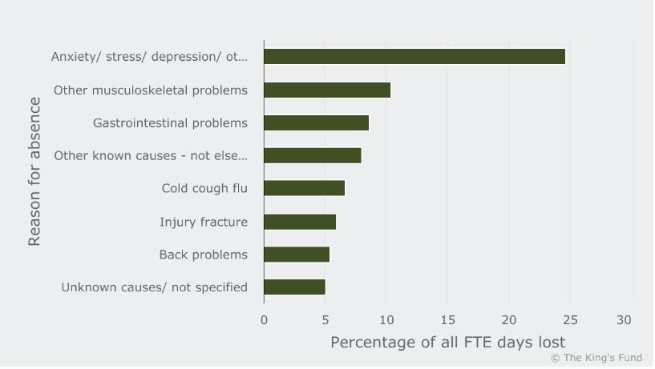
solutions
Increased training across multiple fields ( e.g. undergraduate, post-graduate, apprenticeships) – the number of students starting a nursing degree has increased by 27% compared to 2019
Offer support and development across employees
Preparing ahead and reorganise the health-care workforce to make it suitable for stable period and making sure that it is able to cope during health crisis
Strong hiring, retention and labour-use strategies. (WBS and shortages, 2022)
Helping NHS staff prioritise their own health and wellbeing
Improving work conditions and pay good attention to staff’s well-being.

Slide 10
references
Bush, T., 2022. PESTLE Analysis of the NHS. [online] PESTLE Analysis. Available at: <https://pestleanalysis.com/nhs-pestle-analysis/> [Accessed 4 July 2022].
Campbell, D., 2022. Staffing crisis deepens in NHS England with 110,000 posts unfilled. [online] the Guardian. Available at: <https://www.theguardian.com/society/2022/mar/03/staffing-crisis-deepens-in-nhs-england-with-110000-posts-unfilled> [Accessed 4 July 2022].
England, N., 2022. NHS England » About us. [online] England.nhs.uk. Available at: <https://www.england.nhs.uk/about/> [Accessed 4 July 2022].
Wrighthassall.co.uk. 2022. Medical Negligence Statistics UK - Claims against the NHS explored. [online] Available at: <https://www.wrighthassall.co.uk/knowledge-base/medical-negligence-index-claims-against-the-nhs-explored> [Accessed 4 July 2022].
NHS Providers. 2022. NHS workforce shortage has "serious and detrimental" impact on services. [online] Available at: <https://nhsproviders.org/news-blogs/news/nhs-workforce-shortage-has-serious-and-detrimental-impact-on-services> [Accessed 4 July 2022].
The Nuffield Trust. 2022. The long goodbye? Exploring rates of staff leaving the NHS and social care. [online] Available at: <https://www.nuffieldtrust.org.uk/resource/the-long-goodbye-exploring-rates-of-staff-leaving-the-nhs-and-social-care?gclid=Cj0KCQjwzqSWBhDPARIsAK38LY8gFkwodkPxFwbqA4YL_li5eofkqcfyZlfeKlkOJBIvn2SnN3O16_IaArEKEALw_wcB> [Accessed 4 July 2022].
WBS, W. and shortages, F., 2022. Five policies to improve healthcare staff shortages | News | Warwick Business School. [online] Warwick Business School. Available at: <https://www.wbs.ac.uk/news/five-policies-to-improve-healthcare-staff-shortages/> [Accessed 5 July 2022].

