Slide 1

MANAGEMENT AS AN INTEGRATING ACTIVITY

Slide 2
What is the role of a Manager?
Hiring and staffing.
Training new employees.
Coaching and developing existing employees.
Dealing with performance problems and terminations.
Supporting problem resolution and decision-making.
Conducting timely performance evaluations.
Translating corporate goals into functional and individual goals.
Monitoring performance and initiating action to strengthen results.
Monitoring and controlling expenses and budgets.
Tracking and reporting scorecard results to senior management.
Planning and goal-setting for future periods.

Slide 3
Therefore, It is the responsibility of management to manage.
But organisations can achieve their aims and objectives only through the co-ordinated efforts of their members. This involves the effective management of the people resource.

Slide 4
The People Organisation
It could be argued that the majority of people come to work with the attitude of being eager to do a good job and performing well and to the best of their abilities.
People generally respond in the manner in which they are treated. Where actual performance fails to match the ideal this is largely a result of how staff perceive they are treated by management. Many problems in the people–organisation relationship arise not so much from the decisions and actions of management as the manner in which such decisions and actions are carried out.
Often, it is not so much the intent but the manner of implementation that is the root cause of staff unrest and dissatisfaction.

Slide 5
Therefore, a heavy responsibility is placed on managers and the activity of management on the processes, systems and styles of management. Attention must be given to the work environment and appropriate systems of motivation, job satisfaction and rewards. It is important to remember that improvement in organisational performance will come about only through the people who are the organisation.

Slide 6
The style of management adopted can be seen as a function of the manager’s attitudes towards people and assumptions about human nature and behaviour It is important to bear in mind that the activity of management takes place within the broader context of the organisational setting and subject to the organisational environment and culture. There are also variations in systems and styles of management and in the choice of managerial behaviour.

Slide 7
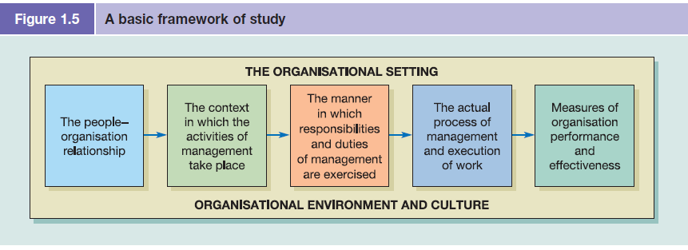

Slide 8
Questions
Consider the following questions and provide your answers in the Week 1, Activity 3 Discussion Forum::
Consider the role of management as an integrating activity. Give your views on the responsibility of management and the manner in which you believe this responsibility should be exercised.

