Slide 1
A Strategic Management Case Study
@Tony Gauvin

Slide 2
Overview
Company Overview
A Brief history of Netflix
Existing Mission and Vision
Existing Objectives and Strategies
Current Issues
New Mission and Vision
External Assessment
Industry analysis
Opportunities and threats
EFE Matrix
CPM Matrix
Internal Assessment
Organizational Structure
Strengths and weaknesses
Financial Condition
IFE Matrix
Strategy Formulation
SWOT Matrix
Space Matrix
Divisional Analysis
Grand Strategy Matrix
Matrix Analysis
QSPM Matrix
Strategic Plan for the Future
    Objectives
    Strategies
Implementation Issues
Technology
EPS/EBIT
Projected Financials
Evaluation
Balanced Score Card
Netflix Update

Slide 3
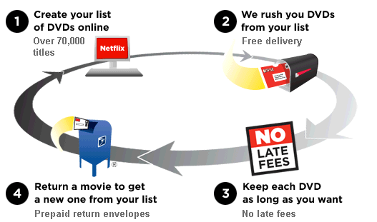
In the Beginning (1997-2007)

Slide 4
Company timeline
1997 – Reed Hastings and fellow software executive Marc Randolph co-found Netflix to offer online movie rentals.
1999 – Netflix launches the subscription service, offering unlimited rentals for one low monthly subscription.
2000 – Netflix launches the personalized movie recommendation system that uses Netflix members’ ratings to accurately predict choices for all Netflix members.
May 22, 2002 – Netflix makes its initial public offering (IPO) of 5,500,000 shares at $15.00 per share on Nasdaq under the ticker “NFLX.” Total Netflix members at the time: 600,000.
2006 – Netflix launches the Netflix Prize, promising $1 million to the first person or team who can achieve certain accuracy goals in recommending movies based on personal preferences. The company releases 100 million anonymous movie ratings ranging from one to five stars, the largest such data set ever released.

Slide 5
Company Timeline
2007 – Netflix introduces streaming, which allows members to instantly watch television shows and movies on their personal computers.
2008 – Netflix partners with consumer electronics companies to stream on the Xbox 360, Blu-ray disc players, TV set-top boxes and the Apple Macintosh computer.
2009 – Netflix partners with consumer electronics companies to stream on the PS3, Internet connected TVs and other Internet connected devices.
2009 – Netflix awards the $1 million Netflix Prize to the "BellKor's Pragmatic Chaos" team of seven researchers from four countries; over three years the contest has attracted more than 40,000 teams from 186 countries.
2010 – Netflix is available on the Apple iPad, iPhone and iPod Touch, the Nintendo Wii, and other Internet connected devices.
2010 – Netflix launches in Canada.

Slide 6
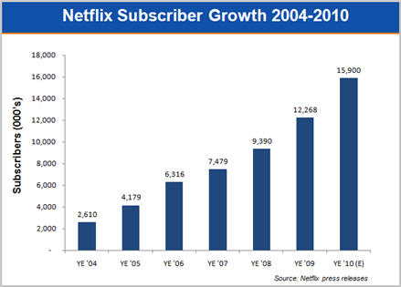
By The Numbers

Slide 7
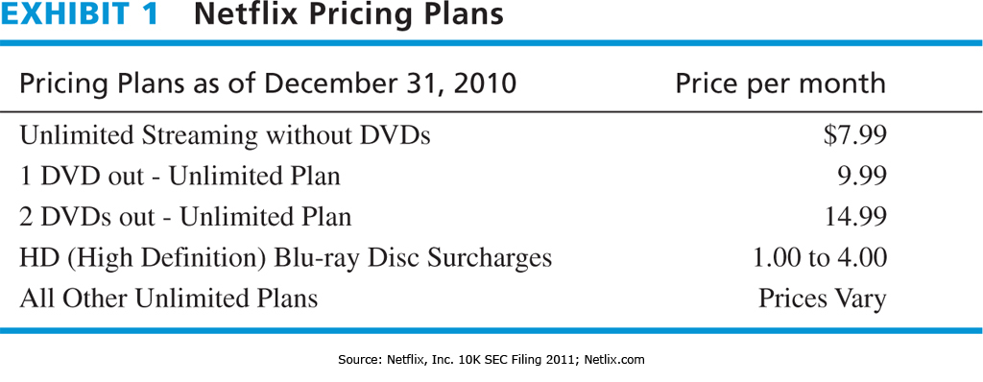
Pricing Plans

Slide 8
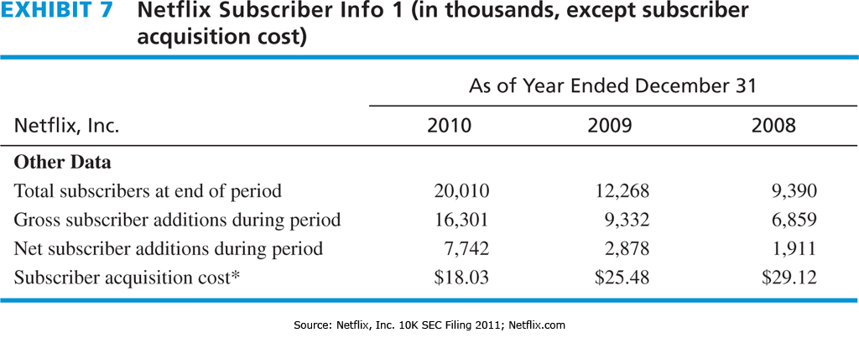
Subscriber Information

Slide 9
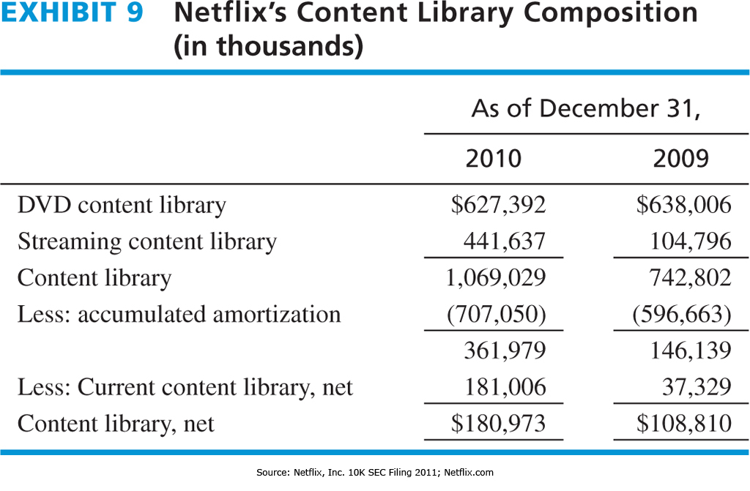
Content Libraries

Slide 10

Existing Mission and Vision Statement

Slide 11
Existing Growth Strategy
Grow numbers of subscribers
    Each subscribers =~ $100 - $120 revenue/year
    Streaming (VOD)
      Marginal cost approaches zero
    DVD by Mail
      greater inventory & delivery expense
Increase number, quality, currency and uniqueness of Content
  Content is King
Global expansion

Slide 12
Vision Statement
To become the number one mail order and live streaming movie company in the world.

Slide 13
Mission Statement
At Netflix, we seek to be the highest quality subscription business that offers Internet streaming and DVD by mail content (2). We believe in offering the best customer service possible by teaching our employees to be honest, respectful and ethical (6) while also valuing every customer’s individual needs. Our employees (9) are provided with the latest technologies, excellent benefits, and the safest working conditions in the industry. We provide outstanding customer service and in return, our customers (1) in our North American and Mexican markets (3) recommend their friends to Netflix (5). Our vast library of DVD’s and streaming service (4) provides a competitive advantage (7) as compared to offering only streaming. At Netflix, we strive to be a good corporate citizen (8).
Customers
Products or services
Markets
Technology
Concern for survival, growth, and profitability
Philosophy
Self-concept
Concern for public image
Concern for employees

Slide 14
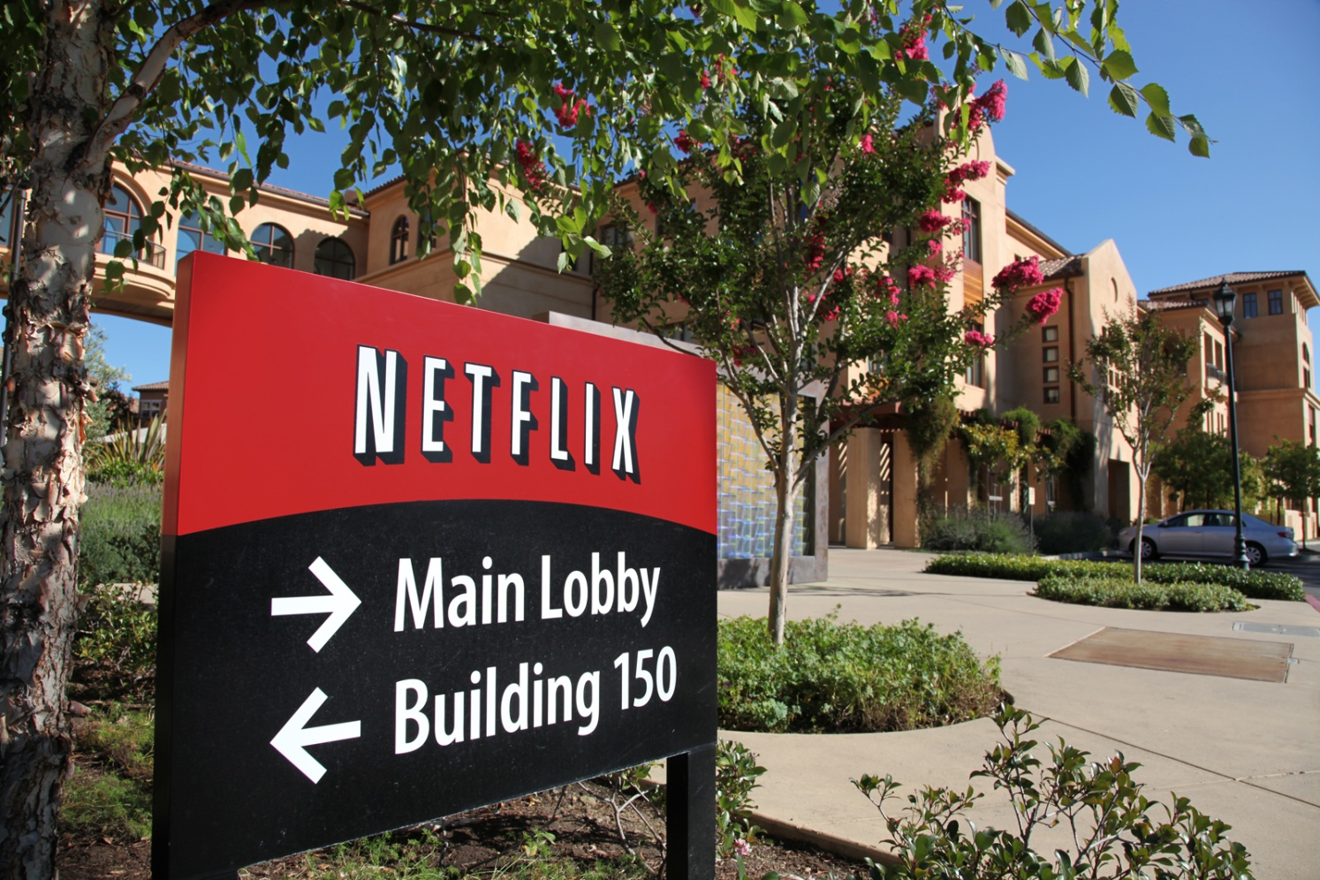
External Audit

Slide 15
Industry Market Analysis
Web Entertainment Sites 2010
Sites are ranked by millions of unique visitors in August 2010.
YouTube 99.00
iTunes 44.60
Glam Media 44.50
Yahoo! Sports 29.70
Gorilla Nation web sites 21.70
IMDB 21.20
Turner Sports and Entertainment 21.20
Netflix 20.60
Digital Video Streaming Market, 2010
Apple is in a three-way tie for third place with a 4% market share.
%
Netflix 61.00
Comcast 8.00
Other 31.00
DVD Rental Market, 2009-2010
Market shares are shown in percent.
2009 2010
% %
Netflix 25.70 34.80
Blockbuster (traditional) 22.80 19.90
Coinstar (Redbox) 11.90 18.90
Other traditional 28.20 16.10
Other subscription 8.60 7.20
Other kiosk 2.70 3.10
DVD Sales and Rental
According to the Digital Entertainment Group (www.dvdinformation.com),
DVD Sales DVD Rental Total Spending
2003: $11.6 billion $4.5 billion $16.1 billion
2004: $15.5 billion $5.7 billion $21.2 billion
2005: $16.3 billion $6.5 billion $22.8 billion
2006: $16.6 billion $7.5 billion $24.1 billion
2007: $16.0 billion $7.5 billion $23.4 billion
2008: $14.5 billion $7.5 billion $21.7 billion*
* Includes $750 million spending to Blu-ray Disc format

Slide 16
Opportunities
147 million people in the United States watch online videos.
Digital distribution of media is growing at a rate of 30% a year.
International markets account for over 50% of spending in US filmed entertainment.
US TV market accounts for less than 15% of the world's TV households.
China's box office annual growth rate continues to grow over 10% a year.
Rivals such as Blockbuster are struggling with their business models.
Consumers spent over $20 billion on home video purchases in 2010.
More people know English now than ever before.
High price of an outing at the movie theater.
Weak US Dollar makes global markets more attractive.

Slide 17
Threats
Poor global economy has reduced personal spending.
YouTube owns over 75% of the multimedia web market share.
Time Warner Cable's movies on demand.
Hulu, an ad based streamer, provides TV shows and movies for free.
DVRs are in 40% of US homes as of 2011.
Barriers to entry are low as startups can be launched for relatively low costs.
By law, Netflix cannot release new DVDs until 28 days after retail release.
Increase in US postal fees would reduce profit margins.
Infringements on Netflix patents and other proprietary assets.
Netflix is the object of complaints regarding collusion with Wal-Mart.

Slide 18
CPM

Slide 19
EFE

Slide 20
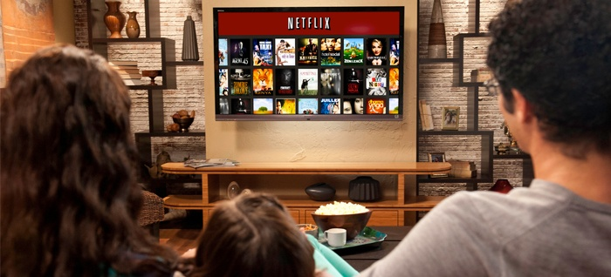
Internal Audit

Slide 21
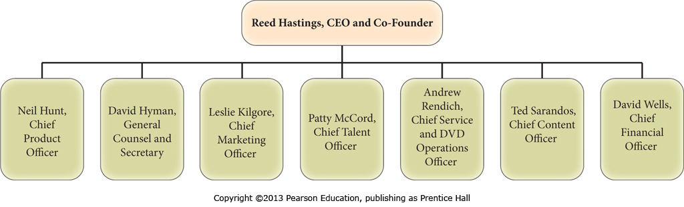
Organizational Structure

Slide 22
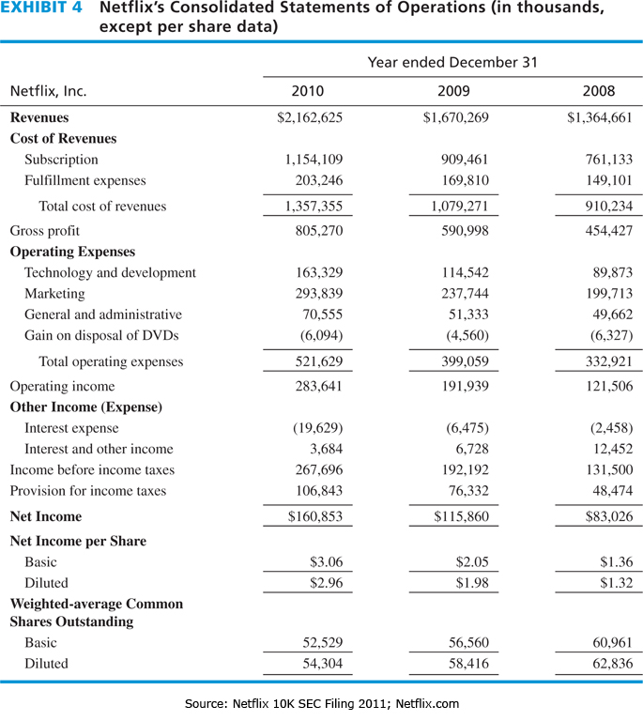
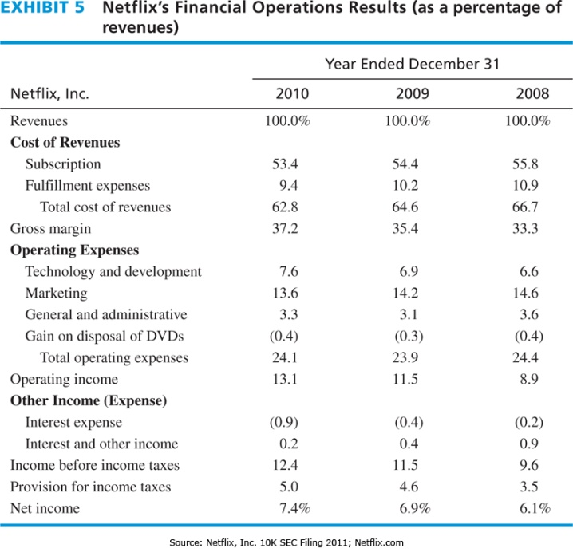
Financial Information (Income)

Slide 23
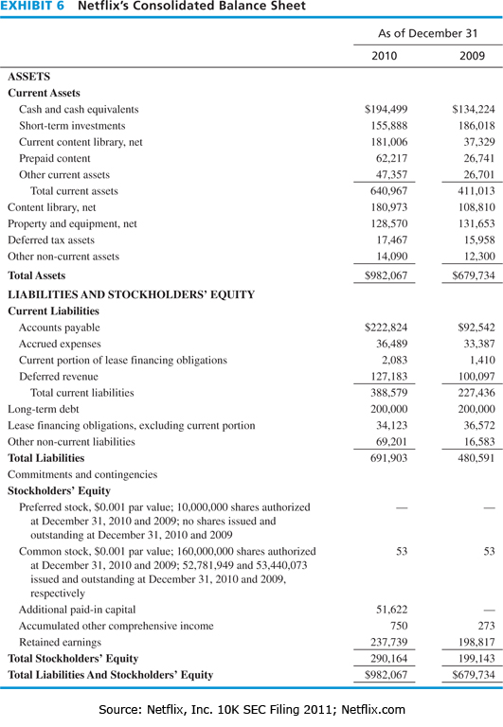
Financial Information
Net Worth Analysis (in millions)

Slide 24
Ratio Analysis
Growth Rate Percent | Netflix | Industry | S&P 500
Sales (Qtr vs year ago qtr) | 48.60 | 47.70 | 14.90
Net Income (YTD vs YTD) | - | - | -
Net Income (Qtr vs year ago qtr) | 64.50 | 51.70 | 65.70
Sales (5-Year Annual Avg.) | 25.95 | 25.47 | 8.28
Net Income (5-Year Annual Avg.) | 30.79 | 30.32 | 8.77
Dividends (5-Year Annual Avg.) | - | - | 5.67
Profit Margin Percent
Gross Margin | 36.6 | 36.5 | 39.5
Pre-Tax Margin | 12.9 | 12.7 | 18.0
Net Profit Margin | 8.1 | 8.0 | 13.1
5Yr Gross Margin (5-Year Avg.) | 35.7 | 35.7 | 39.4
Liquidity Ratios
Debt/Equity Ratio | 2.4 | 0.59 | 1.00
Current Ratio | 1.2 | 1.2 | 1.4
Quick Ratio | - | - | 0.9
Profitability Ratios
Return On Equity | 82.0 | 80.8 | 28.1
Return On Assets | 17.4 | 17.1 | 8.8
Return On Capital | 32.8 | 32.3 | 11.7
Return On Equity (5-Year Avg.) | 28.8 | 28.2 | 23.8
Return On Assets (5-Year Avg.) | 14.6 | 14.3 | 8.0
Return On Capital (5-Year Avg.) | 22.1 | 21.7 | 10.8
Efficiency Ratios
Income/Employee | 109,175 | 107,624 | 118,037
Receivable Turnover | - | 1.4 | 15.2
Inventory Turnover | - | 0.0 | 12.3
Asset Turnover | 2.1 | 2.1 | 0.8

Slide 25
Strengths
Revenues increased 29% from 2009 to 2010.
90% of surveyed subscribers would recommend Netflix to their friends.
Library of choices grew 30% in 2010.
Currently have over 100,000 DVDs available for customers.
Netflix expanded into Canada, Mexico and Latin America in 2011.
Netflix is the largest streaming movie company with over 25 million subscribers as of Fall 2011.
Recent customer satisfaction ACSI score was 85 out of 100.
Unlimited access to internet movies and mail in DVDs for $7.99.
Net income doubled from $83B to $161B from 2008 to 2010.
Apple uses Netflix to stream movies to its Apple TV, iPhone, and iPad.

Slide 26
Weaknesses
Reliance on the US Mail System for delivering of DVDs in US Markets.
Relies upon Amazon for a majority of its cloud computing services and cannot easily switch to another cloud provider.
Only 2 of the top 8 executives are women.
Netflix has no publically available vision or mission statement.
Netflix deal with Disney and Sony expires in 2011.
In 2010, Netflix did not rank in the Top 10 among online video content providers.
Netflix charges $95/year to Amazon's $79/year for unlimited streaming without DVDs.
Netflix collects data from subscribers and some firms have received criticism for this practice.
Netflix is the object of patent infringement regarding client-server communications.
Stock price fell 60% between July 2011 and October 2011.

Slide 27
IFE

Slide 28

Strategy Formulation

Slide 29
SWOT MATRIX
SO Strategies
Increase advertising expenses by 15% in 2012 and 2013. (S1, S4, S5, O1, O2)
Offer first 3 months at reduced price to take advantage of at home movie customers (S8, O7).
Aggressively enter the Chinese market. (S9, O5, O8, O10).
Provide free month service to any customer who recommends 5 friends. (S2, O1, O2).
WO Strategies
Extend expansion into Canada, Mexico, Latin America and China by 15% per year (W6, W10, O3, O4, O5, O8, O10).
Renew deals with Disney and Sony (W5, O2).
ST Strategies
Provide a free month of service for anyone who recommends 5 friends (S2, T1).
Increase R&D by 25% for marketing of online streaming movies (S6, S8, T6, T8).
WT Strategies
Form a partnership with UPS to deliver all DVDs (W1, T8).
Develop a clear mission (W4, T1, T6).

Slide 30
Space Matrix
Possible Strategies
Backwards, Forward, Horizontal Integration
Market Penetration
Market Development
Productions Development
Diversification (related or unrelated)

Slide 31

Grand Strategy Matrix
Possible Strategies
Backwards, Forward, Horizontal Integration
Market Penetration
Market Development
Productions Development
Diversification (related)

Slide 32
Divisional Analysis
Netflix recognizes two segments
  United States
  International Markets
    Canada as of September, 2010
    Streaming only, no DVD’s
    “Substantially all of the Company’s revenues are generated in the United States” (Netflix 2010 10-K)
    Additional expansion to come in 2011
      Mexcio, Latin America, Caribbean

Slide 33
Matrix Analysis
Alternative Strategies | IE | SPACE | GRAND | BCG | COUNT
Forward Integration |  | x | x |  | 2
Backward Integration |  | x | x |  | 2
Horizontal Integration |  | x | x |  | 2
Market Penetration |  | x | x |  | 2
Market Development |  | x | x |  | 2
Product Development |  | x | x |  | 2
Related Diversification |  | x | x |  | 2
Unrelated Diversification |  | x |  |  | 1
Retrenchment
Divestiture
Liquidation

Slide 34
Possible Strategies
Integration Strategies not feasible
  Short supply and delivery chain
  Limited competition
Market Penetration
  SO 1 Increase advertising expenses by 15% in 2011 and 2012. (S1, S4, S5, O1, O2)
  SO 2 Offer first 3 months at reduced price to take advantage of at home movie customers (S8, O7).
  SO 4 & ST 1 Provide free month service to any customer who recommends 5 friends. (S2, O1, O2).
Market Development
  SO 3 Aggressively enter the Chinese market. (S9, O5, O8, O10).
  WO 1 Extend expansion into Canada, Mexico, Latin America and China by 15% per year (W6, W10, O3, O4, O5, O8, O10).
Product Development
  ST 2 Increase R&D by 25% for marketing of online streaming movies (S6, S8, T6, T8).

Slide 35
QSPM

Slide 36
QSPM

Slide 37
Objective →Get Big Fast
Based on Thomas R. Eisemann’s (Harvard Business School) book “Internet Business Models: Text and Cases.”
“Winner-take-all” dynamics apply when
    Network effects (i.e., “viral”)
    Scale economies (i.e., “scalable”)
    Customer retention (i.e., “sticky”)
Competitive risks are “reasonable”
Lifetime value of customer exceeds acquisition cost
You can fund aggressive growth

Slide 38
Strategic Fit
Network effects
  Recommender system
  Friend referrals
Scale economies
  Amortization of content library costs
Customer retention
  Subscription revenue model
  Structural reliance
  Switching costs high
Competitive risks are “reasonable”
  Competitors have smaller market shares
Lifetime value of customer exceeds acquisition cost
  CAC is $ 18 (two months subscription)
  Based on 3 year retention CLV is ~ $300 to $350
  CAC/CLV = 5-6%
You can fund aggressive growth
  Current assets exceed current liabilities by $260 million
  Dept/equity ratio is 0.6 (S&P is 1.0)
  Market Capitalization of $6 billion is 20 times out assets base (~$300 million)

Slide 39
3 Year Goal and Annual Objectives
In 3 years
  Own 70% of the video steaming market by
    Purchasing more and better content for distribution
    Increase marketing efforts
    Create embedded players for any electronic device that has a video screen and a connection to the Internet
    Fuel global expansion
Annual goals
  2011 → 35 million subscribers ( $3.5 billion in revenues)
  2012 → 55 million subscribers ( $5.5 billion in revenues)
  2013 → 80 million subscribers ( $8 billion in revenues)
  There is 147 million potential customers in the US

Slide 40
Strategy Selection with Year 1 Costs
Increase advertising budgets by 15 percent.
  15% of $293M = $44M
Expand by 15 percent into Latin America, Mexico, and China.
  15% of $2,162M = $324 New revenues * 92.5% (exp. ratio) = $300M of added expenses + $500M marketing and development costs
Increase R&D by 25% for marketing and delivery of online streaming movies (S6, S8, T6, T8).
  25% of 293M = $73.25M
Total cost for all three
  Approx. $1,000 Million

Slide 41

Strategic Implementation

Slide 42
Technology Issues
Reliance on a Public Internet
  Network Neutrality
    NetFlix is 20-30% of ALL Internet traffic
  Consumer Broadband Service
  Distributed Distribution
Intellectual Property Protection
  International regulatory bodies

Slide 43
EPS/EBIT
Amount Needed: $1,000
Stock Price: $120
Shares Outstanding: 52 million
Interest Rate: 5%
Tax Rate: 36%

Slide 44
Projected Financials
Assumptions
  Sell stock to raise $1,000 M
    8.33 million new shares @ $120/share
    $1000M paid in capital
  50% increase in revenues
    15% from international
    35% from domestic
  Marketing Budget increases by 15%
  New R&D expense of $73.5M
  No dividends

Slide 45
Projected Income Statement
Netflix, Inc.
Consolidated Statements of Operations
(unaudited)
(in thousands, except per share data)
 |  |  |  |  |  | Projected
 |  |  |  |  | December 31, | December 31,
 |  |  |  |  | 2010 | 2011
Revenues
 | Domestic |  |  |  | $ 2,162,625 | $ 2,919,543.75 | +35%
 | International |  |  |  |  | $ 515,213.60 | +15% of total revenues
 | Total |  |  |  | $ 2,162,625.00 | $ 3,434,757.35
Cost of revenues |  |  |  |  | $ 1,357,355.00 | $ 1,832,429.25 | CGS method
Marketing |  |  |  |  | $ 293,839.00 | $ 456,185.05 | CGS method + additional 15%
Technology and development |  |  |  |  | $ 163,329.00 | $ 236,829.00 | additional $73.5M
General and administrative |  |  |  |  | $ 64,461.00 | $ 87,022.35 | CGS method
Legal settlement |  |  |  |  | $ -
Operating income (loss) |  |  |  |  | $ 283,641.00 | $ 307,078.10
Other income (expense):
 | Interest expense |  |  |  | $ (19,629.00) | $ (19,629.00) | Same
 | Interest and other income (expense) |  |  |  | $ 3,684.00 | $ 3,684.00 | same
Income (loss) before income taxes |  |  |  |  | $ 267,696.00 | $ 291,133.10
Provision (benefit) for income taxes |  |  |  |  | $ 106,843.00 | $ 106,843.00 | same
Net income (loss) |  |  |  |  | $ 160,853 | $ 184,290.10 | add to retained earings
Earnings per share:
 | Basic |  |  |  | $ 3.06 | $ 3.03
 | Diluted |  |  |  | $ 2.96 | $ 2.94
Weighted-average common shares outstanding:
 | Basic |  |  |  | 52,529 | 60,862 | additional 8.33 million shares
 | Diluted |  |  |  | 54,304 | 62,637 | additional 8.33 million shares

Slide 46
Projected Balance Sheet
 | Netflix, Inc.
 | Consolidated Balance Sheets
 | (unaudited)
 | (in thousands)
 |  |  |  |  |  |  |  |  | Projected
 |  |  |  |  |  |  |  | December 31, | December 31,
 |  |  |  |  |  |  |  | 2010 | 2011
 | Assets
 | Current assets:
 |  |  |  | Cash and cash equivalents |  |  |  | $ 194,499 | $ 198,808 | fudge number
 |  |  |  | Short-term investments |  |  |  | $ 155,888 | $ 155,888
 |  |  |  | Current content library, net |  |  |  | $ 181,006 | $ 271,509 | 50% additional titles
 |  |  |  | Prepaid content |  |  |  | $ 62,217 | $ 62,217
 |  |  |  | Other current assets |  |  |  | $ 43,621 | $ 43,621
 |  |  |  |  |  |  | Total current assets | $ 637,231 | $ 732,043
 | Non-current content library, net |  |  |  |  |  |  | $ 180,973 | $ 271,460 | 50% additional titles
 | Property and equipment, net |  |  |  |  |  |  | $ 128,570 | $ 128,570 | same
 | Other non-current assets |  |  |  |  |  |  | $ 35,293 | $ 35,293 | same
 |  |  |  |  |  |  | Total assets | $ 982,067 | $ 1,167,365
 | Liabilities and Stockholders' Equity
 | Current liabilities:
 |  |  |  | Current content liabilities |  |  |  | $ 174,791 | $ 174,791 | Same
 |  |  |  | Accounts payable |  |  |  | $ 54,129 | $ 54,129 | "
 |  |  |  | Accrued expenses |  |  |  | $ 32,476 | $ 32,476 | "
 |  |  |  | Deferred revenue |  |  |  | $ 127,183 | $ 127,183 | "
 |  |  |  |  |  |  | Total current liabilities | $ 388,579 | $ 388,579 | "
 | Non-current content liabilities |  |  |  |  |  |  | $ 48,179 | $ 48,179 | "
 | Long-term debt |  |  |  |  |  |  | $ 200,000 | $ 200,000 | "
 | Long-term debt due to related party |  |  |  |  |  |  | $ - | $ -
 | Other non-current liabilities |  |  |  |  |  |  | $ 55,145 | $ 55,145 | "
 |  |  |  |  |  |  | Total liabilities | $ 691,903 | $ 691,903 | "
 | Stockholders' equity:
 |  | Common stock |  |  |  |  |  | 53 | 61 | add new stock issue
 |  | Additional paid-in capital |  |  |  |  |  | $ 51,622 | $ 52,622 | add 1,000m paid in capital
 |  | Accumulated other comprehensive income |  |  |  |  |  | $ 750 | $ 750 | same
 |  | Retained earnings |  |  |  |  |  | $ 237,739 | $ 422,029 | Add projected Net Income
 |  |  |  |  |  |  | Total stockholders' equity | $ 290,164 | $ 475,462
 |  |  |  |  |  |  | Total liabilities and stockholders' equity | $ 982,067 | $ 1,167,365

Slide 47
Projected Ratios
Growth Rate Percent | Netflix 2010 | Netflix 2011 | S&P 500
Sales ( YTD to YTD) | 48.60 | 58.82% | 14.90
Net Income (YTD vs YTD) | - | 14.57% | -
Profit Margin Percent
Gross Margin | 36.6 | 47% | 39.5
Pre-Tax Margin | 12. | 9% | 18.0
Net Profit Margin | 8.1 | 5% | 13.1
Liquidity Ratios
Debt/Equity Ratio | 2.4 | 1.46 | 1.00
Current Ratio | 1.2 | 1.88 | 1.4
Quick Ratio | 1.2 | 1.88 | 0.9
Profitability Ratios
Return On Equity | 82.0 | 39 | 28.1
Return On Assets | 17.4 | 16 | 8.8
Efficiency Ratios
Asset Turnover | 2.1 | 2.9 | 0.8

Slide 48

Strategic Evaluation

Slide 49
Balanced Score Card
Area of Objectives | Measure or Target | Time Expectation | Primary Responsibility
Customers
1 Satisfaction | Customer Survey results | Yearly | Marketing Department
2 Brand Identity | Industry Reports | Yearly | Marketing Department
Employees
1 Quality and service training | On site and webinars | Yearly | COO
2 Employee Satisfaction | Survey | Yearly | Human resources
Marketing
1. Number of Subscribers | 2011 +15 M, 2012 +20M, 2013 +25M | Yearly | COO
Business Ethics/Natural Environment
1 Waste reduction | volume of recyclable materials | Quarterly | COO
2 Ethics Training | # of ethics training sessions | Yearly | Human resources
Financial
1 Revenues | 50% increase each year | Quarterly | CFO
2 Ratio analysis | better than Industry Avg, | Yearly | CFO

Slide 50

Netflix Update

Slide 51
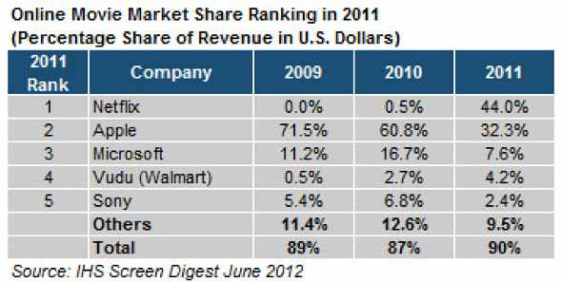
Update

Slide 52
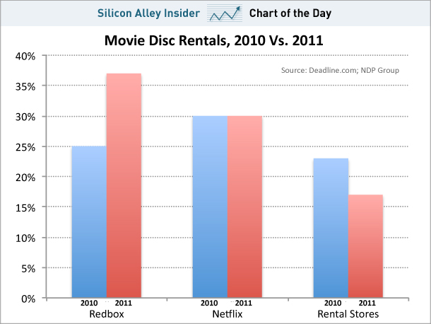
Update

Slide 53
The Quickster Fiasco
In September 2011, Hastings announces that he will split off the DVD rental business into a new company called Qwickster
NetFlix loses 800,000 customers
Stock prices falls from $295 to $108/share
In October 2011, Hastings decides to NOT split off the DVD business

Slide 54
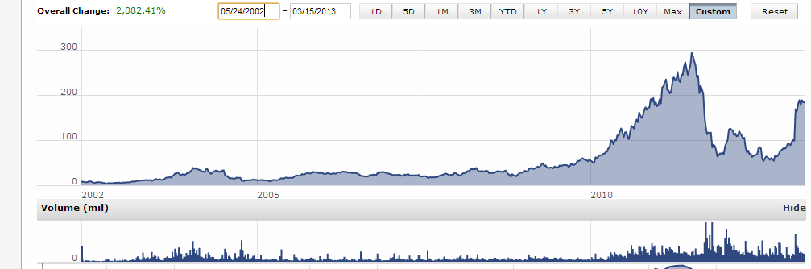
Stock Performance
Source: MorningStar®

Slide 55
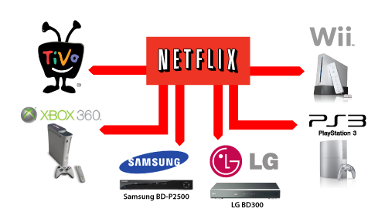

Slide 56
References
Uhle, Frank, and Stephen Meyer. "Netflix, Inc." International Directory of Company Histories. Ed. Derek Jacques and Paula Kepos. Vol. 115. Detroit: St. James Press, 2010. 350-355. Business Insights: Essentials. Web. 22 Mar. 2013. Document URL
http://bi.galegroup.com/essentials/article/GALE|CX2335800079
"DVD Rental Market, 2009-2010." Market Share Reporter. Detroit: Gale, 2012. Business Insights: Essentials. Web. 22 Mar. 2013. Document URL
http://bi.galegroup.com/essentials/article/GALE|I2502040158?u=maine_fortkent
"Top Entertainment Web Sites, 2010." Market Share Reporter. Ed. Robert S. Lazich and Virgil L. Burton, III. 2012 ed. Detroit: Gale, 2012. Business Insights: Essentials. Web. 22 Mar. 2013. Document URL
http://bi.galegroup.com/essentials/article/GALE|I2502036216?u=maine_fortkent
"DVD Rental Market, 2009-2010." Market Share Reporter. Detroit: Gale, 2012. Business Insights: Essentials. Web. 22 Mar. 2013. Document URL
http://bi.galegroup.com/essentials/article/GALE|I2502040158?u=maine_fortkent
"Digital Video Streaming Market, 2010." Market Share Reporter. Ed. Robert S. Lazich and Virgil L. Burton, III. 2012 ed. Detroit: Gale, 2012. Business Insights: Essentials. Web. 22 Mar. 2013. Document URL
http://bi.galegroup.com/essentials/article/GALE|I2502038343?u=maine_fortkent
“The Network Neutrality and the Netflix Dispute: Upcoming Challenges for Content Providers in Europe and the United States. “ Intellectual Property & Technology Law Journal; Mar2011, Vol. 23 Issue 3, p3-6, 4p Document URL http://www.library.umaine.edu/auth/EZProxy/test/authej.asp?url=http://search.ebscohost.com/login.aspx?direct=true&db=bth&AN=58623247&site=ehost-live
Chapter 18: FILMED ENTERTAINMENT. Miller, Richard K. and Washington, Kelli, Leisure Market Research Handbook; 2010, p156-159, $p, 2 Charts Document URL: http://www.library.umaine.edu/auth/EZProxy/test/authej.asp?url=http://search.ebscohost.com/login.aspx?direct=true&db=bth&AN=47565086&site=ehost-live
Eisenmann, Thomas R., ed. Internet Business Models: Text and Cases. New York: McGraw-Hill/Irwin, 2001
Netflix, Inc. – 2011, Lori Radanovich, Bladwin-Wallace College, published in Strategic Management, Concepts and Cases 14th edition, Fred David
Netflix– 2011, case notes, Forest David
http://ir.netflix.com/
All images are from www.netflix.com and are the property of Netflix, Inc.

