Slide 1
ACCA 7025
Applied Machine Learning
Introduction to
Machine Learning
Mark Huntly:
m.huntly@uwtsd.ac.uk

Slide 2
What is Machine Learning (ML)
ML is:
  A subfield of AI that uses previous data to teach computers to.
  Different to standard computer programs, ML algorithms do not follow predefined rules to classify and make predictions.
  Algorithms that can solve problems on their own through learning from large sets of examples in the provided data.

Slide 3
The Definition of ML
The Science of getting computers to learn, without being explicitly programmed. (Ng, Andrew).
Machine learning is the subfield of computer science that "gives computers the ability to learn without being explicitly programmed" (Arthur Samuel, 1959).

Slide 4
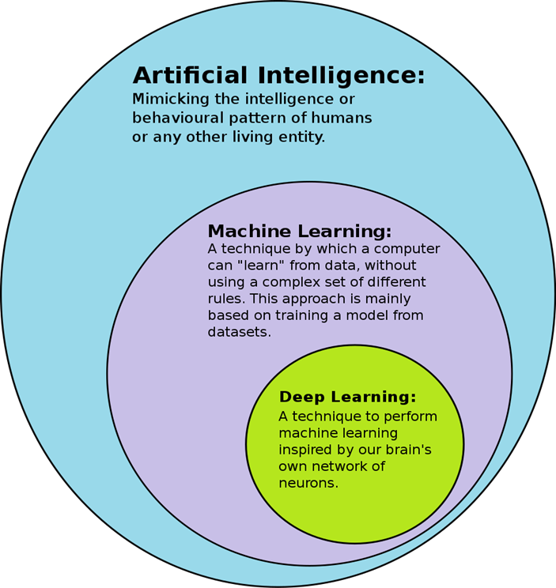
AI and Machine Learning
ML is:
A subfield of AI that uses previous data to teach computers to.
Different to standard computer programs, ML algorithms do not follow predefined rules to classify and make predictions.
Algorithms that can solve problems on their own through learning from large sets of examples in the provided data.

Slide 5
AI and Machine Learning
To make an AI, you need to:
  Identify the problem you’re trying to solve,
  Collect the right data,
  Create algorithms,
  Choose the right platform, pick a programming language
  Train the AI model,
  Finally, deploy and monitor the operation of your AI system.

Slide 6
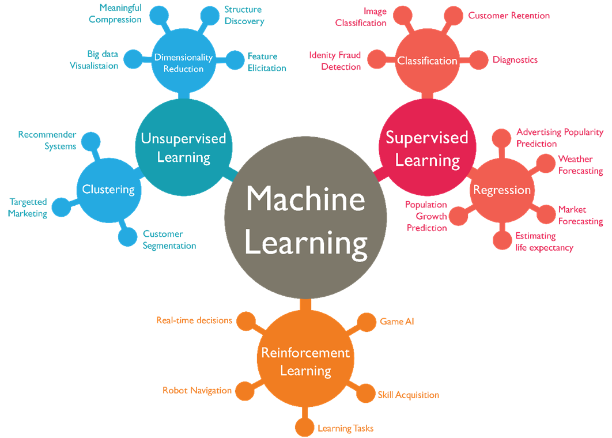
AI and Machine Learning
Components of creation:
  • Hardware/computers
  • Data (annotated)
  • Algorithms
Notes:
So - we need hardware capable of performing the task, frameworks and languages suitable for the task, the right data, and the right choice of AI algorithms

Slide 7
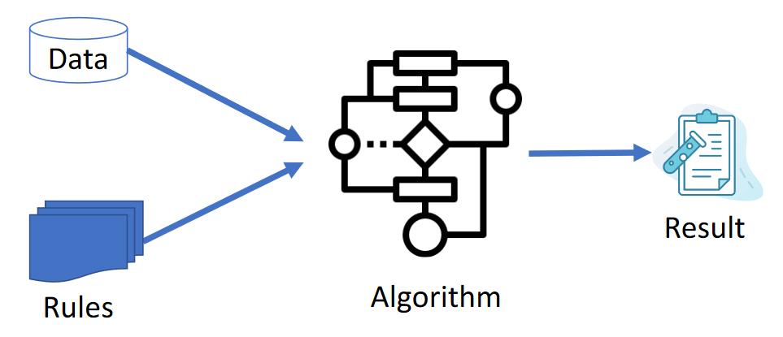
Algorithms
In the way an Expert System works:
  Based on the rules, and using the data, the algorithm will classify an outcome.
  The algorithm will never change unless programatically.

Slide 8
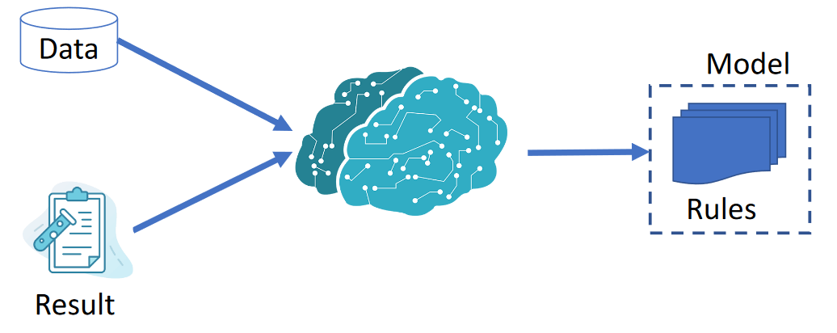
ML Algorithms to Models
ML Algorithm uses the data to tune a parameter
Matches the input results with predicted results
ML Model can be continuously trained and used to predict outcomes / values
ML Model will keep changing to minimise the difference between actual and predicted results.

Slide 9
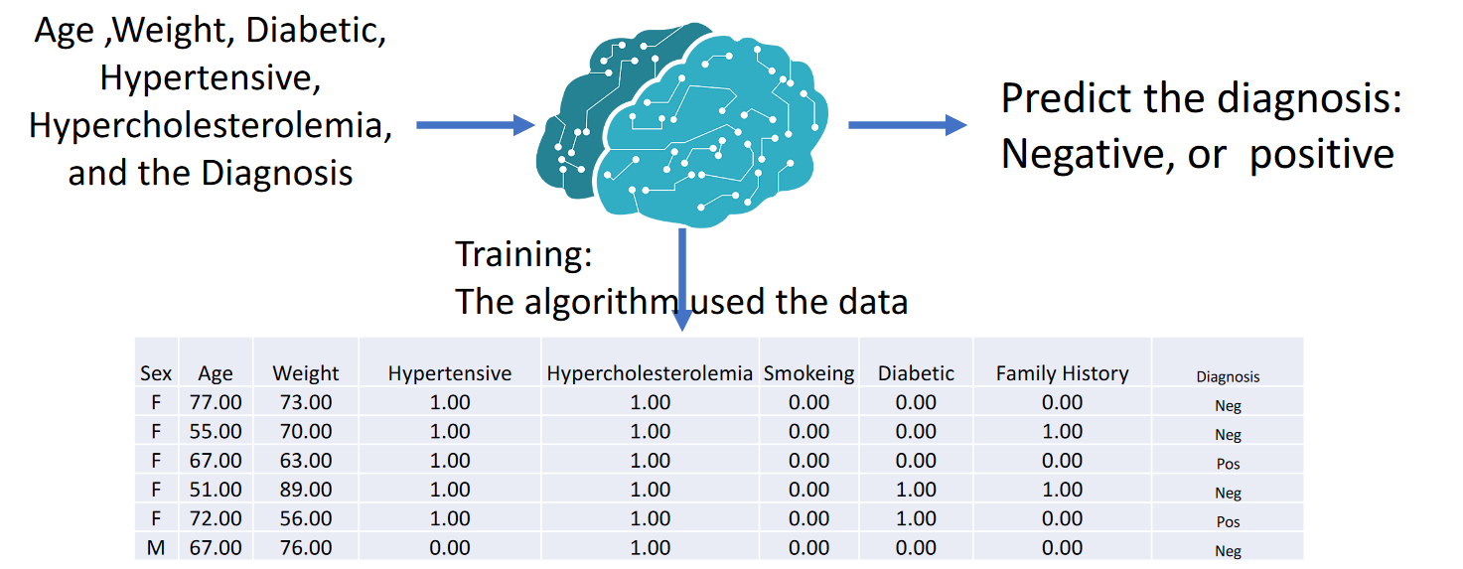
ML Algorithms and Models

Slide 10
Machine Learning Categories
  There are Four main categories within ML:
    Supervised Learning
    Unsupervised Learning
    Semi-Supervised
    Reinforcement Learning

Slide 11
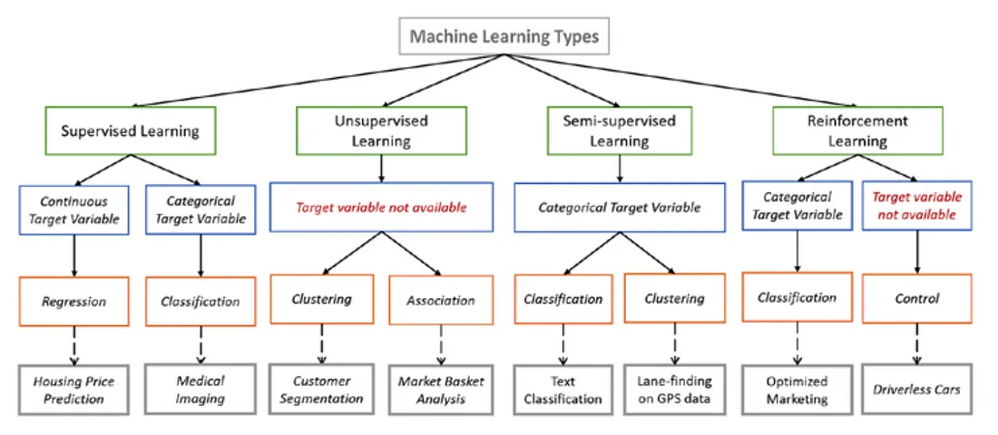
Machine Learning Categories
https://towardsdatascience.com/types-of-machine-learning-algorithms-you-should-know-953a08248861

Slide 12
Supervised Machine Learning
  The algorithm is trained on human-labelled data. The more samples you provide a supervised learning algorithm, the more precise it becomes in classifying new data.
  This solves:
    Classification – Predicting discrete values
    Regression – Predicting continuous values
Common Supervised ML Algorithms:
  Nearest Neighbour (KNN)
  Naïve Bayes
  Decision Trees
  Linear Regression
  Support Vector Machines (SVM)
  Neural Networks (Multi-Layer Perceptron)

Slide 13
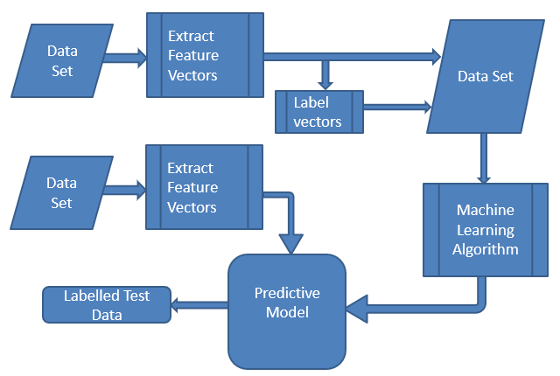
Supervised Machine Learning
Train
Predict
Validate / test

Slide 14
Unsupervised Machine Learning
  The algorithm is trained on unlabelled data and letting it find patterns by itself. You provide the input but not labels, and let the machine infer qualities that algorithm ingests the data, draws inferences, and finds patterns.
  This solves:
    Class Identity
    Clustering
Common Unsupervised ML Algorithms:
  K-Means Clustering
  Association Rules

Slide 15
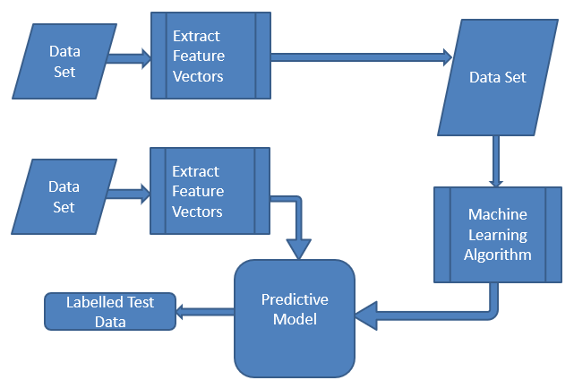
Unsupervised Machine Learning
Train
Predict
Validate / test

Slide 16
Semi-supervised Machine Learning
  The algorithm is trained on partly labelled data and letting it find patterns by itself. This exploits the idea that even though the group memberships of the unlabeled data are unknown, this data carries important information about the group parameters.
Notes:
In the previous two types, either there are no labels for all the observation in the dataset or labels are present for all the observations.
In many practical situations, the cost to labelling is quite high, since it requires skilled human experts to do that.
In the absence of labels in the majority of the observations but present in few, semi-supervised algorithms are the best candidates for the model building.
These methods exploit the idea that even though the group memberships of the unlabeled data are unknown, this data carries important information about the group parameters.

Slide 17
Reinforcement Machine Learning
  • Relies on providing a machine learning algorithm with a set of rules and constraints, and letting it learn how to achieve its goals. You define the state, the desired goal, allowed actions, and constraints.
  • The algorithm figures out how to achieve the goal by trying different combinations of allowed actions and is rewarded or punished depending on whether the decision was a good one.
  • The algorithm tries its best to maximize its rewards within the constraints provided.
  • You could use Reinforcement Learning to teach a machine to play chess or navigate an obstacle course

Slide 18
Stages of
Developing
Machine Learning
Algorithms

Slide 19
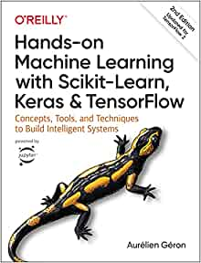
A Handy Book…
  Geron, Aurelien. Hands-On Machine Learning with Scikit-Learn, Keras, and TensorFlow 2nd Ed. (Kindle Locations 841-844). O'Reilly Media.
  Kindle Edition.

Slide 20
Steps to Follow
  • Look at the big picture.
  Get the data.
  Discover and visualize the data to gain insights.
  Prepare the data for Machine Learning algorithms.
  Select a model and train it.
  Fine-tune your model.
  Present your solution.
  Deploy, monitor, and maintain your system.

Slide 21
Step 1 - The Problem
  •Frame the Problem and Look at the Big Picture by:
    Defining the objective in business terms -
      How your solution will be used
      What are the current solutions or workarounds?
      How should the problem be framed?
        Supervised / unsupervised
        Online / offline…. Etc…
      How should performance be measured?
      Is performance measure aligned with a business objective?

Slide 22
Step 1 - The Problem
  •Frame the Problem and Look at the Big Picture by:
    Defining the objective in business terms -
      What would be the minimum performance needed to reach the business objective?
      What are comparable problems?
      Can you reuse experience or tools?
      Is human expertise available?
      How would you solve the problem manually?
      List the assumptions you (or others) have made so far.
      Verify assumptions if possible.

Slide 23
Step 2 - Get the Data
  •Note: Automate as much as possible so you can easily get fresh data.
    List the data you need and how much you need.
    Find and document where you can get that data.
    Check how much space it will take.
    Check legal obligations, and get authorization if necessary.
    Get access authorizations.

Slide 24
Step 2 - Get the Data
  •Note: Automate as much as possible so you can easily get fresh data.
    Get access authorizations.
    Create a workspace (with enough storage space).
    Get the data.
    Convert the data to a format you can easily manipulate (without changing the data itself).
    Ensure sensitive information is deleted or protected (e.g., anonymized).
    Check the size and type of data (time series, sample, geographical, etc.).
    Sample a test set, put it aside, and never look at it (no data snooping!).

Slide 25
Step 3 - Explore the Data
  •Note: try to get insights from a field expert for these steps.
    Create a copy of the data for exploration (sampling it down to a manageable size if necessary).
    Create an electronic notebook to keep a record of your data exploration.
    Study each attribute and its characteristics:
      Name Type (categorical, Int/ float, bounded/ unbounded, text, structured, etc.);
      % of missing values;
      Noisiness and type of noise (stochastic, outliers, rounding errors, etc.);
      Usefulness for the task ;
      Type of distribution (Gaussian, uniform, logarithmic, etc.)

Slide 26
Step 3 - Explore the Data
    Visualize the data. Study the correlations between variables.
    Study how you would solve the problem manually.
    Identify the promising transformations you may want to apply.
    Identify extra data that would be useful (go back to “Get the Data”).
    Document what you have learned.

Slide 27
Step 4 - Prepare the Data
  •Note: Work on copies of the data (keep the original dataset intact).
    Write functions for all data transformations you apply, for five reasons:
      So you can easily prepare the data the next time you get a fresh dataset
      So you can apply these transformations in future projects
      To clean and prepare the test set
      To clean and prepare new data instances once your solution is live
      To make it easy to treat your preparation choices as hyperparameters
    Data cleaning: Fix or remove outliers (optional).

Slide 28
Step 4 - Prepare the Data
  •Fill in missing values (e.g., with zero, mean, median…) or drop their rows (or columns).
  Feature selection (optional): Drop the attributes that provide no useful information for the task.
  Feature engineering, where appropriate:
    Discretize continuous features.
    Decompose features (e.g., categorical, date/ time, etc.).
    Add promising transformations of features (e.g., log( x), sqrt( x), x2, etc.).
    Aggregate features into promising new features.
  Feature scaling: Standardize or normalize features.

Slide 29
Step 4 – Select an Algorithm (Model)
  Shortlist Promising Models
  If the data is huge, you may want to sample smaller training sets so you can train many different models in a reasonable time (be aware that this penalizes complex models such as large neural nets or Random Forests).
  Train many quick-and-dirty models from different categories (e.g., linear, naive Bayes, SVM, Random Forest, neural net, etc.) using standard parameters.
  Measure and compare their performance.
  For each model, use N-fold cross-validation and compute the mean and standard deviation of the performance measure on the N folds.

Slide 30
Step 4 – Select an Algorithm (Model)
  Shortlist Promising Models
  Analyze the most significant variables for each algorithm.
  Analyze the types of errors the models make. What data would a human have used to avoid these errors?
  Perform a quick round of feature selection and engineering.
  Perform one or two more quick iterations of the five previous steps.

Slide 31
Step 5 – Fine-Tune the Model
  You will want to use as much data as possible for this step, especially as you move toward the end of fine-tuning. As always, automate what you can.
  Fine-tune the hyperparameters (number of training steps, learning rate, initialization values, etc.) using cross-validation: Treat your data transformation choices as hyperparameters, especially when you are not sure about them (e.g., if you’re not sure whether to replace missing values with zeros or with the median value, or to just drop the rows).
  Unless there are very few hyperparameter values to explore, prefer random search over grid search.

Slide 32
Step 5 – Fine-Tune the Model
  If training is very long, you may prefer a Bayesian optimization approach (e.g., using Gaussian process priors, as described by Jasper Snoek et al.).
  Try Ensemble methods. Combining your best models will often produce better performance than running them individually.
  Once you are confident about your final model, measure its performance on the test set to estimate the generalization error.

Slide 33
Step 6 – Present the Solution
  Document what you have done.
  Create a nice presentation.
  Make sure you highlight the big picture first.
  Explain why your solution achieves the business objective.
  Don’t forget to present interesting points you noticed along the way.

Slide 34
Step 6 – Present the Solution
  Describe what worked and what did not.
  List your assumptions and your system’s limitations.
  Ensure your key findings are communicated through beautiful visualizations or easy-to-remember statements (e.g., “the median income is the number-one predictor of housing prices”).

Slide 35
Step 7 – Deploy!
  Get your solution ready for production (plug into production data inputs, write unit tests, etc.). Write monitoring code to check your system’s live performance at regular intervals and trigger alerts when it drops.
  Beware of slow degradation: models tend to “rot” as data evolves. Measuring performance may require a human pipeline (e.g., via a crowdsourcing service).

Slide 36
Step 7 – Deploy!
  Also monitor your inputs’ quality (e.g., a malfunctioning sensor sending random values, or another team’s output becoming stale). This is particularly important for online learning systems.
  Retrain your models on a regular basis on fresh data (automate as much as possible).

Slide 37
In Summary - Steps to Follow
  Explore the Data
  Prepare the Data
  Visualize and explore the data
  Select a model (or models)
  Train the model
  Evaluate
  Tune the Model
  Make predictions
  Repeat

