Slide 1
BMSW4009
Effective Team Working and Communication
Week 4
Melanie Squire and Muhammad Cassamo

Slide 2
Today we will…
Recap from last week
Explore Communication Models through theory, practice and a case study
Presentation preparation

Slide 3
Belbin’s 9 Team Roles
Action-Oriented Roles
Shaper: Drives the team forward and thrives on pressure and challenge.
Implementer: Turns ideas into practical actions and organises work that needs to be done.
Completer Finisher: Pays attention to detail, ensures thorough, timely completion of tasks.
People-Oriented Roles
Coordinator: Clarifies goals, delegates tasks, and promotes decision-making.
Team worker: Fosters team spirit, supports others, and helps the team to gel.
Resource Investigator: Explores opportunities, develops contacts, and brings in new ideas.
Thinking-Oriented Roles
Plant: Provides creative ideas and solves difficult problems.
Monitor Evaluator: Offers logical analysis and objective judgment.
Specialist: Brings in-depth knowledge and expertise in a specific area.
Which are you?
Notes:
Ask the group for a rough poll of how many of each role are present in the room – how many shapers? Coordinators? And so on. Make a mental note, so that you can ask them about whether they recognise the traits for each role as they are discussed.

Slide 4
What do we know about communication:
It is shaped by the environment
People see things differently
People are weird!
Conflict is inevitable
Continually changing/adapting
We often do it poorly!
Notes:
This is a chance to both disrupt and reinforce students understanding of people.
We are deliberately starting with understanding individuals and how each person’s awareness of themselves, their relationships and the world around them determines how well they can interact and do things together at a deep and effective level.

Slide 5
Effective Communication
What does it involve?
  Clarity and conciseness
  Active listening
  Choosing the appropriate medium
  Emotional intelligence
  Feedback and engagement
  Nonverbal communication

Slide 6
Effective Communication and Contributing to Discussions
In any communication, the listener’s impression is based
on…
Body language (gestures and movements) (55%)
Tone (38%)
Words (7%)
Notes:
This demonstrates the importance of outside factors rather than what we say. Our tone of voice, energy, attitude, emotions, dress, body language, eye contact, facial expressions, movements and gestures have a stronger impact than words alone. By taking these into consideration in our communication style we can build rapport and relationships more effectively.

Slide 7
The Shannon-Weaver Mathematical Model, 1949
Information Source/ Sender
Transmitter (Encoder)
Channel
Receiver (Decoder)
Destination
Signal
Received
Signal
Message
Message
Noise Source
Notes:
Video link to explore the theory further.
What is this model telling us? This time there is noise……but is this ‘atmospheric interference’….it is 1949, or is it more than this? Students can look this up in their own time and answer these questions! This also seems ‘one-directional’…..is it?

Slide 8
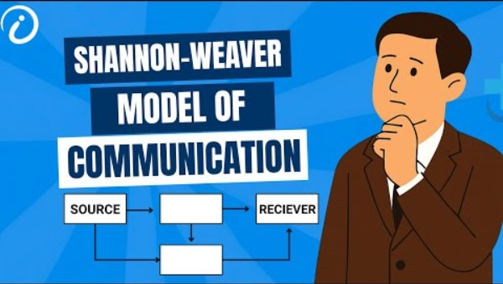
Shannon-Weaver Model of Communication explained - YouTube

Slide 9
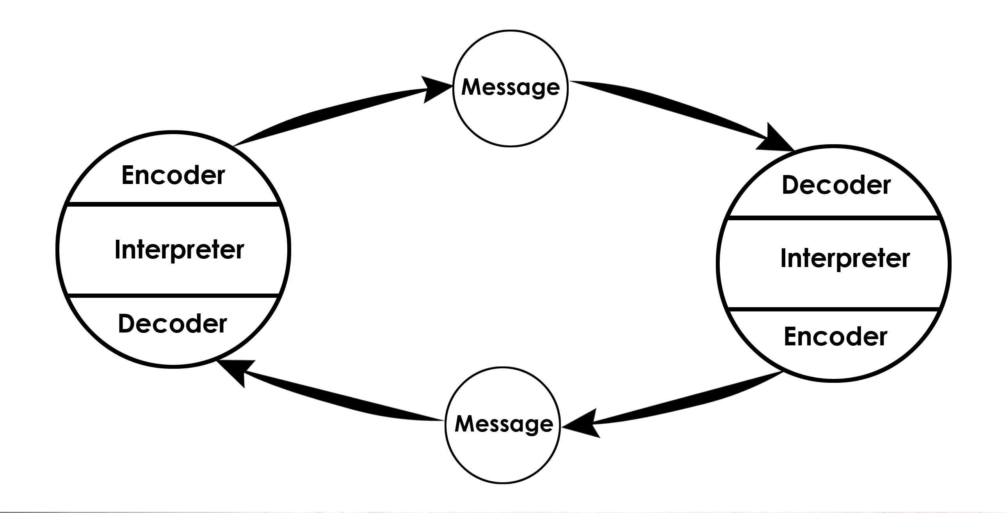
Schramm’s Model of Communication, 1954
Notes:
Schramm's communication model is an easy-to-understand framework that explains how communication works as a two-way, circular process between people. Instead of seeing communication as a simple one-way transmission, Schramm argued that both the sender and receiver continuously exchange roles, with each person encoding (creating), sending, decoding (interpreting), and providing feedback about messages.​
Key Elements
Sender/Source: The person who starts the communication by encoding a message (turning thoughts into words, symbols, or signals).​
Message: The idea or information sent from the sender to the receiver, which can be verbal, written, or non-verbal.​
Channel: The method or medium used to send the message (speech, writing, visual cues, etc.).​
Receiver/Destination: The person who gets the message and decodes it (interprets its meaning).​
Feedback: The receiver’s response to the message, which is sent back to the original sender, turning them into the new receiver.​
Circular Process
Schramm’s model is cyclical, meaning communication doesn’t stop after a message is sent; instead, both parties keep sending messages and feedback in a continuing loop. This ongoing exchange helps both people clarify and better understand each other.​
Importance of Common Experience
For successful communication, Schramm emphasized that sender and receiver should share some common experience or background. Misunderstandings happen when people don’t have similar knowledge or context—for instance, a technical expert talking to someone without the same expertise may be misunderstood.​
Example
If one person says something in a conversation, the other listens, interprets the meaning, and then replies. This reply acts as feedback, creating a roundtrip of messages that helps both sides refine understanding.

Slide 10
Berlo’s Model of Communication – SMCR (1960)
Video of Berlo’s Model of Communication
Source
Communication Skills
Attitudes
Knowledge
Social System
Culture
Message
Content
Elements
Treatment
Structure
Code
Channel
Hearing
Seeing
Touching
Smelling
Tasting
Receiver
Communication Skills
Attitudes
Knowledge
Social System
Culture
Encodes
Decodes
A Source encodes a Message for a Channel, then to a Receiver, who decodes it: S-M-C-R Model
Notes:
Video link for further exploration.
Discuss this with the students – another approach to the tricky subject of communications.

Slide 11
Question
What do these models have in common?
Shannon-Weaver
Schramm
Berlo SMCR
Notes:
Discuss the models with the students – what are the implications? Ask for their thoughts – what do the models highlight? Is there anything missing? They should identify that effective communication can be an iterative process – I send a message, then the recipient checks their understanding, and then I confirm their understanding or refine my message….and so on.
The students might identify that there do not appear to be any ‘barriers’ to communication in some of the models. There are also suggestions that all channels can be equally effective? Do we believe this to be the case? What about the impact of non-verbal communications – where will this be most obvious? Critically analyse the models, not just accepting it at face value.

Slide 12

Group discussion
What barriers to communication have you experienced?
How have you/could you overcome these?

Slide 13
Verbal and Non-verbal Communication
Verbal communication is the things we say
Non-verbal communication is the things we don’t say
Both are important and can say different things.
It is important we are aware of our own and others verbal and non-verbal communication.

Slide 14



The Elements of Communication
1. Vocal
2. Visual
3. Verbal
The Voice
The look
The Words
This includes the vocal variety, quality, rate and vocalised pauses
This includes eye contact, posture, gestures & facial expression
This is what the person says

Slide 15
Communication Exercise
Spilt into pairs and await instructions
Start by facing away from each other
One member of the pair to give instructions, the other has to draw a specific route on the map following these instructions
Reflect on how you found the exercise, what were the challenges?
Notes:
Map exercise
Start by facing away from each other
One member of the pair to give instructions, the other has to draw a specific route on the map following these instructions

Slide 16
Components of Communication
Paralinguistic cues
Non-verbal behaviour
Our words and language:
  language function: instructions, suggestions, directions, statements, questions
  confidence, communication and power-behaviour
  using language and communicating tactfully in difficult conversations

Slide 17
Applying Communication Skills
Active listening:
‘Active listening is the active search for an accurate understanding of another’s message, through the interpretation of verbal and non-verbal messages’.

Slide 18


Listening...
Listen with Fascination
The single most dignifying thing you can do is just listen to someone
Seek first to understand before being understood

Slide 19
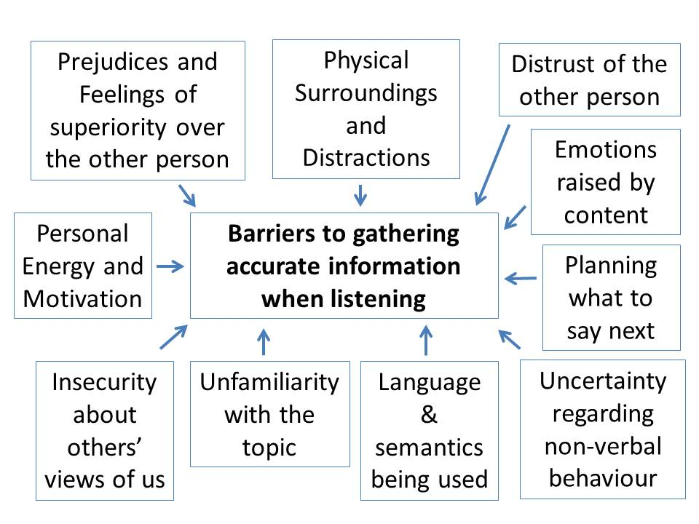
Active Listening: being aware of barriers

Slide 20
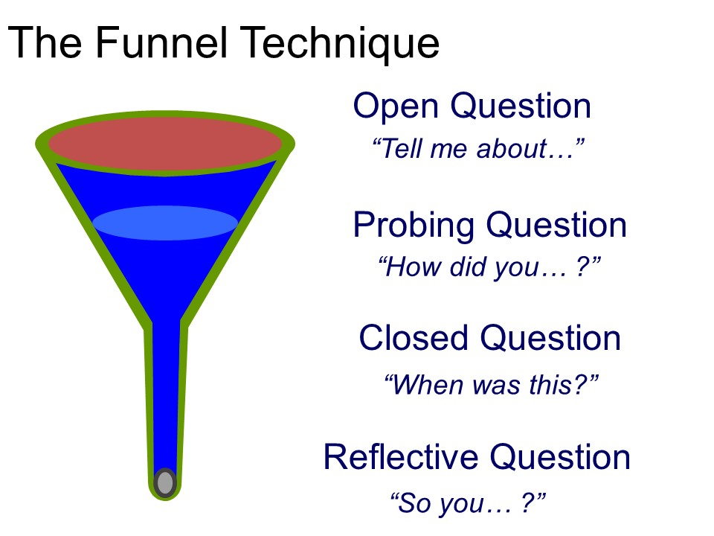
Using questions to build relationships
Questions in conversation…
Notes:
Keeping asking questions to funnel down to get to the answer – Talk through the guidance below and ask the group to test it with each other by asking about their weekends.
Open Questions:
Start with broad, open-ended questions to encourage detailed responses and set a comfortable tone. Use words like who, what, when, where, why, tell, explain, describe to begin these questions
Probing Questions:
Listen carefully to the initial answer and ask follow-up questions that dig deeper into specific points mentioned. These questions should be based on the interviewee’s previous answer and help you gather more detail or clarify understanding
Closed Questions:
End with a closed question to confirm your understanding or clarify a specific detail. These questions typically lead to a “yes” or “no” answer and help wrap up the conversation or topic

Slide 21
Communicating Tactfully
Check any assumptions.
Reframe and purpose of the conversation.
Use the ‘passive voice’ and ‘active voice’ appropriately.
Use a ‘praise sandwich’.
Watch your language.
Be clear about consequences.
Assume good intentions.
Avoid emotion during a conversation.
Ensure there are no surprises.
Leave the conversation on a positive note.
Listen well – avoid interrupting.
Notes:
Link this to the session on Conflict on Week 3.

Slide 22

Case study
Read the case study on Moodle and answer the following questions in groups or pairs:
What were the main communication barriers face by the TechNova project team at the beginning of the project?
List three strategies the project manager implemented to improve team communication.
How did clarifying roles and responsibilities help the team and why is it important?
What lessons can be applied your own academic teams?

Slide 23
Have you started forming teams?
How many of you have sent information to fellow students who have been absent?
How many have offered support those who are struggling?
How many of you have worked closely with other students?
You may never be truly interdependent but you are probably exhibiting some traits of a team

Slide 24
Roles
Everyone working within a team acquires a role (whether consciously or not)
Some people like to lead
Others prefer to be more passive participants
Defining roles, along with a clear goal, is an important strategy for creating a successful teamwork environment
Clearly defined goals, matched with specific tasks, will help team members decide which role is best suited to their personality and abilities

Slide 25

Presentation preparation

Slide 26
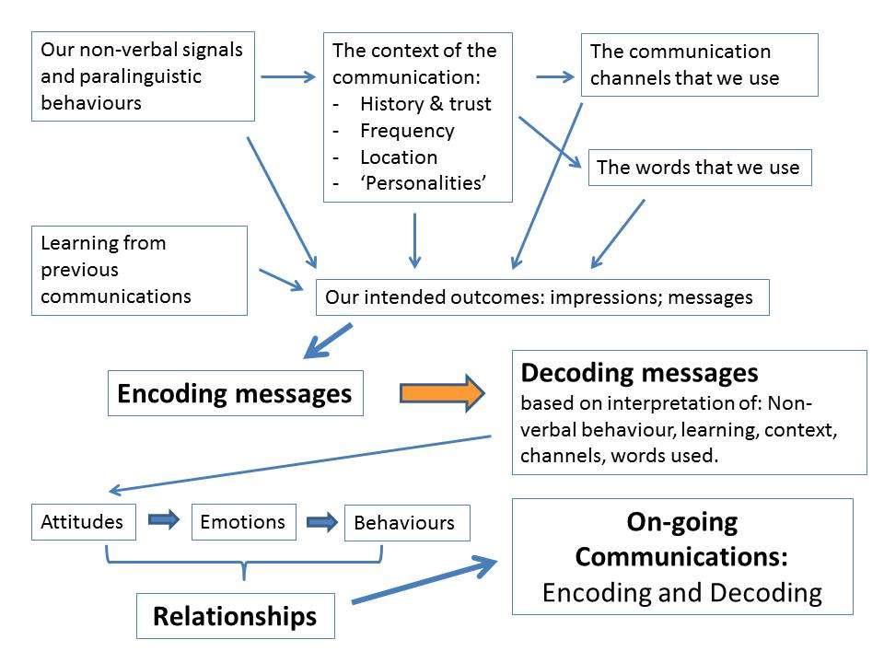
In Conclusion – Communication is Complicated!

Slide 27
Any questions?

