Slide 1
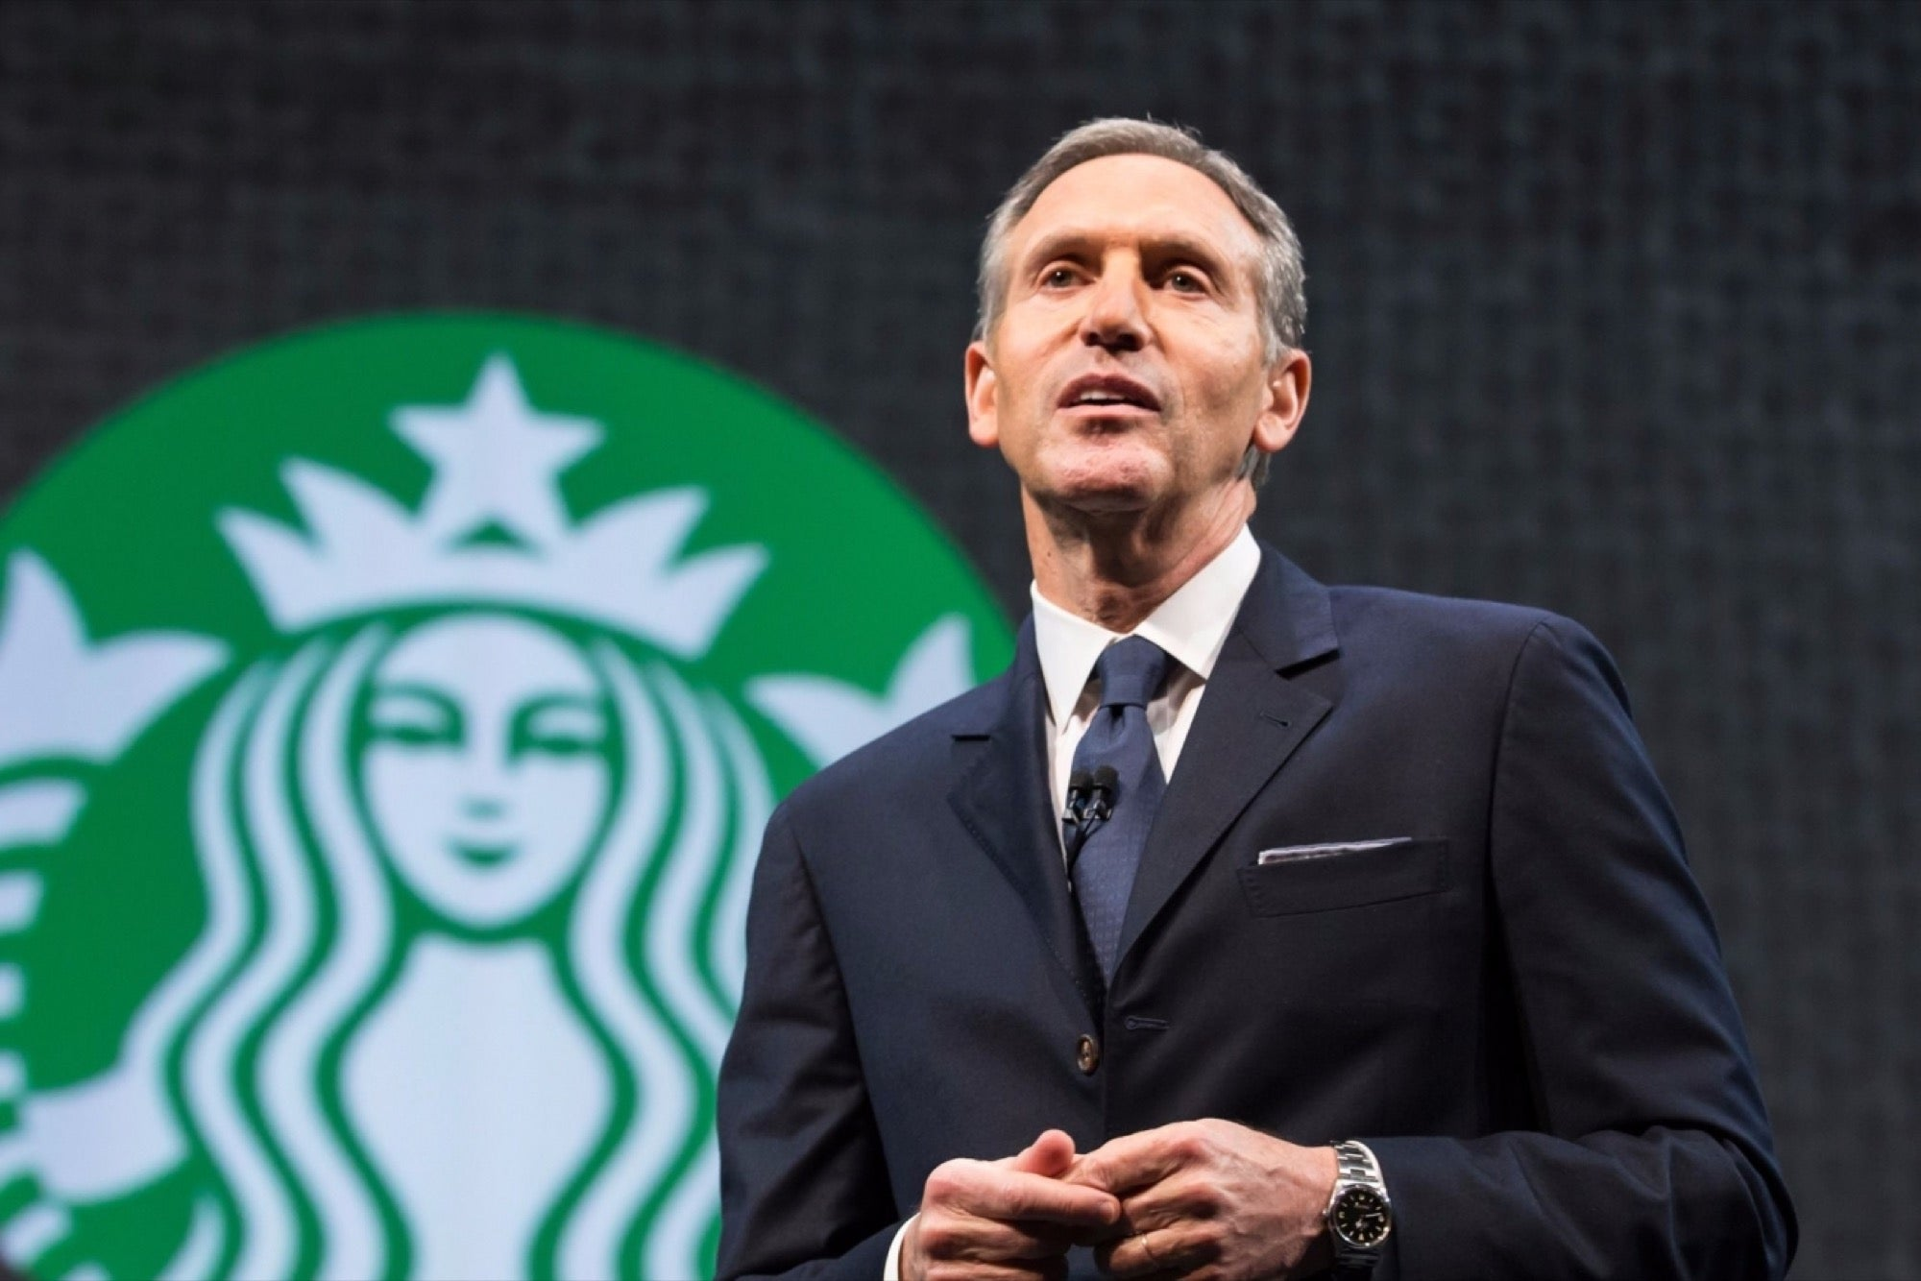
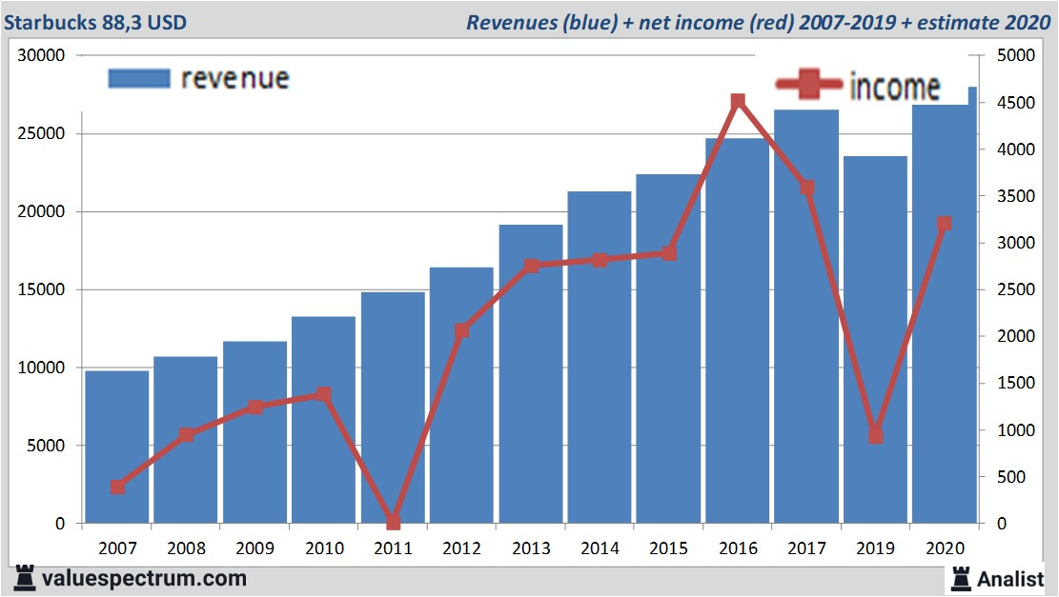
ENTREPRENEURSHIP OF HOWARD SCHULTZ AT STARBUCKS
Introduction
The process of starting, managing, and profiting from an innovative company without taking on financial danger is referred to as entrepreneurship.
Mark Zuckerberg and Bill Gates, demonstrated that a new business owner with a lucrative business idea may earn millions or even billions of dollars (Olanrewaju et al., 2020)
Entrepreneurship involves the process of establishing, running, and making a profit from a new business while taking on financial risk. Entrepreneurship refers to the practice of working for oneself, allowing employees to set their own hours and location. According to Olanrewaju et al., (2020), as some of the most successful business people like Mark Zuckerberg and Bill Gates have shown, a beginning business owner with a profitable business idea can make millions or billions of dollars. Without the burden of bureaucracy inherent in large, well-established companies, entrepreneurs can approach challenges creatively and experiment regularly.
Introduction of Business
Seattle, Washington-based Starbucks is a well-known international network of coffee shops, (Battle et al., 2023)
As the company's CEO, Howard Schultz had a big influence on how Starbucks came to be known as an iconic brand
In 1982, Schultz became a member of the Starbucks team and had the idea of building a community meeting spot that was influenced by Italian coffeehouse tradition, (Logan, 2022)
Under Schultz's direction, Starbucks expanded quickly and completely changed what it meant to visit a coffee shop in America.
The green mermaid emblem, used to identify Starbucks establishments, is spread over the world, (Logan, 2022)
Starbucks is a well-known network of coffee shops with a reputation for serving high-quality coffee and providing outstanding customer service. The firm was established in 1971 in Seattle, Washington, and has expanded from a single site to a huge global network with thousands of locations (Battle et al., 2023). Starbucks started out with the goal of giving consumers the best possible coffee, procuring beans from all over the world, and roasting them to perfection. However, Schultz (2022) reported that Starbucks only became the recognisable brand it is now because of Howard Schultz's business leadership.
In spite of the fact that Schultz's vision for the business extended beyond only making and selling coffee, he joined Starbucks in 1982 as the Director of Operations and Marketing (Fariss, 2021). Schultz recognised an opportunity to establish a gathering spot where individuals could take advantage of not just great coffee but also a sense of community after being inspired by the colourful coffeehouse culture he experienced while travelling across Italy. In order to replicate the atmosphere of an Italian café, Schultz established his own coffee company, Il Giornale, in 1985 (Logan, 2022). In just two years, Il Giornale bought Starbucks and started using its name, making Schultz's idea a reality (Battle et al., 2023).
Due to Schultz's entrepreneurial spirit, novel ideas were introduced, including the ability to tailor beverages to specific tastes and the idea of the "third place," a welcoming area where people could unwind and mingle between their homes and places of employment. Customers responded favourably to these ideas, and Starbucks grew exponentially, quickly spreading out throughout the United States and finally becoming global (Schultz, 2022). Starbucks is now more than simply a location to get a cup of coffee; it is a phenomenon in society. With its distinctive green mermaid emblem, the company's boutiques have become recognisable landmarks in towns all over the world. Starbucks keeps evolving and adapting to shifting consumer tastes by launching new products, growing its menu to include a range of drinks and foods, and adopting technological advancements to improve the customer experience. Starbucks' business path has revolutionised the coffee industry and produced a worldwide brand that stands for more than simply a cup of coffee owing to Howard Schultz's vision and passion (Logan, 2022). In a welcoming and welcoming setting, it serves as a location where people can interact, engage, and enjoy a quality coffee experience.
Impact Skills and Abilities and Motives
Encouragement of meaningful work
Being the CEO of Starbucks, Howard Schultz not only delegates responsibilities, the person even oversees the entire team.
Howard Schultz makes sure that the environment of the workplace is suitable so that employees can work in an effective manner (Ali and Anwar, 2021.).
Along with that, Howard Schultz motivates employees and even inspires them so that they work hard and get rewarded for their hard work (Mansaray, 2019).
The local small businesses were inspired the most due to the motivating speeches of Howard Schultz.
The global people that were planning to do their businesses were also motivated.
In order to encourage the employees, Howard Schultz makes their current role more challenging so that they can be passionate about their work (Putri and Gde, 2021). The person observed that when the staff gets the scope to work which excites them as well as permits them to cultivate new skills and abilities, the employees get passionate about the work (Dehghanan et al., 2021). This not only enhances the productivity of the employees, it even improves their morale. As the person was inspiring, he was able to inspire both the global as well as the local people through his motivating speeches.
Making an open work culture
Howard Schultz being the CEO of Starbucks, created an open culture for their employees within the enterprise so that they can exchange skills with each other.
Any leader needs to have the ability to make their employees feel comfortable in their workplace (Ali and Anwar, 2021).
Open culture is effective as it enhances the rate of willingness to learn new things and at the same time promotes honesty and transparency (Putri and Gde, 2021).
If employees can openly communicate with each other then the productivity of the employees can increase and this can in turn increase the overall productivity of the company (Mansaray, 2019). If the fear of judgements gets diminished among the employees then exchange of ideas and opinions can be done in an effective manner (Dehghanan et al., 2021). Apart from fostering innovation, open work culture boosts the engagement rate of the employees which aids firms to make a collaborative team which is strong.
Improvises the decision making process
The role of an effective leader is to analyse any complex situation and implement decisions accordingly keeping in mind the weight of the outcome of the informed decision (Dehghanan et al., 2021).
It has been observed that Howard Schultz, with the ability to implement effective decisions, makes sure that in the process of decision making, employees can present their point of view and increase the value of the company with their innovative ideas (Ali and Anwar, 2021).
In this way a critical problem can be easily solved within any hustle.
This not only makes a better decision making process, this even leads to empowering employees so that they can excel in their work (Mansaray, 2019). Along with that, as the CEO of Starbucks has successfully made a strong workplace culture which essentially fosters positive relations, this reinforces the values of the organisation and highlights them (Romdhoni et al., 2020). This leads to better engagement of employees in the workplace, which in turn enhances the rate of innovative ideas within the workplace of an organisation. Employees need to learn the various ways to think in a critical manner and then resolve the issue that is taking place.
Decreases the rate of mistakes
In order to minimise the rate of mistakes in a workplace, an efficient leader must be capable of guiding the employees on the right track. In this way, a business can run smoothly.
During the time of high-pressure, employees need to learn the various ways to handle them in an effective manner (Chang, 2020). This is because mistakes in the workplace can lead to serious consequences.
It is the duty of a responsible leader to recognise the potential issues and make sure that they are avoided at any cost.
This not only increases the efficiency rate among the employees, in this way, a leader can be productive. It is the role of a leader to ensure that employees are working to attain the goal of the company (Pérez-Morón et al., 2020). Howard Schultz in this matter provides guidance and direction to employees, delegates tasks so that the strengths of employees can be enhanced (Chang, 2020). In this way Starbucks can earn more profit and at the same time meet the expectation level of employees (Romdhoni et al., 2020). When the employees’ mistakes are reduced, they can get a chance to learn new things and implement them for the betterment of the company.
Improve communication
It has been observed that it is the duty of an effective leader to improve the way employees communicate with each other so that the task can be executed in an effective manner (Azriuddin et al., 2020).
It has been taken into account that ladders generally have a profound impact on the entire work environment.
This helps in creating a work atmosphere where employees can freely exchange thoughts and ideas through effective means of communication (Pérez-Morón et al., 2020).
By communicating in an effective manner, leaders make sure that concise and clear communication is taking place in the workplace.
Effective means of communication leads to an inclusive work environment which is open for creativity (Azriuddin et al., 2020). Along with that, Starsbucks needs to make sure that their work culture is encouraging and it welcomes the ideas of the employees so that they can be encouraged and so that misunderstandings can be avoided (Lee et al., 2022). This in turn can improve the rate of productivity and help Starbucks in generating more revenue. In an organisation, if the employees are motivated then they can execute the work in an effective manner which can be helpful for the organisation (Romdhoni et al., 2020). It is important that leaders like Howard Schultz set an effective example for others so that employees strived hard to achieve success (Lee et al., 2022). Leaders need to inspire other employees so that they can work hard and the leaders must instill team collaboration.
Introduction of Entrepreneur
Howard D. Schultz began his career in sales for Xerox around New York City before being chosen in 1979
Howard D. Schultz, a successful American author, and businessman, served as chairman and CEO of Starbucks.
Schultz began working for Starbucks in 1982. Under Schultz (Le et al., 2022).
Schultz temporarily left Starbucks to open his personal Il Giornale coffee shops but returned as CEO in August 1987 to help local investors buy Starbucks
An entrepreneur was defined as a person who has the skills, drive, and willingness to take the risk needed to found, run, and succeed in a starting business. The best example of entrepreneurship was the beginning of a new business enterprise. An individual who possesses the knowledge, zeal, and capacity to take calculated hazards necessary to launch, manage, and succeed in a new firm is referred to as an entrepreneur. The launch of an entirely novel company is the best illustration of entrepreneurship. Howard D. Schultz, a successful American author, and businessman, served as chairman and CEO of Starbucks. Schultz began working for Starbucks in 1982. Under Schultz, the company established a huge network of locations that affected Seattle's local and international coffee culture (Le et al., 2022). During the span of four decades, the visionary businessman Howard Schultz founded Starbucks. One of the more well-known and admired businesses in the world, Starbucks is committed to improving neighborhoods through innovation and interpersonal connections. After striking important distribution deals, Starbucks expanded into the biggest collection of coffee shops in the world. After getting his degree, Schultz stayed in Michigan and spent a year teaching at a ski resort. He began his career in sales for Xerox around New York City before being chosen in 1979 to lead the American subsidiary of Swedish cookware manufacturer PAI Partners (Kusumo et al., 2020). While managing the business's American operations in 1981, Schultz visited the Starbucks Coffee Organisation in Seattle. Several years later, in 1983, Howard traveled to Italy and developed a love for the country's coffee houses and the personal nature of the coffee experience. His objective was to bring the tradition of the Italian coffeehouse to America. He tried to create a setting that promoted social interaction, communication, and an awareness of belonging in order to close the gap between work and home (Nathwani et al., 2021). Schultz temporarily left Starbucks to open his personal Il Giornale coffee shops but returned as CEO in August 1987 to help local investors buy Starbucks.
Conclusion (reflection)
Starbucks has become a distinctive coffeehouse because to Schultz's ability to see possibilities and think imaginatively.
Starbucks' success was driven by his continuing passion for coffee and dedication to establishing a feeling of community, (Sood, 2022)
Starbucks' continued relevance was made possible by Schultz's flexibility and adoption of cutting-edge ideas like beverage personalisation.
Starbucks' impact goes beyond financial support, spurring a movement towards ethical corporate practises.
The entrepreneurial path of Schultz is a prime example of how entrepreneurship can spur economic growth and inspire constructive change, (Ofori et al., 2023)
When one considers Howard Schultz's entrepreneurial skills and motives and their effect on Starbucks, it becomes clear that he possesses the essential traits needed to establish a successful business enterprise and have a substantial impact on the regional and worldwide economy.
Starbucks had a major transition as a result of Schultz's aptitude to spot possibilities and think creatively. Schultz tapped into an unexplored market and created a distinctive value proposition by realising the possibility of developing a coffeehouse experience that went beyond the simple consumption of coffee (Sood, 2022). An essential entrepreneurial talent that helps people to spot market gaps and develop creative solutions is the capacity to recognise opportunities where others might not. Entrepreneurship also requires motivation, and Schultz's enduring love of fine coffee and desire to foster a feeling of community were the inspirations for Starbucks' success (Kusumo et al., 2020). His dedication to providing excellent client experiences influenced the company's culture and gave its staff members a sense of purpose. Successful entrepreneurs have a strong drive to go above and beyond in providing value to clients.
The significance of flexibility and creativity is also demonstrated through Schultz's business career. He understood that businesses must adapt to shifting consumer demands and market dynamics. Starbucks was able to change course and offer novel ideas, such as beverage personalisation and the idea of a "third place," which helped to keep the company at the forefront of the sector and secure its ongoing relevance (Schultz, 2022). Entrepreneurs must have the ability to adapt to change and innovate constantly to be competitive in a changing business environment. Additionally, Starbucks' impact goes beyond financial contributions. The dedication of Schultz to sustainability and CSR has served as a model for other companies (Ofori et al., 2023). Starbucks has sparked a trend towards more socially responsible company practises by emphasising ethical sourcing, community involvement, and environmental efforts. This cascading impact encourages beneficial change in the economic environment and advances society.
In conclusion, Howard Schultz's entrepreneurial skills and motives were crucial in making Starbucks a worldwide sensation and had a big influence on both the domestic and international economies. Starbucks is now more than simply a coffee company because to his ability to spot possibilities and his unwavering enthusiasm, agility, and dedication to social responsibility. It now stands for excellence, innovation, and progress. The path of Schultz demonstrates the ability of entrepreneurship to spur economic growth, provide job possibilities, and usher in a new era of socially responsible corporate practises.

Slide 2
Reference List
Ali, B.J. and Anwar, G., 2021. Administrative crisis: The role of effective leadership styles in crisis management. Ali, BJ, & Anwar, G.(2021). Administrative Crisis: The Role of Effective Leadership Styles in Crisis Management. International Journal of Advanced Engineering, Management and Science, 7(6), pp.31-41.
Azriuddin, M., Kee, D.M.H., Hafizzudin, M., Fitri, M., Zakwan, M.A., AlSanousi, D., Kelpia, A. and Kurniawan, O., 2020. Becoming an international brand: A case study of Starbucks. Journal of The Community Development in Asia, 3(1), pp.33-43.
Battle, A., Lally, M. and Sorensen, K., 2023. Starbucks Corporation: Fighting Unionization in Coffee Houses. The Eugene D. Fanning Center for Business Communication, Mendoza College of Business, University of Notre Dame.
Chang, W.J., 2020. Experiential marketing, brand image and brand loyalty: a case study of Starbucks. British Food Journal, 123(1), pp.209-223.
Dehghanan, H., Gheitarani, F., Rahimi, S. and Nawaser, K., 2021. A systematic review of leadership styles in organizations: Introducing the concept of a task-relationship–change leadership network. International Journal of Innovation and Technology Management, 18(07), p.2130007.
Fariss, N., 2021. Starbucks’ Dream of a Global Taste. In The Routledge Handbook of Digital Media and Globalization (pp. 100-110). Routledge.
Howard Schultz (2019) Starbucks Stories. Available at: https://stories.starbucks.com/leadership/howard-schultz/ (Accessed: 01 July 2023).
Kusumo, E., Anita, T.L. and Anggiani, S., 2020. Corporate Language as Corporate Strategy to Sustainable Brand in Indonesia (Case of Starbuck Language). In Culture, People and Technology: The Driving Forces for Tourism Cities Proceedings of 8th ITSA Biennial Conference 2020 (p. 256).
Le, T.T., 2022. The competitive advantage of serendipity in the case of Starbucks and Howard Schultz.
Lee, W.S., Jung, J. and Moon, J., 2022. Exploring the antecedents and consequences of the coffee quality of Starbucks: a case study. British Food Journal, 124(4), pp.1066-1080.
Logan, J., 2022, September. High-Octane Organizing at Starbucks. In New Labor Forum (Vol. 31, No. 3, pp. 36-42). Sage CA: Los Angeles, CA: SAGE Publications.
Mansaray, H.E., 2019. The role of leadership style in organisational change management: a literature review. Journal of Human Resource Management, 7(1), pp.18-31.
Nathwani, Y. and Hartalkar, I., 2021. Starbucks: Coffee Shop or Unregulated Bank?. International Journal of Research in Engineering, Science and Management, 4(11), pp.89-91.
Ofori, E.K., Ali, E.B., Gyamfi, B.A. and Agbozo, E., 2023. Taking stock of business strategy and environment (sustainable development): evidence of disparities in research efforts and knowledge gaps—a bibliometric review. Environmental Science and Pollution Research, pp.1-19.
Olanrewaju, A.S.T., Hossain, M.A., Whiteside, N. and Mercieca, P., 2020. Social media and entrepreneurship research: A literature review. International Journal of Information Management, 50, pp.90-110.
Pérez-Morón, J., Madan, S., Cheu, J.Y., Kee, D.M.H., Cheong, L.C., Chin, R., Cheng, J. and García, A.P.M., 2022. Effect of service quality and customer satisfaction on customer loyalty: A case study of Starbucks in Malaysia. International journal of tourism and hospitality in Asia Pasific (IJTHAP), 5(1), pp.62-74.
Putri, W.R.I.A. and Gde, S.I.P., 2021. The role of brand love mediates the influence of brand experience and self-expressive brand on brand loyalty: a case study on Starbucks consumers in Denpasar. Russian Journal of Agricultural and Socio-Economic Sciences, 114(6), pp.182-189.
Romdhoni, M., Hasiholan, L.B. and Amboningtyas, D., 2020. An awareness and analysis consumer perception of application of green marketing Starbucks (Case study at Starbucks in Java Mall Semarang). Journal of Management, 6(1).
Schultz, H., 2022. The competitive advantage of serendipity in the case of Starbucks and.
Sood, G., 2022. Troll Proof Branding in the Age of Doppelgangers. SAGE Publishing India.

