Slide 1

MSc Public Health and Social Care in Practice
Module Code: LCHS7000
Module: Social Epidemiology and Public Health Development
Assignment Title: "Know It. Own It. Protect It: A Sexual Health Awareness Campaign for Young People"
Target Age Group: 15-24
Lecturer: Itse Olaoye
Name | I.D. | Slide Presented
MD MOTIUR RAHMAN | 2518275 | Task-1
Jahanvi sodha | 2530085 | Task-2
Yash kapadiya | 2518277 | Task-3
Presentation Date: 09th March 2026

Slide 2
TASK -1
MD MOTIUR RAHMAN
ID NO: 2518275

Slide 3

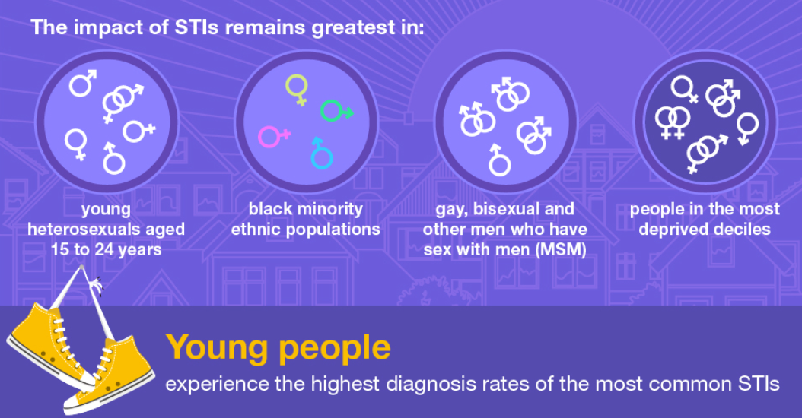
Introduction
Sexual health is an important aspect of overall wellbeing, particularly among young people.
In the United Kingdom, individuals aged 15–24 experience the highest rates of sexually transmitted infections (STIs), making sexual health promotion (UK Health Security Agency, 2024).
In 2023, around 402,000 new STI diagnoses were recorded in England (House of Commons Library, 2024).
Notes:
Introduction:
Sexual health is a significant factor of general wellbeing, especially to youth. Sexually transmitted infections (STIs) are the most common among people between the ages of 15 - 24 in the United Kingdom, and sexual health promotion is the most important public health agenda (UK Health Security Agency, 2024). STIs are estimated to have 402,000 new diagnoses in England in 2023, with chlamydia and gonorrhoea being the most typical ones (House of Commons Library, 2024). Having poor sexual health may cause severe outcomes such as infertility, pelvic inflammatory disease and health disparities. Thus, sensitisation programmes for the youth are meant to enhance knowledge and promote safe practices and responsible decision-making when it comes to sexual health.

Slide 4


Rationale for the campaign
Young people aged 15–24 experience the highest rates of Sexually Transmitted Infections in England (UK Health Security Agency, 2024).
In 2023, more than 400,000 new STI diagnoses were reported in England (House of Commons Library, 2024).
Lack of accurate sexual health knowledge and low condom use increase risks of infections and unplanned pregnancy among young adults (World Health Organization, 2023).
Health promotion campaigns can encourage safer behaviours (NHS England, 2023).
Notes:
Rationale for the campaign:
Young people aged 15–24 experience the highest rates of Sexually Transmitted Infections in England, accounting for nearly half of new STI diagnoses (UK Health Security Agency, 2024).
In 2023, more than 400,000 new STI diagnoses were reported in England, highlighting the need for preventive sexual health education and awareness among young people (House of Commons Library, 2024).
Lack of accurate sexual health knowledge and low condom use increase risks of infections and unplanned pregnancy among young adults (World Health Organization, 2023).
Health promotion campaigns can encourage safer behaviours, including testing, contraception use and informed decision-making, improving long-term public health outcomes (NHS England, 2023).

Slide 5
National Guidelines in UK for Younge People (Age 15-24)
Chlamydia Testing Coverage (%)
Guideline Target 🟩🟩🟩🟩🟩🟩🟩🟩🟩🟩🟩🟩🟩🟩🟩🟩🟩🟩🟩🟩 100%
Actual (2024) 🟥🟥🟥🟥 18%
Detection Rate (per 100,000)
Guideline Target 🟦🟦🟦🟦🟦🟦🟦🟦🟦🟦🟦🟦🟦🟦🟦🟦🟦🟦🟦🟦 3250
Actual (2024) 🟨🟨🟨🟨🟨🟨🟨🟨🟨🟨 1589
Total Chlamydia Tests
Actual (2024) 🟪🟪🟪🟪🟪🟪🟪🟪🟪🟪🟪🟪🟪🟪🟪🟪 601,295
STI Diagnoses (Age 15–24)
Actual (2024) 🟧🟧🟧🟧🟧🟧🟧🟧🟧🟧🟧🟧 135,965
Sexual Health Statistics (Young People 15-24)
Notes:
Graph Explanation:
The chart contains major sexual health statistics about youths between the ages of 15 and 24 in England and makes comparisons with national guidance. It demonstrates that the current guideline issue regarding chlamydia testing coverage is 100%, whereas the current testing level in 2024 is 18%, which means minimal engagement in screening. On the same note, the suggested chlamydia detection is 3,250 per 100,000 individuals, whereas the actual detection is 1,589 per 100,000. The chart also shows that 601,295 chlamydia tests were done and 135,965 STI diagnoses in young people were registered. On the whole, the statistics indicate that the prevalence of the screening is lower than national targets, which indicates the necessity of the enhancement of sexual health education and testing programmes (UK Health Security Agency, 2024).

Slide 6
Short-Term and Long-Term Consequences of Poor Sexual Health Habits
Short-term — daily life (examples):
Increased risk of Sexually Transmitted Infections such as chlamydia and gonorrhoea (NHS England, 2023).
Emotional stress, anxiety, and relationship conflicts (World Health Organization, 2023).
Unplanned pregnancy that can disrupt education, employment, and daily life responsibilities (NHS England, 2023).
Long-term — future (examples):
Untreated STIs may lead to infertility or pelvic inflammatory disease, affecting future reproductive health (UK Health Security Agency, 2024).
Higher healthcare costs and long-term health complications (WHO, 2023).
Increased risk of chronic reproductive health problems and complications during future pregnancies (UKHSA, 2024).
07
Notes:
Short-term and long-term consequences of poor habits:
Short-term consequences (daily life):
Increased risk of Sexually Transmitted Infections such as chlamydia and gonorrhoea due to unprotected sex, causing symptoms like pain or discharge (NHS England, 2023).
Emotional stress, anxiety, and relationship conflicts resulting from fear of infection or unplanned pregnancy (World Health Organization, 2023).
Unplanned pregnancy that can disrupt education, employment, and daily life responsibilities (NHS England, 2023).
Long-term consequences (future impact):
Untreated STIs may lead to infertility or pelvic inflammatory disease, affecting future reproductive health (UK Health Security Agency, 2024).
Higher healthcare costs and long-term health complications if infections remain untreated (WHO, 2023).
Increased risk of chronic reproductive health problems and complications during future pregnancies (UKHSA, 2024).

Slide 7

Three key, measurable aim
Aim 1 — Increase sexual health knowledge:
Goal: Increase sexual health knowledge among young people (16–24) by delivering education sessions and digital awareness content, measured through pre- and post-campaign surveys (NHS England, 2023).
Aim 2 - Increase condom:
Goal: Increase condom use among sexually active young people by promoting safe-sex practices and distributing free condoms through youth centres (UK Health Security Agency, 2024).
Aim 3 – Encourage regular STI testing:
Goal: Encourage regular STI testing among young adults by raising awareness about free testing services and confidential clinics (World Health Organization, 2023).
Notes:
Three key, measurable aim:
Increase sexual health knowledge among young people (16–24) by delivering education sessions and digital awareness content, measured through pre- and post-campaign surveys showing improved understanding of safe sex and STI prevention (NHS England, 2023).
Increase condom use among sexually active young people by promoting safe-sex practices and distributing free condoms through youth centres and clinics; success measured through self-reported behaviour change and service uptake (UK Health Security Agency, 2024).
Encourage regular STI testing among young adults by raising awareness about free testing services and confidential clinics, measured by increased attendance at sexual health clinics (World Health Organization, 2023).

Slide 8
Benefits of Achieving These Aims
Improved knowledge supports informed decision-making and healthier sexual behaviours among young people (WHO, 2023).
Increased condom use and STI testing can significantly reduce transmission of infections such as Chlamydia and Gonorrhoea (UKHSA, 2024).
Profit
Notes:
Benefits of Achieving These Aims:
Improved knowledge supports informed decision-making and healthier sexual behaviours among young people (WHO, 2023).
Increased condom use and STI testing can significantly reduce transmission of infections such as Chlamydia and Gonorrhoea (UKHSA, 2024).

Slide 9
TASK -2
Jahanvi sodha
ID-2530085

Slide 10
Types of Evaluation and Measurement of Campaign Aims
1. Process Evaluation (Implementation of the campaign)
Process evaluation examines how effectively the campaign activities were delivered (World Health Organization, 2023).
Achievement can be measured by the number of young people attending sessions
2. Impact Evaluation (Short-term behaviour change)
Impact evaluation measures immediate changes in knowledge, attitudes, and behaviours (NHS England, 2023).
This can be assessed through pre- and post-campaign surveys, increased condom uptake (NHS England, 2023).
3. Outcome Evaluation (Long-term results)
Outcome evaluation assesses long-term improvements in public health outcomes (UK Health Security Agency, 2024).
Measurement methods include sexual health clinic data (UKHSA, 2024).
4. Cost-effectiveness Evaluation (Resource efficiency)
This evaluation assesses whether campaign resources were used efficiently to achieve health outcomes (WHO, 2023).
Measurement includes comparing campaign costs with improvements in testing rates, condom uptake, and reductions in STI cases.
5. Behavioural Evaluation (Behaviour change monitoring)
Behavioural evaluation assesses whether participants adopt safer sexual behaviours (NHS England, 2023).
Measurement methods include clinic records, condom distribution tracking, and follow-up questionnaires.
Notes:
Types of Evaluation and Measurement of Campaign Aims:
1. Process Evaluation (Implementation of the campaign)
Process evaluation examines how effectively the campaign activities were delivered, including workshops, social media awareness, and distribution of condoms (World Health Organization, 2023).
Achievement can be measured by the number of young people attending sessions, engagement on social media, and distribution records of educational materials (WHO, 2023).
2. Impact Evaluation (Short-term behaviour change)
Impact evaluation measures immediate changes in knowledge, attitudes, and behaviours among the target group after the campaign (NHS England, 2023).
This can be assessed through pre- and post-campaign surveys, increased condom uptake, and greater awareness of STI prevention among young people (NHS England, 2023).
3. Outcome Evaluation (Long-term results)
Outcome evaluation assesses long-term improvements in public health outcomes such as reduced Sexually Transmitted Infections among young people (UK Health Security Agency, 2024).
Measurement methods include sexual health clinic data, increased STI testing rates, and reduced infection diagnoses over time (UKHSA, 2024).
4. Cost-effectiveness Evaluation (Resource efficiency)
This evaluation assesses whether campaign resources were used efficiently to achieve health outcomes (WHO, 2023).
Measurement includes comparing campaign costs with improvements in testing rates, condom uptake, and reductions in STI cases.
5. Behavioural Evaluation (Behaviour change monitoring)
Behavioural evaluation assesses whether participants adopt safer sexual behaviours such as regular STI testing or condom use (NHS England, 2023).
Measurement methods include clinic records, condom distribution tracking, and follow-up questionnaires.

Slide 11

The Poster Image
Notes:
Poster:
The poster for “Know It. Own It. Protect It: A Sexual Health Awareness Campaign for Young People” aims to promote awareness and responsible sexual behaviour among young people aged 16–24. The poster highlights key campaign activities such as educational workshops, free condom distribution, and information about confidential sexual health testing services. These activities encourage young people to make informed decisions and adopt safer behaviours to prevent Sexually Transmitted Infections and unplanned pregnancies. Health promotion campaigns like this are important because education and access to services improve sexual health knowledge and reduce infection risks among young adults (NHS England, 2023; World Health Organization, 2023).

Slide 12



Potential Partner and Their Aims
1. Barnardo’s – Sexual Health Services (UK):
Barnardo’s is a UK-based children’s charity that works locally to support young people, including sexual health education and safeguarding services.
Aim: To educate young people about sexual health, increase access to testing, and reduce risky sexual behaviours through community-based interventions.
Notes:
1. Local Partner: Barnardo’s – Sexual Health Services (UK):
Description: Barnardo’s is a UK-based children’s charity that works locally to support young people, including sexual health education and safeguarding services. They run workshops, one-to-one support, and outreach programs to raise awareness about STIs, consent, and healthy relationships.
Aim: To educate young people about sexual health, increase access to testing, and reduce risky sexual behaviours through community-based interventions (Barnardo’s, 2023).

Slide 13


Potential Partner and Their Aims
2. National Partner: FPA (Family Planning Association, UK)
FPA is a national organisation providing sexual health education, advice, and resources across the UK (FPA, 2023).
Aim: To improve sexual health knowledge and promote safe, responsible sexual behaviours among young people nationwide
Notes:
Potential Partner and Their Aims :
2. National Partner: FPA (Family Planning Association, UK)
Description: FPA is a national organisation providing sexual health education, advice, and resources across the UK. They focus on contraception, STI prevention, and informed decision-making for young adults.
Aim: To improve sexual health knowledge and promote safe, responsible sexual behaviours among young people nationwide (FPA, 2023).

Slide 14

Replicable Resources
Educational workshops and interactive sessions for young people, focusing on STIs, consent, and healthy relationships (Barnardo’s, 2023).
Printed materials and leaflets, such as guides on contraception, STI prevention, and sexual wellbeing (FPA, 2023).
Social media campaigns and online resources, including infographics, videos, and quizzes to engage digitally active youth (UK Health Security Agency, 2024).
Free condom distribution and access to sexual health clinics, encouraging safer sexual behaviours and testing uptake (NHS England, 2023).
Helplines and confidential support services providing advice and information on sexual health concerns (FPA, 2023).
Notes:
Replicable Resources:
Educational workshops and interactive sessions for young people, focusing on STIs, consent, and healthy relationships (Barnardo’s, 2023).
Printed materials and leaflets, such as guides on contraception, STI prevention, and sexual wellbeing (FPA, 2023).
Social media campaigns and online resources, including infographics, videos, and quizzes to engage digitally active youth (UK Health Security Agency, 2024).
Free condom distribution and access to sexual health clinics, encouraging safer sexual behaviours and testing uptake (NHS England, 2023).
Helplines and confidential support services providing advice and information on sexual health concerns (FPA, 2023).

Slide 15
TASK -3
Yash kapadiya
ID-2518277

Slide 16




Challenges of Changing Sexual Health Behaviour
1.Physiological Challenges:
2. Sociological Challenges:
Fear of testing procedures or misunderstanding about symptoms of Sexually Transmitted Infections may discourage young people from regular screening (NHS England, 2023).
Limited access to youth-friendly sexual health services may also act as a social barrier (WHO, 2023).
Notes:
Challenges of Changing Sexual Health Behaviour:
1.Physiological Challenges:
Fear of testing procedures or misunderstanding about symptoms of Sexually Transmitted Infections may discourage young people from regular screening (NHS England, 2023).
2. Sociological Challenges:
Limited access to youth-friendly sexual health services may also act as a social barrier (WHO, 2023).

Slide 17

Challenges of Changing Sexual Health Behaviour
3. Psychological Challenges
Anxiety, low confidence in negotiating condom use, and fear of judgment can discourage behaviour change (WHO, 2023).
Misconceptions about personal risk may lead individuals to underestimate the need for protection (NHS England, 2023).
Notes:
Challenges of Changing Sexual Health Behaviour:
3. Psychological Challenges:
Anxiety, low confidence in negotiating condom use, and fear of judgment can discourage behaviour change (WHO, 2023).
Misconceptions about personal risk may lead individuals to underestimate the need for protection (NHS England, 2023).

Slide 18


Benefits of Adopting Safer Sexual Health Behaviours
1. Physiological Benefits:
Reduced risk of contracting Sexually Transmitted Infections such as chlamydia and gonorrhoea (UK Health Security Agency, 2024).
Lower likelihood of unplanned pregnancies, supporting reproductive health (NHS England, 2023).
Notes:
Benefits of Adopting Safer Sexual Health Behaviours:
1. Physiological Benefits:
Reduced risk of contracting Sexually Transmitted Infections such as chlamydia and gonorrhoea (UK Health Security Agency, 2024).
Lower likelihood of unplanned pregnancies, supporting reproductive health (NHS England, 2023).

Slide 19



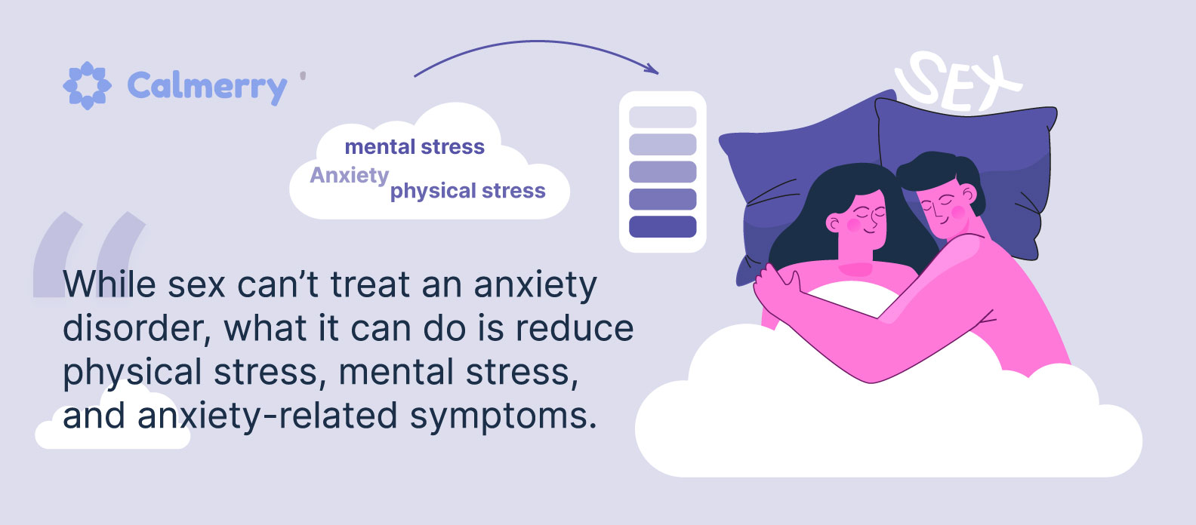
Benefits of Adopting Safer Sexual Health Behaviours
2. Sociological Benefits:
Improved relationships and communication through responsible sexual behaviour and respect for partners (WHO, 2023).
Reduced burden on healthcare systems and communities due to fewer STI cases (UKHSA, 2024).
3. Psychological Benefits:
Increased confidence and reduced anxiety regarding sexual activity (FPA, 2023).
Greater sense of personal responsibility and empowerment in decision-making (WHO, 2023).
Notes:
Benefits of Adopting Safer Sexual Health Behaviours:
2. Sociological Benefits:
Improved relationships and communication through responsible sexual behaviour and respect for partners (WHO, 2023).
Reduced burden on healthcare systems and communities due to fewer STI cases (UKHSA, 2024).
3. Psychological Benefits:
Increased confidence and reduced anxiety regarding sexual activity (FPA, 2023).
Greater sense of personal responsibility and empowerment in decision-making (WHO, 2023).

Slide 20
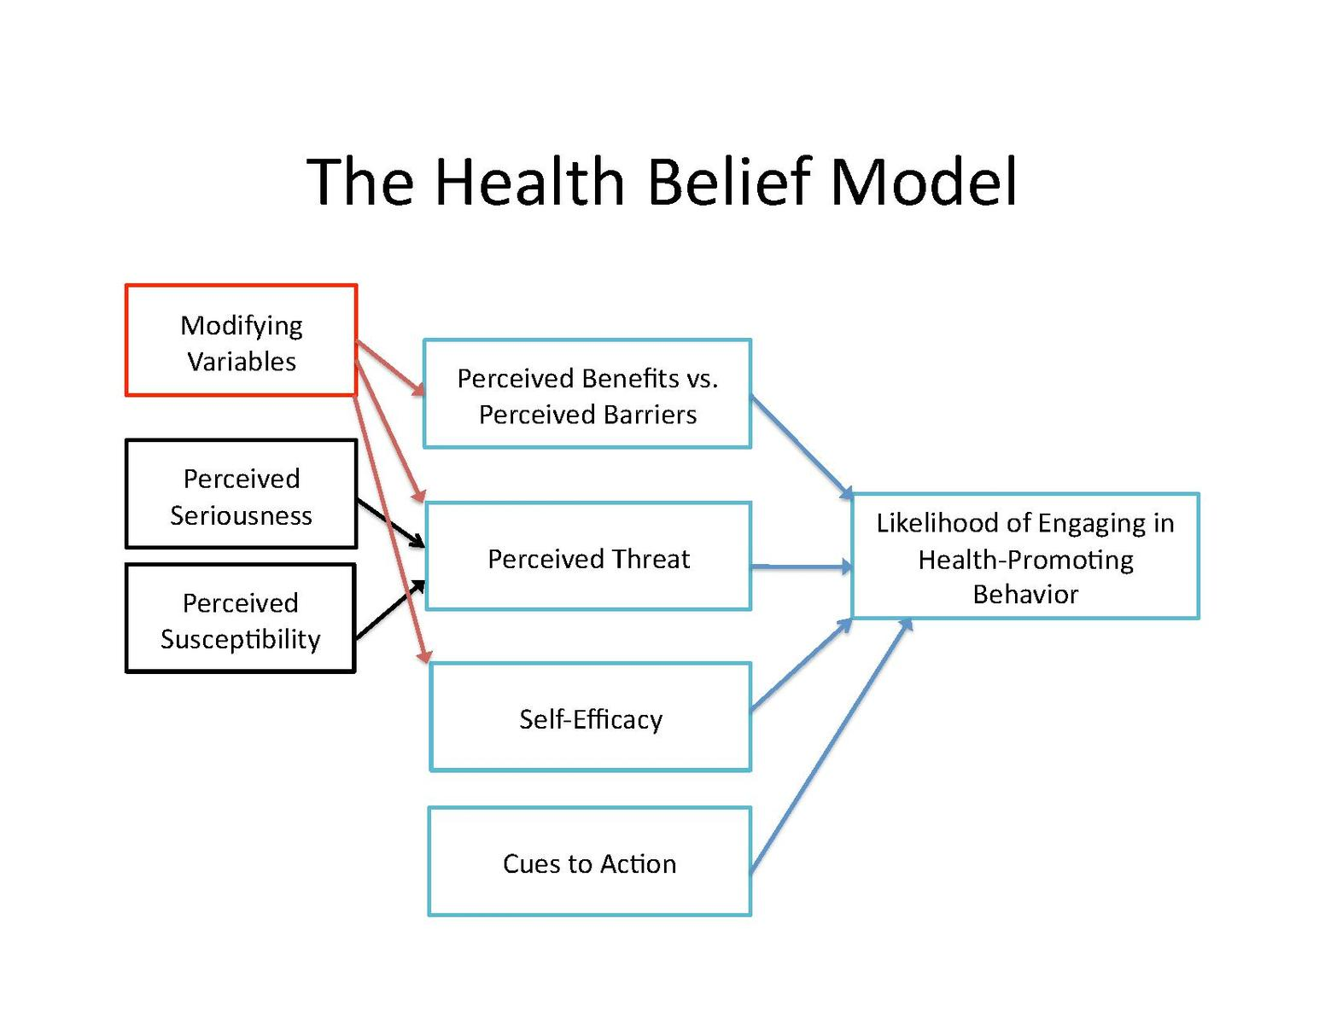
Health Behavioural Theories
1. Health Belief Model (HBM)
Modifying Variables: Demographic (age, gender) and psychological (personality, peer pressure) factors influence an individual's perceptions (Wikipedia, 2024).
Perceived Susceptibility & Severity: These form the "perceived threat"; the belief in the likelihood and seriousness of developing a condition (Wikipedia, 2024).
Health Motivation: The general drive to maintain health affects the likelihood of taking action (Wikipedia, 2024).
Perceived Benefits & Barriers: An individual weighs the effectiveness of the action against the potential costs or obstacles (Wikipedia, 2024).
Cues to Action: Internal or external triggers necessary to prompt the final behavior (Wikipedia, 2024).
Action: The ultimate health-related behavior change resulting from these combined perceptions (Wikipedia, 2024).
Notes:
Models of Health Behavior Change: Barriers:
1. Health Belief Model (HBM)
The Health Belief Model (HBM) is a social psychological health behavior change model used to predict health-related behaviors (Wikipedia, 2024).
Modifying Variables: Demographic (age, gender) and psychological (personality, peer pressure) factors influence an individual's perceptions (Wikipedia, 2024).
Perceived Susceptibility & Severity: These form the "perceived threat"; the belief in the likelihood and seriousness of developing a condition (Wikipedia, 2024).
Health Motivation: The general drive to maintain health affects the likelihood of taking action (Wikipedia, 2024).
Perceived Benefits & Barriers: An individual weighs the effectiveness of the action against the potential costs or obstacles (Wikipedia, 2024).
Cues to Action: Internal or external triggers necessary to prompt the final behavior (Wikipedia, 2024).
Action: The ultimate health-related behavior change resulting from these combined perceptions (Wikipedia, 2024).

Slide 21
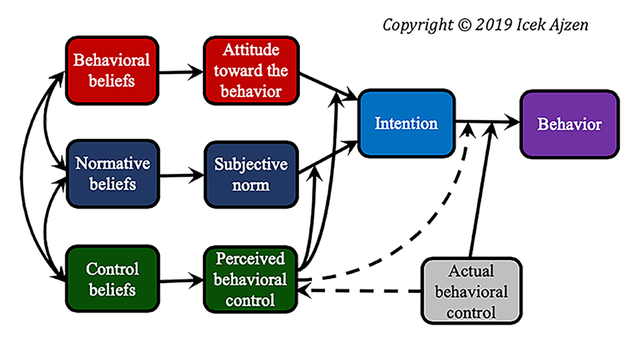
Health Behavioural Theories
2. Theory of Planned Behaviour (TPB):
Attitude: This refers to the degree to which a person has a favorable or unfavorable evaluation of the behavior in question (Wikipedia, 2024).
Subjective Norm: This represents the social pressure an individual perceives from important others to perform or not perform the behavior (Wikipedia, 2024).
Perceived Behavioral Control: This reflects a person's perception of the ease or difficulty of performing the behavior, encompassing both internal factors and external constraints (Wikipedia, 2024).
Intention: This is the most proximal determinant of behavior; it indicates how hard people are willing to try (Wikipedia, 2024).
Behavior: This is the observable response or action taken by the individual; as shown by the dashed line in the model (Wikipedia, 2024).
Notes:
Health Behavioural Theories:
2. Theory of Planned Behavior (TPB)
Attitude: This refers to the degree to which a person has a favorable or unfavorable evaluation of the behavior in question (Wikipedia, 2024).
Subjective Norm: This represents the social pressure an individual perceives from important others to perform or not perform the behavior (Wikipedia, 2024).
Perceived Behavioral Control: This reflects a person's perception of the ease or difficulty of performing the behavior, encompassing both internal factors and external constraints (Wikipedia, 2024).
Intention: This is the most proximal determinant of behavior; it indicates how hard people are willing to try (Wikipedia, 2024).
Behavior: This is the observable response or action taken by the individual; as shown by the dashed line in the model (Wikipedia, 2024).

Slide 22


Solutions to Overcome Individual Challenges
Confidential STI testing services to reduce embarrassment and fear of judgment (NHS England, 2023).
Interactive educational workshops to increase knowledge and perceived benefits of safe sexual behaviours (Barnardo’s, 2023).
Free condom distribution and demonstrations to improve self-efficacy and practical skills (FPA, 2023).
Social media campaigns to address peer pressure and normalize sexual health conversations among young people (UKHSA, 2024).
Notes:
Solutions to Overcome Individual Challenges:
Confidential STI testing services to reduce embarrassment and fear of judgment (NHS England, 2023).
Interactive educational workshops to increase knowledge and perceived benefits of safe sexual behaviours (Barnardo’s, 2023).
Free condom distribution and demonstrations to improve self-efficacy and practical skills (FPA, 2023).
Social media campaigns to address peer pressure and normalize sexual health conversations among young people (UKHSA, 2024).

Slide 23



Conclusion
The “Know It. Own It. Protect It” campaign empowers young people to take control of their sexual health through education, awareness, and access to services. By addressing barriers such as stigma, low knowledge, and peer pressure, the campaign promotes safer behaviours, including condom use, regular STI testing, and informed decision-making. Collaboration with local and national partners like Barnardo’s and FPA ensures wide reach and support. Achieving these objectives not only improves physiological, psychological, and sociological wellbeing but also reduces STI transmission and unplanned pregnancies, fostering a healthier, more responsible generation of young adults.
Notes:
Conclusion:
The “Know It. Own It. Protect It” campaign empowers young people to take control of their sexual health through education, awareness, and access to services. By addressing barriers such as stigma, low knowledge, and peer pressure, the campaign promotes safer behaviours, including condom use, regular STI testing, and informed decision-making. Collaboration with local and national partners like Barnardo’s and FPA ensures wide reach and support. Achieving these objectives not only improves physiological, psychological, and sociological wellbeing but also reduces STI transmission and unplanned pregnancies, fostering a healthier, more responsible generation of young adults.

Slide 24
Reference:
House of Commons Library (2024) Sexual and reproductive health statistics for England. Available at: https://commonslibrary.parliament.uk/research-briefings/cbp-10049/
UK Health Security Agency (2024) Sexually transmitted infections and screening for chlamydia in England: 2024 report. Available at: https://www.gov.uk/government/statistics/sexually-transmitted-infections-stis-annual-data-tables
Department of Health and Social Care (2019) Health matters: preventing STIs. Available at: https://www.gov.uk/government/publications/health-matters-preventing-stis/health-matters-preventing-stis
World Health Organization (2023) Sexual health and its linkages to reproductive health. Geneva: WHO.
NHS England (2023) Sexual health services and prevention guidance. Available at: https://www.nhs.uk.
Ajzen, I. (1991) The theory of planned behavior. Organizational Behavior and Human Decision Processes, 50(2), pp.179–211.
Fishbein, M. and Ajzen, I. (2010) Predicting and changing behavior: The reasoned action approach. New York: Psychology Press.
Glanz, K., Rimer, B.K. and Viswanath, K. (2015) Health behavior: Theory, research, and practice. 5th ed. San Francisco: Jossey-Bass.
Rosenstock, I.M. (1974) Historical origins of the Health Belief Model. Health Education Monographs, 2(4), pp.328–335.
UK Health Security Agency (2025) University freshers urged to use condoms as STI cases remain high. Available at: https://www.gov.uk/government/news/university-freshers-urged-to-use-condoms-as-sti-cases-remain-high
UK Health Security Agency (2024) Ready for uni life? Use condoms to keep STIs away. Available at: https://www.gov.uk/government/news/ready-for-uni-life-use-condoms-to-keep-stis-away
World Health Organization (2024) Condom use among adolescents declining in Europe. Available at: https://www.theguardian.com/society/article/2024/aug/29/young-peoples-health-at-risk-from-fall-in-condom-use-warns-who
NHS England (2023) Sexually transmitted infections (STIs). Available at: https://www.nhs.uk/conditions/sexually-transmitted-infections-stis/
Barnardo’s (2023) Sexual health services for young people. Available at: https://www.barnardos.org.uk/what-we-do/services/sexual-health
FPA (2023) About FPA: sexual health education and support. Available at: https://www.fpa.org.uk/about-us

Slide 25



Thank
you

