Slide 1
Father And Son
The relationship of Kingsley and Martin Amis
By Dylan Phillips

Slide 2

Kingsley Amis

Slide 3

Martin Amis

Slide 4
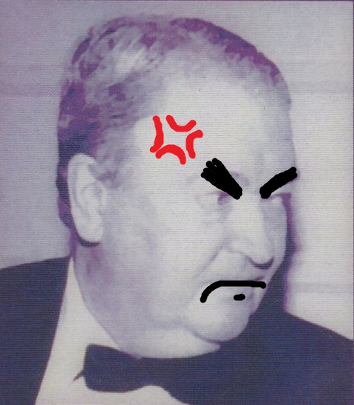
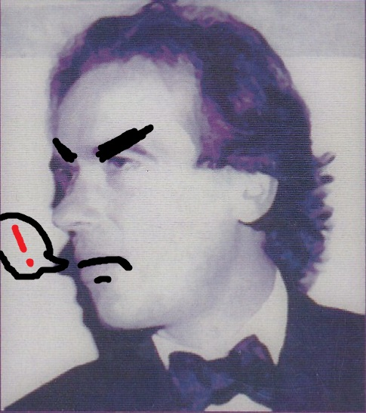
The Perceived Rivalry Between The two
As Presented by Gavin Keulks book

Slide 5
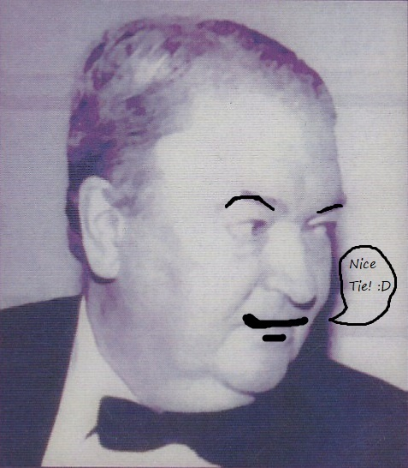
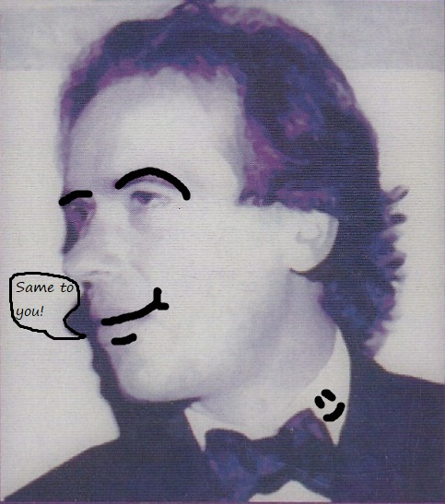
Was their relationship really that bad?

Slide 6
CONCLUSION!

Slide 7
bibliography
Amis, M., 2000. Experience. 1st ed. London: Jonathan Cape.
-Keulks, G., 2003. Father & Son, Kingsley Amis, Martin Amis, And The British Novel Since 1950. 1st ed. Madison, Wisconsin: University of Wisconsin Press.
-Diedrick, J., 1995. Understanding Martin Amis. Columbia: University of Carolina Press.
-Amis, K., 1991. Memoirs. 1st ed. New York: Summit Books.
-Baker, R.S, 2005. The Ironic Inferno of British Satire. Contemporary Literature, [Online]. Vol 46, 544-554. Available at: https://web-a-ebscohost-com.ezproxy.uwtsd.ac.uk/ehost/pdfviewer/pdfviewer?vid=1&sid=40ccb52b-6352-46d7-b858-3b2abf73797e%40sessionmgr4010 [Accessed 19 April
2018].
-Amis, M., 1973. The Rachel Papers. 1st ed. London: Jonathan Cape.
-Amis, M., 1975. Dead Babies. 1st ed. London: Jonathan Cape.
-Amis, K., 1974. Ending Up. 1st ed. London: Jonathan Cape.
-Amis, K., 1954. Lucky Jim. 1st ed. London: Victor Gollancz.
-Amis, K., 2000. The Letters Of Kingsley Amis. 1st ed. London: Harper Collins.

